Slide 1
M.C. Studies of CDC Axial/Stereo Layer Configuration
David Lawrence, JLab
Sept. 19, 2008

Slide 2
How χ² is defined
The χ² is formed using the residuals between the fit and thrown parameters:
If the components are independent and drawn from a Gaussian parent distribution, this would follow a “chi-squared” distribution with a well-known probability distribution

Slide 3
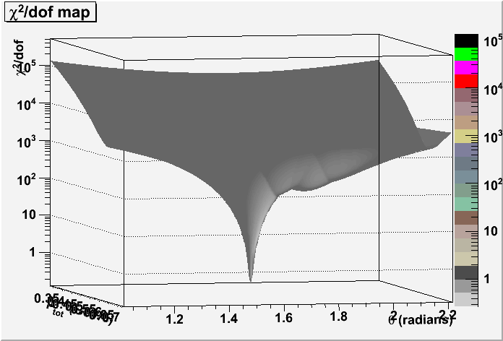
Map of χ²/dof as a function of 2 of the 5 fit parameters
Event A
Event B

Slide 4
Event 1914 has a large χ²/dof
A bird’s eye view of the event looks like everything is OK
Blue (thick) is the thrown track
Orange (thin) is the fit track

Slide 5
Event 1914 has a large χ²/dof
X-Y view of Event 1914
Thrown track
Fit track

Slide 6
Event 1179 has a large χ²/dof
X-Y view of Event 1179
Thrown track
Fit track

Slide 7
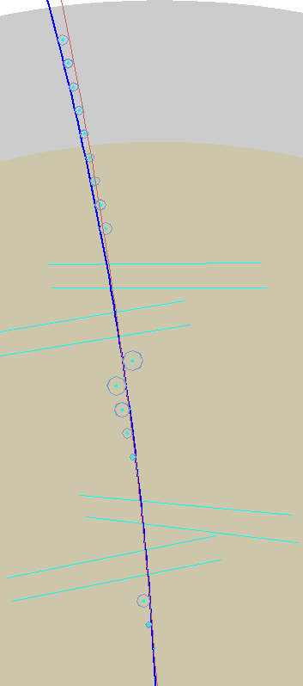
Other events with poor χ²/dof with p_{t} as dominant term
Event 1277
Event 2342

Slide 8
Two options for CDC stereo configuration
2 stereo superlayers
3 stereo superlayers
stereo8
stereo9

Slide 9
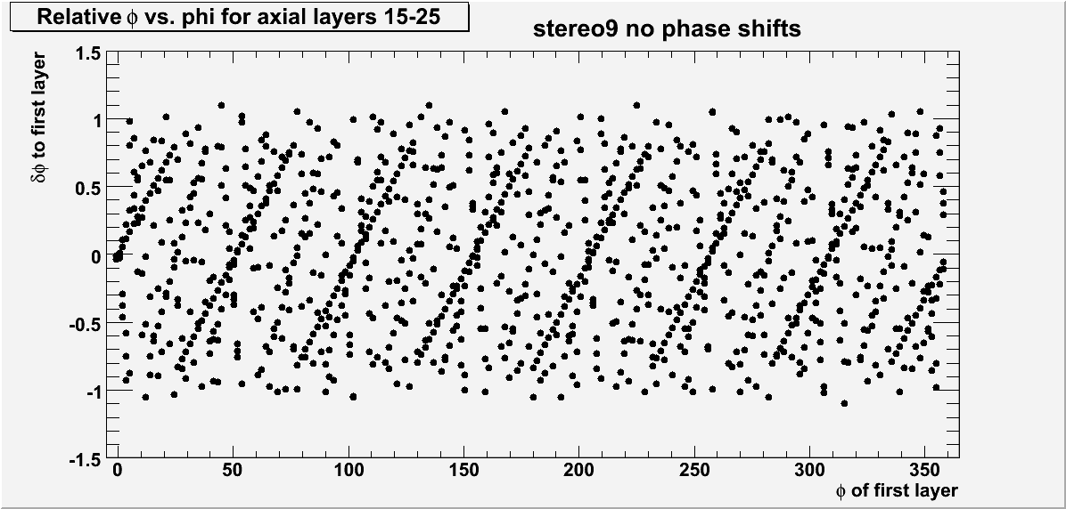
Alignment of CDC straws
δφ relative to the φ of the wire in layer 23 as a function of φ.
Pattern comes from neighboring layers having only slightly more (or less) straws than layer 23.
φ values with high density of points indicate areas where there is a high degree of alignment.

Slide 10
Alignment of CDC straws w/ phase shifts
To disrupt the alignment of the wires, phase shifts in φ were introduced for each layer.
Every 4th layer was rotated by:
0
+Δφ_{i}/2
−Δφ_{i}/3
+Δφ_{i}/5
where Δφ_{i} is the angle between adjacent wires in the layer

Slide 11
Reciprocal of phase difference density
In this plot, larger values indicate greater alignment of the straws in the outer layers (15-25).
The stereo9 configuration is slightly better than stereo8, but both are improved significantly by adding relative phase shifts between layers.

Slide 12
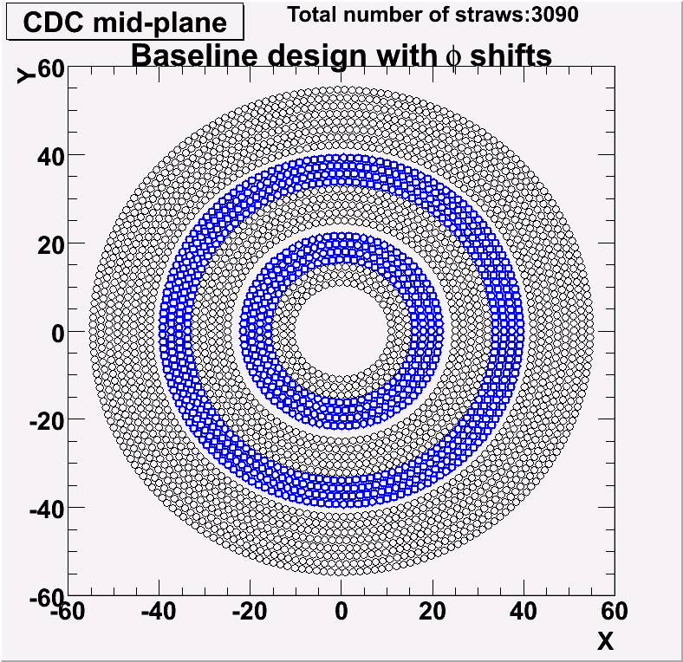
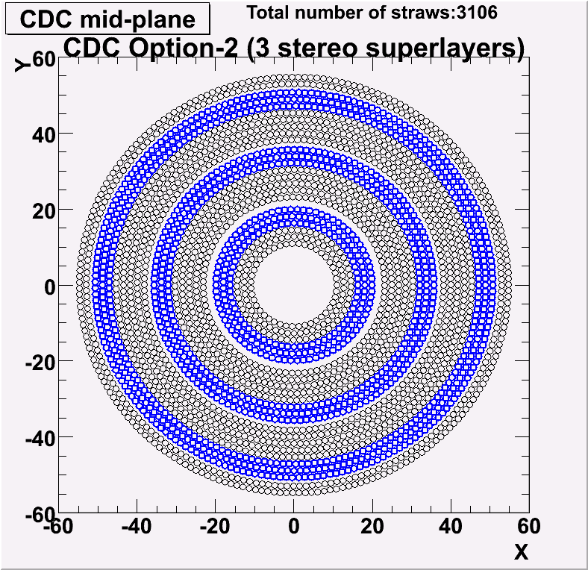
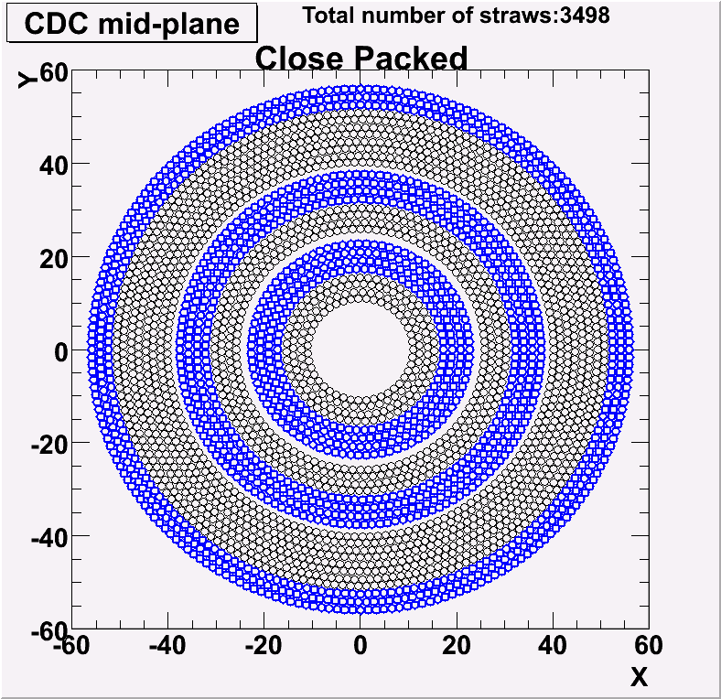
5 CDC configurations studied (yes, only 4 are shown)
24 layers
27 layers

Slide 13
What was simulated
1 million single π⁺ events for each configuration. MS, E-loss on, but no position smearing
Finder and fitter used in conjunction (previously, all fit results came from using the thrown values for the candidates)
Efficiency determined by cut on χ²/dof derived from parameters (not hit residuals)

Slide 14
“Tracking Efficiency” compared to χ² cumulative distribution function

Slide 15
Pulls with double Gaussian fits
Red = Tracking Results
Thick black = double gaussian
Thin black = gaussian (sampled)
δpt/pt
δθ
δφ
χ²

Slide 16
Efficiency as a function of phase space
0.2 GeV/c ≤ p ≤ 2.0 GeV/c
15º ≤ θ ≤ 140º

Slide 17
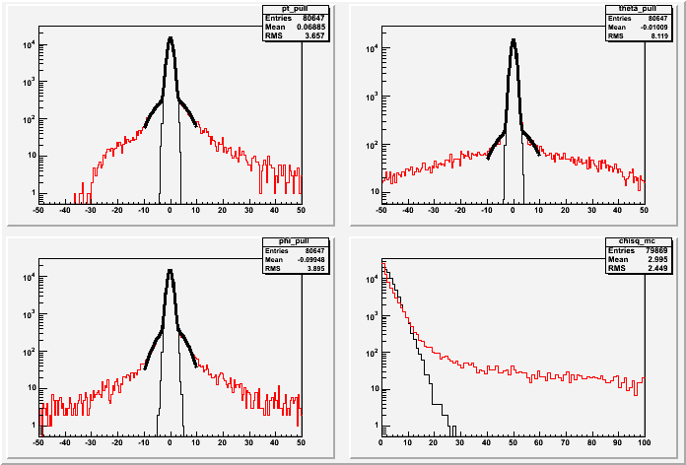
Toy model χ² shares features with MC Simulation study
Toy model plot (left) includes all L-R solutions (including 15 “wrong” ones)
MC Simulation includes 1 guess for L-R solution
MC Simulation with reconstruction

Slide 18
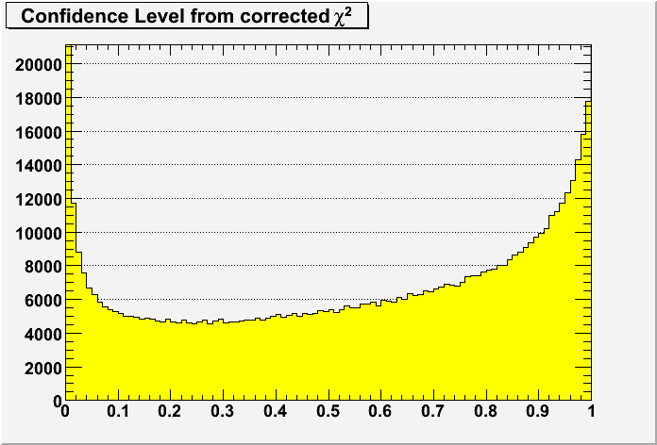
Probability Distributions for two ways of fitting pull distributions
Gaussians fit only to core of pull distributions
Gaussians fit to full pull distributions

Slide 19
Tracking Efficiency for Several CDC Configurations
Phasespace: range

Slide 20
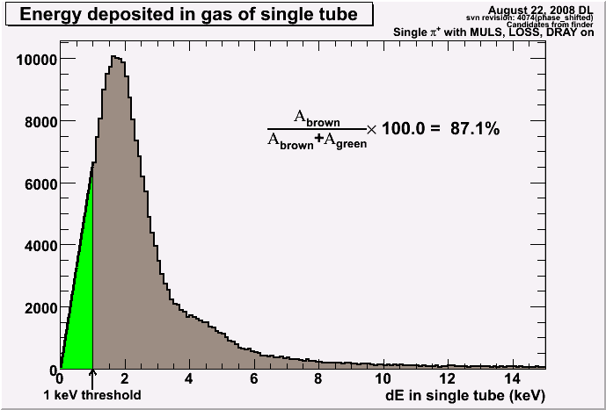
dE in single tube reported by hdgeant
Phasespace: 1 GeV/c ; 90º
Nominal Geometry
Close Packed
Green regions are estimates of hits discarded by dE threshold. Estimate is made by straight line from 0,0 to 1keV point. This likely overestimates the below-threshold contribution.
NOTE: Max energy deposition at 90º : (1.6 cm)(2.6 keV/cm) = 4.16 keV

Slide 21
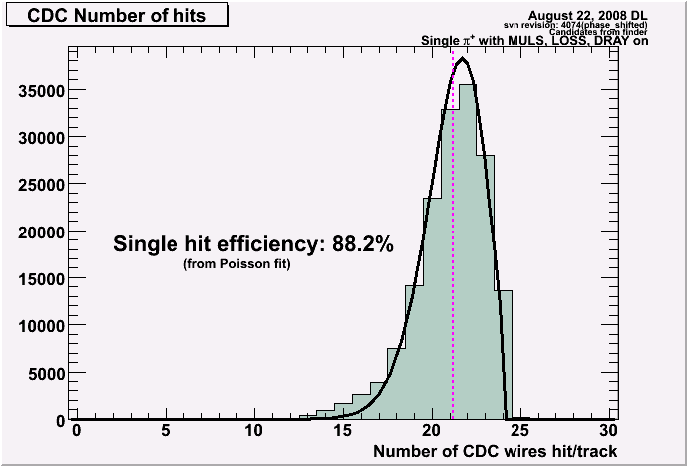
CDC hits per track
Phasespace: range
Nominal Geometry
Close Packed
The number of missing hits was fit to a Poisson and the mean taken as the average number of missed hits.
The Nominal Geometry is consistent with the single hit efficiency derived from the dE plots.
The Close Packed geometry is consistent with ~9% inefficiency on average due to gaps in the “close-packed” axial layers.

Slide 22
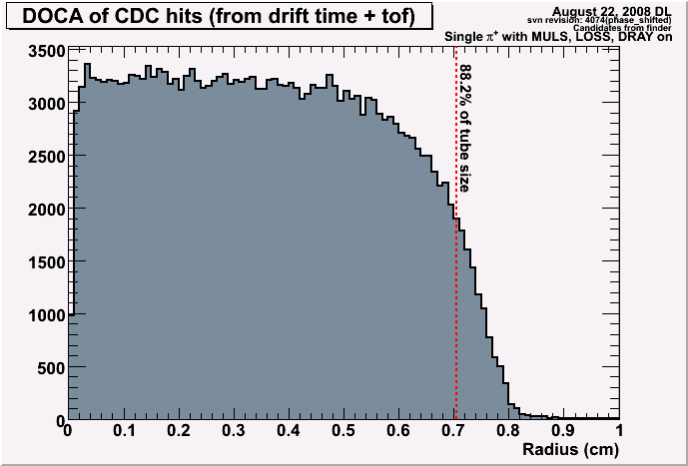
Distance of Closest Approach (DOCA) (calculated from t_{drift}-tof)
Phasespace: 1 GeV/c ; 90º
Nominal Geometry
Close Packed
DOCA distributions seem consistent with the 88.2% single hit efficiency and cut on dE which corresponds to the outer part of the tube.

Slide 23
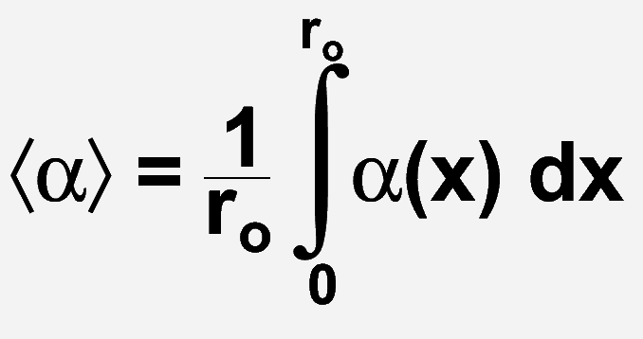
Expected energy loss in CDC gas
 | dE/dx (MeV/g cm²) | ρ (g/l) | dE/dx (keV/cm)
Ar (85%) | 1.519 | 1.622 | 2.464
CO₂(15%) | 1.819 | 1.842 | 3.351
Total for CDC gas dE/dx = 2.597 keV/cm
α
= 1.26cm
3.27 keV
x
Note: for a 1 keV energy loss, expect x=7.8mm or about 2.45% inefficiency

Slide 24
Tracking Efficiency with and without dE threshold
Phasespace: range

Slide 25
Close packing vs. extra layers
The low-threshold baseline design (shifted) has approximately the same number of hits per track as the close packed design with a high threshold. This gives a suggestion as to how much close packing buys vs. extra layers.
2 stereo superlayers

Slide 26
Conclusions
3 stereo superlayers improves tracking efficiency
Additional layers improves tracking efficiency (we seem to be in a region of high sensitivity)
Single hit efficiency due to 1keV threshold is ~88%. The energy distribution from hdgeant needs to be verified and then the threshold examined more closely
χ² distribution is not yet fully understood, but tests are underway to see if it is linked to the Left-Right ambiguity issue

Slide 27
Backup Slides

Slide 28
Gaussian fits to full pull distributions (not just Gaussian cores)

Slide 29
Expected Probability Density as a Function of the Integral Fraction

Slide 30
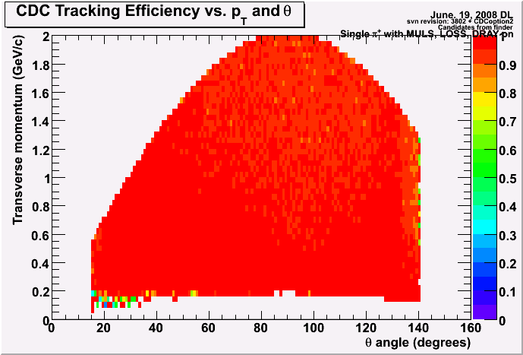
Efficiency as a function of transverse momentum and polar angle
stereo8
stereo9
Total momentum range: 150MeV/c - 2GeV/c
Total angular range: 15º – 140º
Differences not really noticeable here!

Slide 31
Pulls of momentum parameters for CDC option-1 and option-2

Slide 32
Efficiency vs. accuracy of fit parameters

Slide 33
Pulls from fits with perfect conditions for stereo8
off

Slide 34
Why “perfect” isn’t perfect
hdgeant estimates the point of closest approach (POCA) to be the midpoint of the entrance and exit points of the tube. This is true to about 10 μm (systematic)
Tracking reconstruction approximates trajectory as parabola near wire and calculates POCA from that

Slide 35
Efficiency for “perfect” conditions

