Slide 1
Tracking Studies and the CDC
Jan 30, 2009
David Lawrence JLab

Slide 2
Nostalgia from Sept. 2008 …
MC Studies of the CDC layer configuration had begun starting with option-1 (2 stereo s.l.) and option-2 (3 stereo s.l.) from the V4 geometry
The studies used a parameter χ² as the figure of merit leading to χ²/Ndof of>1000
Straw alignments had been discovered in the CDC baseline design that lead to a φ dependence in the tracking efficiency.

Slide 3
Take a few steps back in order to move forward…
The CDC endplate design was needed by January so we needed to quickly get a handle on the tracking efficiency and the χ²>1000 problem
On Sept. 26, 2008, we had a phone conference with 2 tracking experts from Hermes. They suggested looking at the residual χ² rather than the parameter χ²
In addition, we decided to proceed with both multiple scattering and energy loss turned off in the simulation in order to have complete control over the residuals

Slide 4
Consistency Checking
4k single π⁺ 1GeV/c events were thrown at 5 discrete angles ranging from 30º to 110º. Multiple scattering etc. was turned OFF
Drift times were smeared via Gaussian to give them a position resolution of 150 μm
A tracking χ²/N_{dof} was formed from the hit residuals using the known
150 μm resolution
The χ²/N_{dof} distribution was integrated and compared to the known cumulative χ² function
To check consistency between the simulation and reconstruction geometries as well as transport through the magnetic field etc. , thrown values were used

Slide 5
1 GeV/c track locations in CDC
90º
70º
50º
30º

Slide 6
9 Geometries Were Studied
Various configurations of the axial and stereo layers were studied
Once the layer configuration was finalized, different stereo angles were looked at
All of these designs (except the baseline “A”) used φ-shifting and many used close-packing
geomC was ultimately shown to give the best tracking efficiency using the available tools

Slide 7
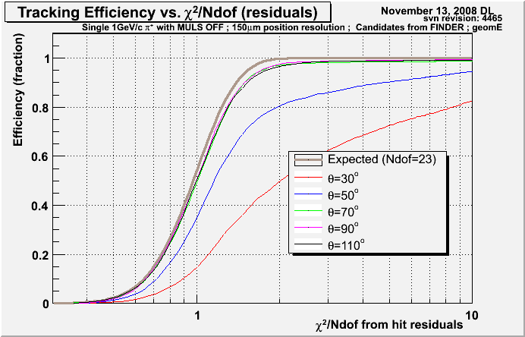
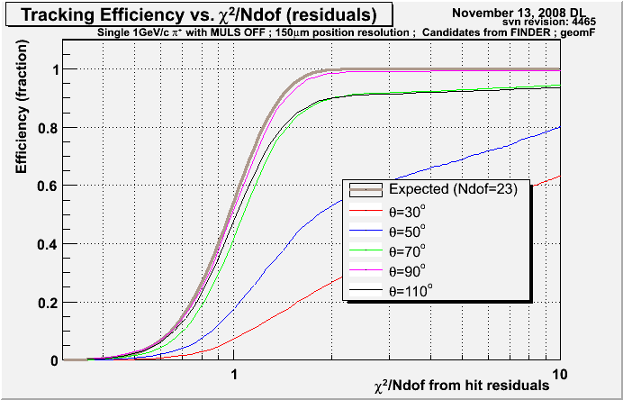
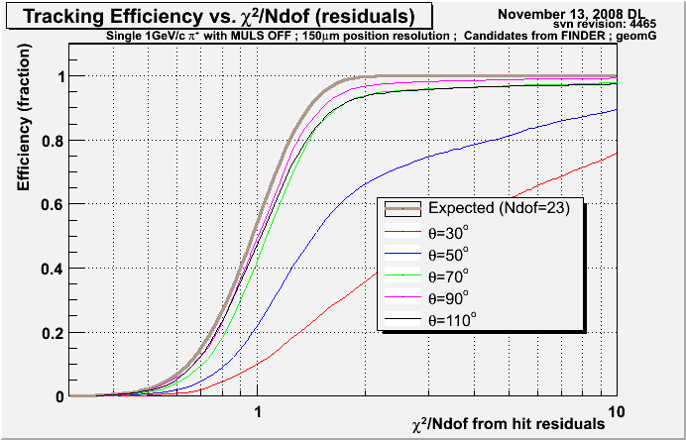
Full Reconstruction – layer configs
geomC
geomE
4a,4s-,4s+,4a,4s-,4s+,4a
4a,8s+,4a,8s-,4a
geomF
geomG
3º stereo
4a,8s+,4a,8s-,4a
4a,8s+,6s-,11a

Slide 8
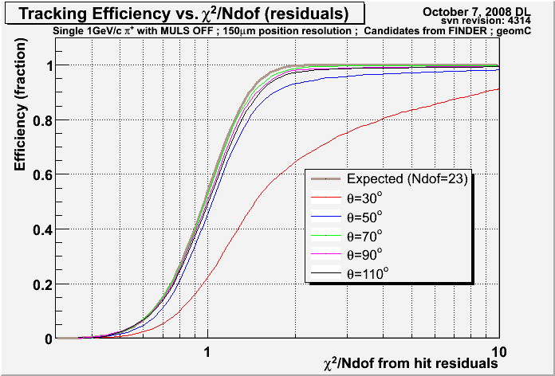
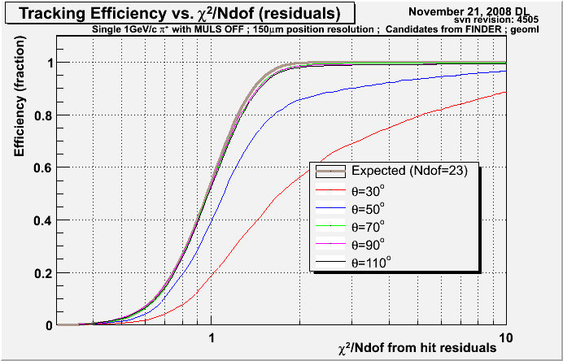
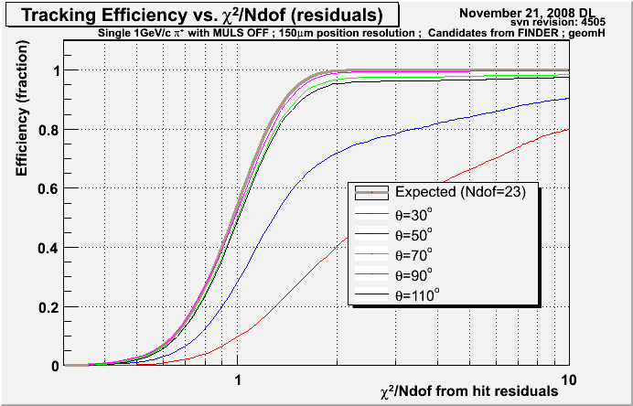
Full Reconstruction – stereo angle
geomC
geomI
6º
4.5º
4a,4s-,4s+,4a,4s-,4s+,4a
4a,4s-,4s+,4a,4s-,4s+,4a
geomH
geomF
3º
3º
4a,4s-,4s+,4a,4s-,4s+,4a
4a,8s+,4a,8s-,4a
Tracking efficiency gets worse as the stereo angle decreases!

Slide 9
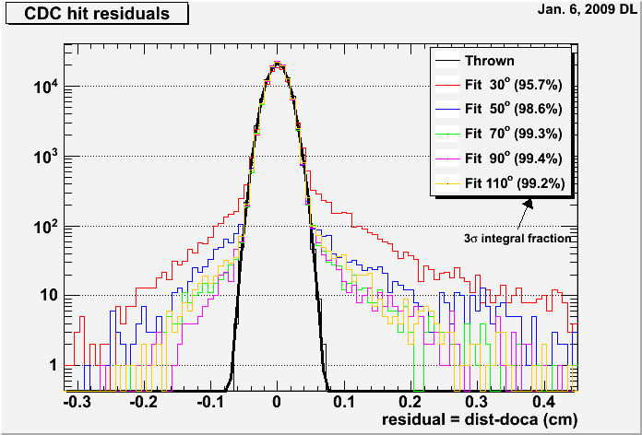
CDC residuals by angle
1 GeV/c π+ tracks
30º tracks have larger “wings” than other angles which pushes the tracking χ² further out in the tails of the χ² distribution.

Slide 10
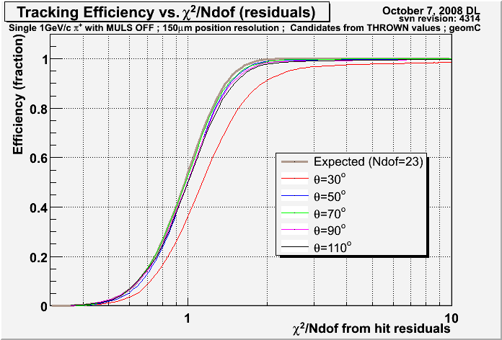
Night of the living target constraint
For a long time the ALT1 global track fitter has included a fuzzy target constraint.
This did very bad things when the candidate’s vertex was inaccurate.
with target constraint
no target constraint
geomC
geomC
The target constraint has now been disabled.

Slide 11
Vertex resolution for track candidates
The “vertex constraint” used is based on a 3cm segment of the beamline centered on the z_vertex reconstructed for the track candidate.
The way the candidate determines the z vertex is biased to finding it in the center of the target
This actually gave some benefit early on when developing the fitting algorithm, but now turns out to be a bias that hurts more than helps
All tracks thrown
from z=65 cm

Slide 12
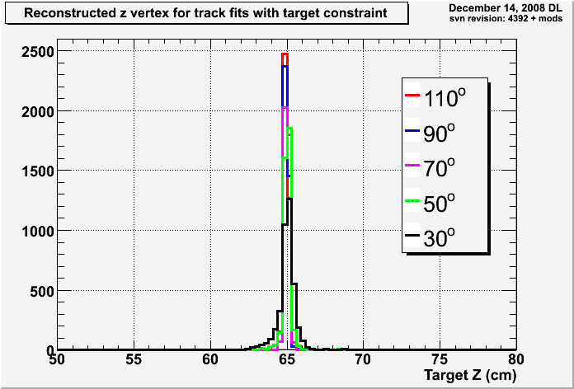
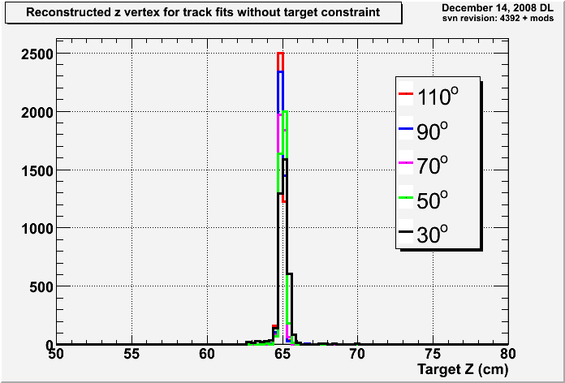
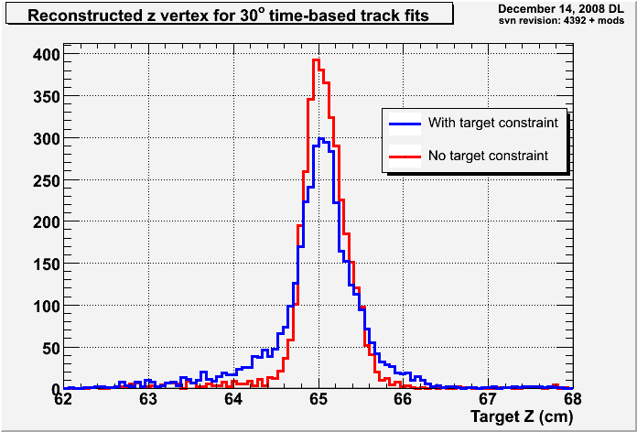
Vertex Reconstruction
with target
constraint
without target
constraint
30º tracks
(zoomed in)

Slide 13
DOCA values based on LR correctness

Slide 14
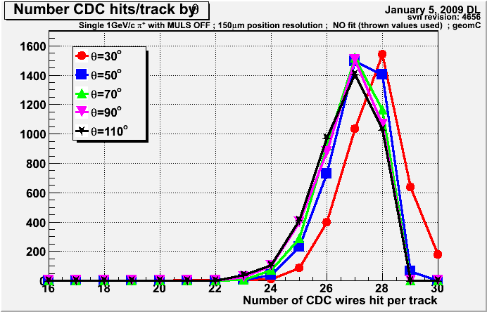
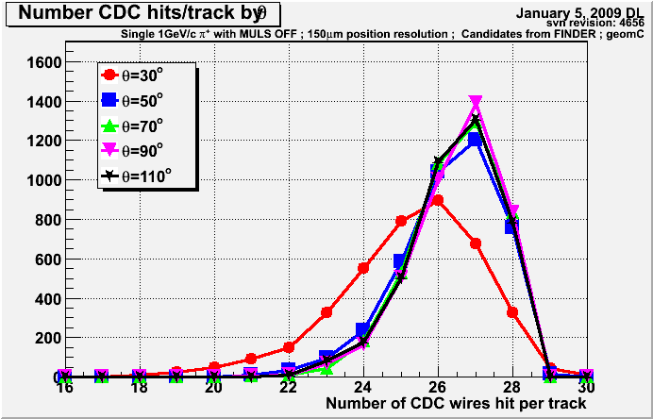
Number of hits per track in CDC
1 GeV/c π+ tracks
There is simultaneously a higher probability of getting multiple hits per layer in 30º tracks and a higher probability of rejecting hits that belong to a track.
Hit selection based on proximity to helical fit which will be worse in forward region where field becomes less uniform.
Thrown tracks (no fit)
30º
70º
Found and fit tracks
30º
70º

Slide 15
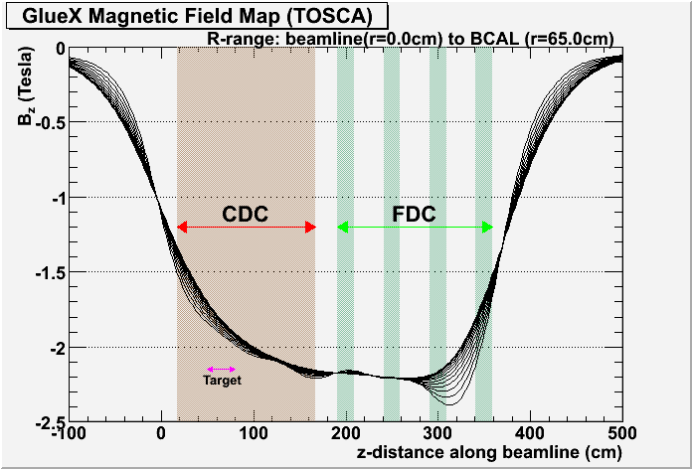
CDC Number of hits per track
B_{z} of inhomogeneous field map
Thrown tracks (no fit)
B-field map
Target Center: B_{z} ≈ 1.8T
CDC downstream end: B_{z} ≈ 2.2T
Found and fit tracks
field changes by more than 20% for tracks going forward through the CDC
B-field map

Slide 16
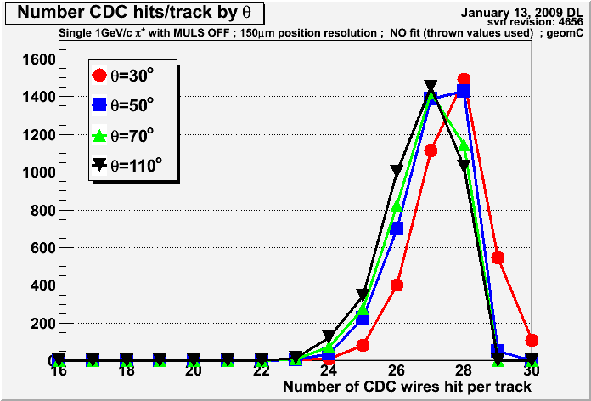
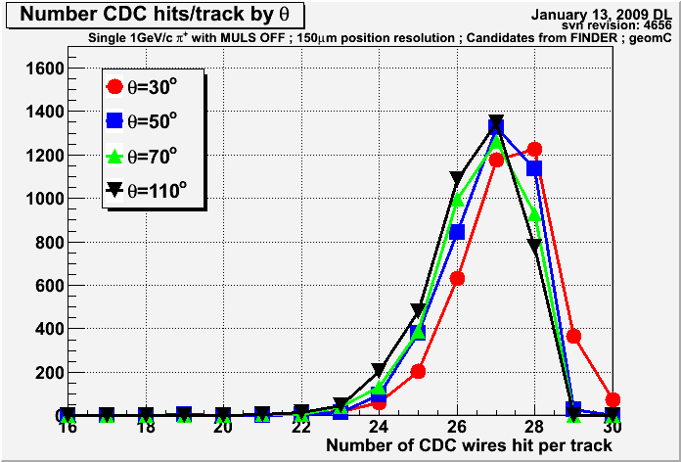
CDC Number of hits per track
Thrown tracks (no fit)
Thrown tracks (no fit)
B-field map
Uniform B-field
Found and fit tracks
Found and fit tracks
B-field map
Uniform B-field

Slide 17
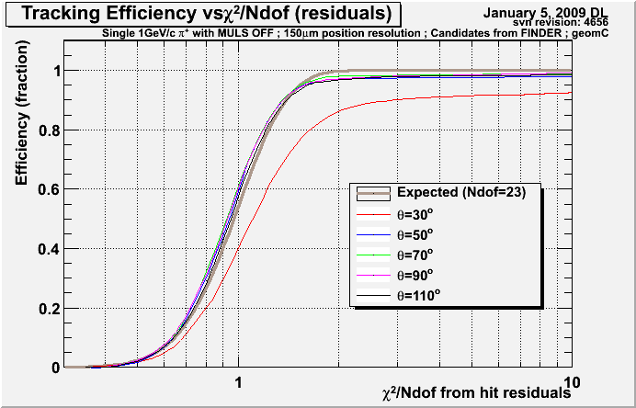
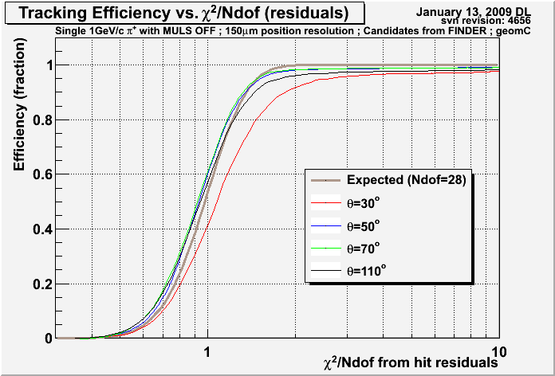
Cumulative χ² distributions with uniform and non-uniform Magnetic fields
Found and fit tracks
B-field map
Found and fit tracks
Uniform B-field
30º tracks still stand out a little with the uniform field but the difference is greatly reduced from the non-uniform case.

Slide 18
…clutch-in, shift, clutch-out …
At this point, we felt that we understood the efficiency plots and the cumulative χ² distributions were a good figure of merit for optimizing the design.
We had some confidence that the geomC layer configuration for the CDC with a 6º stereo angle was close to the optimal design and decided to fix that as the new baseline.
The hole pattern of CDC end plate still depended on the overall length of the CDC so more studies with more geometries were needed.

Slide 19
Additional Geometries
Name | CDC length
geomL | 175 cm
geomC* | 150 cm
geomJ | 125 cm
geomK | 100 cm
*geomC is the baseline geometry
Upstream end of CDC and position of last FDC package held fixed. Upstream FDC package positions adjusted to maintain equal spacing and spacing from CDC downstream end.
71 changes required in 3 XML files to modify CDC length!
(XML -> perl script -> XML-> C program -> Fortran code ->gfortran)

Slide 20
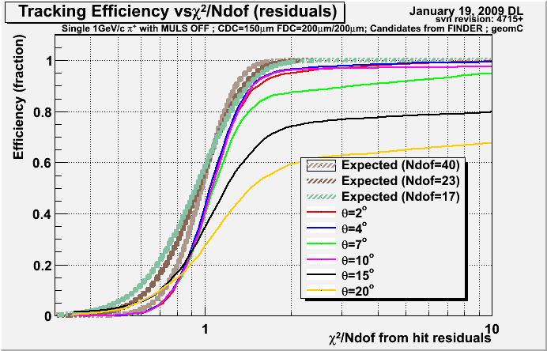
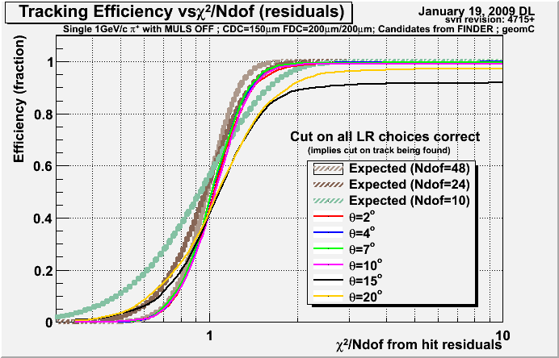
Locking in the LR choice
The ALT1 fitter locks in the left-right choice based on the results of fitting to the wire positions. Looking only at tracks that were found and had the correct L-R choice made for all hits gives a limit on what might be achieved with a better algorithm.
Notice on the left plot below that the 7º curve is out of order.
geomC
geomC

Slide 21
Single hit in CDC can cause big problems when LR choice is locked
7º track
A single wire hit has only a little influence on the fit which leads to a higher rate of incorrect LR choices from the wire-based fit.
geomC
This problem showed up at 7º for the baseline geometry with 150 cm long CDC straws.
A similar problem shows up at 15º for a geometry with 175 cm long straws where there is a single hit in the 2nd FDC package.

Slide 22
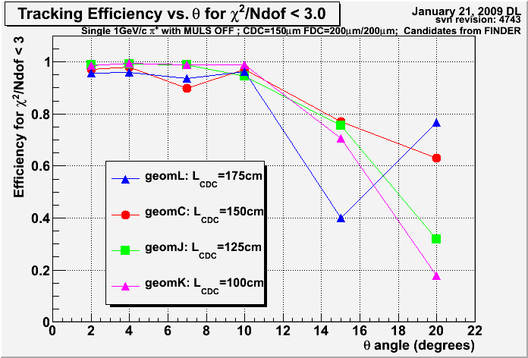
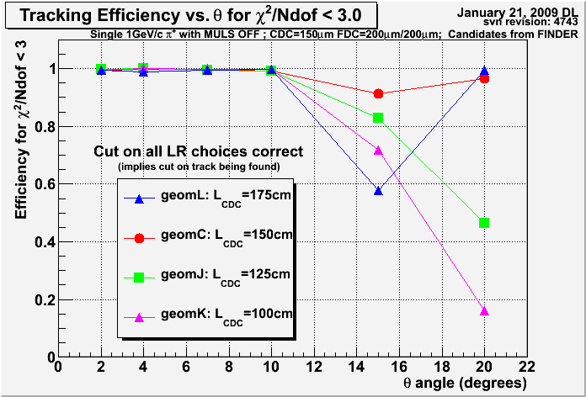
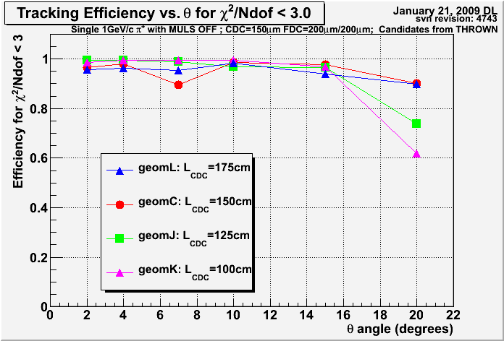
Efficiency vs. angle
Found Candidates
Found Candidates
Some of the inefficiencies are due to poorly defined track candidates which don’t capture all of the hits from the true track.
Some are due to locking in a poor LR choice after wire-based fitting.
Inefficiency at higher angles and shorter CDC length attributed to CDC-FDC gap.
Thrown Candidates

Slide 23
Summary
Monte Carlo simulations resulted in a decision to fix the CDC design at:
28 layers, φ-shifted where possible
Configuration: 4ax,4st-,4st+,4ax,4st-,4st+,4ax
Close-packed stereo and axial layers
6º stereo angle
150 cm straw length
Some problems were (re)identified in the ALT1 tracker:
No mechanism to try alternate L-R solutions
Target constraint sometimes constrained to places true track did not cross (disabled now).

