Slide 1
Offline Software Status
Jan. 30, 2009
David Lawrence JLab

Slide 2
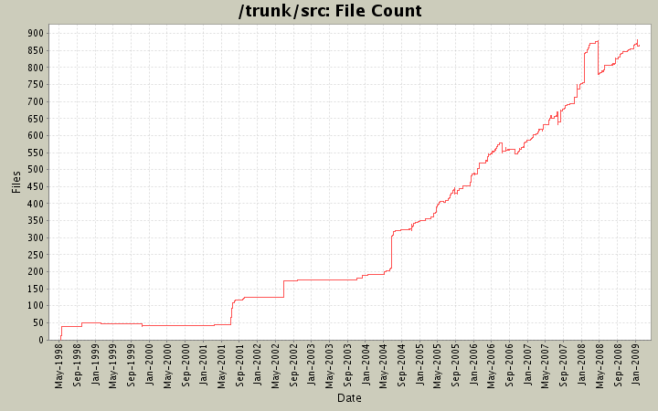
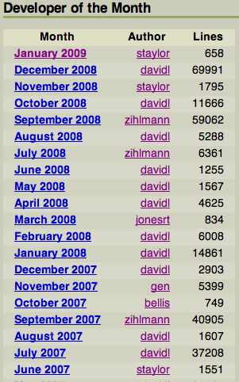
Repository Activity

Slide 3
Changes to Simulation Geometry
“geomC” new baseline for CDC
Complete update of collimater cave (currently with “review2008” suffix in repository)
Magnets + fields
Pair spectrometer
Collimater
Tagger microscope moved to behind fixed array
Active collimater detail
40 stave Start Counter rumored to exist

Slide 4
Changes to Reconstruction
Development on Kalman Filter (Simon)
Development on Least Squares Global track fitter (Mark)
(Re)Adoption of standard units
DHelicalFit class merging multiple helical fitters
Detector element numbering (plan)

Slide 5
JLab Computing Resources
Batch farm:
Until recently, Hall-D had no allocation of the JLab computer farm. We now have a guaranteed 4.4%
Wireless Networking:
Major policy changes on the JLab wireless network
Non-managed laptops will be outside of the JLab firewall
All ports (protocols) disabled by default with only a few open
Computers registered on network though web page (may or may not require WEP key)
Computer to Computer communications will be blocked
Disk Space:
Currently, the Hall-D work disk is 1.5TB (only using 51%)
Tight budgets resulted in smaller than usual increases this year so only ~14TB of usable space could be added over the whole Physics Division
Work disk
Cache disk
We requested 1TB to 1.5TB be allocated for Hall-D work disk space

Slide 6
ACAT Conference
SIMD/vectorization
Single Instruction, Multiple Data
Altivec, MMX, SSE, 3DNow!, …
llvm-g++ compiler (non-commercial Apple project)
Drop-in replacement for g++
Link-time optimization (-O4) has potential speed increases of 20%
Parameterization of Magnetic Field map
Current GlueX 2D map is 2.5MB
Expect 3D map to be at least 100x larger

Slide 7
Data Rates in 12GeV era
 | Front End DAQ Rate | Event Size | L1 Trigger Rate | Bandwidth to mass Storage
GlueX | 3 GB/s | 15 kB | 200 kHz | 300 MB/s
CLAS12 | 100 MB/s | 20 kB | 10 kHz | 100 MB/s
ALICE | 500 GB/s | 2.5 MB | 200 kHz | 200 MB/s
ATLAS | 113 GB/s | 1.5MB | 75 kHz | 300 MB/s
CMS | 200 GB/s | 1 MB | 100kHz | 100 MB/s
LHCb | 40 GB/s | 40 kB | 1 MHz | 100 MB/s
STAR | 8 GB/s | 80 MB | 100 Hz | 30 MB/s
PHENIX | 900 MB/s | ~60 kB | ~ 15 kHz | 450 MB/s
private comm.
JLab
CHEP2007 talk
Sylvain Chapelin
LHC
*
BNL
**
* NIM A499 Mar. 2003 ppg 762-765
** CHEP2006 talk MartinL. Purschke

Slide 8
Available Projects
The following projects are not currently being worked on. All of these could be developed primarily offsite. All projects are expected to require at least 6 months of work some of which can be done by a student or post-doc.
Magnetic Field Simulation Studies
Full Featured Event Viewer
Calibrations/Conditions Database
MC Acceptance studies for specific physics channels
Monte Carlo Meister
Online monitoring system
Detector Alignment

