Slide 1
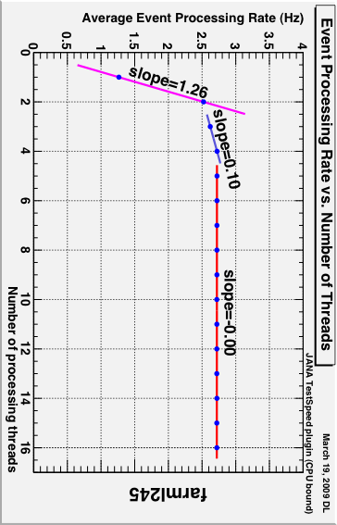
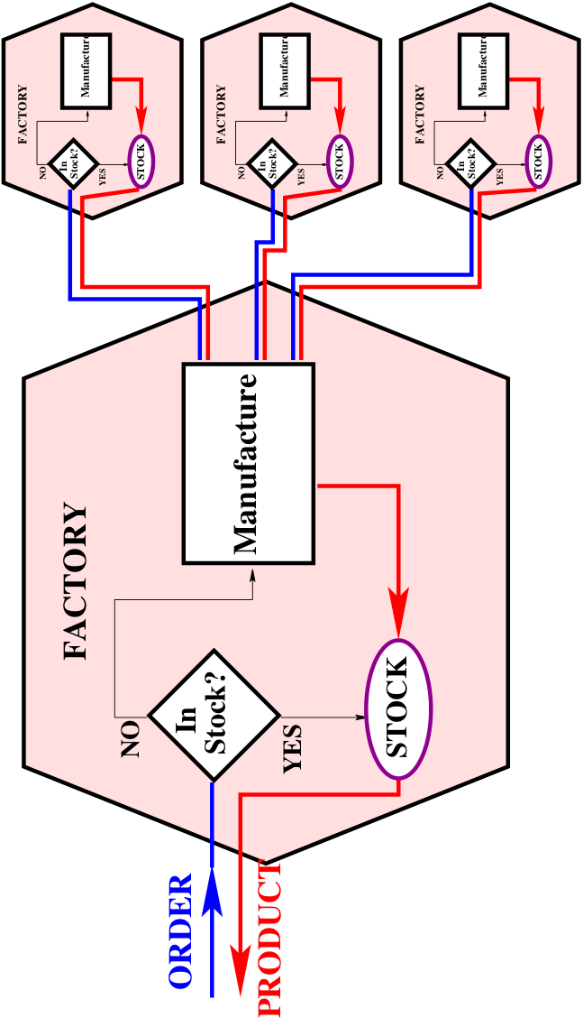
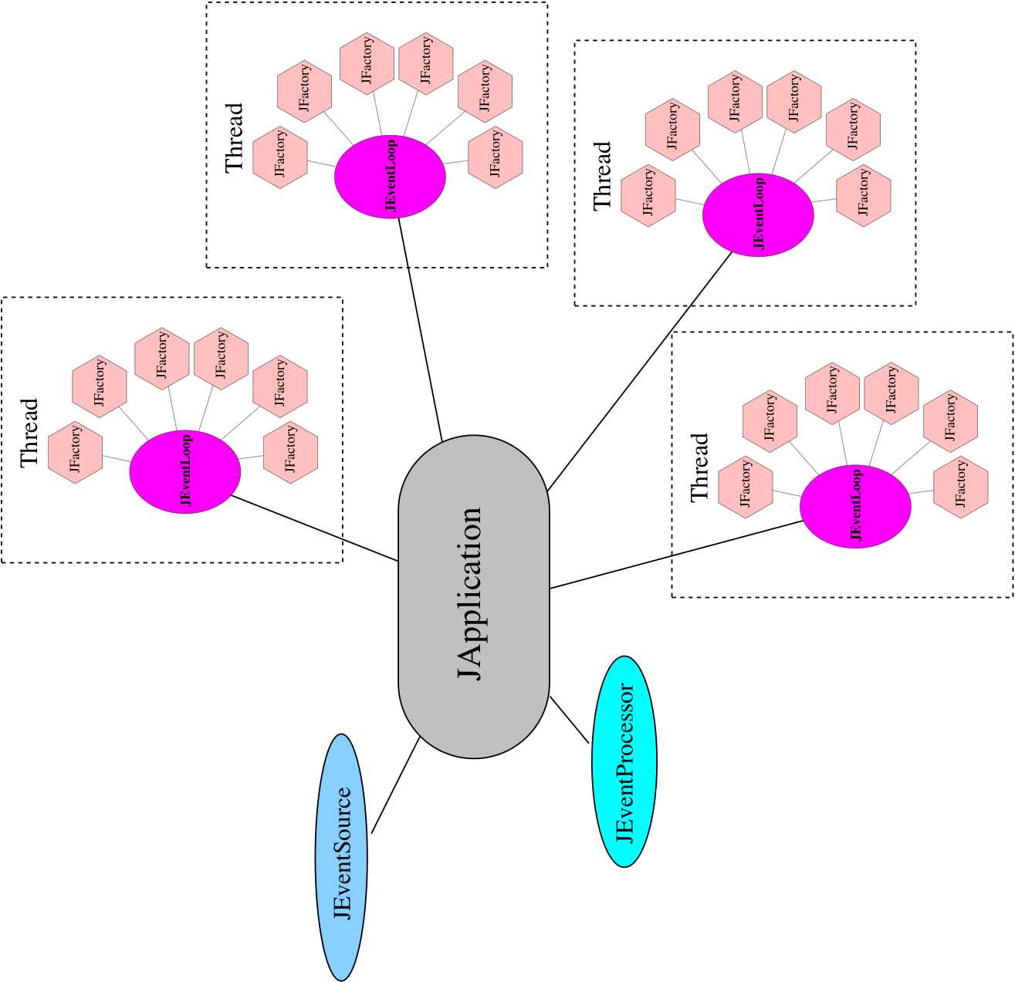
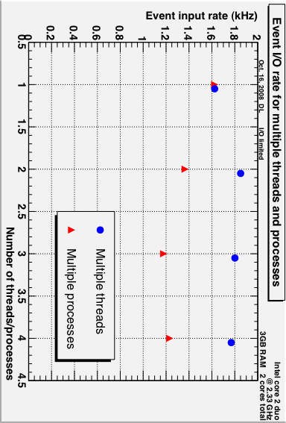
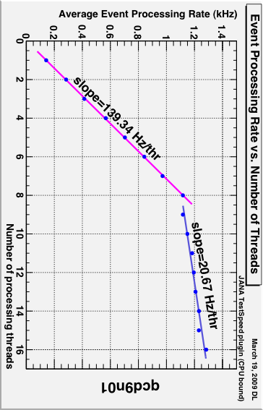
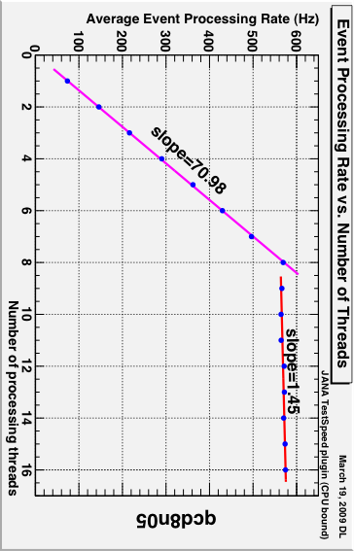
Multi-threaded Event Reconstruction
with
JANA
CHEP 2009
Prague
JANA
JANA is a multithreaded event reconstruction framework written in C++. It is designed to utilize all of the available cores of a CPU while processing high volume HENP data.
Website : http://www.jlab.org/JANA
CPU bound Jobs
CPU bound jobs benefit from
the parallelism achieved through
multi-threading. This benefit can
be lost if the framework requires
frequent mutex (un)locking. These
plots show event processing rates
for CPU bound jobs. The linear
shape indicates proper scaling with
the number of threads which implies
virtually no overhead is imposed by
the framework which is designed to
minimize mutex (un)locking.
Hyperthreading
These plots also show how
“hyperthreading” in Intel CPUs
can improve performance for
CPU bound jobs
Intel Xeon (5560) 2.8GHz
Dual Processors
8 cores/processor + hyperthreading
For this test, each hyperthread gave the equivalent of 15% of a full core
Data On Demand
JANA’s modified factory model produces data only on demand. This avoids wasting CPU cycles on reconstruction that is not needed for that particular event.
AMD Opteron (2352) 2.1GHz
Dual Processors
4 cores/processor with no hyperthreading
Without hyperthreading, a modest improvement (2% of a core) is observed when processing threads are over-subscribed
Alternate Factory Model
Reconstruction code is built into
factory classes as callback methods.
Inputs come from other factories.
In JANA’s model, ownership of
the objects stays with the factory.
Only const pointers are passed,
ensuring data integrity.
Threading Model
A JANA application consists of a single
JApplication object and multiple JEventLoop
objects (one for each thread). Each thread
has its own complete set of factory objects
that together, can completely process an event. JANA uses POSIX pthreads.
Intel Xeon (circa 2004)
2.8GHz
Dual Processors with
1 core/processor + hyperthreading
An older machine shows hyperthreads gaining only about 8% of a core.
I/O bound Jobs
Multiple processes accessing the same
disc leads to competition for the
position of the read head. A multi
-threaded process can stream events in
sequence, dispatching them to
individual threads resulting in faster
event processing rates for I/O bound
jobs as shown in these test results.
Notice: Authored by Jefferson Science Associates, LLC under U.S. DOE Contract No. DE-AC05-06OR23177. The U.S. Government retains a non-exclusive, paid-up, irrevocable, world-wide license to publish or reproduce this manuscript for U.S. Government purposes.
David Lawrence davidl@jlab.org

