Slide 1
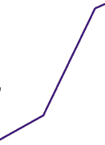
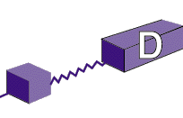
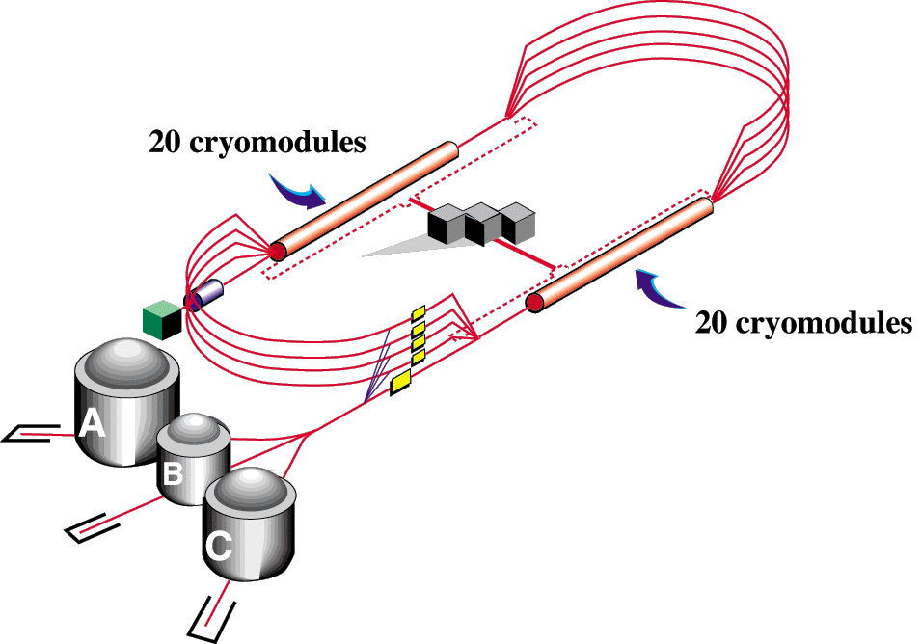
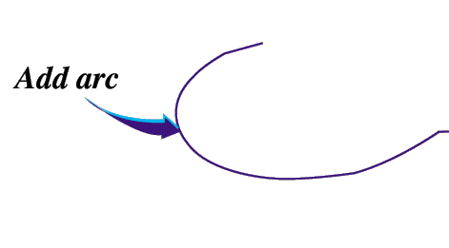
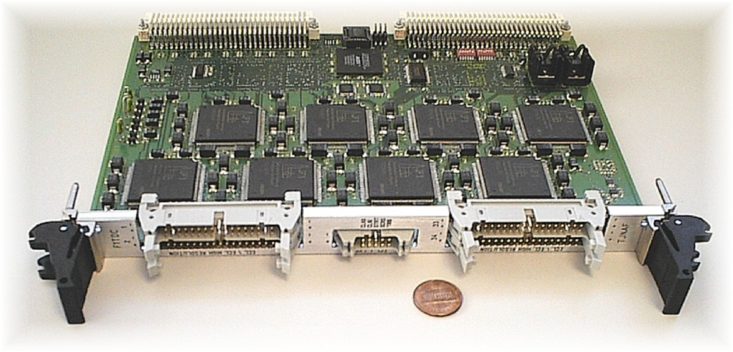
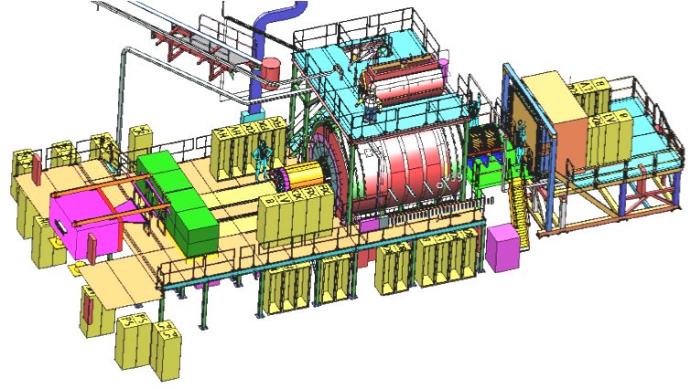
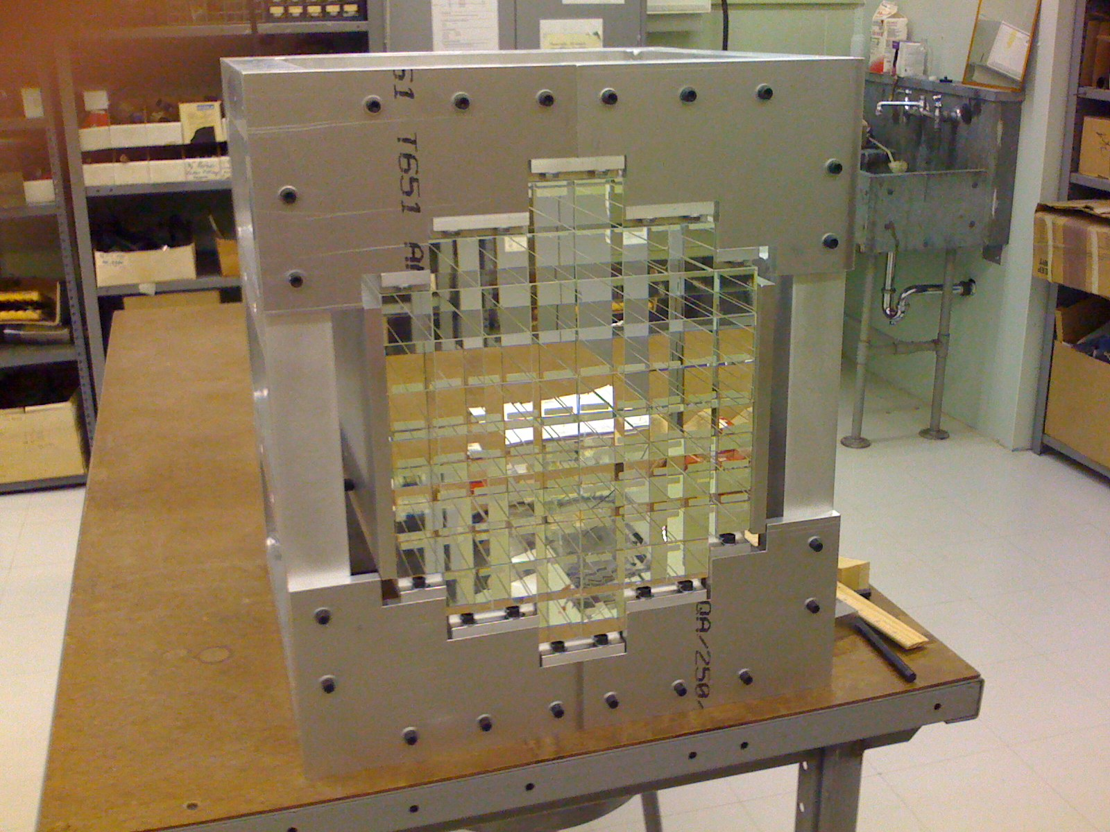
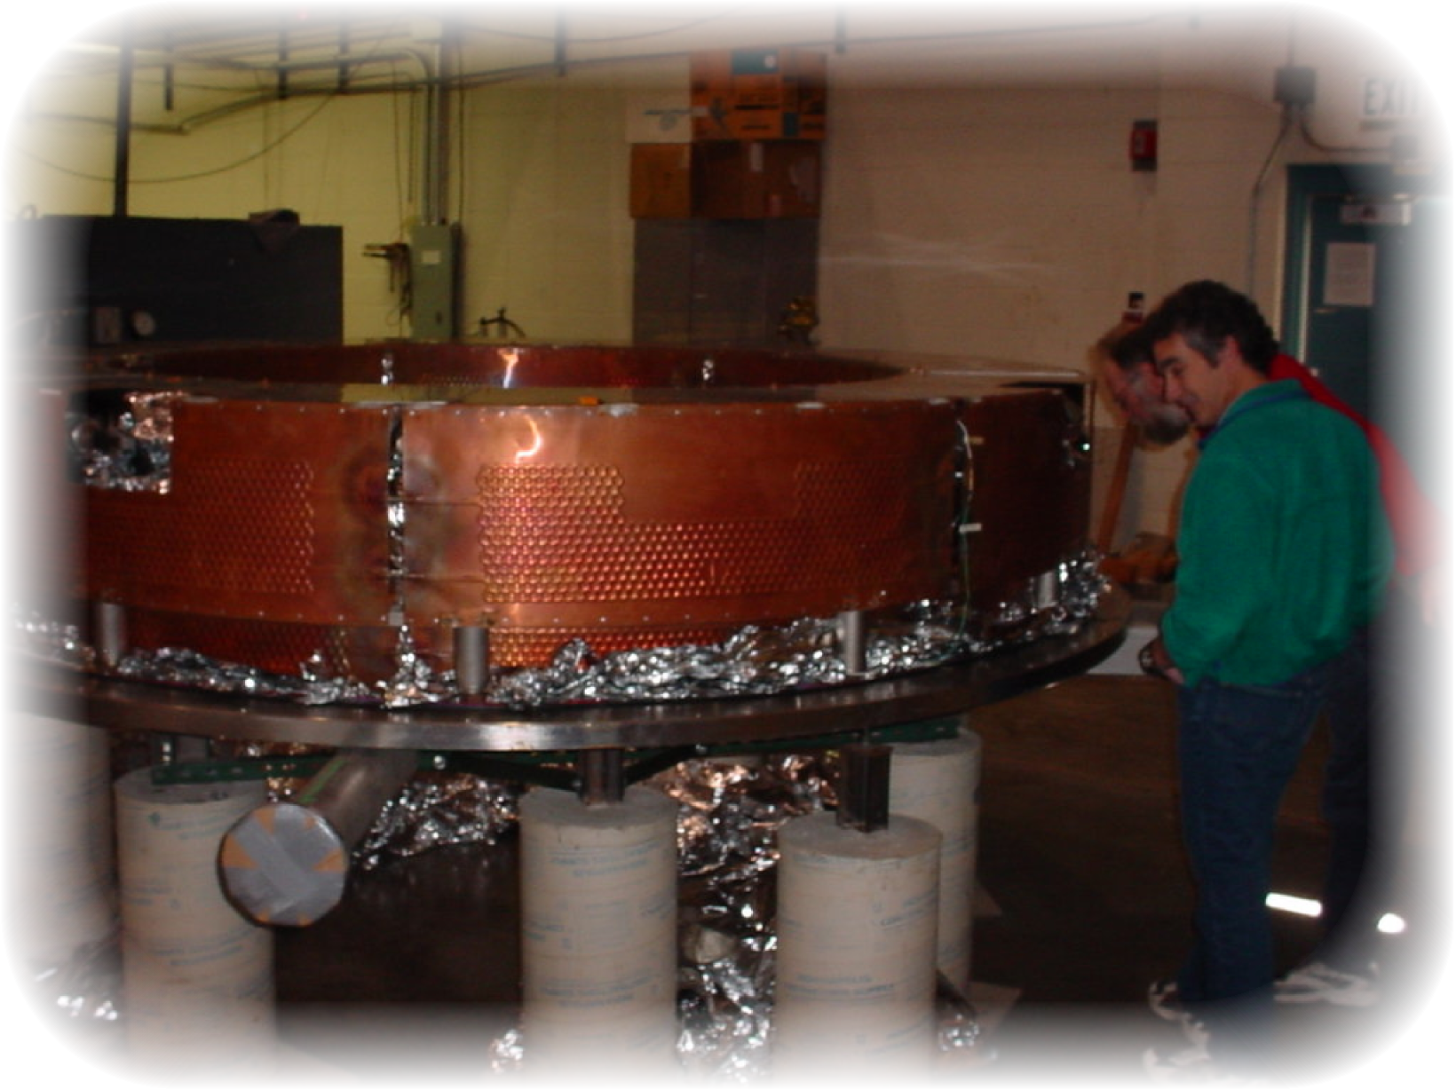
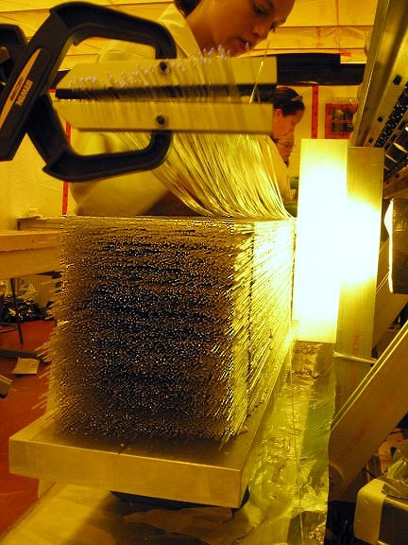
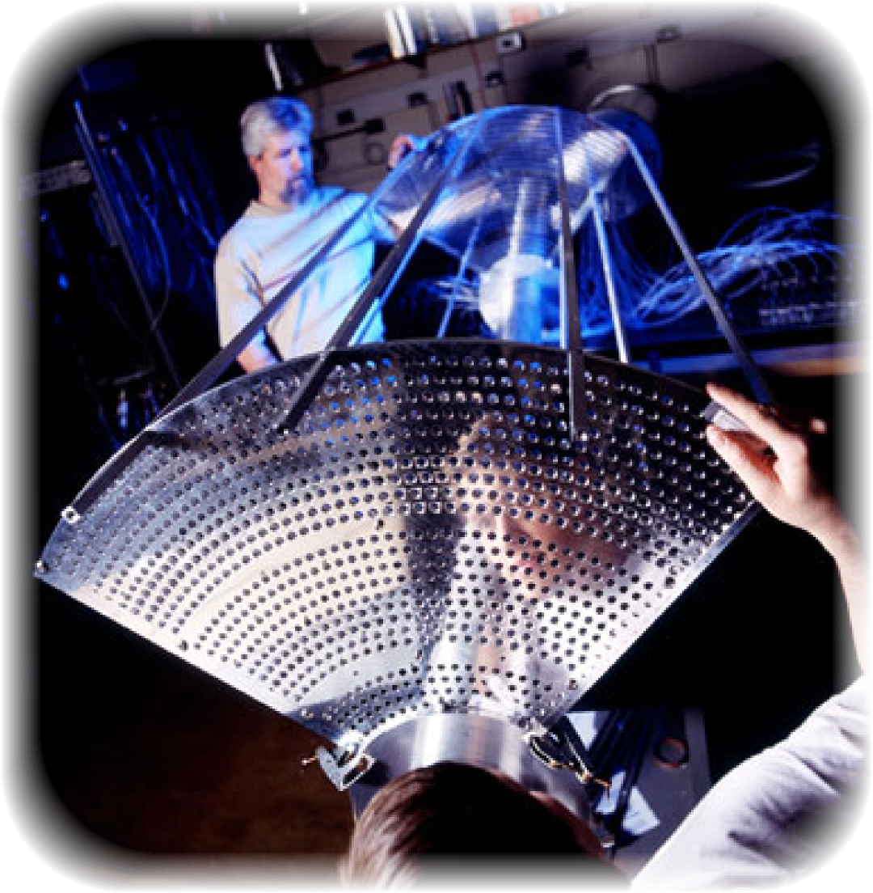
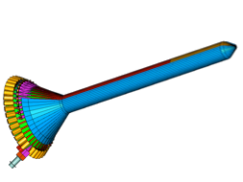
The GlueX Experiment
CHL-2
A New State of Matter?
From the furthest stars to the molecules in your fingernail, everything in the universe is made of tiny particles called quarks. Quarks have a peculiar behavior called "confinement” which means they are always bound together in groups of two, three or more quarks. The "glue" which binds them is made up of particles called "gluons".
The GlueX experiment in Hall-D will attempt to produce and detect 2-quark particles in which the "glue" has been excited. The signature we will look for is to find particles with properties which cannot be explained by two quarks alone. At the same time, these "exotic" signatures will not match the known spectrum of 3 quark states.
Observing and measuring states with excited glue will give us insight into the nature of "glue" and thus, the nature of confinement. Understanding confinement is considered one of the most important scientific questions of our time.
Meson in Ground State
Meson in Excited State
Electronics play a critical role in modern accelerator physics experiments. Events will be recorded at a rate of 200,000/second. Modular electronics such as the F1 TDC shown here are used to record signal times with a precision of 60 picoseconds (or 0.00000000006 seconds!) Other, similar electronics are used to record signal amplitudes. The F1 TDC is one of several modules designed here at JLab based on requirements of the GlueX experiment.
The forward calorimeter is used to measure energy of electrons and photons. It is composed of approximately 2800 modules made of lead-glass. When an energetic particle enters the calorimeter, it creates a "shower" of particles which will spread into several modules. Having many modules allows us to determine where the particle hit in addition to its energy. This photo shows a prototype with just a few modules. In the actual detector, the blocks will be wrapped in reflective material in order to keep the blocks optically isolated.
The superconducting solenoid provides a very intense magnetic field (about 2 Tesla). The magnet is actually made of 4 separate superconducting coils. The photograph here shows one of the coils being tested at the Indiana University Cyclotron Facility. The coils are being refurbished for use in the GlueX experiment after having been used in the LASS and MEGA experiments at Los Almos
This picture shows a prototype of a cathode plane for the Forward Drift Chambers of the GlueX detector. The plane consists of many thin copper strips attached to a thin Kapton sheet. This plane is mounted on a laser scanning device that can map the entire surface to 10μm (0.01 millimeter) precision. A Drift Chamber can detect charged particles as they pass through. The magnet will cause the charged particles to travel in a spiral though the chambers. The size and shape of the spiral tells us the momentum and direction of the particle at the time it was created.
The “Start Counter” is made of 40 thin plastic scintillators arranged in a bullet-like shape around the liquid Hydrogen target at he heart of the GlueX detector. These scintillators will produce light when charged particles pass through them allowing us to identify where, and more importantly when the particle was there. This picture is a computer generated rendering based on the detailed design parameters of the start counter, light-guides (flared part) and light detection devices.
The Central Drift Chambers (like the planar drift chambers shown on the right) detect electrically charged particles as they pass through the ArCO₂ gas that fills the chamber. The gas is ionized by the particles and the electrons freed in the process are moved toward the wires by an electric field produced using high voltage (1,00 -2,000 Volts).This photo shows R & D work being done at Carnegie Mellon University on a prototype of the CDC detector.
The Barrel Calorimeter is a large cylindrical detector that can measure the energy of photons or electrons. The calorimeter is made by gluing together many layers of scintillating fibers and lead. This photo shows one section being made at the University of Regina in Saskatchewan, Canada, one of a number of international collaborators on the GlueX experiment.
http://www.halld.org
http://www.gluex.org
http://www.jlab.org/Hall-D

