Slide 1
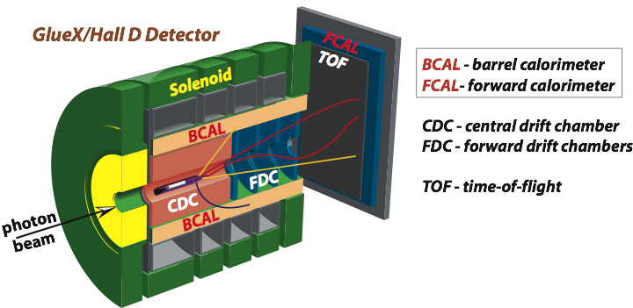
Level-1 Trigger Commissioning Status
A.Somov Jefferson Lab
Collaboration Meeting, May 10, 2010

Slide 2
Trigger Commissioning and Monitoring Tools
GlueX Level-1 trigger group responsibilities are to commission the trigger electronics
and provide tools for monitoring the trigger performance.
Main tools:
• Test Vector
• Trigger monitors
Test Vector:
• Check performance of the electronic boards (synchronization, code loaded to FPGAs…)
and calibration constants.
• Verify the trigger algorithm.
• Will be performed during the trigger commissioning phase and before taking the data.
Implementation:
• Write predefined signal shapes to the FADC250’s FPGA memory.
• Run the trigger hardware.
• Compare hardware output with the MC predictions.
Trigger Monitors:
• Perform online monitoring of the trigger rates, occupancies, … during data taking
• Will be implemented as scalers residing inside FPGAs.
Level 1 Trigger Commissioning Status, GlueX Collaboration Meeting, May 10, 2010 2

Slide 3
Test Vector Implementation
Hai Dong
Ed Jastrzembski
David Abbott
Ben Rayado
Alex Somov
Play Back
TI
TD
FADC
Trigger
• • • 16 ch
SD
SD
• • • 1 - 16 FADC
CTP
SSP
GTP
TS
FADC
• • • 1 - 8
SSP
• • • 16 ch
Load FADC amplitudes of signal pulses to FPGA’s memory.
Trigger Supervisor initiates processing of the samples through the trigger hardware.
Play Back signal will be delivered to the FADC through one of the trigger lines.
Level 1 Trigger Commissioning Status, GlueX Collaboration Meeting, May 10, 2010 3

Slide 4
Play Back Mode: FADC
Current version of FADC250
Trig from TI
(one line for play back)
Load Samples to Memory
VMEbus
Play Back
Altera FPGA
LX25
FIFO
Self Trigger
CTP
pulse in the memory
FX20 ∑
16 x 4 ns = 64 ns (currently)
LX25
FIFO
play back pulse
Load amplitudes of signal pulses (samples) to FPGA memory.
Play Back pulse width defines how many samples to process.
Trigger from TI initiates the VME readout (trigger can also be initiated by FX20 –
self trigger mode)
Level 1 Trigger Commissioning Status, GlueX Collaboration Meeting, May 10, 2010 4

Slide 5
Trigger Test Stand
ROCK
TI
FADC
Trig OUT
Trig IN
VME
Trig IN
Play Back
- CODA
- Load Samples
Discriminator
Pulse
Generator
Trigger
Delay
Maximum width of a signal pulse loaded to the memory: 16 x 4 ns. The same pulse shape is
loaded to all 16 channels.
Play Back signal is send to FADC through the VME P2 bus.
Use external trigger. TI initiates trigger interrupt.
FADC is operated in the “Window Raw Data” mode (read out specified number of samples).
Other readout modes have been checked as well (Pulse Raw Data, Pulse Integral).
Level 1 Trigger Commissioning Status, GlueX Collaboration Meeting, May 10, 2010 5

Slide 6
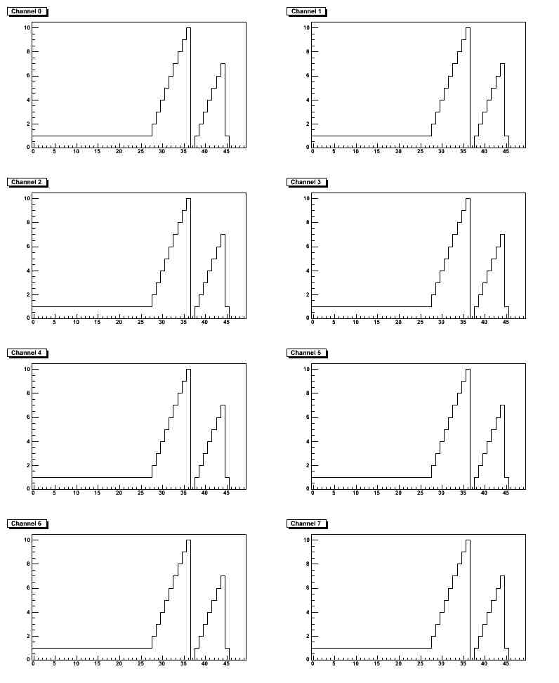
Trigger Test Stand
FADC in the Window Raw Data mode
Load 11 amplitudes (samples) into
FADC memory.
The Play Back pulse width: ~ 70 ns.
The same pulse shape for all 16 channels.
Some work is needed to be able to load
different pulse shapes into different FADC
channels.
Loaded Pulse
Readout Window
Play Back pulse
Level 1 Trigger Commissioning Status, GlueX Collaboration Meeting, May 10, 2010 6

Slide 7
Summary / Future Plans
We have started preparing for the Level-1 Trigger commissioning.
We received a lot of support/help from the Fast Trigger Electronics and DAQ groups.
Next Steps:
Finish with implementation of the “Play Back” mode – should be able to write
different samples to the16 FADC channels.
We are on the way to the 2 crate test stand.
- The new TI prototype and the new FADC version will be ready by the fall of 2010.
- DAQ official software is under development.
Level 1 Trigger Commissioning Status, GlueX Collaboration Meeting, May 10, 2010 7

