Slide 1
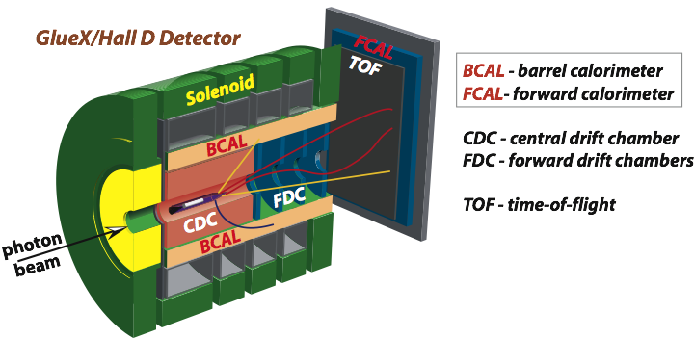


Status of the Beamline Simulation
A.Somov Jefferson Lab
Collaboration Meeting, May 11, 2010

Slide 2
Simulation Overview
Tagger magnet simulation
• Energy resolution and rate of microscope counters of the narrow magnet
• Check the magnetic field map of the narrow magnet produced with TOSCA
Pair Spectrometer Simulation
• End-point energy calibration
• PS alternative readout
Status of the Beamline Simulation, GlueX Collaboration Meeting, May 11, 2010 2

Slide 3
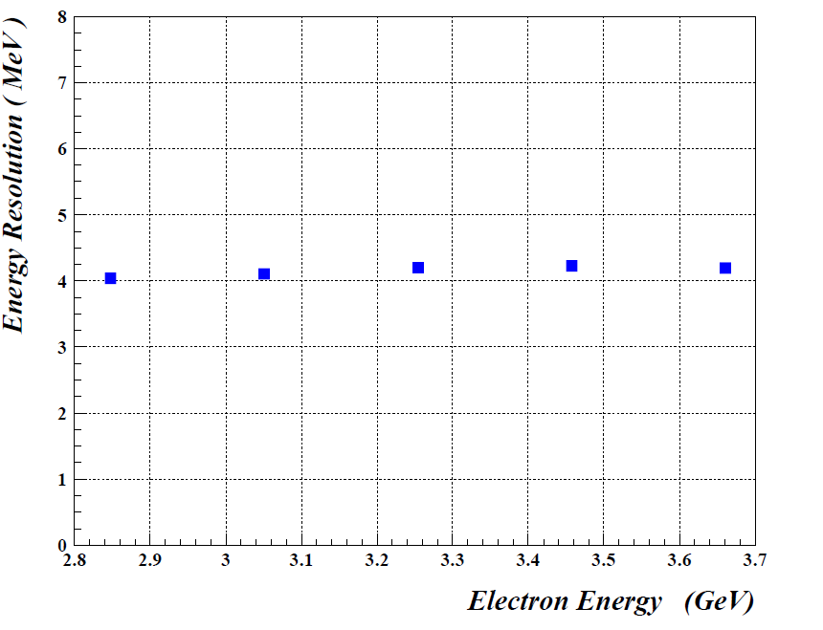
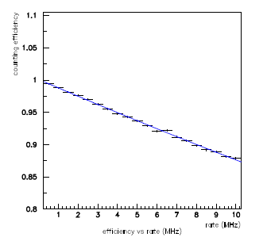
Summary on the Simulation of 6 cm Narrower Magnet
Microscope counters
Fixed-Array Hodoscopes
ΔE / E ~ 0.07 %
ΔE / E ~ 0.05 %
GlueX-doc-1368
Resolutions due to the finite counter sizes are not included in these plots: σ (microscope) ~ 2.8 MeV σ (fixed-array) ~ 8.7 MeV
Counting efficiency versus rate
RMS time resolution versus rate
GlueX-doc-1369
At the counter rate of 5 MHz the counting efficiency is close to 95% and the timing resolution is
about 200 ps
The expected rate in the microscope counters per energy bin is about 3.8 MHz
Status of the Beamline Simulation, GlueX Collaboration Meeting, May 11, 2010 3

Slide 4
Summary on the Simulation of 6 cm Narrower Magnet
Microscope counters
Uncertainties due to the multiple scattering:
• 0.32 mm multiple scattering of electrons in the
diamond crystal
• 0.38 mm scattering in the VC exit window and
fixed-array counters
σ ~ 0.5 mm
New magnetic field map for the narrow magnet generated with TOSCA (Yang)
• Check position of electrons on the focal plane
• Check position of full-energy electrons at the Beam Position Monitors (z = 26 m)
The technical drawings with the new focal plane will be updated shortly (Bill Crahen is
working on them)
To be done
Implement the new magnetic field map produced with ANSYS to the Geant simulation (work in progress)
Update Geant geometry (to be done )
Study methods for the tagger calibration (work in progress)
- calibrate energy using pair spectrometer (do we need to map the tagger field ?)
Status of the Beamline Simulation, GlueX Collaboration Meeting, May 11, 2010 4

Slide 5
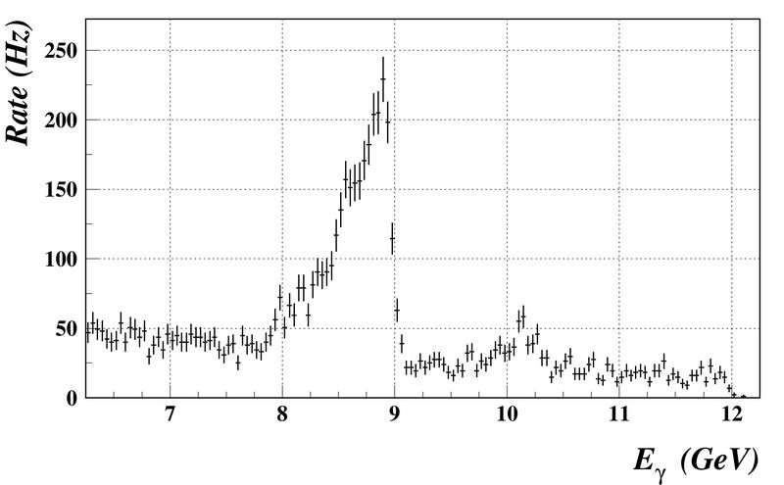
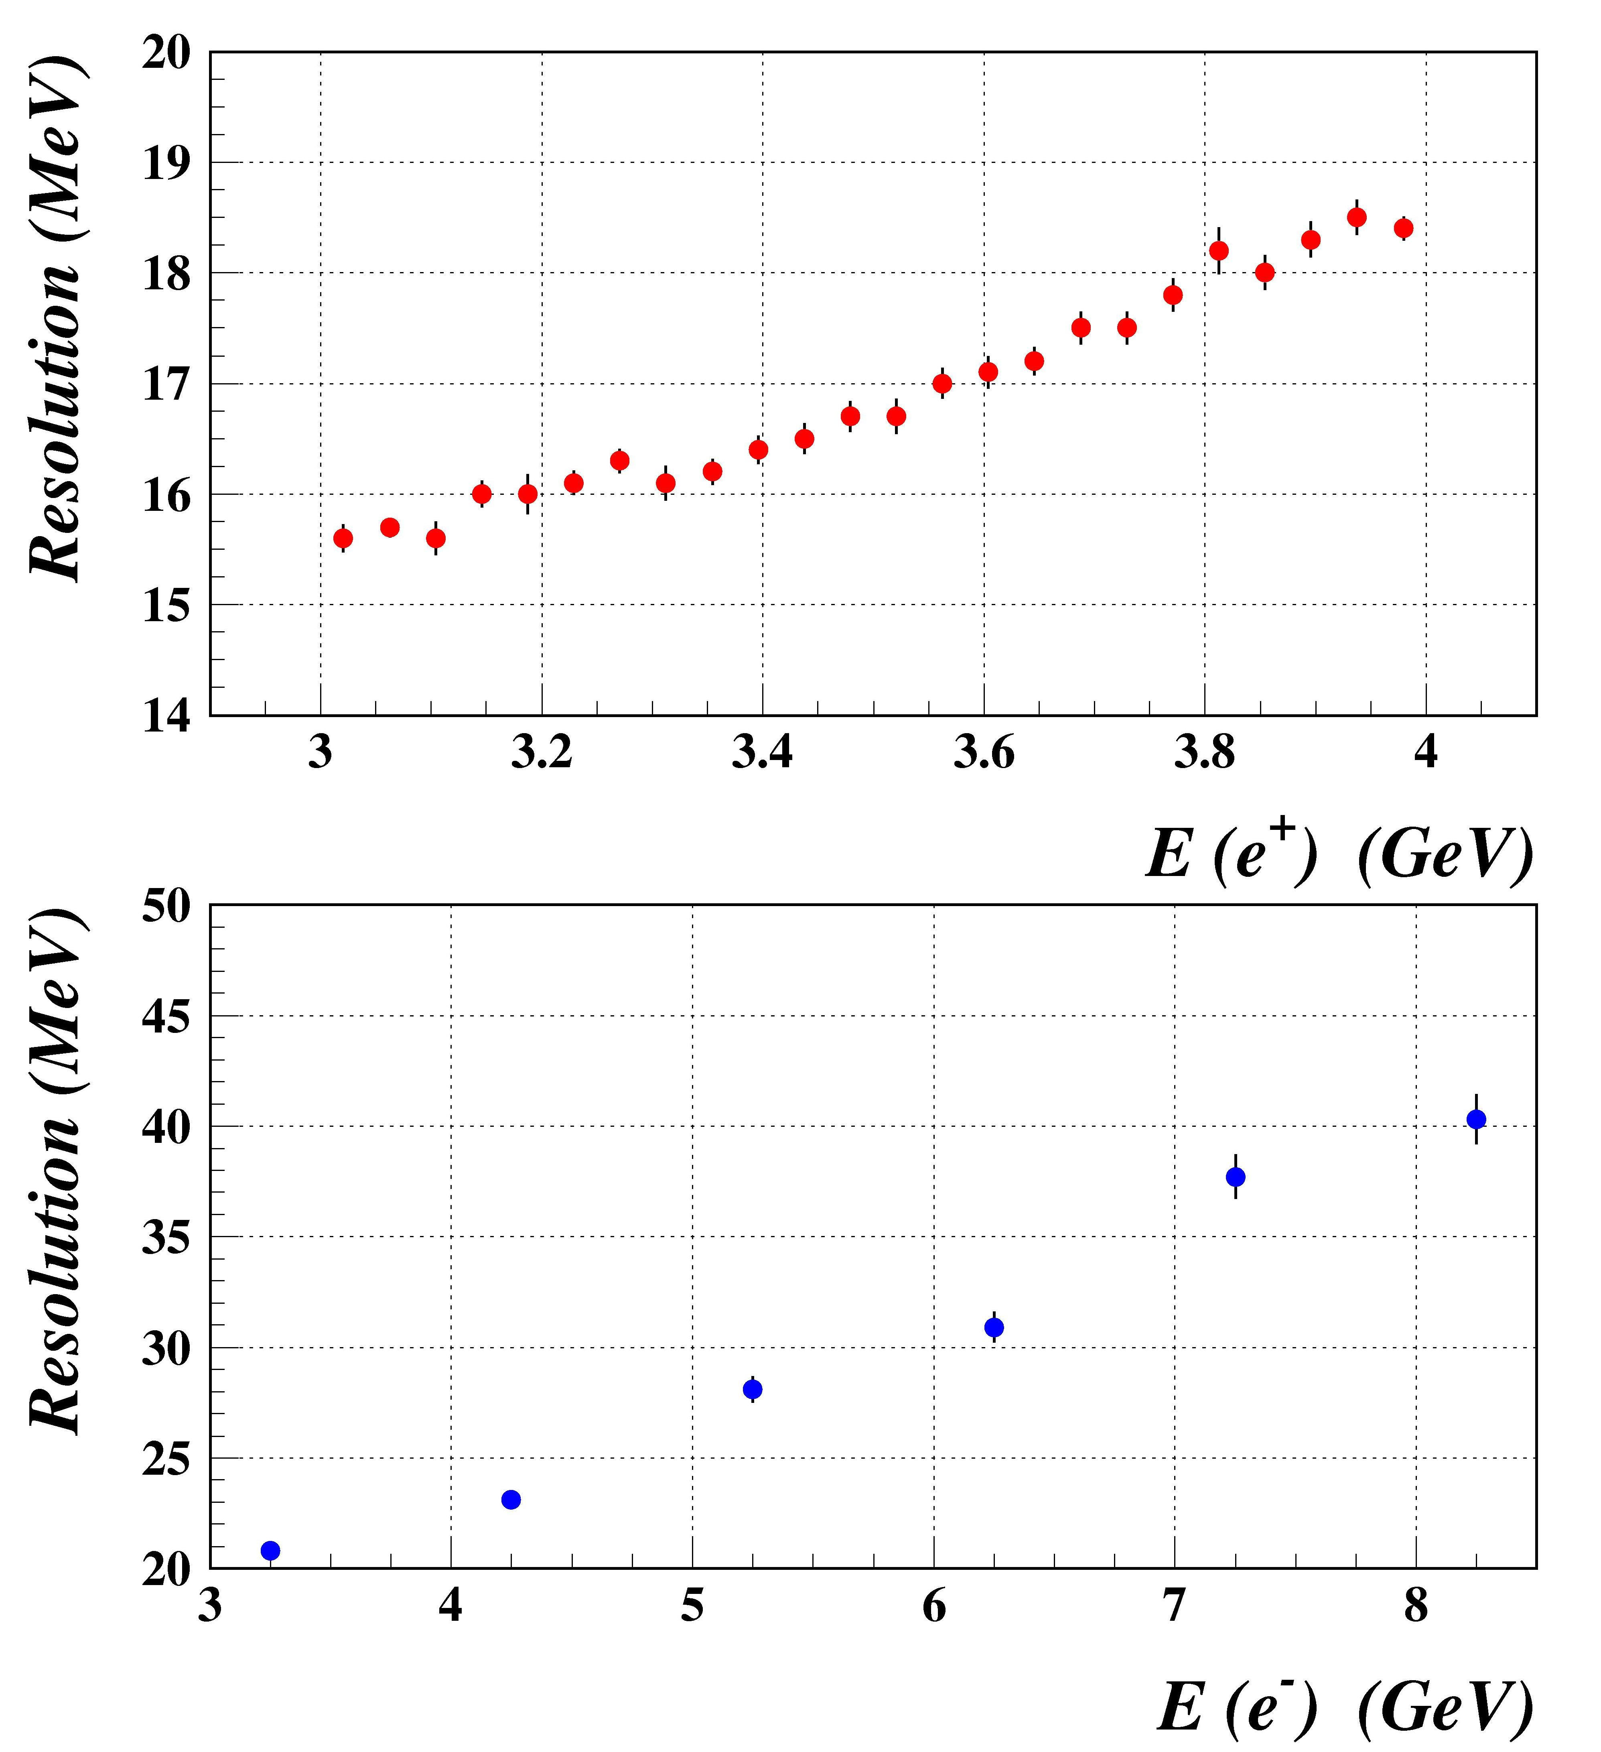
Simulation of the Pair Spectrometer
Recent Pair Spectrometer geometry:
• 2 m long dipole magnet with the nominal operation field of 1.6 T
• 1.5 m long vacuum chamber
• 24 FSF counters covering the range 3 - 4 GeV
- bin size 41.7 MeV, σ(E) = 12 MeV
• 8 WSF counters positioned ar 3.25 GeV, … , 8.25
- σ(E) = 17 MeV
Photon energy measured at high luminosity
(Al converter with the thickness 5x10⁻³ X₀ )
Counter resolution obtained with the Geant
simulation (converter thickness 5x10⁻³ X₀)
FSF
~ 20 Hz
WSF
Counter width 2 mm. The resolution is
dominated by the beam spot ( ~ 4 mm )
Status of the Beamline Simulation, GlueX Collaboration Meeting, May 11, 2010 5

Slide 6
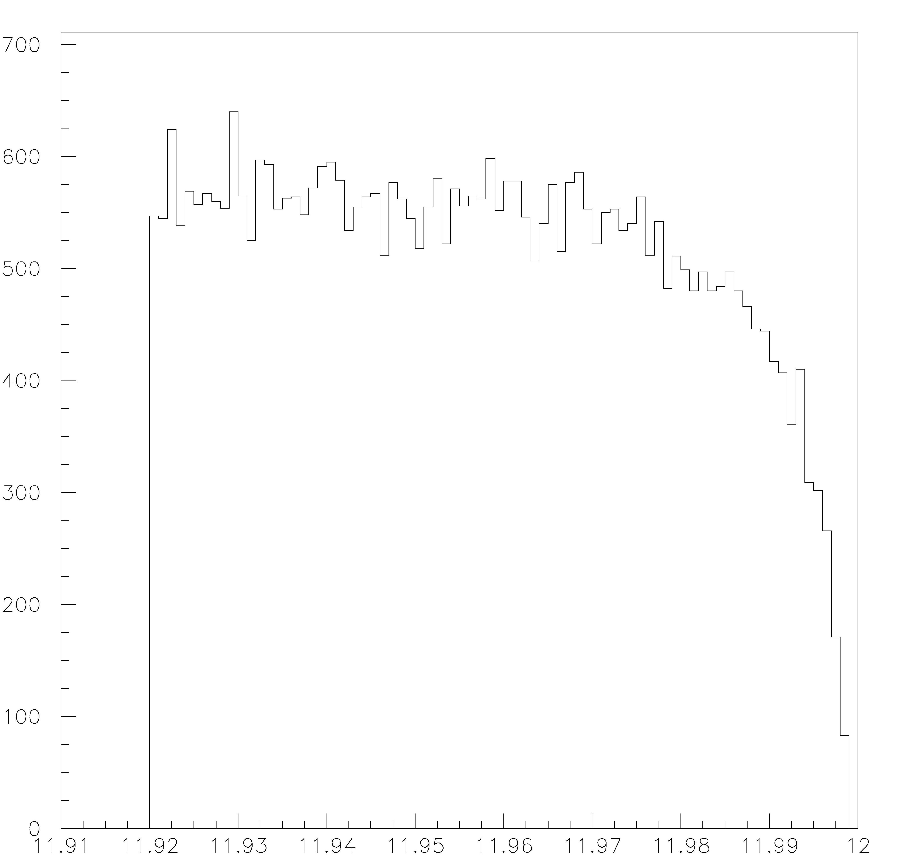
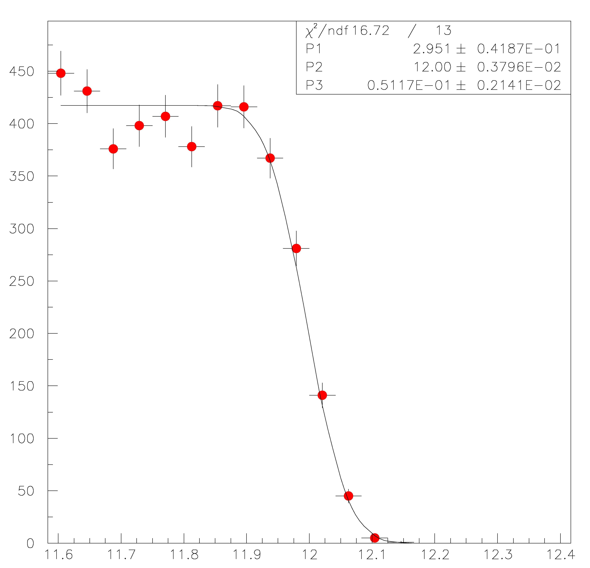
PS End-Point Energy Calibration
We can calibrate the pair spectrometer by fitting the measured photon spectrum at the end-point region
The tagger hodoscopes can subsequently be calibrated using the Pair Spectrometer
- required precision on the realative end-point energy measurement ~10⁻³ (12 MeV)
We need parameterization of the bremsshtrahlung energy in the end-point region – under study
Use Toy MC to estimate accuracy of the energy measurements. Generate MC samples using the beamgen
energy shape and the energy resolution of 50 MeV. Fit for E_{max} and σ(E). Preliminary results:
- taking the calibration data for 5 – 10 min (for low luminosity runs) will provide the precision on the
energy measurement better than 10⁻³
- main uncertainties come from the energy bin size, which is 41 MeV (to be studied in detail). Use
additional WSF counter between 7.25 GeV and 8.25 GeV.
The end-point energy distribution for incoherent
Bremsstrahlung predicted by beamgen generator
Toy MC. Energy distribution at the end-point
Fit for E_{max} and σ
MC input values:
E_{max} = 12 GeV
σ = 50 MeV
GeV
GeV
Status of the Beamline Simulation, GlueX Collaboration Meeting, May 11, 2010 6

Slide 7
PS: Summary on the Default Instrumentation
The current instrumentation of the Pair Spectrometer with the FSF and WSF counters
seems to be the simple and reliable design.
- the PS rate should be sufficient for the precise monitoring of the photon flux
- good precision in the online/offline determination of the photon polarization
- the PS counters covering the energy region close to the end-point can be calibrated
by fitting the end-point energy spectrum (we have to study the theoretical uncertainties
in the shape of the end-point spectrum); we will probably need to add additional
WSF counter(s) in the energy range between 7.25 GeV and 8.25 GeV
Some disadvantages:
- small acceptance of about 0.1% ( and the size of the counter positioned closest to the
beamline). We need a procedure to calibrate the acceptance of each WSF counters
- small rate when operating with the wire target
Consider the feasibility of using Microstrip detectors as an additional PS instrumentation
Status of the Beamline Simulation, GlueX Collaboration Meeting, May 11, 2010 7

Slide 8
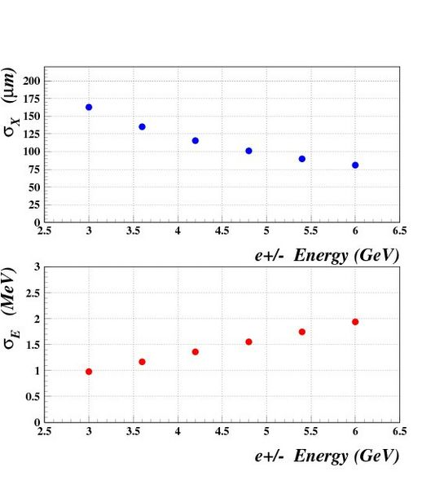
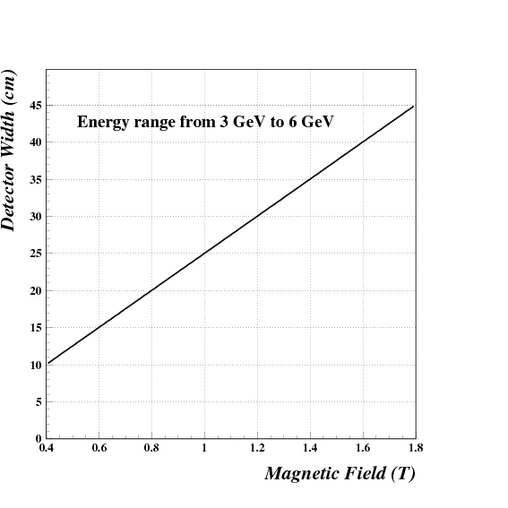
Using Microstrip Detectors for the PS
Consider symmetric design of the Microstrip detectors:
each arm covers the energy range between 3 GeV – 6 GeV
The detectors should be about 25 – 30 cm wide when operating the magnet at 1 – 1.2 T
Contribution from the multiple scattering
( 10⁻⁴ X₀ thick converter)
The detector width and position from the
beamline as a function of the B-field
Status of the Beamline Simulation, GlueX Collaboration Meeting, May 11, 2010 8

Slide 9
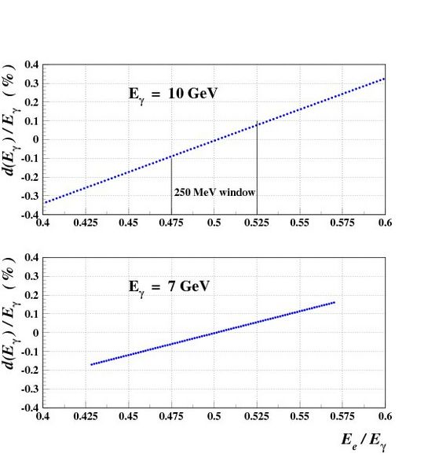
Using Microstrip Detectors for the PS
Microstrips provide some ‘redundant’ measurements which can be used to control
systematic errors
Impact of the beam profile distribution and beam motion on the energy resolution.
Relative shift of measured photon energy for the beam displacement of dx = 2.5 mm.
The magnetic field is set to 1 T.
Status of the Beamline Simulation, GlueX Collaboration Meeting, May 11, 2010 9

Slide 10
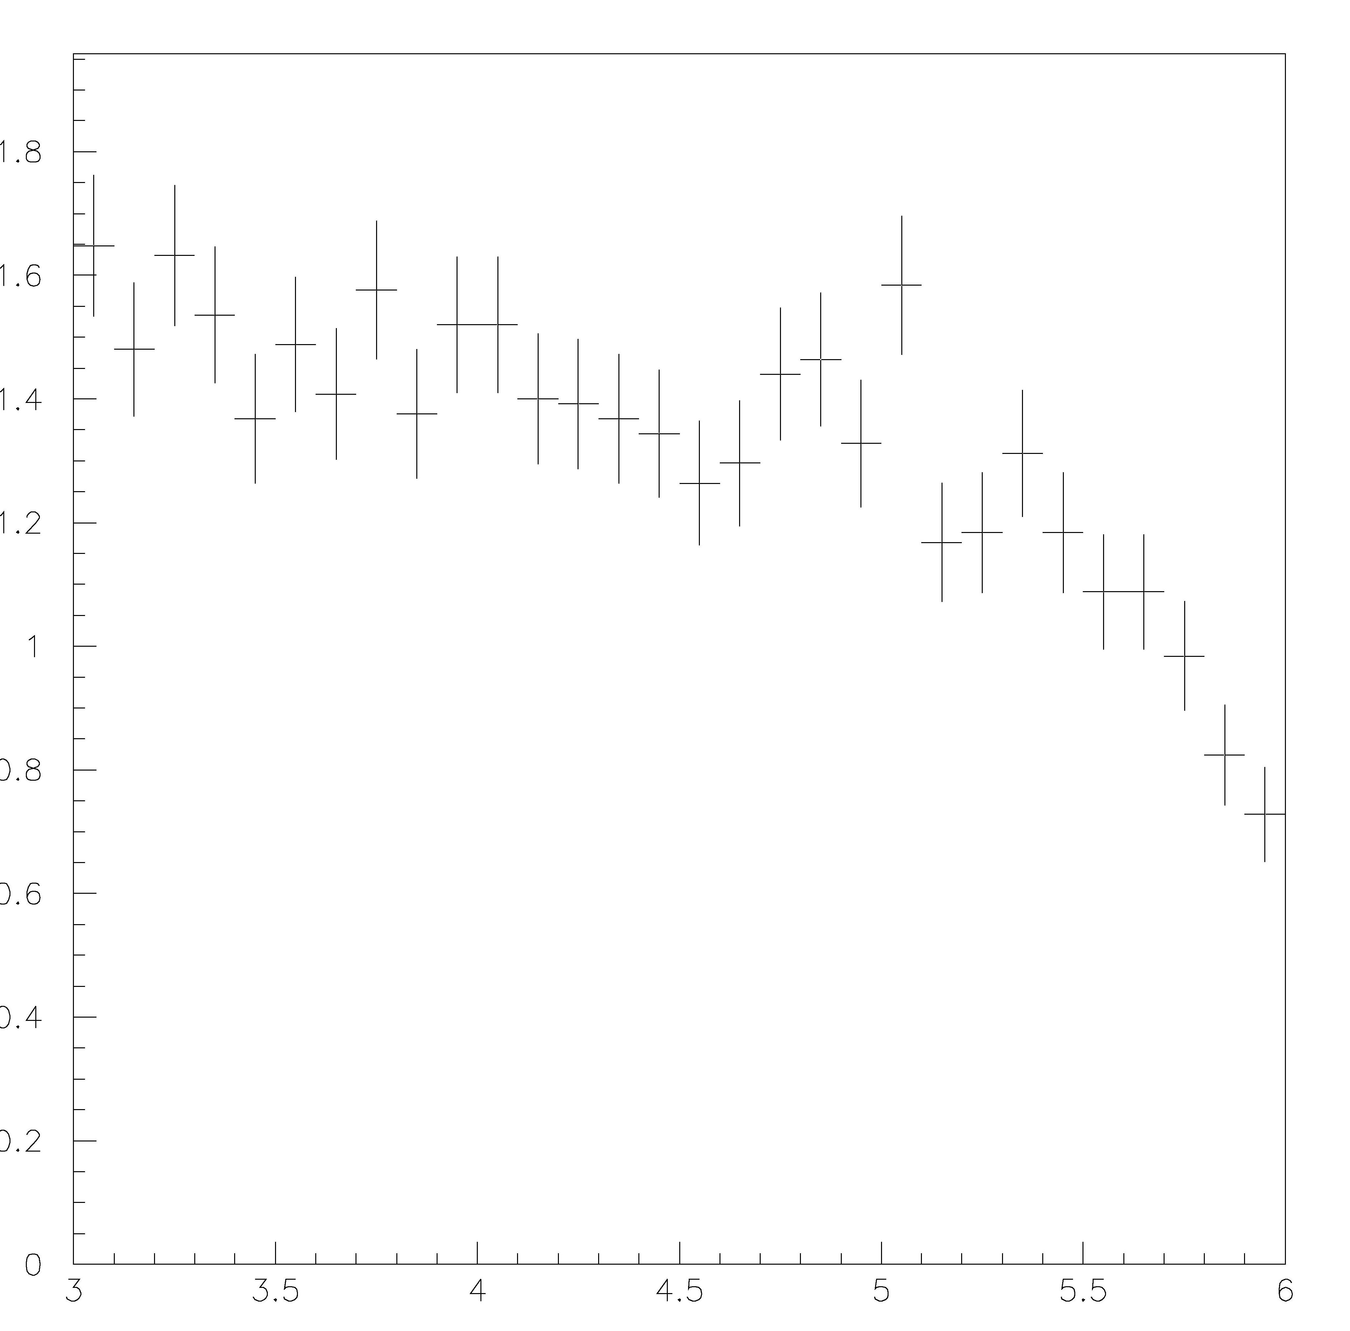
Using Microstrip Detectors for the PS
Rate per cm ( counter width 30 cm, 10⁻³ X₀ thick converter)
Rate / cm (kHz)
Total rate in the energy range between
3 GeV- 6 GeV is about 44 kHz
e⁺/e⁻ Energy (GeV)
Status of the Beamline Simulation, GlueX Collaboration Meeting, May 11, 2010 10

Slide 11
Summary
The simulation of the narrow tagger dipole magnet is completed.
The future plans are:
• Implement ANSYS magnetic field map to the Geant simulation
• Update Geant geometry of the narrow magnet and the vaccum chamber
• Study calibration procedure of the tagger hodoscopes
• Complete the studies of the Pair Spectrometer calibration using the end-point
energy ( and the feasibility of calibration of the tagger hodoscopes using the
Pair Spectrometer)
• Produce the magnetic field map of the Pair Spectrometer magnet using ANSYS
and implement the map to the Geant simulation
• Study the feasibility of using the microstrip detectors as an additional Pair
Spectrometer instrumentation
Status of the Beamline Simulation, GlueX Collaboration Meeting, May 11, 2010 11

