Slide 1
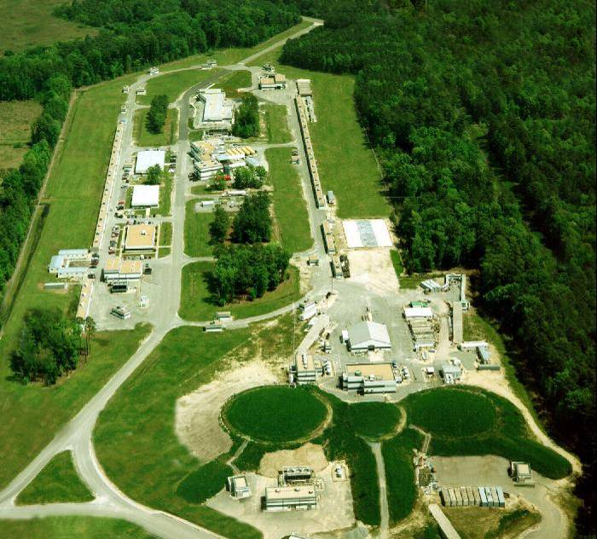
The GlueX Detector
David Lawrence (JLab)
Electron beam accelerator
continuous-wave (1497MHz, 2ns bunch structure in halls)
Polarized electron beam
Upgrading to 12GeV (from 6GeV)
70 μA max @ 12Gev (200μA max @ 6GeV)
Future Hall-D site
Existing experimental halls A, B, C

Slide 2
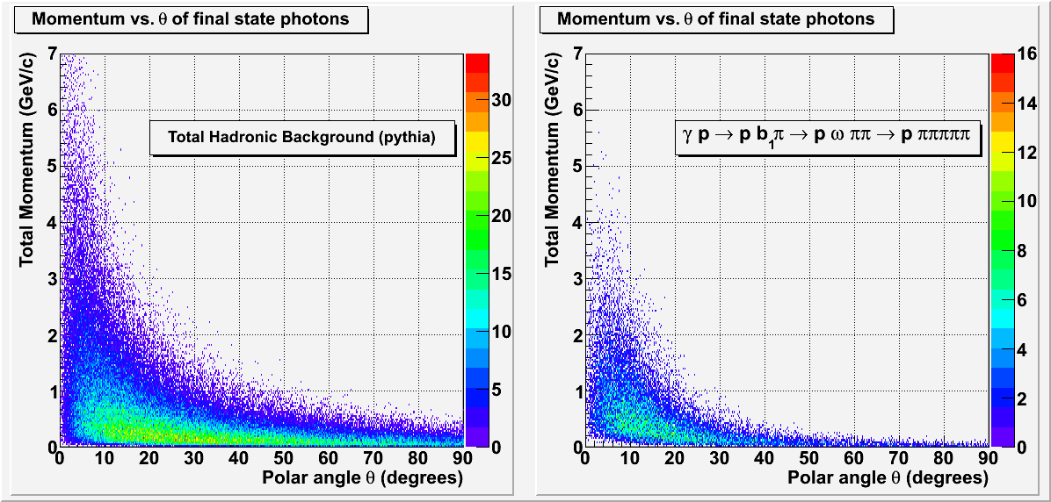
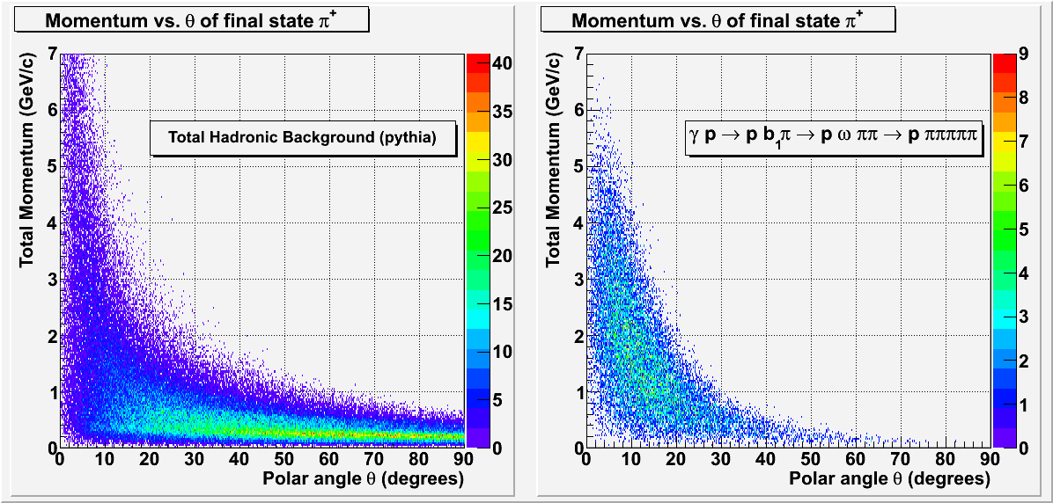
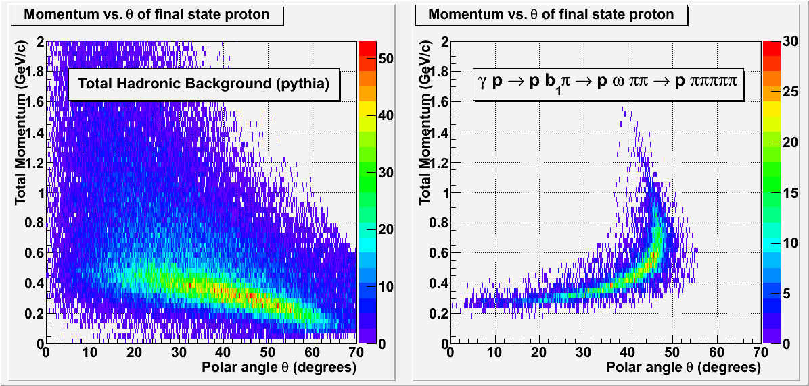
The GlueX Experiment
Goal: map the spectrum of exotic hybrid mesons
Method: Photo-produce hybrids off proton target and identify the quantum states using Partial Wave Analysis of decay product distributions
detectable final state
9GeV linearly polarized
hybrid meson
(mixed charged and neutral)
See Matt Shepherd’s and Jo Dudek’s talks Saturday @ 16:30 “QCD, Hadron Spectroscopy and Exotics” session

Slide 3
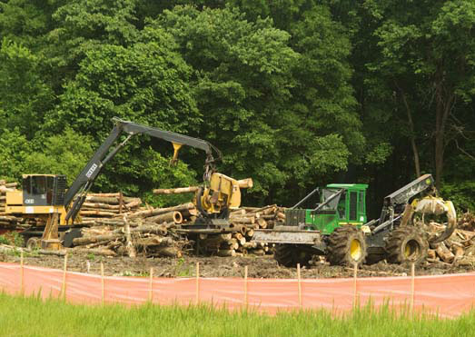
Hall-D Complex at Jefferson Lab
electron beam
Construction has recently begun and will be completed Fall 2011. (Buildings only, detectors will follow)
~100 meters

Slide 4
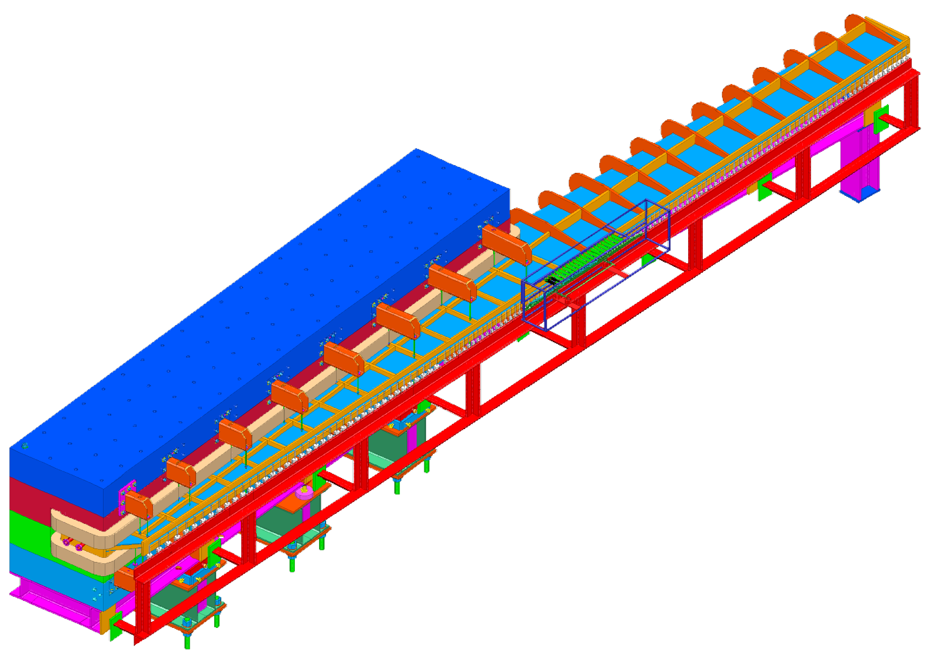
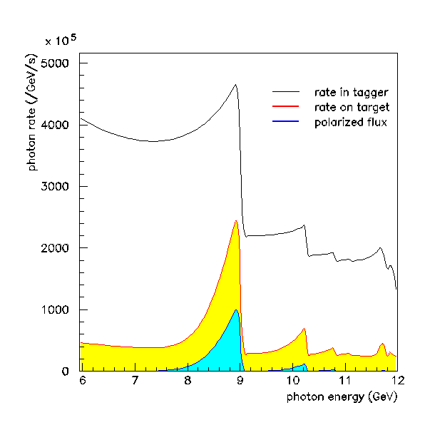
The Photon Beam
Photon Polarization:
20 μm diamond radiator
Coherent peak is linearly polarized
~40% polarization with peak @ 9GeV
Peak location tunable with diamond angle
Microscope:
Movable to cover different energy ranges
100 x 5 scintillating fibers (2mm x 2mm)
800MeV covered by whole microscope
100MHz tagged γ/sec on target
~8MeV energy bite/column
12m long vacuum chamber
photon energy (GeV)
1.5T dipole magnet
4
coherent bremstrahlung spectrum
e⁻
Fixed array hodoscope:
190 scintillators
50% coverage below 9GeV γ
100% coverage above 9GeV γ
Tags 3.0-11.7 GeV γ
~30MeV energy bite/counter
3.5 – 17 MHz/counter
20μm diamond radiator

Slide 5
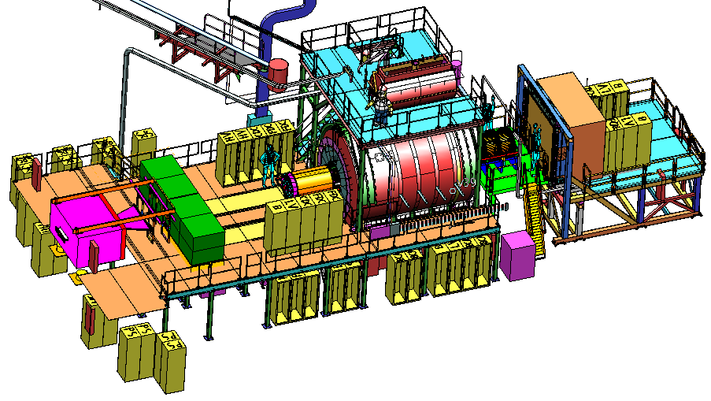
The GlueX Detector
2.2 Tesla
Solenoid
2.2T superconducting solenoidal magnet
Fixed target (LH₂)
10⁸ tagged γ/s (8.4-9.0GeV)
hermetic
TOF
time of flight
SC
start counter
Charged particle tracking
Central drift chamber (straw tube)
Forward drift chamber (cathode strip)
Calorimetry
Barrel Calorimeter (lead, fiber sandwich)
Forward Calorimeter (lead-glass blocks)
PID
Time of Flight wall (scintillators)
Start counter
Barrel Calorimeter

Slide 6
A single γ p ➔ pb₁π event
Final state: p π⁺ π⁺ π⁻ π⁻ πº

Slide 7
Calorimetery
Calorimeters measure the energy of single, energetic particles
To do this, the energy must be converted into a measurable form
Several detectors available that convert a fraction of the energy to light
Light detected by photo-sensitive devices
For GlueX, calorimeters designed to measure γs (not hadrons)
Material needs to be:
Thick
Dense
Optically Clear
Incident γ will generate a “shower” through a series of E.M. interactions
e+/e- pair production
γ production via bremstrahlung

Slide 8
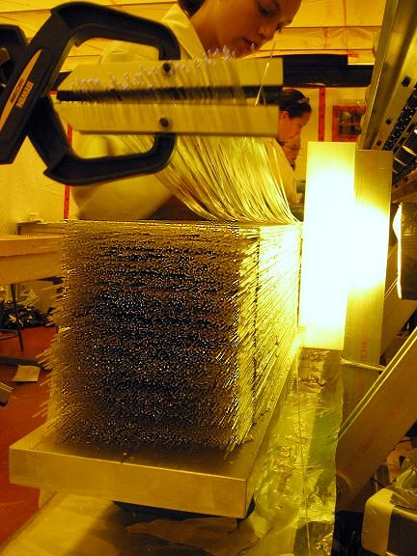
BCAL: Barrel Calorimeter
Barrel Calorimeter:
191 layer Pb-scintillating fiber sandwich (15.5X_{o})
12.5% sampling fraction
1152 + 192 = 1344 readout sections/end
σ_{E}/E= (5.54/√E 1.6) %
σ_{z} = 5mm/√E
σ_{t} = 74ps/√E 33ps
angular coverage 11º < θ < 120º
BCAL module being constructed
BCAL has 2-ended readout allowing one to reconstruct in 3-D
Photo-detection devices
Light Guides
390 cm
illustration does not accurately represent the number of photo-detection devices

Slide 9
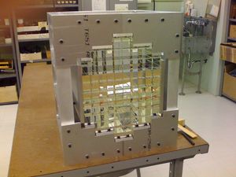
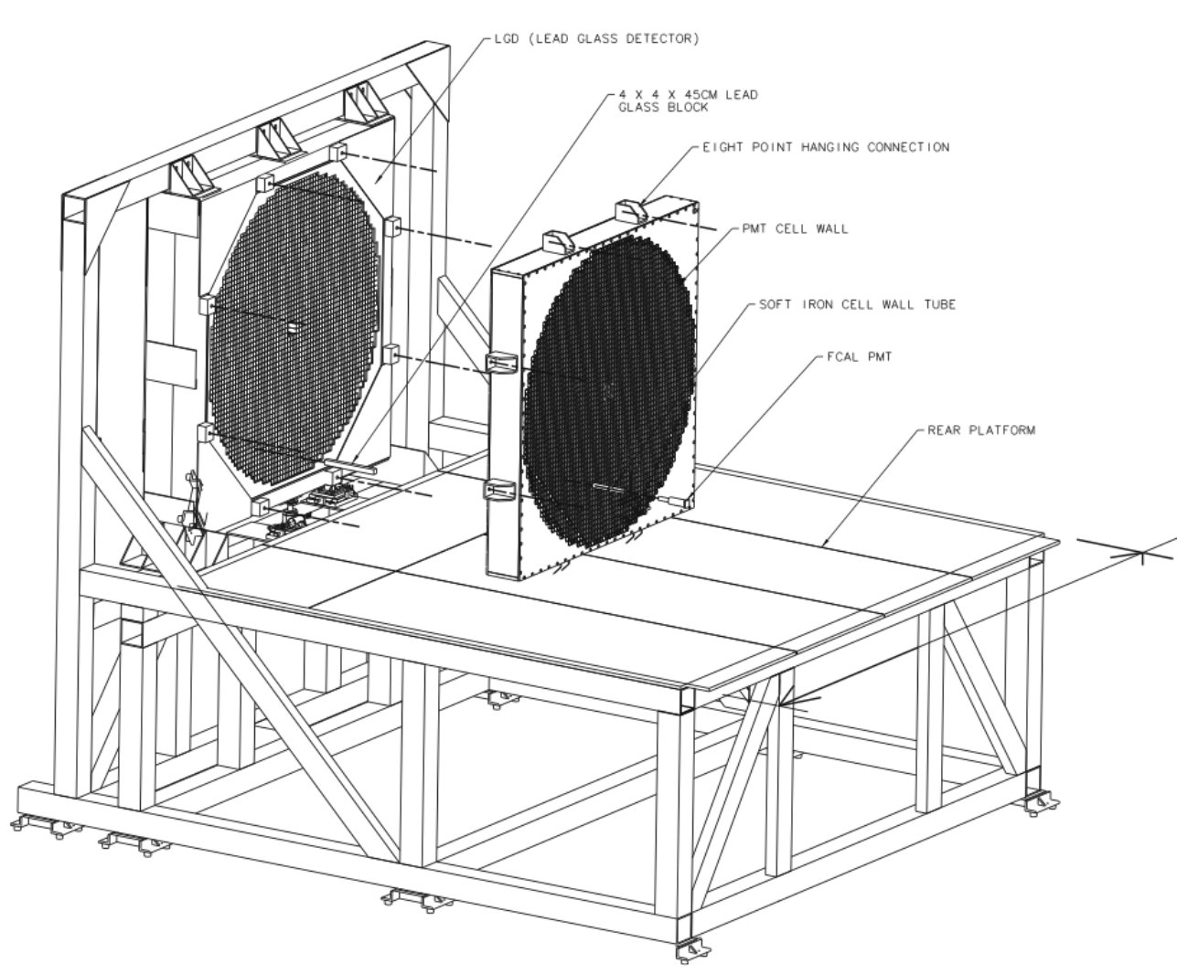
FCAL: Forward Calorimeter
Forward Calorimeter:
2800 F8-00 and F108 (center) Pb-glass blocks
4cm x 4cm x 45cm
σ_{E}/E= (5.7/√E 2.0) %
σ_{xy} = 6.4mm/√E
angular coverage 2º < θ < 11º
Prototype FCAL Array
An FCAL module
Lead-glass produces Cerenkov light (not scintillation light!)

Slide 10
Charged Particle Tracking
Drift chambers are used to measure single, energetic charged particles
To do this, the particle is passed through a region with a strong magnetic field
The field curves the path of the particle in a way that depends on its momentum
Drift chambers measure position of particle at several places (15-30) along its trajectory
Easily ionizable gas (Ar CO₂) in chambers allows charged particle to leave trail of electron/ion pairs
Electrons drift to the “sense” wire due to high voltage induced electric field
Drift time related to drift distance
Wire ID: 1329
Time: 234 ns
Time-of-flight: 27 ns
DIST: 3.337 mm
DOCA: 3.425 mm
residual: 88 μm

Slide 11
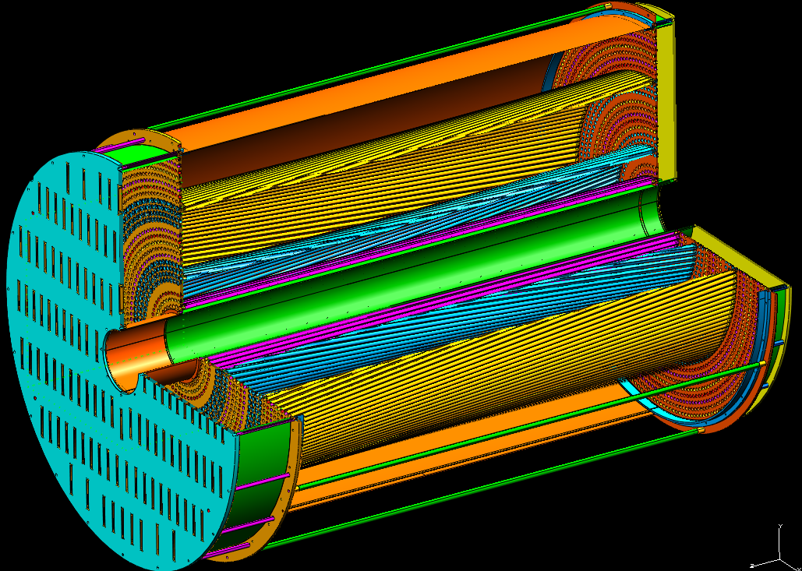
CDC: Central Drift Chamber
Central Drift Chamber:
3522 straw tubes (1.6cm diameter)
12 axial layers, 16 stereo layers (6º)
dE/dx for p < 450 MeV/c
σ_{r} = 150μm
angular coverage 6º<θ<155º
A straw tube being cut
CDC prototype II
σ_{p}/p : 1.5 - 3.0%
CAD drawing of CDC
Track is fit to tangent points of circles representing drift distance

Slide 12
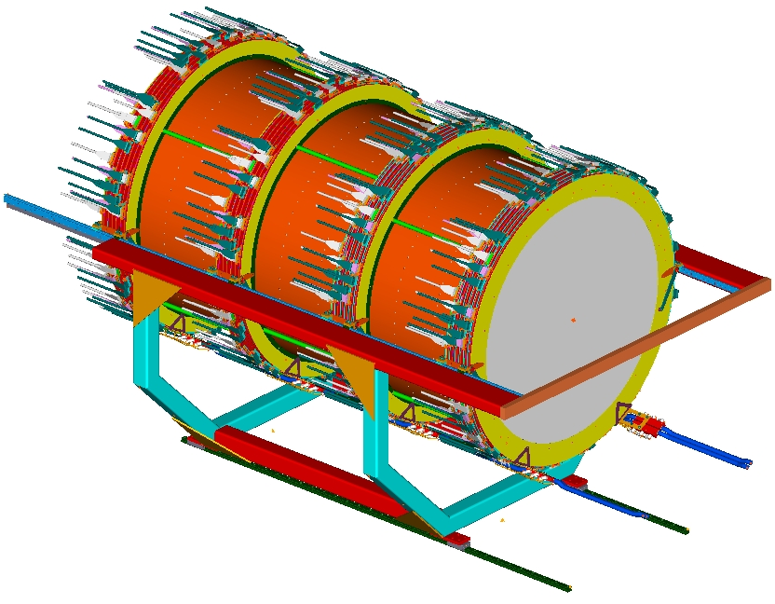
FDC: Forward Drift Chamber
Forward Drift Chamber:
4 packages, 6 planes/package, 96 wires/plane (2304 sense wires)
cathode strip readout (48 planes x 216 strips/plane = 10,368 strips)
σ_{r} = ~200μm perpendicular to wire (drift time)
σ_{s} = ~200μm along wire (cathode strips)
angular coverage 1º<θ<30º
FDC Cathode Plane
FDC planes rotated 60º wrt neighbors
Electric field around 1 FDC wire
FDC Frames
FDC Active Area
Illustration of FDC wire plane and cathode planes

Slide 13
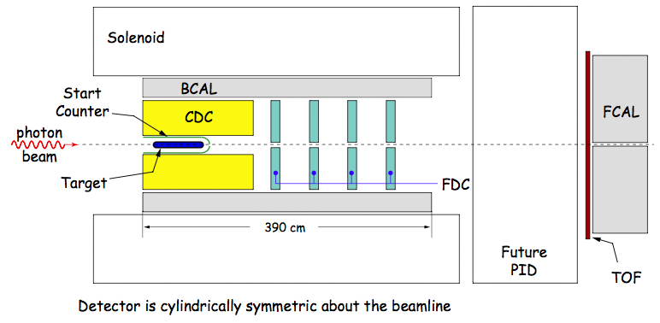
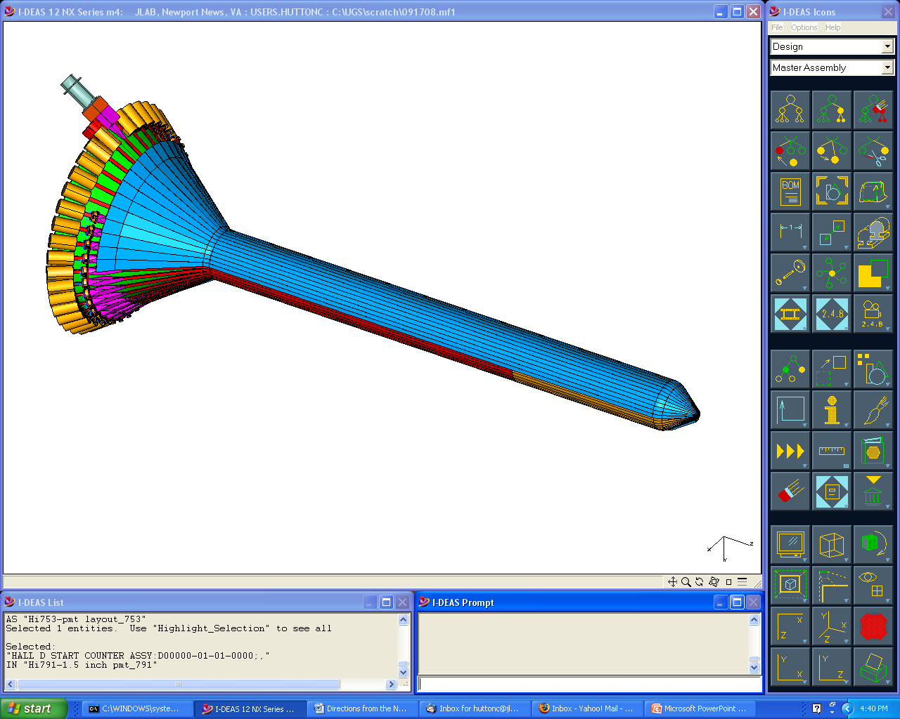
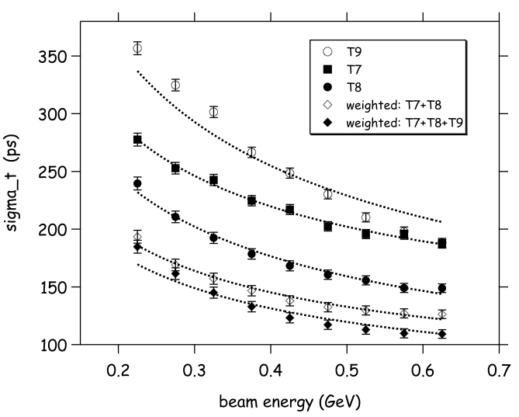
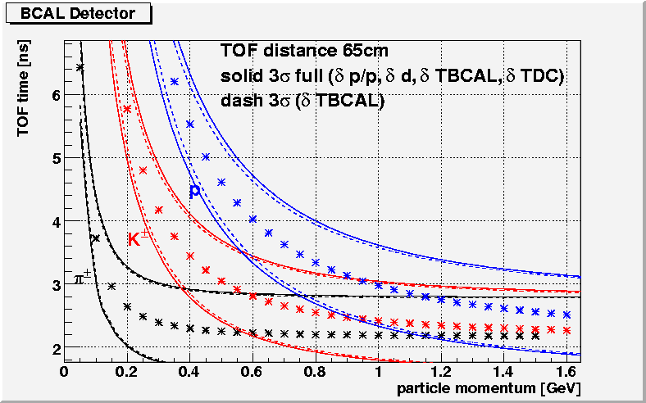
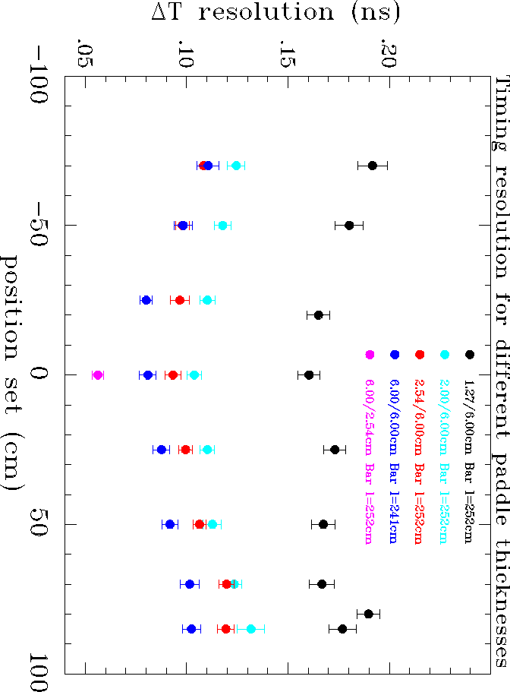
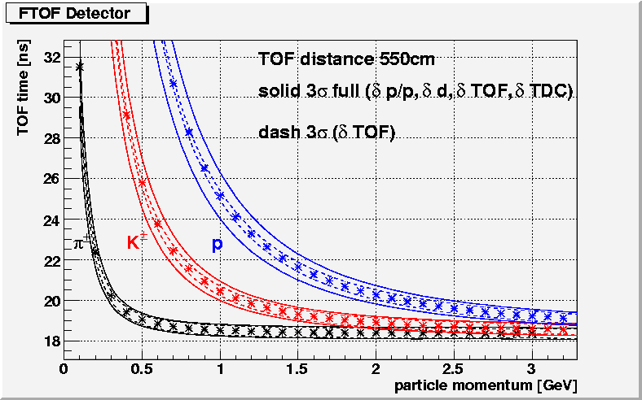
Particle ID
Particle ID is done primarily through time of flight with some help from dE/dx in chambers. Space is left in design for a future PID detector.
Beam Test Data
Expected Separation
~200 ps
Start Counter
Barrel Calorimeter
40 scintillators
300 ps (w/tracking)
Used for start-up
σ_{diff} (ps)
~80 ps
CDC dE/dx
Forward TOF
σ_{diff} (ns)
πp separation <450MeV/c
πK separation <275MeV/c

Slide 14
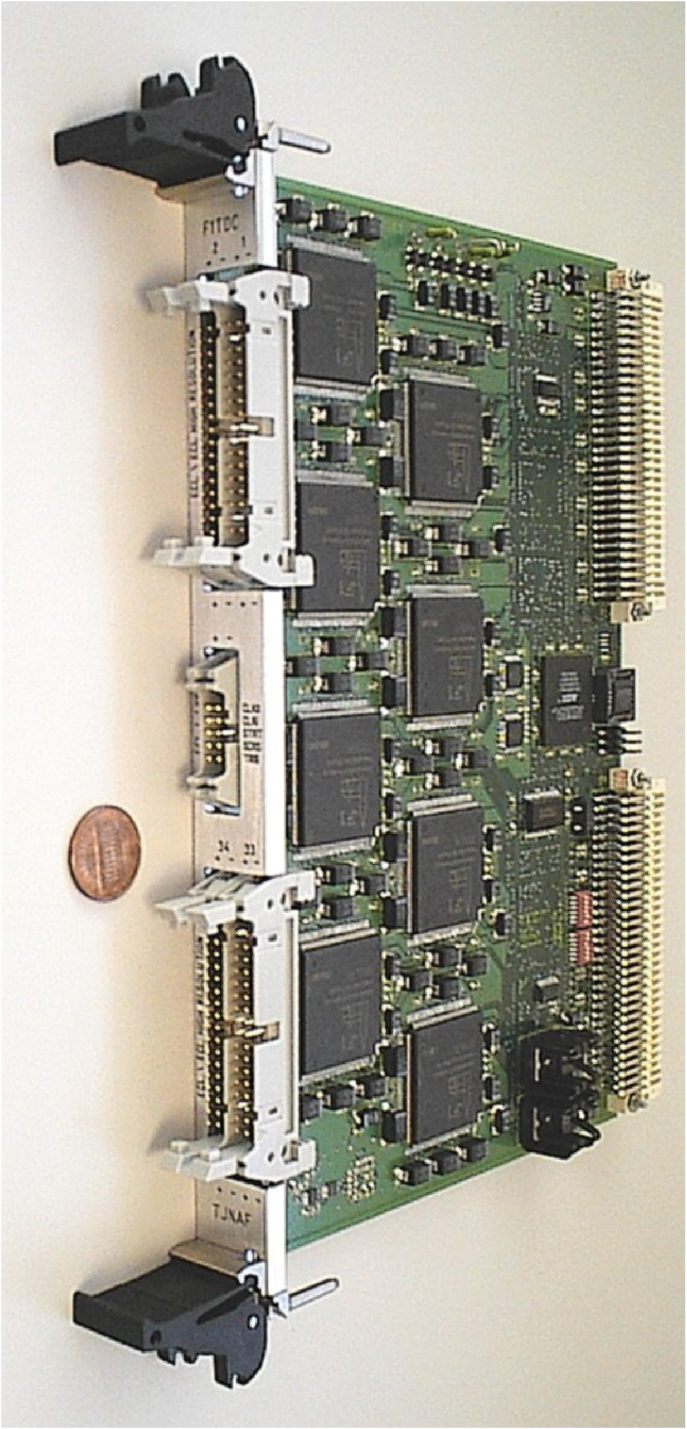
Electronics and Data Rates
Electronics
All digitization electronics are fully pipelined (VME64x-VXS)
F1TDC (60 ps, 32 ch. or 115 ps 48 ch.)
125 MHz fADC (12 bit, 72 ch.)
250 MHz fADC (12 bit, 16 ch.)
Trigger latency ~3 μs
3GB/s readout from front end
300MB/s to mass storage
3PB/yr to tape
Level 1 trigger test stand
F1TDC
Signal distribution board
Crate Trigger Processor
Offline software
C++ object oriented framework (JANA)
Multi-threaded event processing
Highly modular through use of templates

Slide 15
Trigger System
slide stolen from C. Cuevas’ talk at May 2010 GlueX Collab. Meeting

Slide 16
Summary
The GlueX detector is a large acceptance, hermetic detector with a solenoidal geometry
Capable of detecting multi-charged, multi-neutral final states with high resolution
Fully pipelined electronics allow 3 μs trigger latency and a 3GB/s data rate off the front end (300MB/s to disk)
See Matt Shepherd’s and Jo Dudek’s talks Saturday @ 16:30 “QCD, Hadron Spectroscopy and Exotics” session

Slide 17
Backups

Slide 18
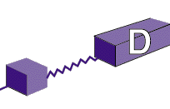
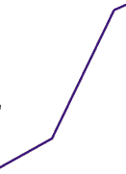
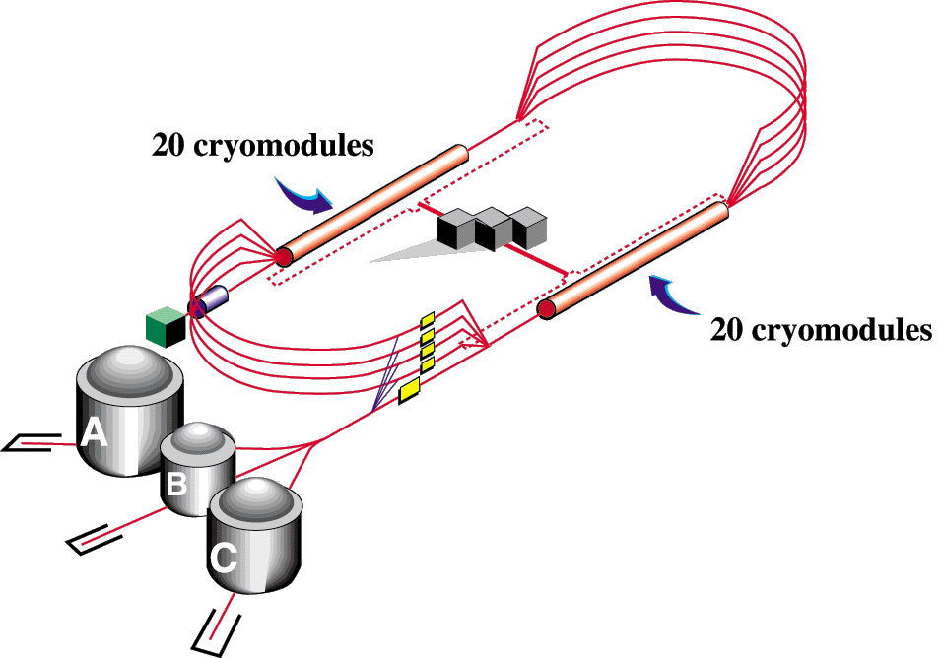
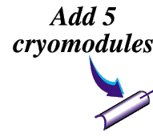
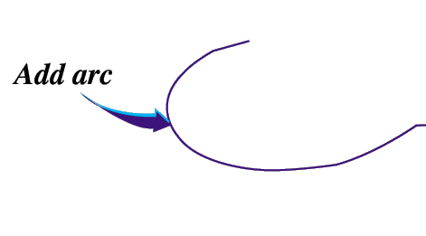
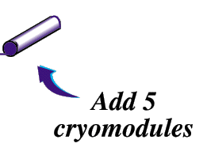
The JLab 12GeV Upgrade
6 GeV CEBAF
12 GeV CEBAF
11 GeV CEBAF
Upgrade magnets and power supplies
CHL-2
Two 1.1GV linacs
Two 0.6 GV linacs
Enhanced capabilities
in existing Halls
Notes:
help me

Slide 19
Hall D: Detector Design Parameters
Capability | Quantity | Range
Charged particles | Coverage | 1º < θ < 160º
 | Momentum Resolution (5º-140º) | σ_{p}/p = 1 − 3%
 | Position resolution | σ ~ 150-200 μm
 | dE/dx measurements | 20 < θ < 160º
 | Time-of-flight measurements | σ_{ToF} ~ 60 ps; σ_{BCal} ~ 200ps
 | Barrel time resolution | σ_{t} ^{γ} < (74 /√E 33) ps
Photon detection | Energy measurements | 2º < θ < 120º
 | LGD energy resolution (E > 60 MeV) | σ_{E}/E = (5.7/√E 2.0)%
 | Barrel energy resolution (E > 60 MeV) | σ_{E}/E =(5.54/√E 1.6)%
 | LGD position resolution | σ_{x,y,} ~ 0. 64 cm/√E
 | Barrel position resolution | σ_{z} ~ 0.5cm /√E
DAQ/trigger | Level 1 | < 200 kHz
 | Level 3 event rate to tape | ~ 15 kHz
 | Data rate | 300 MB/s
Electronics | Fully pipelined | 250 / 125 MHz fADCs, TDCs
Photon Flux | Initial: 10⁷ γ/s | Final: 10⁸ γ/s
Page 19

Slide 20
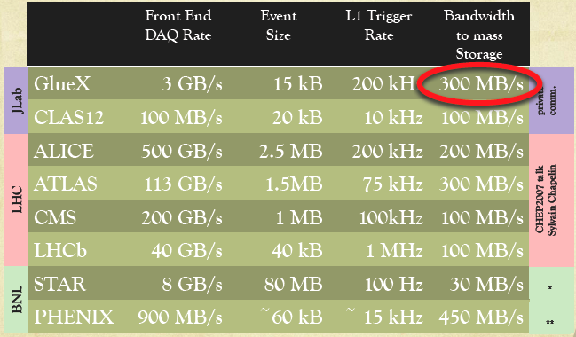
Electronics and Data Rates
Electronics
All digitization electronics are fully pipelined (VME64x-VXS)
F1TDC (60 ps, 32 ch. or 115 ps 48 ch.)
125 MHz fADC (12 bit, 72 ch.)
250 MHz fADC (12 bit, 12 ch.)
Trigger latency ~3 μs
3GB/s readout from front end
300MB/s to mass storage
3PB/yr to tape
Offline software
C++ object oriented framework (JANA)
Multi-threaded event processing
Highly modular through use of templates
125MHz fADC layout

