Slide 1
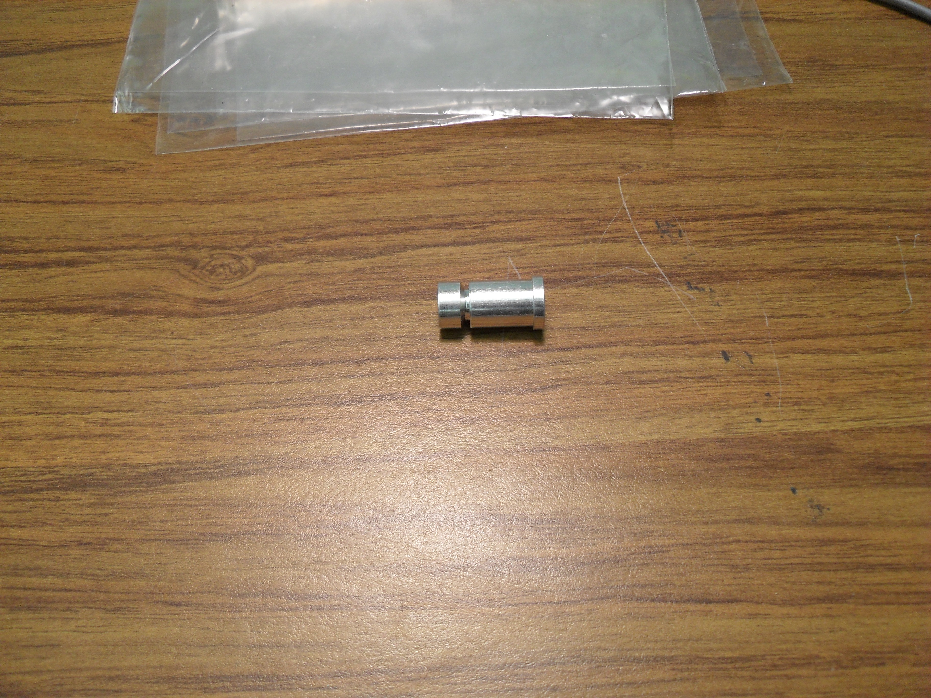
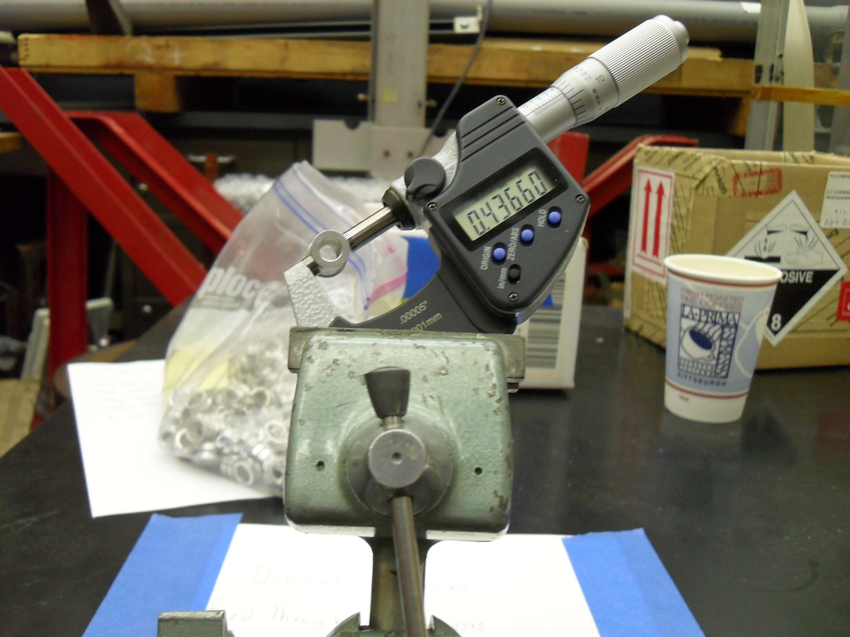
GlueX-doc 1554
Checking Aluminum Feed-Thrus
Check the outer diameter of the feed-thru. It
Should be between 0.4355 and 0.4375 inches.
If it is out of range, reject the part.
0.4355 to 0.4375 inches

Slide 2
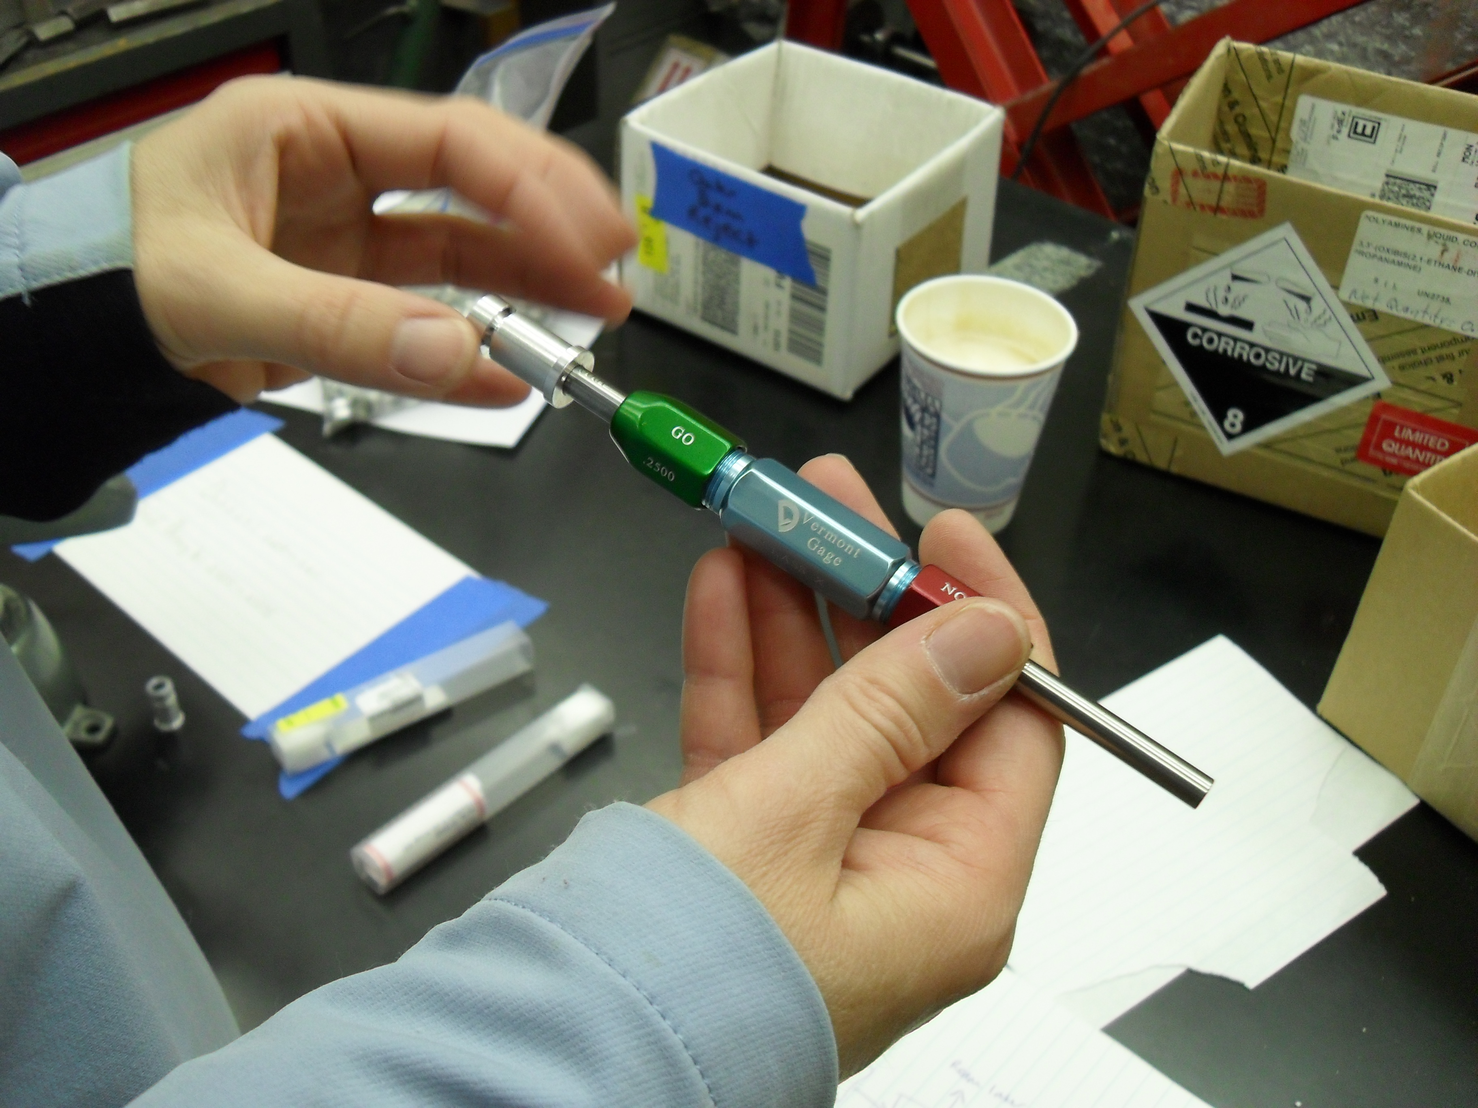
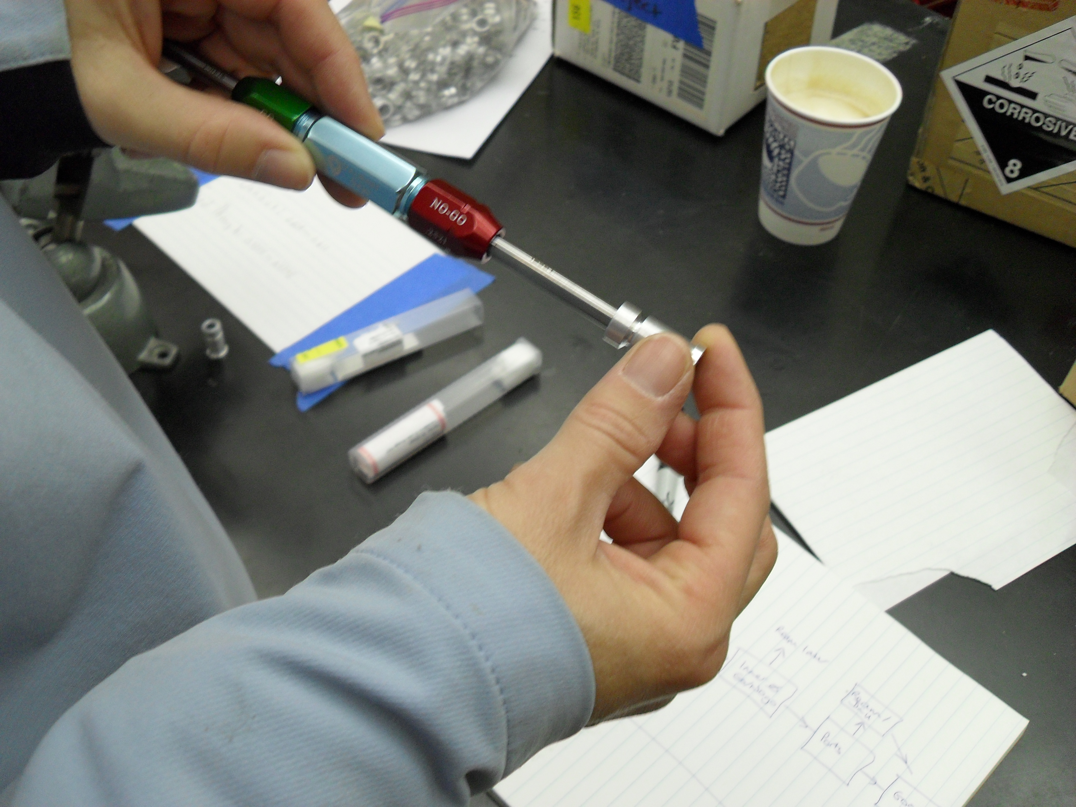
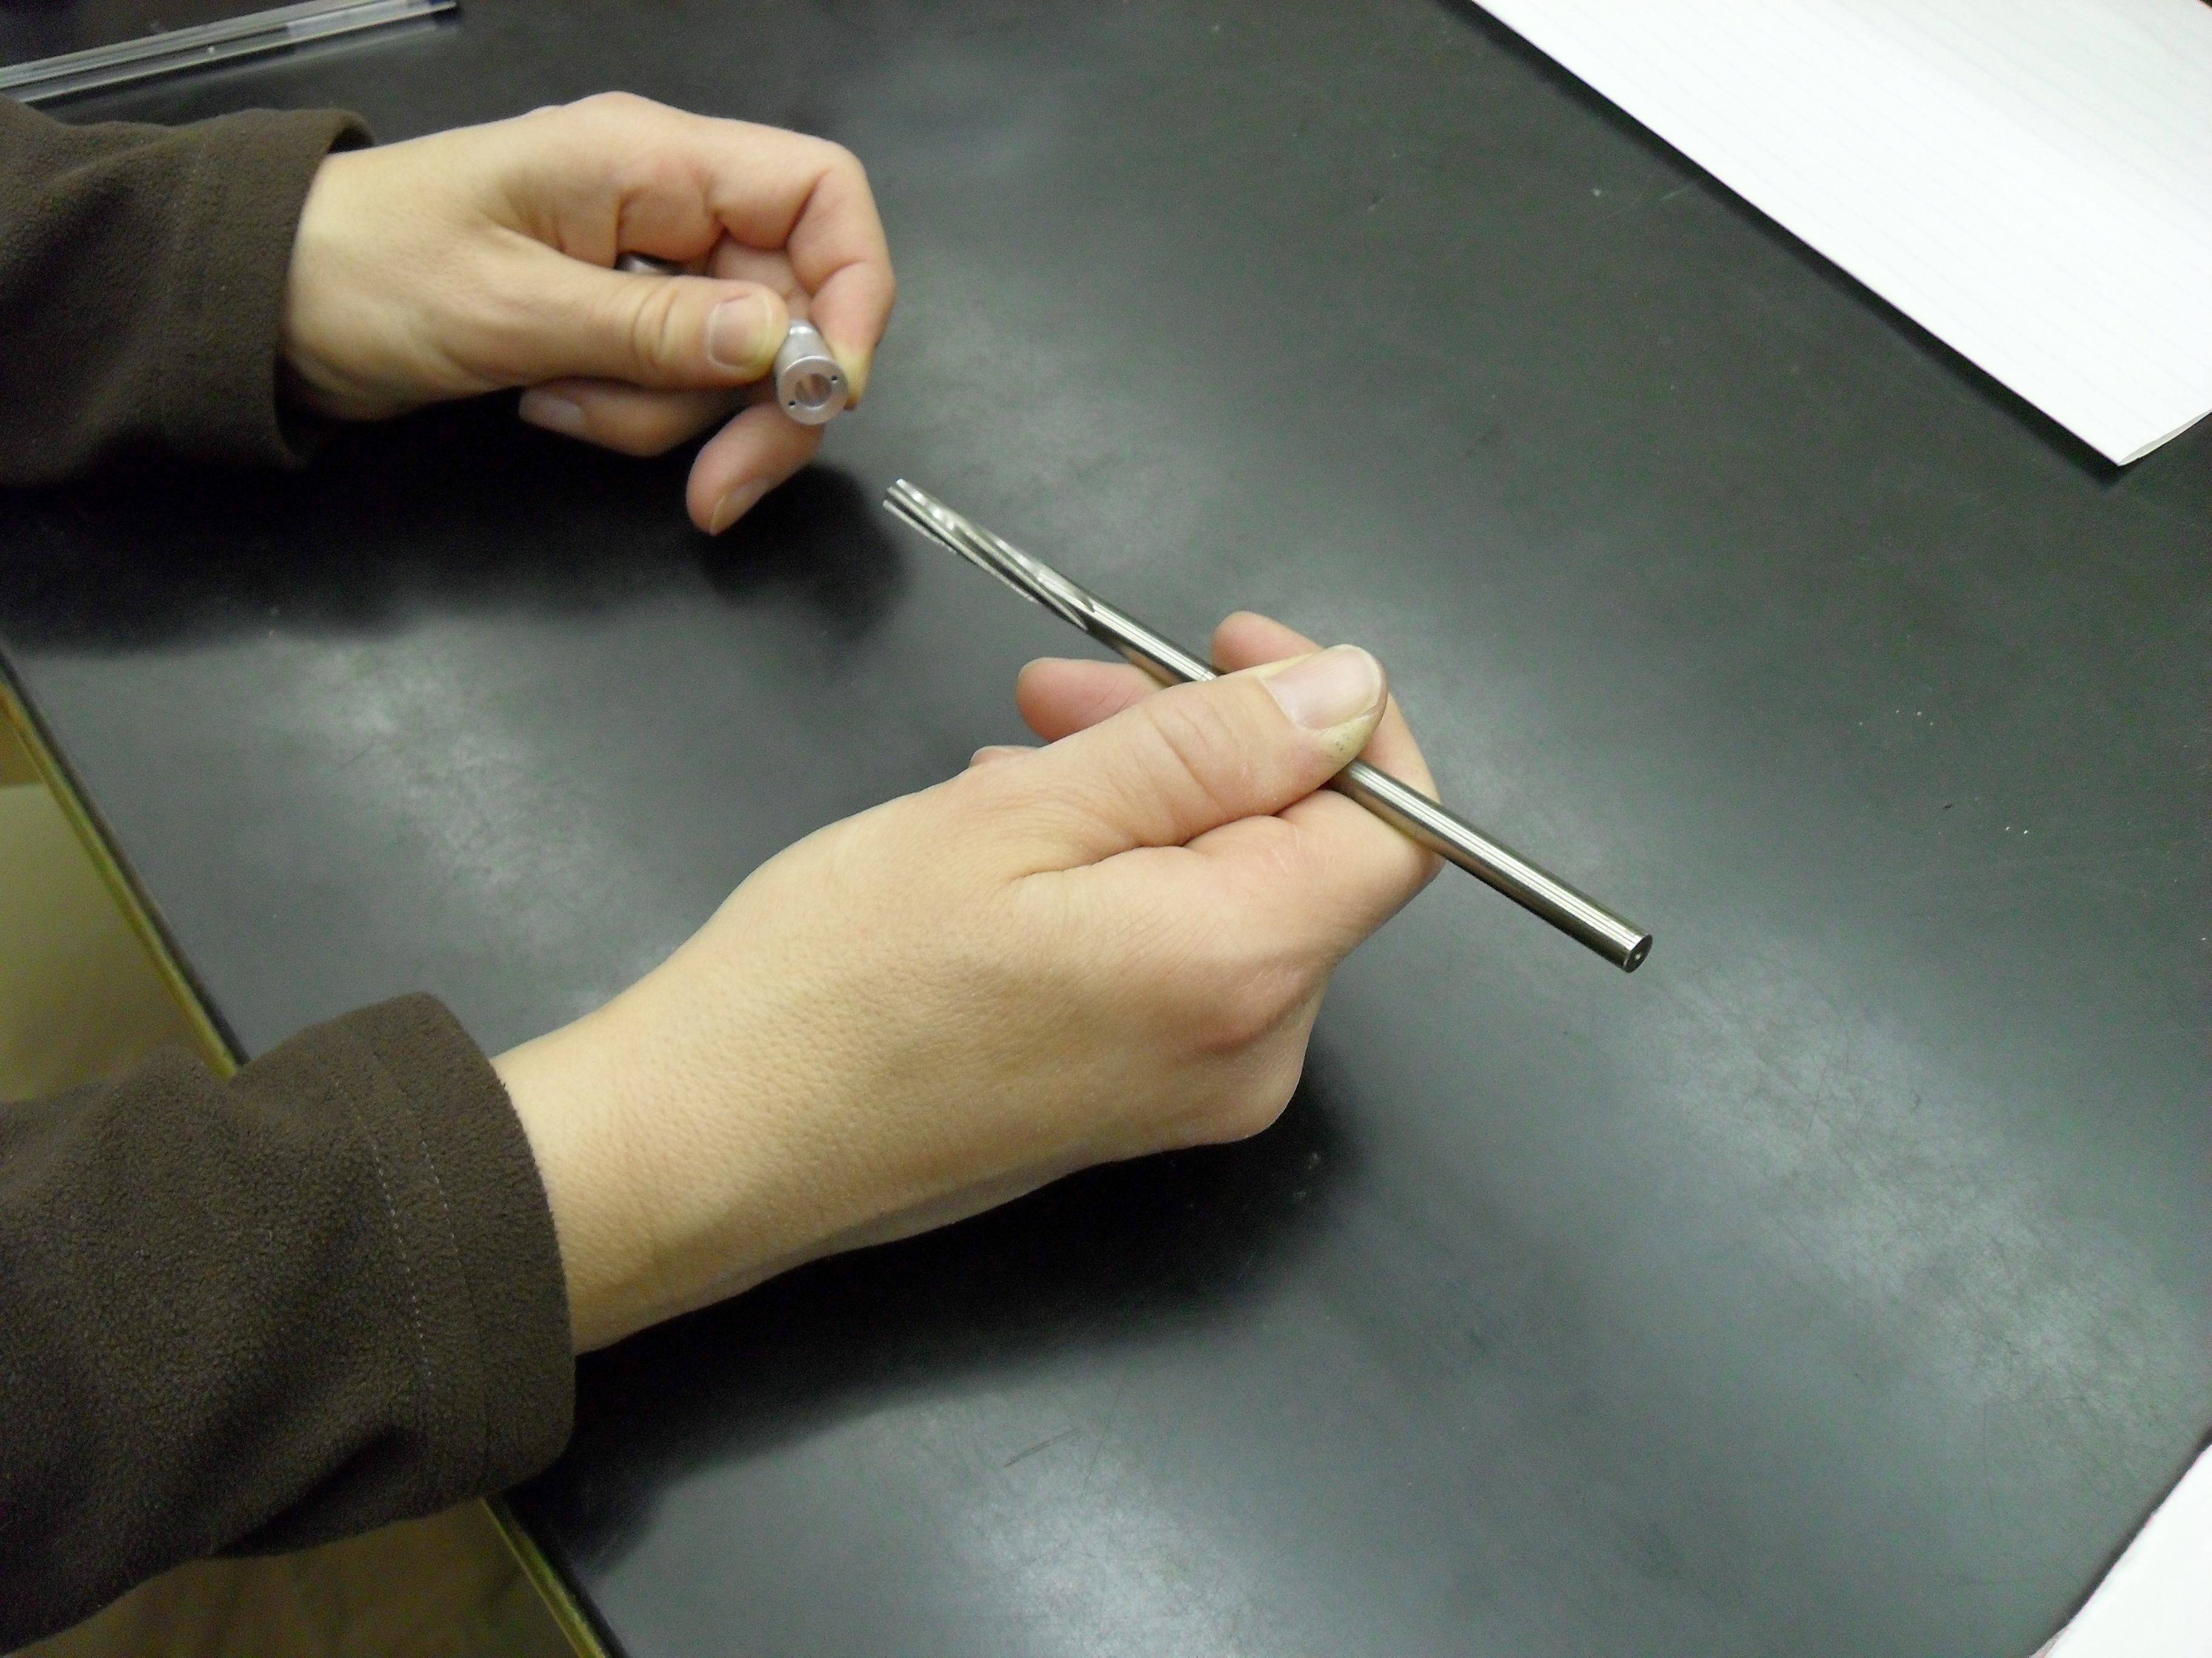
Checking Aluminum Feed-Thrus
Check the inside hole with the go-no-go
gauge. If the green end goes in, it is ok.
If the green end does not go in, then ream
Out the hole with the hand reamer.
If the fit with the green felt loose, check
The size of the hole with the red no-go
Gauge. It should not fit.
If the no-go fits, reject the part

Slide 3
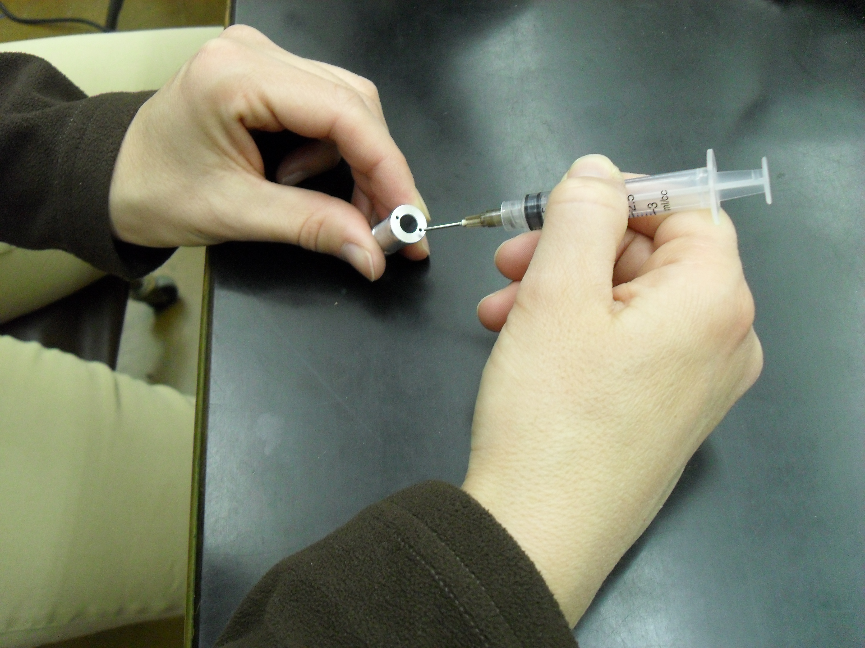
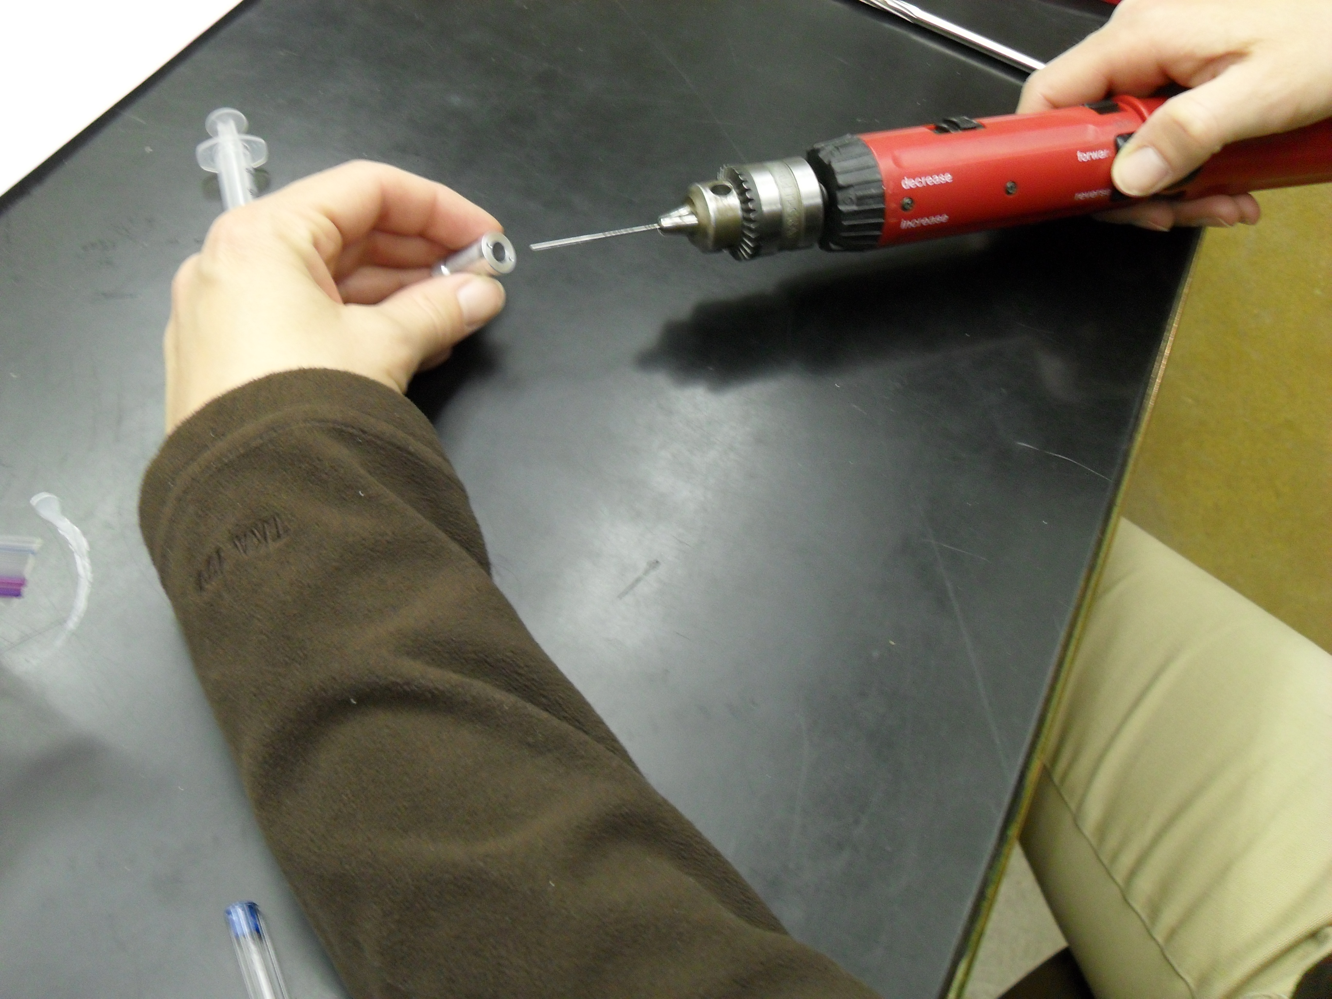
Checking Aluminum Feed-Thrus
Check the size of the glue ports.
The needle should slide in about 1/8” and then
out easily. If it does, the ports are ok.
If it does not fit, the ports need to be reamed
out. If the reamer does not fit, the ports need to
be drilled out.

