Slide 1
The JANA Reconstruction Framework
David Lawrence - JLab
May 25, 2010

Slide 2
What is JANA?
JLab ANAlysis framework (more accurately, a reconstruction) framework
C++ framework that formalizes the organization of algorithms and data transfer for event based processing
True multi-threaded event processing
Numerous features custom for experimental Nuclear Physics

Slide 3
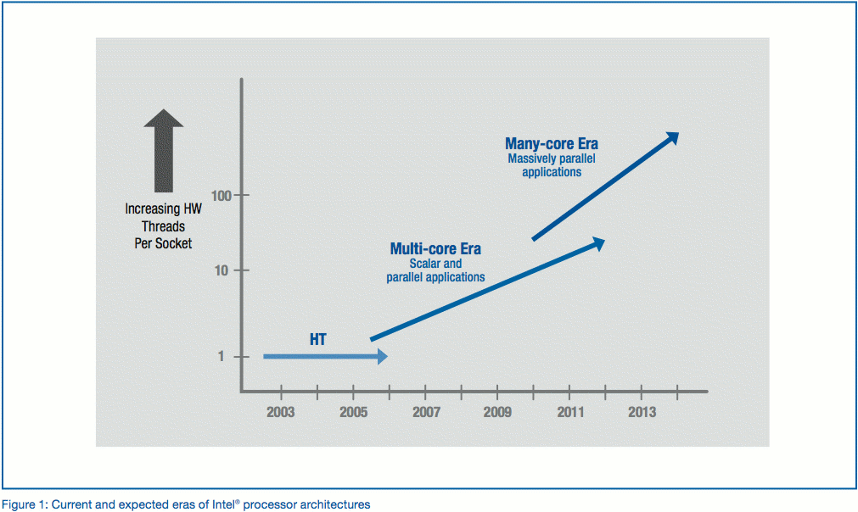
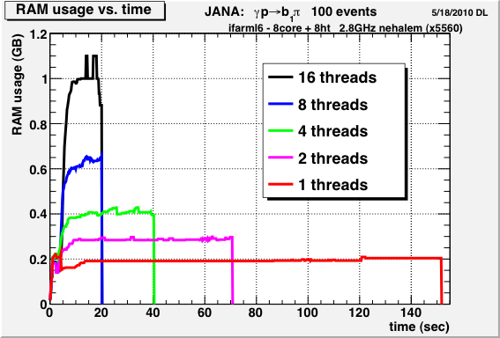
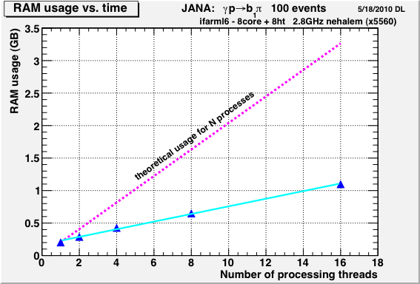
Why Multi-threading?
Multi-core processors are already here and commonly used. Industry has signaled that this will be the trend for the next several years. Consequence: Parallelism is required
2002 - 2014
Maintaining a fixed memory capacity per core will become increasingly expensive due to limitations on the number of controllers that can be placed on a single die (#pins).
Example: Memory accounts for about 10%-25% of system cost today but that will increase by as much as 5%/year over the next several years leading to 50% of system cost going toward RAM

Slide 4
Factory Model
FACTORY
(algorithm)
FACTORY
in stock?
NO
NO
MANUFACTURE
ORDER
in stock?
YES
STOCK
MANUFACTURE
YES
FACTORY
in stock?
NO
PRODUCT
MANUFACTURE
STOCK
YES
STOCK
Data on demand = Don’t do it unless you need it
Conservation of CPU cycles!
Stock = Don’t do it twice

Slide 5
Complete Event Reconstruction
Framework has a layer that directs object requests to the factory that completes it
HDDM File
EVIO File
ET system
Event Source
Web Service
Multiple algorithms (factories) may exist in the same program that produce the same type of data objects
Event Loop
Event Processor
This allows the framework to easily redirect requests to alternate algorithms specified by the user at run time
User supplied code
Fill histograms
Write DST
L3 trigger

Slide 6
Multi-threading
thread
Each thread has a complete set of factories making it capable of completely reconstructing a single event
thread
Event Source
Factories only work with other factories in the same thread eliminating the need for expensive mutex locking within the factories
thread
Event Processor
All events are seen by all Event Processors (multiple processors can exist in a program)
thread

Slide 7
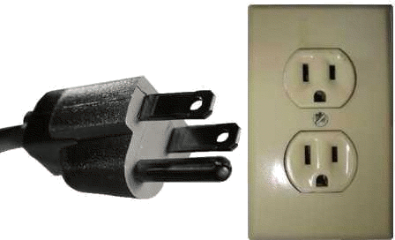
Plugins
JANA supports plugins: pieces of code that can be attached to existing executables to extend or modify its behavior
Plugins can be used to add:
Event Processors
Event sources
Factories (additional or replacements)
Examples:
Plugins for creating DST skim files
Reconstruction is done once with output to multiple files
hd_ana --PPLUGINS=kaon_skim,ppi+pi-_skim run012345.evio
Plugins for producing subsystem histograms
Single ROOT file has histograms from several pieces of code
hd_root --PPLUGINS=bcal_hists,cdc_hists,tof_hists ET:GlueX

Slide 8
Associated Objects
associated objects
A data object may be associated with any number of other data objects having a mixture of types
Hit
Hit
Each data object has a list of “associated objects” that can be probed using a similar access mechanism as for event-level object requests
object
Hit
Hit
Cluster
(calorimeter)
Hit
Hit
Hit
Hit
vector<const DCluster*> clusters;
loop->Get(clusters);
for(uint i=0; i<clusters.size(); i++)
{
vector<const DHit*> hits;
clusters[i]->Get(hits);
// Do something with hits …
}
track
MC generated

Slide 9
Configuration Parameters
in a factory’s init method one might write …
Variables are data members of factory class
MIN_SEED_HITS = 4;
MAX_STEP_SIZE = 3.0; // cm
gPARMS->SetDefaultParameter("TRKFIND:MIN_SEED_HITS",MIN_SEED_HITS);
gPARMS->SetDefaultParameter("TRK:MAX_STEP_SIZE" , MAX_STEP_SIZE
, "Maximum step size in cm to take when swimming a track with adaptive step sizes");
Value may be overwritten if user specifies a value at run time
NEW: Optional 3rd argument allows description to be stored with parameter
Parameters can be set via command line or configuration file
Complete list of parameters can be dumped using option --dumpconfig
Parameters can read in using option --config=filename

Slide 10
Example Configuration Parameter dump file

Slide 11
janadot plugin

Slide 12
A closer look at janadot

Slide 13
… and in closing …
Additional features:
janaroot plugin for auto-magical generation of ROOT trees from data objects
janactl plugin allows for remote control and monitoring of process health via cMsg
Calibration/Conditions DB interface with working Web Service implementation (doi: 10.1088/1742-6596/219/4/042011)
XML geometry interface with integrated Xpath parser
Thread safe stream logging support
http://www.jlab.org/JANA
doi: 10.1088/1742-6596/119/4/042018

Slide 14
Backup Slides

Slide 15
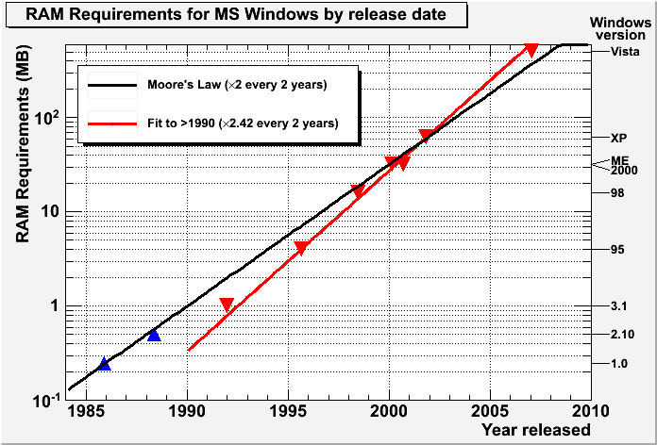
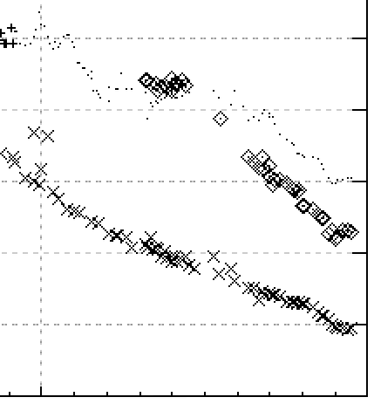
Memory Prices
Memory Requirements
trend: ÷2.5 every 2 years
trend: ×2.4 every 2 years
1
0.1
$US/MB
0.01
2000
2010

Slide 16
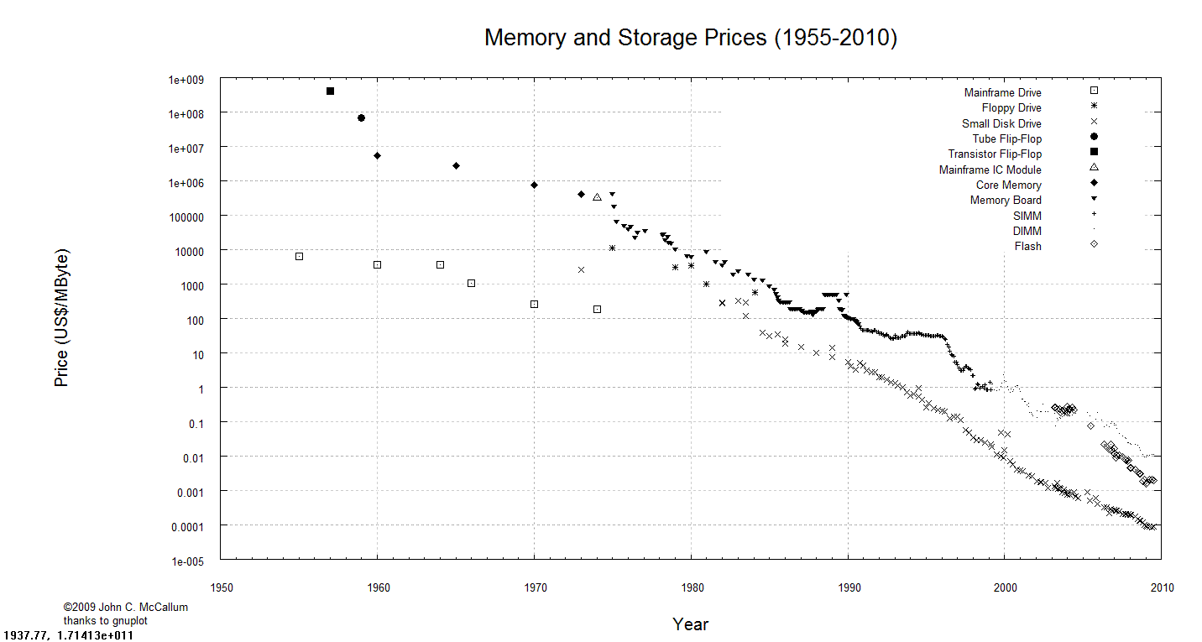

Slide 17
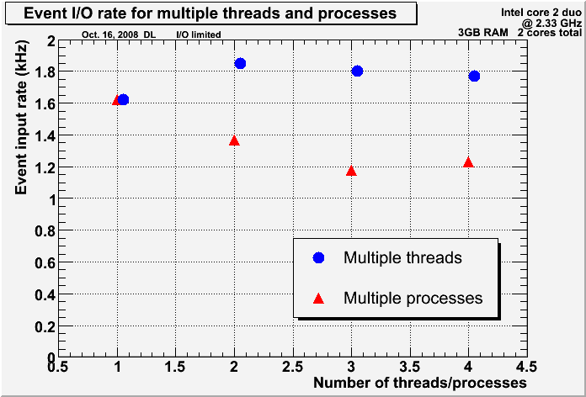
I/O Scaling
Multiple processes simultaneously reading and writing to the same local disk will cause the disk head to thrash, ultimately leading to an I/O bottleneck
Multiple threads will stream events from a single file leading to much less competition for the head position

Slide 18
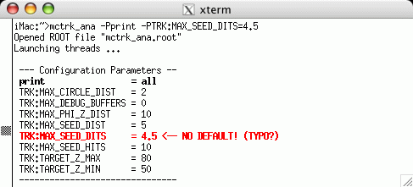
Configuration Parameters

