Slide 1
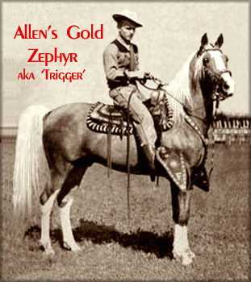
3rd Annual
12GeV Trigger Workshop
Christopher Newport University
8 July 2010
R. Chris Cuevas
Welcome!
Opening comments – Dean David Doughty – CNU
Workshop purpose and goals
Update from 1 year ago: What have we done?
Brief review of trigger requirements
Identify additional requirements/features for hardware proposed at CD3
Hardware Status
Have requirements changed for modules yet to be designed? (GTP, TS)
3. Summary and brief overview of other sessions

Slide 2
Workshop Format & Goals
Four work sessions with overview presentations and plenty of time for questions and discussions!
Discussion topics are listed in the agenda for each session and I strongly encourage comments from all attendees.
The goals of this workshop are:
Discuss the most recent hardware developments
Understand and document any new features that have not been identified at CD3 and that must be implemented for the 12GeV experimental programs.
Share recent trigger ‘application’ results from existing prototype modules and also share trigger applications that are in the development stage. ** See B. Sawatzky’s & S. Boyarinov’s talk **
2

Slide 3
Requirement Review
12GeV trigger system performance requirements have been driven by the GlueX (Hall D) design.
CLAS12 (Hall B) trigger requirements are significantly different, but our trigger hardware design will support the sector geometry of CLAS12
New requirement/proposal for a Drift Chamber Track Finding Trigger upgrade
New proposal will have an impact for global trigger hardware development but the present design implementation should support this idea.
Instrumentation electronics for 12GeV (Hall A) experiments are not included in the project scope, and Hall C requirements need to be reviewed.
SBS (Super Bigbite Spectrometer) is planning to use new trigger hardware. (Even though I do not believe it is in the cost plan)
A few 6GeV experiments will benefit from the new pipelined electronics, and provide a perfect testing environment for the pre-production modules.
3

Slide 4
New Requirements Listed from
2009 Trigger Workshop
Use the two trigger signals, Trig1 and Trig2 to change the mode of the flash board readout. Presently the readout mode is selected when the User programs the module before starting a ‘run’. Presently the mode does not change during a ‘run’. Using the two Trigger bits, the trigger supervisor can issue a specific readout mode for a given trigger event type. (Change mode for scaler readout data for example)
Dedicate a VXS differential pair from the TI to CTP and from the TI to the SD. Keep the I^2C link, but a differential pair will be needed to transfer data from the two switch cards at a higher rate than the I^2C allows. (The dedicated pair is not required to be a gigabit serial link.)
Add input/output signaling capabilities to the CTP and TI front panels. The number and type of signaling levels were not defined, but I/O signals will be required and allow for a number of useful features.
Global Trigger -- Implement multiple trigger partitioning “sessions”. Ed and David A. outlined a simple idea for up to 4 concurrent trigger sessions using CODA3.
5. Global Trigger – The Trigger Supervisor will need to manage external signals for calibration systems. Presently the TS is specified to connect directly to the Global Trigger Processor and the additional input/output to pulsers or other hardware will need to be managed.
4

Slide 5
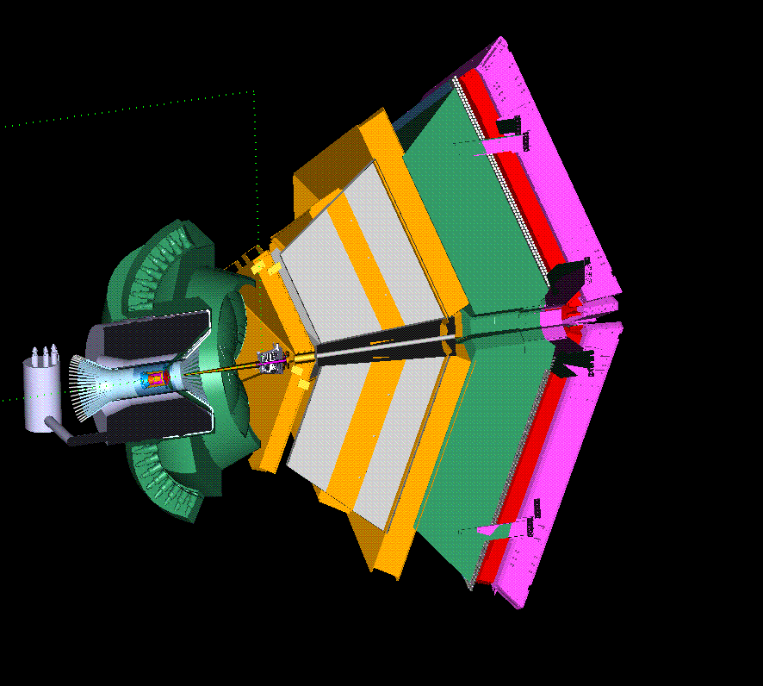
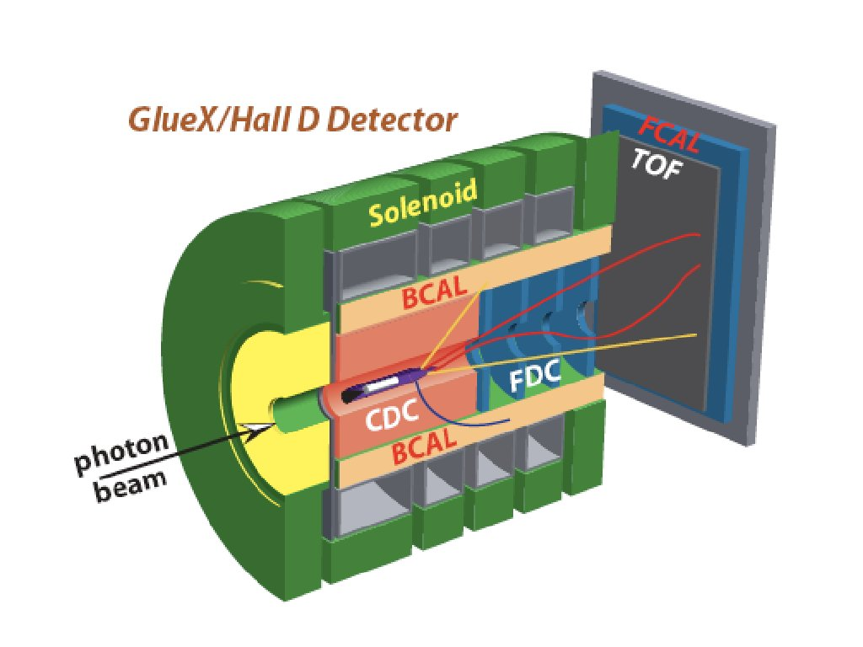
Brief review of 12GeV Trigger Systems
Hall D-GlueX Hall B-CLAS
Channel Count: ~20k ~40k
Event Size: ~15kB ~6kB
L1 Rate: 200kHz 10kHz
L1 Data: 3GB/s 60MB/s
To Disk: L3, 20kHz, 300MB/s L2, 10kHz, 60MB/s
5

Slide 6
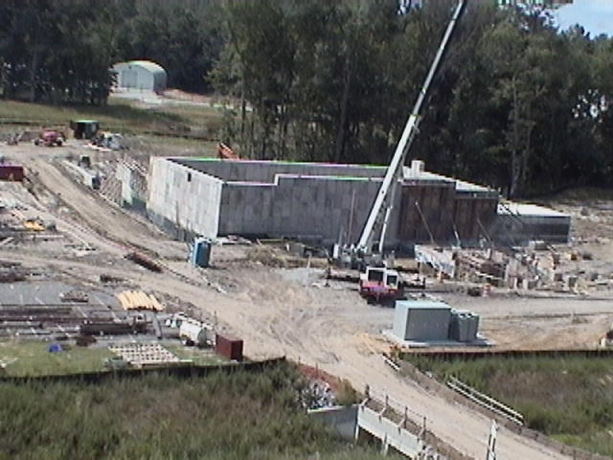
Hall D Construction
18 June 2010
6

Slide 7
Trigger Requirements Review
Halls B & D
200kHz average L1 Trigger Rate, Dead-timeless, Pipelined, 2ns bunch crossing (CW Beam) -- Hall D
Data Acquisition: at least 10kHz event rate, at least 100MB/s data rate, ‘dead-timeless’ -- Hall B
Electronics: all new equipment to achieve required performance
L1 trigger supporting streaming subsystem hit patterns and energy summing with low threshold suppression
Trigger System: reliable electron identification, multi-particle events
Scalable trigger distribution scheme (GlueX: ~30 L1 crates, ~50 total readout crates)
Low cost front-end & trigger electronics solution
Reconfigurable firmware – CLAS12 (Hall B) will use different programmable features than Hall D
7

Slide 8
Module Definitions
From CD3 Review
Decision to use VXS (VITA 41) high speed serial backplanes
Flash ADC 250Msps ( FADC250 ) ** Version 2 nearly complete **
This is where the trigger ‘data’ begins
Crate Trigger Processor ( CTP ) ** 2 units tested in 2009 **
Collects trigger data (SUM) from 16 FADC250 modules within one crate
Transports trigger data over fiber to Global Trigger crate
10Gbps capability ( 8Gbps successfully tested )
Signal Distribution ( SD ) ** 2 units tested in 2009 **
Precision low jitter fanout of ADC clock, trigger and synch signals over VXS backplane to FADC250 modules
Trigger Interface – Trigger Distribution ( TI - TD ) ** 2 units at assembly **
Direct link to Trigger Supervisor crate
Distributes precision clock, triggers, and sync to crate SD
Manages crate triggers and ReadOut Controller events
8

Slide 9
Module Definitions
From CD3 Review
SubSystem Processor ( SSP ) ** 1 unit assembled **
Collects trigger data from up to 8 front end crates. (2048 channels!)
Trigger data received on front panel with fiber transceivers
10Gbps input capability ( 4 lanes @3.125Gbps*(8/10b) )
10Gpbs output stream to GTP
Global Trigger Processor ( GTP ) (FY11-12) ** Schematic phase **
Collects trigger data from 8 SSP modules within global trigger crate
Requirement for more than 8 SSP??
8 SSP allows 64 crates to participate in trigger
CLAS12 may need support for at least 13 SSP
Need to design prototype to support 8 SSP
Trigger Supervisor ( TS ) (FY11-12) ** Specification complete**
New board format – VXS Payload module
Distributes precision clock, triggers, and sync to crate TI-TD
Manages crate triggers and ReadOut Controller events
9

Slide 10
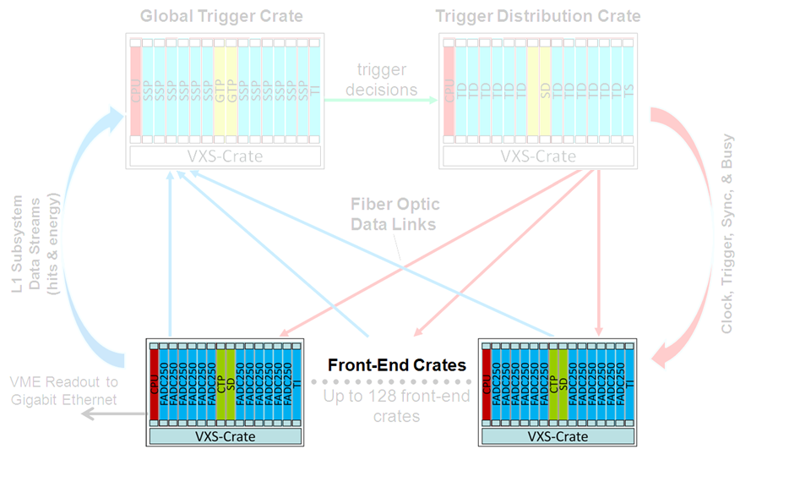
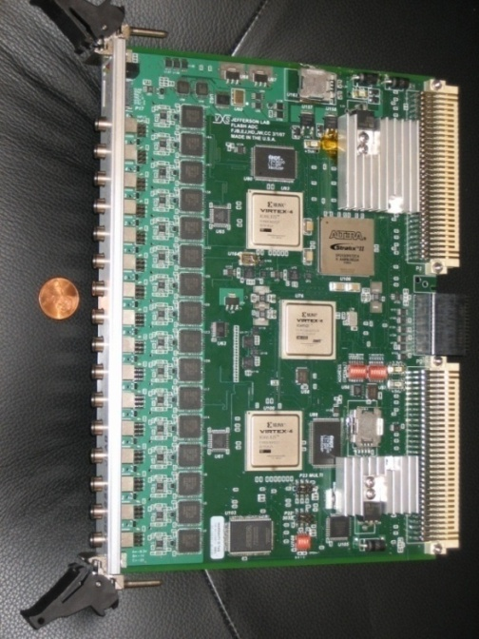
Front-End Electronics: FADC250-V1
F. Barbosa
H. Dong
J. Wilson
E. Jastrzembski
16 Channel 10bit, 250Msps Flash ADC
9 full prototype units have been tested and in use for at least 2 years.
Significant development effort and success for:
Custom firmware loaded through VME
Leading edge time extraction (62.5ps LSB)
Pulse window sum (Charge)
Zero suppression – Data minimization
“Playback” mode for system testing
Module supports 2eSST VME transfers at 200MB/s transfer rate
Large event block sizes (>100) to minimize CPU interrupt handling
VXS P0/J0 outputs 5Gbps L1 data stream (hit patterns & board sum)
4 FPGA
3 Xilinx
1 Altera
Used in existing 6GeV program:
Hall A BigBite
Upgraded Hall A Moller Polarimeter
JLab-FADC250:
10

Slide 11
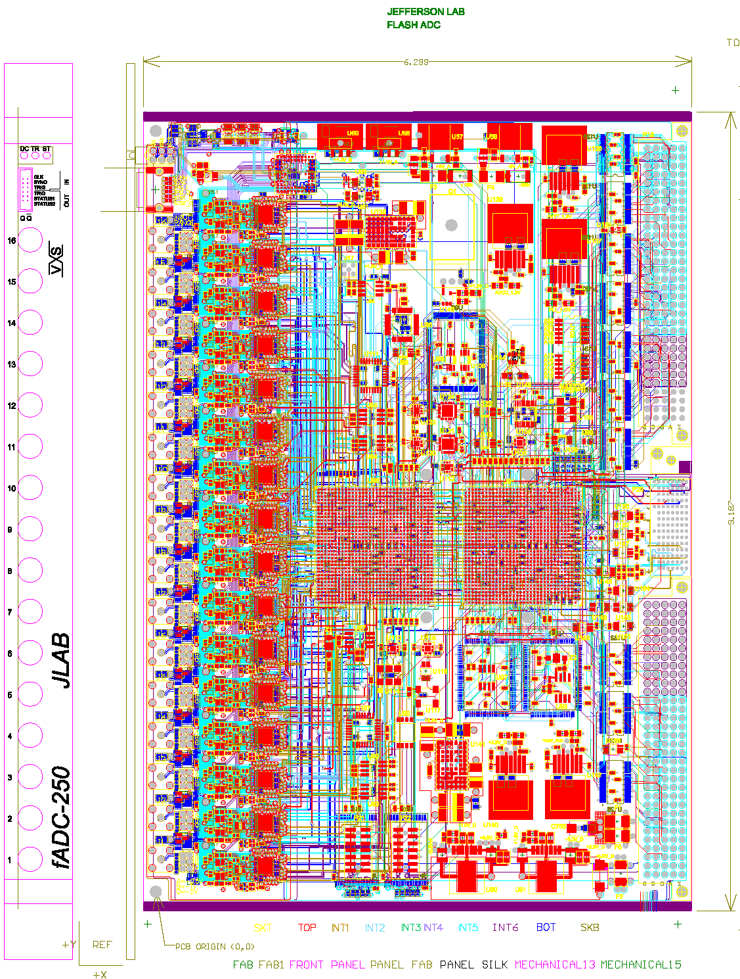
Front-End Electronics: FADC250-V2
F. Barbosa
H. Dong
J. Wilson
E. Jastrzembski
16 Channel 12bit, 250Msps Flash ADC
Version 2 has significant part reduction.
Consolidation of logic from 4 FPGA to 2 FPGA
VHDL firmware for VME section
Maintain original specifications
Maintain all existing features
Increase capability of trigger data transfer through additional VXS lanes and higher performance FPGA
Module supports 2eSST VME transfers at 200MB/s transfer rate
Large event block sizes (>100) to minimize CPU interrupt handling
Two units to be fabricated before end of FY10 and tested
“Orders” for pre-production units (<40) have started!
11

Slide 12
Front-End Electronics: FADC250
L1 Energy & Hit Processing
L1 Data Stream
Energy & Time Algorithms
VME Readout
Event #1
Event #2
Detector Input
ADC
8μs ADC Sample Pipeline
Trigger Input
Trigger #1
Trigger #2
Readout Features: Raw Data mode
Pulse window sum (Charge)
Leading edge timing extraction (62.5ps LSB)
VME-2eSST
Event blocking
Trigger Features: 16 ‘Hit Bits’ updated at 4ns for all channels over threshold
Energy summing for 16 channels
Coincidence logic for 16 channels
Gigabit serial transfer through VXS to CTP
12

Slide 13
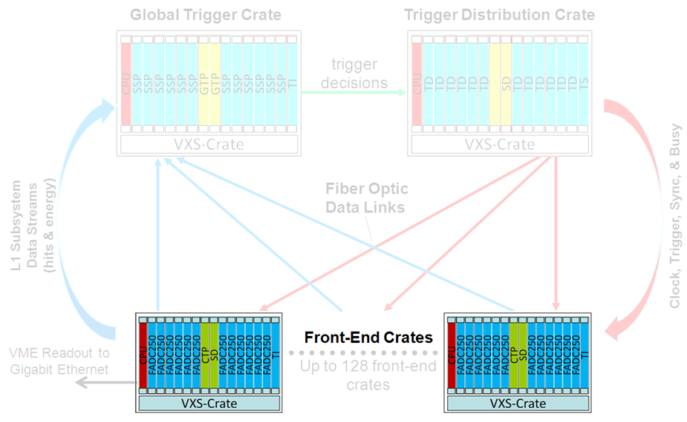
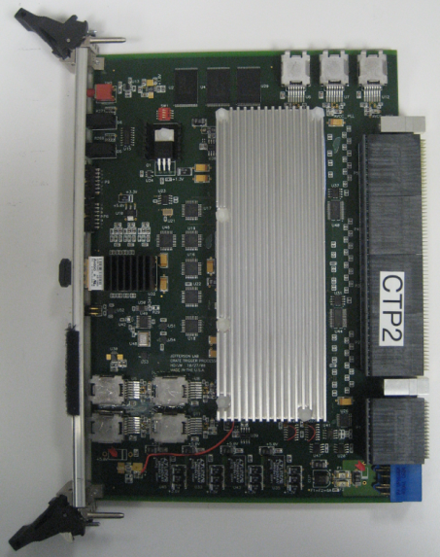
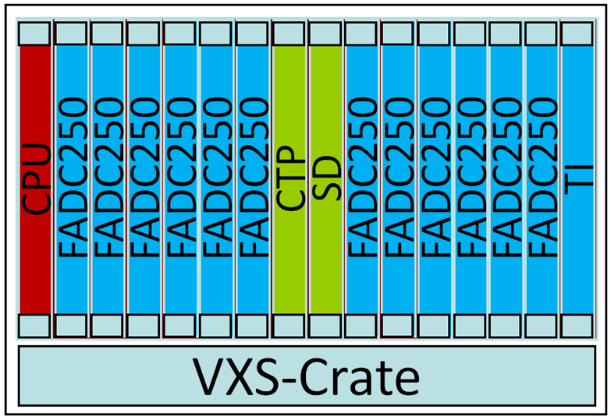
Crate Trigger Processor
2 units successfully tested in 2009!!
2 more units will be assembled with new Virtex V FX70T that supports higher serial speeds.
Each FADC250 streams energy sum/hit to Crate Trigger Processor (CTP)
Crate Trigger Processor computes a crate-level energy sum (or hit pattern)
Computed crate-level value sent via 10Gbps fiber optics to Global Trigger Crate (32bits every 4ns)
CTP Prototype:
Board Energy/Hits
Up to 10Gbps to CTP
Fiber Optics Transceiver
VXS Connectors
Collect serial data from 16 FADC-250
Crate Sum/Hits
10Gbps Fiber to SSP in global trigger crate
13

Slide 14
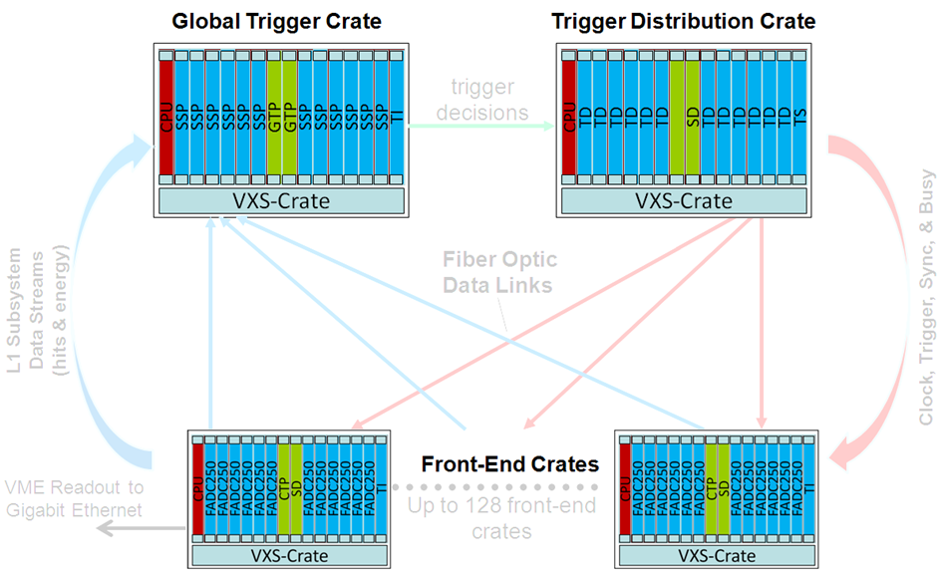
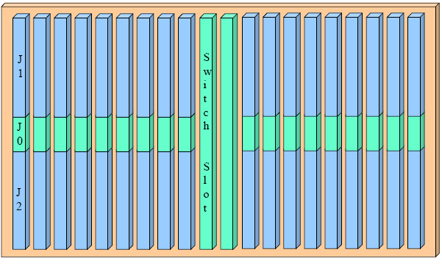
Crate Level – Signal Distribution
VXS Based, 20 Slot Redundant Star Backplane
VME64x backplane w/VXS (VITA 41 Standard) provides standard with high speed serial extension (new J0 connector)
18 Payload slots w/VME64x, 2 Switch slots
Each payload slot has 8 high speed differential pairs (10Gbps each) to both switch slots
VXS Backplane Physical Layout:
Crate Level Use:
VME64x used for event readout
VXS: Low jitter clock & trigger distribution
VXS: Gigabit serial transmission for L1 data streams to switch slot for processing
VXS (VITA 41 standard)
VME64x + high speed
serial fabric on J0
14

Slide 15
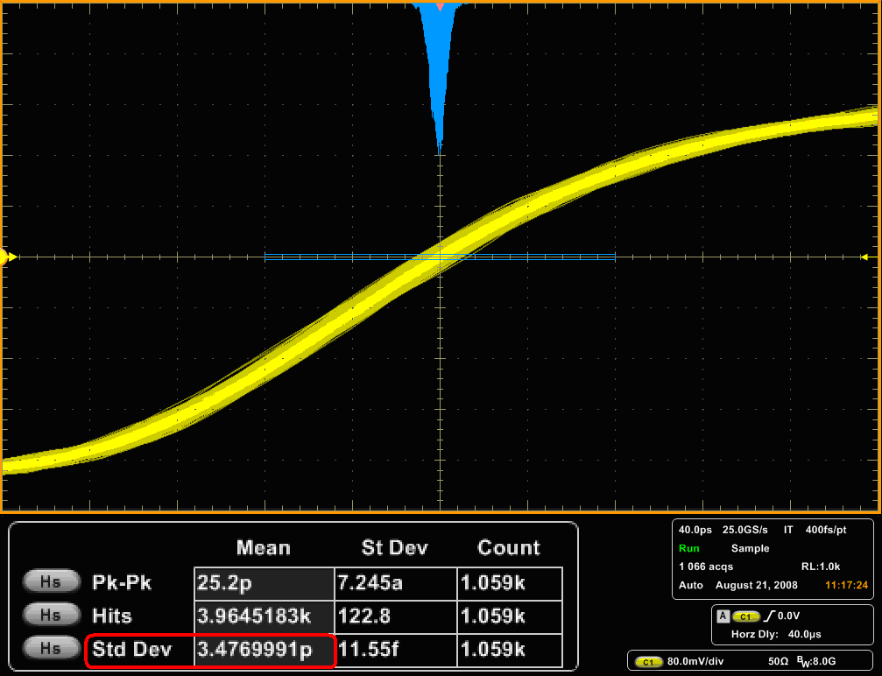
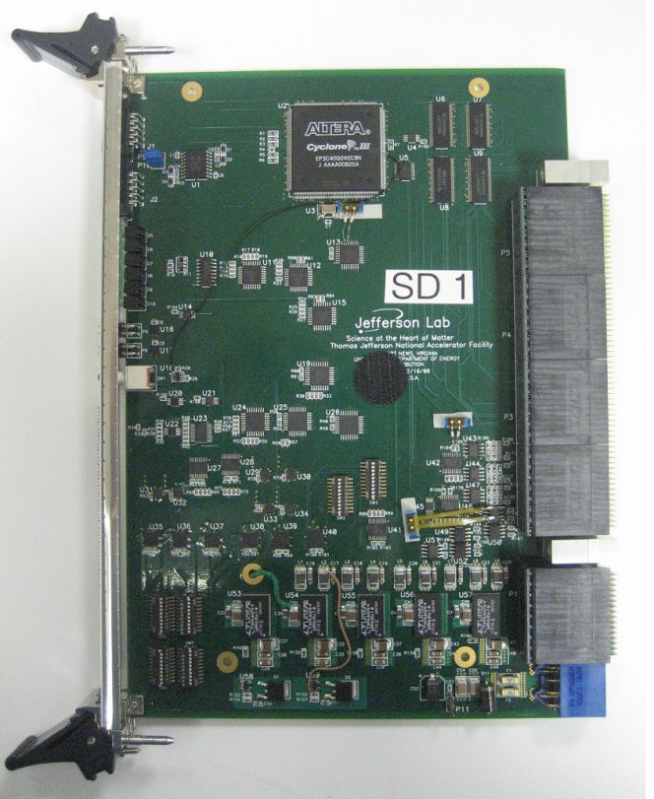
Crate Level – Signal Distribution (SD) -Prototype
3.47ps RMS 250MHz Clock Jitter after 150m fiber distribution
VME64x backplane w/VXS (VITA 41 Standard) provides high speed serial connections from payload slots to switch slots (Dual Star)
Supports 18 Payload slots with precision clock, synchronization, and trigger signal distribution.
Receives signals from TI and distributes common signals to each payload module ( i.e. FADC250, FADC125, F1TDC )
VXS (VITA 41 standard)
VME64x + high speed serial fabric on J0
VITA 41
Switch
Slot
Connectors
Gupta
M. Taylor
C. Cuevas
15

Slide 16
Crate Level – Signal Distribution (SD) Final Version FY10
N. Nganga
M. Taylor
C. Cuevas
2 Prototype SD modules successfully tested with two crate configuration in 2009
Specification updated to support final pair mapping for front end boards and addition of PLL jitter attenuation for clock signals.
Power circuitry has been optimized from prototype version
Specifications for synchronization, trigger signal distribution plus collection of BUSY, and management of token passing are virtually unchanged from original version.
Welcome to Mr. Nick Nganga!
Work plan for final board revision at end of FY10 and testing in FY11
16

Slide 17
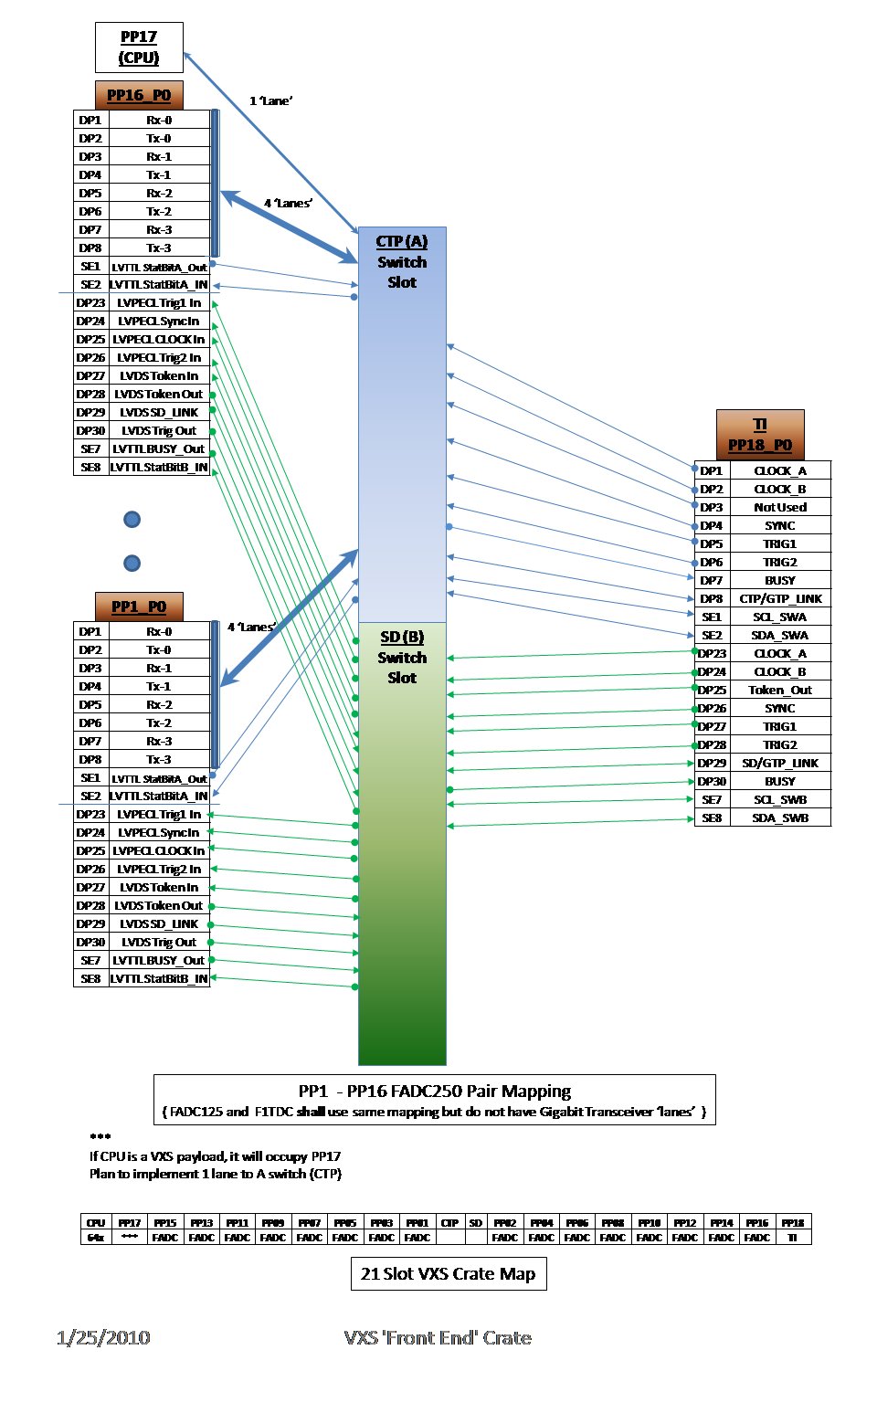
VXS
Pair Mapping
17

Slide 18
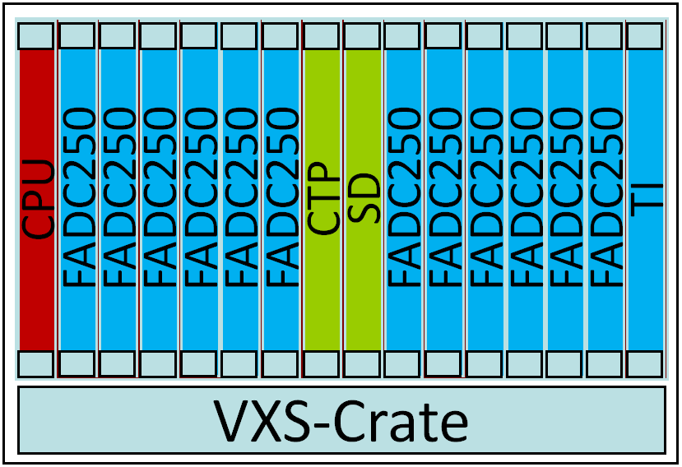
Level 1 & Trigger Distribution
Global Trigger Crate
Trigger Decisions
Trigger Distribution Crate
CPU
SSP
SSP
SSP
SSP
SSP
SSP
GTP
GTP
SSP
SSP
SSP
SSP
SSP
SSP
TI
CPU
TD
TD
TD
TD
TD
TD
SD
TD
TD
TD
TD
TD
TD
TS
L1 Subsystem Data Streams (hits & energy)
VXS-Crate
VXS-Crate
Fiber Optic
Links
SSP can manage
8 CTP
(Crates)
Fiber Optic
Links
TD can manage
8 TI
(Crates)
Clock
Trig1
Trig2
Sync
Busy
256 FADC channels/Crate
Front-End Crates
VME Readout to Gigabit Ethernet
Up to 128 front-end crates
18

Slide 19
TID
**See William Gu’s discussion at next session**
Trigger/Clock/Sync distribution/Busy
Two sided, 12-layer VME board (6Ux160mm)
PCB layout finished
PCB fabrication after independent review/check
FPGA firmware development underway
Board testing in the summer. (Virginia summer is earlier)
Module has been designed to function as Trigger Interface or Trigger Distribution
Module can be configured to function as a Trigger Supervisor
(Trigger signals received on front panel I/O connector)
VXS payload board format
Provides communication from VME to SD & CTP modules via I^2C serial links.
19
11

Slide 20
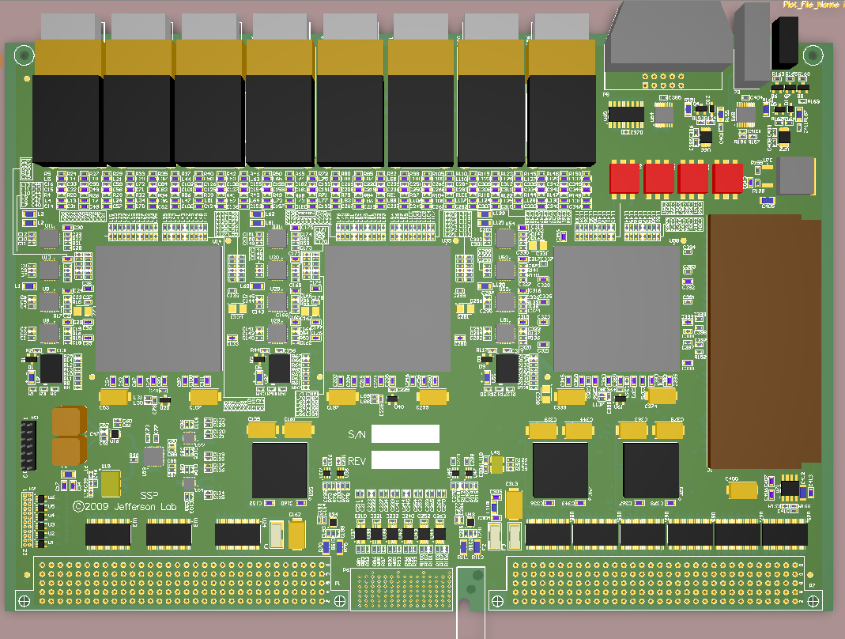
SSP PCB Module Overview
Ben Raydo
8x 10Gbps Fiber Transceivers
4x LVDS/PECL/ECL Inputs
4x LVDS Outputs
2x Bi-Directional NIM Ports
Status LEDs
VME Address
DIP Switches
DDR2 SO-DIMM (up to 4GBbyte)
Jtag
Power Supply Margin Header
VME64x P2
VXS P0
VME64x P2
20

Slide 21
SSP Block Diagram
Ben Raydo
To GTPs (Global-Trigger-Processors)
Front-Panel I/O
TX: 4x LVDS
RX: 4x AnyLevel (LVDS,ECL,PECL)
Bidirectional: 2x NIM
VXS-P0
Receives: CLK250,TRIG1,TRIG2,SYNC,LINKUP
Transmits: TXDATA[3..0],Busy
2x10Gbps L1 Streams
HFBR-7934
4-Channel Full Duplex 2.5Gbps Fiber Streams
Clock Distribution
-Distributes to all FPGAs: 50MHz, 250MHz Clocks
-Local 250MHz & 50MHz
-SMA 250MHz, VXS-P0 SWA or SWB
10Gbps L1 Stream
Virtex 5 - FX70T
- 4x 10Gbps Fiber Transceiver
Reed Solomon FEC Decoder
500MB/s FX70T<->LX50T Bus
Used for VME Bridge
4x 5Gbps FX70T->LX50T Bus
Used for L1 Streams
HFBR-7934
4-Channel Full Duplex 2.5Gbps Fiber Streams
4Gbps VME Bridge
HFBR-7934
4-Channel Full Duplex 2.5Gbps Fiber Streams
Virtex 5 – LX50T
- 2x 10Gbps VXS Switch Links
VME64x Interface
500MB/s FX70T<->LX50T Bus
Used for VME Bridge
8x 5Gbps FX70T->LX50T Bus
Used for L1 Streams
DDR2 SO-DIMM
Used for L2 dictionary
From CTPs (Crate-Trigger-Processors)
HFBR-7934
4-Channel Full Duplex 2.5Gbps Fiber Streams
VME64x
-Support for A24/A32, D32/D64 Transactions
-Single Cycle, BLT, 2eSST Support
4x 5Gbps L1 Streams
4x 5Gbps L1 Streams
HFBR-7934
4-Channel Full Duplex 2.5Gbps Fiber Streams
Virtex 5 - FX70T
- 4x 10Gbps Fiber Transceiver
Reed Solomon FEC Decoder
500MB/s FX70T<->LX50T Bus
Used for VME Bridge
4x 5Gbps FX70T->LX50T Bus
Used for L1 Streams
10Gbps L1 Stream
HFBR-7934
4-Channel Full Duplex 2.5Gbps Fiber Streams
4Gbps VME Bridge
HFBR-7934
4-Channel Full Duplex 2.5Gbps Fiber Streams
DD2 SO-DIMM
Up to 4GB Memory Module
<60ns Random Access Time
3.2Gbyte/sec burst rate
HFBR-7934
4-Channel Full Duplex 2.5Gbps Fiber Streams
21
8

Slide 22
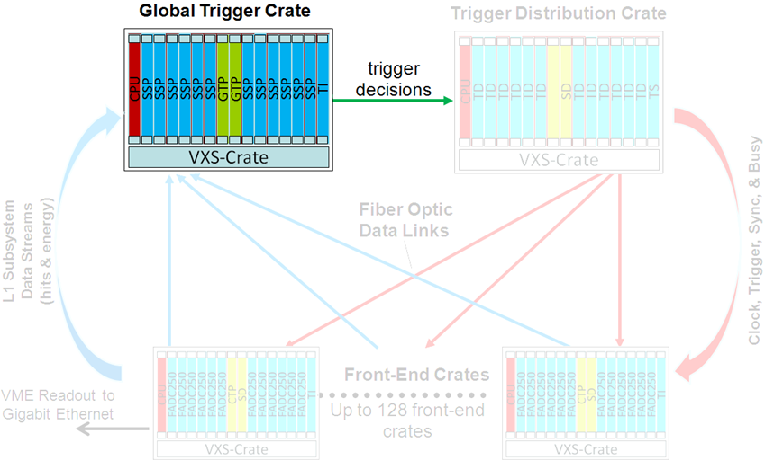
Ben Raydo
Global Trigger Processor: (GTP)
Global Trigger Processor (GTP) receives all subsystem Level 1 data streams
Trigger decisions made in GTP and distributed to all crates via the Trigger Distribution (TD) modules in the Trigger Supervisor Crate
SSP
Up to 8x L1 Crates per SSP
SSP
FCAL (Energy)
SSP
SSP
GTP
BCAL (Energy)
SSP
TOF (Hits)
GTP
SSP
Start Counter (Hits)
SSP
Tagger (Hits)
Trigger Decisions
to Trigger Distribution Crate
Each Connection: 8Gbps SSP->GTP (32bits every 4ns)
from CTPs
up to 8 SSP Modules
(64 L1 Front-End Crates)
22

Slide 23
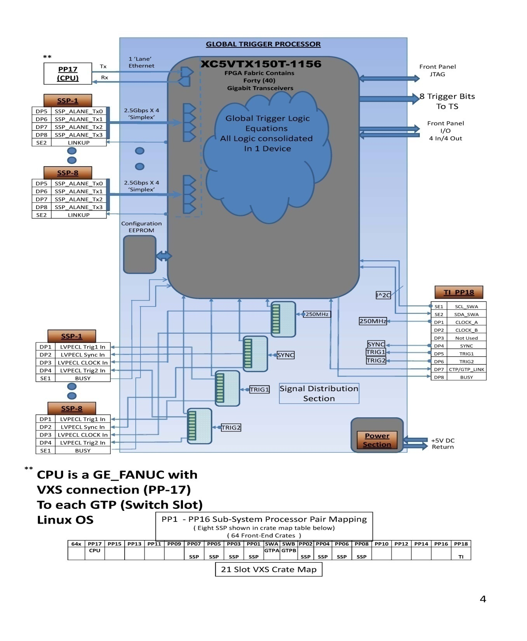
Virtex 5 devices available now that have high GigaBit transceiver counts capable of managing the data from up to 8 Sub-System Processors
GTP logic will effectively have all trigger data from up to 64 Level 1 crates in one FPGA.
23

Slide 24
Discussion Point
Questions about existing hardware designs?
What other features would be useful or have been omitted on existing prototypes?
Recognize that firmware features take significant development and test time
Must meet 12GeV construction schedules too!
Advanced question: Have requirements changed for GTP and TS modules?
What capabilities/features must these boards support?
i.e. GTP must support >12 SSP for CLAS12
What other global trigger equations will be required?
Are there incompatibility issues with legacy readout systems? (i.e. Hall A, Hall C)
Other issues?
24

Slide 25
Summary
Several module designs are at the final ‘production’ revision stage:
FADC-250
SD
CTP
Significant test effort will be needed for full multi-crate setup
Proposal exists to use new electronics for 6GeV beam test in Hall B (~Sept-11)
Real hardware prototypes, SSP, TI-D have been designed and assembled. (FY10)
Significant test work for FY11
Plenty of engineering details (“Electronics & DAQ groups” ) remain
CODA Library development progressing for these new modules
Global Trigger Processor (GTP) and Trigger Supervisor (TS) need to be designed,
assembled and tested in FY11!
Low quantities needed but complexity will demand significant test period
DAQ Crate procurement ready for final RFP from selected manufacturers
25

Slide 26
Overview of other Sessions
Thanks in advance to the presenters for their contributions
DAQ System Update (David Abbott)
Linux Front-Ends (Bryan Moffit)
Trigger Interface and Distribution (William Gu)
Global trigger and Commissioning (Alex Somov and Hai Dong )
Tools for high level trigger algorithms in Sub-System Processor & GTP (Ben Raydo)
Recent experience with FADC-250 trigger features on PREx (Brad Swatzky)
Trigger system applications for CLAS 12 (Sergey Boyarinov)
26

Slide 27
BACKUP SLIDES

Slide 28
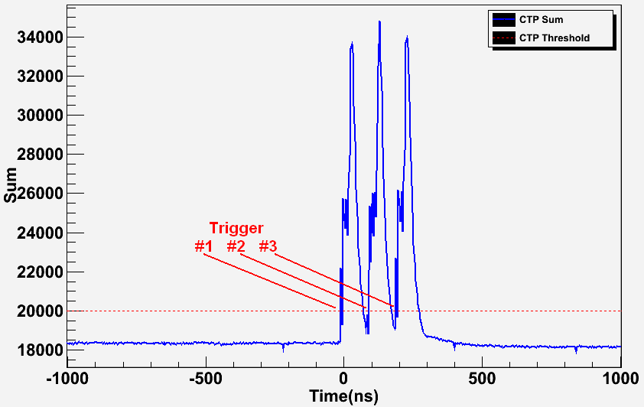
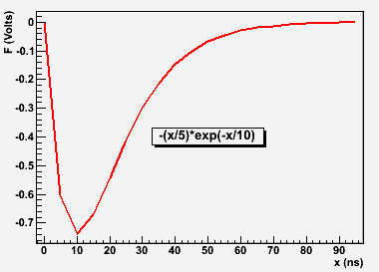
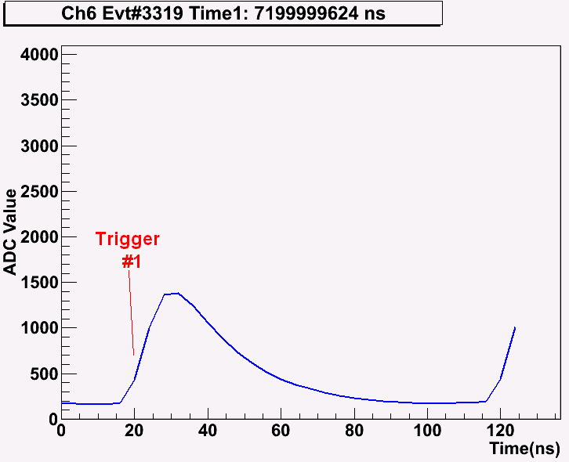
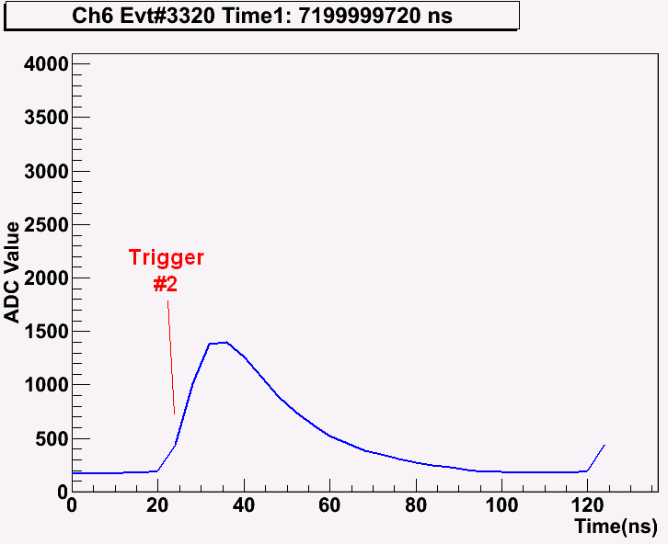
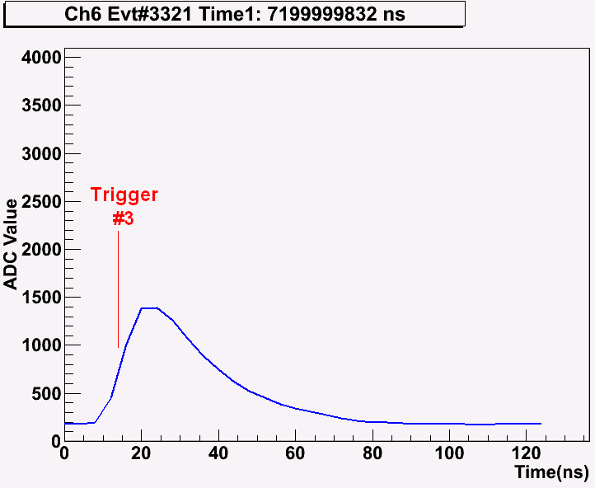
2 Crate Energy Sum Testing
Global Sum Capture (at “SSP”):
Input Signal(to 16 FADC250 Channels):
Raw Mode Triggered Data (single channel shown only):
Threshold applied to global sum (80 digitized channels) produces 3 triggers.
Raw channel samples extracted from pipeline shown for 1 channel.
Runs at 250kHz in charge mode
Latency: 2.3µs(measured) + 660ns(GTP estimate) < 3µs

Slide 29
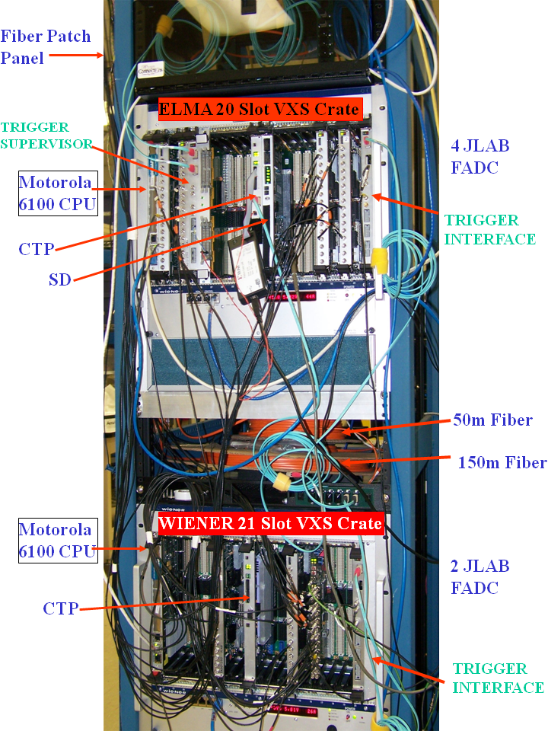
2 Fully Prototyped Front-End Crates
SSP*
TD
Trigger
Decision
Trigger/Clock/Sync/Busy
L1 Crate Sum 10Gbps Stream
CPU - 6100
FADC250
FADC250
CTP#1
SD
FADC250
FADC250
TI
“davw1” VXS crate
CPU - 6100
FADC250
CTP#2
SD
FADC250
TI
“davw5” VXS crate
*SSP function embedded inside 2nd CTP

Slide 30
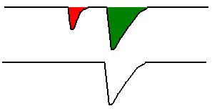
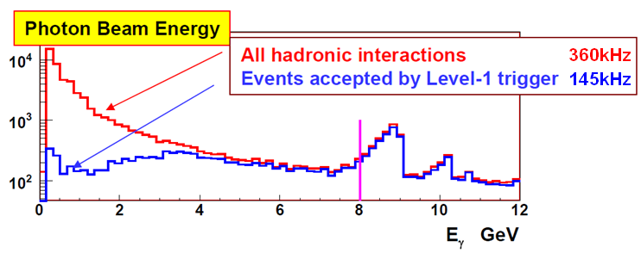
Example L1 Trigger cont…
BCAL & FCAL <30MeV Channel Suppression (done at FADC250):
<30MeV – Rejected by FADC250
FADC Channel Input:
>30MeV – Accepted by FADC250
FADC L1 Sum Output:
GTP Trigger Equation:
Resulting L1 Acceptance Spectrum:
L1 Rate < 200kHz
In Signal Region:
L1 Trigger Efficiency > 92%

