Slide 1
The GlueX CDC
Curtis A. Meyer
Carnegie Mellon University
September 9, 2010
GlueX Collaboration Meeting
September 2010
University of Regina

Slide 2
Outline
Staffing for the project.
Status of the CDC.
Work with the ASIC preamplifiers.
The GlueX Central Drift Chamber: Design and Performance ,
Y. Van Haarlem, C. A. Meyer, F. Barbosa, B. Dey, D. Lawrence, V. Razmyslovich, E. Smith, G. Visser, T. Whitlatch, G. Wilkin and B. Zihlmann,
Nucl. Instrum. Methods A622, 142, (2010).
The Status of Exotic-quantum-number Mesons,
C. A. Meyer and Y. Van Haarlem,
Phys. Rev. C82, 025208 (2010).

Slide 3
CDC Construction Team
Dr. Naomi Jarvis Scientific Lead
Gary Wilkin Construction Manager
Amy Woodhall Technician
Kaitlyn Mueller Technician
Curtis Meyer
Dr Yves VanHaarlem Left end of August for AU
Undergraduate Students as work picks up.

Slide 4
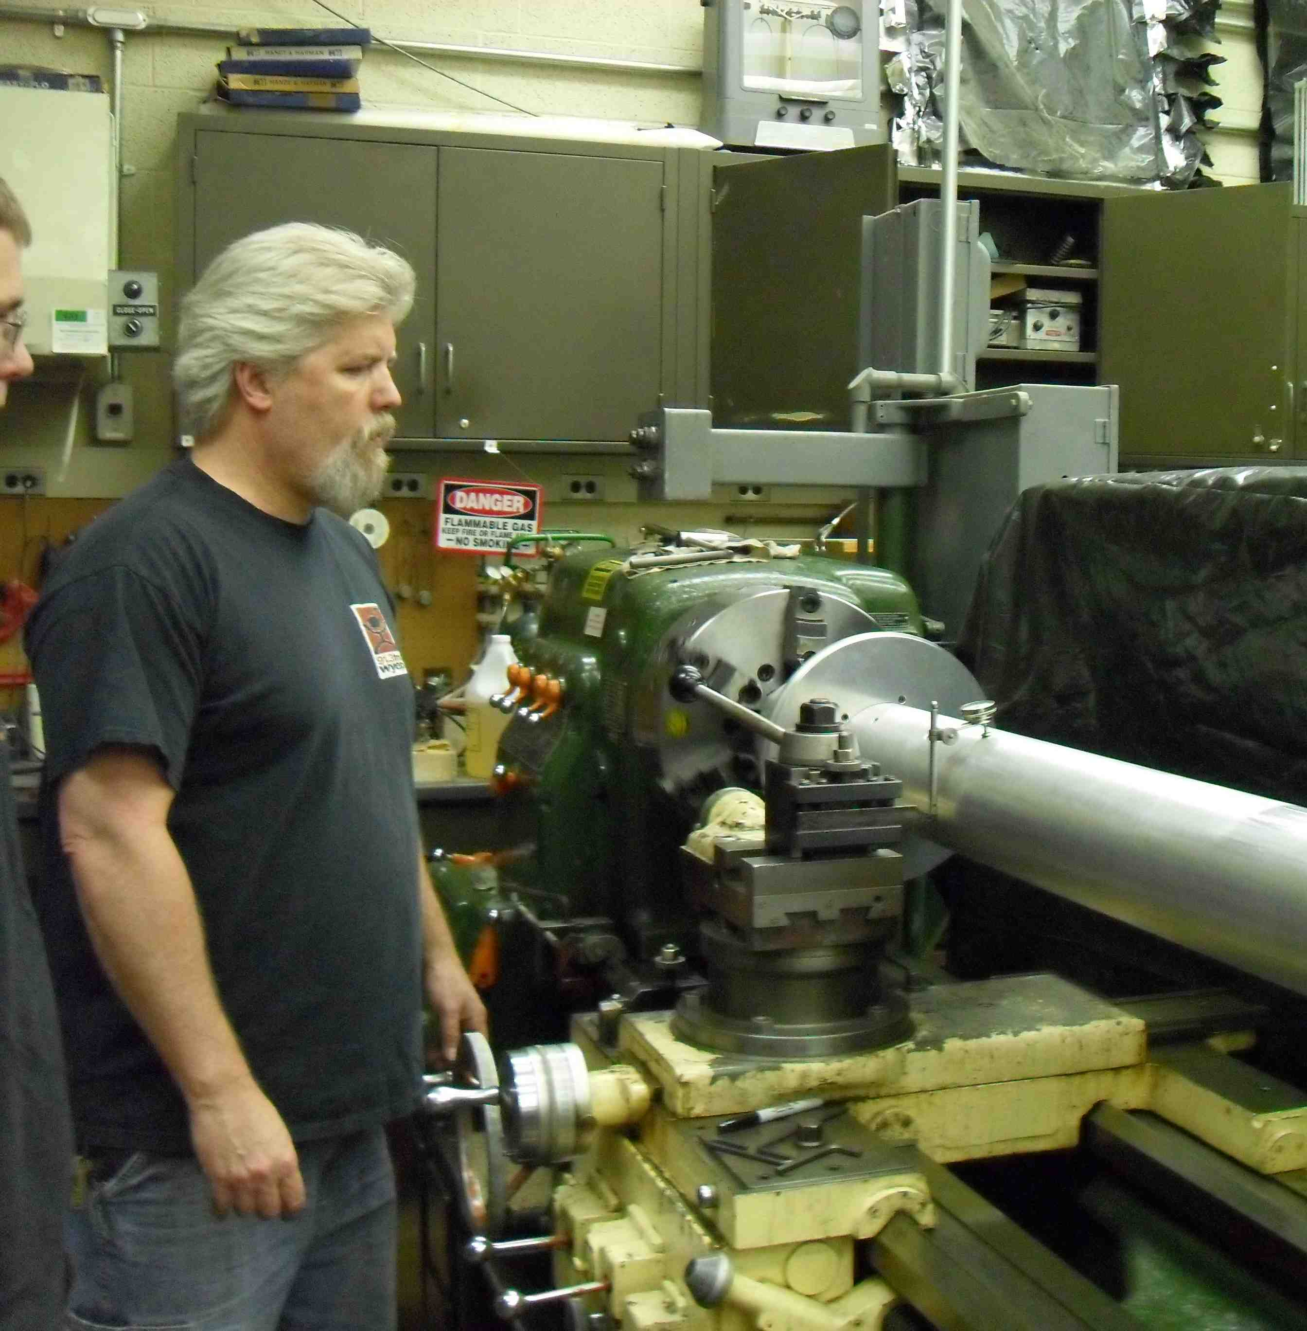
Staffing
Gary Wilkin
Construction Manager
Kaitlyn Mueller
Technician
Started August 15
Amy Woodhall
Technician
Started June 1

Slide 5
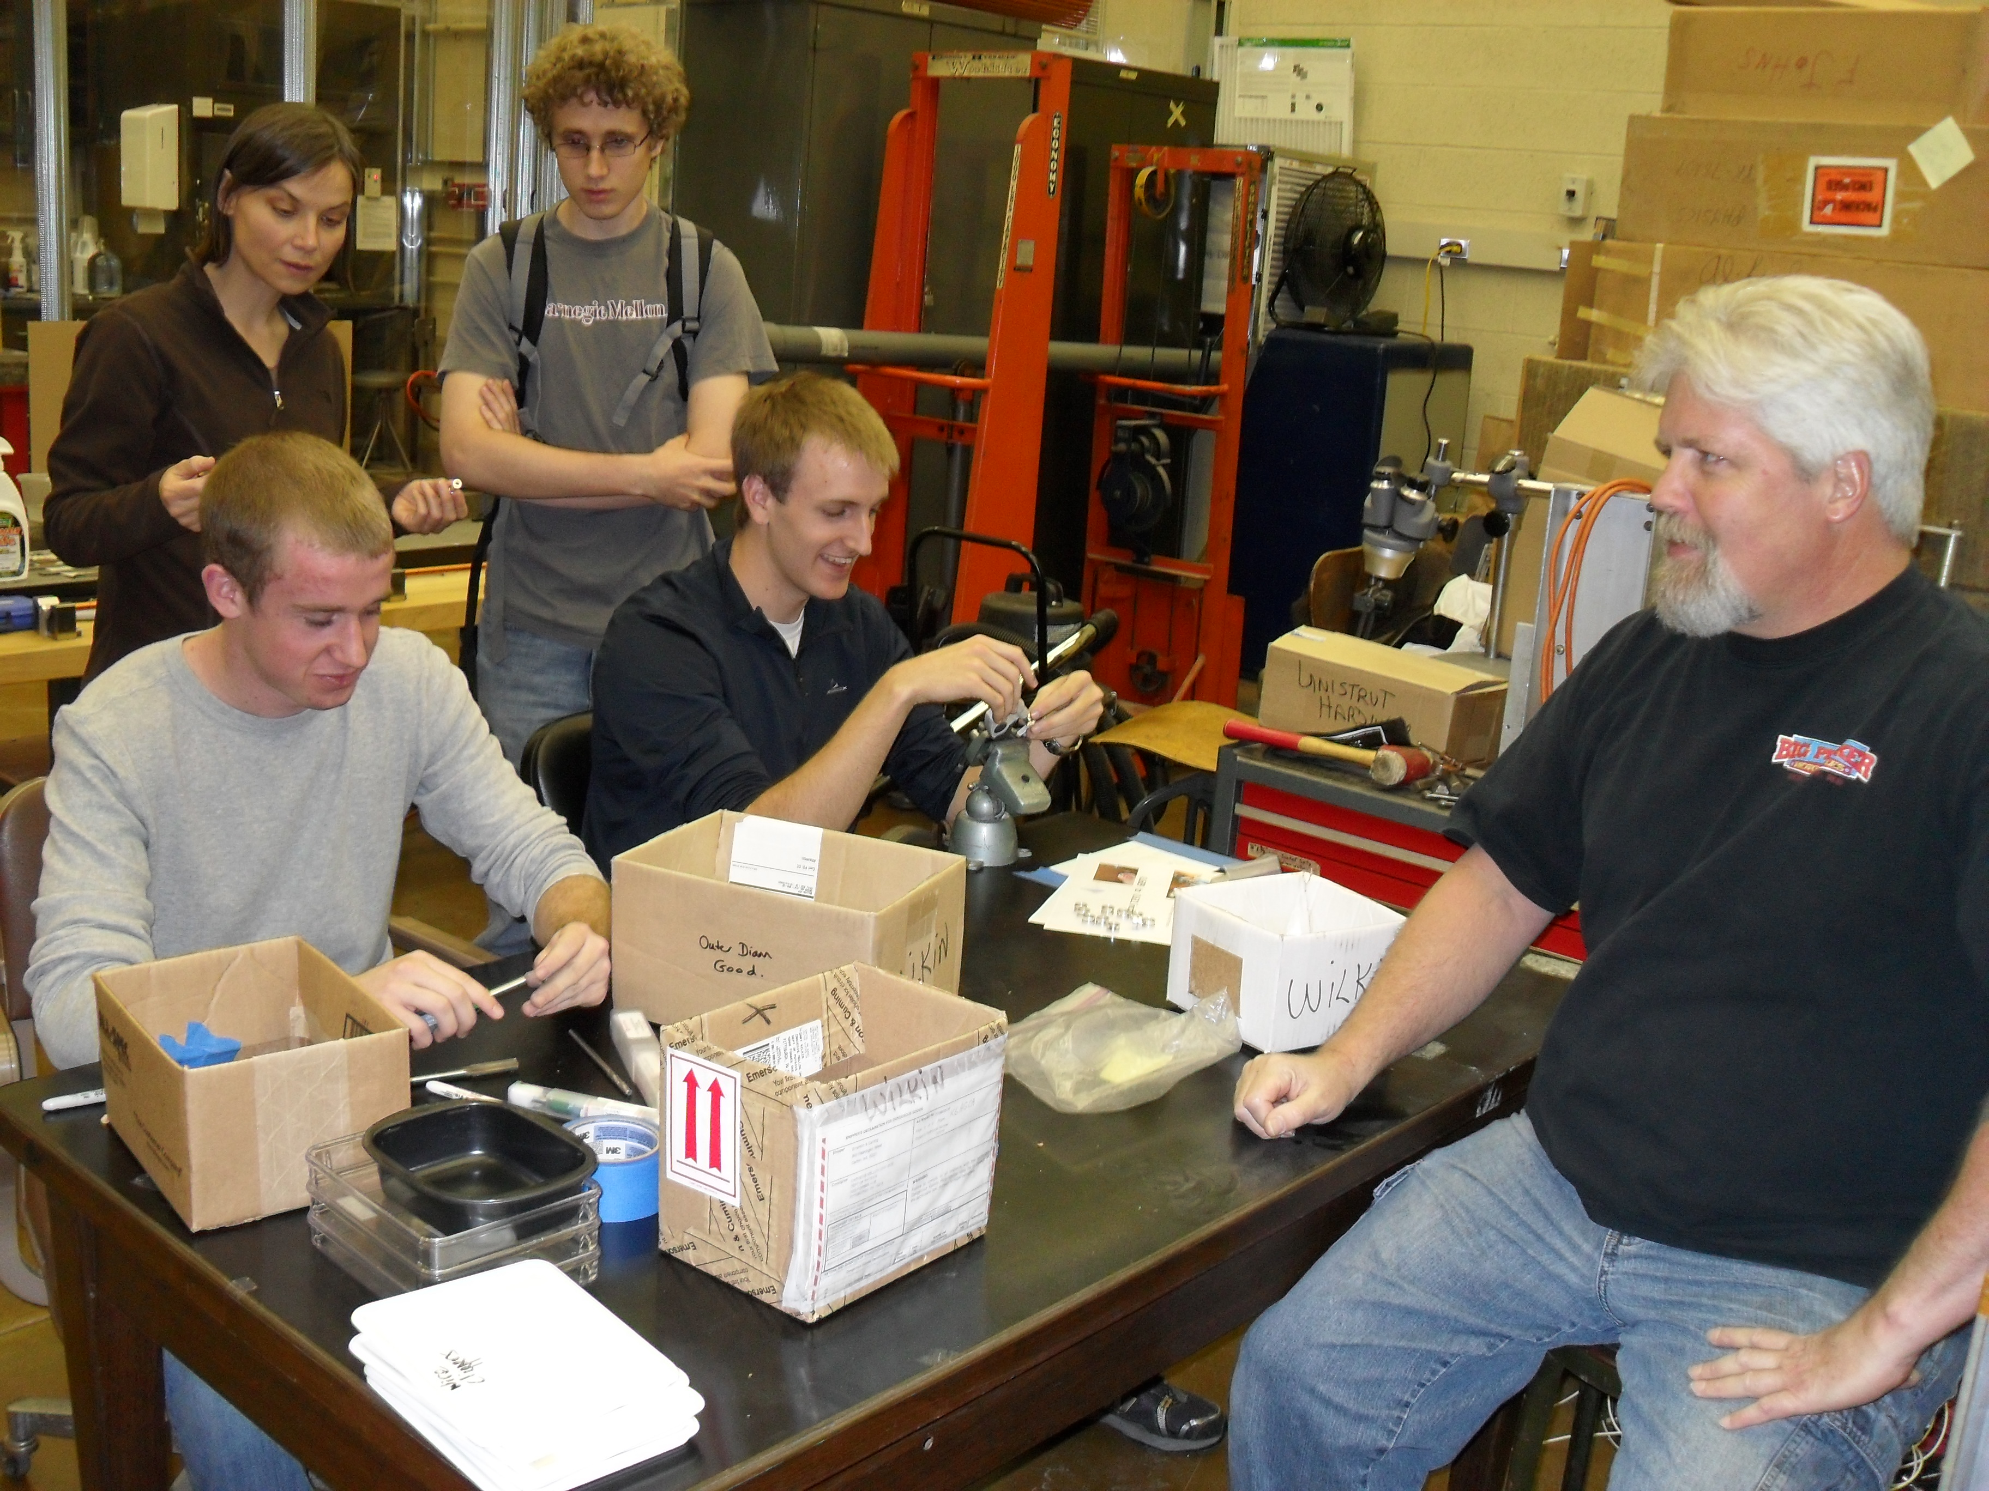
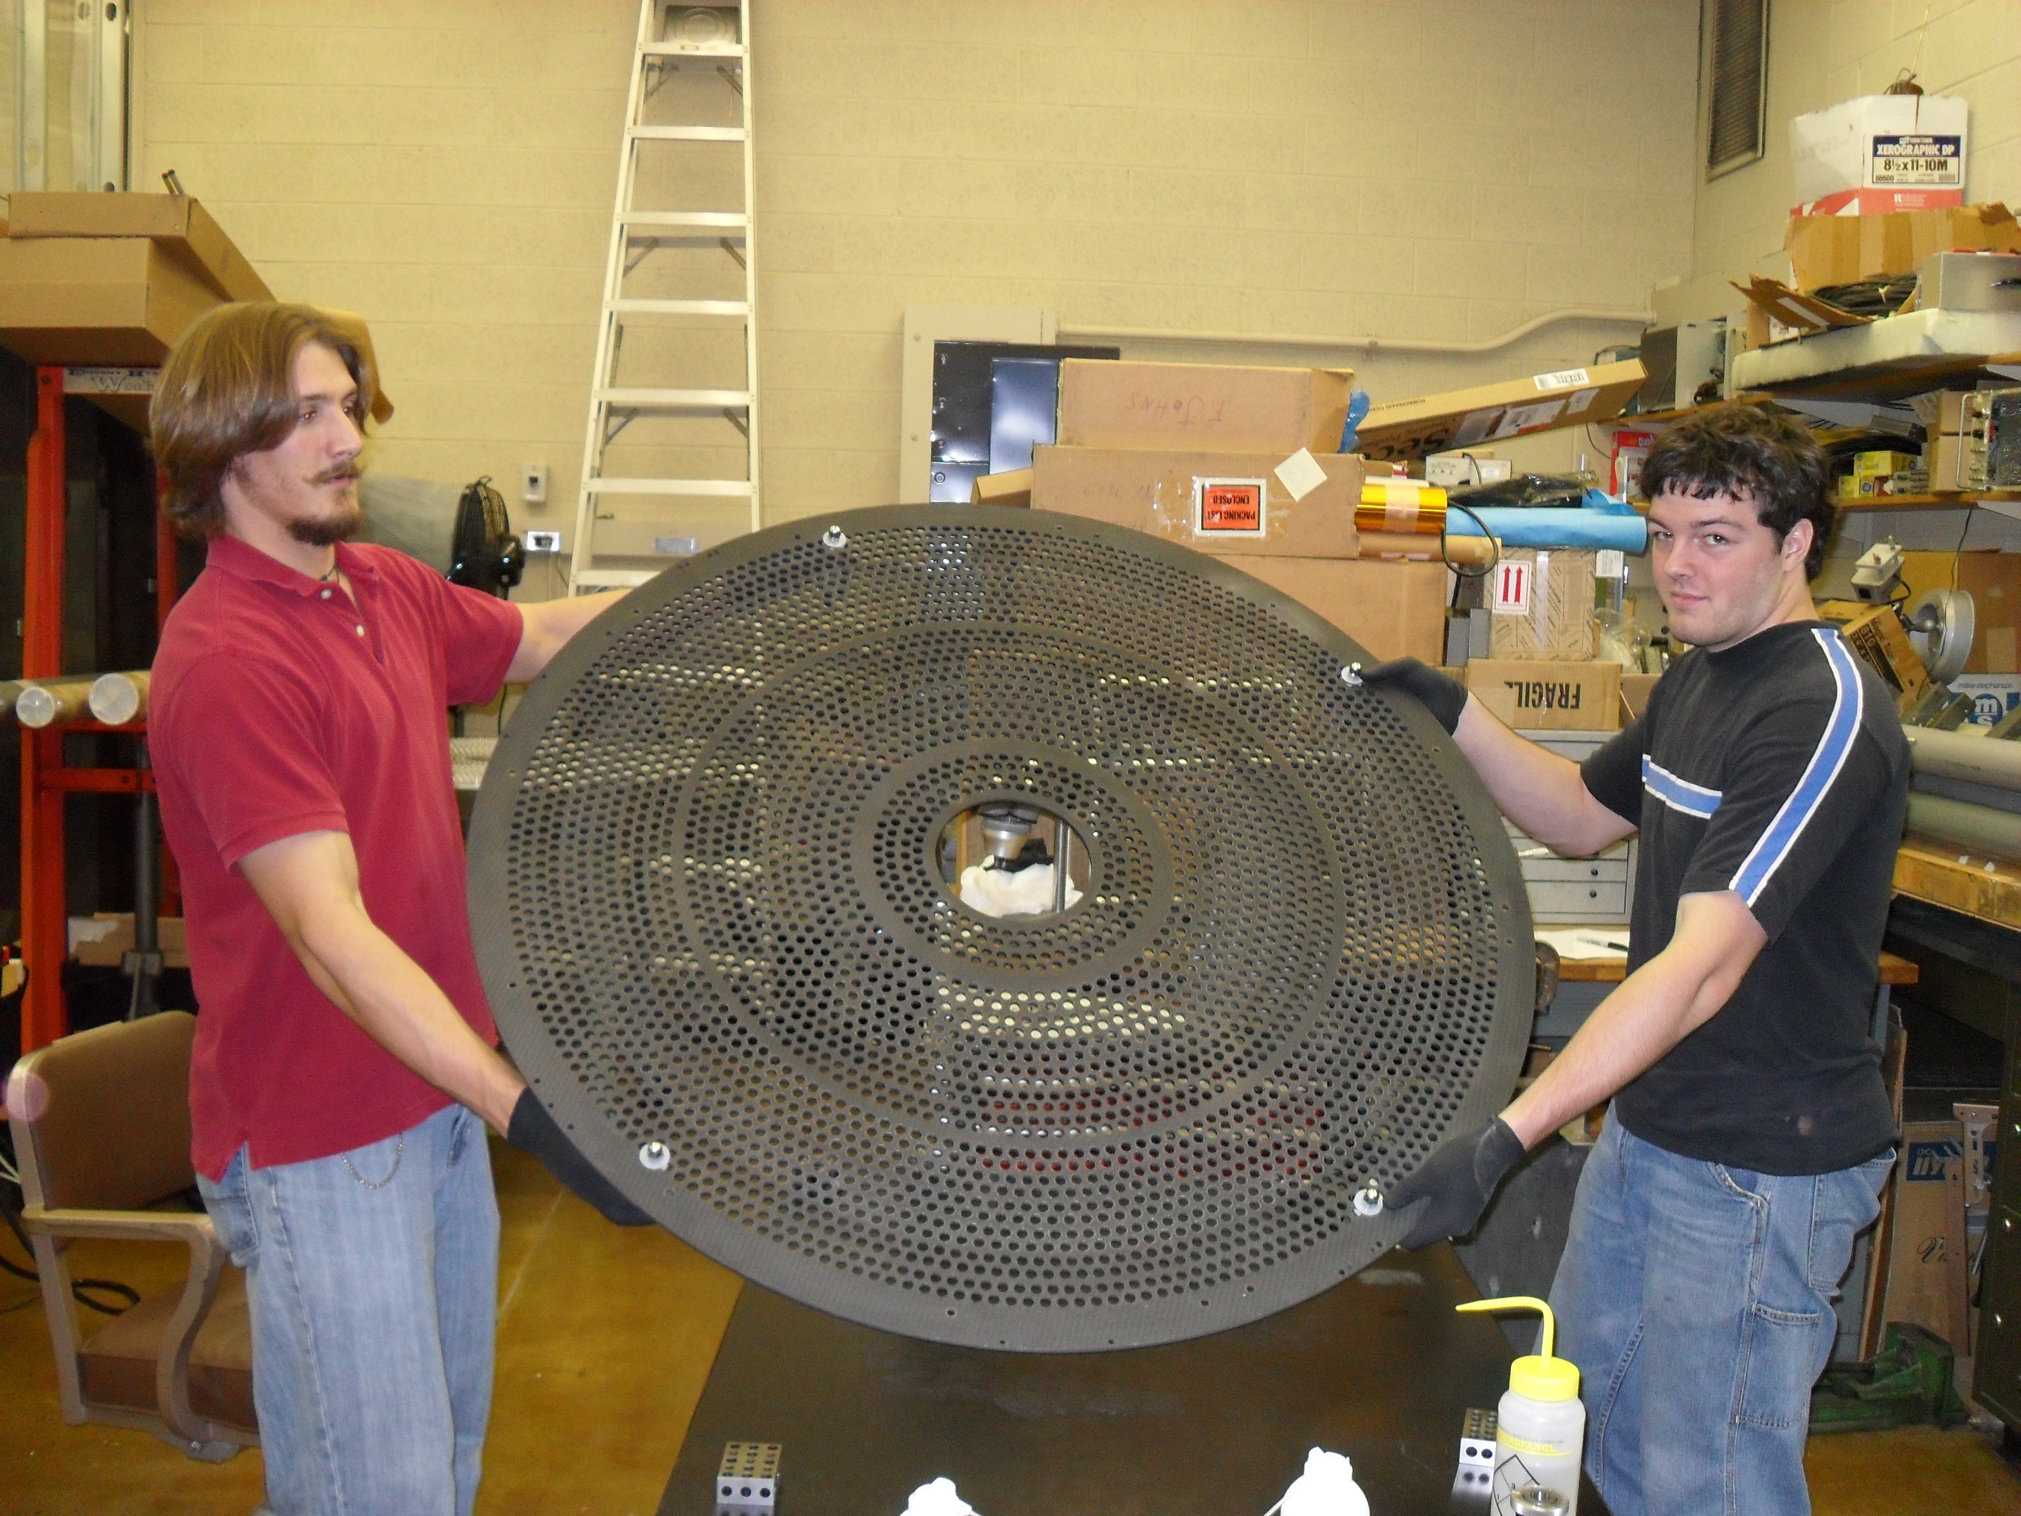
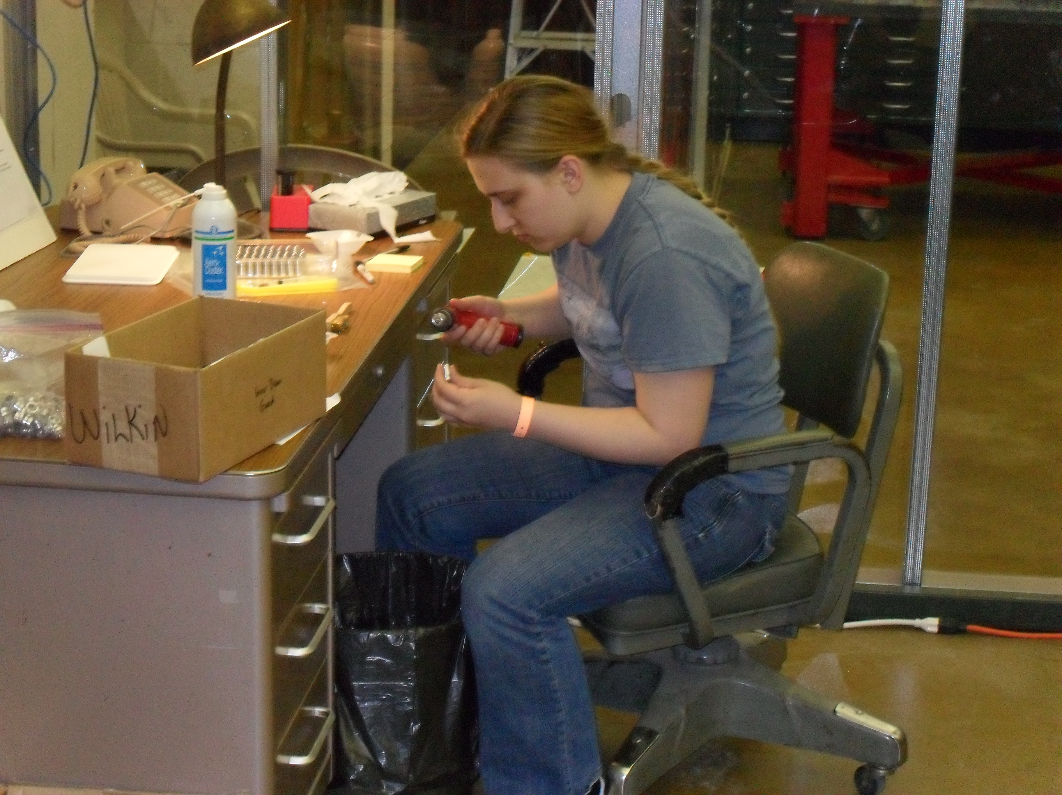
Undergraduate Students

Slide 6
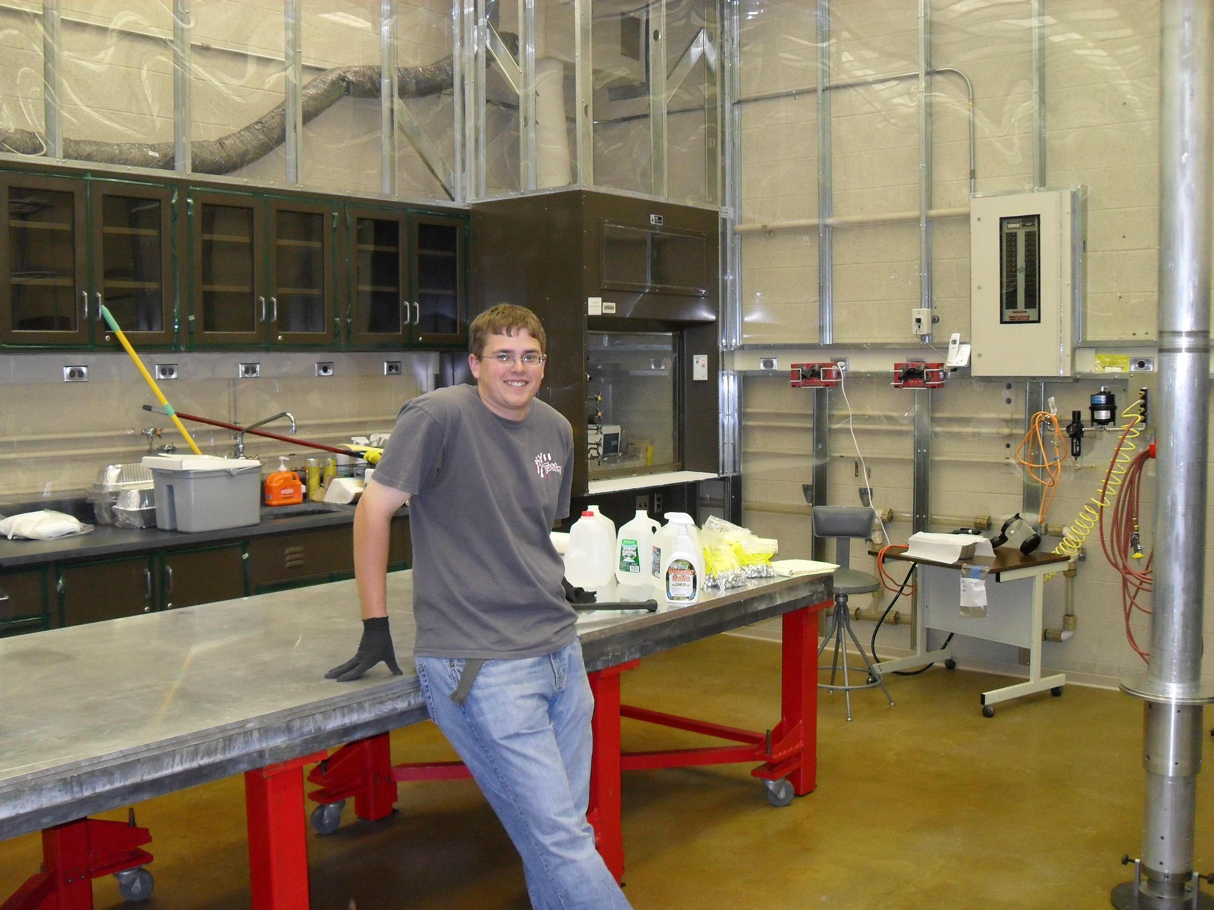
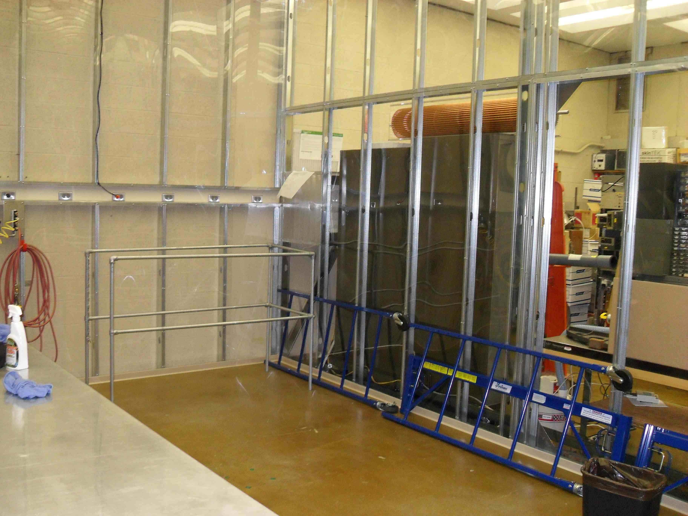
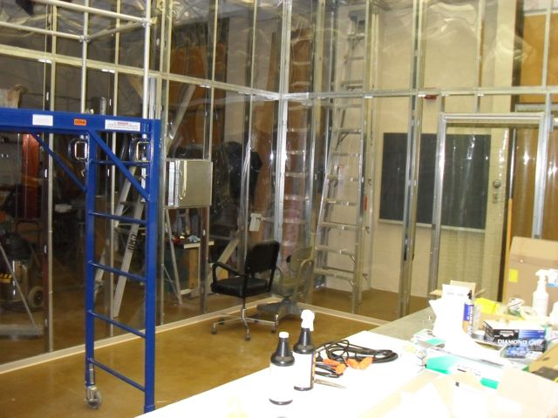
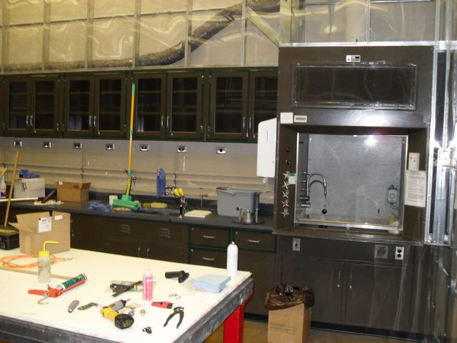
The Clean Room

Slide 7
Construction Space
At least class 4000 clean room.
18 by 24 high-bay space.
Hood, gas, filtered air, water, phone, …
Vestibule entrance.
Preparation space is about 18 by 24 high-bay.
All needed utilities.
Pass through into clean area.

Slide 8
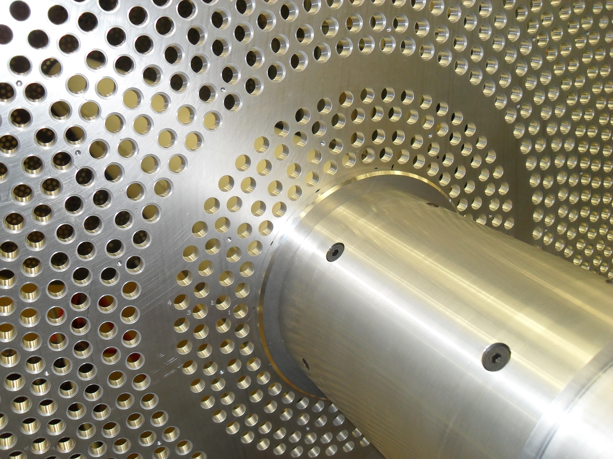
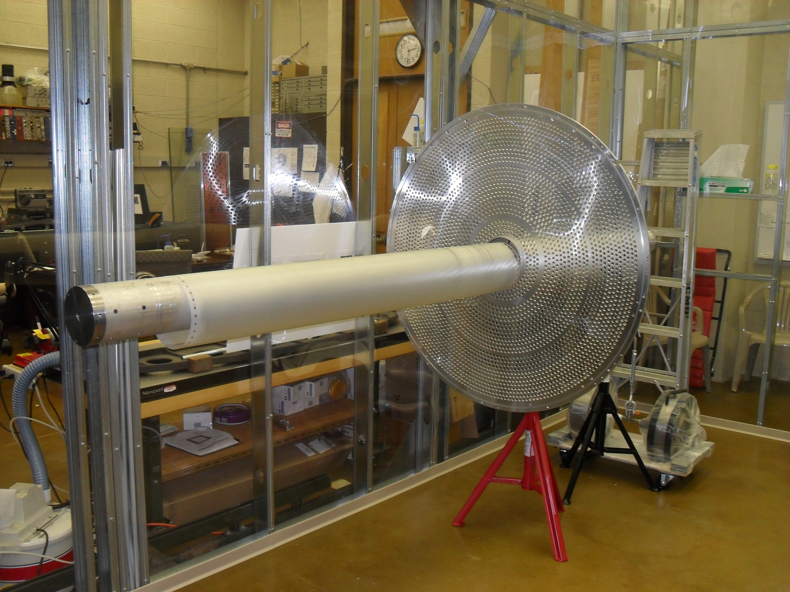
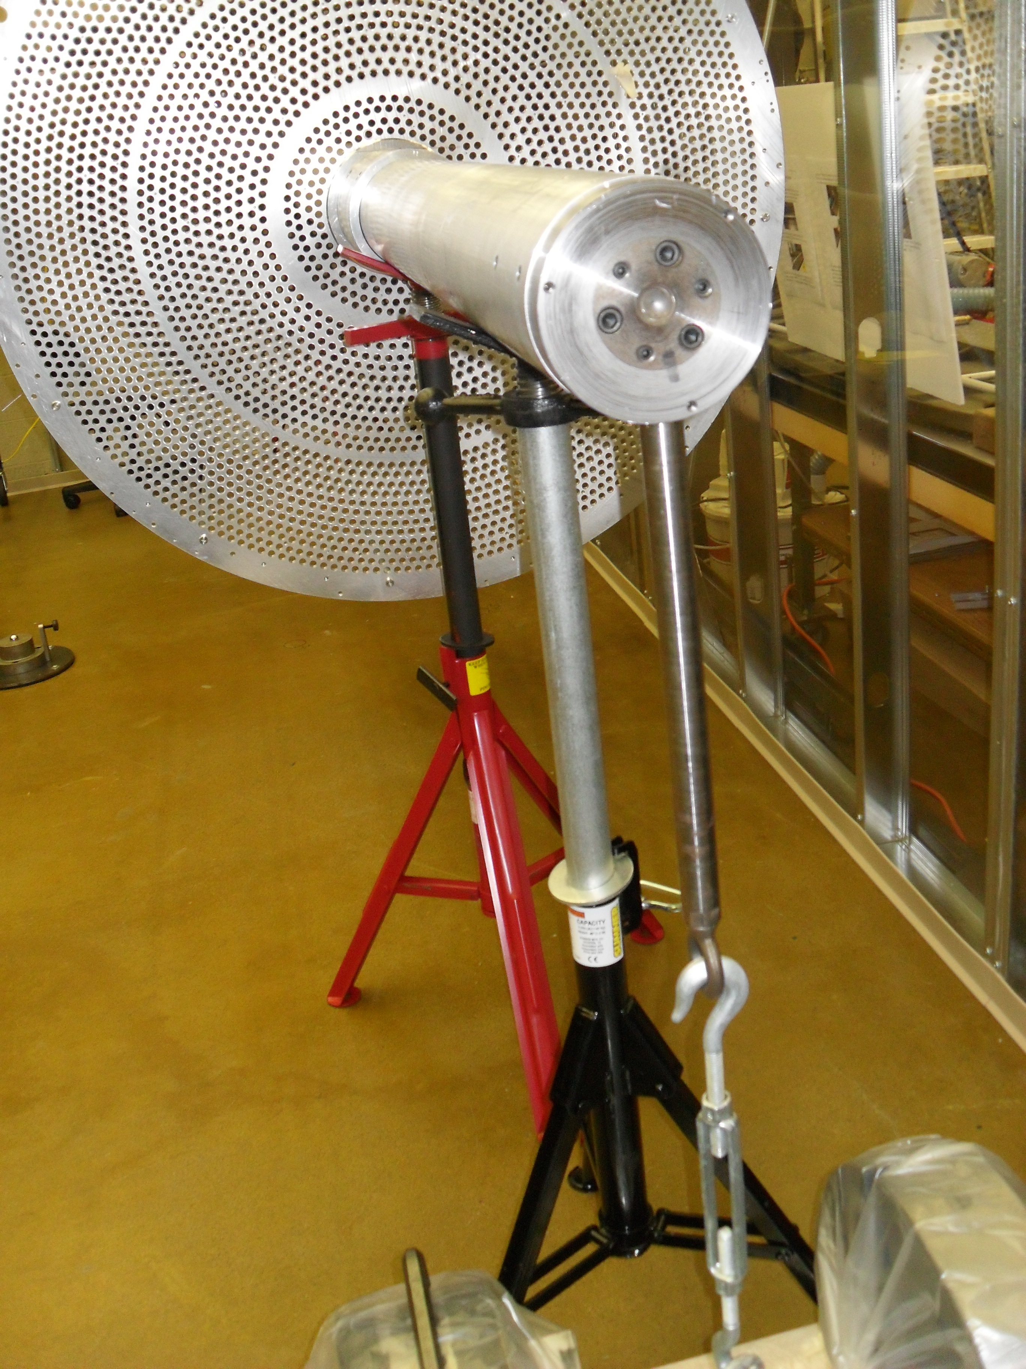
Frame Assembly
Aluminum plate on mandrill.
Inner shell on mandrill

Slide 9
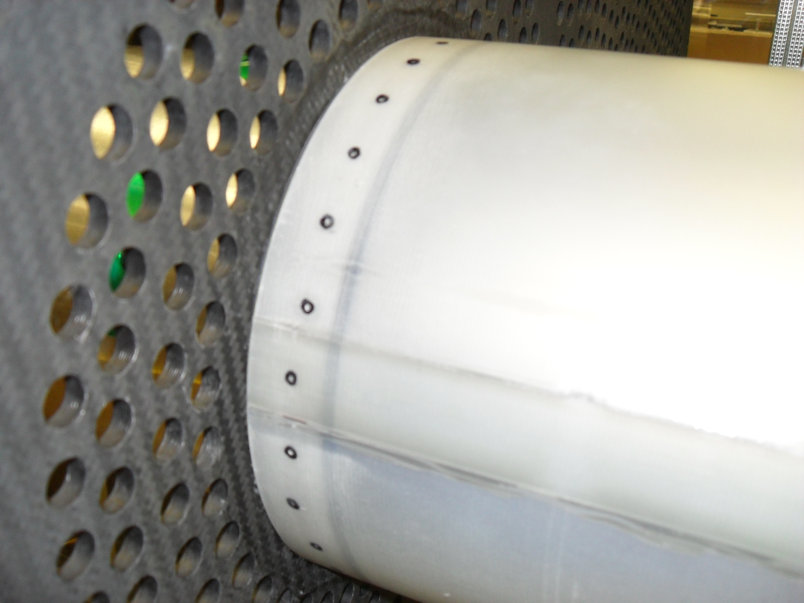
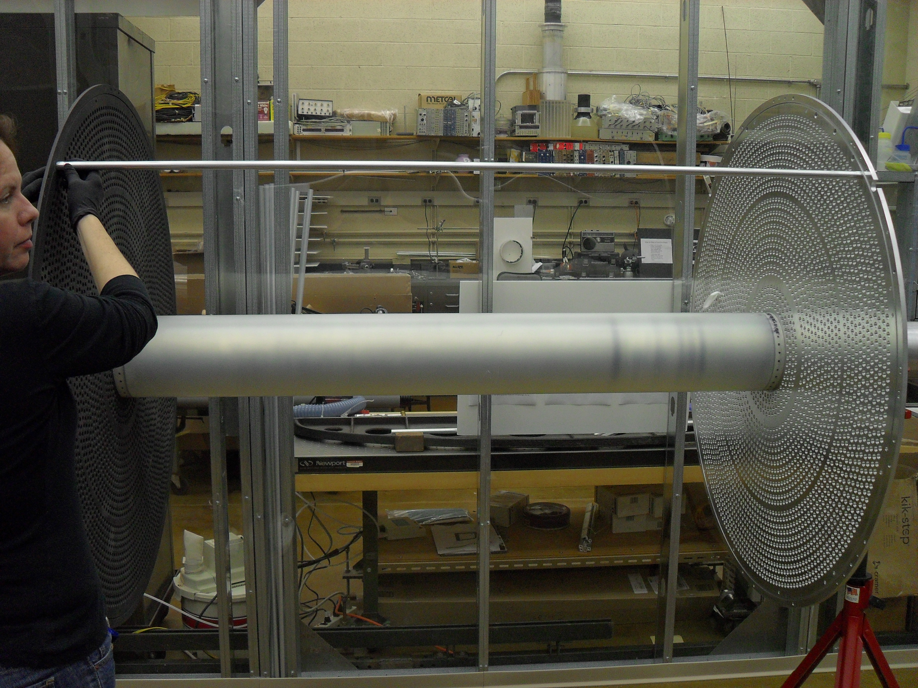
Frame Assembly
Carbon fiber plate on mandrill.
Install support rods.
Inner shell dry fit at each end.

Slide 10
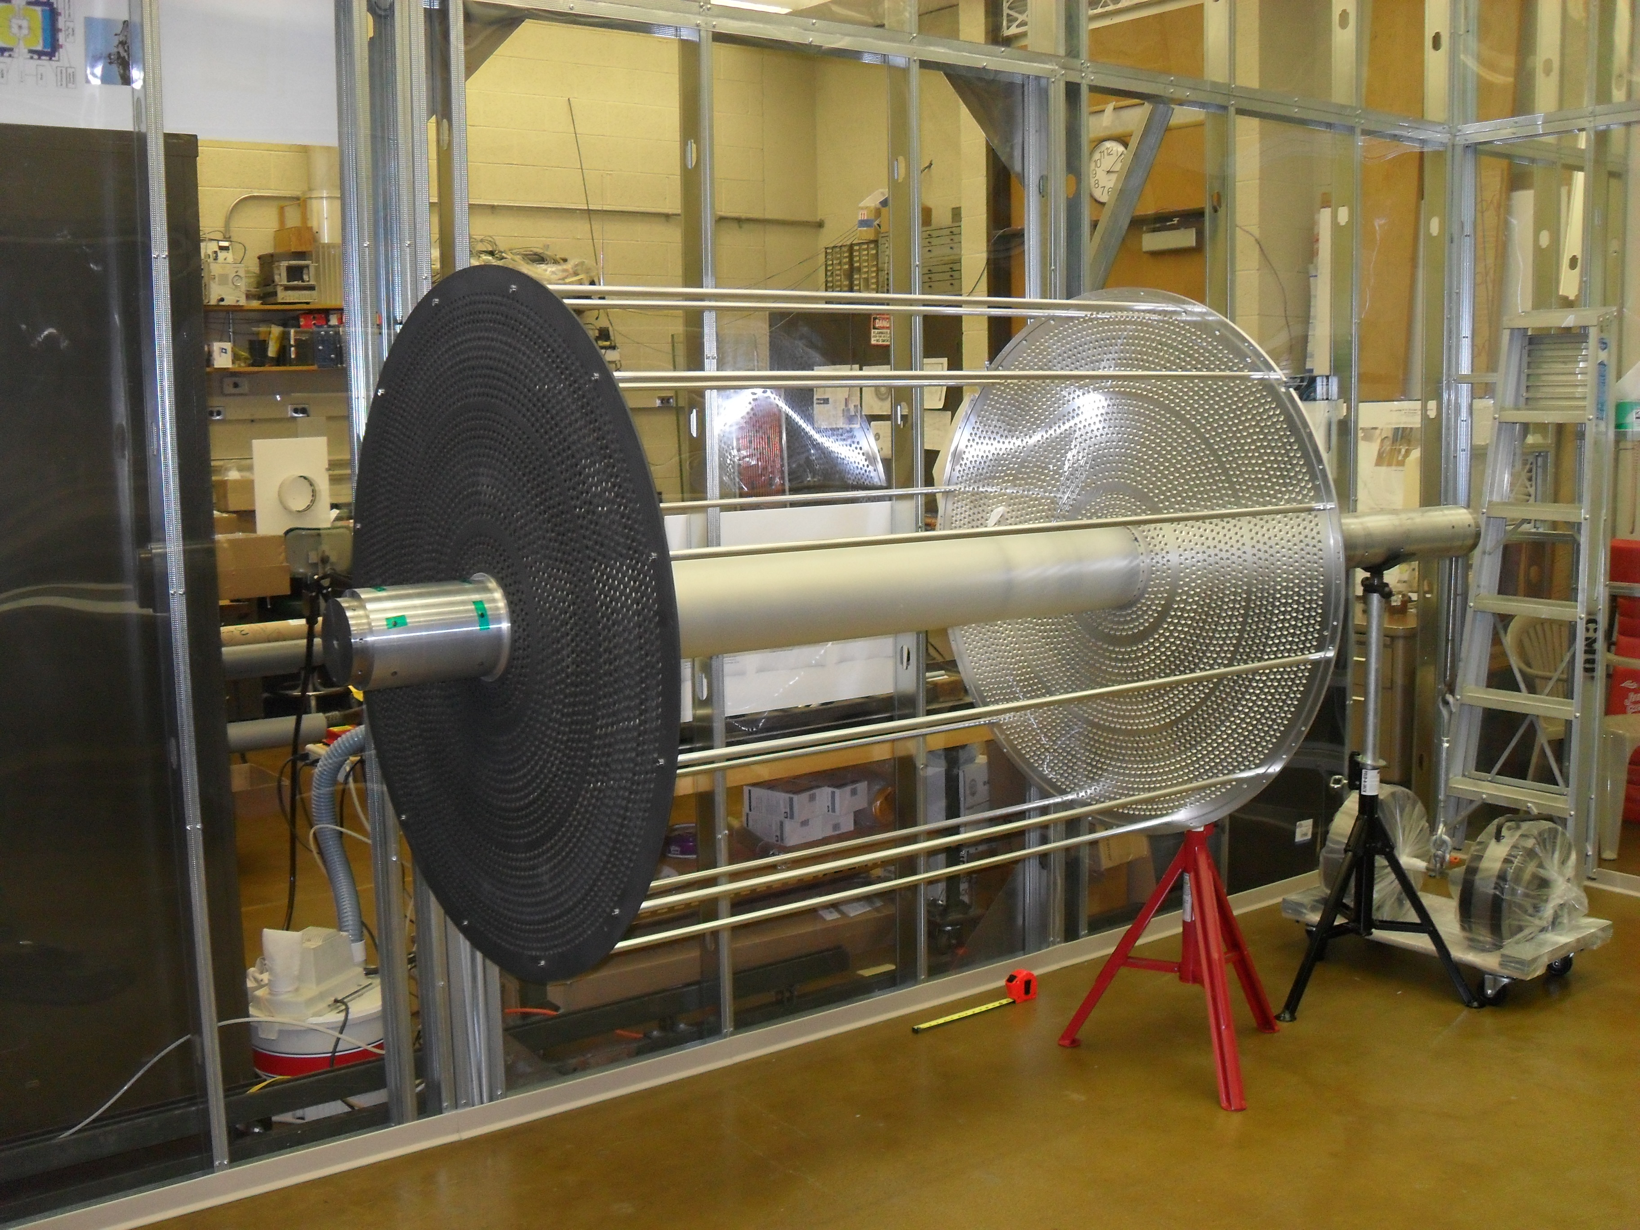
Frame Assembly
All support rods in place.

Slide 11
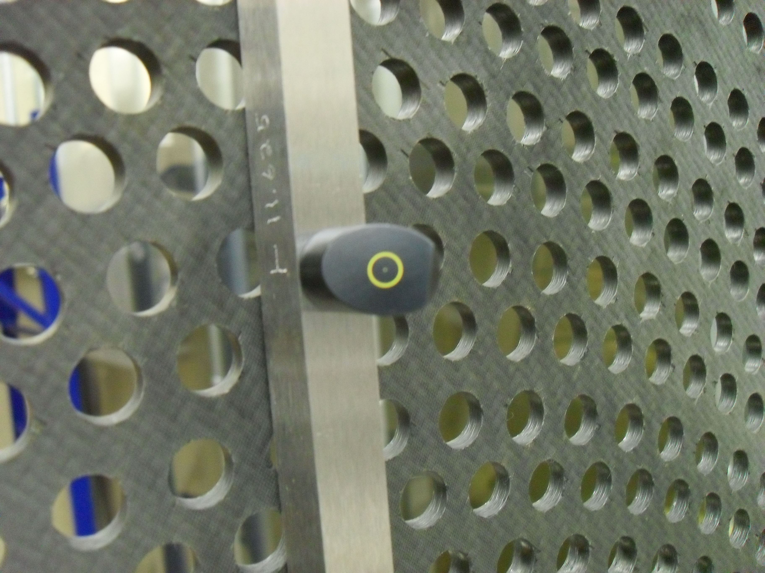
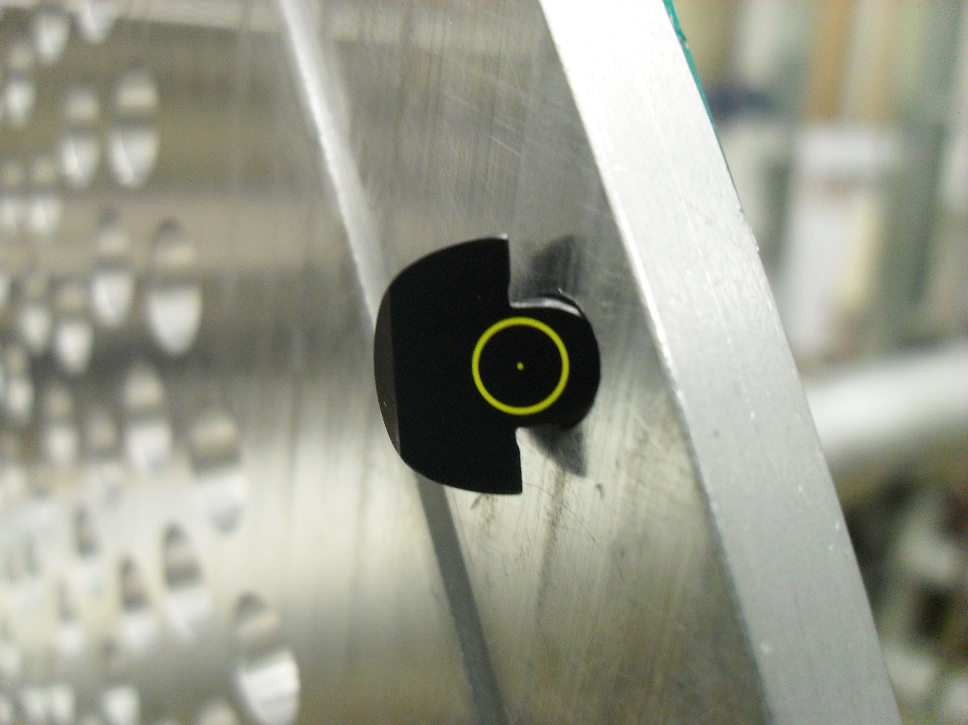
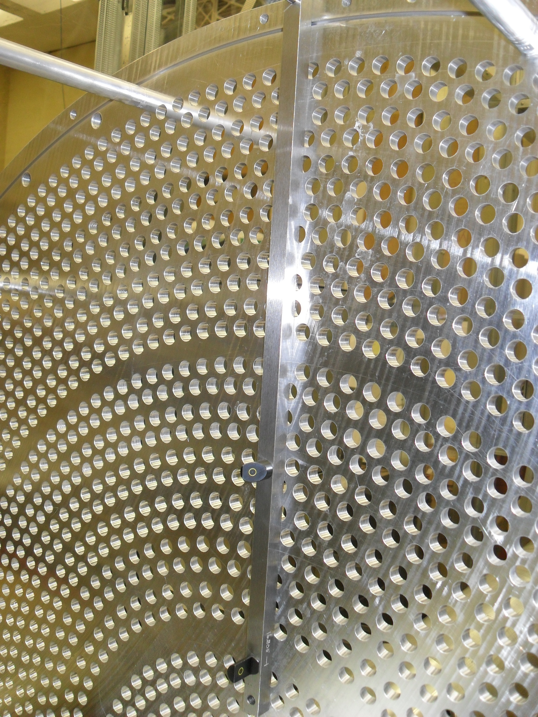
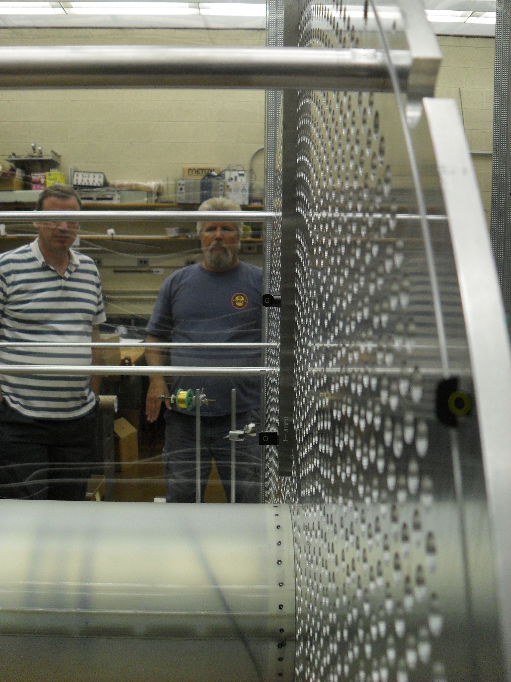
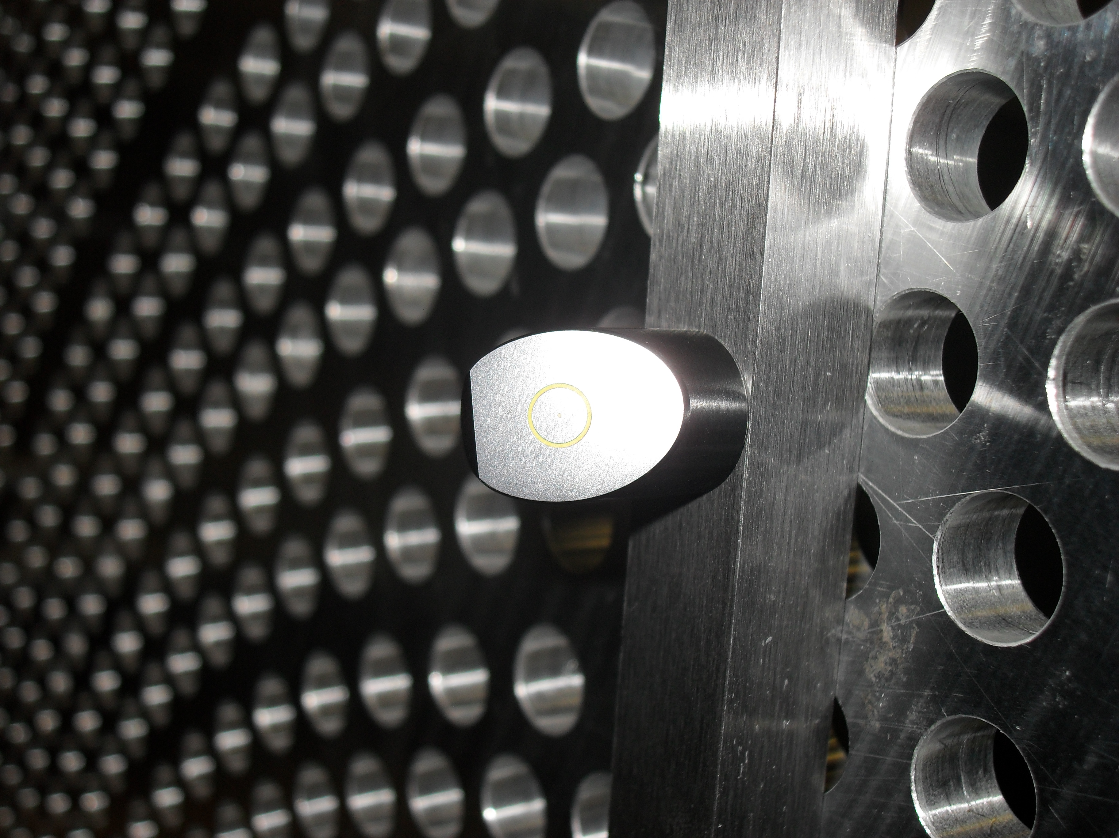
Frame Assembly
Install survey features

Slide 12
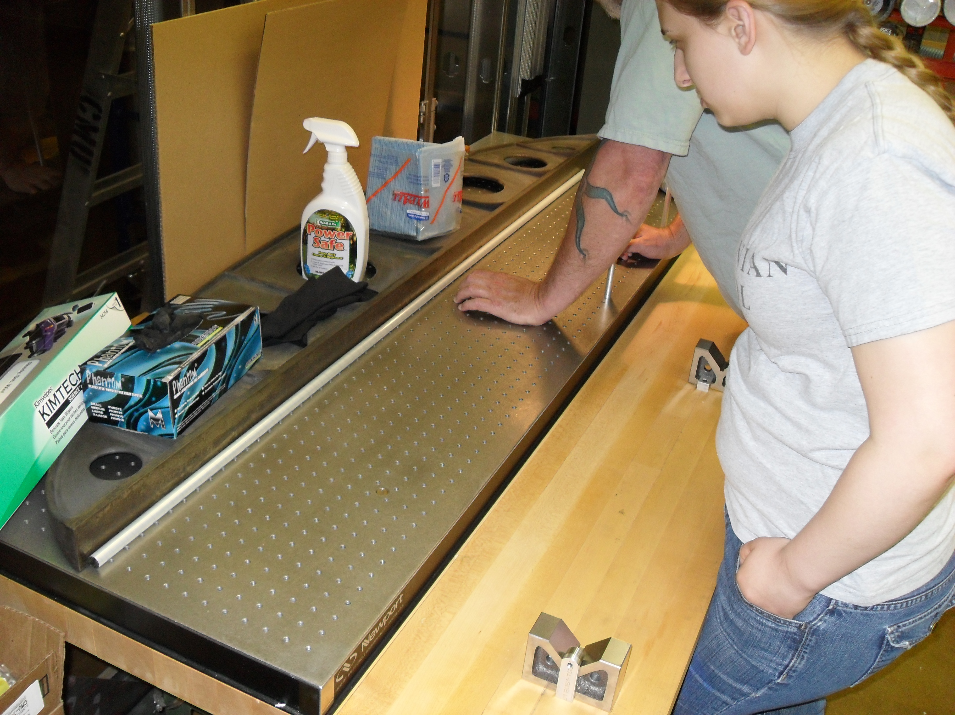
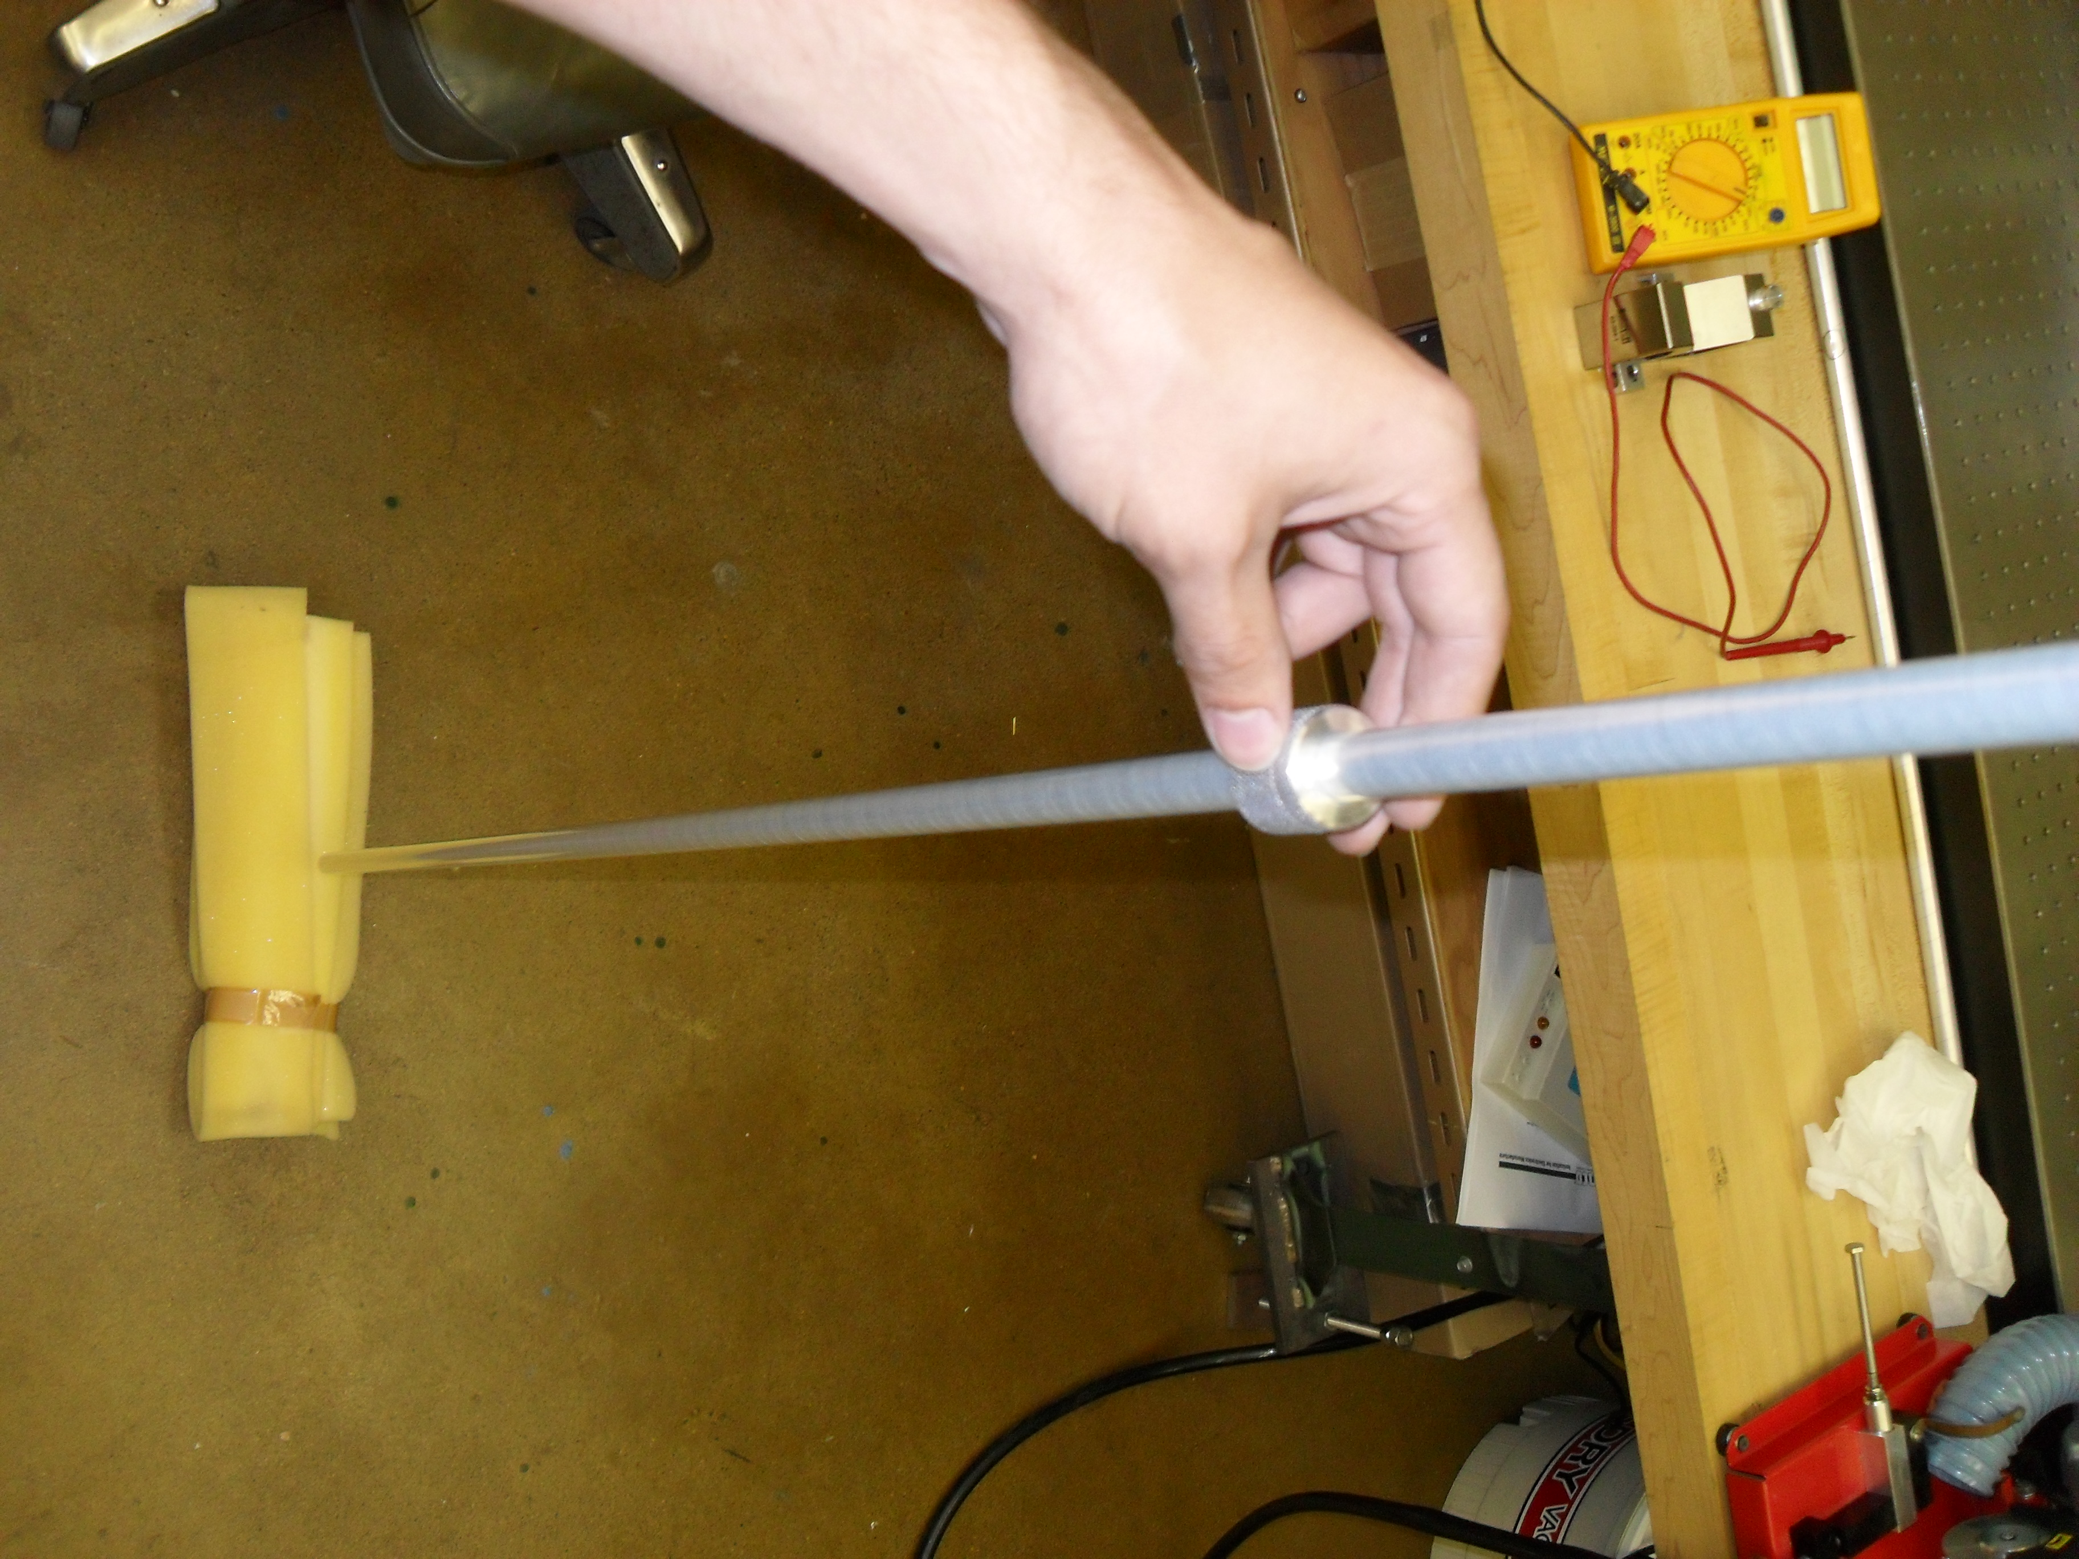
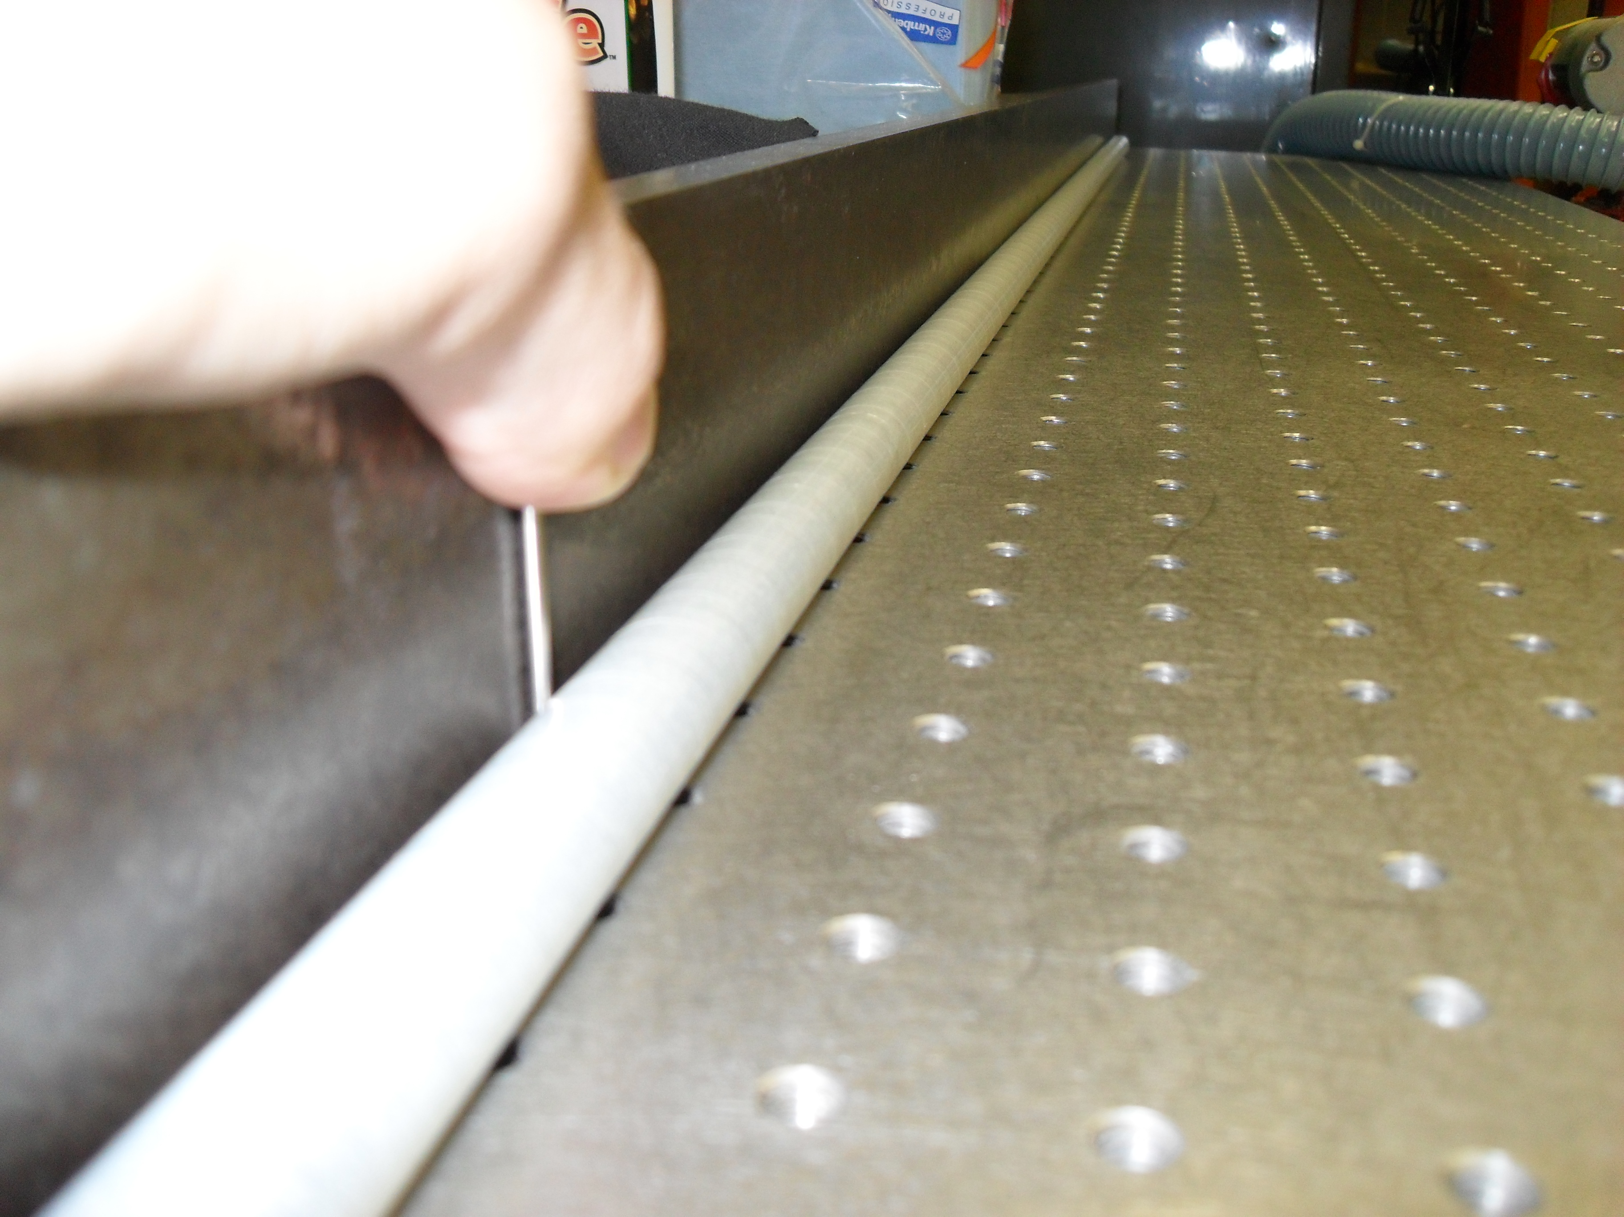
Check Straw Tubes

Slide 13
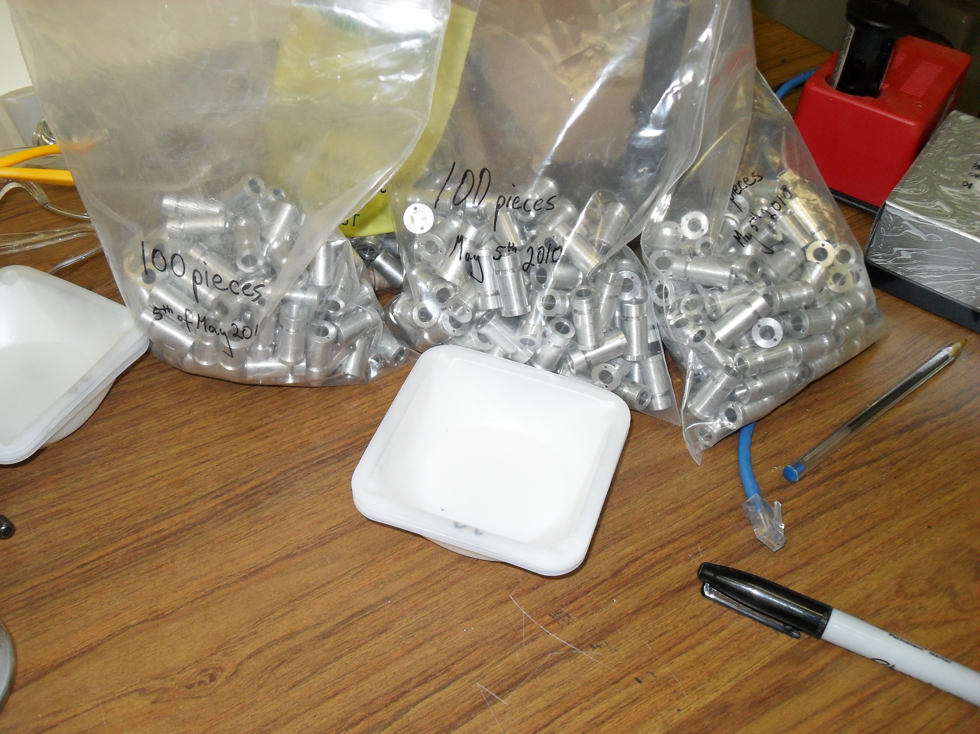
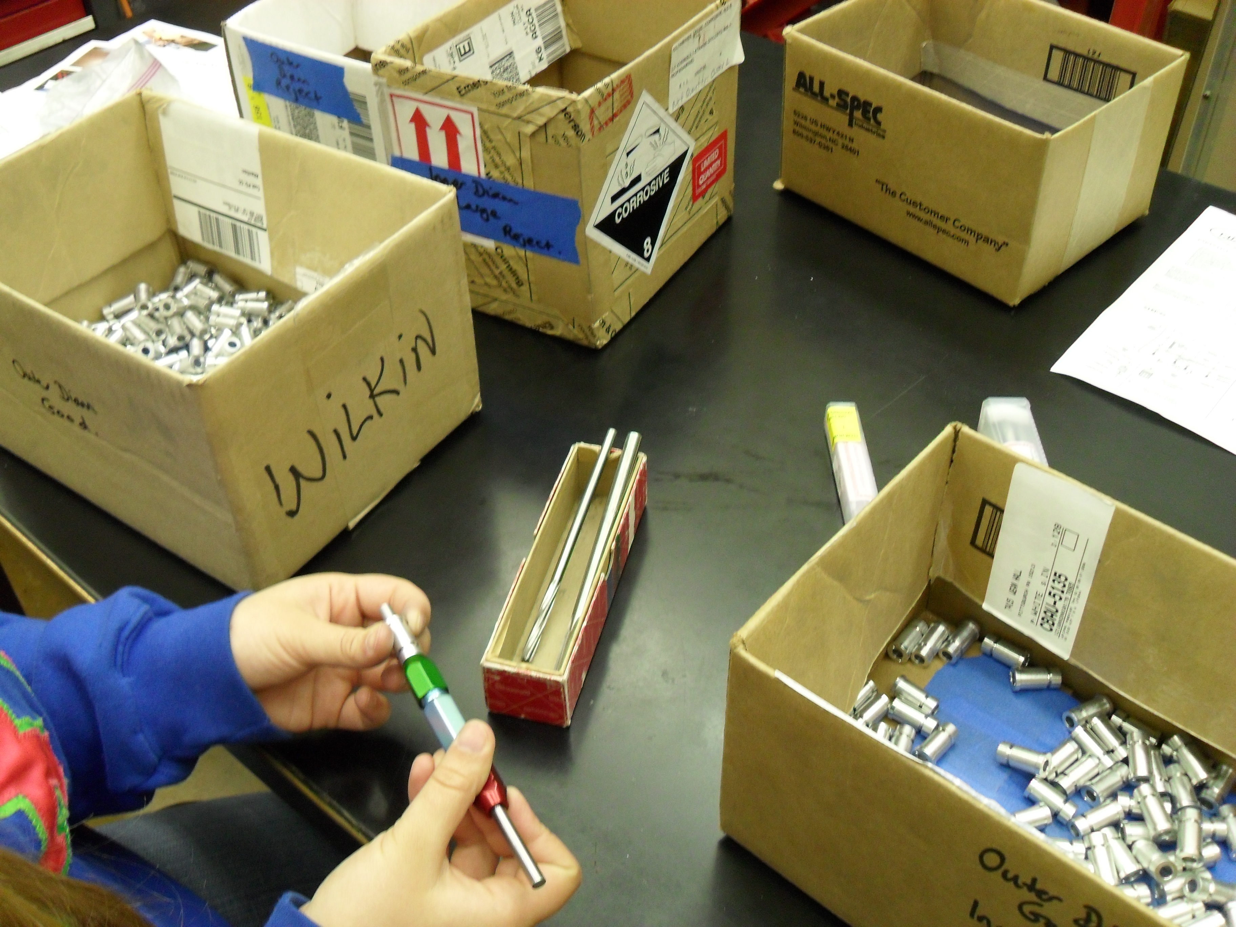
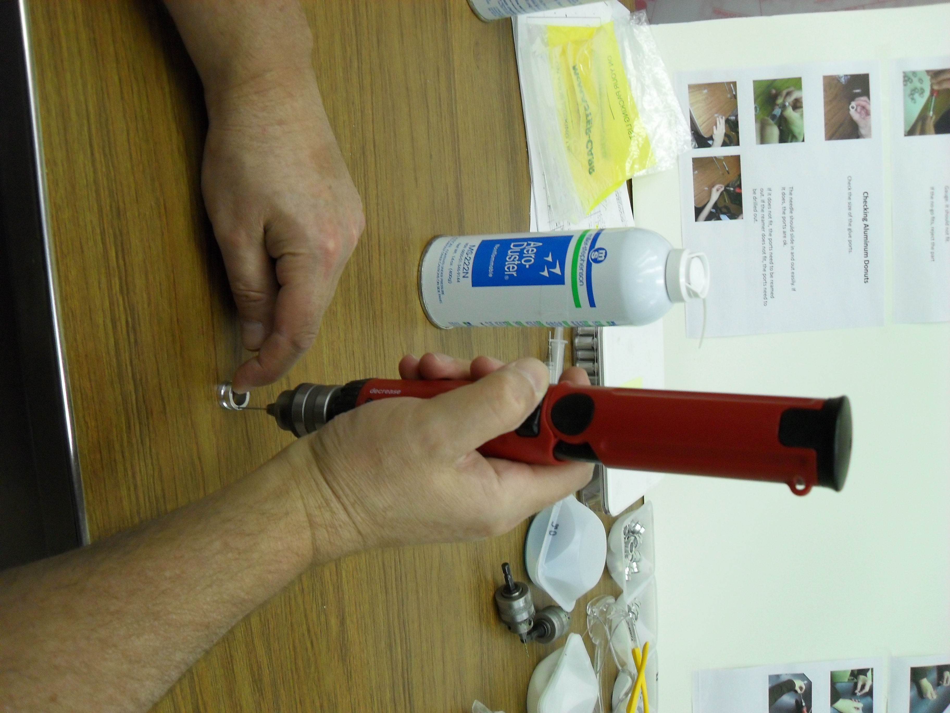
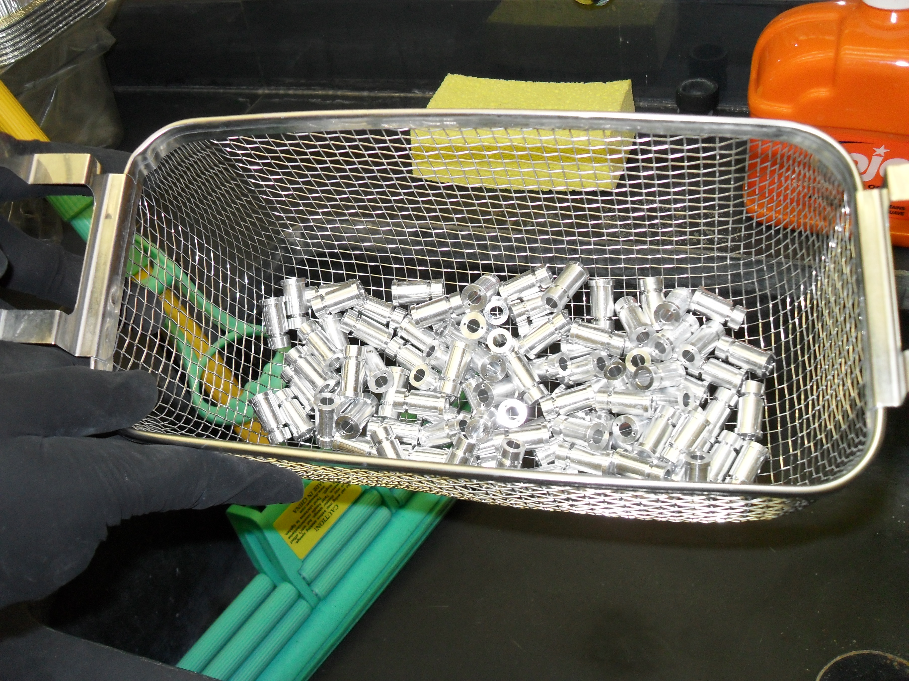
Check and Clean Parts

Slide 14
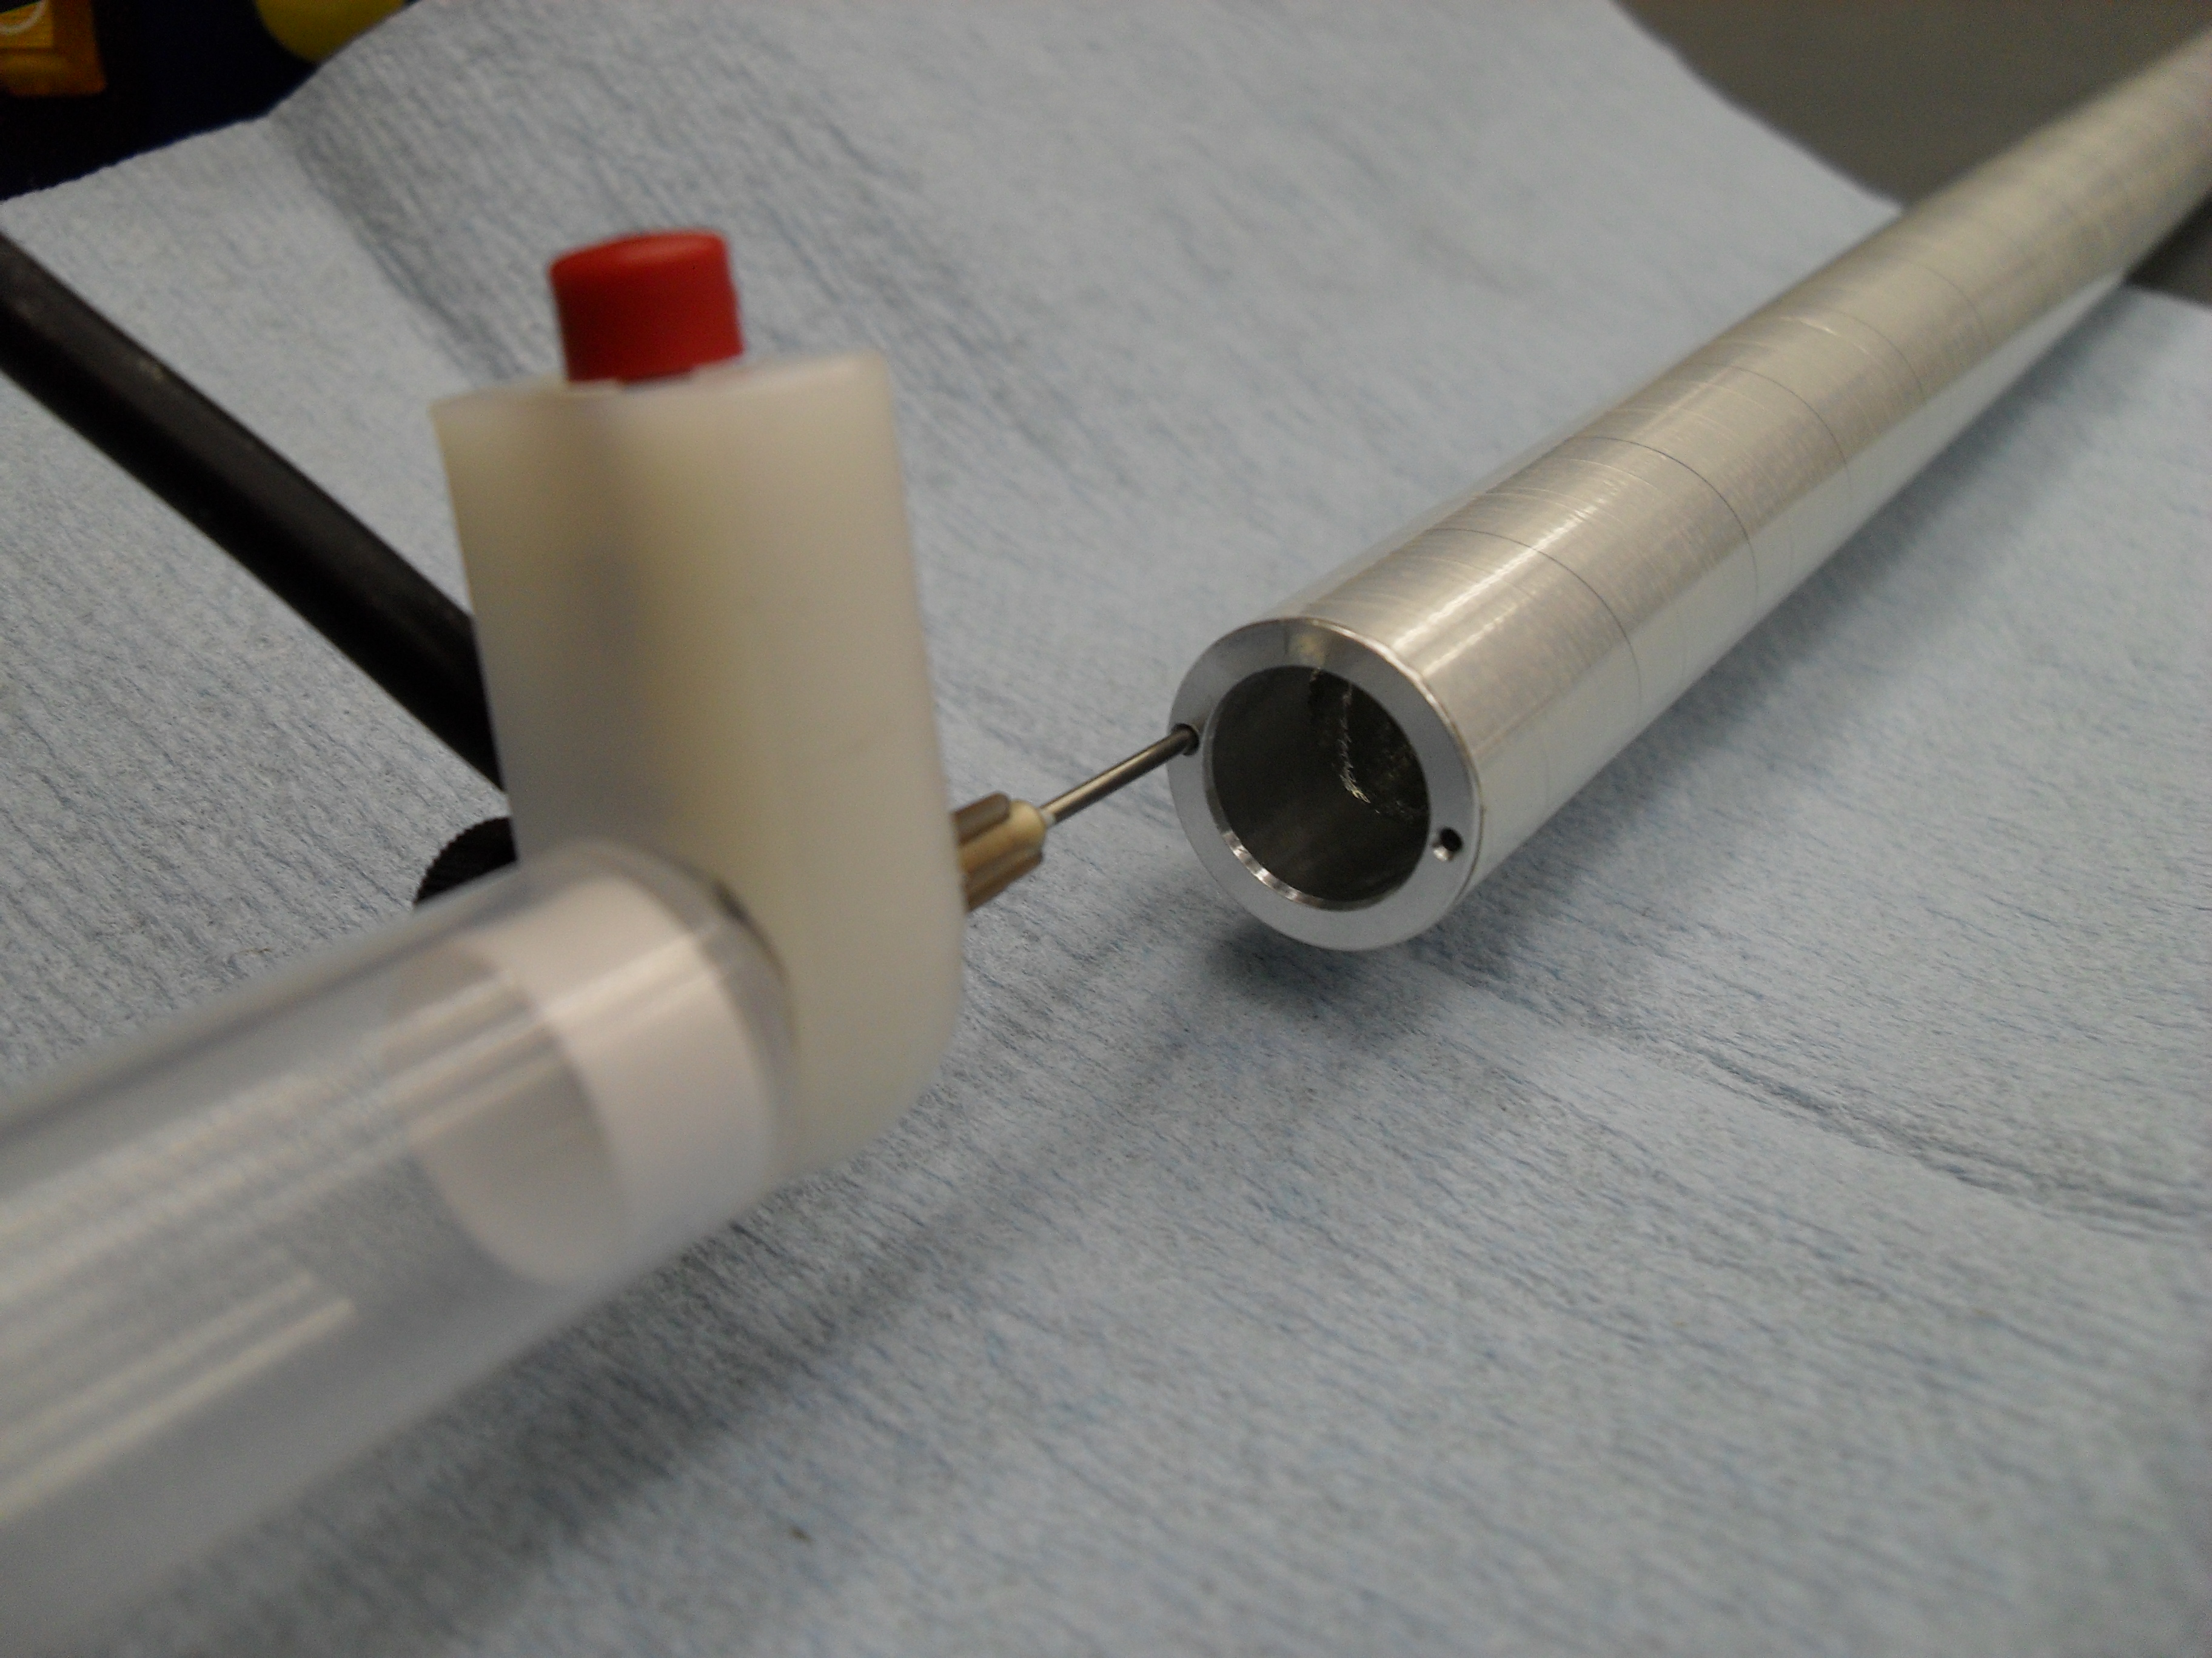
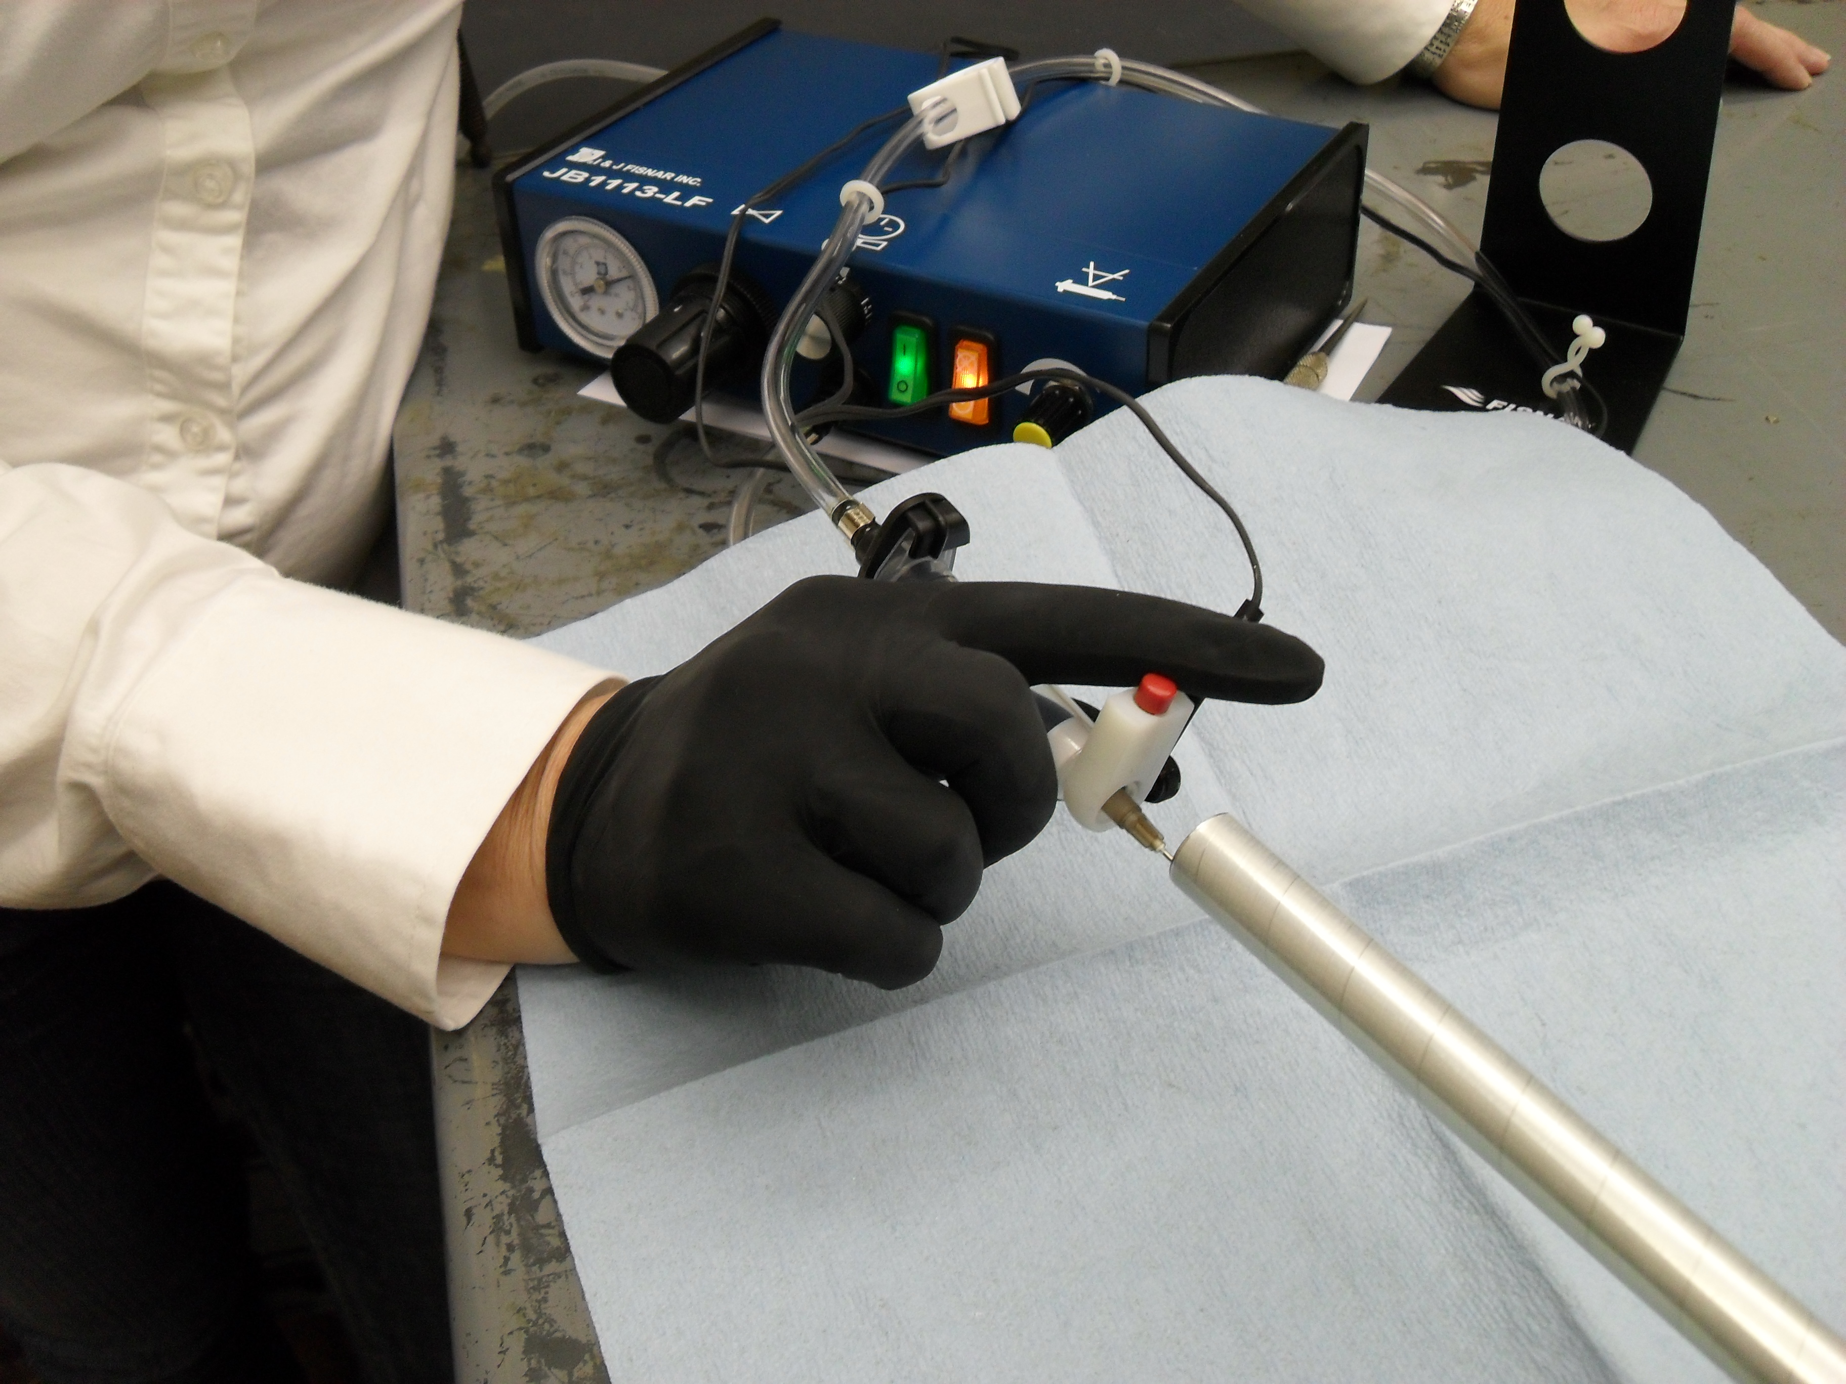
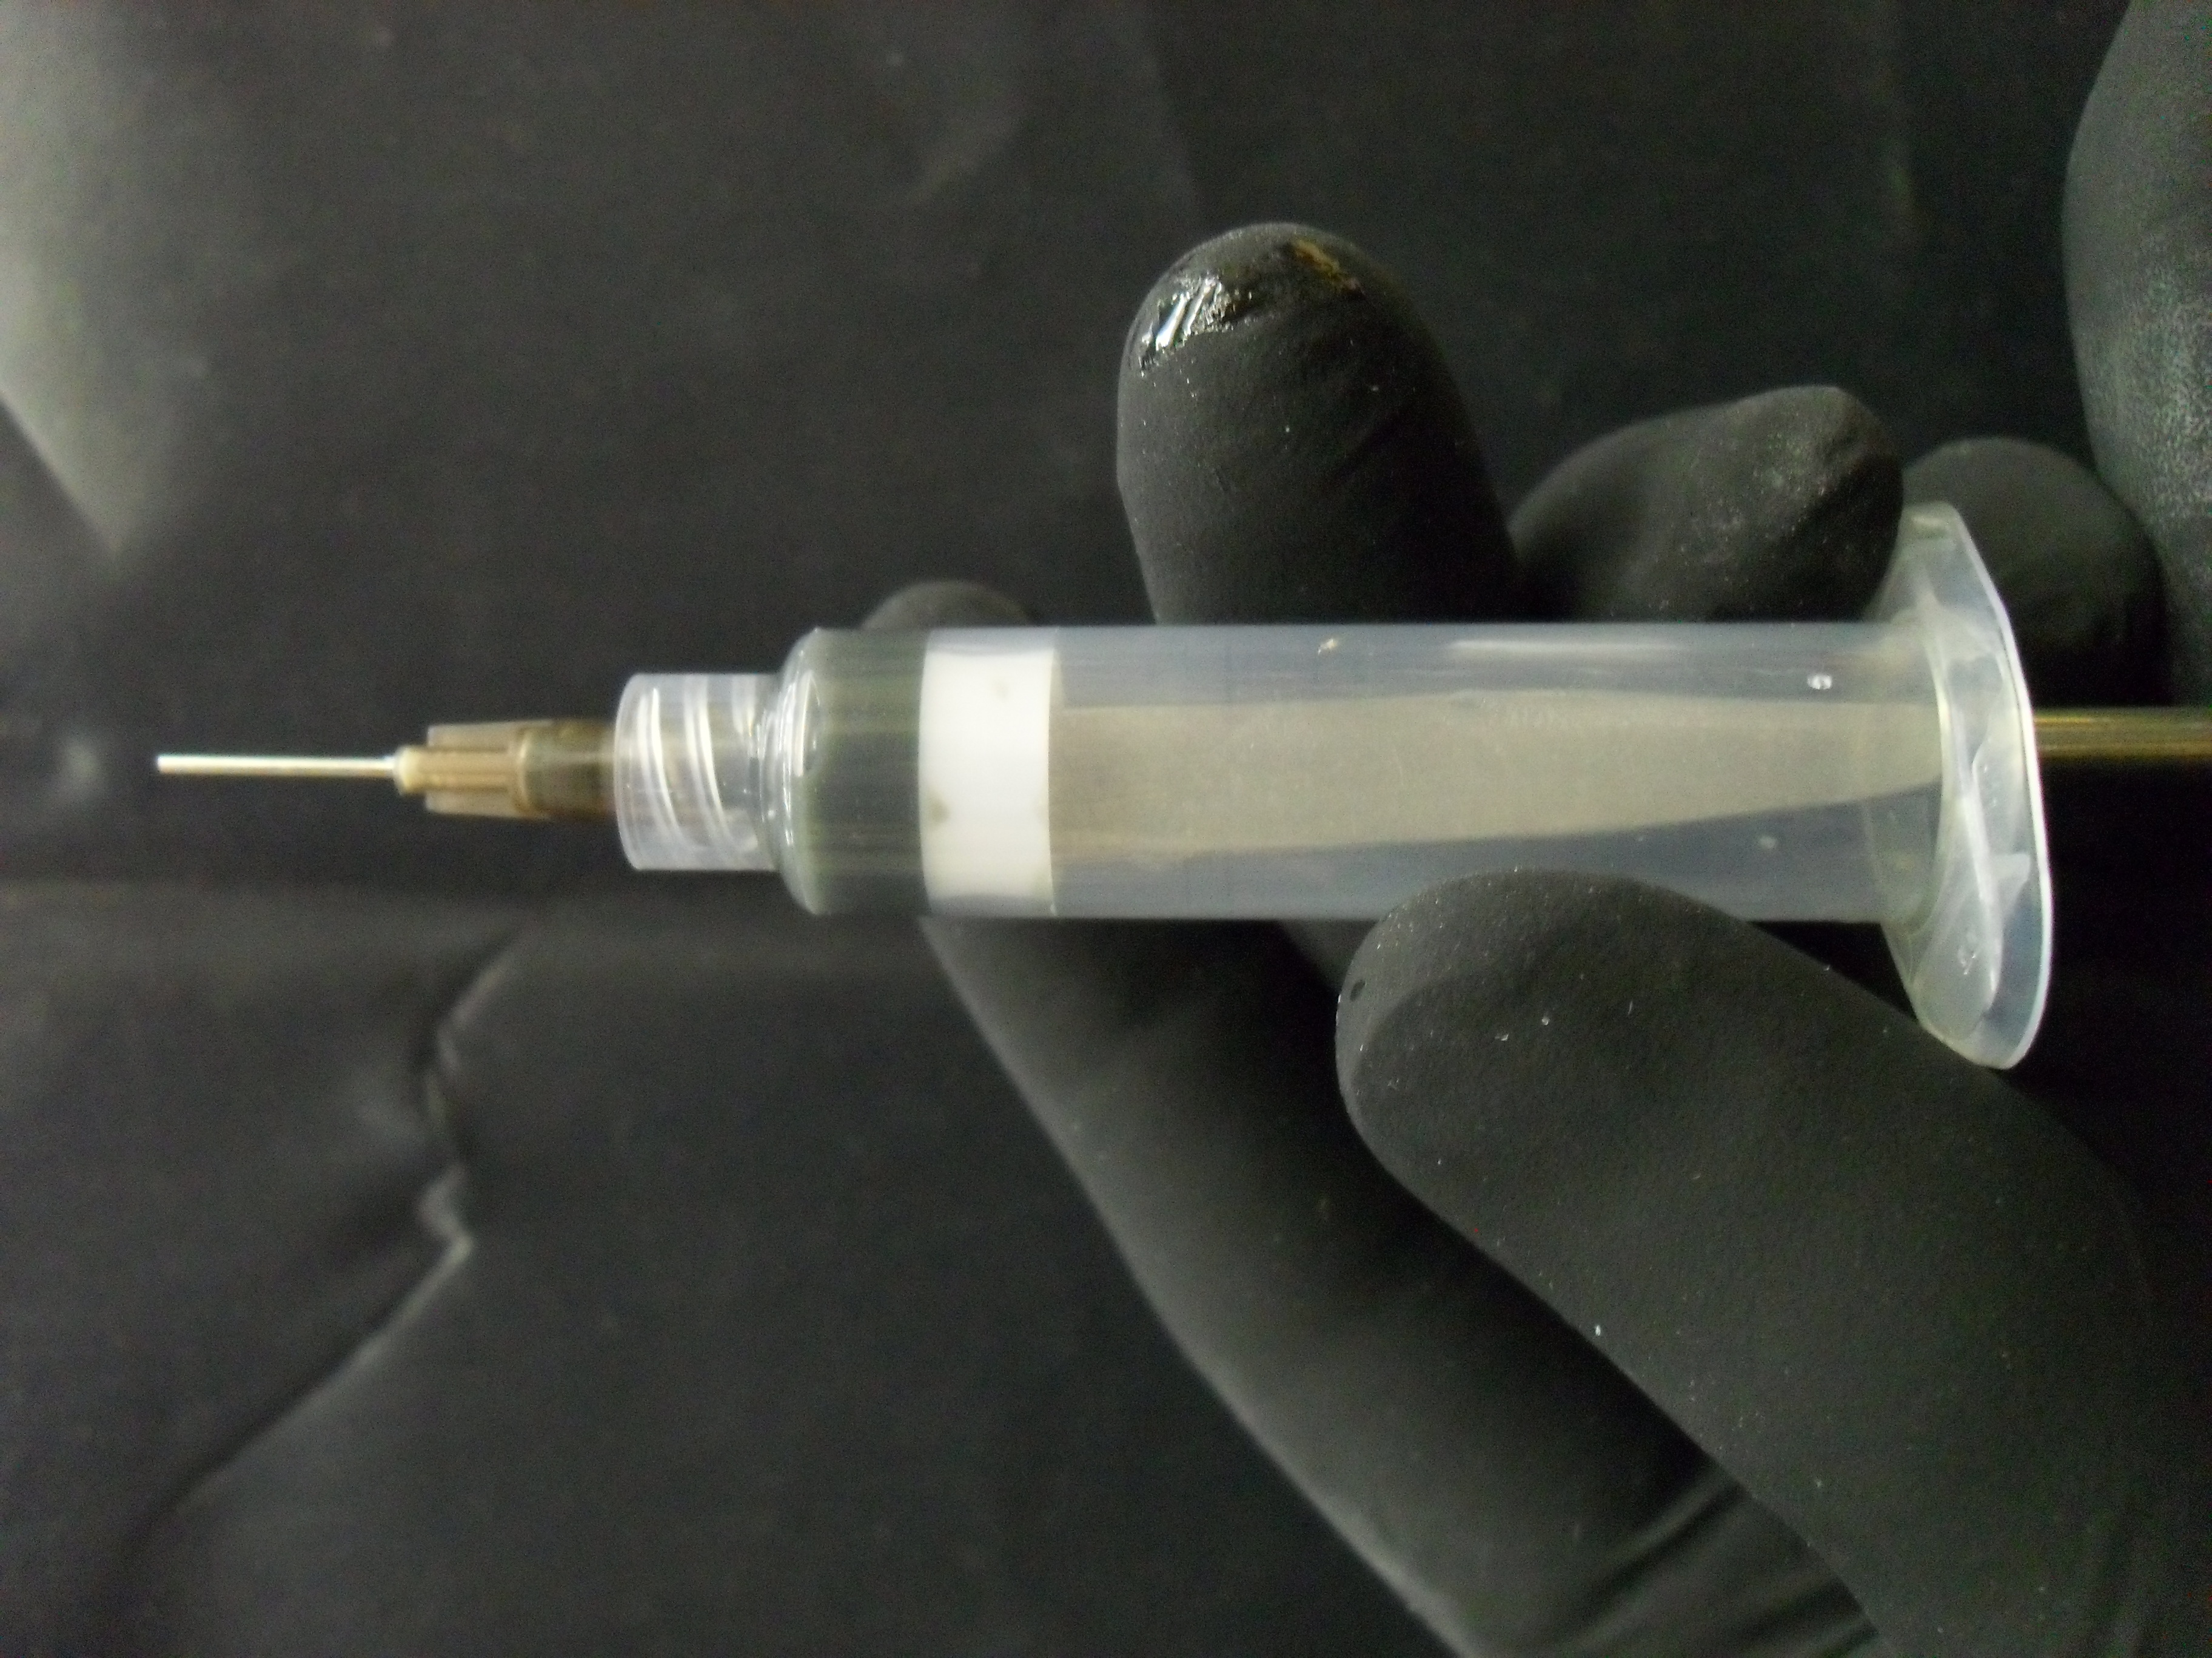
Glue Parts in Straws

Slide 15
Where are we?
Endplates checked, cleaned and touched up.
Inner shell ready to be glued.
Shell assembly set up and waiting for final bolts.
Will be aligned and fixed in place with final bolts.
Chamber will then move to vertical assembly position.
--- Completes Phase One ---
250/ 4200 Straws at CMU & Checked.
1600/4200 Straws shipped.
8000 Al. Parts checked, cleaned and in storage.
9% of conducting epoxy at CMU.
23% of conducting epoxy on order.
Waiting for 16000 Noryl parts to come in.
--- Start Installation of Straw Tubes, Phase Two ---
Two technicians have now been hired. Students will be taken on as needed.

Slide 16
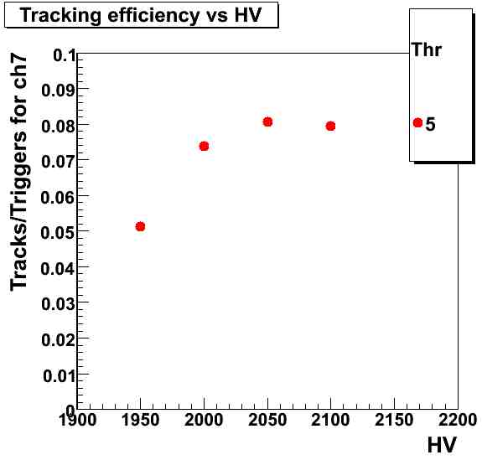
ASIC Preamplifier
Latest version of the ASIC arrived in May. Our initial work was confusing at best. It appeared that the gain had gone up, rather than down.
After a lot of time-consuming work with cosmics, we finally realized that out gas mixing system was not providing the correct mixture. Switching to a premixed cylinder, things made sense.
Detailed studies showed that while the gain had gone down, the actual increase in dynamic range had not been achieved. It was still the same as the older version.
Fernando has modified the HVB to attenuate the signal going into the preamplifier. This change as achieved the desired increase in dynamic range.
50/50 Ar-CO2 premix

Slide 17
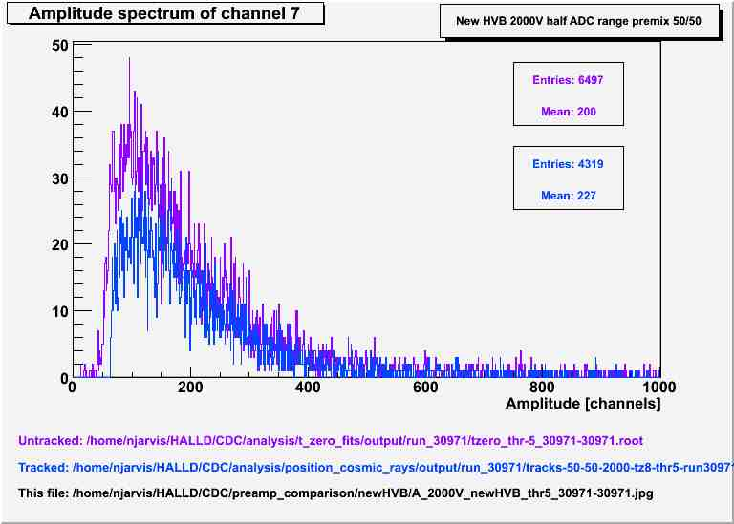
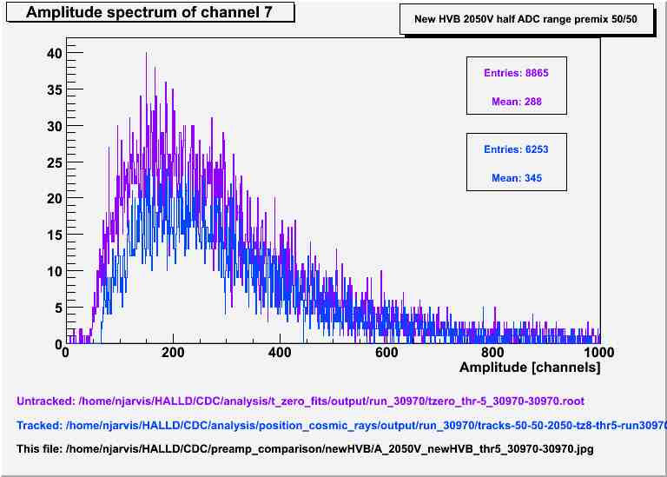
Cosmic Rays
2000V 50/50 Mix
2050V 50/50 Mix

Slide 18
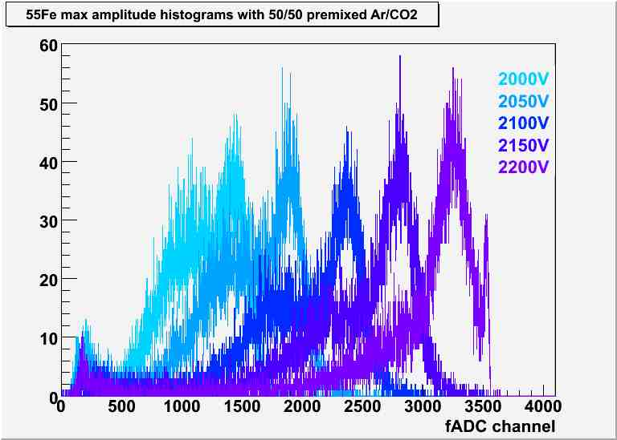
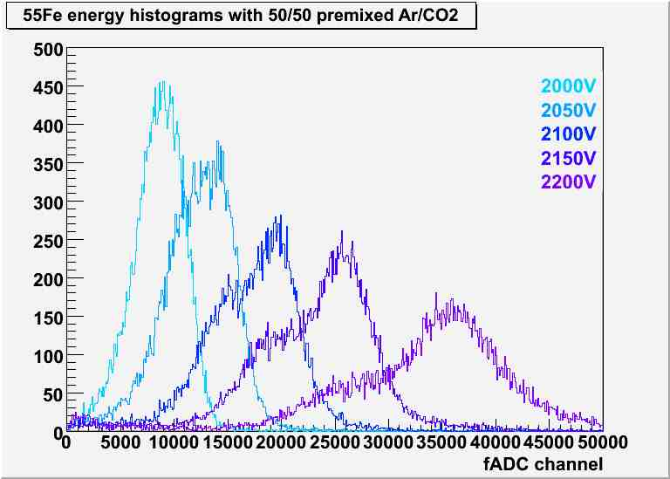
The New Asic with Attenuation
Fe-55 Source runs with several high voltages.
Maximum Amplitude
Energy Sum

Slide 19
Summary
Ready to go into full production of the CDC as soon as the parts arrive and are checked and cleaned.
Readiness review after straw installation has started.
New ASIC with attenuation in HVB satisfies the needs of the CDC.

