Slide 1
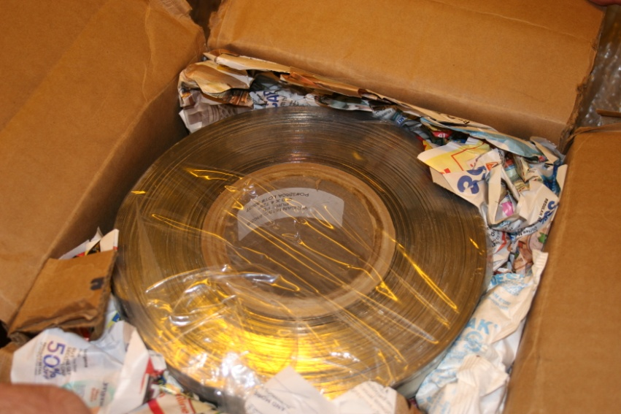
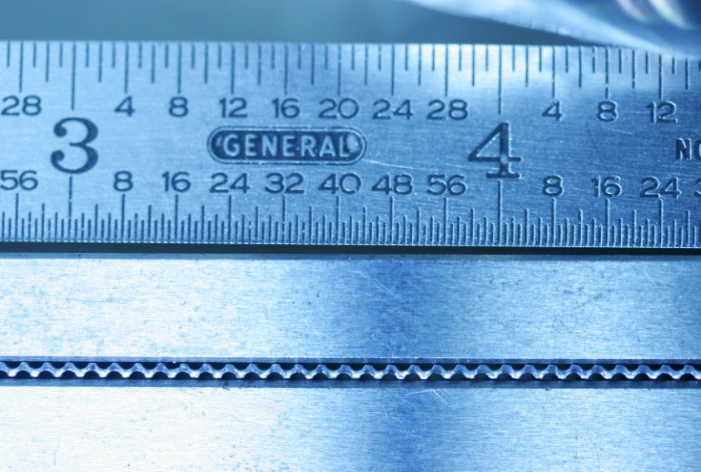
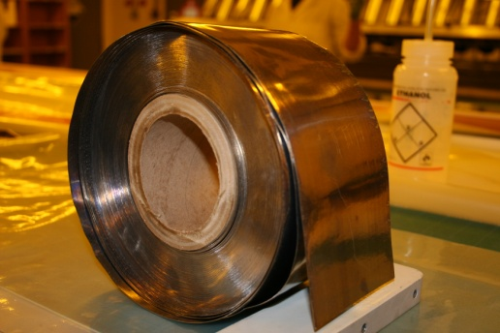
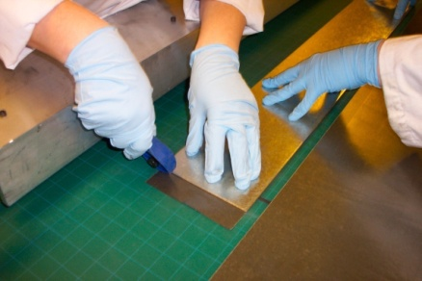
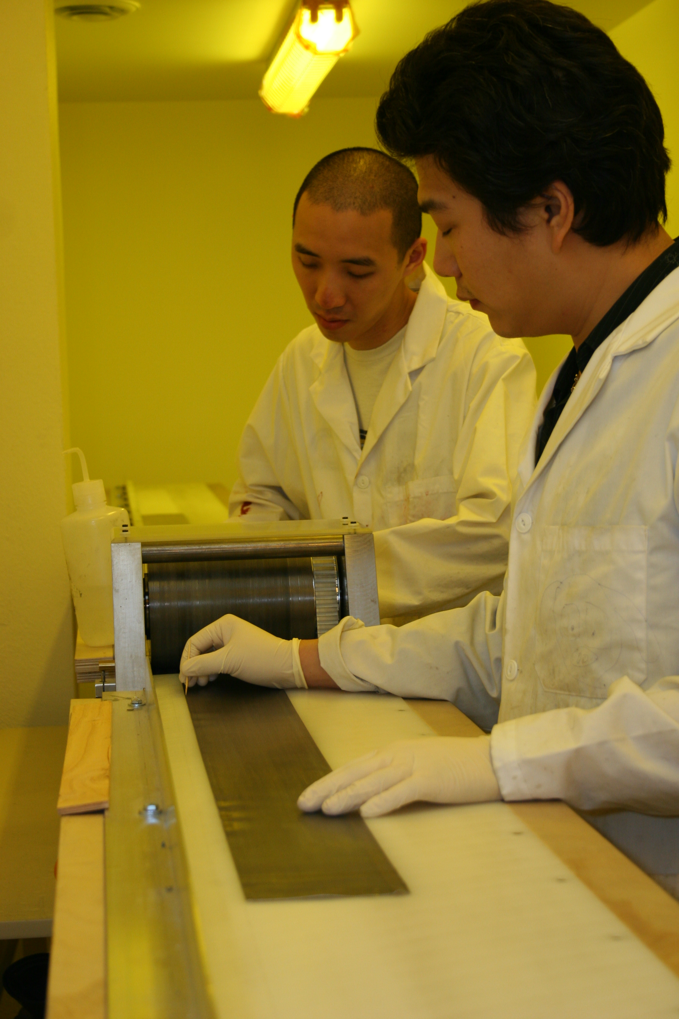
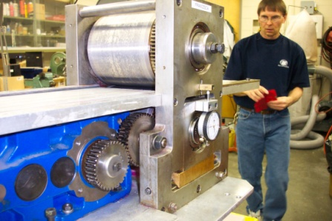
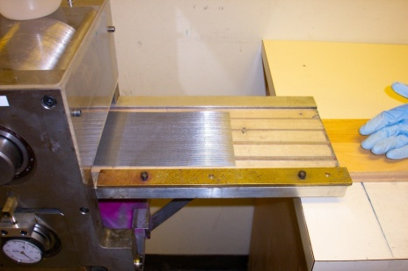
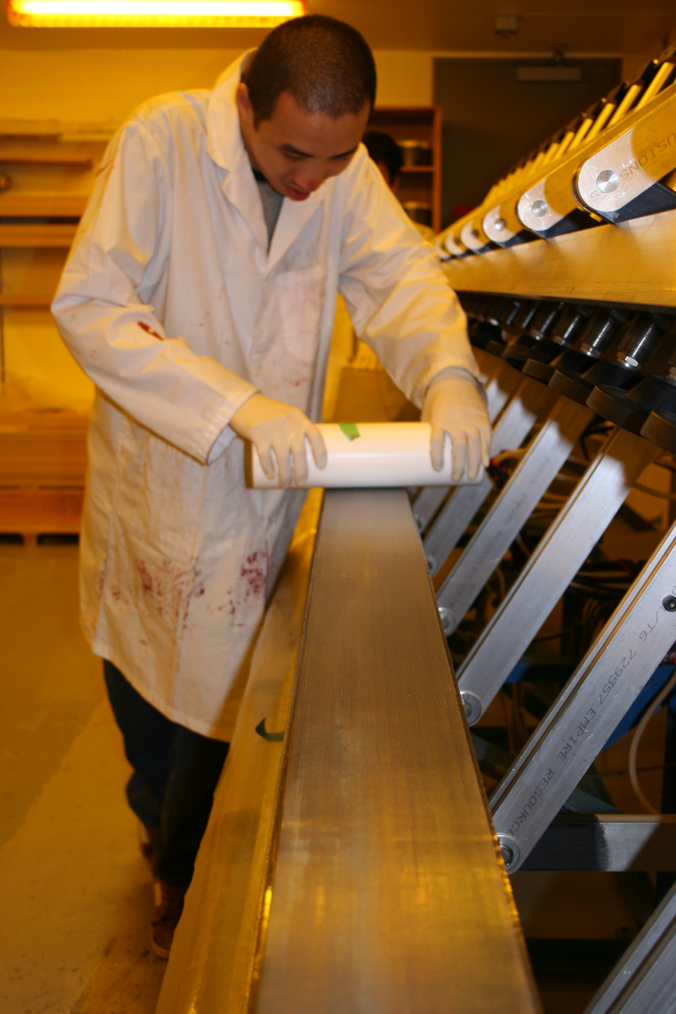
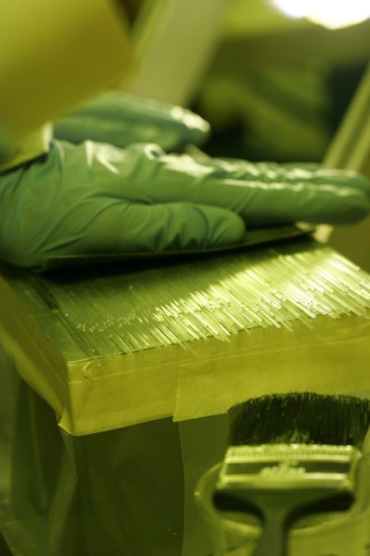
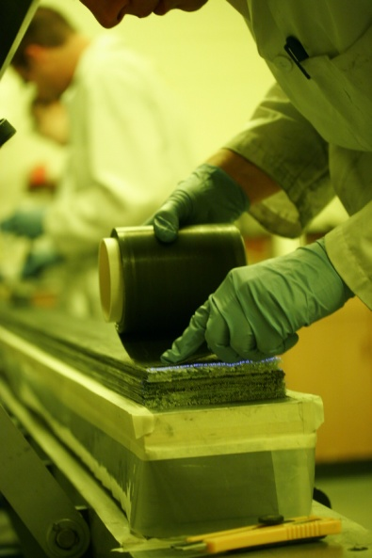
Lead & Swaging
Lead arrives coiled in 4 widths: 10, 11, 12, 13 cm. Each coil contains at least 10 398 cm pieces to be cut and swaged.
Lead pieces are cut to the desired length of 398 cm and labelled according to width.
Each piece is carefully cleaned and kneaded to be flat and straight. Then, each piece is slowly propelled into the swaging machine. The swaging machine pushes grooves into the lead to fit the fibres.
Each piece is labelled according to its orientation as it is rolled onto plastic storage rolls. They are placed in an alternating fashion into the matrix, ensuring that the matrix remains straight and flat. Each groove of the swaged lead corresponds to a fibre so that the matrix remains straight.

