Slide 1
GlueX Collaboration Meeting
12GeV Trigger Electronics
2-4 February 2011
R. Chris Cuevas
Hardware Design Status Updates
The regular list of acronyms
SD; TI-D; SSP; CTP; GTP; TS
Trigger System – Fiber Optics
Preparation for full crate testing
1st Article VXS Crate Testing
Summary

Slide 2
Trigger Hardware Status
Flash ADC 250Msps ( FADC250 )
This is where the trigger ‘data’ begins
** Version 2 design complete – See Fernando’s update **
Many tests have been completed!
Significant layout revision with consolidation of firmware and FPGA
Crate Trigger Processor ( CTP )
** 2 units tested in 2009 ** 2 more sent for assembly Sept-2010
2 new CTPs assembled and received. New modules have different FPGA and support higher Gigabit speed (5Gbps)
Initial CTP used for verification of new WIENER VXS backplane
New boards will be thoroughly tested and used in full crate test plan
Collects trigger data (SUM) from 16 FADC250 modules within one crate
Transports trigger data over fiber to Global Trigger crate
10Gbps capability ( 8Gbps successfully tested )
2

Slide 3
Trigger Hardware Status
Signal Distribution ( SD )
2 prototypes tested in 2009 ** Rev-1 ready to manufacturer Oct-2010 **
Precision low jitter fan-out of ADC clock, trigger and synch signals over VXS backplane to FADC250 modules
Minor revisions to include clock jitter attenuation PLL
2 Rev-1 boards have been assembled and received
A few power supply issues have been resolved, and updates to firmware have been completed to support jitter attenuation PLLs
I^2C communication with latest TI-D has been tested
We have components for at least six more units
Two boards will be used for full crate testing before ordering pre-production quantities. (June 2011)
3

Slide 4
Trigger Hardware Status
Trigger Interface – Trigger Distribution ( TI - TD )
FY10 Goals achieved.
FY11 test goals are ahead of schedule and firmware has been completed.
Design changes have been recorded and peripheral modules for TI-D have been completed. (i.e. Fan-out board for CAEN V1290 TDC)
CODA library has been updated for latest TI-D revision.
After full crate testing, pre-production quantities will be ordered.
Direct link to Trigger Supervisor crate
Distributes precision clock, triggers, and sync to crate SD
Manages crate triggers and ReadOut Controller events
4

Slide 5
Trigger Hardware Status
SubSystem Processor ( SSP )
Prototype received and is undergoing detailed functional testing!!
FY10 goals achieved and FY11 test activities will continue
Will use SSP during full crate testing in the spring
Collects trigger data from up to 8 front end crates. (2048 channels!)
Trigger data received on front panel with fiber transceivers
10Gbps input capability ( 4 lanes @3.125Gbps*(8/10b) )
10Gpbs output stream to GTP
Global Trigger Processor ( GTP ) (FY10-11)
Schematic work is back on schedule (Scott Kaneta )
FY11 goal is to build initial prototype and test with SSP and TI-D
Revisions to initial specification has been updated and finalized
Interface requirements to SSP and TS have been finalized
Large scale FPGA has been selected and Xilinx Aurora protocol has been tested with Altera FPGA
5

Slide 6
Trigger Hardware Status
Trigger Supervisor ( TS ) (FY11-12)
New board format – VXS Payload module
Distributes precision clock, triggers, and sync to crate TI-TD
Manages crate triggers and ReadOut Controller events
Direct cable link to Global Trigger Processor (32 trigger bits)
Specification has been updated to match GTP output
Schematic and board layout activities can begin after full DAQ crate testing is complete and pre-production orders for TI-D and other boards have been completed.
6

Slide 7
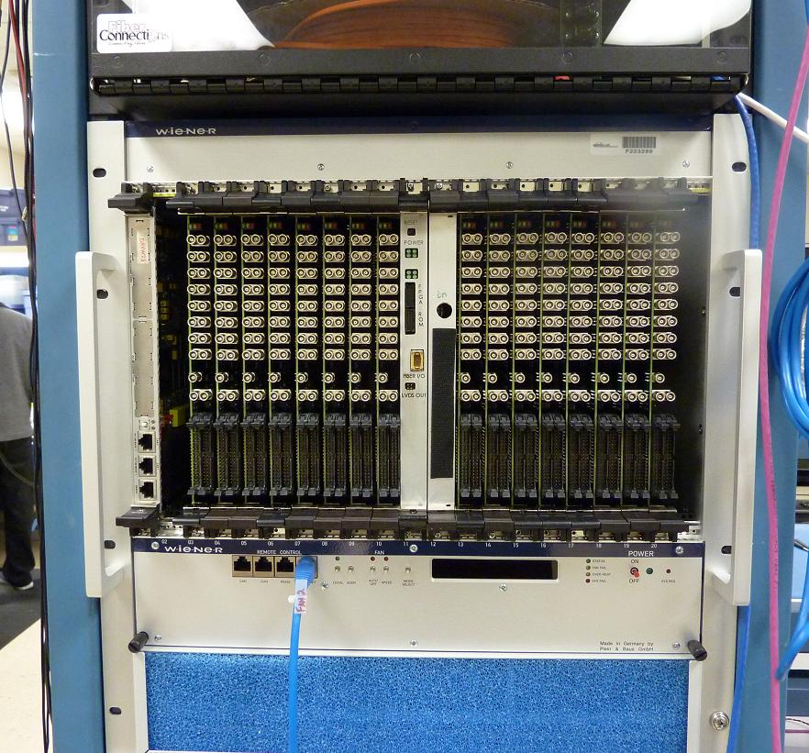
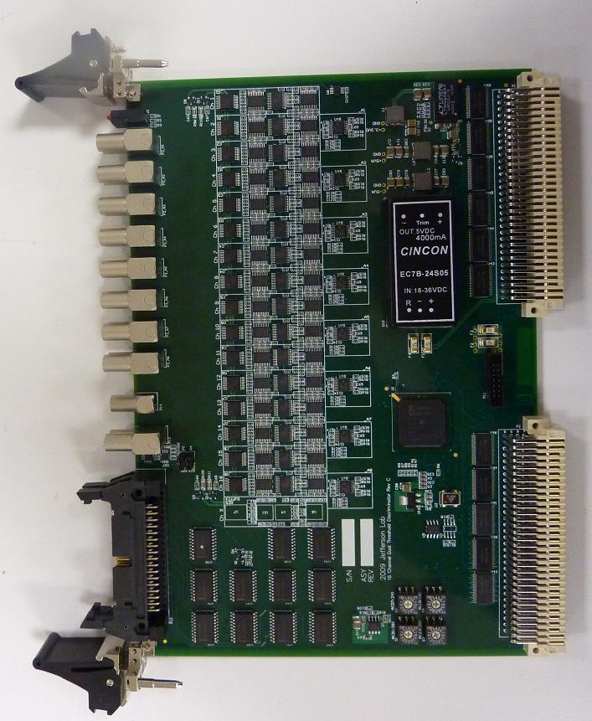
Discriminator Status
(Not truly trigger system hardware, but very nice new development)
Ben Raydo
16 Pre-Production modules have been assembled and received
Significantly cheaper than V895:
-cost < $2,000
Provides several features not found on V895:
32bit scalers on all channels at both thresholds
Calibrated pulse widths: from 8 to 40ns
Trimmed input offset (<2mV error)
Second 34pin output connector is fully programmable.
Able to perform logic based on all channels at both thresholds
Final revision has VME64x J1-J2 connector
Full test stand developed by Pedro Toledo(USM – Chile) will be re-used
Hall Groups will test with detectors
16 modules in crate
Pre-Production version
Note: VME64x connectors
7

Slide 8
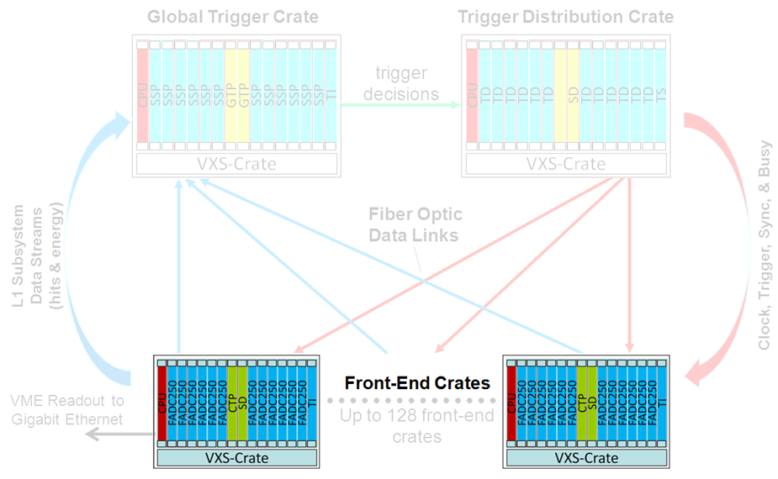
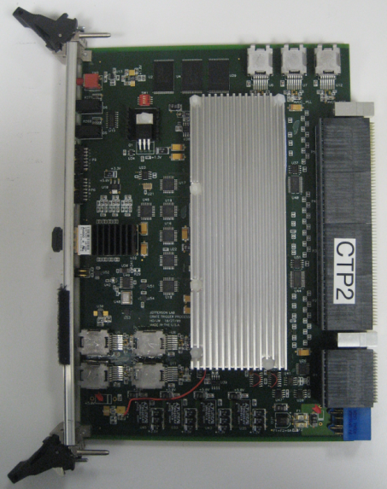
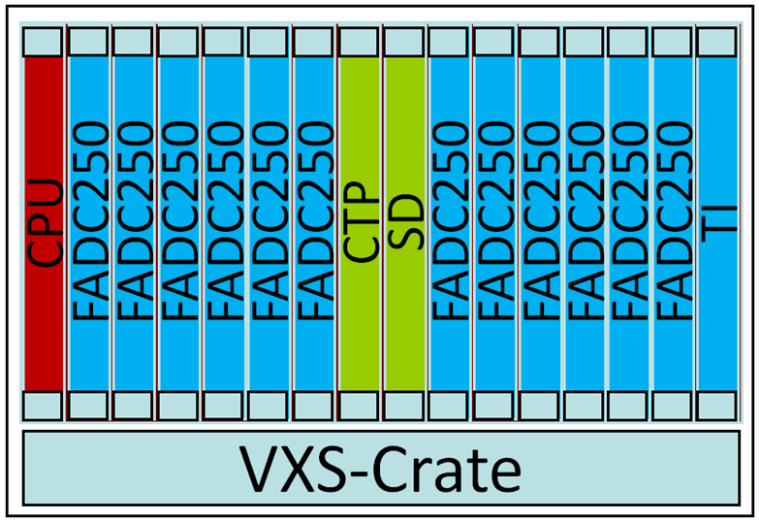
Crate Trigger Processor
4 Fully assembled units are in the lab!!
2 newest units include VirtexV FX70T that supports higher serial speeds. (5Gbps) Matches FX70T on FADC250
Initial CTP unit used to verify new WIENER VXS backplane map
Crate Trigger Processor computes a crate-level energy sum (or hit pattern)
Computed crate-level value sent via 10Gbps fiber optics to Global Trigger Crate (32bits every 4ns)
CTP Prototype:
Board Energy/Hits
Up to 10Gbps to CTP
Fiber Optics Transceiver
VXS Connectors
Collect serial data from 16 FADC-250
Crate Sum/Hits
10Gbps Fiber to SSP in global trigger crate
8

Slide 9
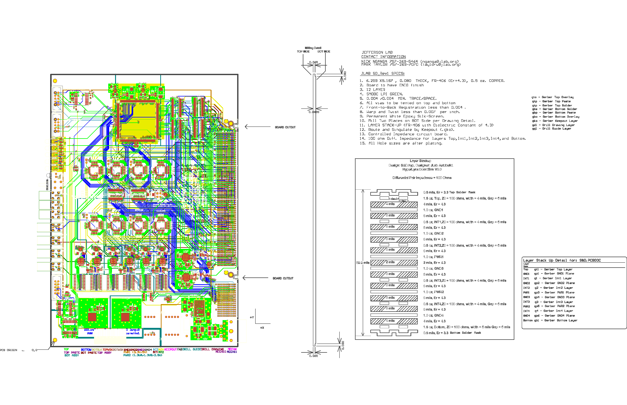
Crate Level – Signal Distribution (SD) -Rev 1
N. Nganga
10-Oct-2010
Two boards fully assembled and almost completely tested
VITA 41
Switch
Slot
Connectors
9
14

Slide 10
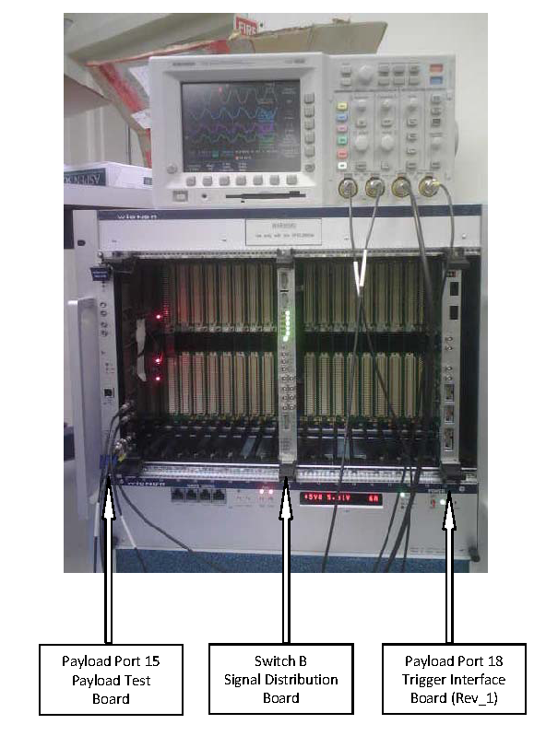
Crate Level – Signal Distribution (SD) -Rev 1
N. Nganga
M. Taylor
C. Cuevas
New power regulation scheme tested
New (final) front panel complete
Token In/Out tested
Latest I^2C firmware has been tested with TI-D.
Supports the control of the on board PLLs from
the FPGA via SPI. Users can select Jitter Attenuation mode (PLL) or non-PLL mode.
All common signals from TI ( i.e. Busy, Sync, Trig1, Trig2 have been tested.
Final results from PLL jitter attenuation tests will be completed before 15-Feb-2011
10

Slide 11
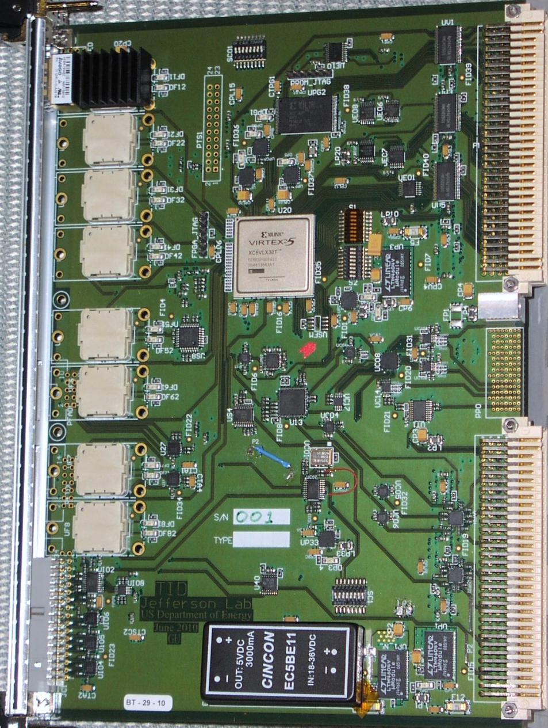
Trigger Interface - Distribution
W. Gu
DAQ Group
TID Components
VME→PROM
(FPGA firmware)
Emergency/remote
re-programming
‘Legacy’
Trigger
Supervisor
Interface
Xilinx
VirtexV
LX30T-FG665
VME 64x
Eight
Optical Transceivers
HFBR-7924
VXS P0
TD mode: from SD
TI/TS mode: to SD
One dedicated link for redundant data collection
External I/O
(trg, clk…)
Trg/Clk/Syc
outputs
On row_C
11

Slide 12
Trigger Interface - Distribution
W. Gu
DAQ Group
2/2/2011
What is tested:
The power distribution for the board is tested and working.
All the discrete components (drivers, buffers, receivers etc)
are tested, and working
The on-board clock distribution network is working.
The on-board trigger distribution network is working.
Serialized trigger data re-sampling (ADN2805).
FPGA firmware:
VME to I2C engine;
VME data readout;
VME remote firmware loading;
Customized the firmware for TI, TD, mini-TS mode
Initial Jitter analysis results for 250MHz clock are low ~2ps
12

Slide 13
TI-TD Testing
W. Gu
DAQ Group
The scope used: Tek7254, probe: TDS3500 differential probe
Scope setting: 40GS/sec ➔ 25 Ps/Pt, 2.5 GHz limited
Measuring software: TDSJIT3 ADVANCED, 400K samples (auto set)
or DPOJET ESSENTIAL, 50M samples.
Measured on TID#2, TID#1 may be used as clock source
TID#1
HFBR #1
TID#2
Mux
Clock Osc
P0
ClkC
ClkA
Clock Osc
Mux
HFBR
Buffer
HFBR #5
Buffer
Measurement diagram
DPO7254, TDSJIT3, DPOJET
13

Slide 14
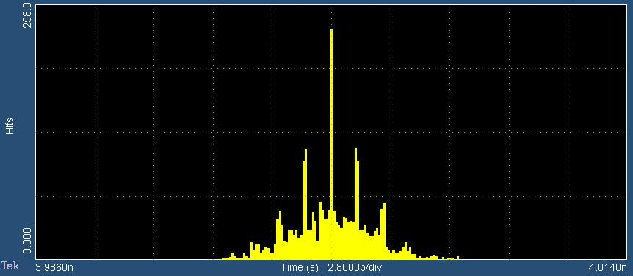
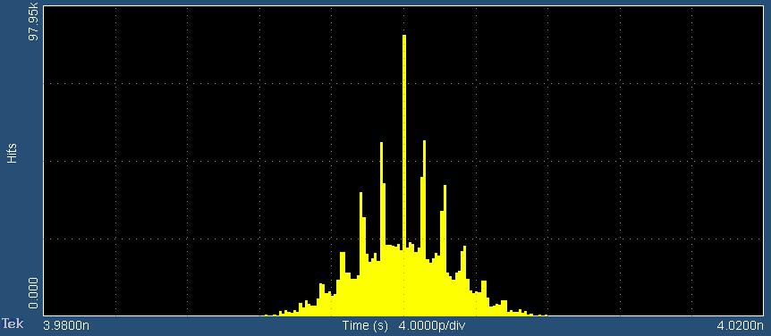
TI-TD Testing
W. Gu
DAQ Group
Assuming that the oscillator has negligible jitters, the TID to P0 distribution has a jitter of less than 2ps, and the two HFBR_7924/34 distribution has a jitter of less than 2ps too ( sqrt(2.65*2.65-1.88*1.88)=1.87ps ).
TID#2 on-board oscillator as clock source, the ClkC jitter measured: 1.88ps
TID#2, HFBR#5 as clock source, the ClkC jitter measured: 2.65ps
14

Slide 15
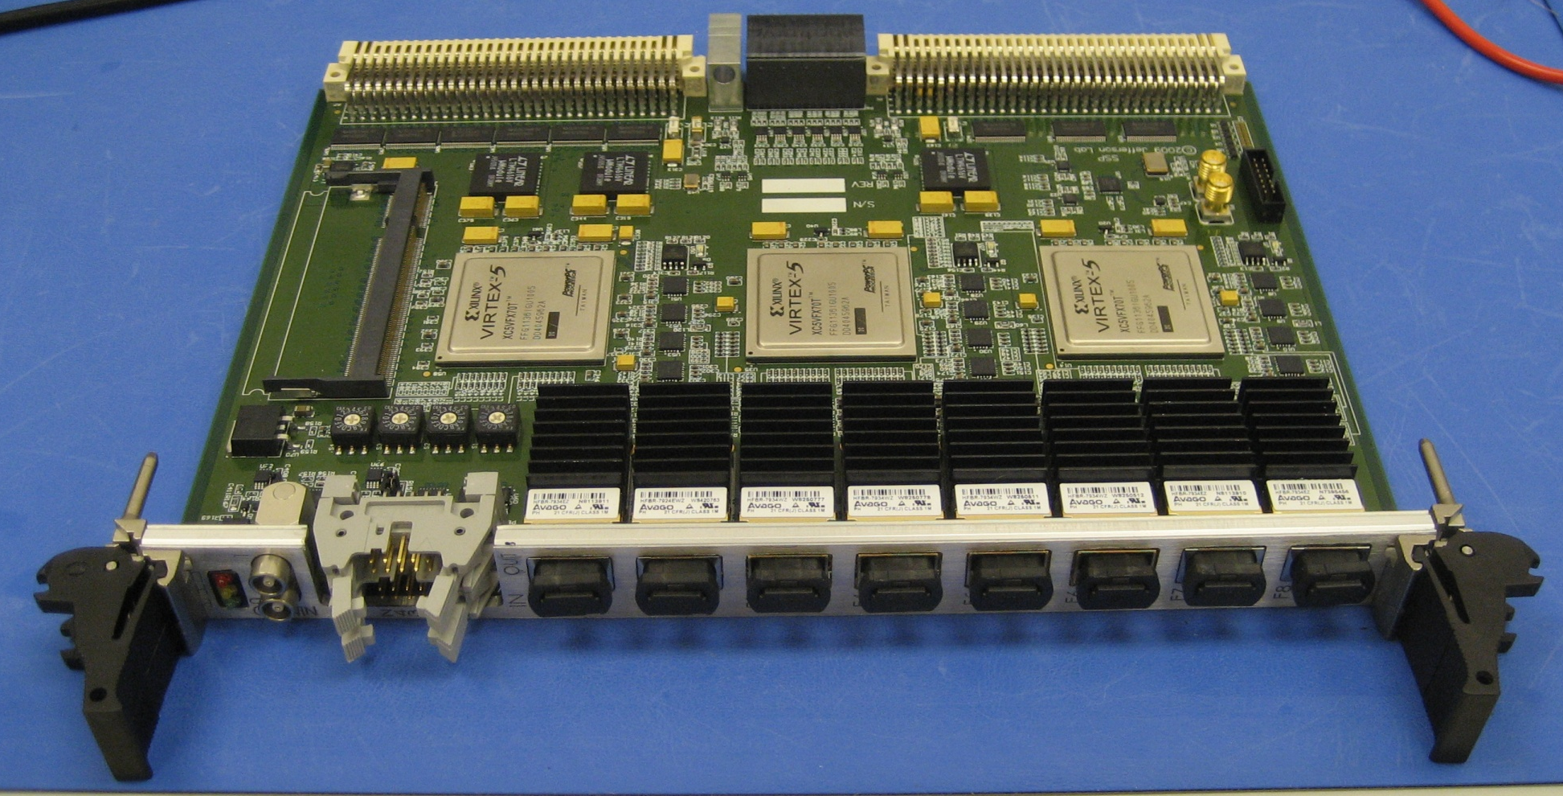
SSP Prototype
Ben Raydo
9-Sept-2010
Optional DDR2 Memory Module (up to 4GByte)
VME64x
(2eSST support)
VXS-P0
(up to 16Gbps to each GTP)
2x NIM
(bidirectional)
4x ECL/PECL/LVDS In 4x LVDS Out
8x Fiber Ports ( 10Gbps each to CTP )
15

Slide 16
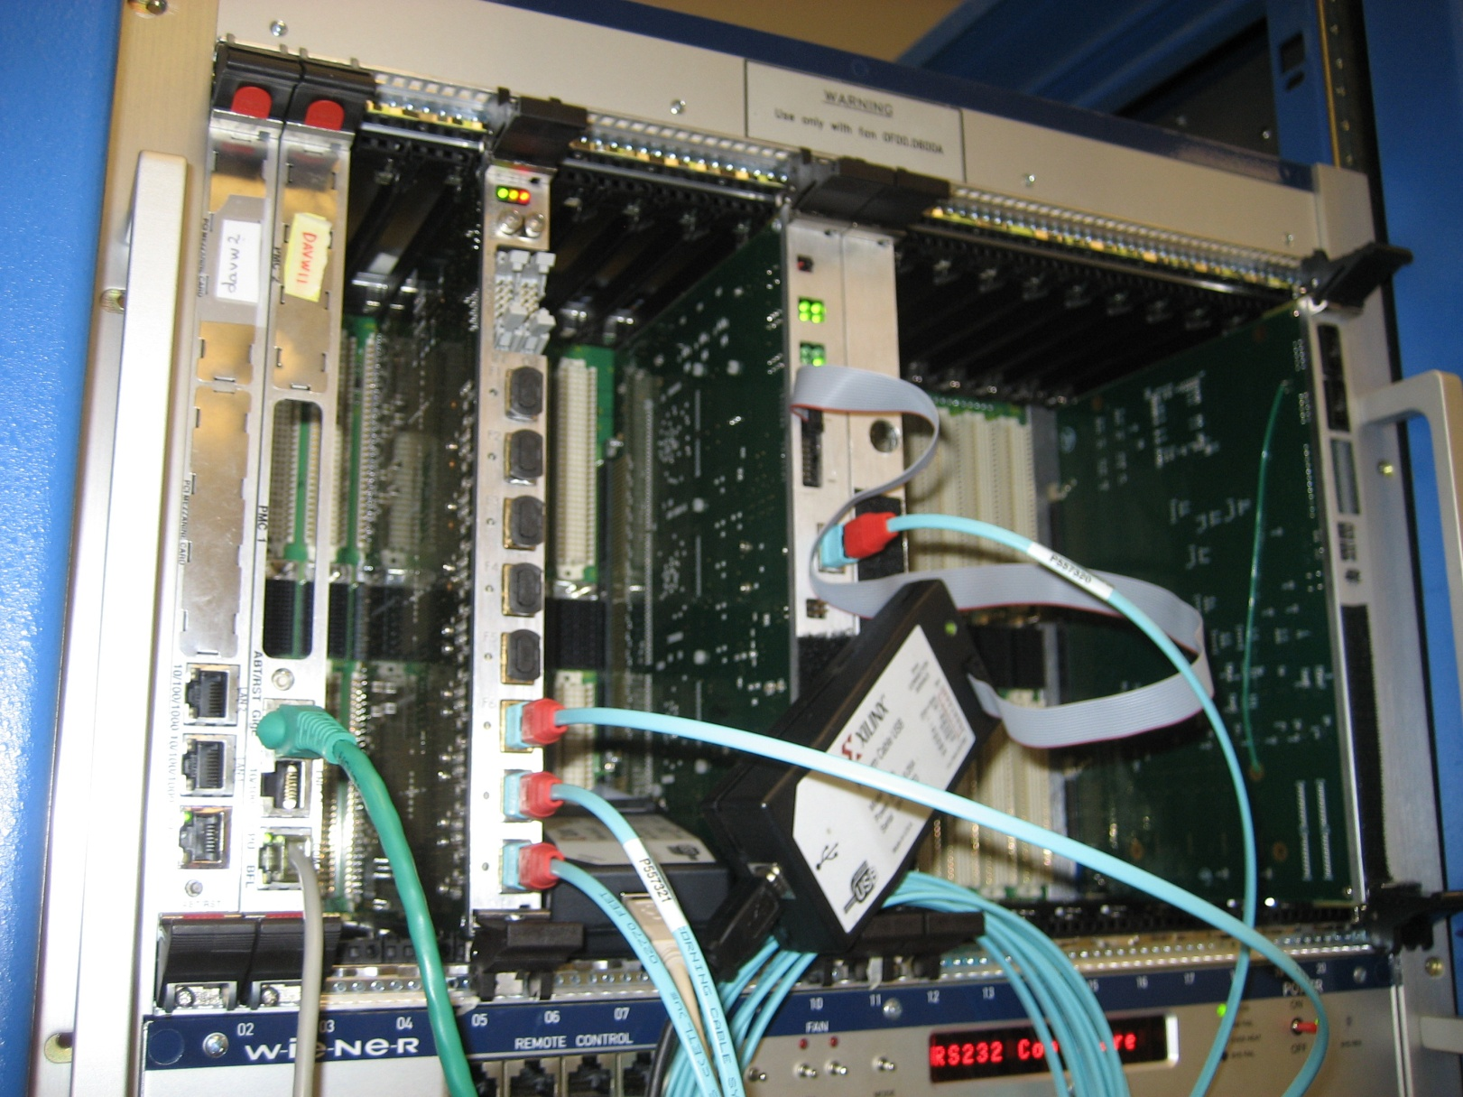
SSP Working with CTP
Ben Raydo
9-Sept-2010
SSP
CTP
10Gbps ‘Ribbon’ Fiber
4Tx 4Rx
16

Slide 17
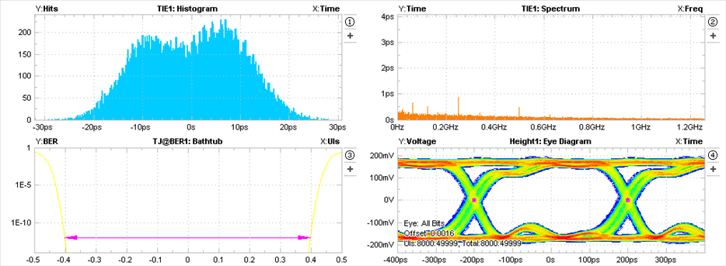
SSP 2.5Gbps Fiber Eye (1 of 32 shown)
Ben Raydo
9-Sept-2010
FPGA → F/O Transceiver
Fiber optics
Tektronix DSA70000
COAX
SSP
“Optic Probe”
8GHz Scope
Eye analysis
0 Crossing Jitter
Time-Interval-Error
Single Ended Capture (amplitude is really double what’s seen).
Reflections mainly due to test fixture.
Very wide receiver eye (0.8UI) at 1E-12 BER.
UI = Unit Interval = 1/Bit Rate
400ps Bit Width
Gigabit transceivers & optics are performing much better than device specifications – further testing will reveal accurate bit-error rate estimates.
17

Slide 18
SSP Summary
Ben Raydo
1-Feb-2011
BGA assembly issues have been resolved.
SSP will be used for two DAQ crate testing in spring.
Link quality tests remain between fibers and FPGAs, as well as FPGA and FPGA, but is looking very good so far.
DDR2 Memory testing needs to be completed
Testing with GTP will have to wait for GTP prototype. (June ‘11)
SSP Project ahead of schedule!
18

Slide 19
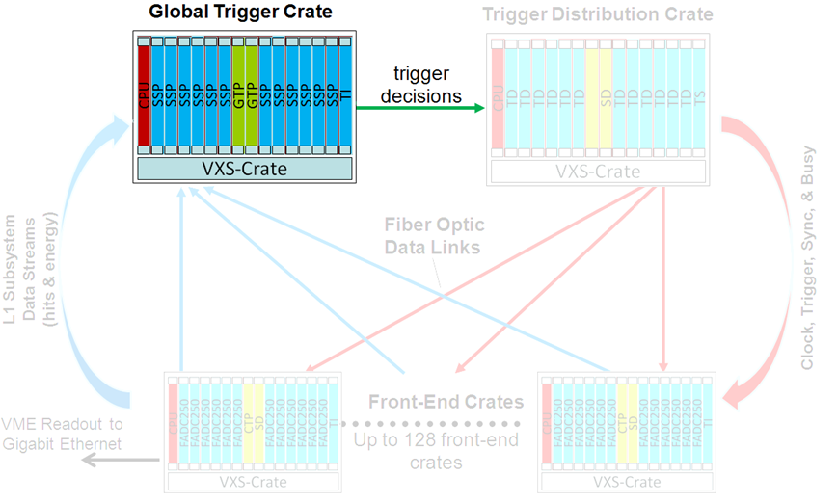
Global Trigger Processor: (GTP)
Global Trigger Processor (GTP) receives all subsystem Level 1 data streams from SSP
Trigger decisions made in GTP and distributed to all crates via the Trigger Distribution (TD) modules in the Trigger Supervisor Crate
Schematics and component selection activities are progressing well
Preliminary component placement and layout strategies have been completed
Xilinx’s ‘Aurora’ Gigabit protocol has been ported to Altera device successfully
Trigger Decisions
to Trigger Distribution Crate
{Trigger Supervisor}
19

Slide 20
Scott Kaneta
Jan-2011
Global Trigger - Block Diagram:
CTP
1
Global Trigger Crate
4
SSP 1
Payload 1
.
.
.
Trigger Distribution Crate
CTP
8
4
/
TS
4 x 8 LVPECL
‘Densishield’
GTP
Switch A
.
.
.
Fiber
32
CTP 121
4
/
SSP 16
Payload 16
.
.
.
CTP 128
4
/
SD
Switch B
TI
Payload 18
20

Slide 21
Scott Kaneta
Jan-2011
Global Trigger Processor: (GTP)
Front Panel
VXS Backplane
Ethernet
DDR2
LVDS
Ethernet
36 Transceivers at 8.5 Gbps
RGMII
2
/
RJ45
PHY
Altera Stratix IV GX
180
Nios II
Processor(s)
SSP Data 0
Link Up 0
Code Flash
.
.
.
2
/
Multi-Image Configuration Flash
Configuration Controller CPLD
SSP Data 15
Link Up 15
JTAG
Clock, Sync
Trig1, Trig2
4
/
Fiber Transceiver
/
4
Legend
Trigger Out
High Speed
4x Densishield
General Purpose
/
32
Configuration
21

Slide 22
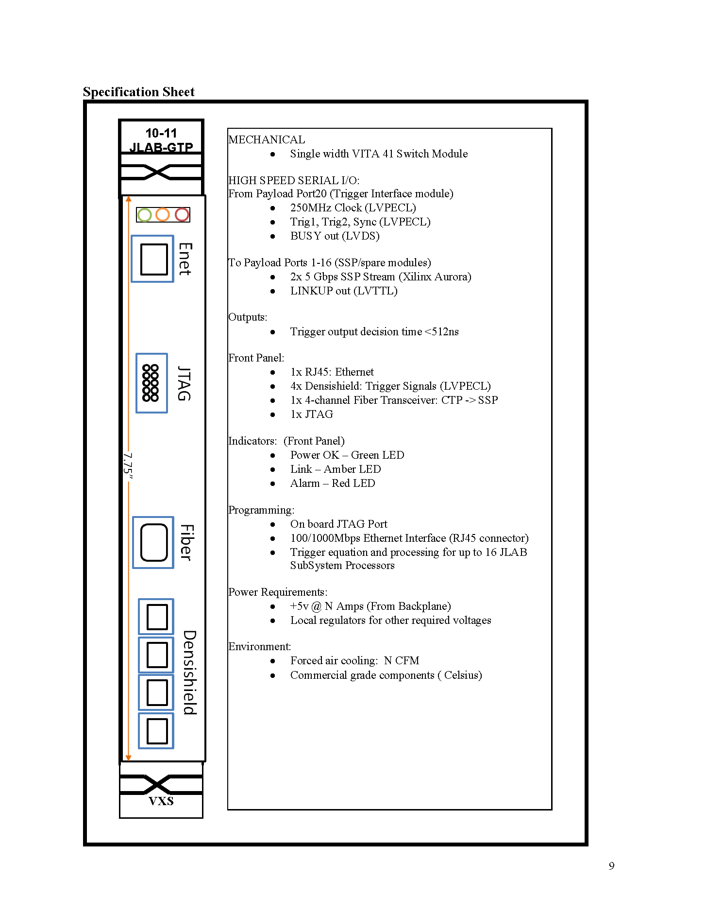
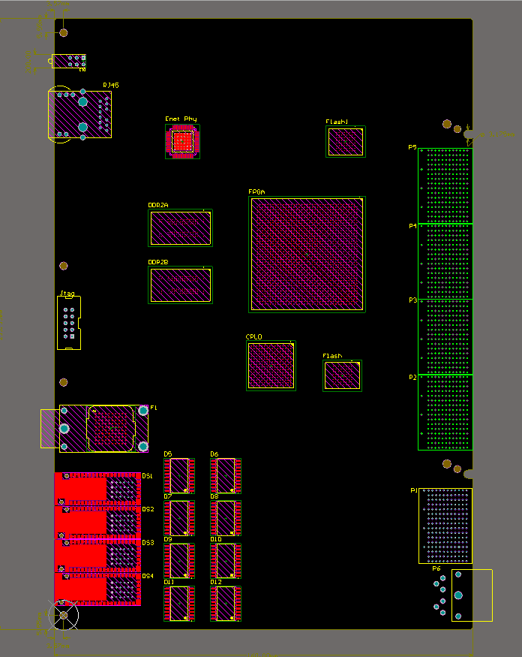
Scott Kaneta
Jan-2011
Global Trigger Processor: (GTP)
Ethernet
VXS
Switch
Slot
Altera FPGA
JTAG
MTP Fiber TxRx
/
32
+5VDC
LVPECL 4 x 8 pair to TS (P2)
22

Slide 23
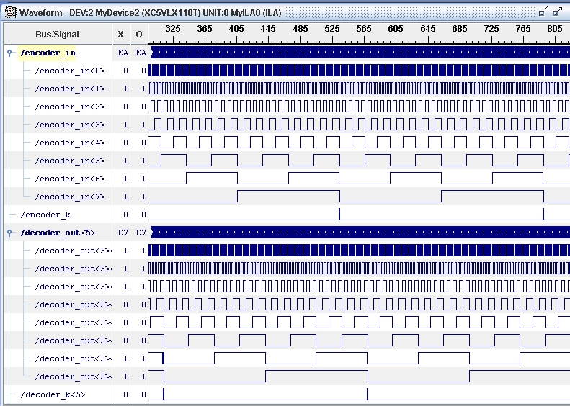
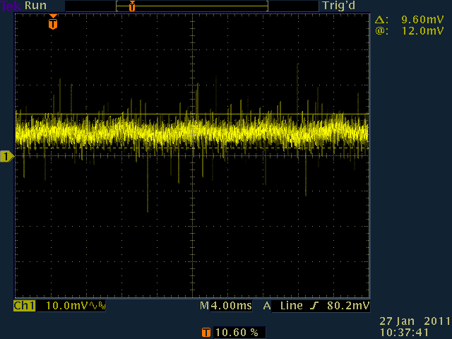
Other Trigger System Essentials
23
VXS and VME64x powered card enclosures
Crate specification complete
Multi-year contract awarded to W-IE-NE-R, Plein & Baus, Ltd.
First article crates (VXS) received 24-Jan-2011
Acceptance tests nearly complete
(6) –> VME64x & (8) –> VXS crates will be delivered before May-2011
Will need storage location!!
Hartman VXS 21 Slot Backplane
CTP @2.5Gbps to each payload port
Correctly mapped
+5VDC; Ripple Measurement
<10mVp-p; 50A load

Slide 24
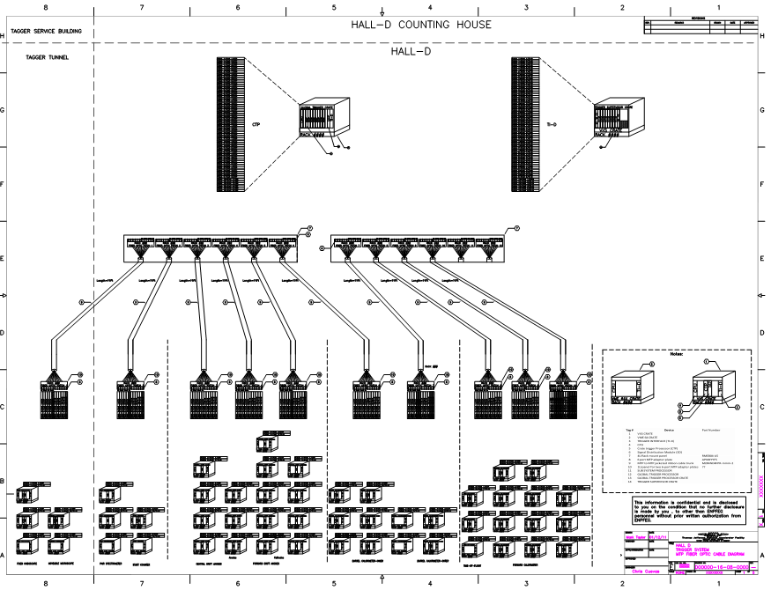
Other Trigger System Essentials Trigger System Fiber Optics FY11 Work Plan
System diagrams have been updated for Hall D installation
24
Preparing for procurement now! (Material and installation labor)
Final component specifications are complete
i.e.(Fiber patch panels, Fiber (trunk) cables, MTP patch cables, etc)
23

Slide 25
Two DAQ Crate Testing: FY11
Front End Crate:
2.5Gbps/
VXS lane
Several modules have been revised and will need to be thoroughly tested. (FADC250, SD, TI-D)
The initial SSP will be used to sum the trigger data from 2 CTP
Multiple crate ‘system level’ testing is imperative before approving large quantity orders.
Will verify Gigabit serial lanes from each slot
1st Time for 16 boards!!!
Will measure trigger latency
Will measure trigger rates/VME data rate
Will measure BitErrorRates
Will test using “Playback” mode
(No input cables necessary)
Perfect opportunity to fully test latest revision
of CODA board ‘libraries’
Plan to use latest CPU as proposed by DAQ group
25

Slide 26
Summary
FY10 board design project goals have been achieved
FY11 plan includes aggressive test plans for all modules
GTP prototype and completion of FINAL revisions for trigger modules in FY11
High level of detailed design work is exemplary and board tests meet specification
Work activity schedule shows estimate to completion plan is reasonable
Production quantities for all halls have been considered
2 full DAQ crates with all trigger module units will be tested in spring
Time to think about 4th annual 12GeV Trigger Workshop
Will have plenty of results from full crate testing
Plenty of other work remains for pre-commissioning ‘tools’ and test plans
Weekly 12GeV Trigger meeting continues to produce good discussions and ideas
for implementation of system level test programs and details of hardware designs.
26

Slide 27
Backup Slides
All sorts of good stuff

Slide 28
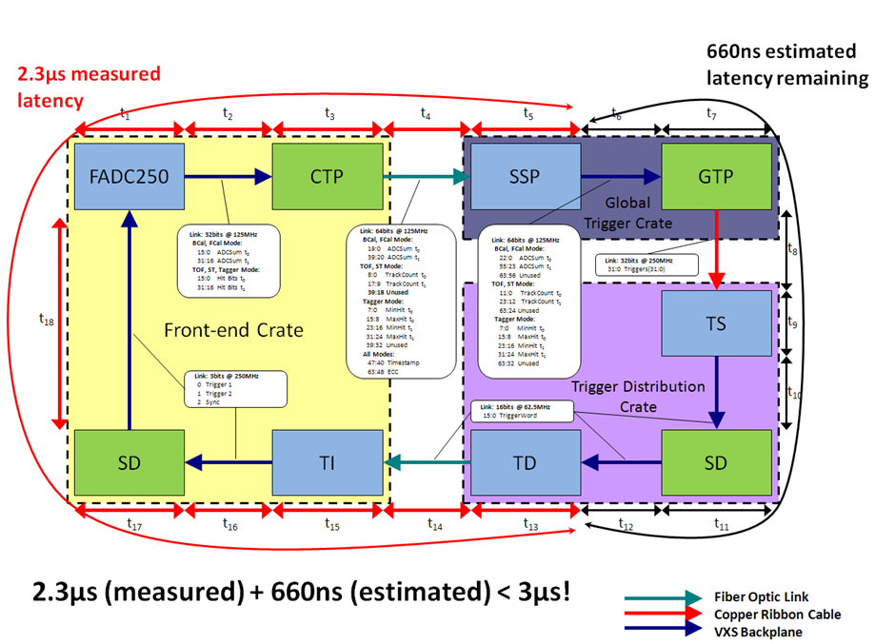
GlueX Level 1 Timing
21

Slide 29
Schedules, work plans for FY11 - FY13
FY10 design projects are at full resource pace!
FADC250 → Latest revision at end of FY10. TEST in FY11.
F1TDC-V2→ Work plan moved to FY11
SD → Latest revisions virtually complete. Order, assemble, TEST in FY11
SSP → Prototype received. Initial testing is proceeding nicely.
Further testing in FY11.
TI-TD → Prototype(s) received. Initial testing is proceeding nicely.
Firmware development and multi-crate testing in FY11
16 Channel LE Discriminator/Scaler (Hall B requirement)
7 ‘production’ units under test now
VXS Crate Specification → Order should be awarded before Oct-10
GTP → Scott Kaneta joins the group! GTP slips to FY11
TS → Specified, and planned for FY11-FY12
Baseline Improvement Activities (BIA) review on 17-September
FY11 will be an intensive year of significant ‘system’ level testing to assure
that these boards are ready for final production quantity orders in early FY12
20

Slide 30
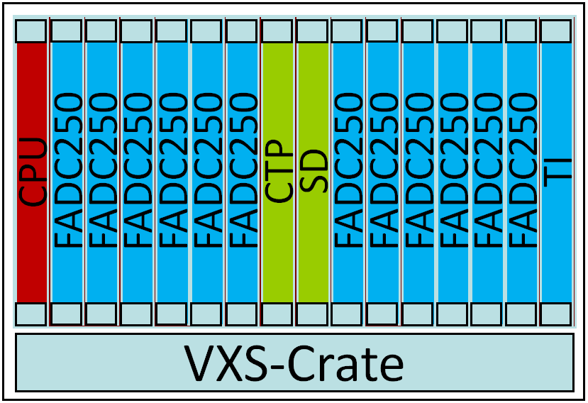
Level 1 & Trigger Distribution
Global Trigger Crate
Trigger Decisions
Trigger Distribution Crate
CPU
SSP
SSP
SSP
SSP
SSP
SSP
GTP
GTP
SSP
SSP
SSP
SSP
SSP
SSP
TI
CPU
TD
TD
TD
TD
TD
TD
SD
TD
TD
TD
TD
TD
TD
TS
L1 Subsystem Data Streams (hits & energy)
VXS-Crate
VXS-Crate
Fiber Optic
Links
SSP can manage
8 CTP
(Crates)
Fiber Optic
Links
TD can manage
8 TI
(Crates)
Clock
Trig1
Trig2
Sync
Busy
Front-End Crates
VME Readout to Gigabit Ethernet
Up to 128 front-end crates
13

Slide 31
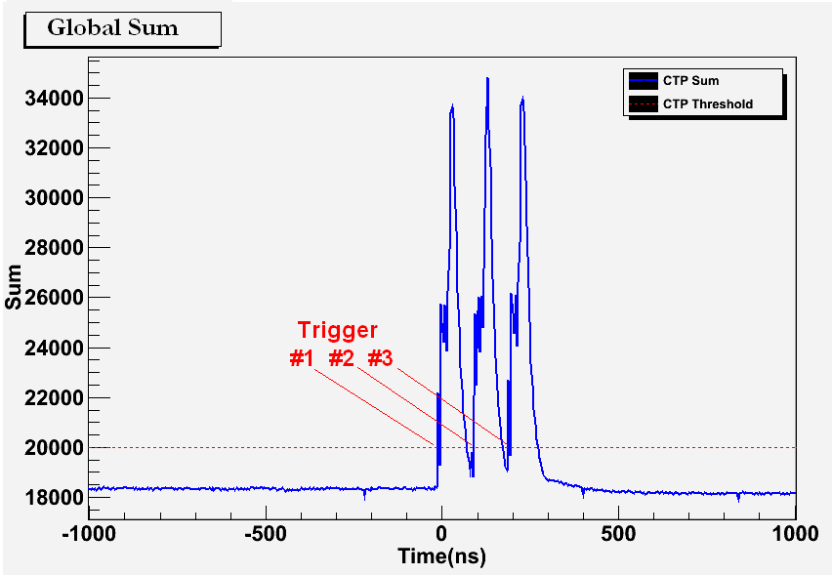
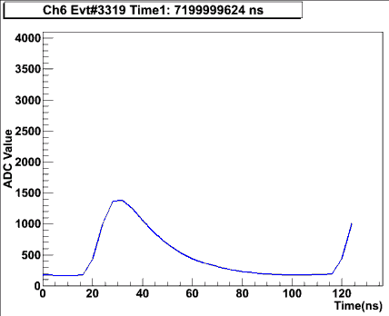
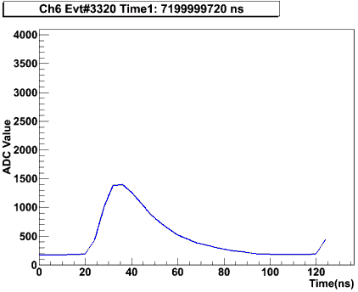
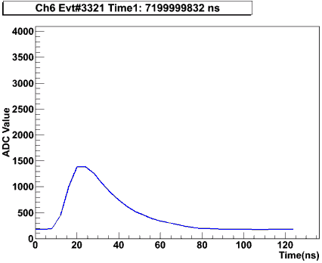
Synchronized Multi-Crate Readout
CTP #2 is also acting as an SSP (by summing the local crate + CTP#1 sum over fiber
A programmable threshold is set in CTP, which creates a trigger when the global sum (6 FADC boards => 96 channels) is over threshold.
Example test with a burst of 3 pulses into 16 channels across 2 crates/6 FADC modules
A 2μs global sum window is recorded around the trigger to see how the trigger was formed:
Example Raw Event Data for 1 FADC Channel:
B. Raydo

Slide 32
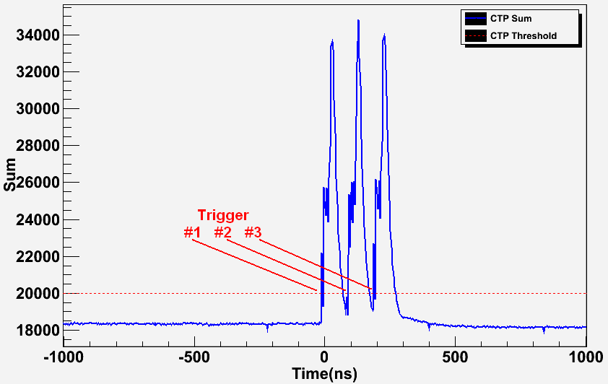
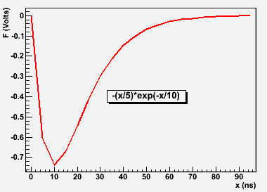
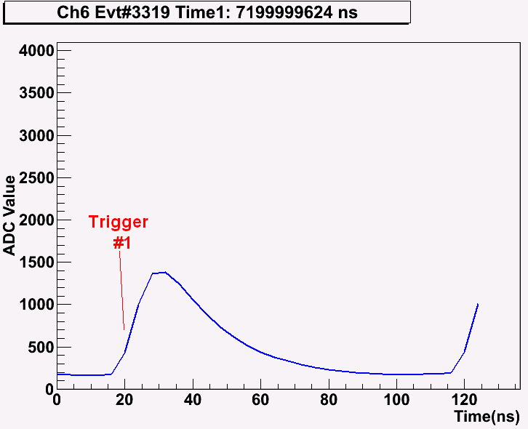
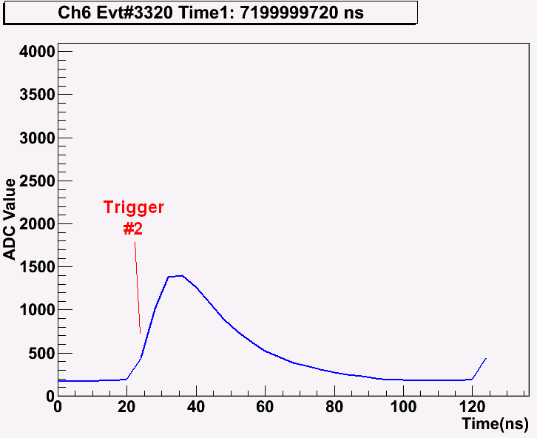
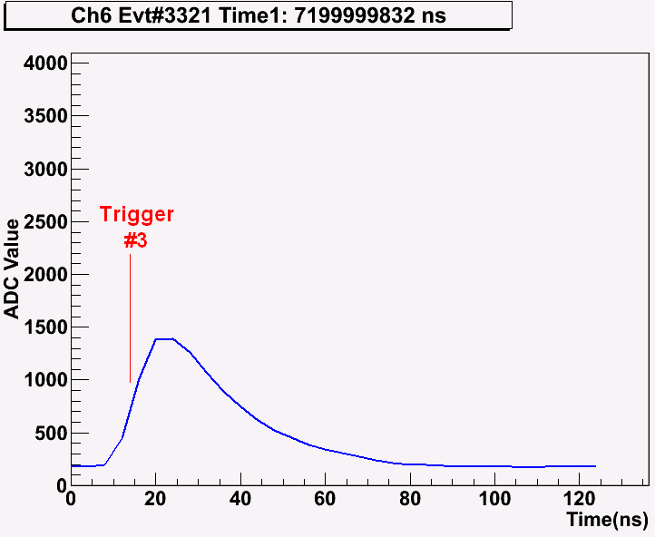
2 Crate Energy Sum Testing
Global Sum Capture (at “SSP”):
Input Signal to 16 FADC250 Channels:
Raw Mode Triggered Data (single channel shown only):
Threshold applied to global sum (96 digitized channels) produces 3 triggers.
Raw channel samples extracted from pipeline shown for 1 channel.
Runs at 250kHz in charge mode
Latency: 2.3µs(measured) + 660ns(GTP estimate) < 3µs
B. Raydo

Slide 33
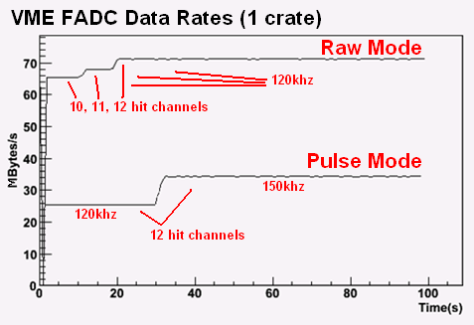
Synchronized Multi-Crate Readout Rates
FADC event synchronization has been stable for several billion events @ ~150kHz trigger rate.
Have run up to 140kHz trigger rate in raw window mode, up to 170kHz in Pulse/Time mode.
Ed Jastrzembski has completed the 2eSST VME Interface on FADC allowing ~200MB/s readout
Single Crate
12 signals distributed
to four FADC250
18% Occupancy
B. Raydo

