Slide 1


GlueX Collaboration Meeting
12GeV Trigger Electronics
9 – 10 May 2011
R. Chris Cuevas
  Hardware Design Status Updates
    Trigger Interface
    Signal Distribution
    Crate Trigger Processor
    Sub-System Processor
    Global Trigger Processor
    DAq ‘crate’ status
    Parallel Fiber Optics
  Two full crates → DAq and Trigger Testing
  Summary

Slide 2
Trigger Hardware Status
Flash ADC 250Msps ( FADC250 )
  Initial version 2 boards have been thoroughly tested and are working in the lab. – See Fernando’s update
  Will receive 35 pre-production boards in May!
  Automatic board level verification test station is complete.
  CODA library ‘driver’ updated and will be used for two full crate DAq testing
Crate Trigger Processor ( CTP )
  We have 4 fully functional CTP modules
  2 latest CTPs include FPGA that support higher Gigabit speed (5Gbp/s)
  A new CTP was used for verification of new WIENER VXS backplane
  FADC250-V2 Gigabit outputs verified with CTP @2.5Gb/s per lane!
  Collects trigger data (SUM) from 16 FADC250 modules within one crate
  ( 16 bit sum every 4ns from 16 boards equals 64Gb/s!)
  Transports trigger data over fiber to Global Trigger crate (SSP)
    10Gbp/s capability ( 8Gbp/s successfully tested )
2

Slide 3
Trigger Hardware Status
Signal Distribution ( SD )
  Precision low jitter fan-out of ADC clock, trigger and synch signals over VXS backplane to FADC250 modules
  Revisions include clock jitter attenuation PLL
  Two Rev-2 boards have been tested with Trigger Interface
  A few power supply issues have been resolved, and updates to firmware have been completed to support PLL for jitter attenuation
  I^2C communication with latest Trigger Interface is complete
  Two boards will be used for full crate testing before ordering pre-production quantities.
  Pre-production quantity of six boards will be ordered as soon as two crate DAq test verifications are complete. (June, 2011)
  We have components and front panels for at least six more units
3

Slide 4
Trigger Hardware Status
Trigger Interface – Trigger Distribution ( TI - TD )
  FY11 test goals have been achieved and two units have been configured and installed in two crate DAq test station.
  Minor design changes have been recorded and schematics and board layout changes have been implemented for pre-production order.
  Plan is to order ten units after two crate DAq tests are verified.
  Peripheral modules for TI-D have been completed.
  (i.e. Fan-out board for CAEN V1290 TDC)
  CODA library has been updated for latest TI-D revision.
  Direct link to Trigger Supervisor crate via parallel fiber optic cable
  Distributes precision clock, triggers, and sync to crate SD modules
  Board design supports both TI and TD functions, plus can supervise up to eight front end crates.
  Manages crate triggers and ReadOut Controller events
4

Slide 5
Trigger Hardware Status
SubSystem Processor ( SSP )
  Prototype board has been tested and is ahead of schedule.
  New applications have been proposed for the SSP (CLAS12)
  Will use SSP during two crate DAq testing
  Firmware to handle trigger information from two CTP streams will be completed soon.
  SSP will collect trigger data from the two full crates and deliver the final trigger signal to the Trigger Interface.
  SSP to GTP serial link definitions have been fully specified and implemented for VXS
  Manages trigger information from up to 8 front end crates.
  (2048 channels!)
  Trigger data received on front panel with fiber transceivers
  10Gbp/s input capability ( 4 lanes @3.125Gbps*(8/10b) )
  10Gpb/s output stream to GTP on VXS backplane
5

Slide 6
Trigger Hardware Status
Global Trigger Processor ( GTP ) (FY - 11)
  Schematic is complete and board layout activities are nearly complete!
  Significant activity for checking board fabrication files and assembly data before ordering prototype unit.
  On track for FY11 goal to build initial prototype and test with SSP for global crate functions
  Revisions to initial specification has been updated and finalized
  Interface requirements to SSP and TS have been finalized
  Large scale FPGA has been purchased and received including other long lead items.
  Xilinx’s Aurora protocol has been tested with Altera FPGA. Will be verified when prototype is received.
  Great deal of firmware and verification activity after prototype is received from assembly company’
6

Slide 7
Trigger Hardware Status
Trigger Supervisor ( TS ) (FY-12 activity)
  New board format – VXS Payload module
  Distributes precision clock, triggers, and sync to front end crates via the Trigger Distribution modules.
  Manages global triggers and ReadOut Controller events
  Global Trigger Processor drives 32 bit trigger word to TS over copper cables.
  Specification has been updated to match GTP output
  Schematic and board layout activities will become full time activity after full DAQ crate testing is complete and pre-production orders for TI-TD and other boards have been completed.
7

Slide 8
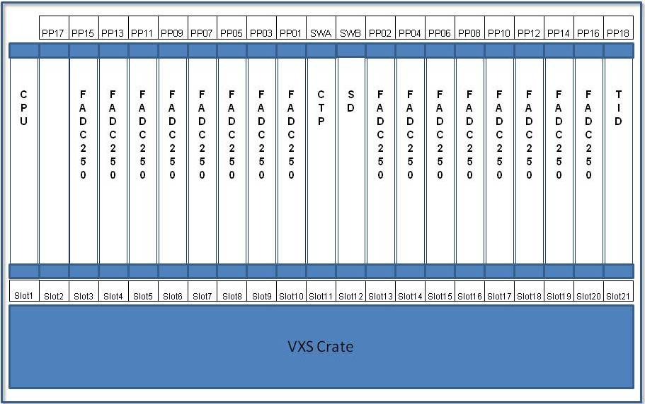
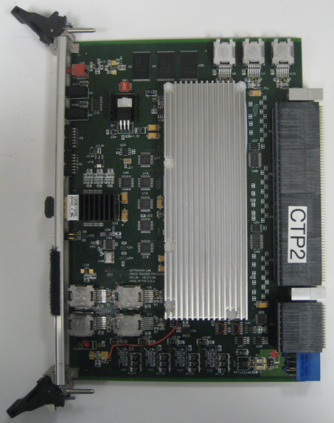
Crate Trigger Processor
4 Fully assembled are tested and in the lab!!
2 newest units include VirtexV FX70T that supports higher serial speeds. (5Gbps) Matches FX70T on FADC250
Initial CTP unit used to verify new WIENER VXS backplane map
Crate Trigger Processor computes a crate-level energy sum (or hit pattern)
Computed crate-level value sent via 10Gbps fiber optics to Global Trigger Crate (32bits every 4ns)
CTP Prototype:
Minor circuit modifications (ECO) needed before ordering production units. Goal is to order pre-production quantity by fall.
Significant verification testing will be performed with 2 crate DAq station.
Hall D requires 23 units
Hall B requires 21 units
MTP Parallel Optics
10Gb/s to SSP
VXS Connectors
Collect serial data from 16 FADC-250
8

Slide 9
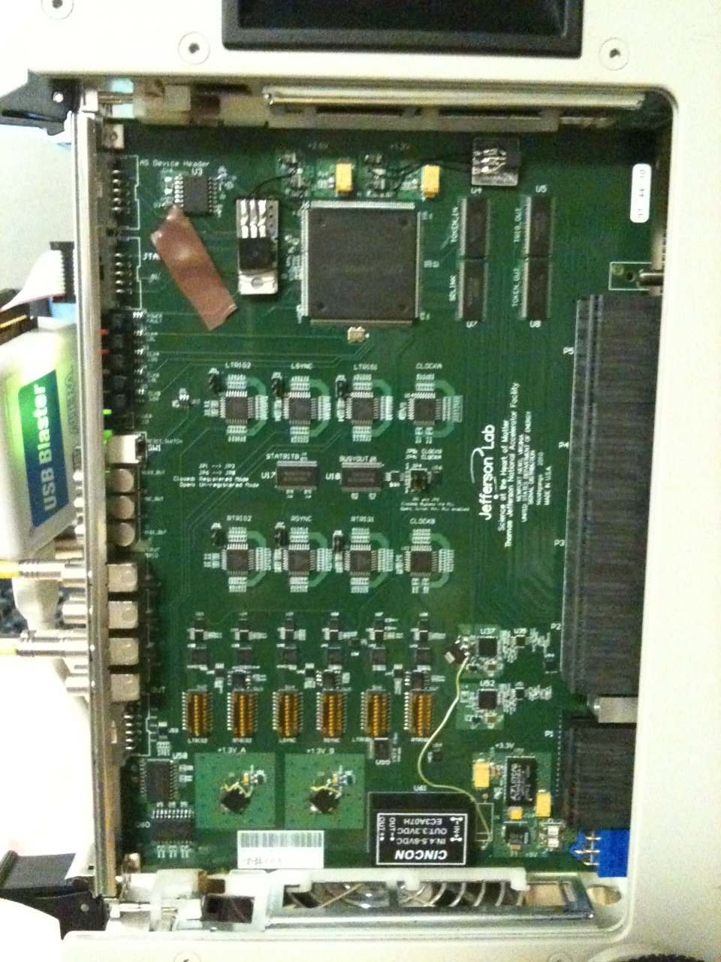
Crate Level – Signal Distribution (SD) -Rev 1
N. Nganga
10-Oct-2010
Two boards fully assembled and essential functions have been tested
Rev_1 includes jitter attenuation PLL circuit that significantly reduces clock jitter to final payload (FADC250) slots
  Jitter Attenuation achieves 1.5ps rms measured at payload slots.
I^2C programming functions via TI have been tested
Circuit corrections (ECO) have been identified and implemented in schematic and circuit board in preparation for pre-production order.
We have the components and front panels required for a pre-production order of 6 units. Order by late summer.
Production quantities:
  Hall D needs 49 SD units
  Hall B (and other Halls) need 30 units
VITA 41
Switch
Slot
Connectors
9
14

Slide 10
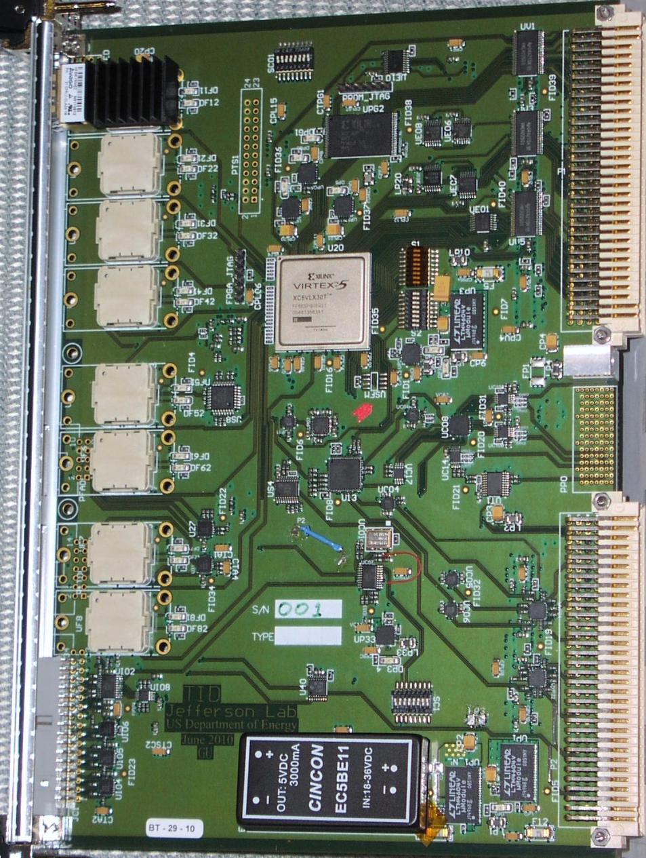
Trigger Interface - Distribution
W. Gu
DAQ Group
TID Components
VME→PROM
(FPGA firmware)
Emergency/remote
re-programming
‘Legacy’
Trigger
Supervisor
Interface
Xilinx
VirtexV
LX30T-FG665
VME 64x
Eight
Optical Transceivers
HFBR-7924
VXS P0
TD mode: from SD
TI/TS mode: to SD
One dedicated link for redundant data collection
External I/O
(trg, clk…)
Trg/Clk/Syc
outputs
On row_C
10

Slide 11
Trigger Interface - Distribution
W. Gu
DAQ Group
5/6/2011
Testing is complete and this TI revision is ready for a pre- production order. Order will be placed as soon as two crate DAq testing is verified.
Minor circuit modifications (ECO) have been completed and the circuit board files updated in preparation for the pre-production order.
Ten pre-production units will be ordered and tested by end of summer. Final production quantities as follows:
  Hall D: 56 units
  Other Halls: 35+ units
Procedure to align (de-skew) trigger signal has been completed and verified with two crates in the lab.
11

Slide 12
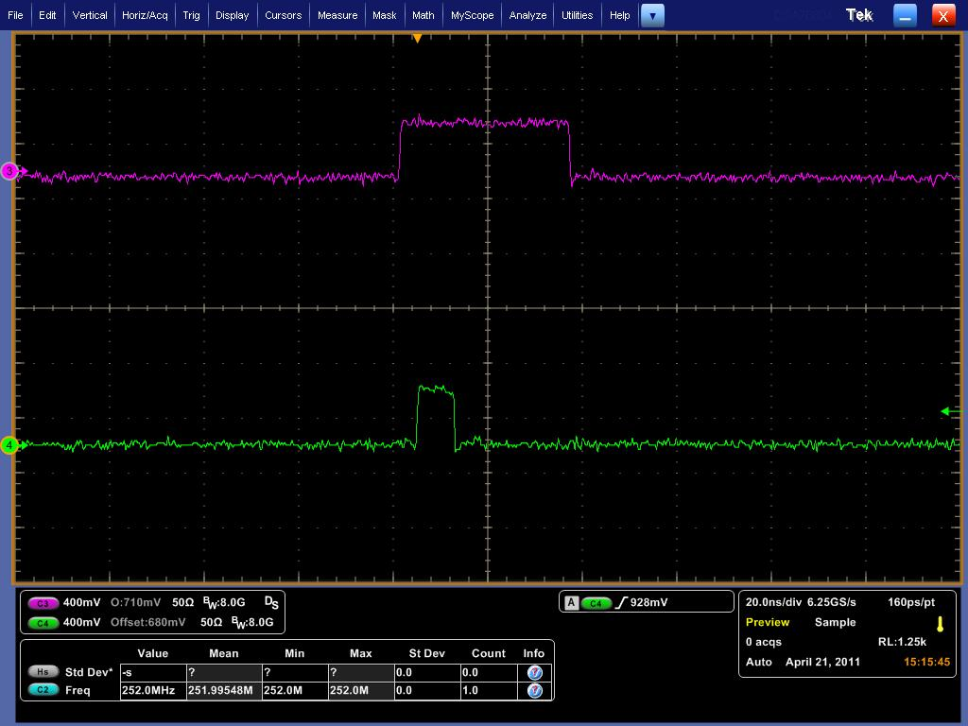
Trigger Interface - Distribution
W. Gu
DAQ Group
5/6/2011
Trigger signal aligned for two crates
Trigger pulse width is programmable from 4ns to 128ns via TI
100m is fiber optic length difference that has been ‘de-skewed’ in this photo
12

Slide 13
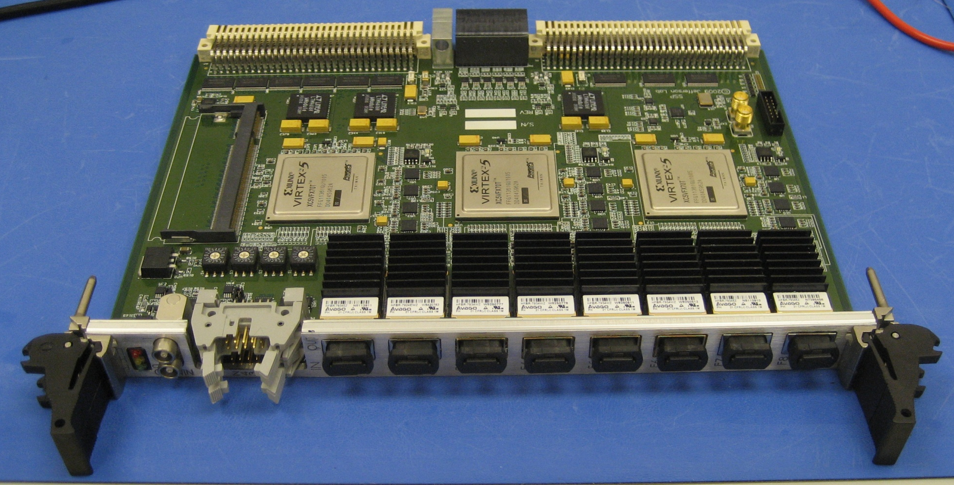
SSP Prototype
Ben Raydo
9-Sept-2010
Optional DDR2 Memory Module (up to 4GByte)
VME64x
(2eSST support)
VXS-P0
(up to 16Gbps to each GTP)
2x NIM
(bidirectional)
4x ECL/PECL/LVDS In 4x LVDS Out
8x Fiber Ports ( 10Gbps each to CTP )
13

Slide 14
Sub-System Processor
Ben Raydo
9-Sept-2010
5/6/2011
SSP prototype has been thoroughly tested and has been ahead of schedule.
SSP will be used in the two crate DAq testing to demonstrate crate summing and other features, plus will source the final trigger output to the TI
Very minor circuit modifications (ECO) have been identified on the prototype and the circuit board files updated in preparation for the production order.
Relatively low quantity for all 12GeV experimental Halls, so pre-production order may not make sense. Final production quantities as follows:
  Hall D: 8 units
  Other Halls: <20 units
On track to order by end of fiscal year 2011
14

Slide 15
Global Trigger Processor: (GTP)
Scott Kaneta
May 2011
Schematic Complete
Layout essentially complete
FPGA purchased and received
Other long lead items received
15

Slide 16
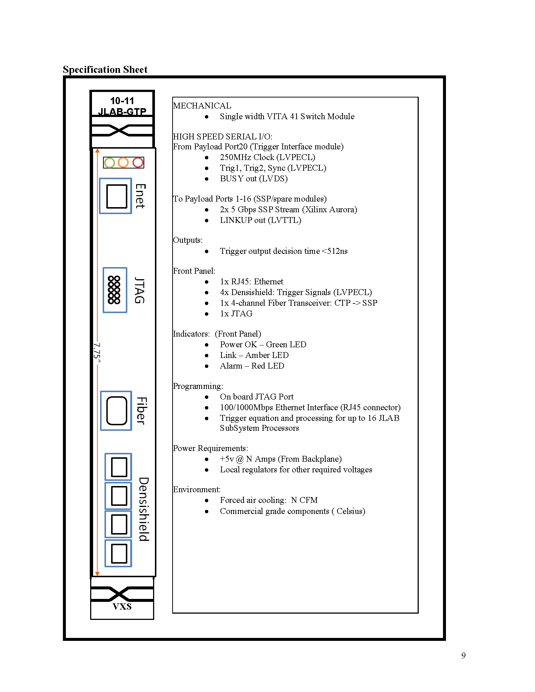
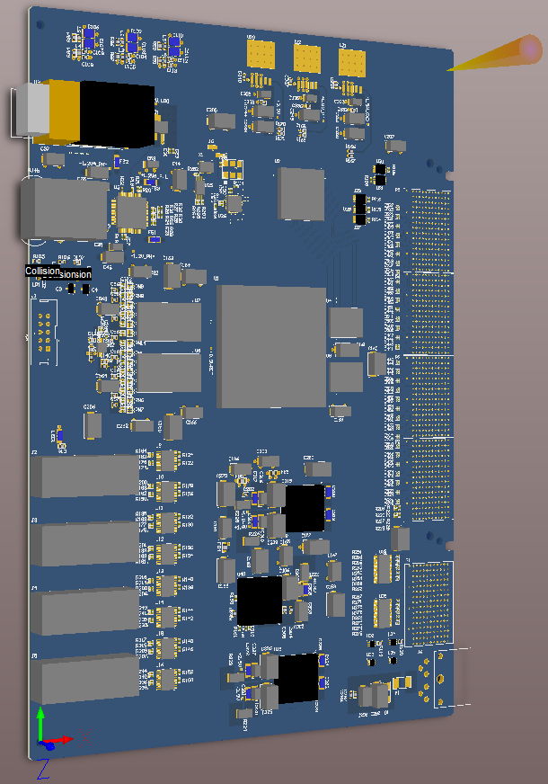
Scott Kaneta
Jan-2011
Global Trigger Processor: (GTP)
MTP
Fiber
Ethernet
VXS
Switch
Slot
Ethernet
Altera FPGA
Altera
FPGA
EP4SGX180K
VXS
Gigabit
Serial
From
SSP
JTAG
MTP Fiber TxRx
4 x 8
PECL
Trigger
Bits
To TS
/
32
Power
+5VDC
16
21

Slide 17
Scott Kaneta
Jan-2011
Global Trigger - Block Diagram:
CTP
1
Global Trigger Processor (GTP) receives all subsystem Level 1 data streams from SSP
Trigger decisions made in GTP and distributed to all crates via the Trigger Distribution (TD) modules in the Trigger Supervisor Crate
Schematics and component selection activities are progressing well
Preliminary component placement and layout strategies have been completed
Xilinx’s ‘Aurora’ Gigabit protocol has been ported to Altera device successfully
Global Trigger Crate
4
SSP 1
Payload 1
.
.
.
Trigger Distribution Crate
4
/
CTP
8
TS
32
GTP
Switch A
.
.
.
Fiber
4
/
CTP 121
4 x 8 LVPECL
‘Densishield’
SSP 16
Payload 16
.
.
.
4
/
CTP 128
SD
Switch B
TI
Payload 18
17

Slide 18
Specification Status
VXS and VME64x powered card enclosures
  Multi-year contract awarded to W-IE-NE-R, Plein & Baus, Ltd.
  First article crates (VXS) accepted February 2011
  12 VME64x crates received 8-Feb-2011. Test when needed.
  Slight delay for remainder of FY11 order
    16 VXS due 8-May-2011 ( Original plan was 10-March )
    56 VXS due in FY-12 (Date To Be Determined)
    17 VME64x due in FY-12 (Date to Be Determined)
Trigger System Fiber Optics (FY11 work plan)
  System diagrams have updated for Hall D installation
  Pre-Procurement Plan in draft form
  Received budgetary pricing from two companies for Hall D quantities (lengths) including labor for installation and post installation testing.
  Draft specification for parallel fiber optic cable and required peripheral components will be complete before June.
  Hall B will use the same specification, and the quantities (lengths) will be the only difference.
18

Slide 19
CODA
Two crate Trigger Signal
From SSP to TI(TS)
150m fiber
through MTP
patch panel
LINUX
Dell 2GHz Xeon
Dual core 1U
“DSC8”
Ethernet
50m fiber
through MTP
patch panel
Network Switch
LINUX
“DSC9”
Two DAQ Crate Testing: FY11
19

Slide 20
Two DAQ Crate Testing: FY11
Activities are progressing well for the two full crate DAq test station.
This test station is an essential infrastructure element needed to test and verify the front end and trigger hardware/software before installation in the Halls.
After commissioning and CD4 the test stand will be vital to troubleshoot and repair the plethora of custom front end and trigger modules.
Multiple crate ‘system level’ testing is imperative before approving large quantity orders.
  Will verify Gigabit serial lanes from each slot
    1st Time for 16 boards/crate!!!
  Will measure total trigger latency
  Will measure trigger rates/VME data rate
  Will measure BitErrorRates
  Will test using “Playback” mode
    No input cables necessary
Fully verify Trigger Interface features
Test station used for firmware and software development
Commissioning “tools” can be developed and tested with the front end hardware
Minor Re-configuration of two crate test station will allow for Global Trigger module testing in the near future.
  SSP→GTP→TS→TD
20

Slide 21
Summary
FY11 board design project goals are on track
  Small pre-production orders will be completed this year for TI, and SD to support detector test plans
  Possible to order pre-production quantity for CTP and SSP by end of FY11 but immediate detector test plans do not require CTP and SSP functions
Can never give enough credit to the exemplary work efforts of the design team!
Weekly 12GeV Trigger meeting continues to produce good discussions and implementation reports.
Two full crate DAq testing is imminent and will produce essential test results to fully qualify the existing board designs.
21

Slide 22
Backup Slides
All sorts of good stuff

Slide 23
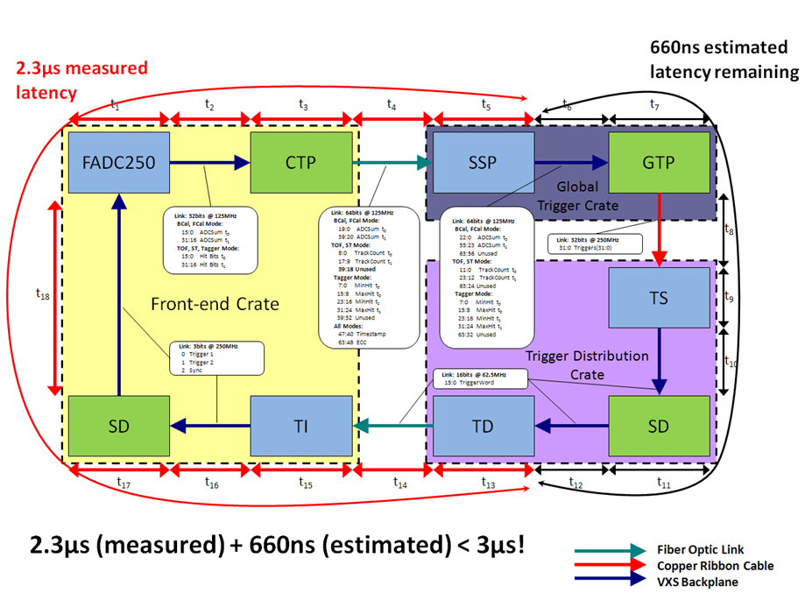
GlueX Level 1 Timing
21

Slide 24
Schedules, work plans for FY11 - FY13
FY10 design projects are at full resource pace!
  FADC250 → Latest revision at end of FY10. TEST in FY11.
  F1TDC-V2→ Work plan moved to FY11
  SD → Latest revisions virtually complete. Order, assemble, TEST in FY11
  SSP → Prototype received. Initial testing is proceeding nicely.
        Further testing in FY11.
  TI-TD → Prototype(s) received. Initial testing is proceeding nicely.
        Firmware development and multi-crate testing in FY11
  16 Channel LE Discriminator/Scaler (Hall B requirement)
    7 ‘production’ units under test now
  VXS Crate Specification → Order should be awarded before Oct-10
  GTP → Scott Kaneta joins the group! GTP slips to FY11
  TS → Specified, and planned for FY11-FY12
Baseline Improvement Activities (BIA) review on 17-September
FY11 will be an intensive year of significant ‘system’ level testing to assure
that these boards are ready for final production quantity orders in early FY12
20

Slide 25
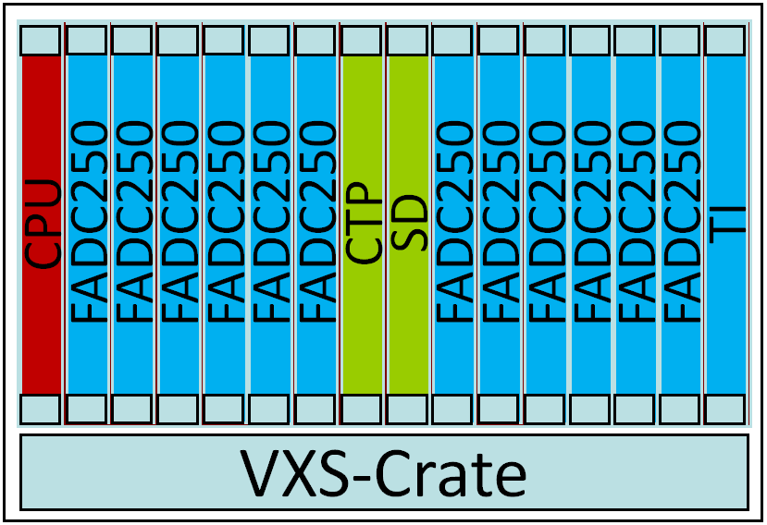
Level 1 & Trigger Distribution
Global Trigger Crate
Trigger Decisions
Trigger Distribution Crate
CPU
SSP
SSP
SSP
SSP
SSP
SSP
GTP
GTP
SSP
SSP
SSP
SSP
SSP
SSP
TI
CPU
TD
TD
TD
TD
TD
TD
SD
TD
TD
TD
TD
TD
TD
TS
L1 Subsystem Data Streams (hits & energy)
VXS-Crate
VXS-Crate
Fiber Optic
Links
SSP can manage
8 CTP
(Crates)
Fiber Optic
Links
TD can manage
8 TI
(Crates)
Clock
Trig1
Trig2
Sync
Busy
Front-End Crates
VME Readout to Gigabit Ethernet
Up to 128 front-end crates
13

Slide 26
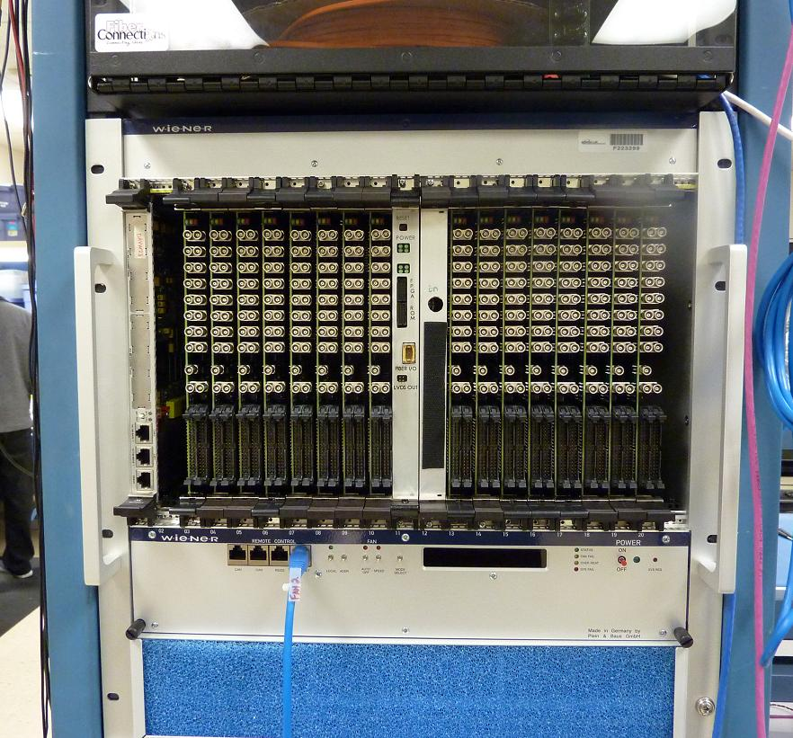
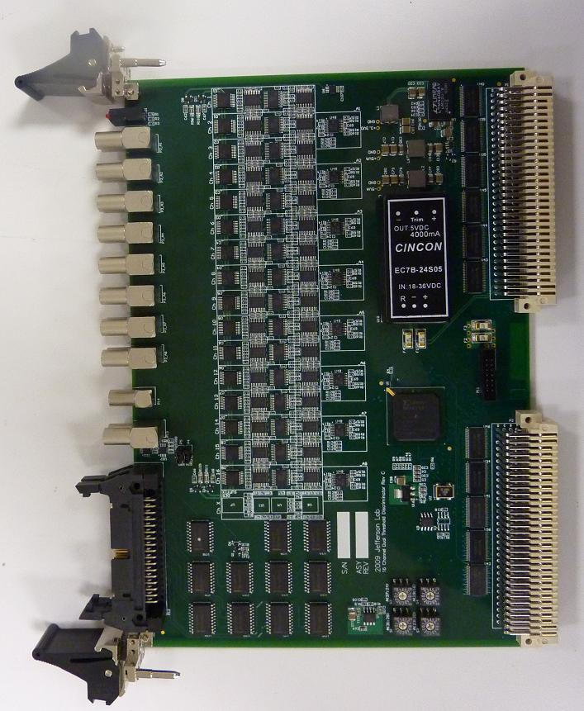
Discriminator Status
(Not truly trigger system hardware, but very nice new development)
Ben Raydo
16 Pre-Production modules have been assembled and received
Significantly cheaper than V895:
  -cost < $2,000
Provides several features not found on V895:
  32bit scalers on all channels at both thresholds
  Calibrated pulse widths: from 8 to 40ns
  Trimmed input offset (<2mV error)
  Second 34pin output connector is fully programmable.
  Able to perform logic based on all channels at both thresholds
Final revision has VME64x J1-J2 connector
Full test stand developed by Pedro Toledo(USM – Chile) will be re-used
Hall Groups will test with detectors
16 modules in crate
Pre-Production version
Note: VME64x connectors
19

Slide 27
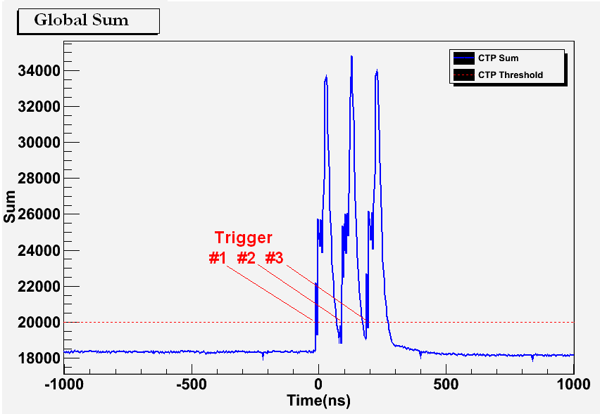
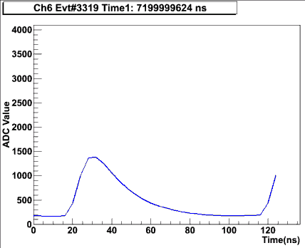
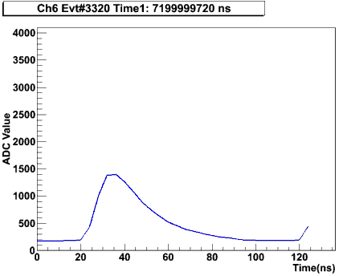
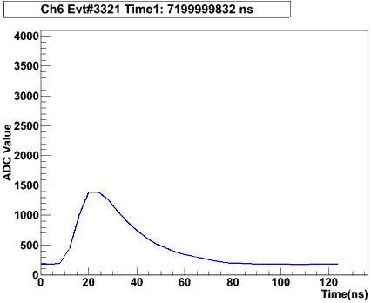
Synchronized Multi-Crate Readout
CTP #2 is also acting as an SSP (by summing the local crate + CTP#1 sum over fiber
A programmable threshold is set in CTP, which creates a trigger when the global sum (6 FADC boards => 96 channels) is over threshold.
Example test with a burst of 3 pulses into 16 channels across 2 crates/6 FADC modules
A 2μs global sum window is recorded around the trigger to see how the trigger was formed:
Example Raw Event Data for 1 FADC Channel:
B. Raydo

Slide 28
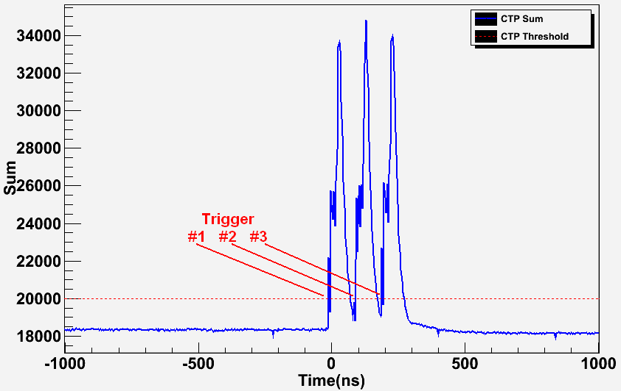
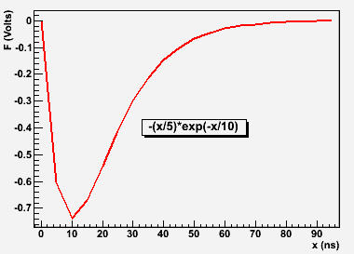
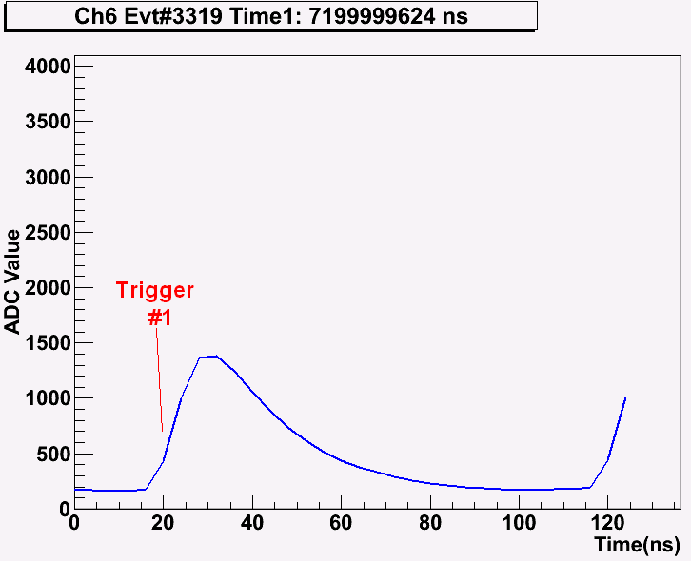
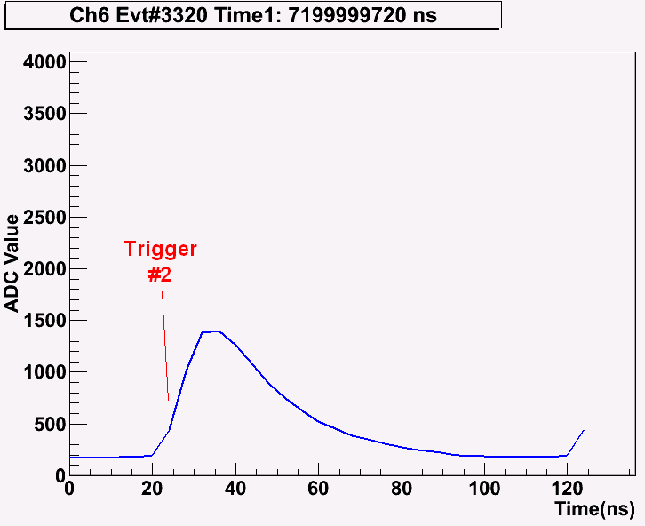
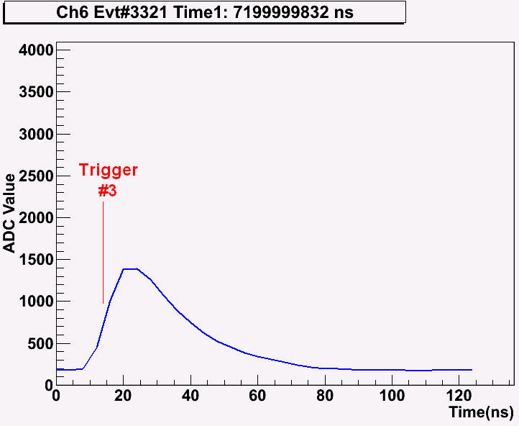
2 Crate Energy Sum Testing
Global Sum Capture (at “SSP”):
Input Signal to 16 FADC250 Channels:
Raw Mode Triggered Data (single channel shown only):
Threshold applied to global sum (96 digitized channels) produces 3 triggers.
Raw channel samples extracted from pipeline shown for 1 channel.
Runs at 250kHz in charge mode
Latency: 2.3µs(measured) + 660ns(GTP estimate) < 3µs
B. Raydo

Slide 29
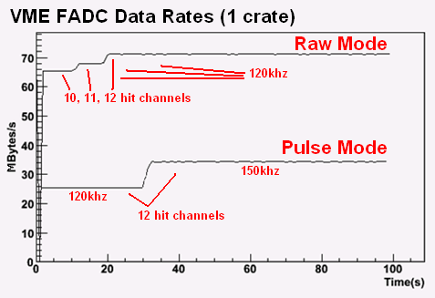
Synchronized Multi-Crate Readout Rates
FADC event synchronization has been stable for several billion events @ ~150kHz trigger rate.
Have run up to 140kHz trigger rate in raw window mode, up to 170kHz in Pulse/Time mode.
Ed Jastrzembski has completed the 2eSST VME Interface on FADC allowing ~200MB/s readout
Single Crate
12 signals distributed
to four FADC250
18% Occupancy
B. Raydo

