Slide 1
Start Counter Update
W. U. Boeglin, L. Guo, E. Pooser
Prototype production
Timing studies SiPM
Summary and Plans

Slide 2
Prototype Production
Material bought from Eljen: EJ-2123x 15 x 600 mm², 5 pieces
Sent to Plastic Craft (PC)
Sample of 5 machined elements ordered
Production delayed due to flooding this spring
Price for initial setup ~5K, order confirmed
Ordered sample of 1mm clear fibers from Kuraray (they do not make 3x3mm² and do not have samples of 2x2mm²

Slide 3
Timing Studies
Further studies:
Moved source to the end of the scintillator bar
to study the worst case scenario (~55mm from detector)
2 x 15 mm² scintillator, no wrapping, VM2000 at end
‘Standard’ SiPM array (4x4 element each 3x3mm²)
Improvised cooling using dry ice in dark box

Slide 4
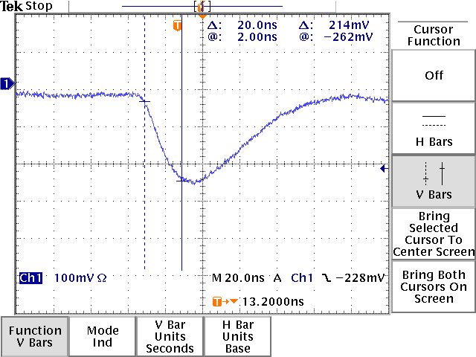
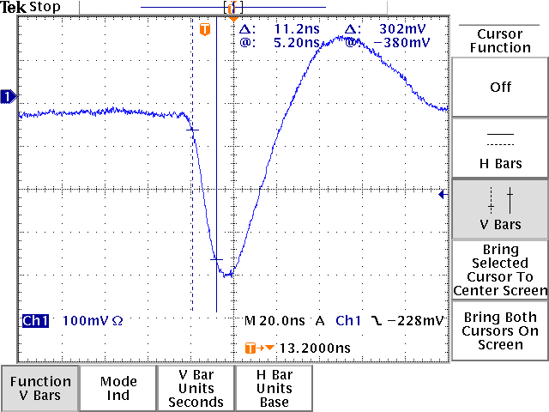
SIPM Signals (Single Trig.)
Amplified signal:
rise time ~20ns
Amplified and differentiated
τ =10ns, rise time ~11ns

Slide 5
Previous Result
SiPM
2x15
Last measurements
3x12
Best current result
3x15

Slide 6
Results
Temperature | σ | Amplifier | Comment
Room temp. ~20ºC | 1075 | LeCroy | No Shaping
Room temp. ~20ºC | 875 | LeCroy & 1711 | 10ns diff.
~ -2ºC | 810 | LeCroy & 1711 | 10ns diff.
~ -5ºC | 780 | 1711 | 10ns diff., removed the LeCroy amp.
~ -5ºC | 580 | 1711 | Optimized CFD
~ -5ºC | 753 | 1711 | Leading edge, software corr.
~ -5ºC | 930 | 1711 | No diff., leading edge

Slide 7
σ = 753
σ = 930
σ does not improve if ADC> 500

Slide 8
Summary
Cooling of SiPM in a reproducible manner
seems to be important, more testing necessary
Time resolution very sensitive on signal size
Rise time is crucial for good timing
Best resolution of 580ns for 2mm material
implies that 400ns at the end should be feasible
with 3mm material and wrapping

Slide 9
Plans
Get faster detector
Test PC manufactured paddles with PM and SiPM
Wrap detector with reflective material: need to
be able to get VM2000 like material!
Build small light guide to connect to photo detector
Test fiber light guide with PMT for fall back
solution

Slide 10
<1%
3%
achievable
7%
13%

