Slide 1
The June Software Review
David Lawrence, JLab
Feb. 16, 2012

Slide 2
(some history) May 10, 2011 IT Review
An internal JLab review of IT readiness was done on May 10th, 2011. This was intended as a “warm up” for the review coming this summer.
Charge to the review panel:
We request that the review panel address the following points for IT in the 12 GeV era:
An assessment of the state of current software and systems developments An assessment of planning for bringing all software to a suitable level of maturity, including software testing for correctness and performance
An assessment of planning for an evolution of computing, networking and storage capacity and performance to address the needs of detector simulation and data analysis
An assessment of the IT infrastructure to meet requirements including support for other areas, e.g. accelerator, light source, theory, operations
An assessment of the quality and effectiveness of the management of the major efforts to prepare
As assessment of the resources, budget and staffing, to meet the needs of the program
one day review
afternoon session focused on non-ENP* software
Management Information Systems
Networking and Infrastructure
Accelerator Controls
Hall-D had one 25-minute talk given by Mark Ito.
*ENP=Experimental Nuclear Physics

Slide 3
From May IT Review closeout
… these items were specific to the experimental halls…
Software: No common process for defining requirements, no common management structure
4 halls not sharing much software
Hall D:
D’s requirements not as well defined as other halls
Software head seems to have insufficient authority to direct software development priorities (i.e. software architect)
2 FTE seems too small for 40% of effort planned for Jefferson Lab
Hall D Offsite computing & networking requirements nebulous
Halls do not yet have robust plans for testing and reviewing readiness to operate.
Identification of risks, and addressing risks, still needs to be done
-- We disagreed with some of the findings in the close-out and first draft of committee report. These were communicated to the committee but a final draft of the report was never publically released --

Slide 4
Rough Diagram of GlueX Software
The software effort centers around reconstruction where a large fraction of the effort is spent.
Reconstruction requires inputs from databases to 1.) translate the geographic DAQ info into detector ids and 2.) convert digitized values into physical units.
Software is used to fill these databases with the bulk of that effort focused on the calibration programs.
Simulated data is required for the Amplitude Analysis. It does not require translation, but will be processed by the same reconstruction software as is used for the real data.
Web Interface
Calibration
Programs
Calibration
Programs
Calibration
Programs
Calibration
Programs
scripts
Translation
Table DB
CalibrationDB
DST DB
Raw Data
Translation
Reconstruction
DST Generator
DST
Analysis
primary reconstruction program
Simulation + Digitization
Sim.Data
Configuration DB
The configuration DB will hold information used to configure the online systems prior to data taking. The conditions DB will have values read from the online systems streamed into it during data taking.
For simplicity, not all connections are shown. (e.g. arrow from “Raw Data” to “Calibration Programs” )
Conditions DB

Slide 5
Hall-D Software Activity Schedule
Activity schedule adopted for BIA (Baseline Improvement Activity) schedule.
Tracking of BIA stopped in 2009
Minor tweaks including addition of a couple of lines (e.g. Data Format under DST Generation)
% complete column added and based purely on my “engineering judgment”
Responsible Persons column added

Slide 6
Overall status of Hall-D Software Activities

Slide 7
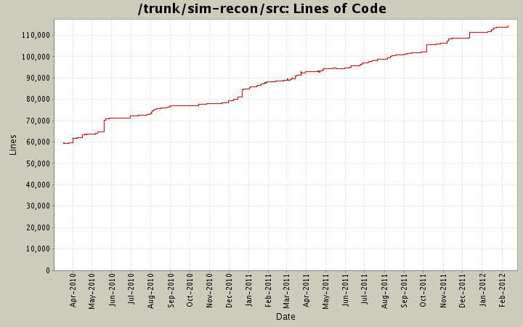
Hall-D Software Development
Steady development over the last few years. (Repository restructuring 2 years ago limits the reach of this plot).
2 years
Includes GlueX simulation and reconstruction only (no CalibDB or JANA)

Slide 8
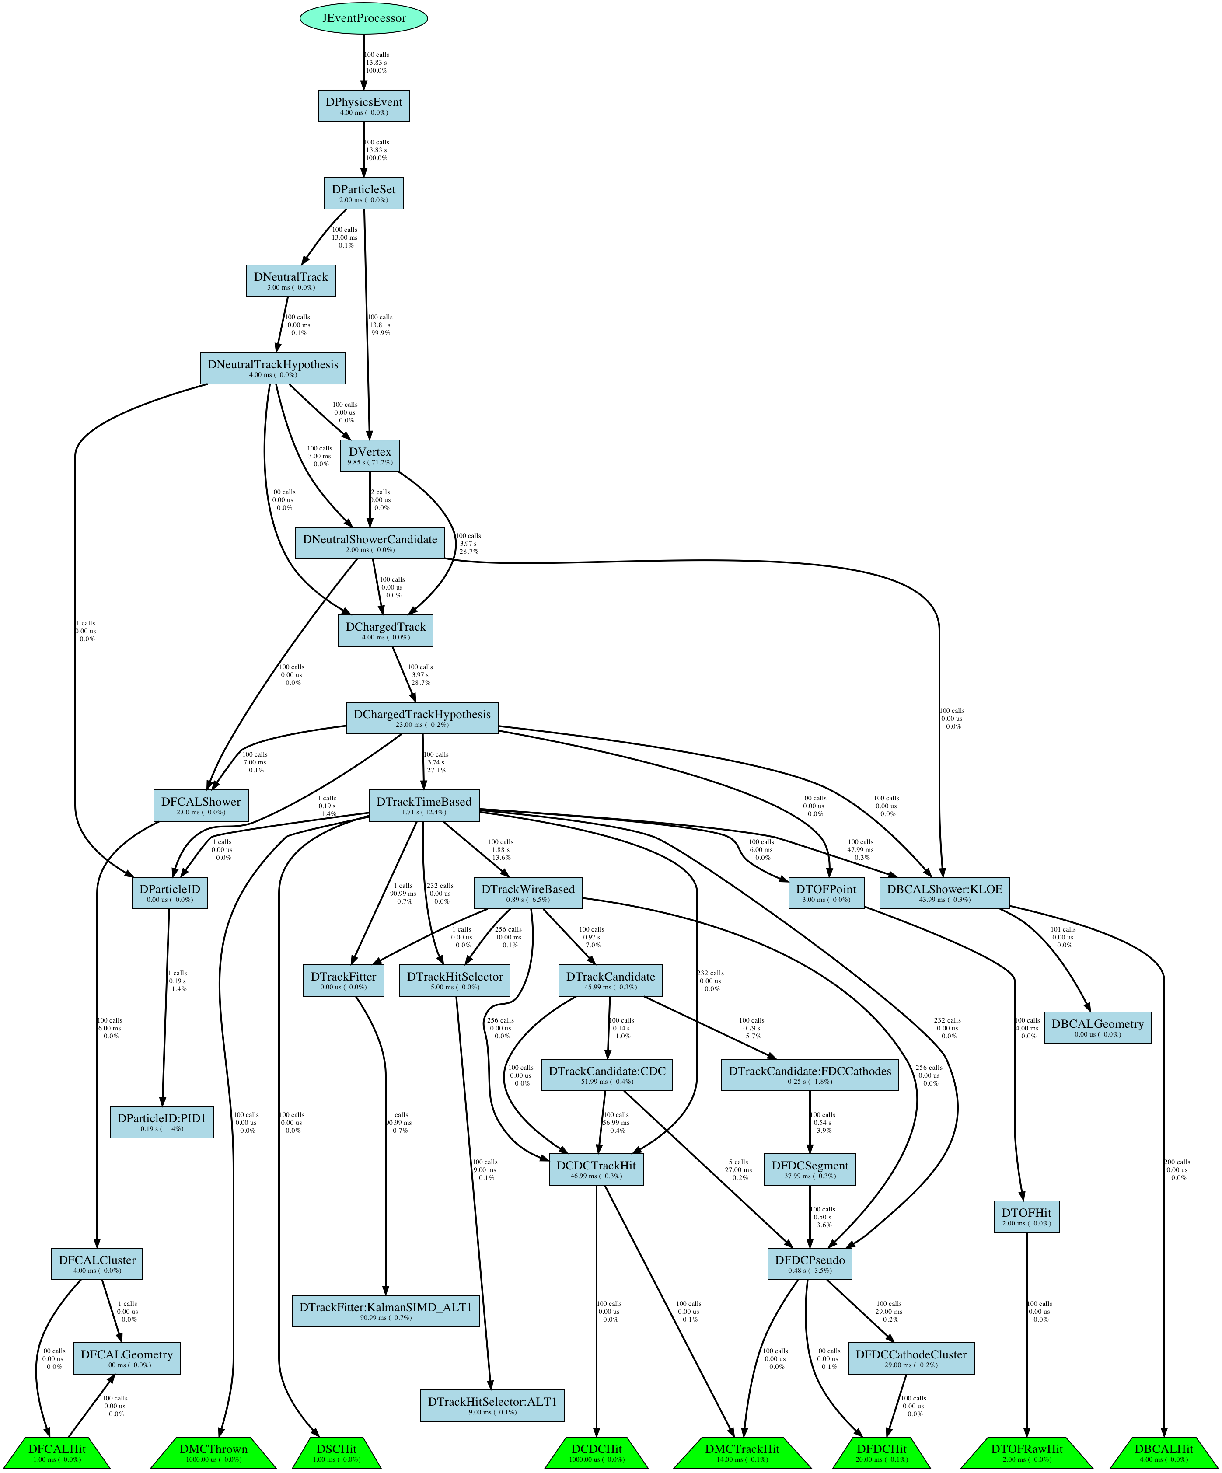
Requests for objects originate here
Hall-D reconstruction factory call graph auto-generated by JANA
Objects read from file enter here

Slide 9
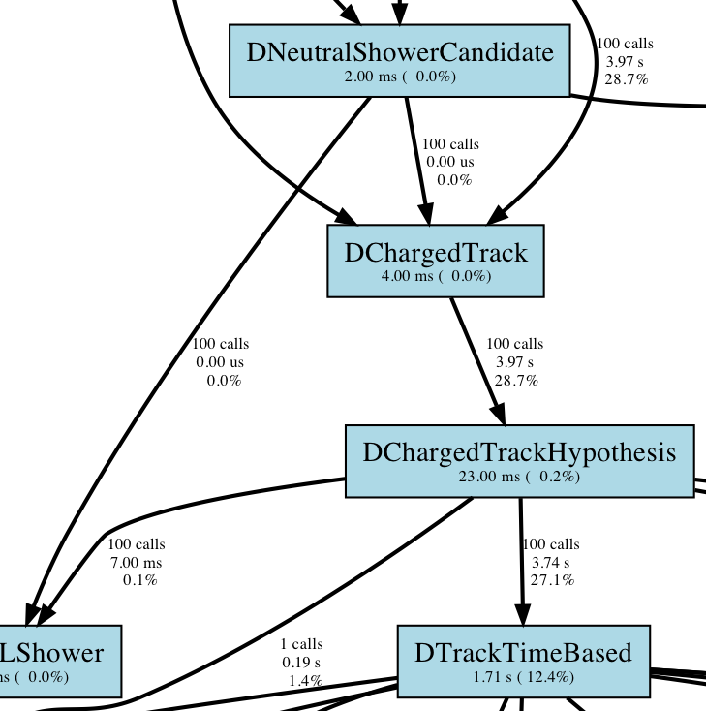
Detailed profiling of entire reconstruction chain provided by JANA framework for diagnosing where time is spent.
Profiling at subroutine level can be done using standard C/C++ debugging utilities.

Slide 10
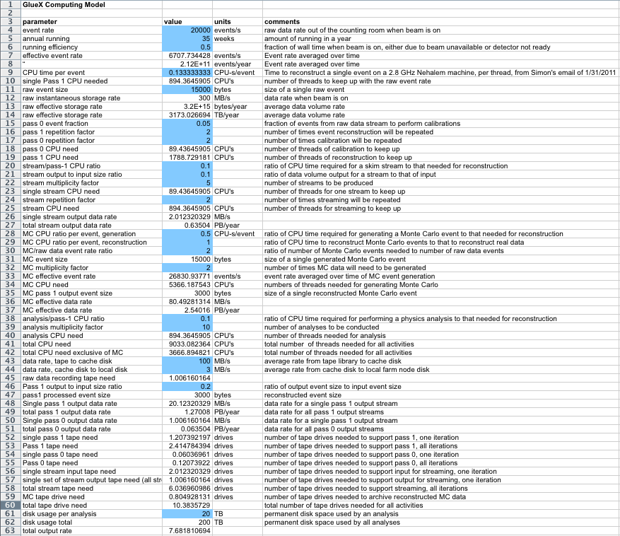
Estimated Resource Requirements (from Mark’s spreadsheet prepared for May 2011 IT review)

Slide 11
Estimated Resource Requirements (from Mark’s spreadsheet prepared for May 2011 IT review)
About 115 computers with 32 cores each will be needed just to keep up with time-averaged data acquisition + calibration
Another 170 will be needed for simulation (+recon.)

Slide 12
Software Sharing Among Halls
Meeting was held on Jan. 26th to discuss areas where halls could share software, minimizing duplication of effort.
All halls were represented
Rolf Ent asked halls to get together to discuss specific topics and explore sharing opportunities
Two items were given to Halls B and D to discuss (a few others for all halls):
Tracking Algorithms
Multiple, organized discussions have taken place between primaries
Hall-B has read-access to our repository and is using it as a reference as they develop their own tracking package
CLARA and JANA
(see next few slides)

Slide 13
Primary Differences between JANA and CLARA
CLARA
JANA
“Loosely Coupled”:
Allows multiple languages to be combined since each module is a separate process
Data passed between modules by value
Built-in ability to distribute reconstruction job over multiple computers (cloud)
“Tightly Coupled”:
Single language, all modules contained within a single process
Data passed between modules by reference
Utilizes external distributed computing mechanisms like the GRID and Auger
CLARA is designed to provide interactive access to a system of services hosted either on a single node or distributed over a cloud
JANA is designed to make maximal use of a local, multi-core resource

Slide 14
Functionality common to both JANA and CLARA
Framework for event reconstruction
Modular:
allow easy replacement of one or more algorithms
allow independent development of modules by separate groups
Provides mechanism to parallelize reconstruction using multiple cores on the same computer
Plugin mechanism to allow extension of existing functionality at run time

Slide 15
How JANA and CLARA might used in conjunction
JANA could be used to implement CLARA services that need to be highly efficient.
CLARA could be used to deploy JANA applications as shared services in a network distributed cloud computing environment.
The primary benefit to CLAS12 users of integrating JANA-based components into a CLARA-based system could be overall faster reconstruction for a fixed set of resources.
The primary benefit to Hall-D users of wrapping JANA-based programs as CLARA services would be gaining an interactive distributed computing environment that could provide a faster simulation/analysis cycle for specific studies.

Slide 16
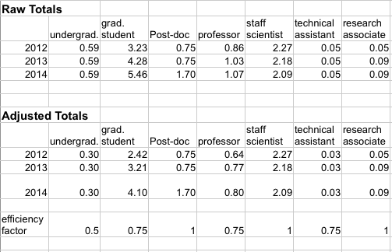
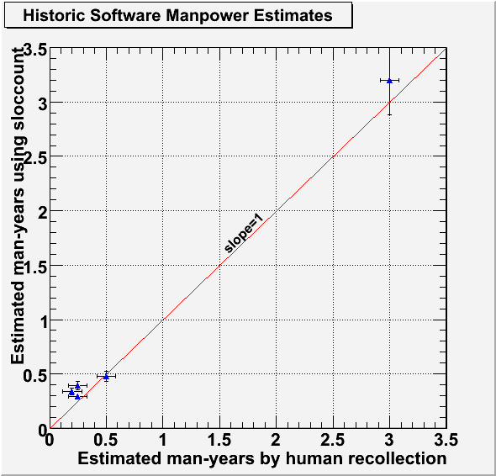
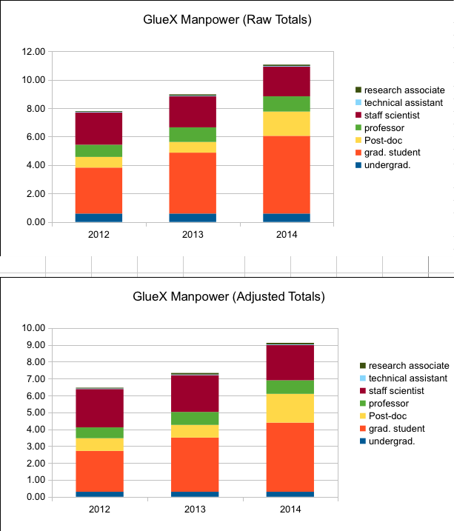
Manpower
from GlueX-doc-767 (2007)
Use standard COCOMO model to estimate man-years put into CLAS offline software
Estimate was ~53 man-years for core CLAS offline
GlueX was estimated to need ~40 man-years to be ready for start of operations
~28 FTE-years
It is estimated that we will need approx. 40 FTE-years of offline software effort total for GlueX*
Estimate is that we have done ~ 50% of work for offline software*
Remaining 20 FTE-years of estimated work is well matched with manpower commitments from collaboration*
~23 FTE-years
*every one of these estimates could be completely wrong

Slide 17
Summary
Software review is scheduled for early June 2012.
Focus will be on having offline software development on track to be ready for analysis by the start of data taking
Integrated GlueX manpower seems to be well-matched with what is needed to meet this goal

Slide 18
Backup Slides

