Slide 1
GlueX Collaboration Meeting
16-18 February, 2012
Curtis A. Meyer
Our 33rd GlueX Collaboration Meeting

Slide 2
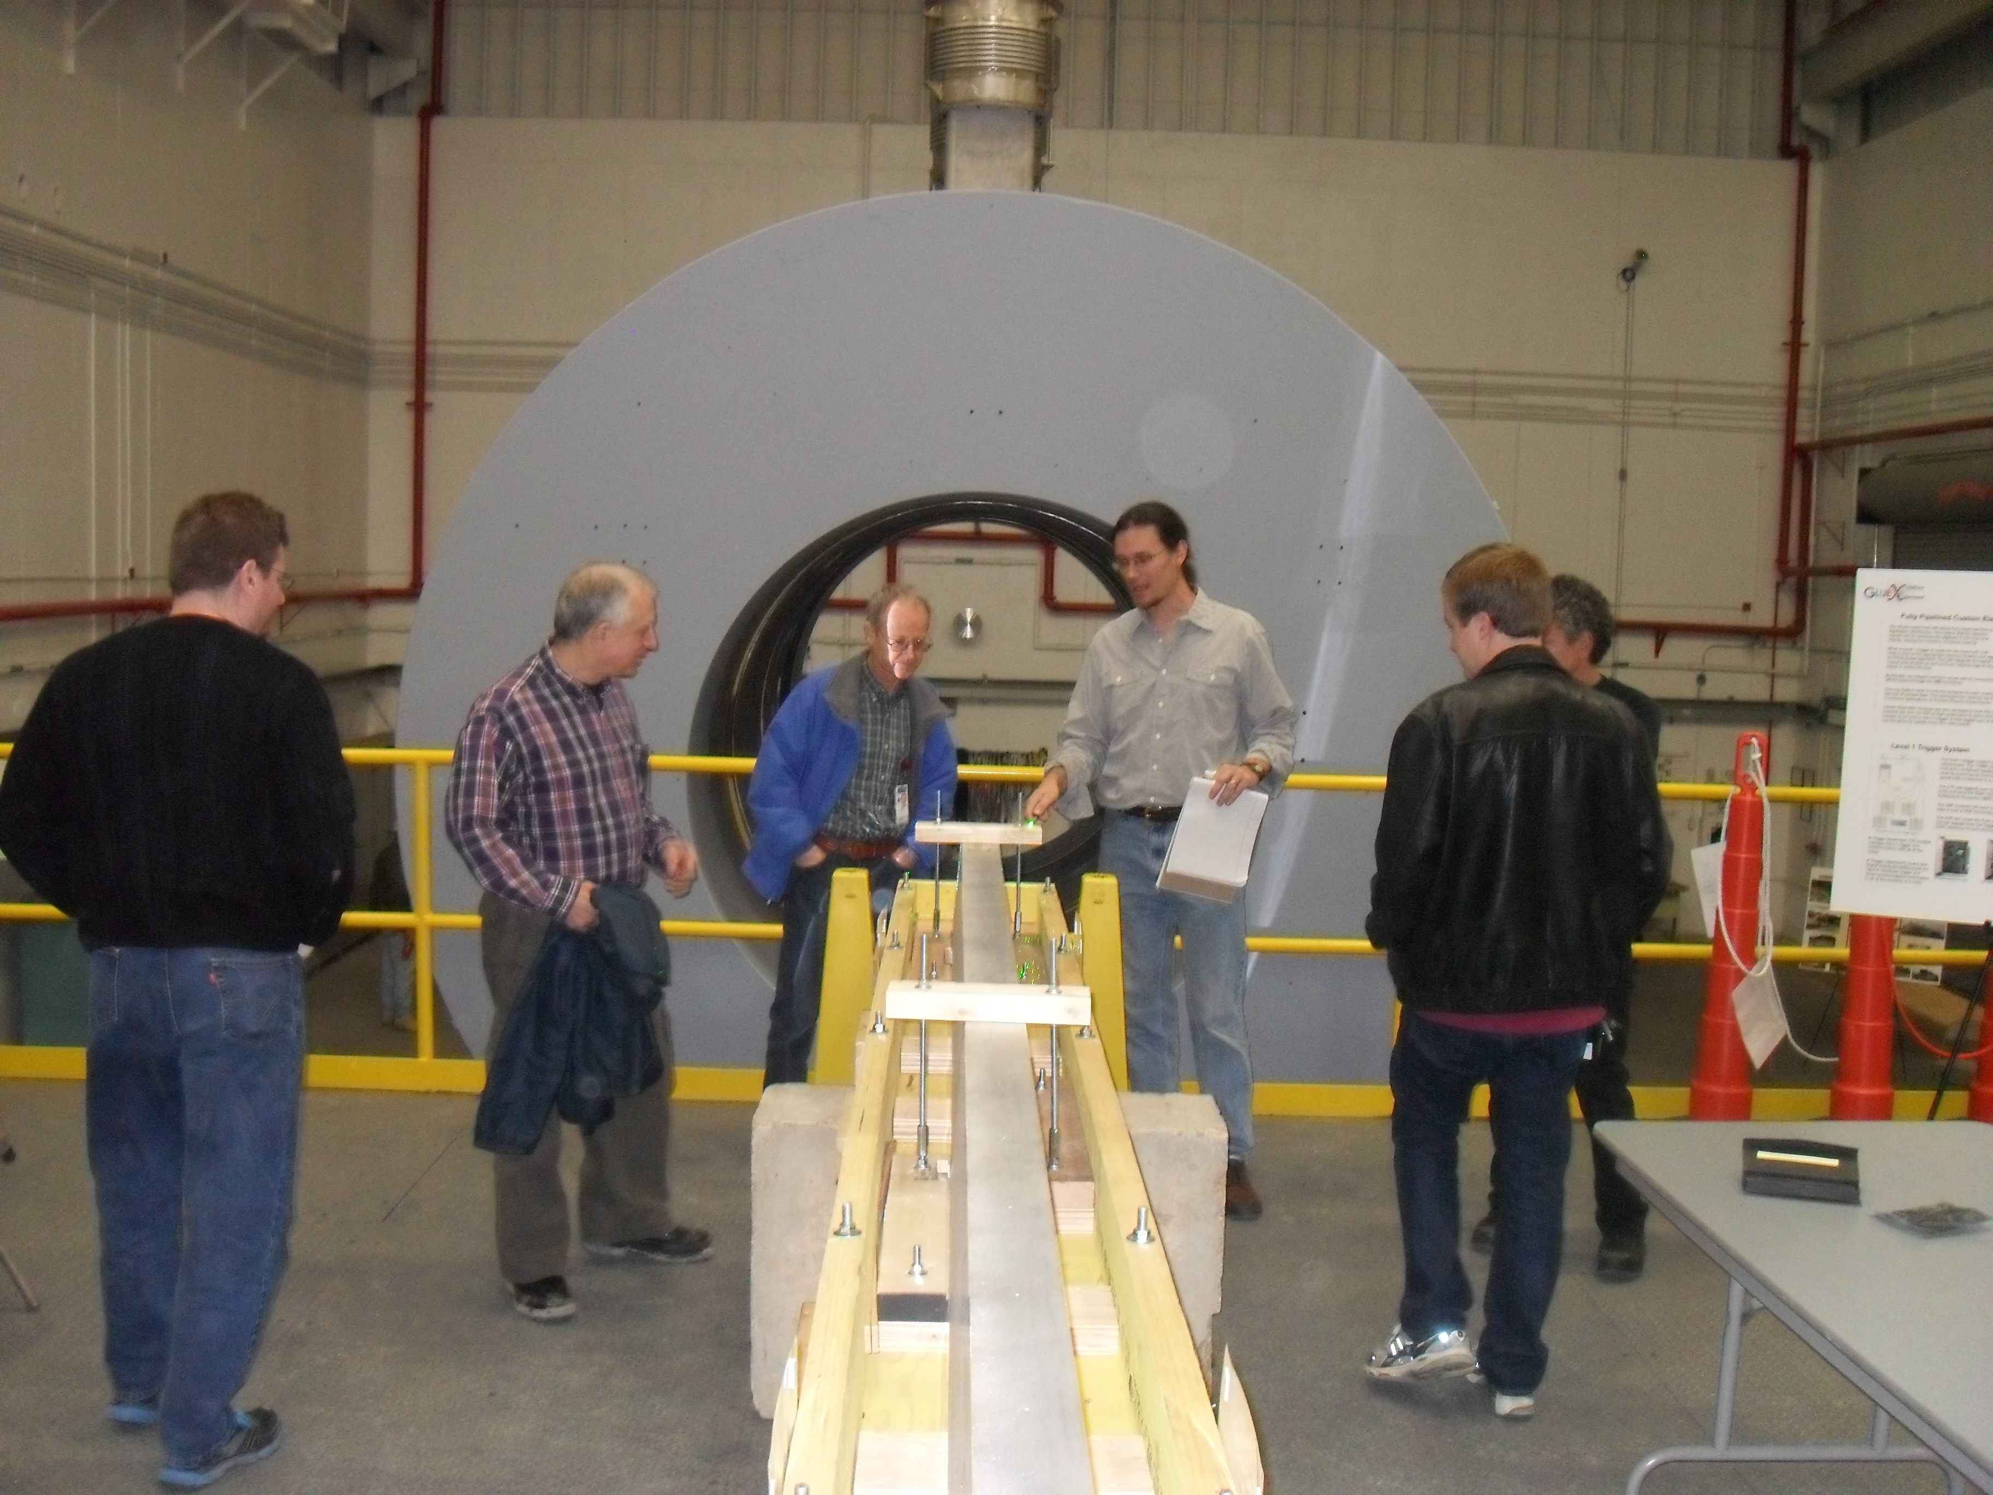
BCAL Delivered to JLab

Slide 3
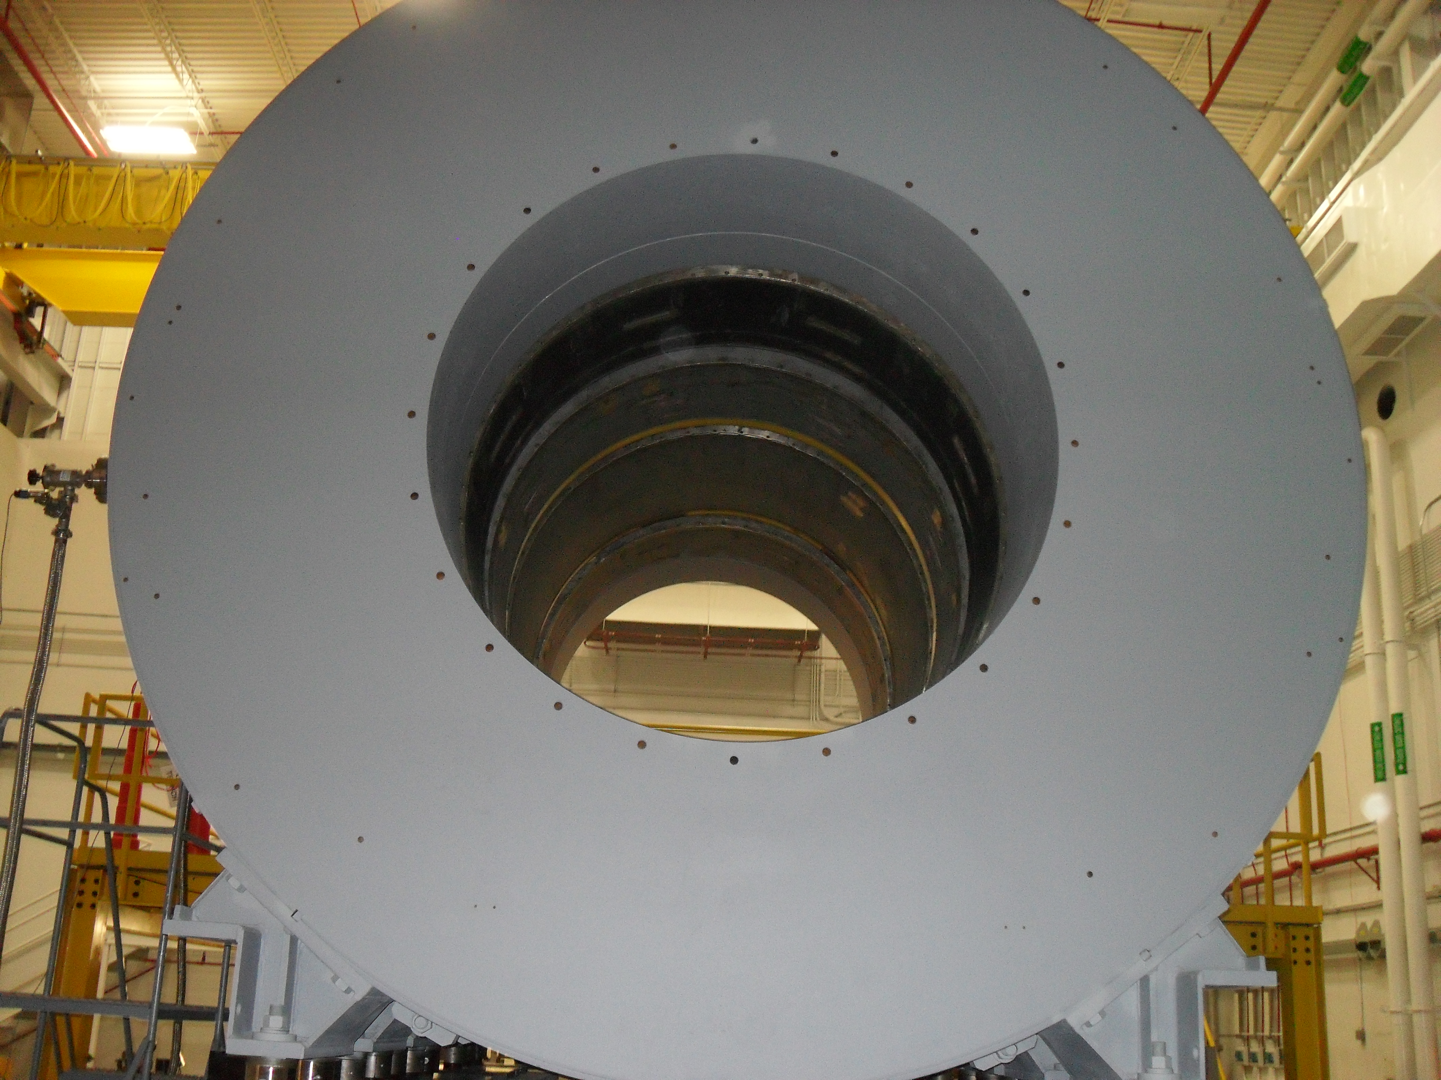
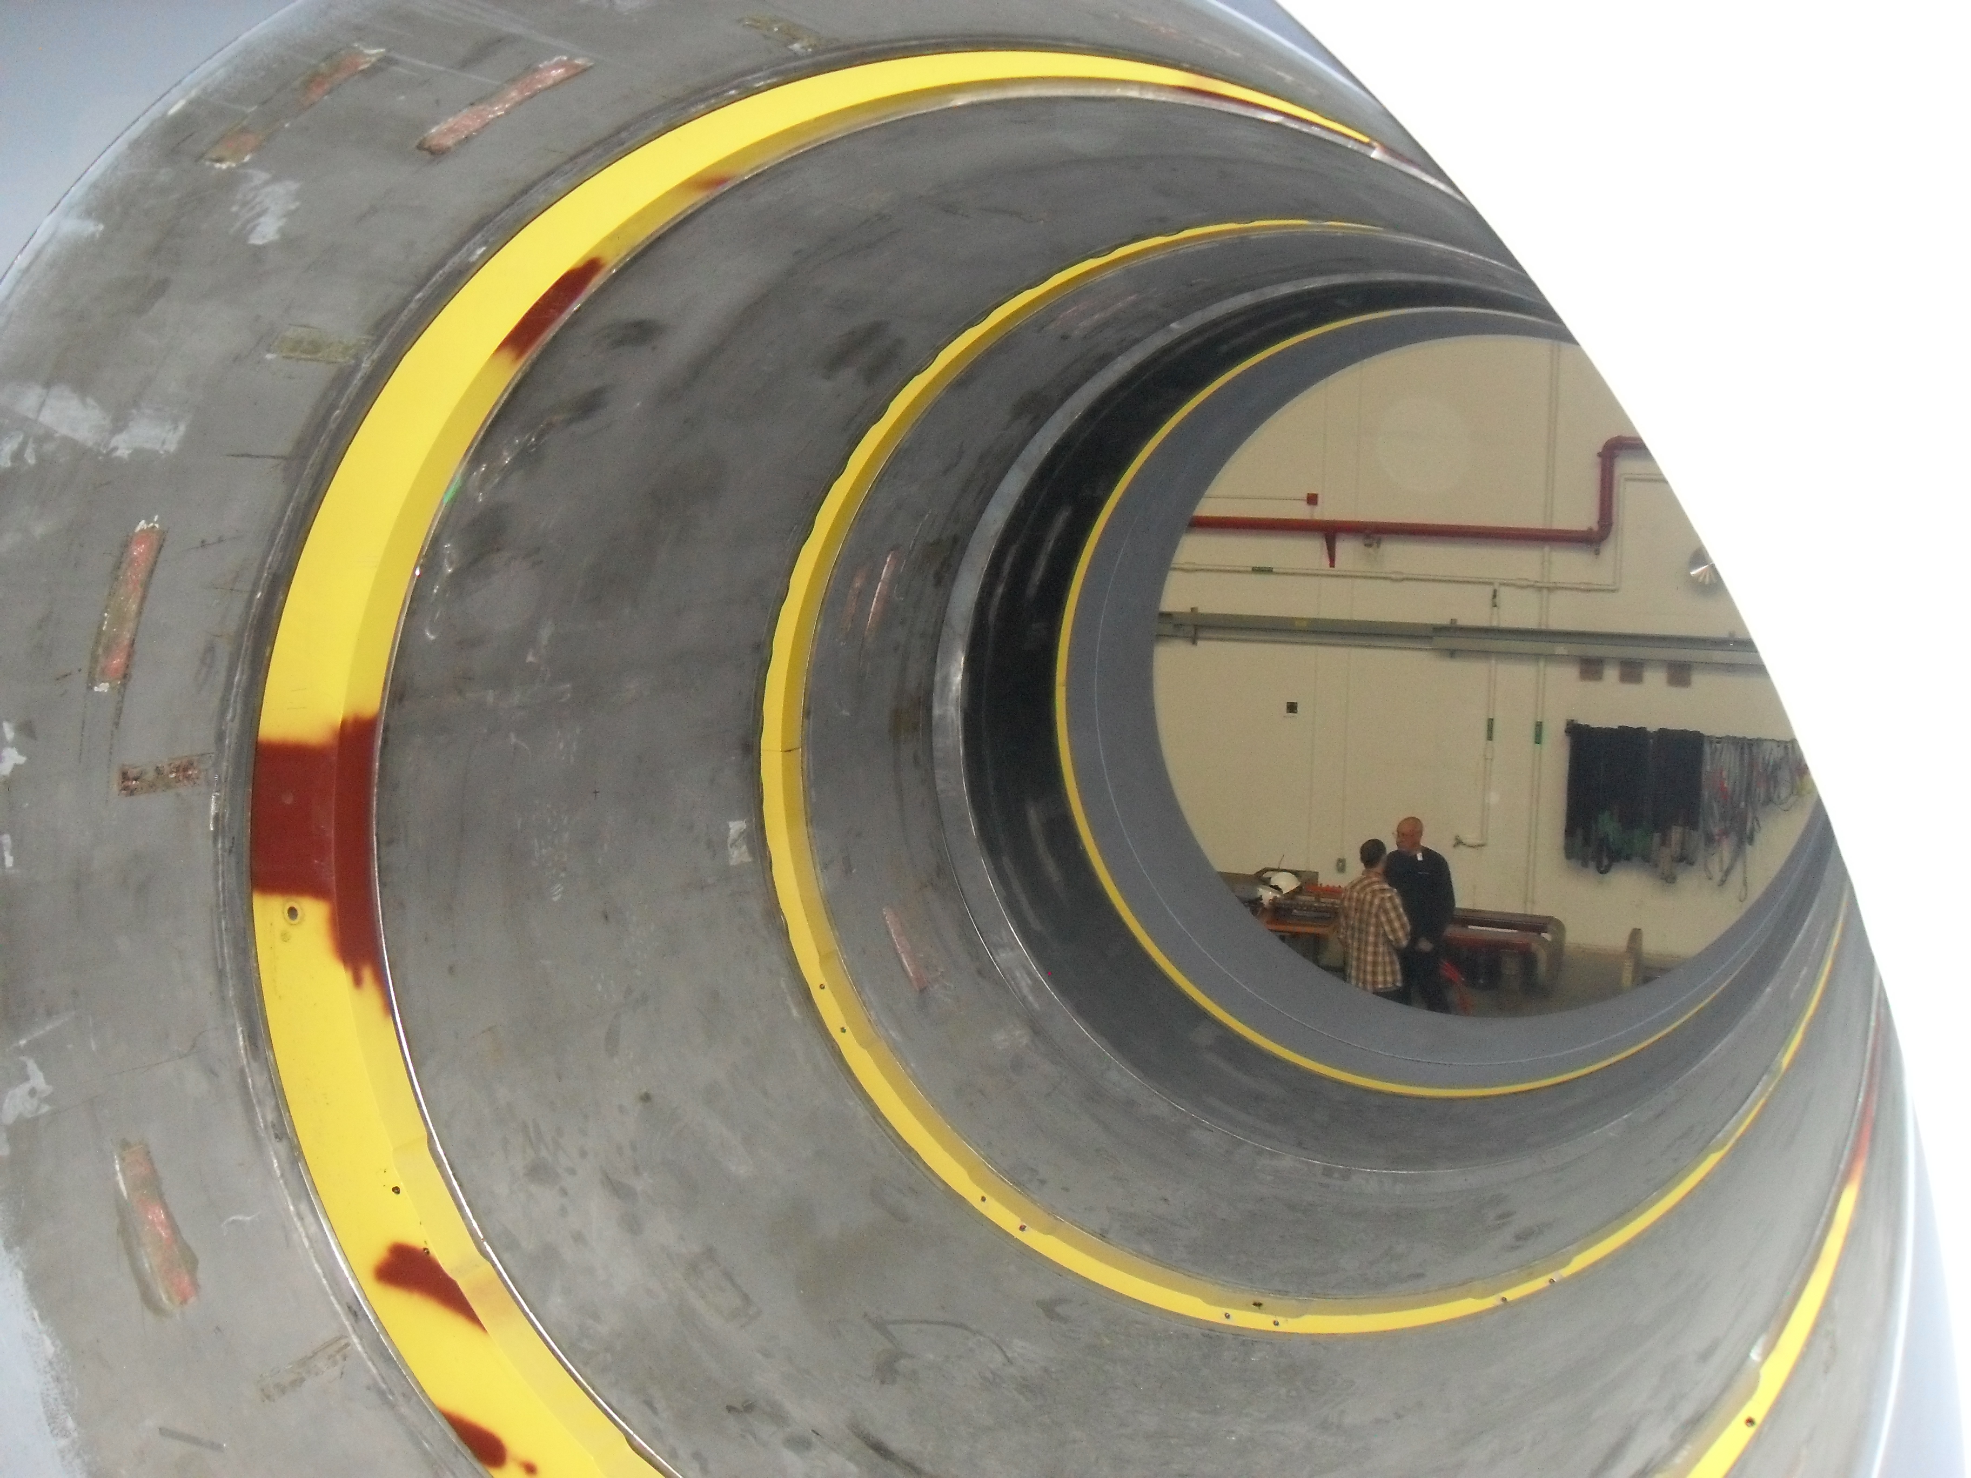
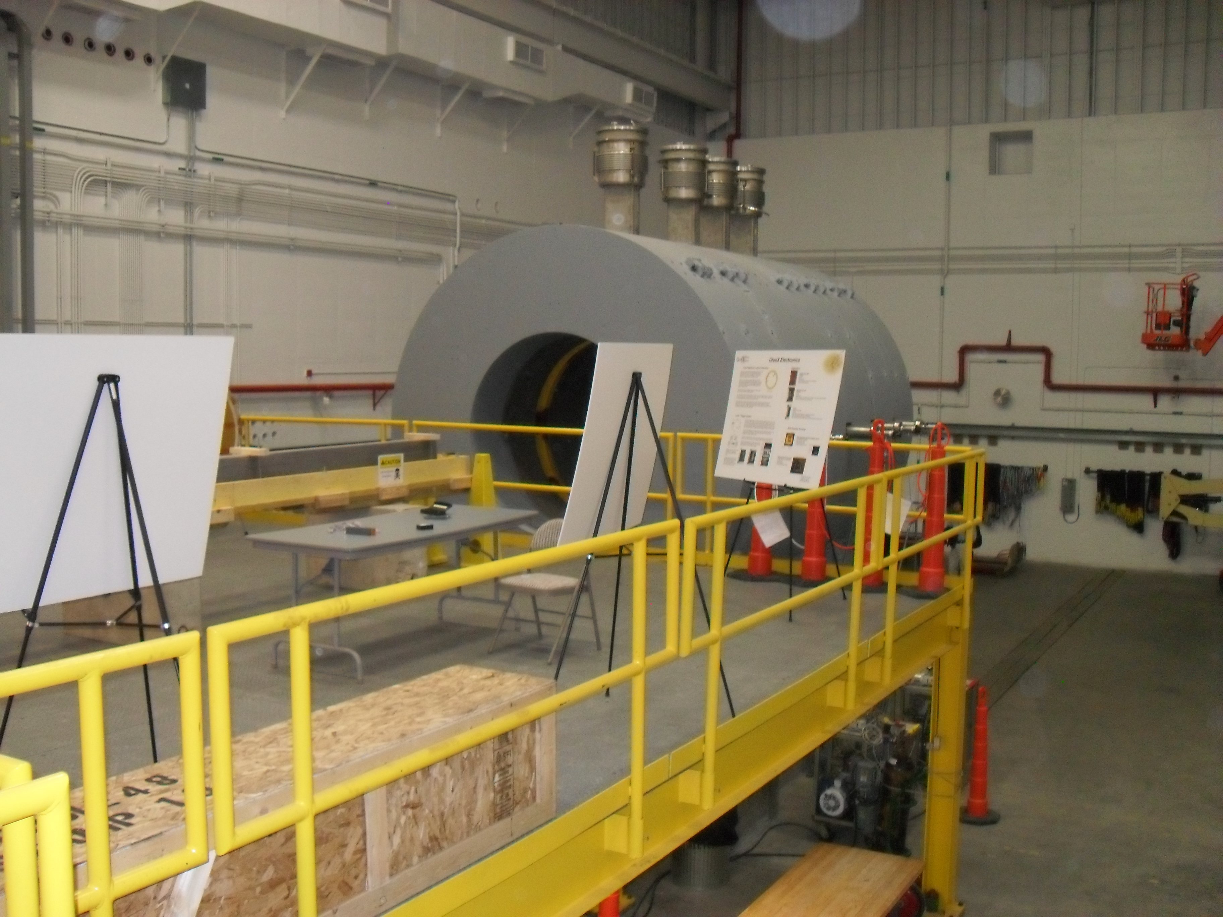
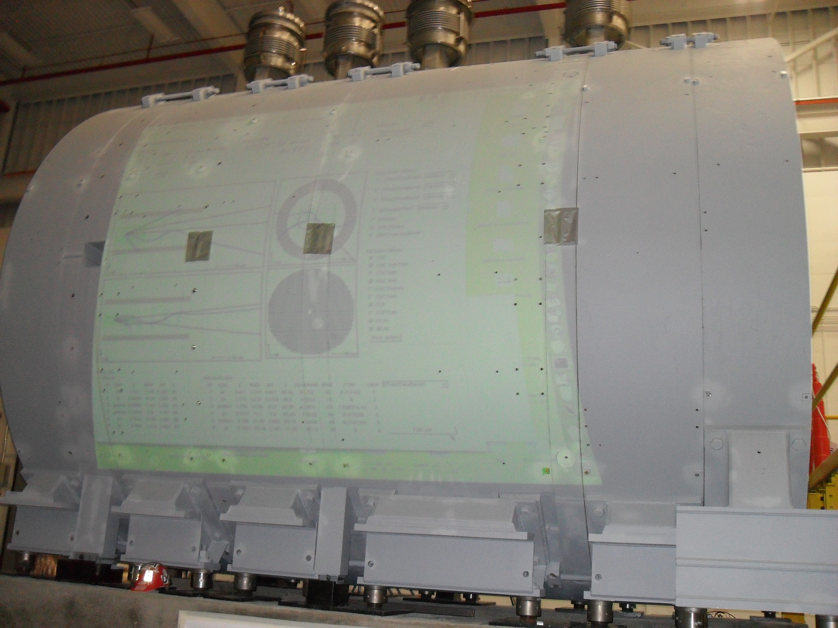
The Solenoid
Full-magnet tests in the fall.
Do we know
What color(s)
Yet?

Slide 4
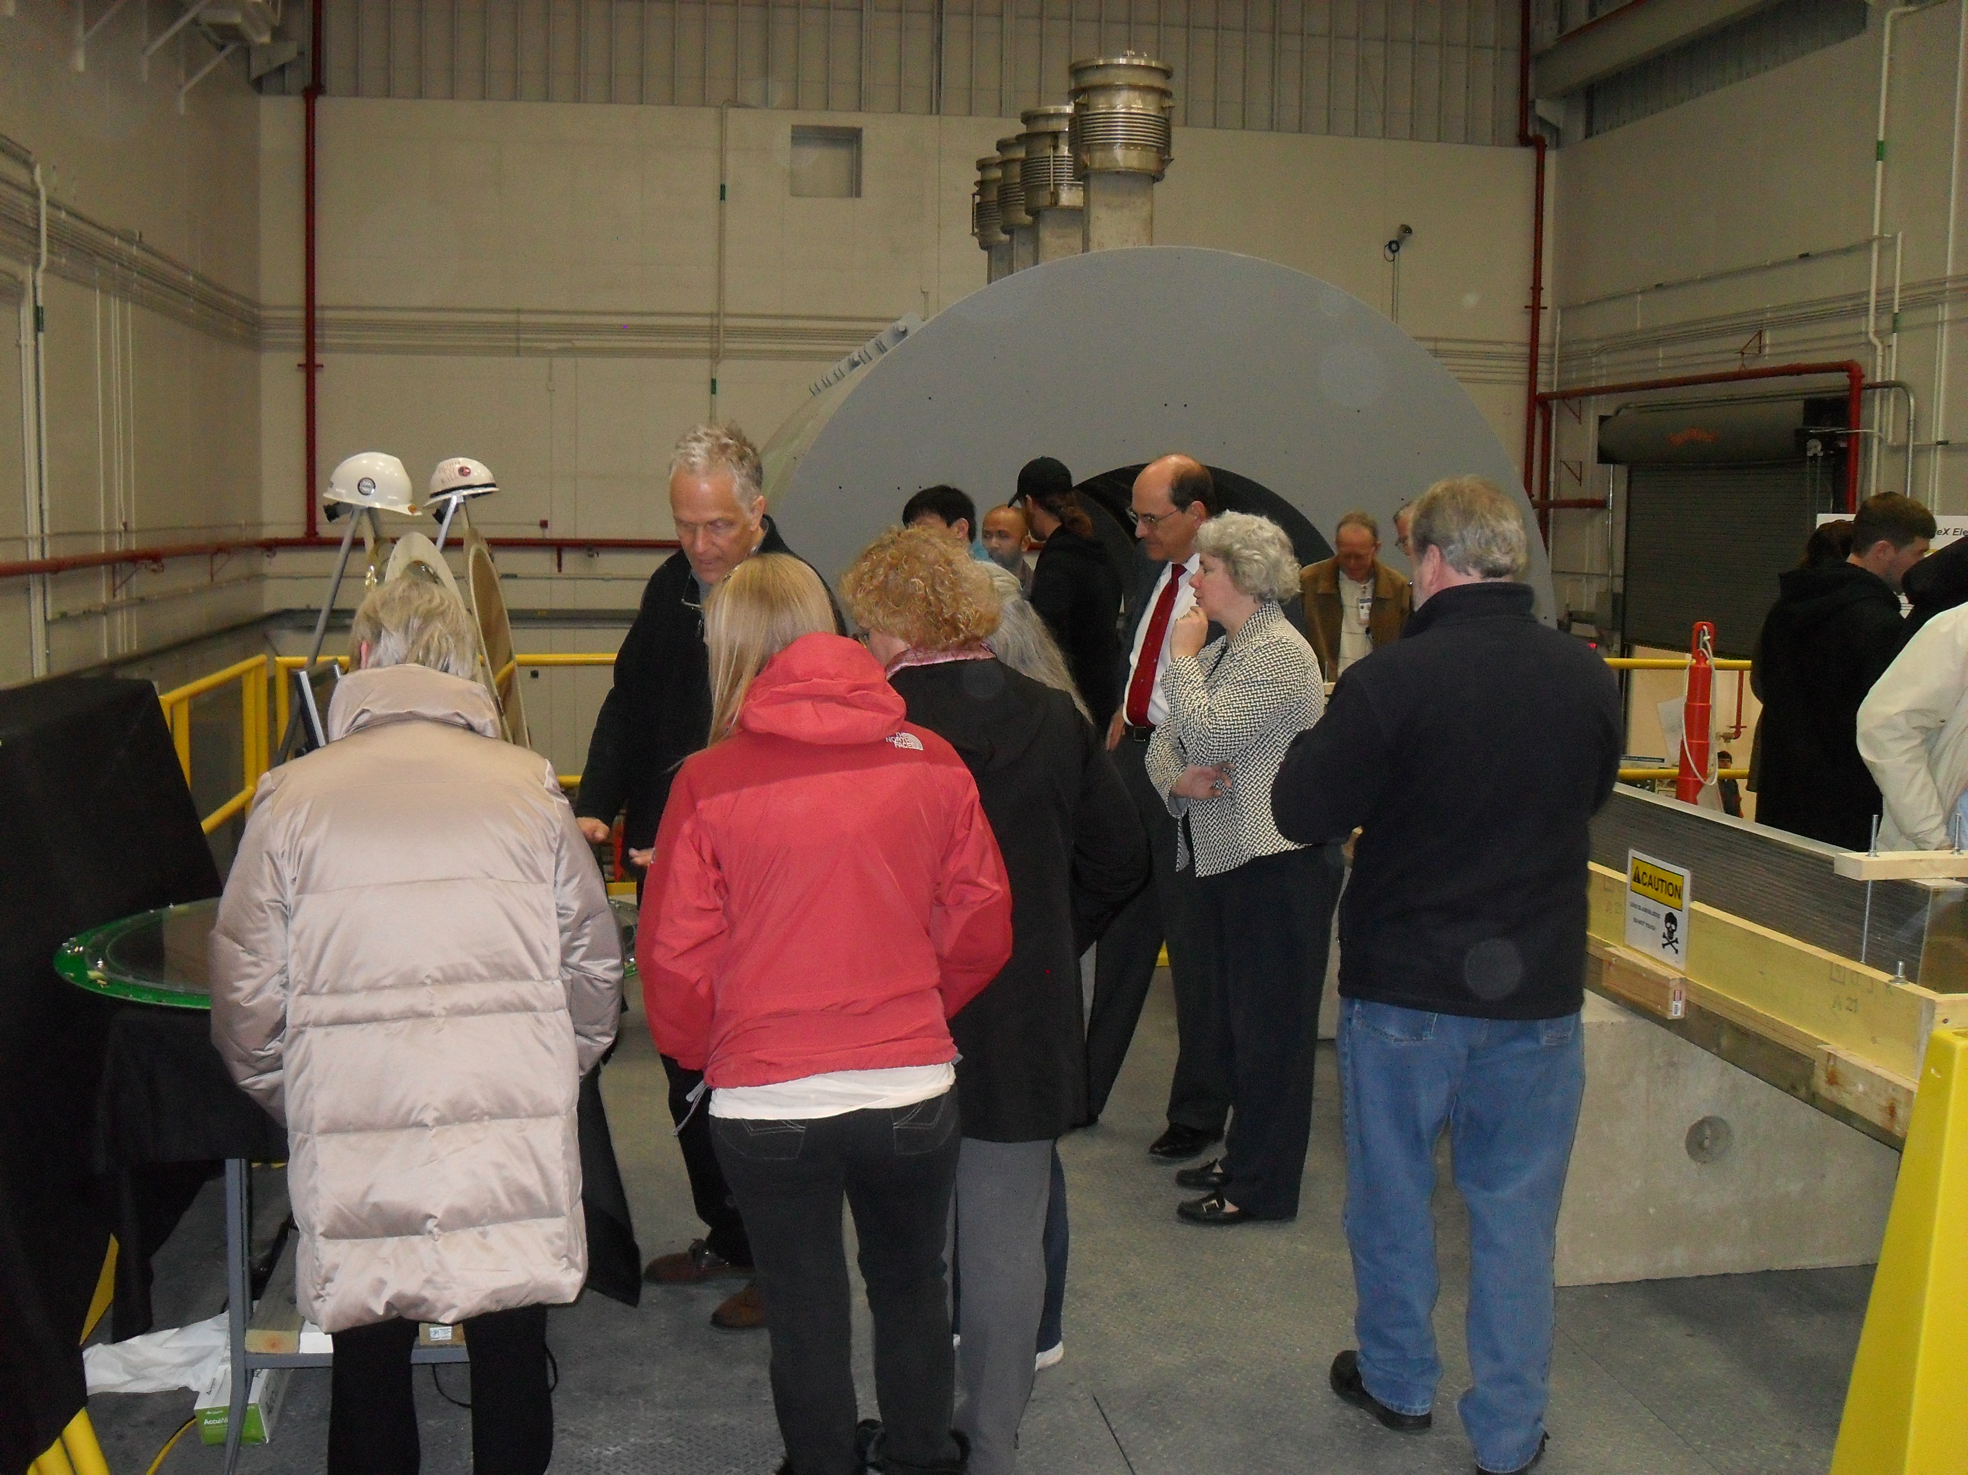
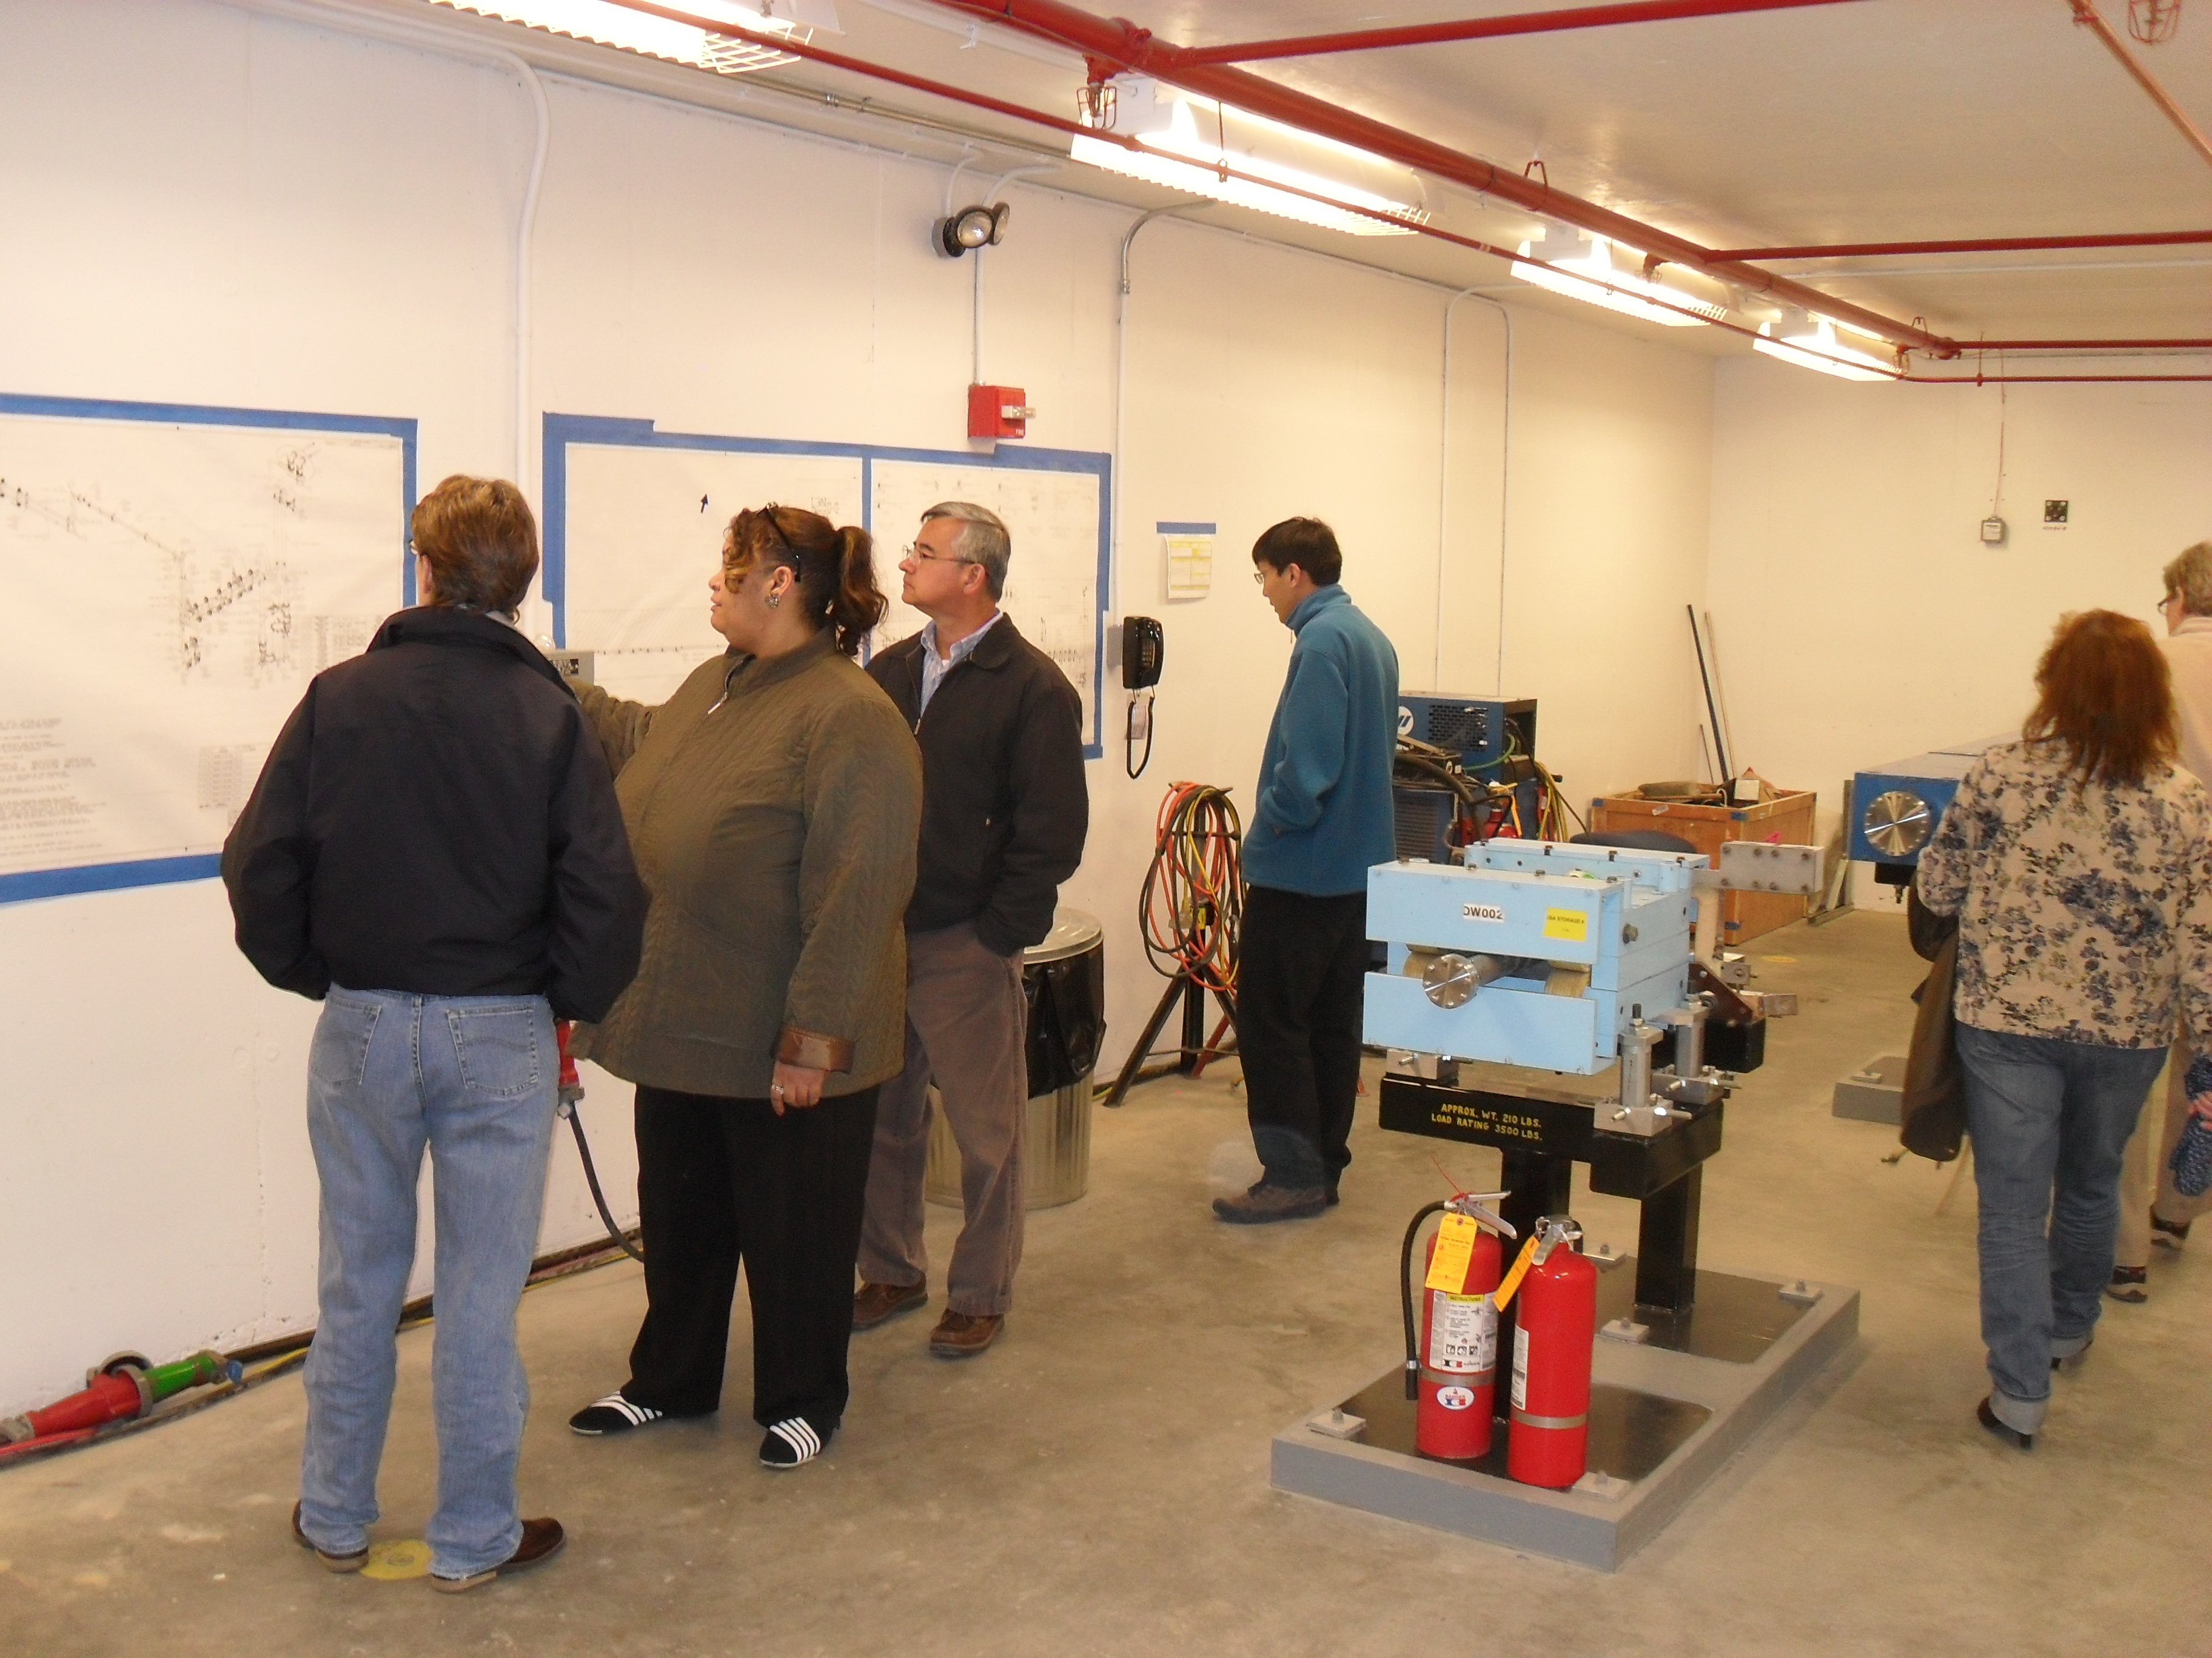
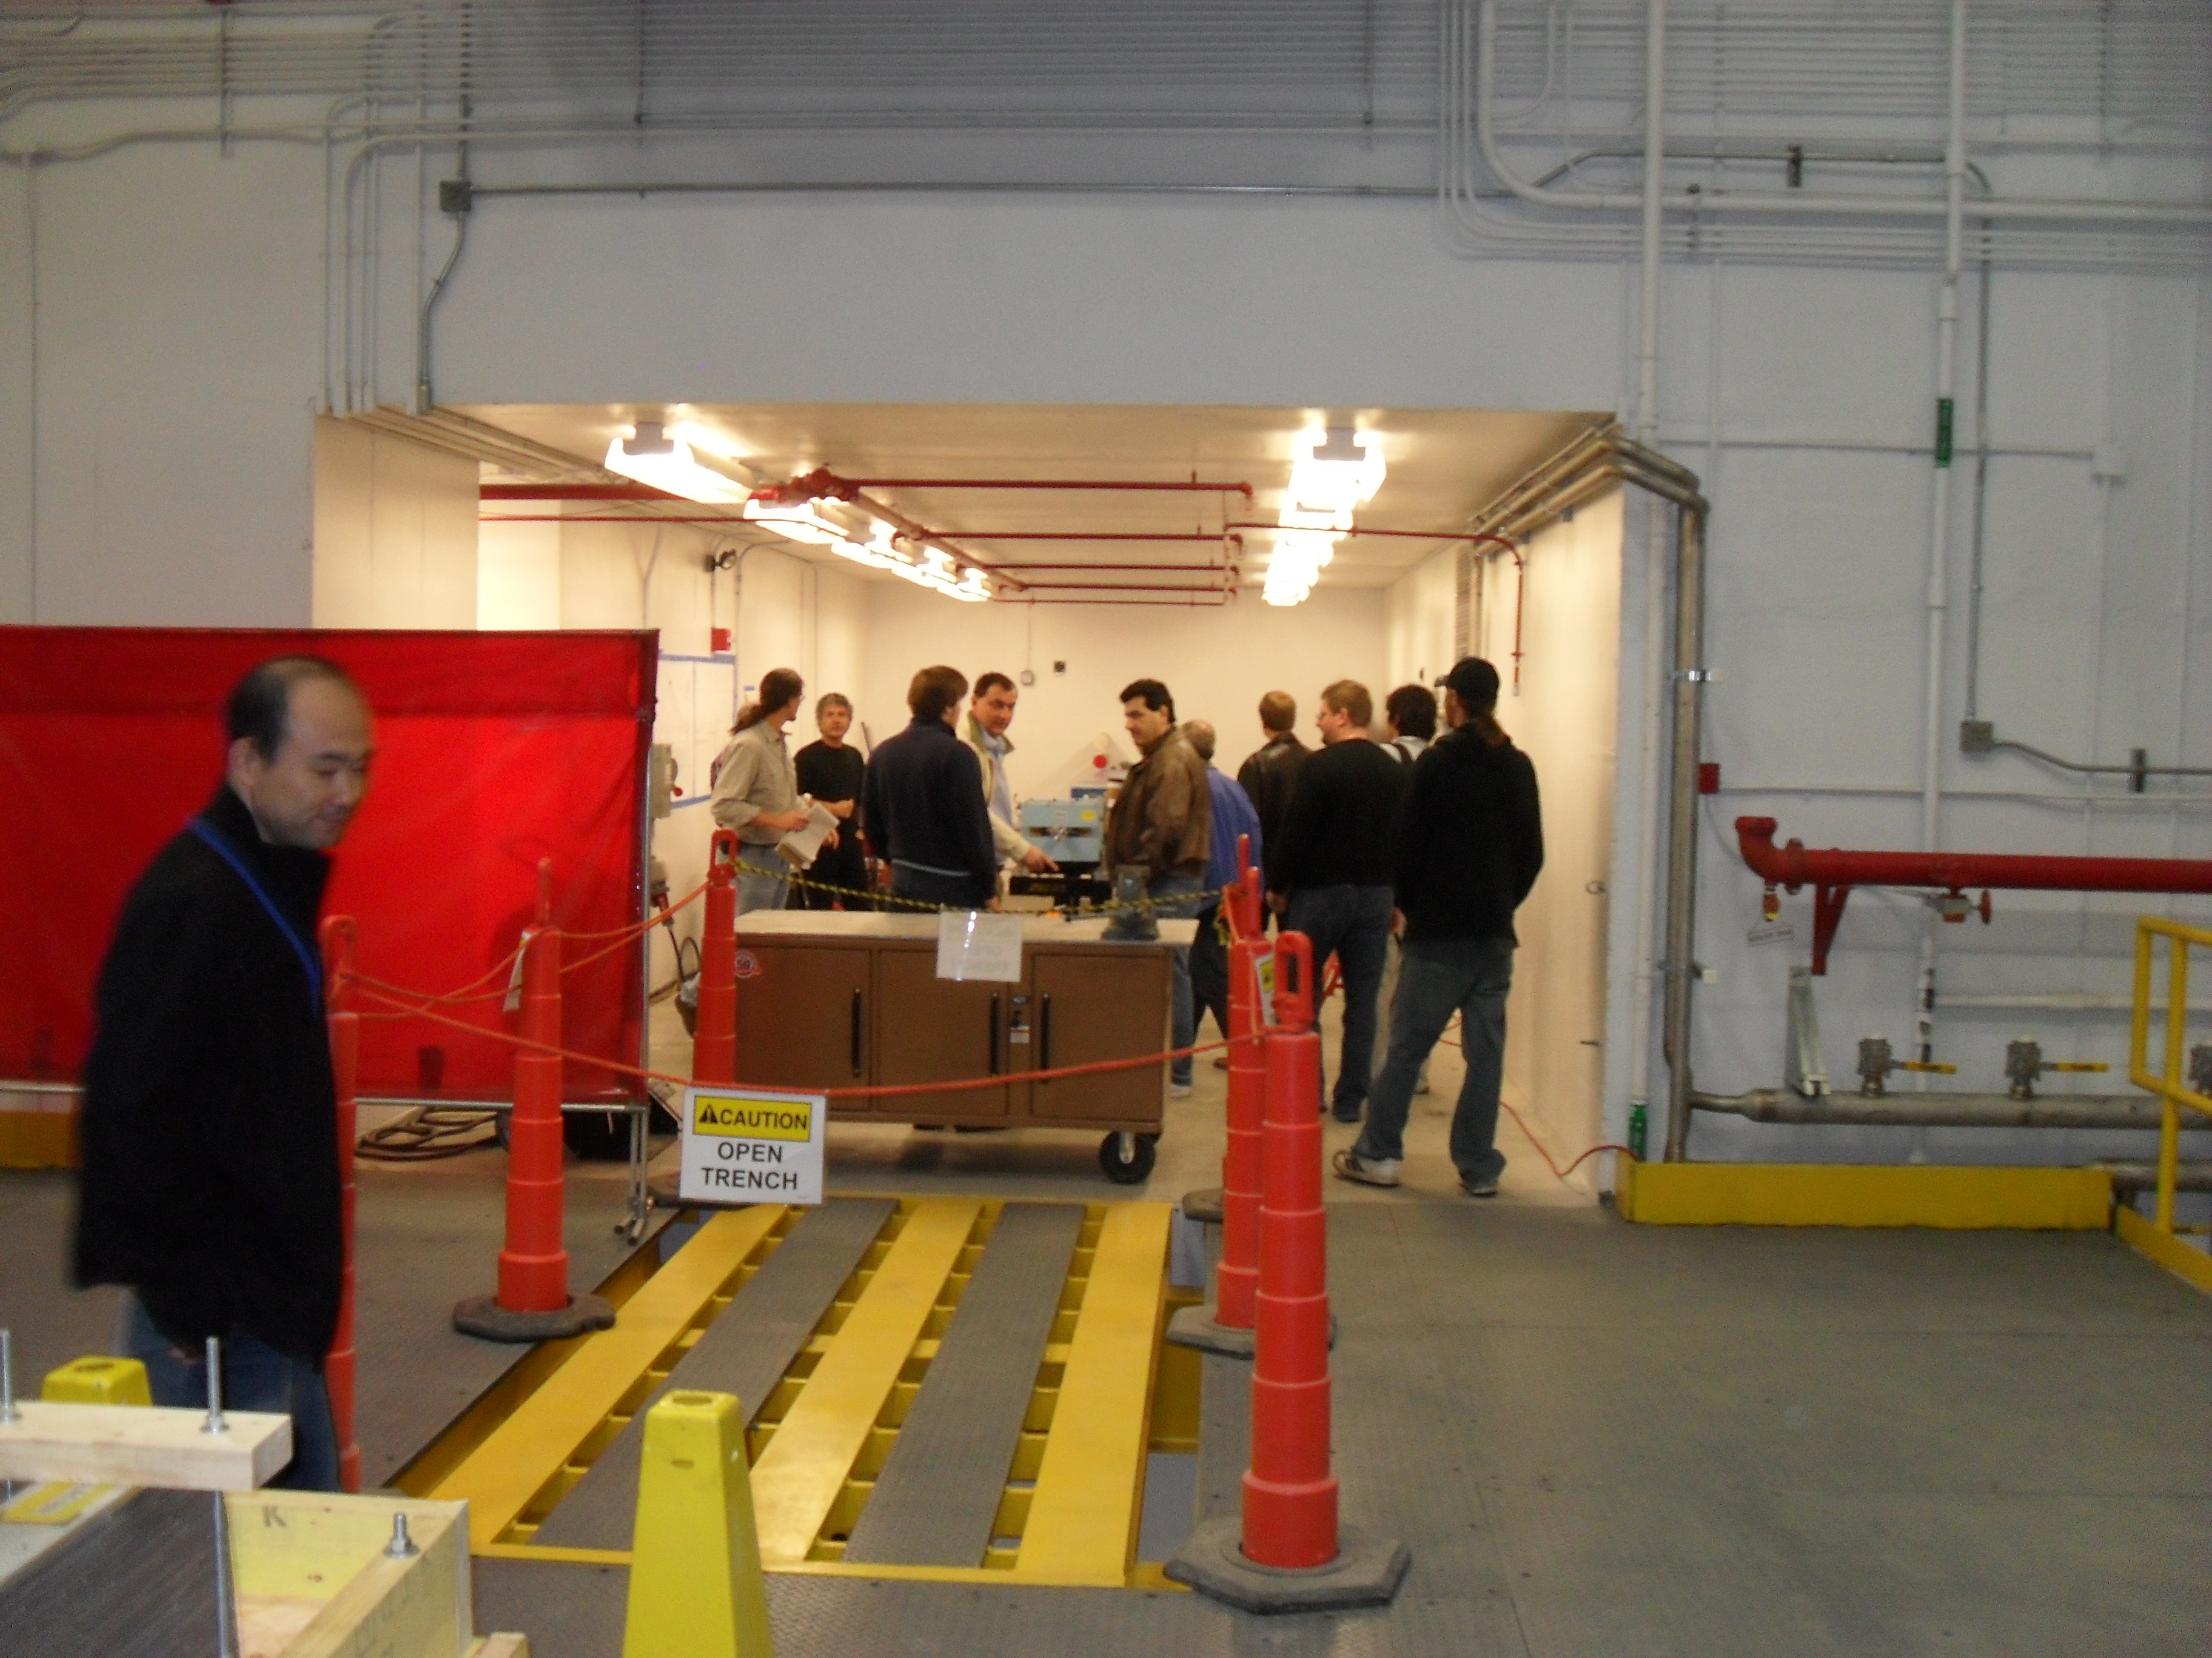
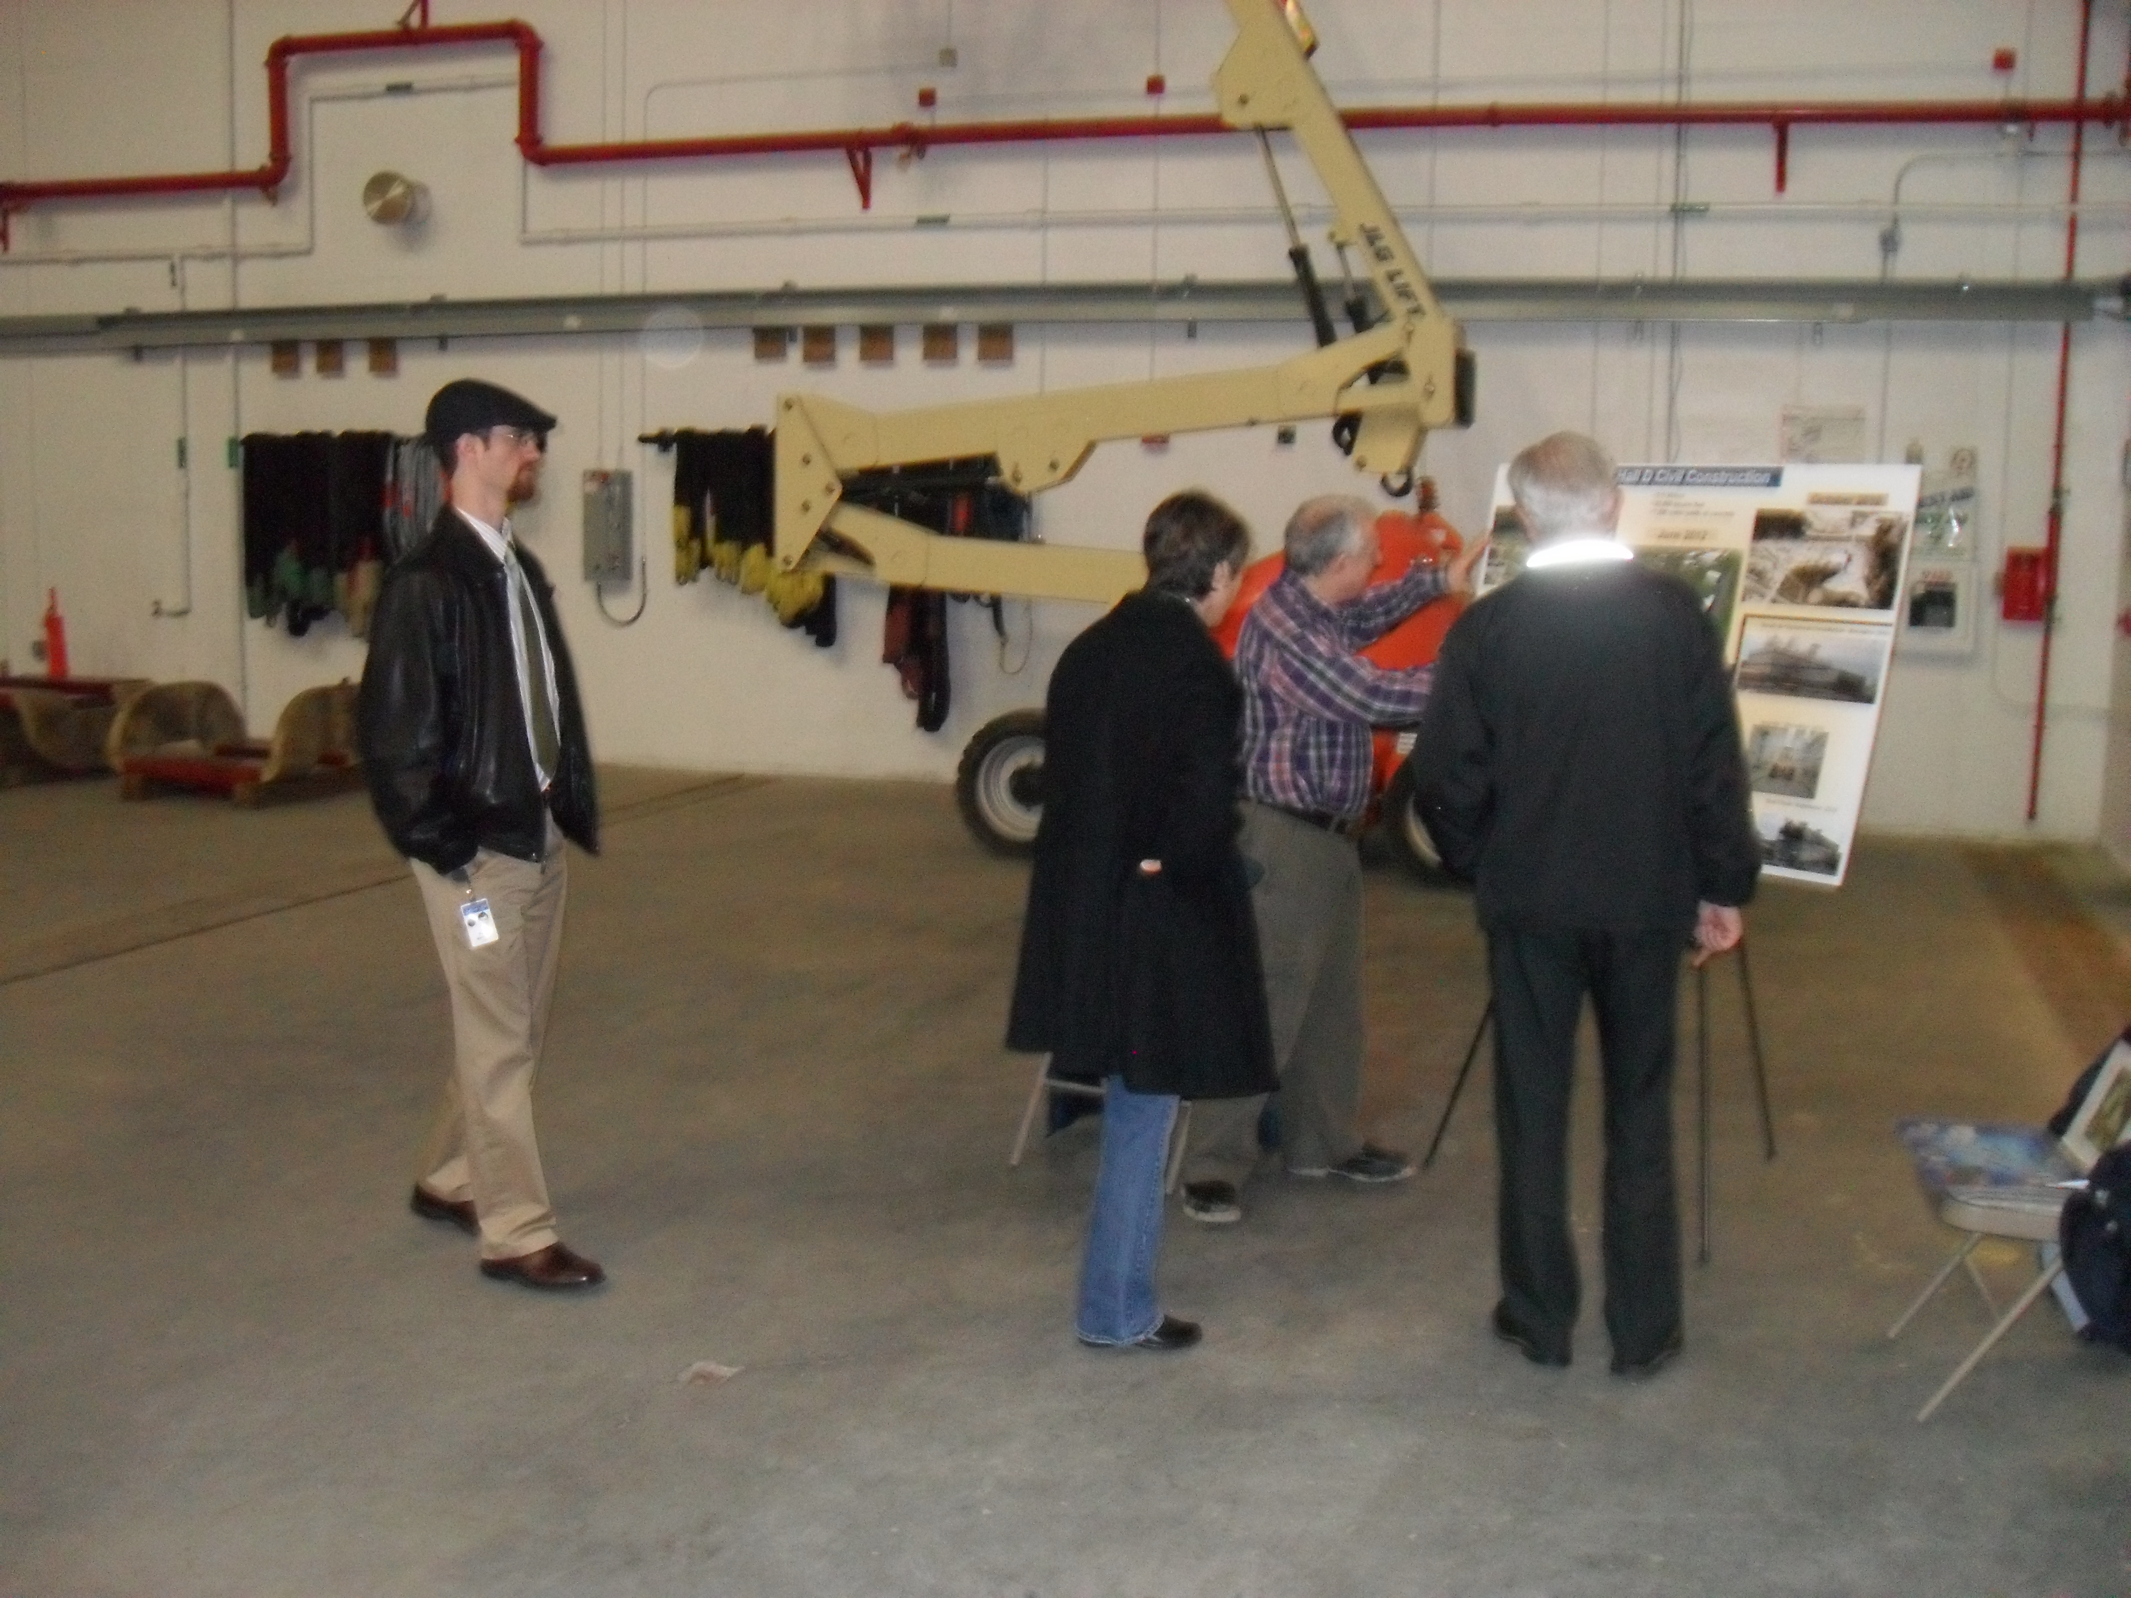
Hall-D Open House
January 11, 2012 --- nearly 400 people toured HallD

Slide 5
HallD & Tagger Hall
We now have beneficial occupancy of both the experimental hall and the tagger hall!
I think that we will have lunch-time tours of both buildings---one today and the other tomorrow.
You need GERTxx and SAFxxx training to go to the halls and they are hard-hat areas.

Slide 6
Elections
Spokesperson – my service was extended for a second 4-year term.
Deputy Spokesperson – Matt Shepherd agreed to take on this task. Thanks to George Lolos for his service.
Collaboration Board – The members are:
Liping Gan (new)
George Lolos (new)
Alex Somov (new)
Will Brooks (continuing)
Richard Jones (continuing)
Ryan Mitchel (continuing)

Slide 7
New Collaborators
The Arizona State Group – Barry Ritchie & Mike Dugger was voted into GlueX in November of 2011.
The MIT Group – Mike Williams and students will be discussed at the collaboration board meeting. Mike will talk briefly later this morning.
The Glasgow Gorup – Ken Livingston and Dave Ireland will be discussed at the collaboration board meeting.

Slide 8
More Reviews
Software Review in early June 2012. Appears to be to make sure that the software in all four halls is ready to go on time.
This software is not part of 12-GeV.
Eugene asked David Lawrence to coordinate this on the Jefferson Lab side.
I asked Matt Shepherd to coordinate this on the collaboration side.
David will report later this morning.

Slide 9
Workshop
On Wednesday May 2, 2012, we will have a one-day workshop at Jefferson Lab on possible upgrades to the GlueX detector.
Some of the topics are as follows, but more ideas are very welcome.
Particle Identification.
FCAL upgrades.
Polarimetry.

Slide 10
PAC Beam Request
We have been asked to submit a request to the PAC for additional GlueX beam time. This will be due in May and the PAC will be held in June.
The last PAC presentation was in August of 2010. This will be a nice opportunity to update the PAC on where we stand, and talk about what we would be able to do using higher-intensity beams and hopefully PID.

Slide 11
Enjoy the Meeting

