Slide 1
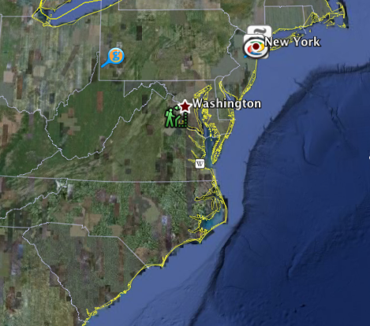
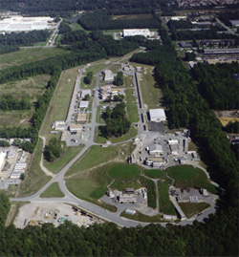
The GlueX Experiment and the 12GeV Upgrade at Jefferson Lab
April 12, 2012
David Lawrence JLab
Newport News, Virginia

Slide 2
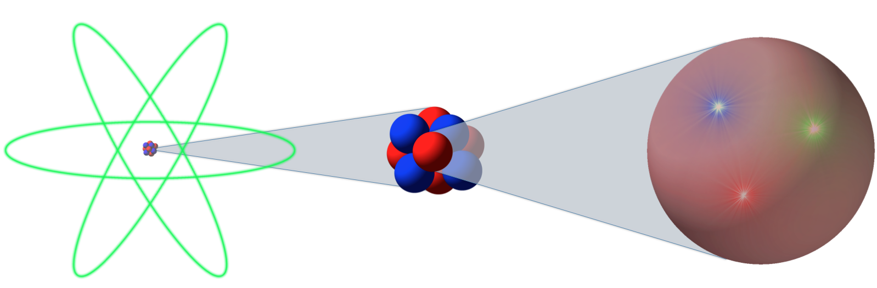
Atom
Nucleus
Nucleon
10⁻¹⁰ m
10⁻¹⁴-10⁻¹⁵ m
10⁻¹⁵ m

Slide 3
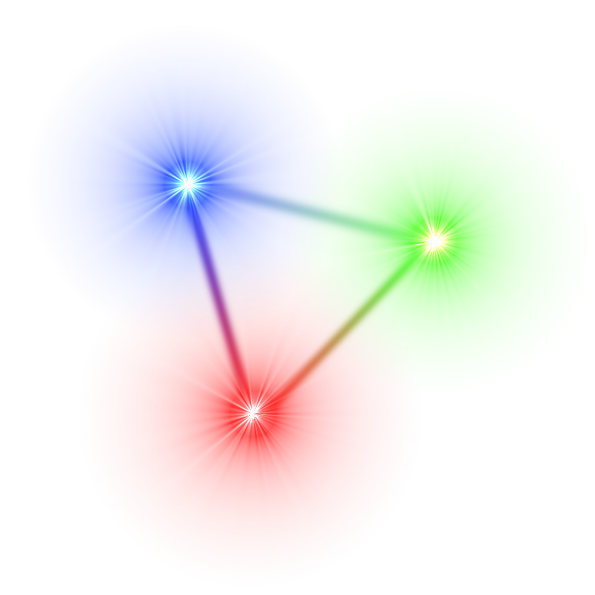
Protons and Neutrons are each made of 3 quarks
quarks
leptons
U = up
d = down
s = strange
c = charm
t = top
b = bottom
e = electron
ν_{e} = elec. neutrino
μ = muon
ν_{μ} = mu neutrino
= tauon
ν_{τ} = tau neutrino

Slide 4
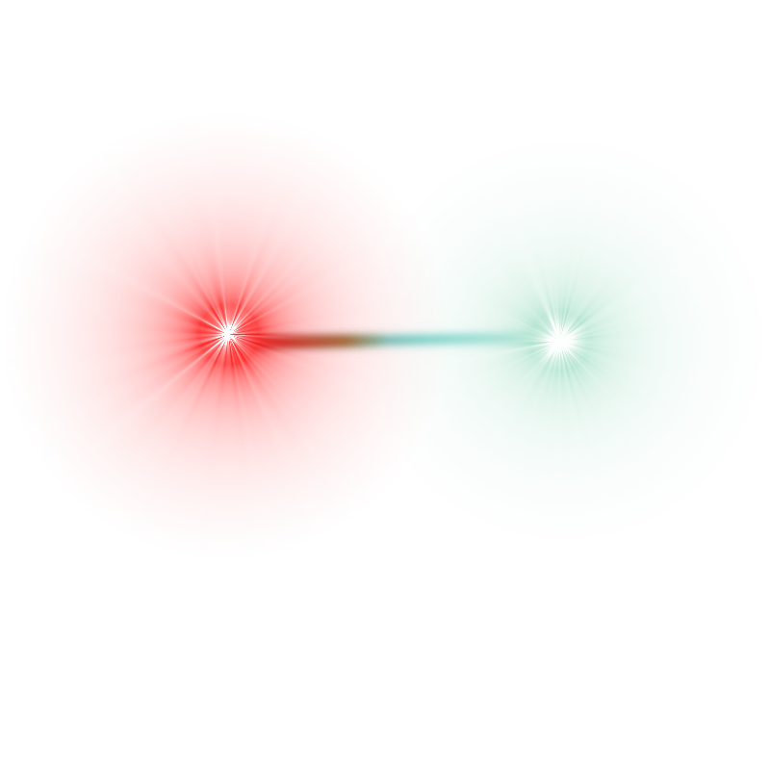
Quarks must combine into
“colorless” particles
“confinement” =
Each quark has a “color” charge of
“red”, “green”, or “blue”
Each anti-quark has a “color” charge of
“anti-red”, “anti-green”, or “anti-blue”
Mesons:
Baryons:
anti-quark color is opposite of quark color
2 quarks
qq
3 quarks
qqq
1 red quark
1 green quark
1 blue quark

Slide 5


Exotic Hybrid Mesons
Conventional meson has quantum numbers determined only by constituent quarks
Hybrid meson has some quantum properties due to contributions from the “glue”
J^{PC}
J = L + S
P = (-1)^{L+1}
C = (-1)^{L+S}
J^{PC} = 0⁻⁺, 0⁺⁺, 1⁺⁺, 1⁺⁻, 2⁻⁺, 2⁺⁺
J^{PC} = 0⁻⁺, 0⁺⁺, 0⁺⁻, 1⁺⁺, 1⁻⁺, 1⁺⁻, 2⁻⁺, 2⁺⁺, 2⁺⁻
“exotic” states

Slide 6
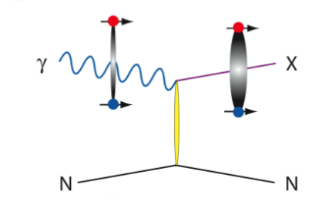
Creating Exotic Hybrids
A beam of energetic γs (particles of light) will be shot at a liquid Hydrogen target
A single γ will interact with a single proton
The γ energy will be used to create an exotic hybrid*
*Many different things can actually be created and only a small fraction of the time will it be an exotic hybrid
The γ wave function spends part of its time as a virtual quark/anti-quark pair
When interacting with the proton, this part can be selected with some of the energy going to excite the glue
The massless photon is essentially turned into a massive exotic hybrid meson with the proton recoiling away so that momentum and energy are conserved.
p
p

Slide 7
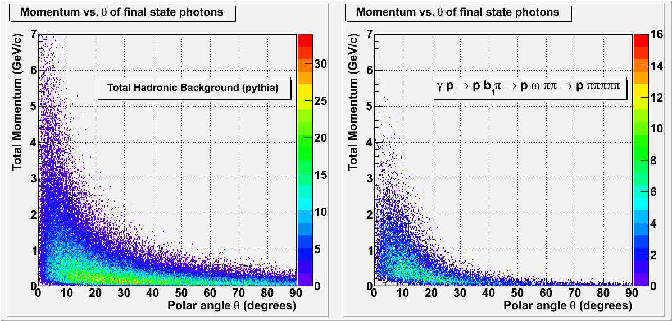
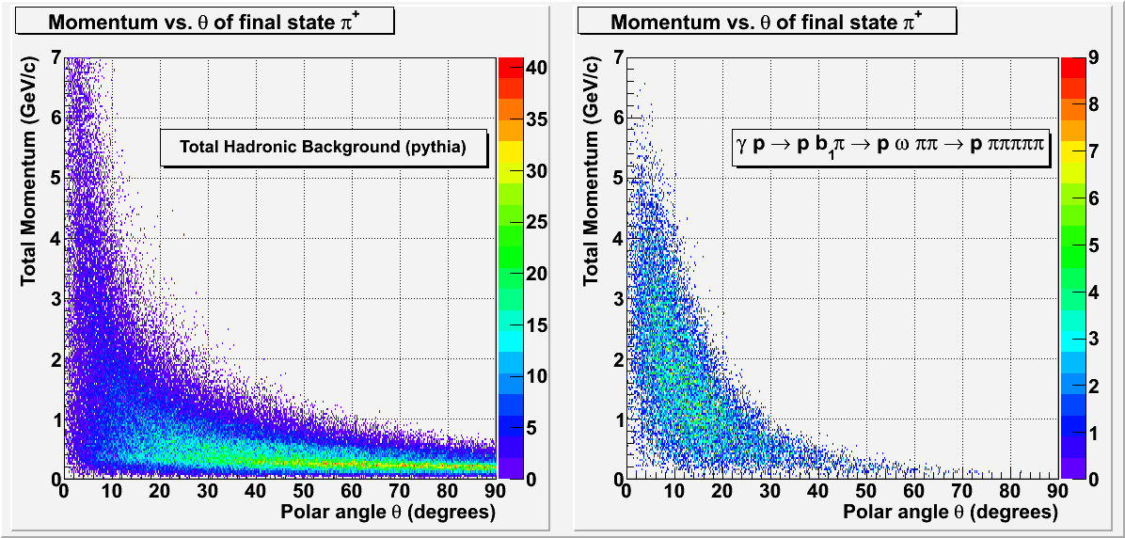
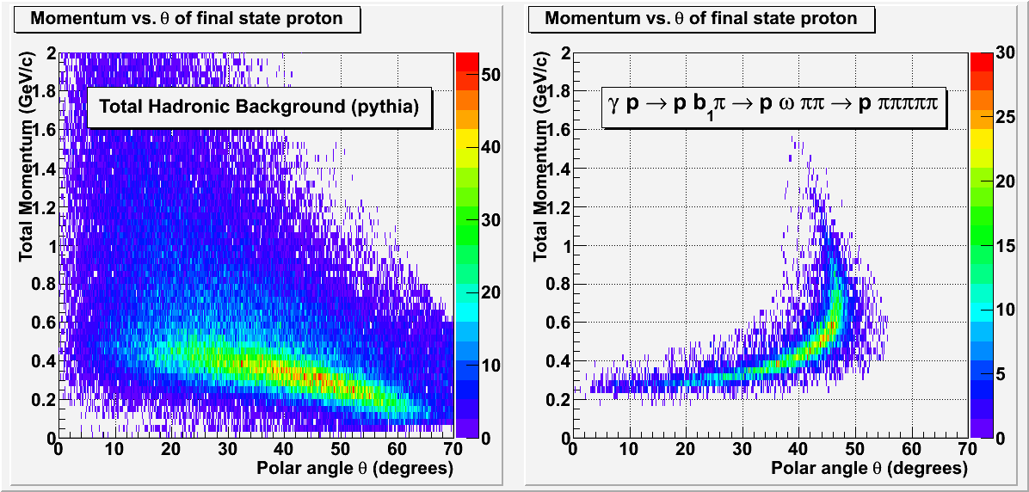
The GlueX Experiment
Goal: map the spectrum of exotic hybrid mesons
Method: Photo-produce hybrids off proton target and detect daughter particles from exotic hybrid meson decay
Two examples of the possible decay chain of “X”
(“X” will have a lifetime on the order of 10⁻²⁰ seconds)
detectable final state
9GeV linearly polarized
hybrid meson
(mixed charged and neutral)

Slide 8

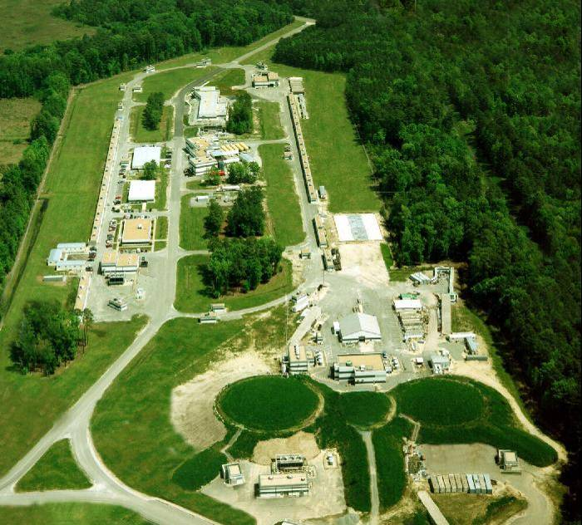
The Jefferson Lab Accelerator and Experimental Halls
Electron beam accelerator
  continuous-wave
  (1497MHz, 2ns bunch
  structure in halls)
  Polarized electron beam
  Upgrading to 12GeV
  (from 6GeV)
  70 μA max @ 12Gev
  (200μA max @ 6GeV)
Hall-D site
(old picture. Hall-D actually exists now!)
Existing experimental halls A, B, C

Slide 9
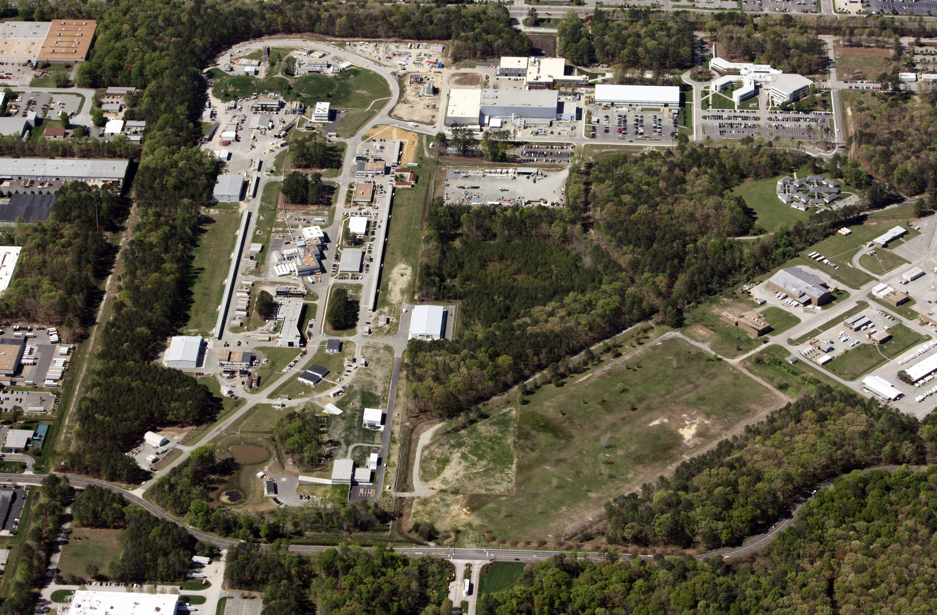
Aerial Photo taken April 3rd 2012
Warwick Blvd.
CEBAF Center
Hall-D
Canon Blvd.

Slide 10







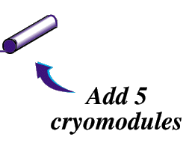
The JLab 12GeV Upgrade
6 GeV CEBAF
12 GeV CEBAF
11 GeV CEBAF
Upgrade magnets and power supplies
CHL-2
Two 1.1GV linacs
Two 0.6 GV linacs
Enhanced capabilities
in existing Halls
Notes:
help me

Slide 11
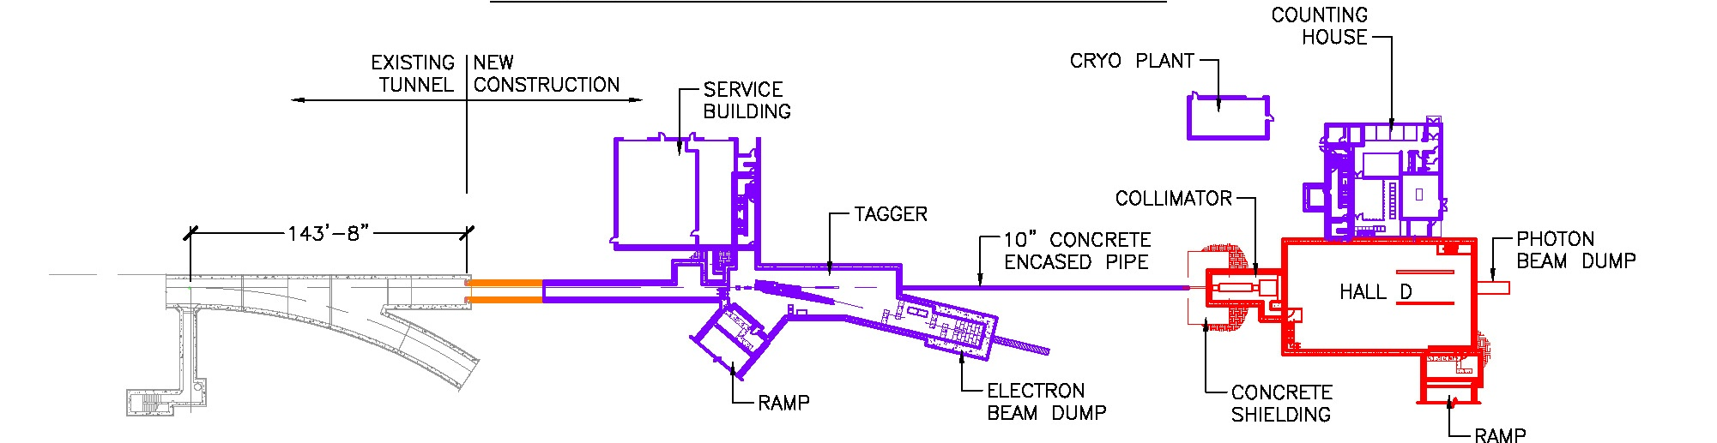
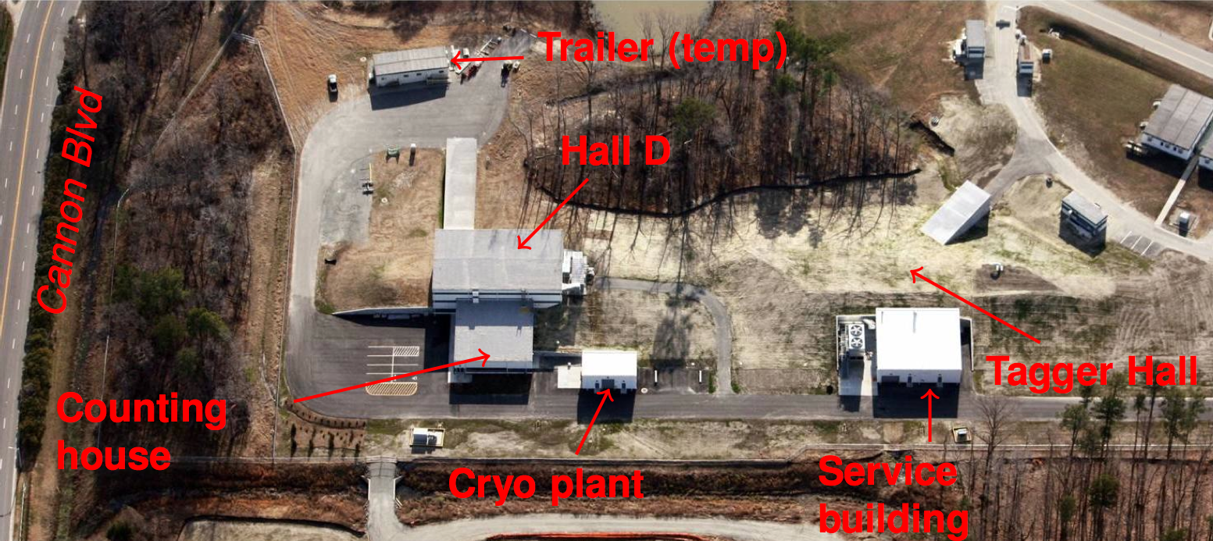
Hall-D Complex at Jefferson Lab
electron beam
~100 meters
Beneficial Occupancy of Hall-D received within the last few months.
Direction of pictures flipped!
electron beam

Slide 12
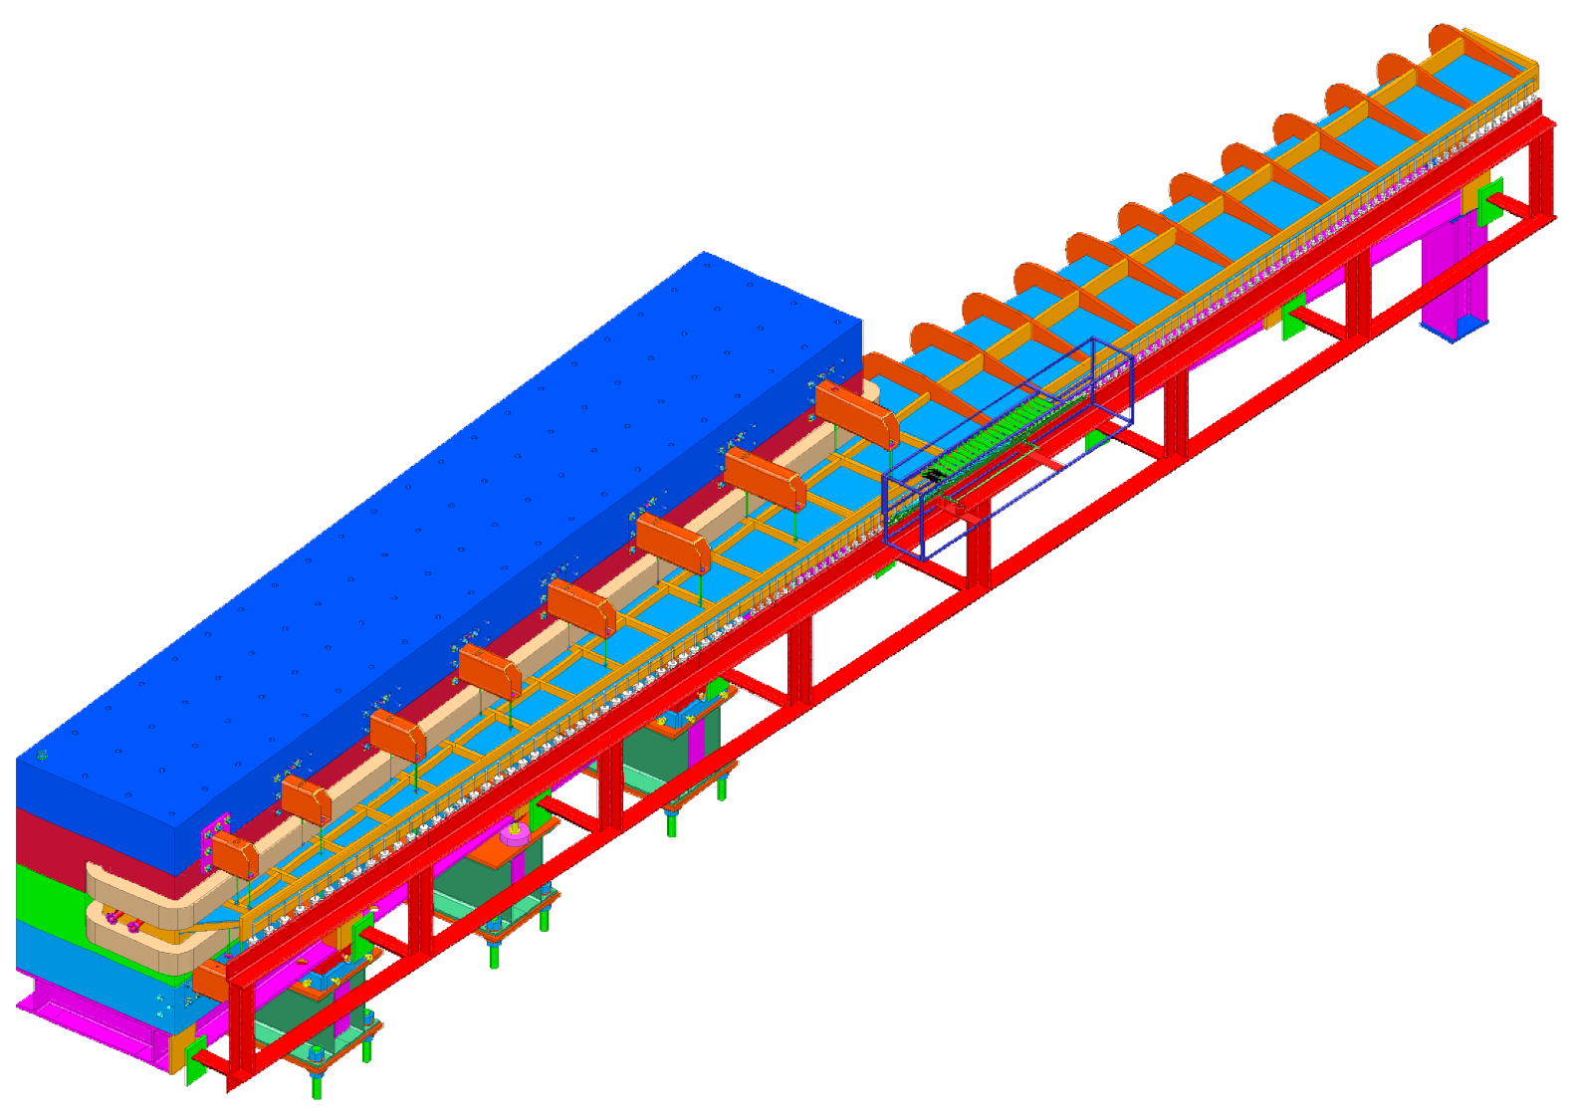
The Photon Tagger
1. Electron beam passes through very thin diamond
e⁻
2. A few electrons emit a photon as they go through
photon
12m long vacuum chamber
3. Electrons are bent in high magnetic field while photons go straight
e⁻
4. Electrons that gave up energy to photon are bent more by magnet
1.5T dipole magnet
5. Detectors measure remaining energy in electron thereby “tagging” the energy of the photon
The vacuum chamber (light blue region that extends into the magnet) is about 0.5 cubic meters in volume that is kept at 10⁻⁵ torr or better.
e⁻
Thin exit window presents risk of hearing damage should it rupture. (Ear plugs required!)
20μm diamond radiator

Slide 13
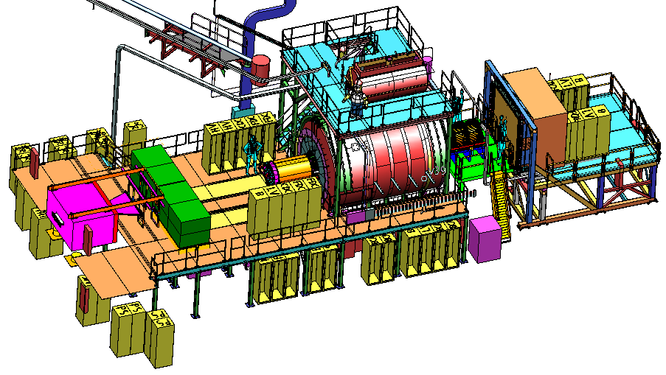
The GlueX Detector
2.2 Tesla
Solenoid
2.2T superconducting solenoidal magnet
Fixed target (LH₂)
10⁸ tagged γ/s (8.4-9.0GeV)
hermetic
TOF
time of flight
SC
start counter
Charged particle tracking
Central drift chamber (straw tube)
Forward drift chamber (cathode strip)
Calorimetry
Barrel Calorimeter (lead, fiber sandwich)
Forward Calorimeter (lead-glass blocks)
PID
Time of Flight wall (scintillators)
Start counter
Barrel Calorimeter

Slide 14
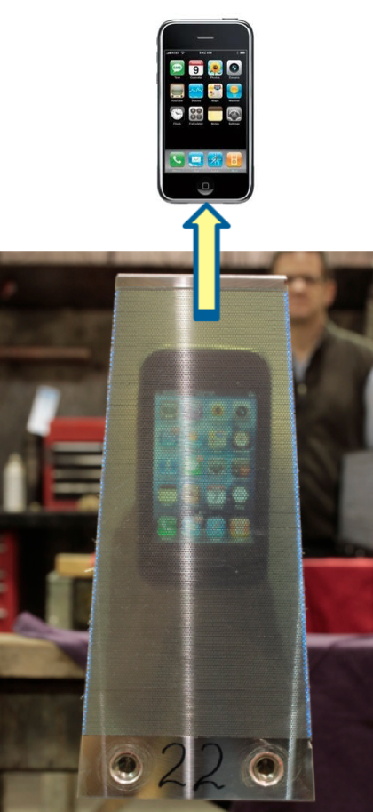
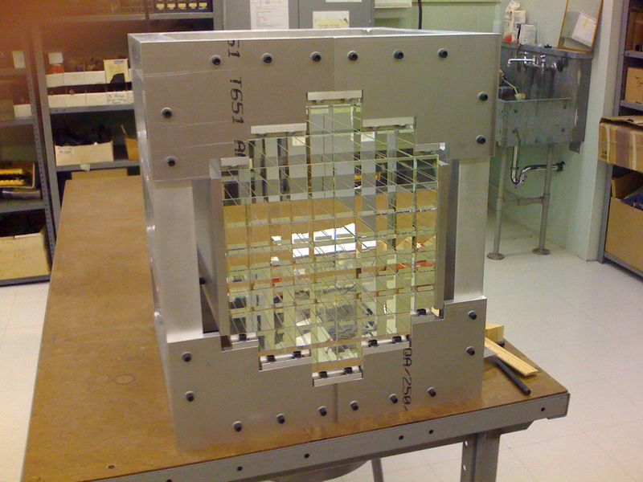
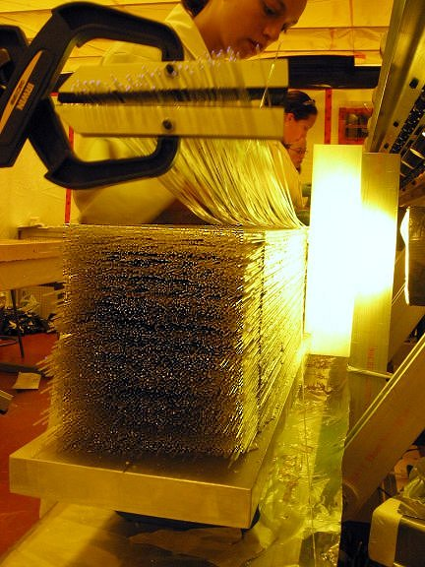
Calorimetry
γs coming from the target are neutral and therefore do not bend in a magnetic field.
Energy of the γ is measured by absorbing it in a thick, dense material.
Small amounts of light is produced as the energy is deposited.
Sensitive detectors are used to read out the light.
FCAL prototype with 72 lead-glass modules. The full detector will have ~2800 modules.
BCAL module under construction. Approximately 30k plastic fibers are used to make one module.
Completed BCAL module. The iPhone is placed against the opposing surface of the 4 meter module.

Slide 15
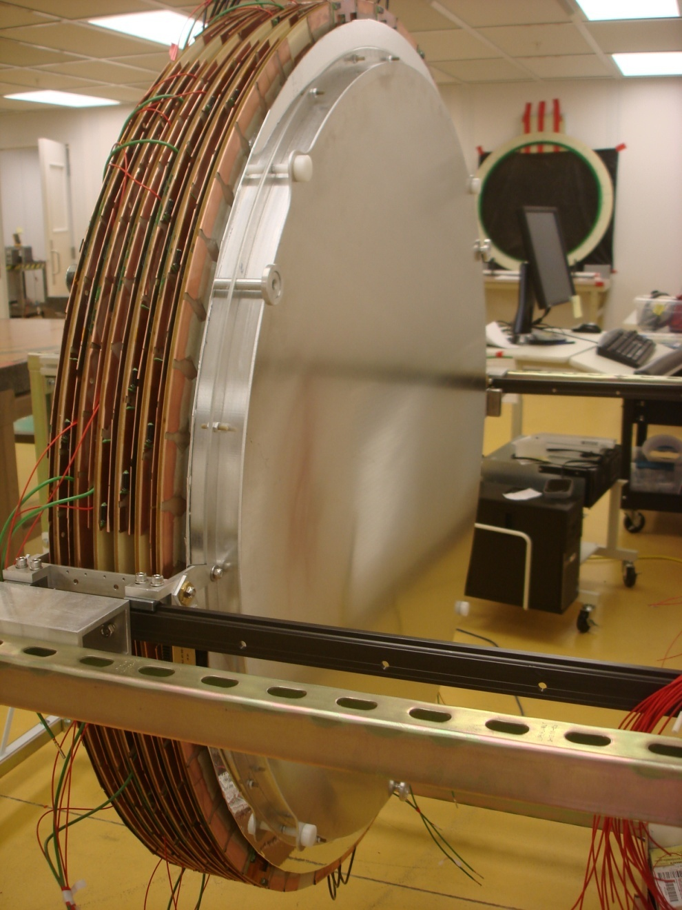
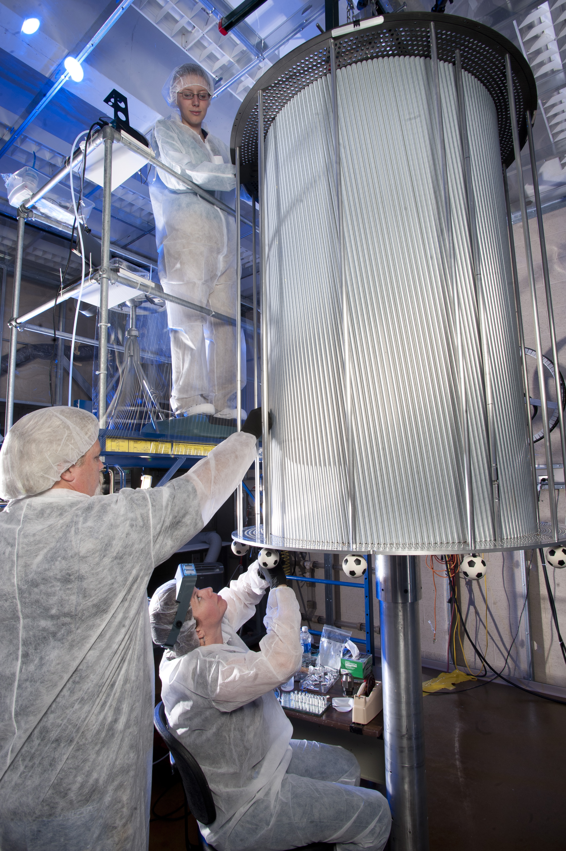
Charged Particle Detection
Charged particle momentum is measured by looking at its curvature in a magnetic field
As a particle passes through a gas-filled “drift chamber” it creates ions by occasionally knocking electrons loose
High Voltage creates a strong electric field that causes the electrons to drift toward a sense wire
The drifting electrons create more ions on the way eventually leading an avalanche that creates a signal big enough to measure
The Central Drift Chamber (CDC) being constructed at Carnegie Melon University. Construction is done with the device in the vertical position, but it will be turned sideways for installation.
A Forward Drift Chamber (FDC) being tested in the lab. The GlueX detector will have 4 of these custom made chambers.
B
v
F

Slide 16
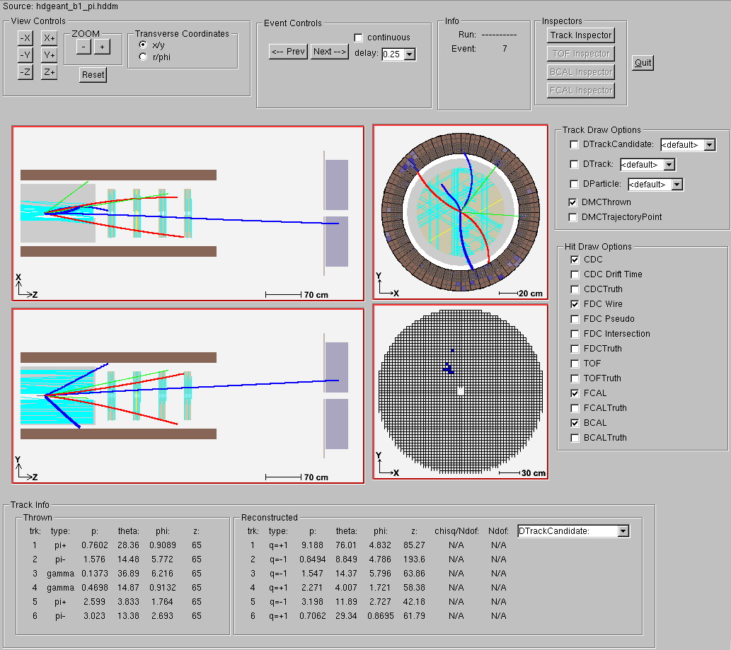
A single γ p ➔ pb₁π event
Final state: p π⁺ π⁺ π⁻ π⁻ πº

Slide 17
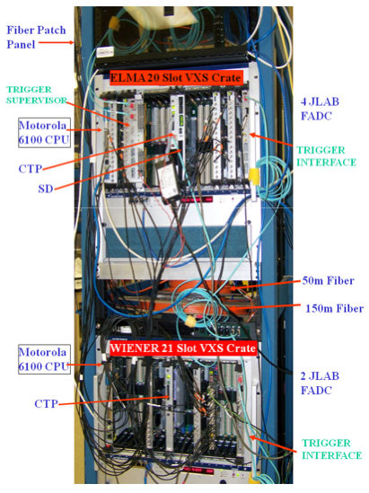
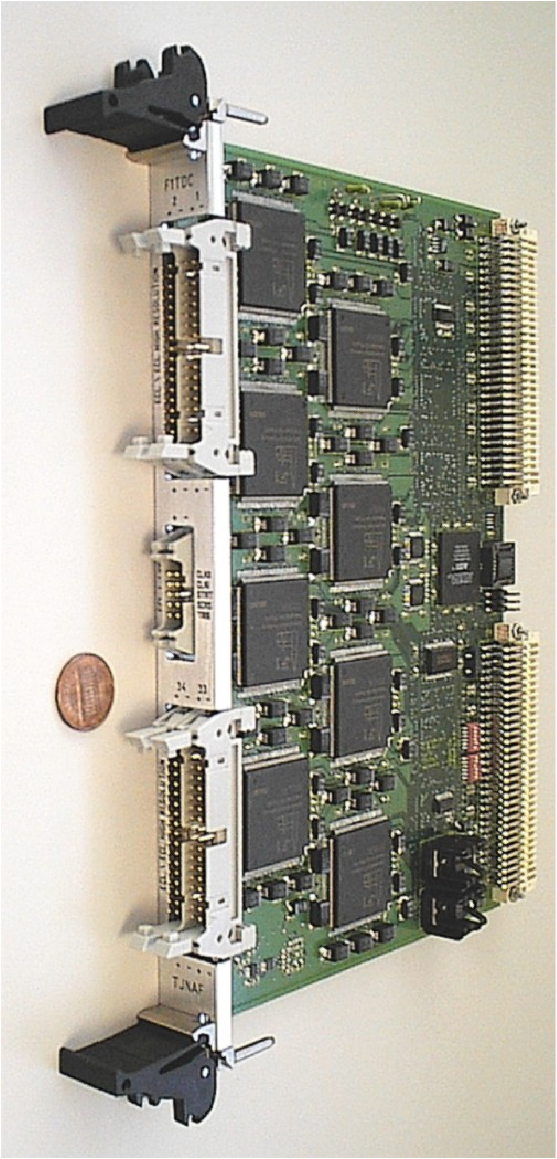
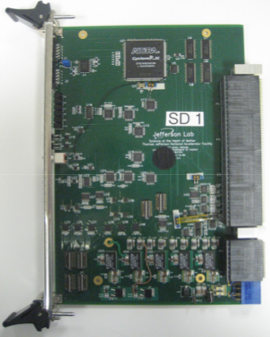
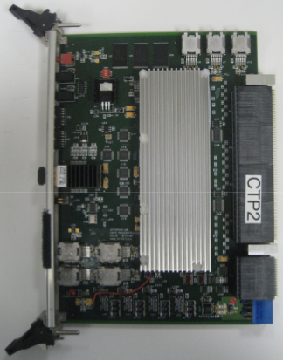
Electronics and Data Rates
Electronics
All digitization electronics are fully pipelined (VME64x-VXS)
  F1TDC (60 ps, 32 ch. or 115 ps 48 ch.)
  125 MHz fADC (12 bit, 72 ch.)
  250 MHz fADC (12 bit, 16 ch.)
Trigger latency ~3 μs
3GB/s readout from front
end
300MB/s to mass storage
3PB/yr to tape (that’s 3million GB/yr !)
Level 1 trigger test stand
F1TDC
Signal distribution board
Crate Trigger Processor

Slide 18
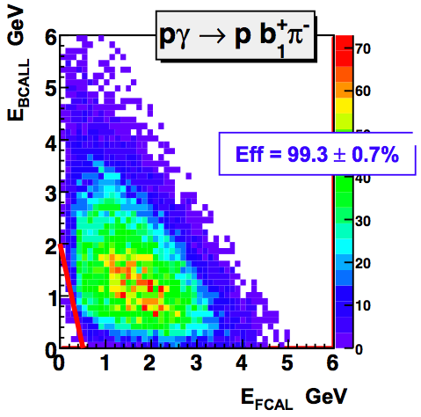
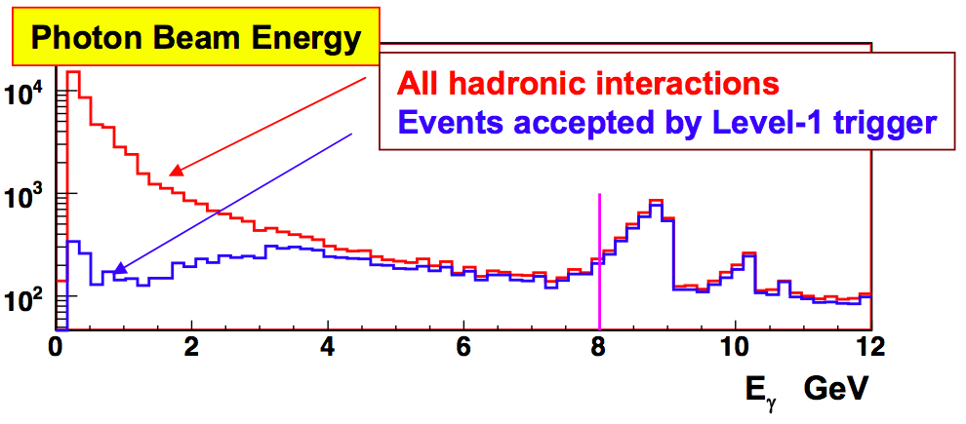
Level 1 Trigger
L1 trigger made from:
Hits in scintillators (tracks)
Total energy in Calorimeters
L1 trigger made from:
Hits in scintillators (tracks)
Total energy in Calorimeters
L1 trigger made from:
Hits in scintillators (tracks)
Total energy in Calorimeters
All fast (<100ns) detectors used in trigger
γ beam
Digital integration of calorimeter responses
Hardware (FPGA) implementation of complex trigger logic

Slide 19
GlueX Data Rates
David Lawrence, Jefferson Lab
 | Front End DAQ Rate | Event Size | L1 Trigger Rate | Bandwidth to mass Storage
GlueX | 3 GB/s | 15 kB | 200 kHz | 300 MB/s
CLAS12 | 0.1 GB/s | 20 kB | 10 kHz | 100 MB/s
ALICE | 500 GB/s | 2,500 kB | 200 kHz | 200 MB/s
ATLAS | 113 GB/s | 1,500 kB | 75 kHz | 300 MB/s
CMS | 200 GB/s | 1,000 kB | 100 kHz | 100 MB/s
LHCb | 40 GB/s | 40 kB | 1000 kHz | 100 MB/s
STAR | 50 GB/s | 1,000 kB | 0.6 kHz | 450 MB/s
PHENIX | 0.9 GB/s | ~60 kB | ~ 15 kHz | 450 MB/s
private comm.
JLab
CHEP2007 talk
Sylvain Chapelin
LHC
BNL
*
**
* Jeff Landgraf Private Comm. 2/11/2010
** CHEP2006 talk Martin L. Purschke. current capability is 800MB/s peak, 500MB/s sustained (priv. comm. 2/14/2010

Slide 20
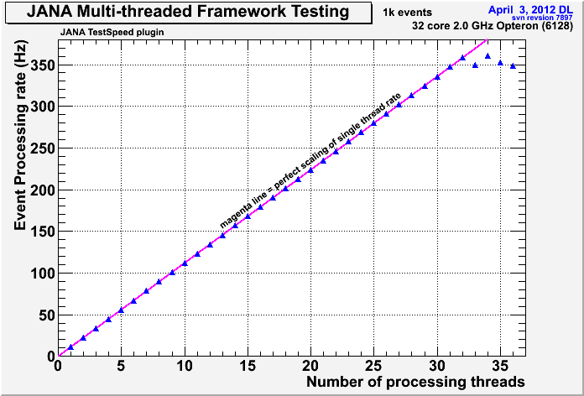
Multi-threaded event processing
Reconstruction of events requires a large amount of custom software.
Many physicists must contribute to the software and so it must be developed in a modular framework
Farms of computers are used to process all of the data
Reconstruction is done using multi-threaded, parallel programming techniques that take advantage of modern many-core CPUs

Slide 21
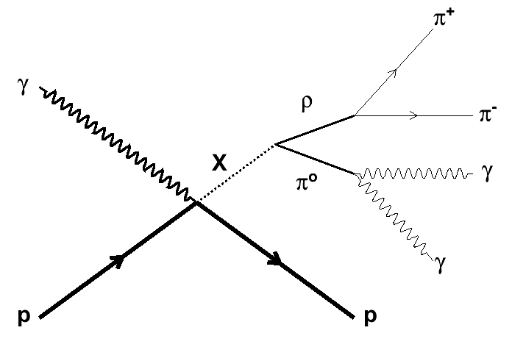
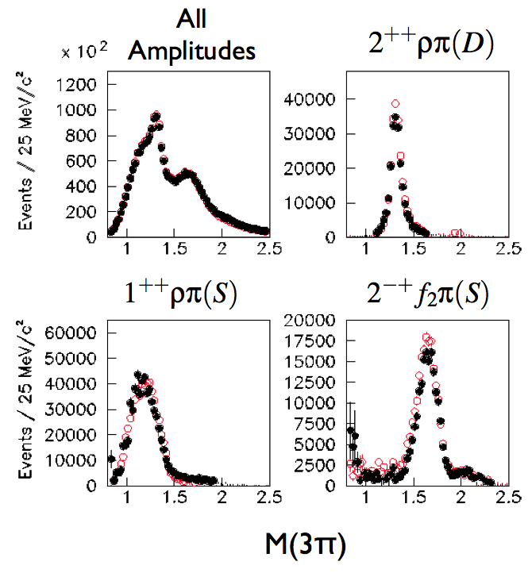
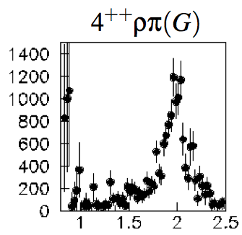
Amplitude Analysis
Angular and momentum distributions of decay products can tell you something about the quantum state of the decaying meson
Impossible to determine quantum state of an individual event. Only statistical analysis reveals contributions from different states

Slide 22
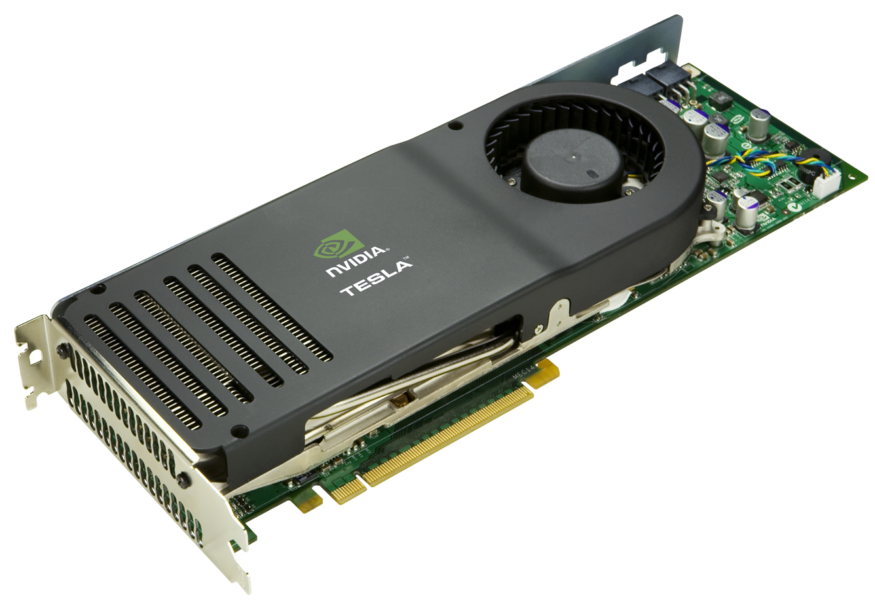
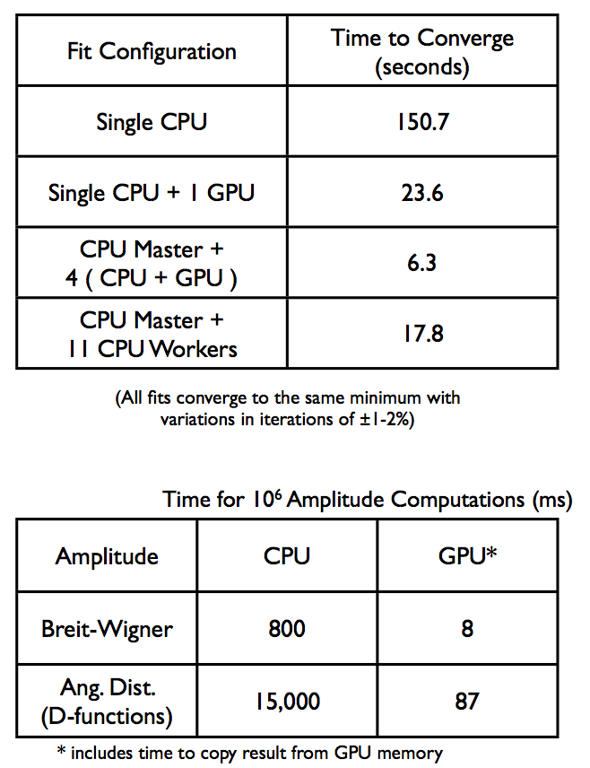
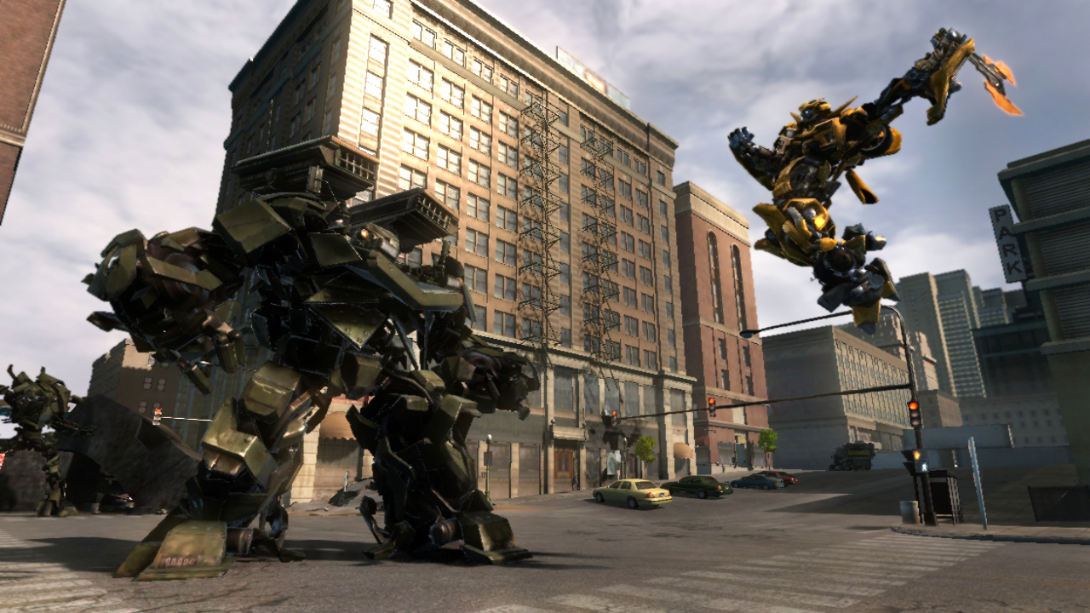
Amplitude Analysis and GPUs
Graphics Processing Units (GPUs) developed for the gaming industry are finding many applications in the scientific community.
GPUs are massively parallel devices that turn out to be well suited for certain applications including Amplitude fitting
Tables from Jan. 6, 2011 talk by Matt Shepherd at “Parallelism in Nuclear Physics Workshop” at JLab

Slide 23
Summary
The 12GeV upgrade at Jefferson Lab will extend the energy reach that will allow us to produce exotic hybrid mesons in the mass range predicted by theory
Mapping the spectrum of exotic hybrids will confirm the theoretical predictions of their existence and allow us to refine those theories, leading to better insight into the nature of the the “glue” that holds nucleons together
The GlueX detector is a large acceptance, hermetic detector with a solenoidal geometry
  Capable of detecting multi-charged, multi-neutral final states with high resolution
  Fully pipelined electronics allow 3 μs trigger latency and a 3GB/s data rate off the front end (300MB/s to disk)
Schedule
  Detector commissioning starts in ~2015 (hopefully!)
  Production data taking starts in 2016
  Analysis will be carried out over a few years before results are published

Slide 24
Backup Slides

Slide 25
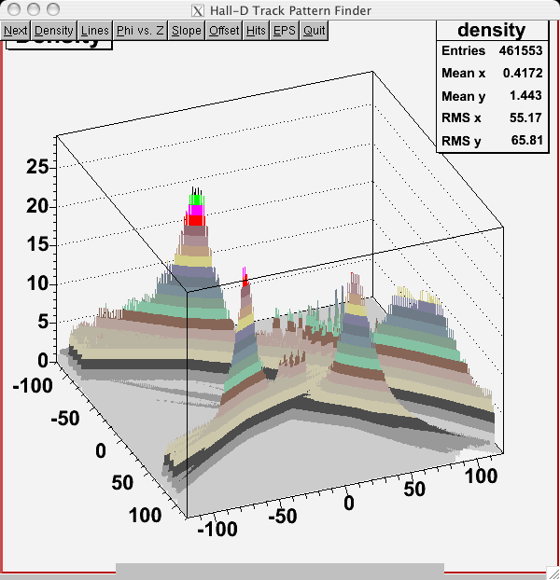
Track Finding: Hough Transform
X/Y coordinates of hits on tracks coming from the beamline can be transformed into a space where they will resonate.
Helical axes emerge as peaks in a histogram of the transformed parameters.
Histogram of parameters
Obtained from a Hough
Transform of a 4-track event

Slide 26
Hall D: Detector Design Parameters
Capability | Quantity | Range
Charged particles | Coverage | 1º < θ < 160º
 | Momentum Resolution (5º-140º) | σ_{p}/p = 1 − 3%
 | Position resolution | σ ~ 150-200 μm
 | dE/dx measurements | 20 < θ < 160º
 | Time-of-flight measurements | σ_{ToF} ~ 60 ps; σ_{BCal} ~ 200ps
 | Barrel time resolution | σ_{t} ^{γ} < (74 /√E 33) ps
Photon detection | Energy measurements | 2º < θ < 120º
 | LGD energy resolution (E > 60 MeV) | σ_{E}/E = (5.7/√E 2.0)%
 | Barrel energy resolution (E > 60 MeV) | σ_{E}/E =(5.54/√E 1.6)%
 | LGD position resolution | σ_{x,y,} ~ 0. 64 cm/√E
 | Barrel position resolution | σ_{z} ~ 0.5cm /√E
DAQ/trigger | Level 1 | < 200 kHz
 | Level 3 event rate to tape | ~ 15 kHz
 | Data rate | 300 MB/s
Electronics | Fully pipelined | 250 / 125 MHz fADCs, TDCs
Photon Flux | Initial: 10⁷ γ/s | Final: 10⁸ γ/s
Page 26

Slide 27
Detector Rates
Avg. number of hits per L1-trigger event
Total bytes per signal event by digitizer type
Detector | E.M. | Hadronic Eγ<8.0GeV | Hadronic Eγ>8.0GeV
Start Counter | 2.7 | 3.2 | 4.0
BCAL | 6.19 | 83.6 | 112.2
FCAL | 11.5 | 8.9 | 17.9
TOF | 32.3 | 28.7 | 38.8
CDC | 49.9 | 62.7 | 70.5
FDC anode | 28.9 | 28.3 | 46.9
FDC cathode | 275.8 | 269.9 | 444.6
Tagger | 25 | 25 | 25
Detector | Nhits | bytes/hits | header bytes
F1TDC | 285 | 4 | 548
FADC-125 | 1518 | 8 | 752
FADC-250 (wihout timing) | 180 | 4 | 808
FADC-250 (with timing) | 18 | 8 | 700
Average size of all L1 triggered events: 15kB
(Event Size for L1 triggered Eγ>8.0GeV : 16.5kB)
Front-end data rate for high luminosity running
15kB/event * 200k events/sec = 3GB/sec
For high luminosity running, Level-3 trigger will reject 90% of events
For low luminosity running, all events will be kept.
Data rate to tape: 300MB/sec

Slide 28
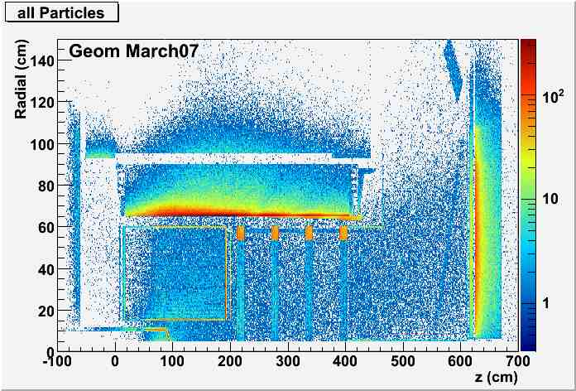
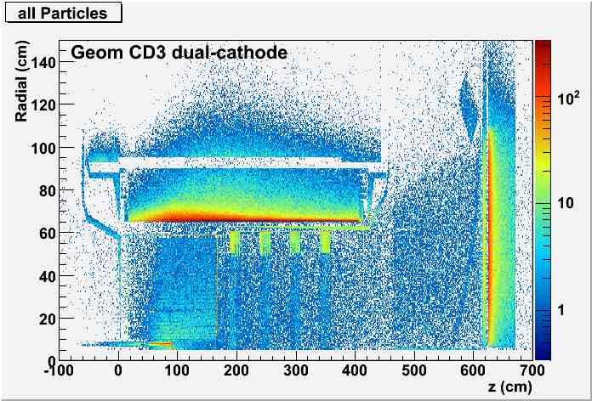
Locations of Primary Particle Interactions
BCAL
BCAL
CDC
FDC
FCAL
CDC
FDC
FCAL

Slide 29
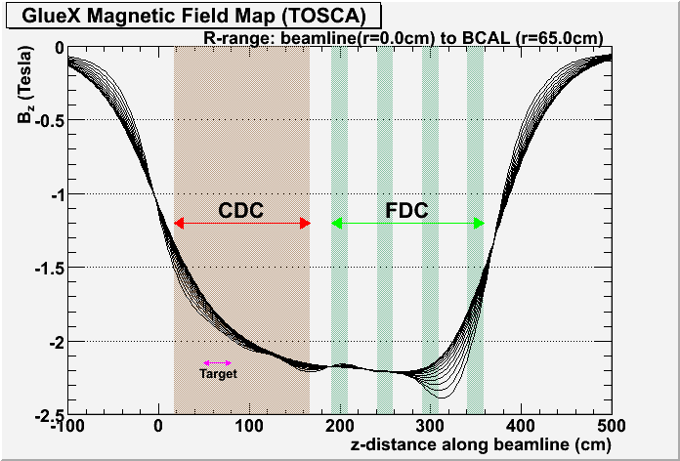
Inhomogeneous Magnetic Field Map (φ-symmetric)

Slide 30
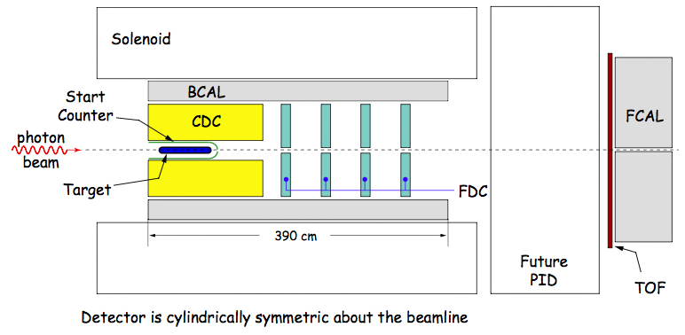
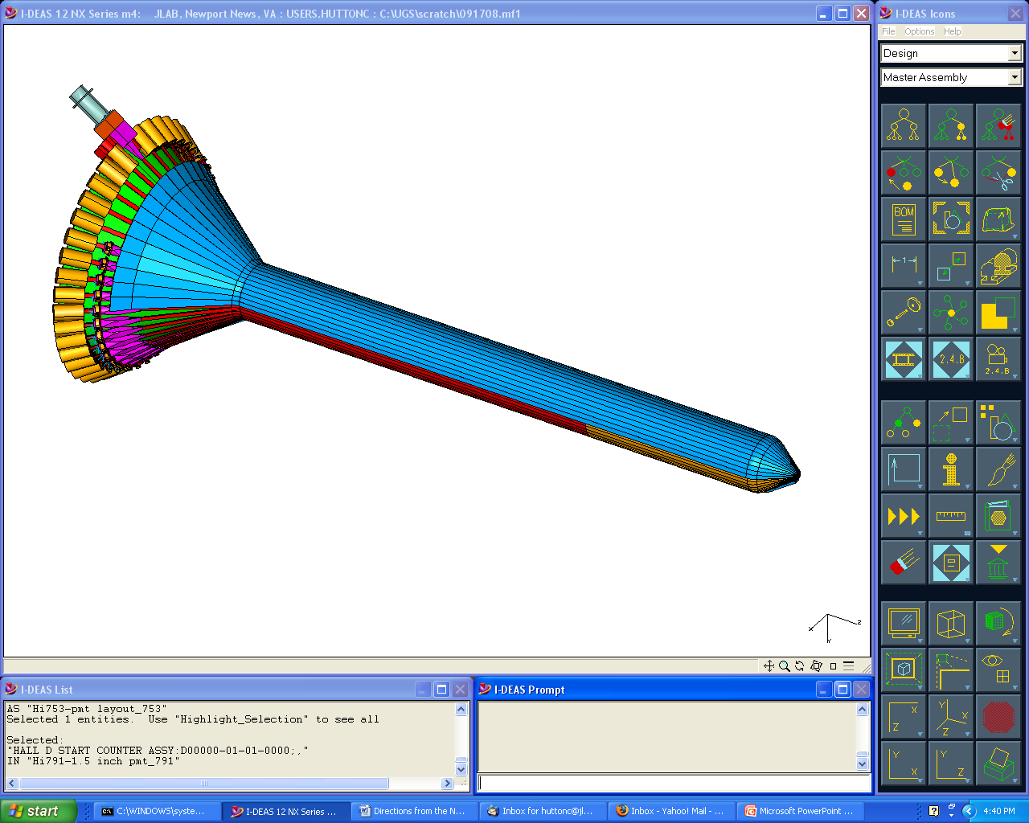
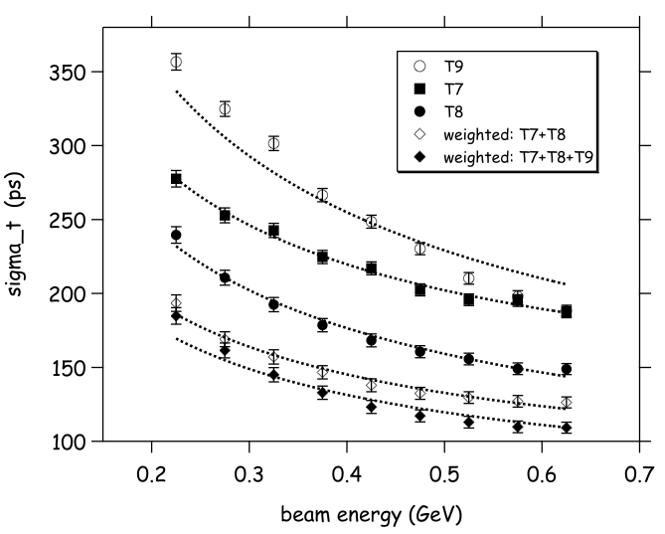
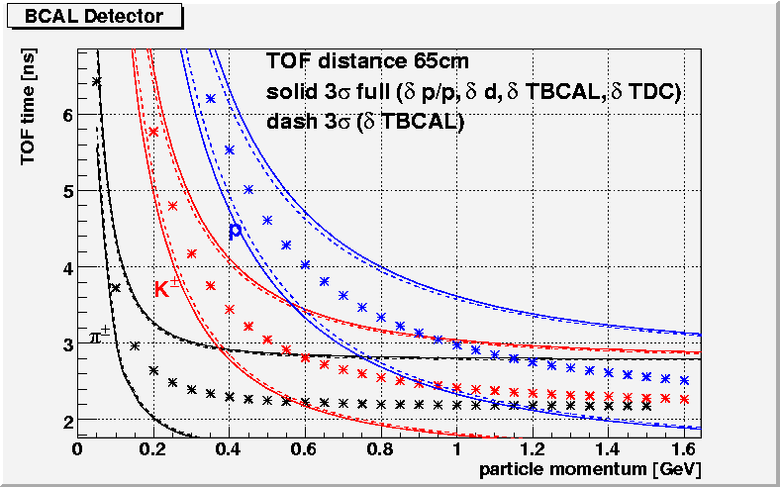
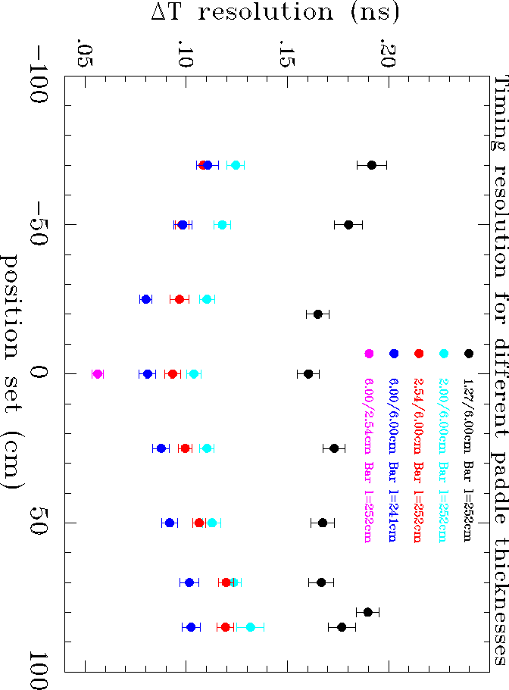
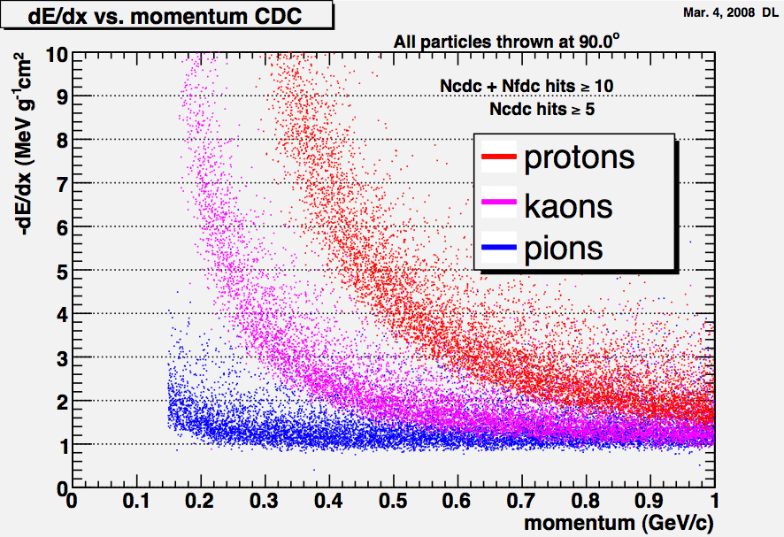
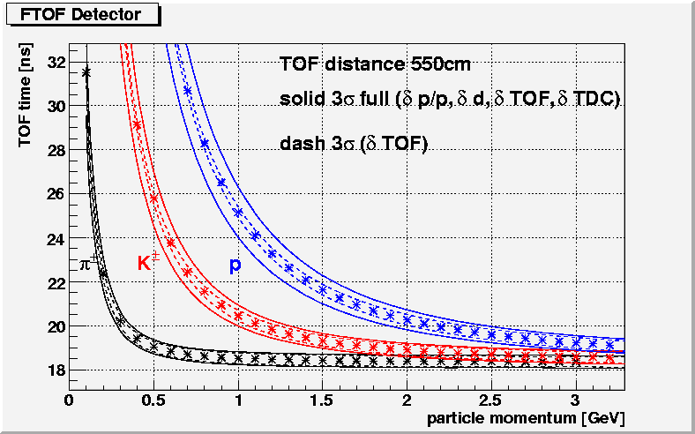
Particle ID
Particle ID is done primarily through time of flight with some help from dE/dx in chambers. Space is left in design for a future PID detector.
Beam Test Data
Expected Separation
~200 ps
Start Counter
Barrel Calorimeter
40 scintillators
300 ps (w/tracking)
Used for start-up
σ_{diff} (ps)
~80 ps
CDC dE/dx
Forward TOF
σ_{diff} (ns)
πp separation <450MeV/c
πK separation <275MeV/c

