Slide 1
Level 3 Trigger
Elliott Wolin
GlueX Upgrade Workshop
2-May-2012

Slide 2
Outline
History and Pre-History
Current Understanding
Revisiting Strategy
Summary and Conclusions

Slide 3
1. History and Pre-History
My earliest reference is 1999 Design Report
Original analysis and strategy from Dave Doughty
Chapter 7 “Rates, Trigger and DAQ”
Based on experience from CLAS
higher-level hardware trigger expensive
general-purpose computers cheap
➔Skip custom hardware, go with online trigger farm ⬅
Dave called it a “Level 2” trigger then
We complained and he eventually switched to “Level 3”
Analysis performed by Dave D, Elton, Larry D and me

Slide 4
History and Pre-History - 1999
 | Low Rate | High Rate
Event Size | 5 kB | 5 kB
Event Rate to L3 Farm | 10 kHz | 100 kHz
Data Rate to L3 Farm | 50 MB/s | 500 MB/s
Num Links | 20 | 20
Rate per Link | 2.5 MB/s | 25 MB/s
Link Technology | 100 MBit Ethernet | GBit Ethernet
Events/s/Link | 500 | 5000
Num Instr/Event for L3 | 1,000,000 | 1,000,000
Processing Power/Link | 500 MIPS | 5000 MIPS
Num 1000 MIPS Procs/Link | 1 | 10
Total 1000 MIPS Procs | 20 | 200

Slide 5
History and Pre-History - 2002
 | Low Rate | High Rate
Event Size | 5 kB | 5 kB
Event Rate to L3 Farm | 20 kHz | 200 kHz
Data Rate to L3 Farm | 100 MB/s | 1000 MB/s
Num Links | 1 | 10
Rate per Link | 100 MB/s | 100 MB/s
Link Technology | GBit Ethernet | GBit Ethernet
Events/s/Link | 20000 | 20000
SPECints/Event for L3 | 0.1 | 0.1
SPECints/Link | 2000 | 2000
SPECints/Link x 2 | 4000 | 4000
Num 200 SPECint Procs/Link | 20 | 20
Total 200 SPECint Procs | 20 | 200

Slide 6
History and Pre-History – 2008
 | Low Luminosity | High Luminosity
L1 trigger rate | 20 kHz | 200 kHz
Average event size | 15 kB | 15 kB
Date rate off detector | 300 MB/s | 3 GB/s
L3 rejection | None | Factor 10
Rate to storage | 300 MB/s | 300 MB/s

Slide 7
300 MB/s
300 MB/s
DAQ at Low Luminosity
300 MByte/sec
300 MB/s
ROC
E
MU
E
MU
ROC
16 TB
16 hrs
300 MB/s
300 MB/s
ROC
E
MU
E
MU
RAID
Monitoring
Farm
No Rejection
E
MU
ROC
1
EMU
ROC
E
MU
E
MU
300 MB/s
ROC
SILO in Computer Center
2 PB/year
6
EMUs
6
EMUs
12
Monitoring
Nodes
50
ROCs
Event Builder
Crossbar

Slide 8
2. Current Understanding
Changes and concerns since 2008 for high luminosity
VME backplane speed, ≤150 MB/s
Might have to split crates
L3 event classification @ 100 Hz/core
Need 2000 cores, not 200, for 200 kHz event rate
10x faster than current Pythia reconstruction rate
Upgrade ROC-to-EMU network
ROC network board to 10 Gbit (from 1 Gbit)
Some concentrator switches won’t handle aggregate rate

Slide 9
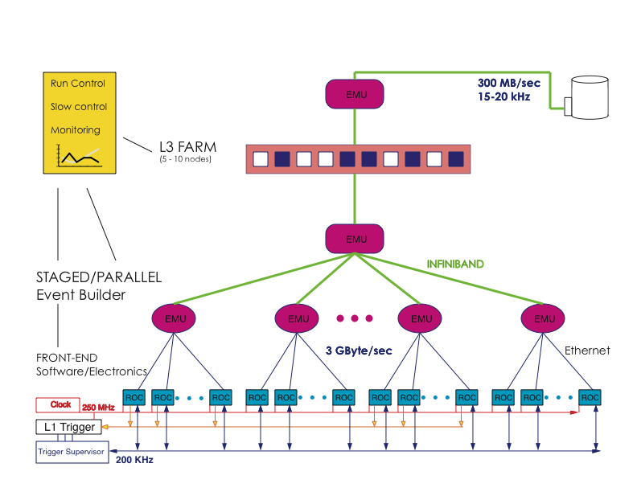

Slide 10
If backgrounds 30% larger, or 20 kB events
Networks and switches ok
10 Gbit Ethernet, Infiniband (40 Gbit)
DAQ ok
May need additional EMU’s @ $5k each
Storage ok
RAID and tape drives should handle rate

Slide 11
3. Revisiting Strategy
Skip L3, just write 200k events/sec to tape?
Analysis by Dave Lawrence and Sandy Philpott
Data rate 3 GB/sec @ $10/TB storage
$300k/year for tapes, no backup
Tapes currently 3x more expensive
Tape silo
Would need 1-2 additional silos @ $250k each no backup
Assumes data in silo 4 years
Some network upgrades
Infiniband or 10GBit Ethernet or ???

Slide 12
Revisiting Strategy
Compare to L3 trigger strategy
$200k for the L3 farm
2000 cores @ $100/core

Slide 13
4. Summary and Conclusions
Original strategy still optimal
Event size, data rates, cpu req’s have increased
Computing and network costs keep decreasing
Overall L3 design easily scalable
Robust against increased data rate
At most might need to
Split VME crates
Add few EMU’s
Upgrade some network connections

Slide 14
Backup

Slide 15
Full Experiment Trigger
Trigger Signal
Level 1
Energy Sum
Trigger
16 bits
T
r
igger
Inputs
Detector
O
u
t
p
u
t
Pulser 1
Pulser n
Add’l
Trigger
Logic
16 bits
Calib 1
Calib n
Trigger
Supervisor
Module

