Slide 1
Online Update
Elliott Wolin
GlueX Collaboration Meeting
22-Feb-2013

Slide 2
Outline
Rebaseline
Counting House
Hall D Computer Cluster (HDCC)
DAQ System and Testing
Simulated Raw Data
Monitoring/L3 Farm
Control Systems
EPICS
UPS Power
Solenoid Test
Elog
JInventory Database
Future Plans
Don’t muck with network equipment!

Slide 3
Rebaseline
Online/DAQ equipment mostly stayed the same
Bottom’s-up rework of manpower
Resulting cost slightly less than original
Basis-of-estimate in progress
Problematic for programming
Count lines of code?
Count GUI’s?

Slide 4
Counting House
Should be ready this summer
Office area
Chairs, computers and phones
Conference area
Large table, chairs, large monitor, conference equipment
Control room
Consoles, chairs, lots of monitors, computers and phones
Rack room
Lots of computer equipment
DAQ test setup

Slide 5
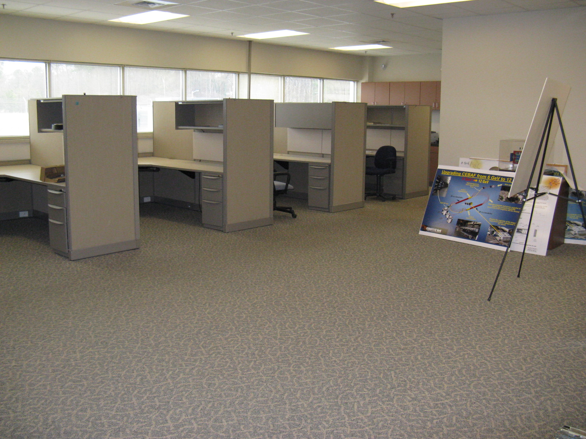

Slide 7
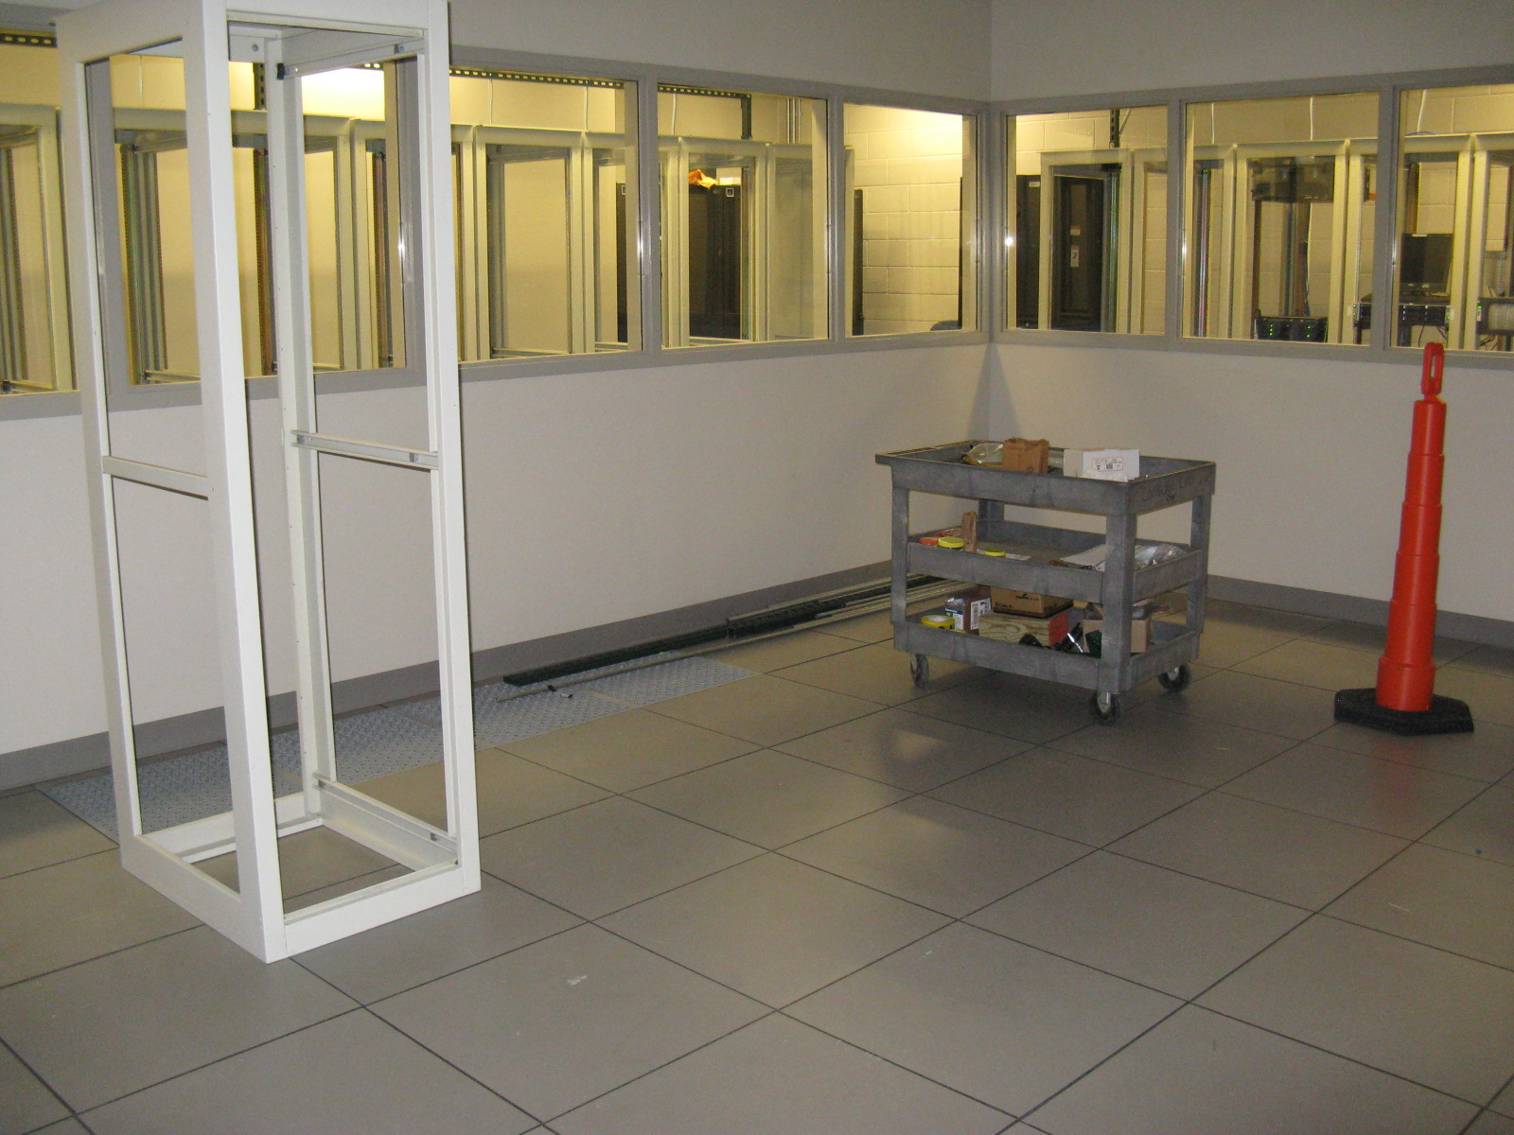

Slide 8
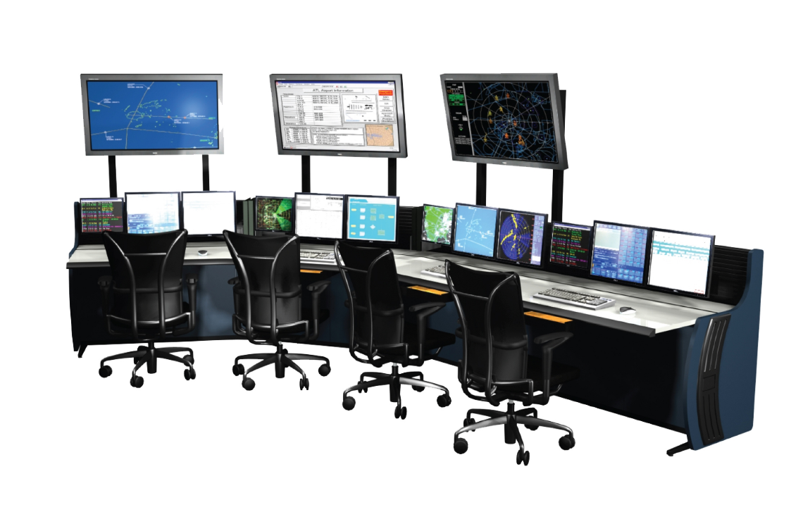

Slide 9
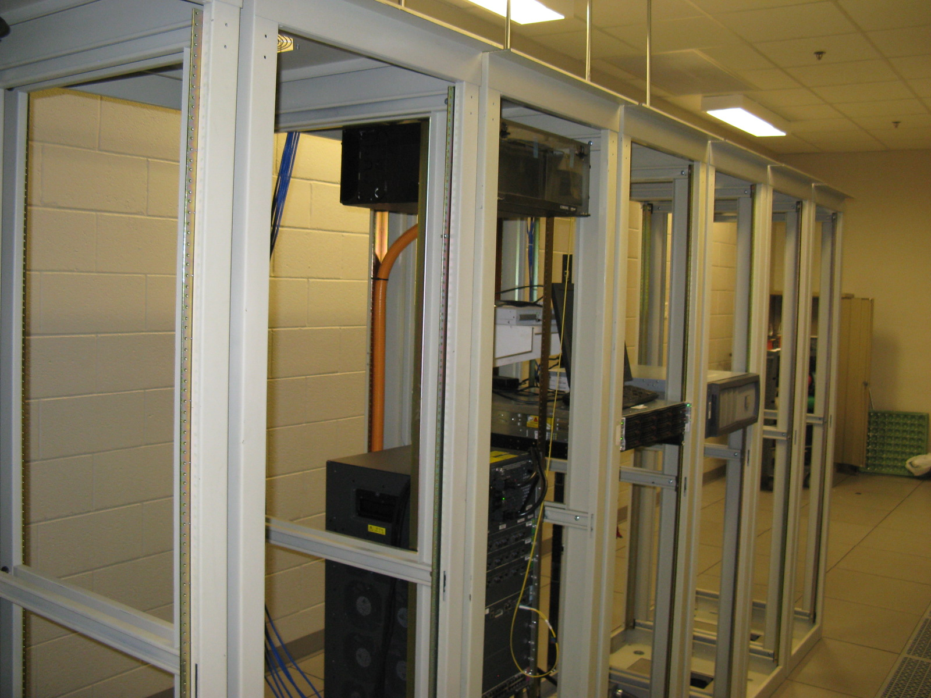

Slide 10
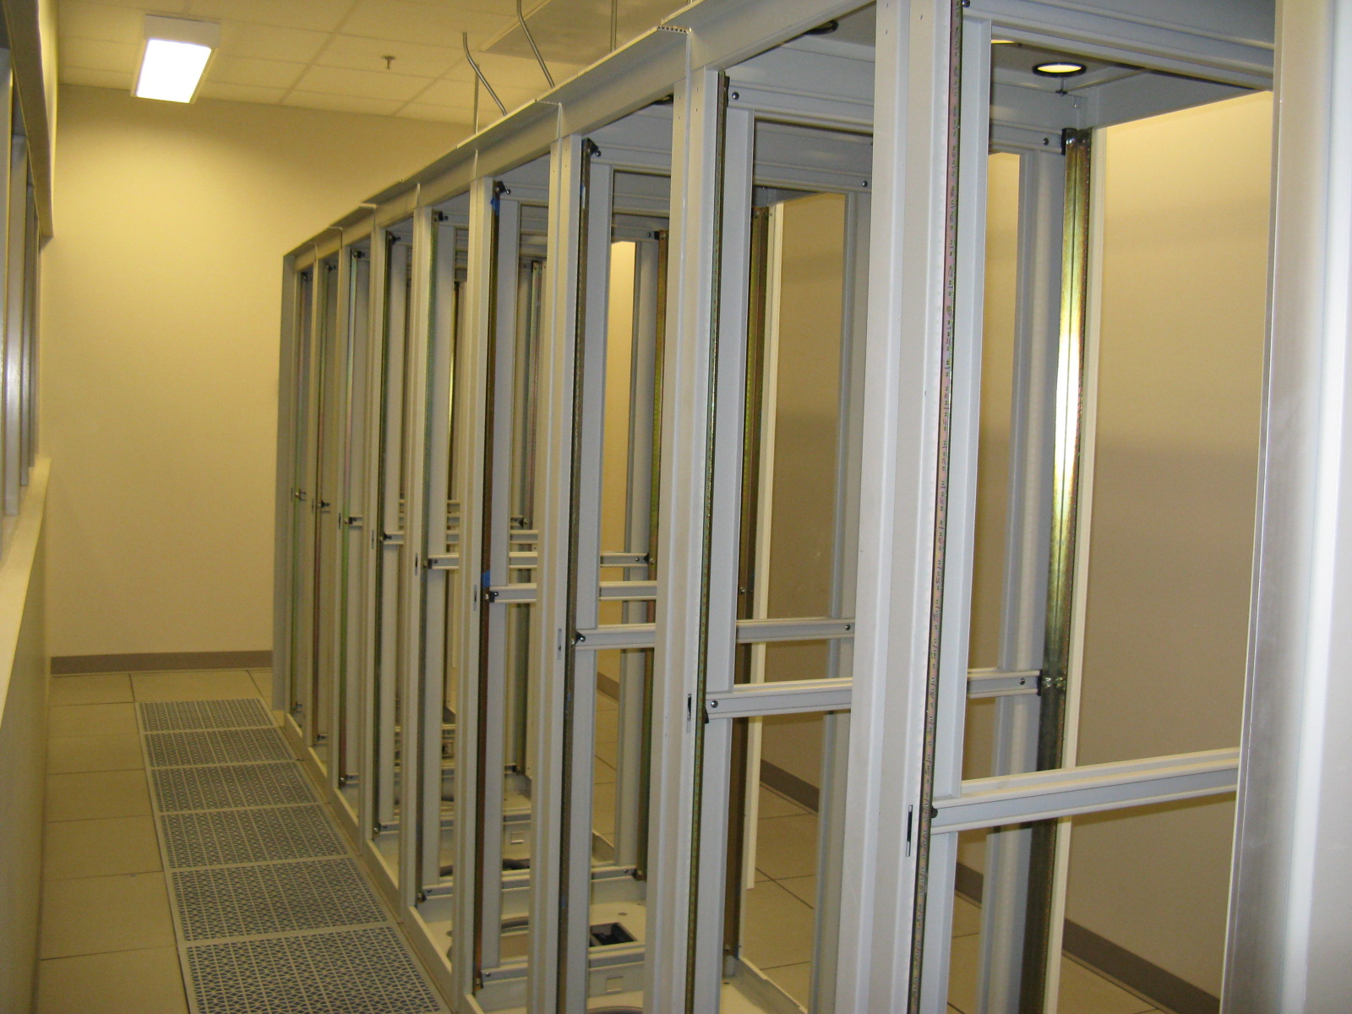

Slide 11
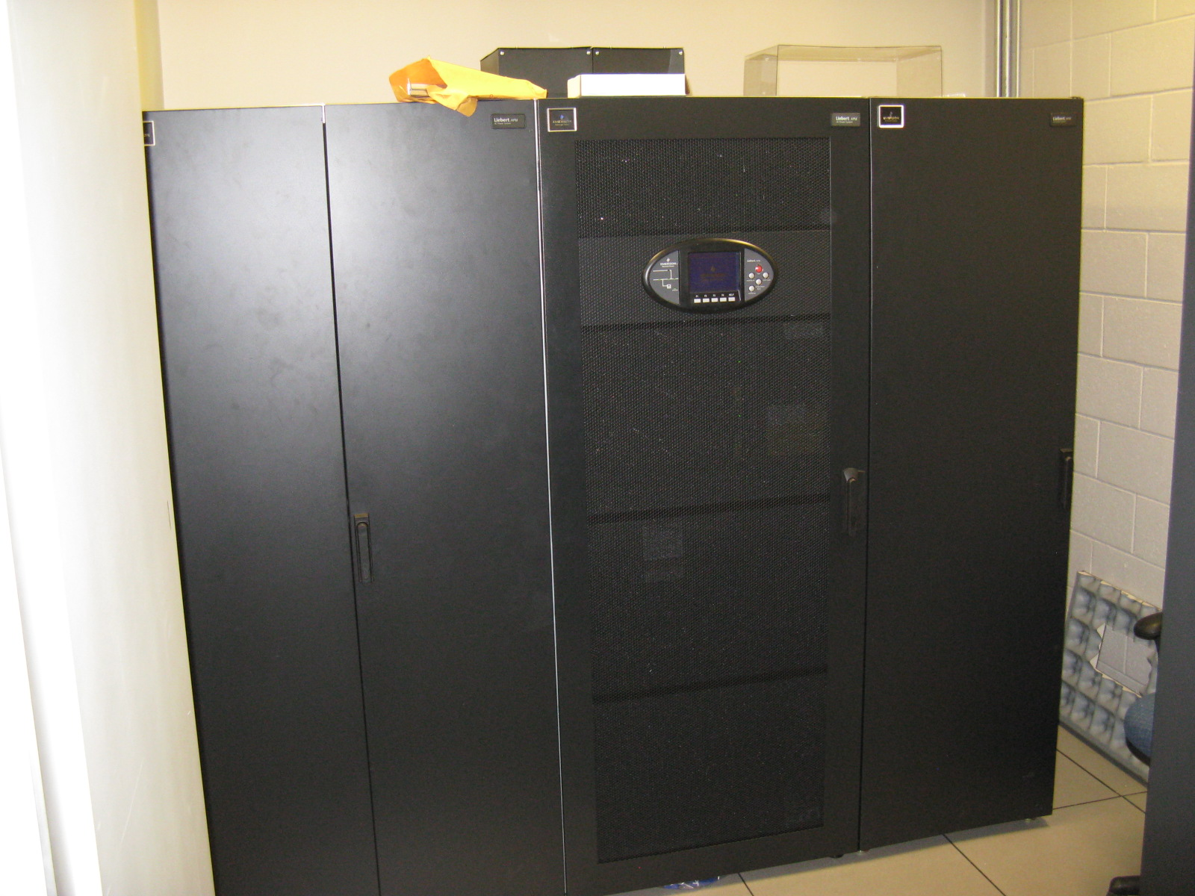

Slide 12
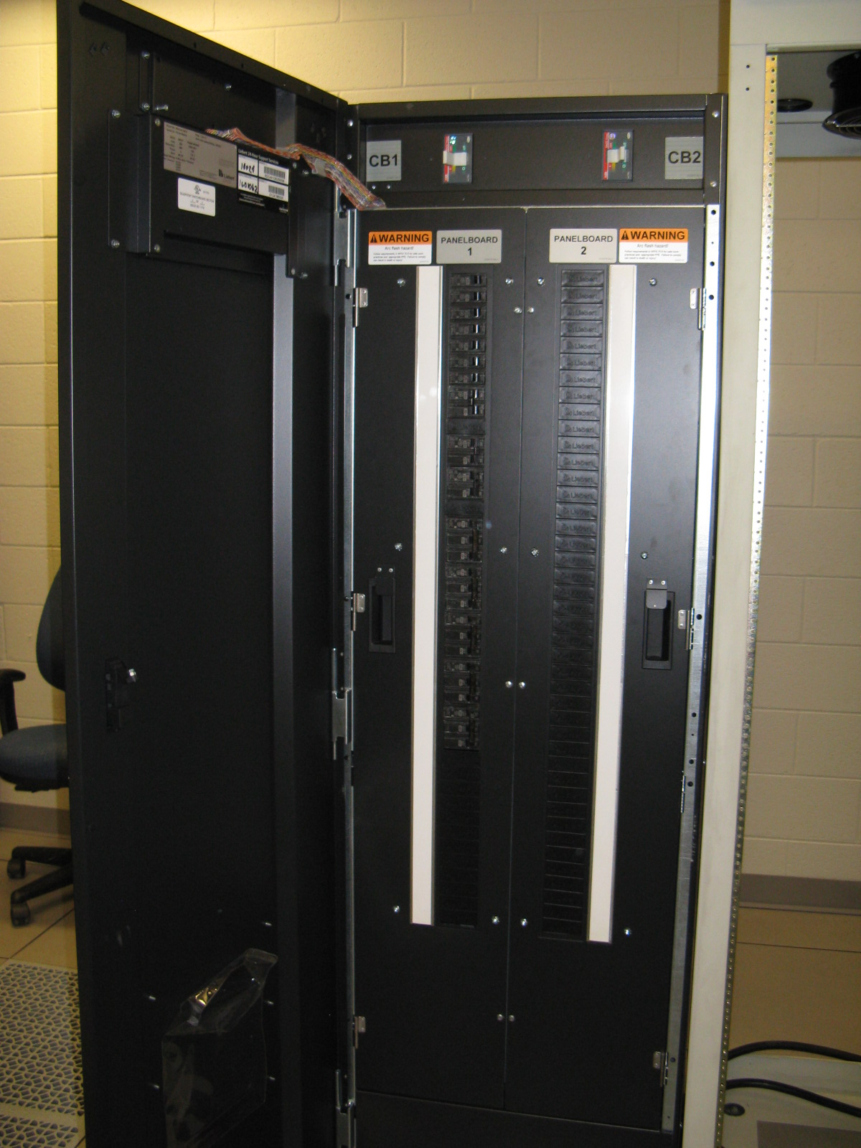

Slide 13
Hall D Computer Cluster
First version running by end of Feb
File server, RAID, many compute nodes
Ethernet and InfiniBand switches
Some equipment borrowed
Set up accounts, disk areas
Access to CUE disks
Code management using offline SVN repository (GIT?)
Hall D subnets
DAQ, Controls, Development (can be lab-wide)
Access requires two-factor authentication!
White-list only web access (use rdesktop to remove this limitation)
Will have some CUE desktop machines here and there
Most of the remainder ready this summer
Large purchase in May with CC
Potential for significant cost savings ($10-$20k)

Slide 14
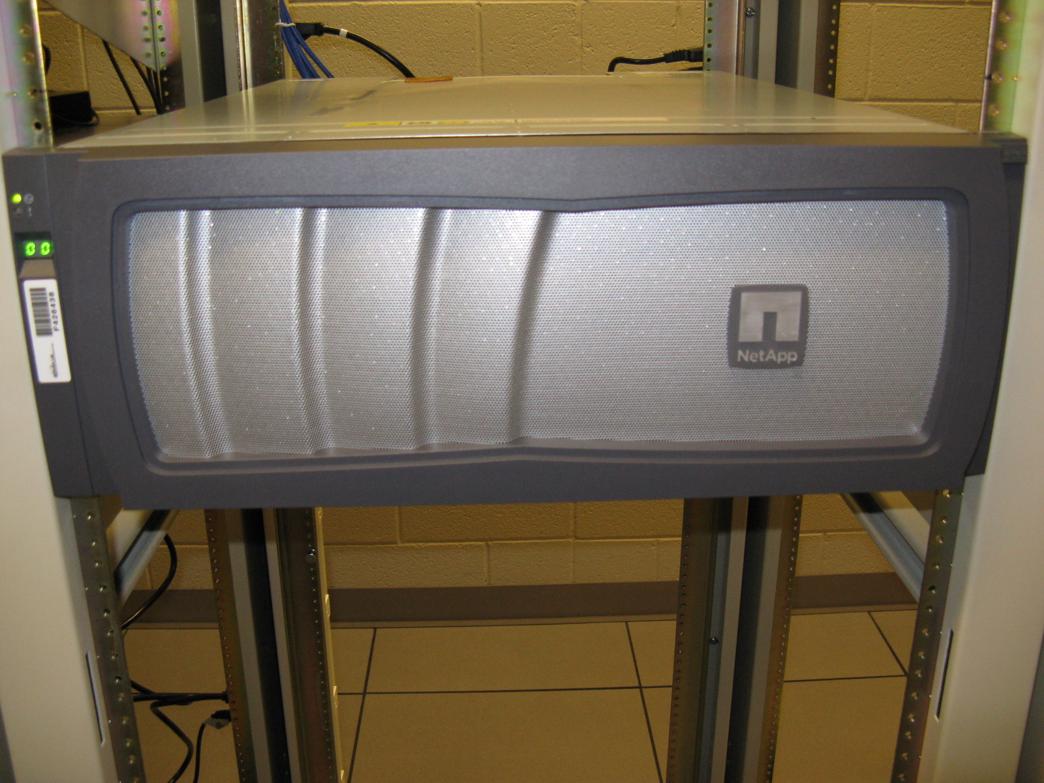

Slide 15
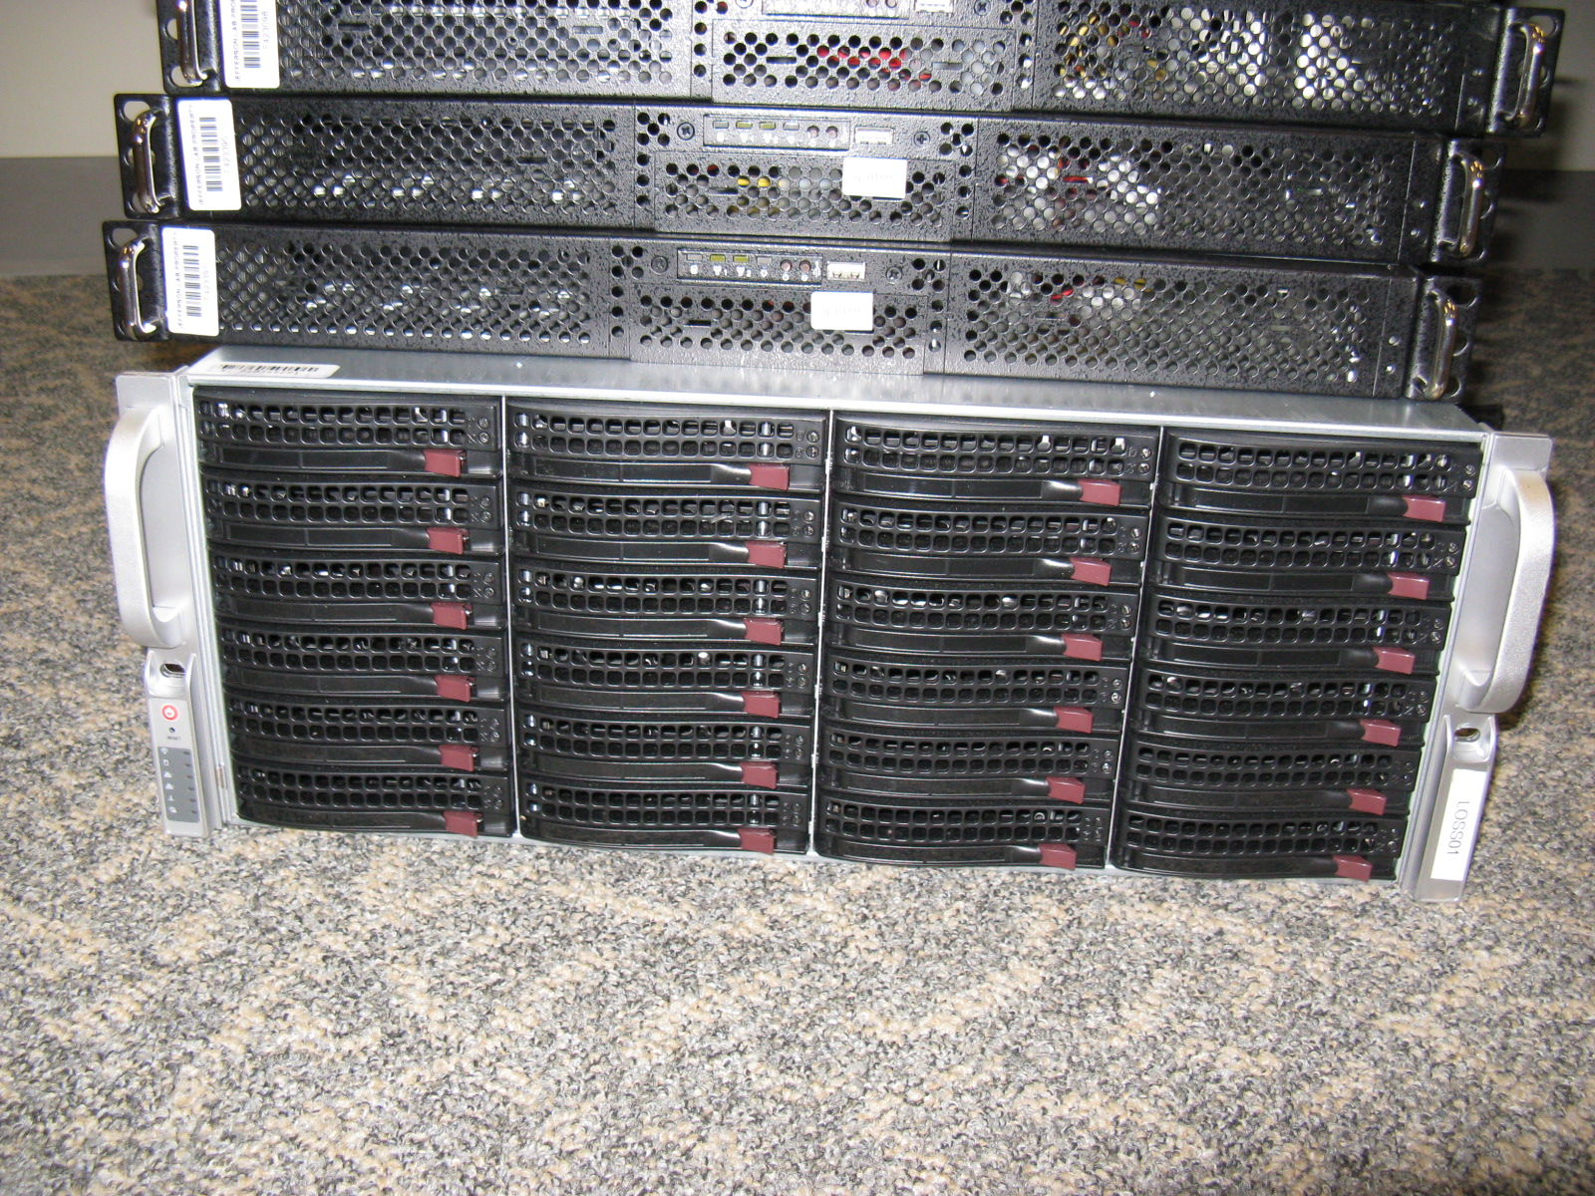

Slide 16
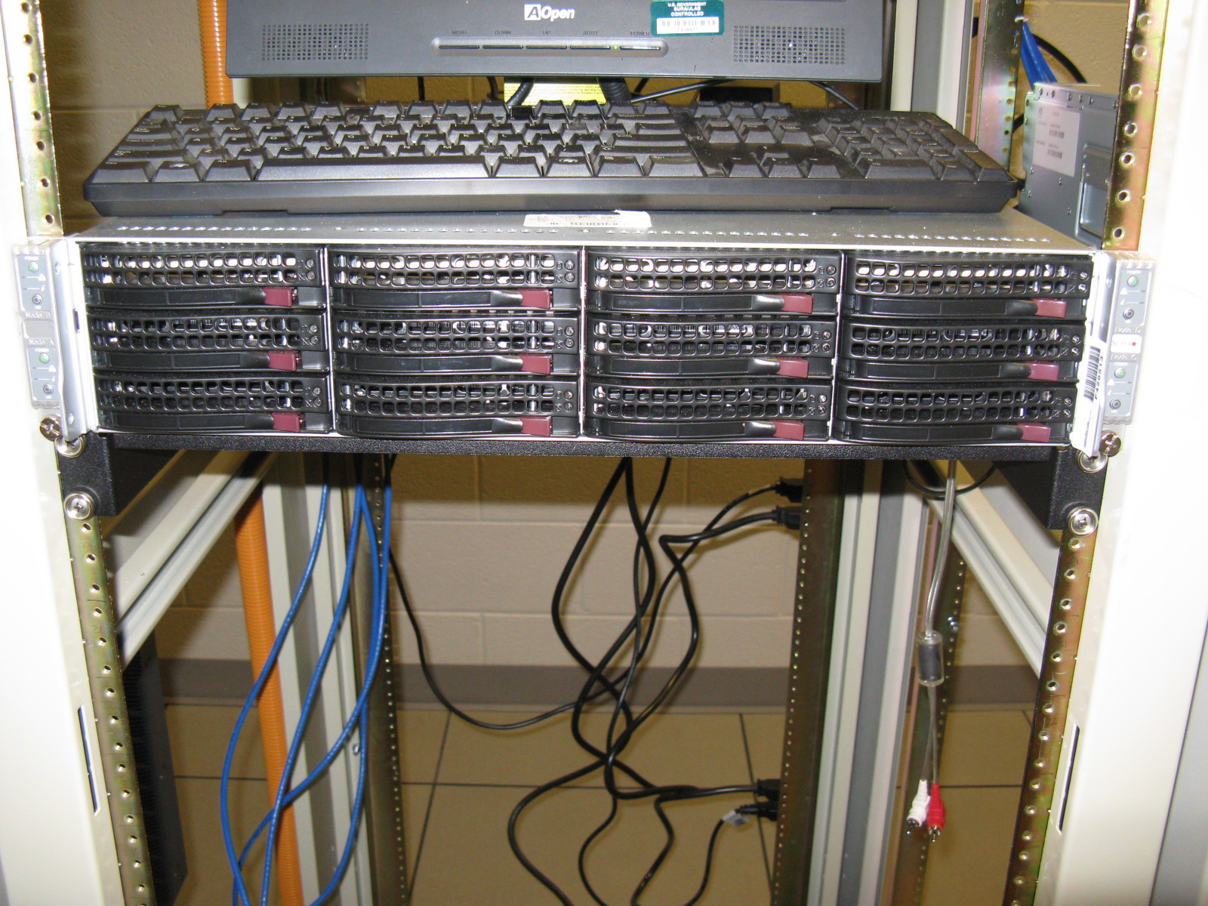

Slide 17
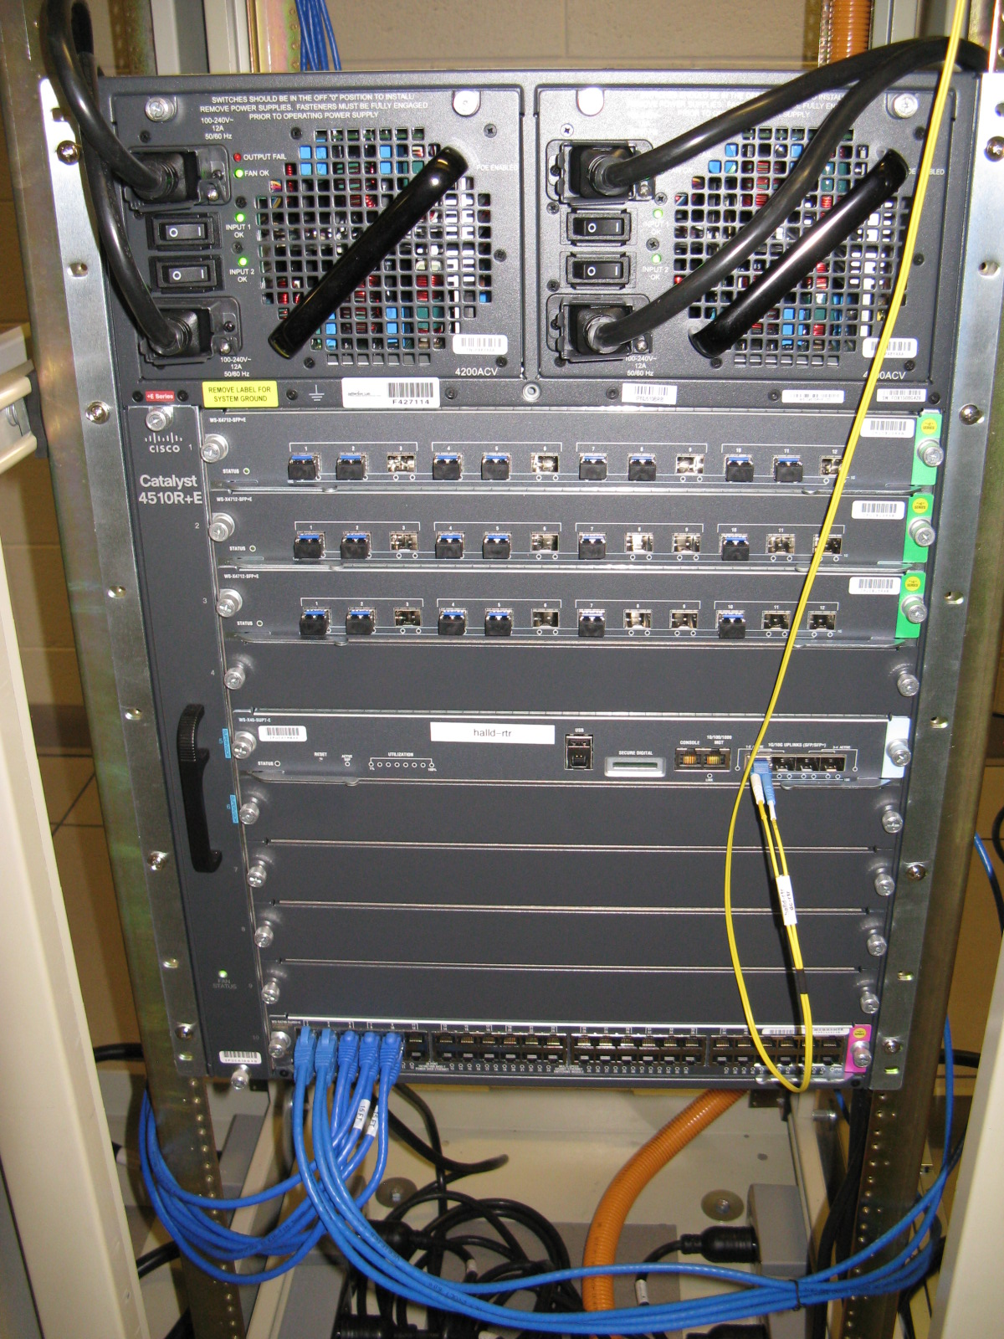

Slide 18
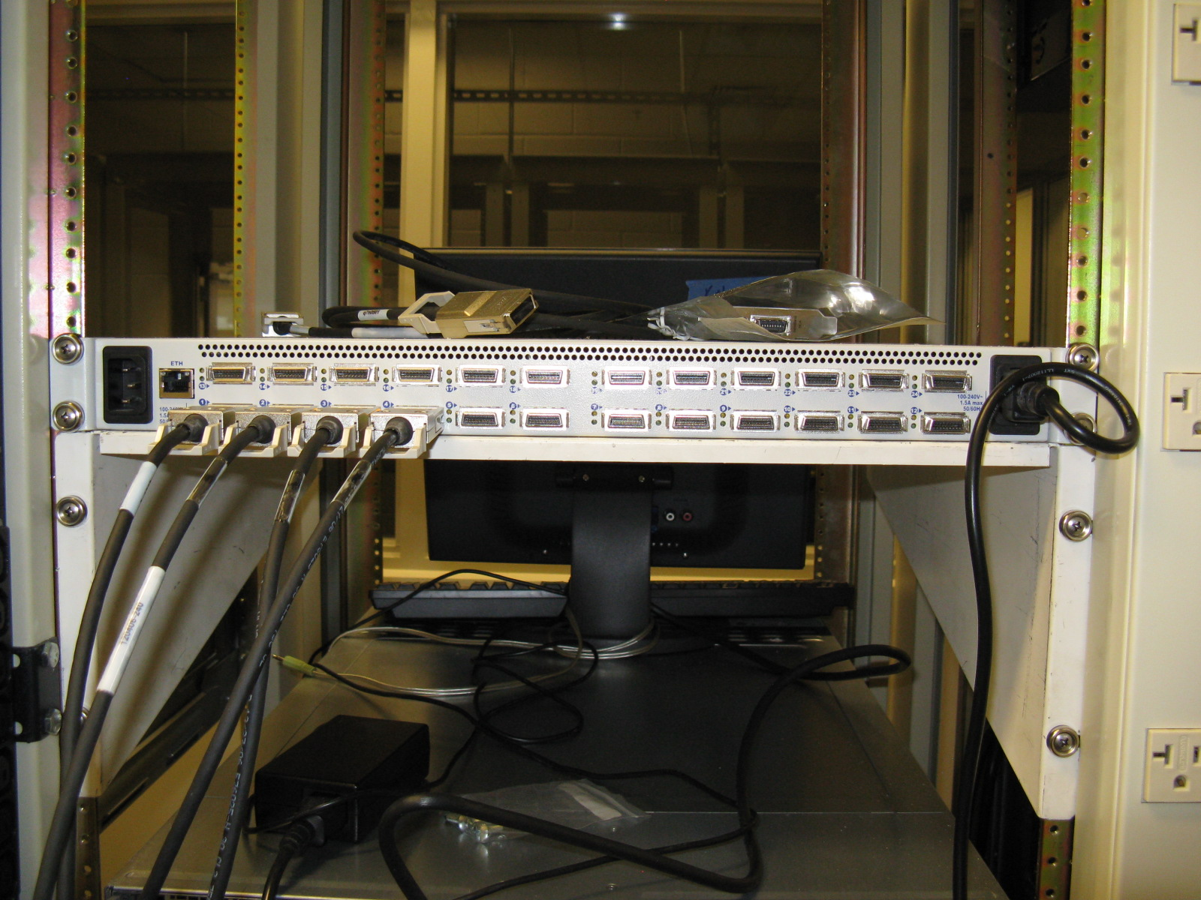

Slide 19
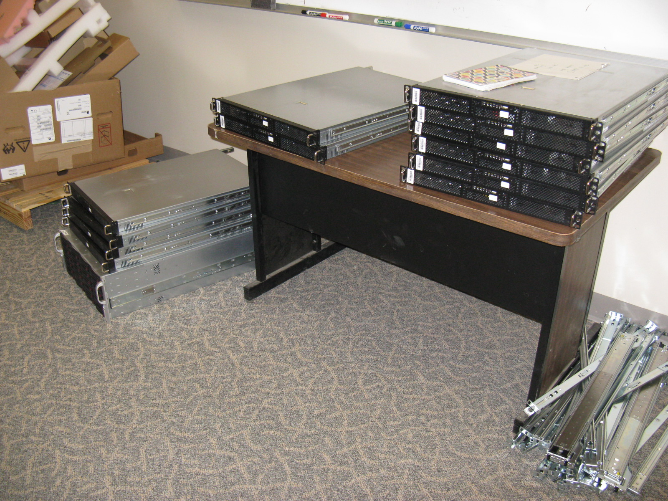

Slide 20
DAQ System and Testing
Full details in Dave Abbott’s talk later
Extensive DAQ testing in Rack Room
Starting around 1-Mar
10 DAQ + 2 Trigger crates, two-level event building
Will have computers, networking equipment
Crates will come in slowly, will ramp up

Slide 21
Simulated Raw Data
Dave A created mc2coda library
Generates EVIO output from MC data
Integrated into JANA via plugin
Dave L developing code to read EVIO data
Still debugging
Two formats, Raw (Dave A) and Compressed (EJW)
Compressed data factor 3 smaller with no loss of info
Simple algorithm eliminates module headers and redundant info
Expect to write compressed format to disk
Still need to integrate translation table into JANA

Slide 22
Monitoring/L3 Farm
Prototype ready early Mar
Initially Monitoring System will just make ROOT hist, no event rejection
Eventually L3 System will reject events
Note: all events move through farm
Even if no rejection
Possibility to slowly increase rejection rate and beam rate
Farm manager
CODA component, controlled by Run Control
Manages farm processes
Farm processes
JANA-based, uses CodaObject library to talk to Farm Manager
Histogram routines provided by detector groups!

Slide 23
Control Systems
David Butler taking over for Josh Ballard
Before purchase contact Dave and me concerning all devices in your system!
Allen-Bradley PLC-based control system design evolved
More distributed than originally envisioned
ControlLogix and CompactLogix processors
Point I/O for remote chassis
More robust
Thanks to Josh for realizing this was a cost-effective strategy
Test setup in ARC
Learn how to talk to all devices
Detector groups provide example of each device they plan to use
Not needed for simple 0-10V or 4-20mA devices

Slide 24
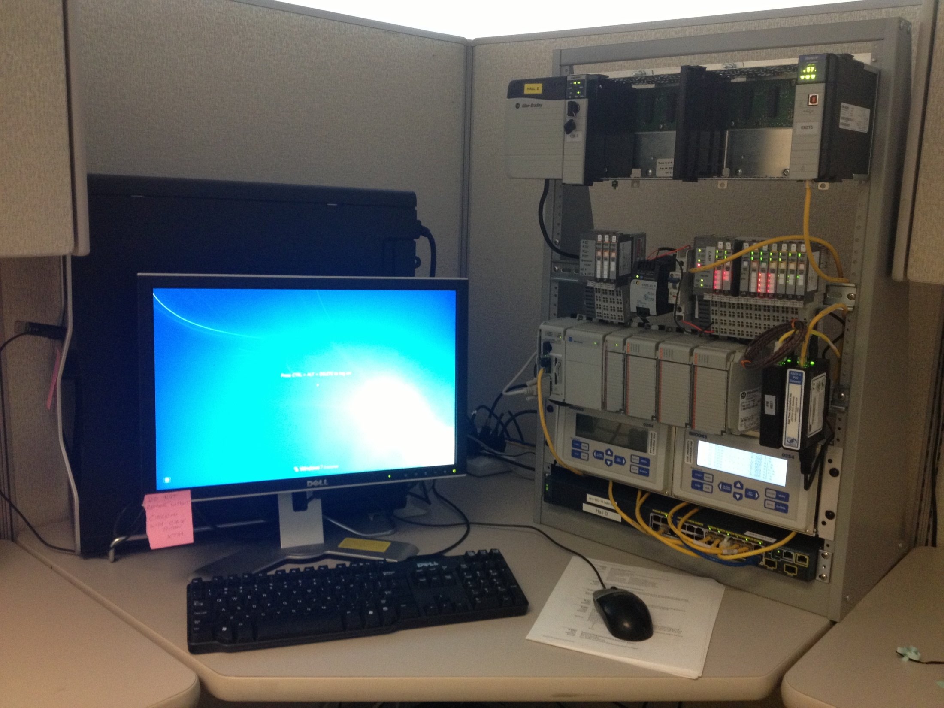

Slide 25
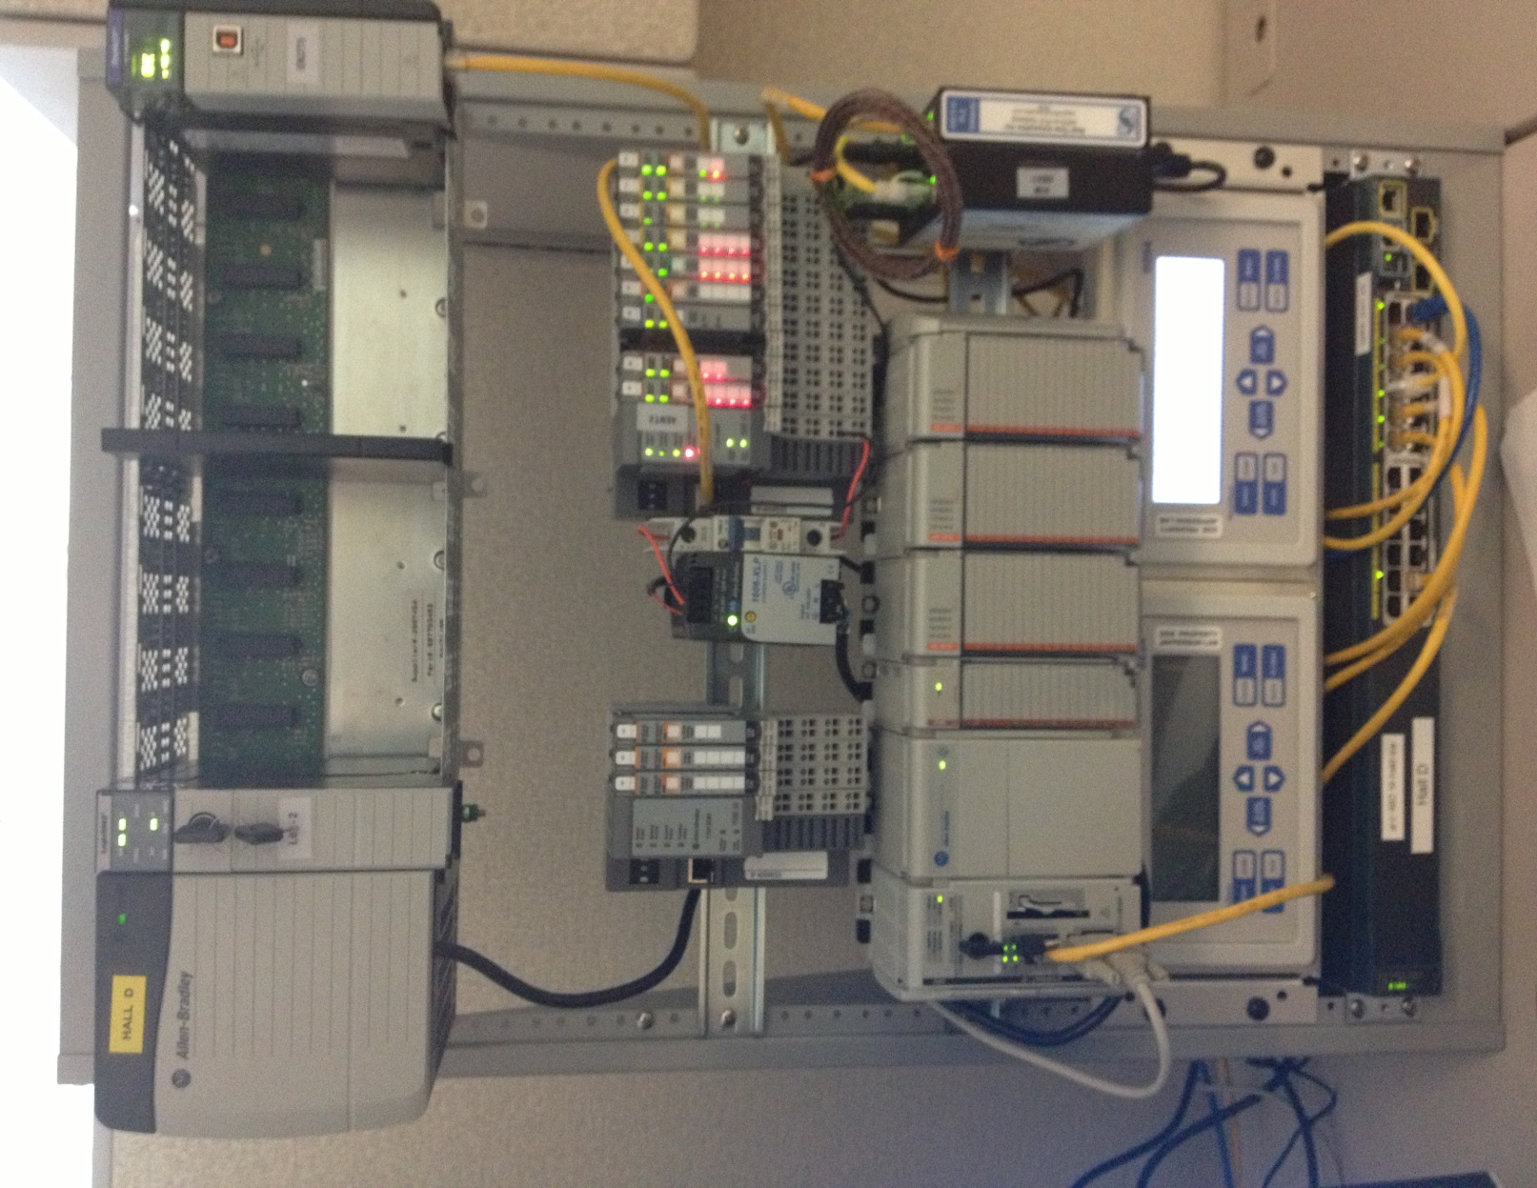

Slide 26
Control Systems
Currently working on
FDC/CDC gas system (Beni and Narciso G)
FCAL (John, Dan and Manuel)
CDC TC’s (Naomi)
BCAL monitoring/cooling (Jim F)
FDC cooling (Bill C)
Target (Chris K)
Start Counter (Werner?)

Slide 27
EPICS
Manpower
May finally be able to get Nerses back from Armenia
Archiver
Planning to use MyA from JLab Accelerator Div.
Asking for ~$20k (down from $55k!)
Our requirements different than theirs
Archiver would run on their computers
Cost and requirements still being evaluated
Can use SNS archiver if necessary (unlikely)
About 60k channels, 30 kB/sec archive rate
CSS
Beni developed HV/LV gui’s using scripting capabilities

Slide 28
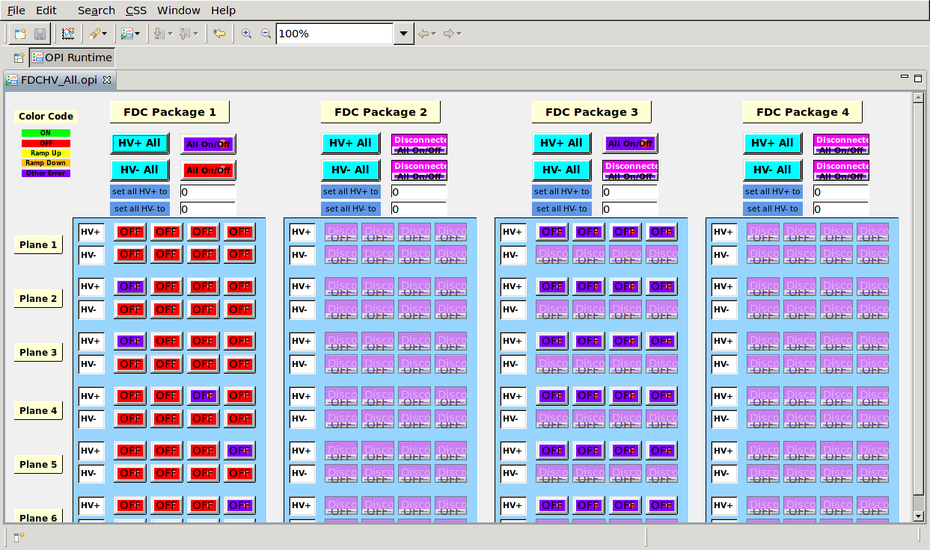

Slide 29
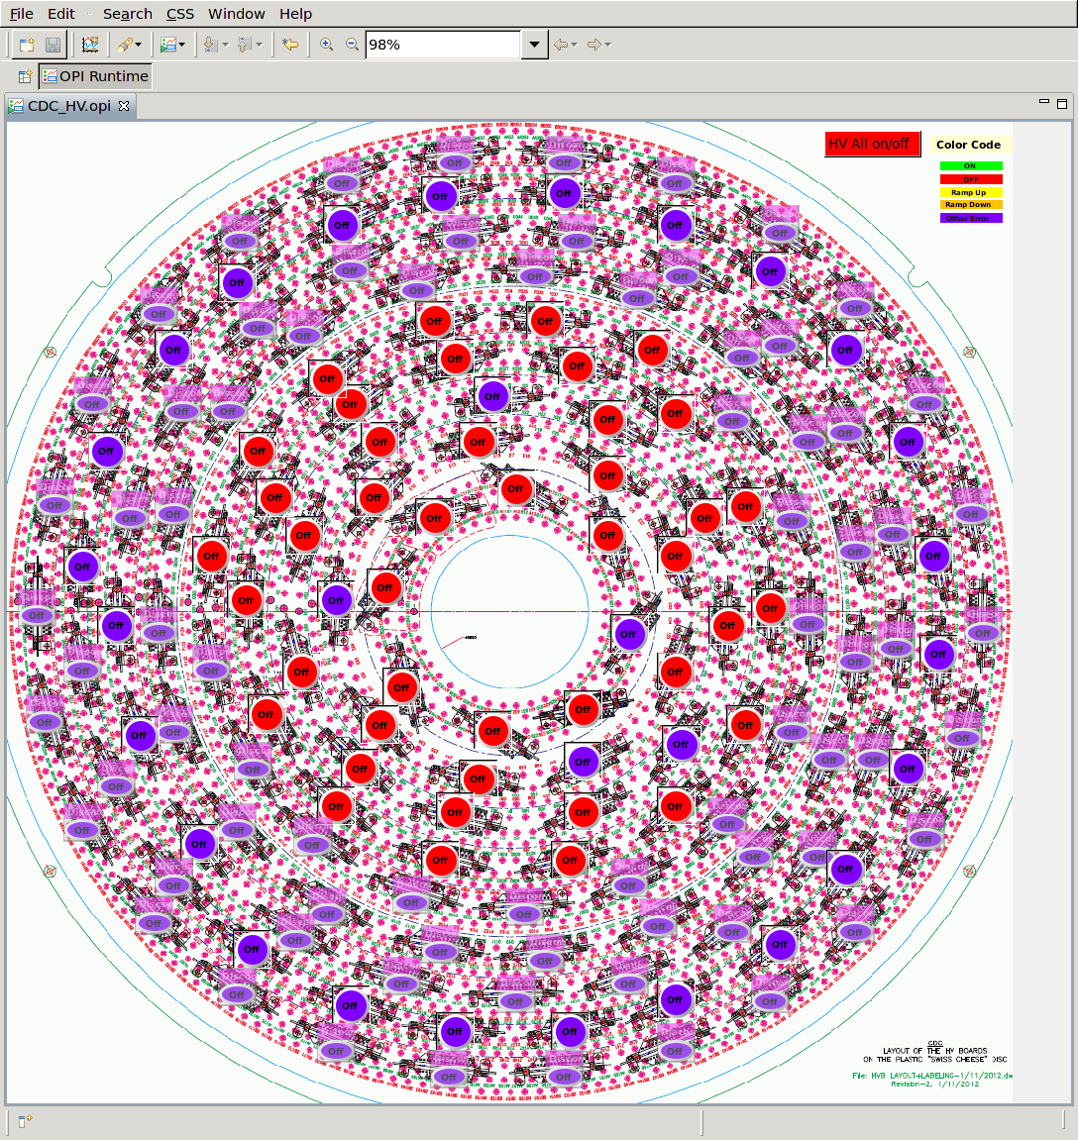

Slide 30
UPS Power
Main UPS and RDC working
All circuits wired in Rack room
UPS and clean power
Need to send power to Control room
Bundled with purchase of console furniture
Thinking of sending UPS power to hall
Requires inexpensive line filters + wiring + labor
Alternative is to purchase many FCC Class B UPS units

Slide 31
Solenoid Test
Cooled down to LN2 temperature
Had two vacuum leaks, one fixed, one temporary fix
Will eventually have to warm up for permanent fix
Currently in many-week holding pattern
Problems with LHe compressors (Cryo group)
No He flow, just LN2
May restart cooling in two weeks
Control system working fine so far
Monitoring, archiving, EPICS connection to Cryo group, auto-elog entries
Dave Butler learning about Josh’s system
New
SOE, modified QD, many Danfysik mods, new cryo system
PXI/Labview system for all coil voltage/current measurements/processing
Can talk to PLC and EPICS

Slide 32
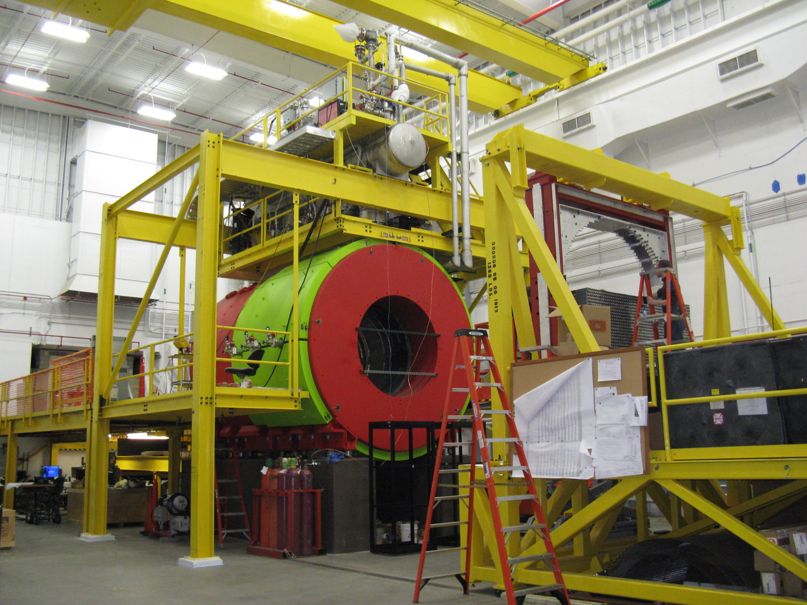

Slide 33
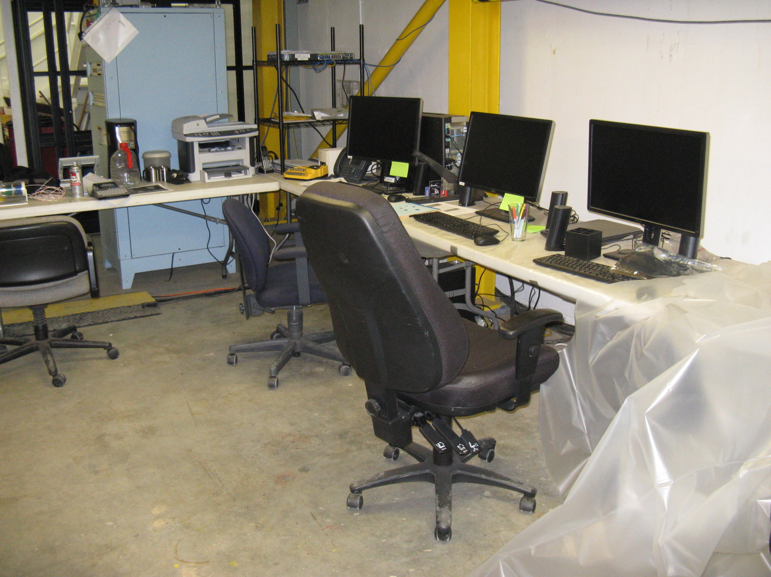

Slide 34
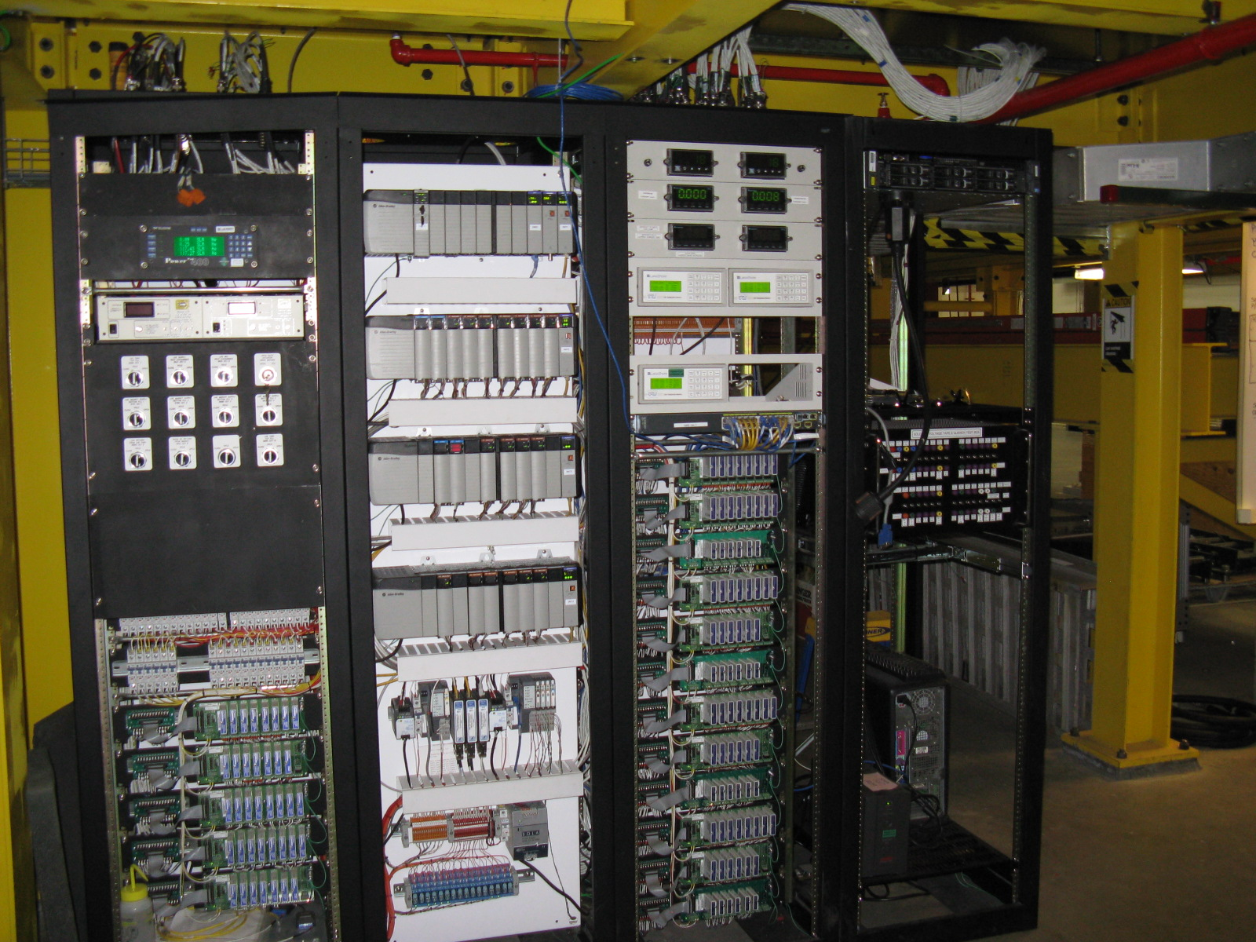

Slide 35
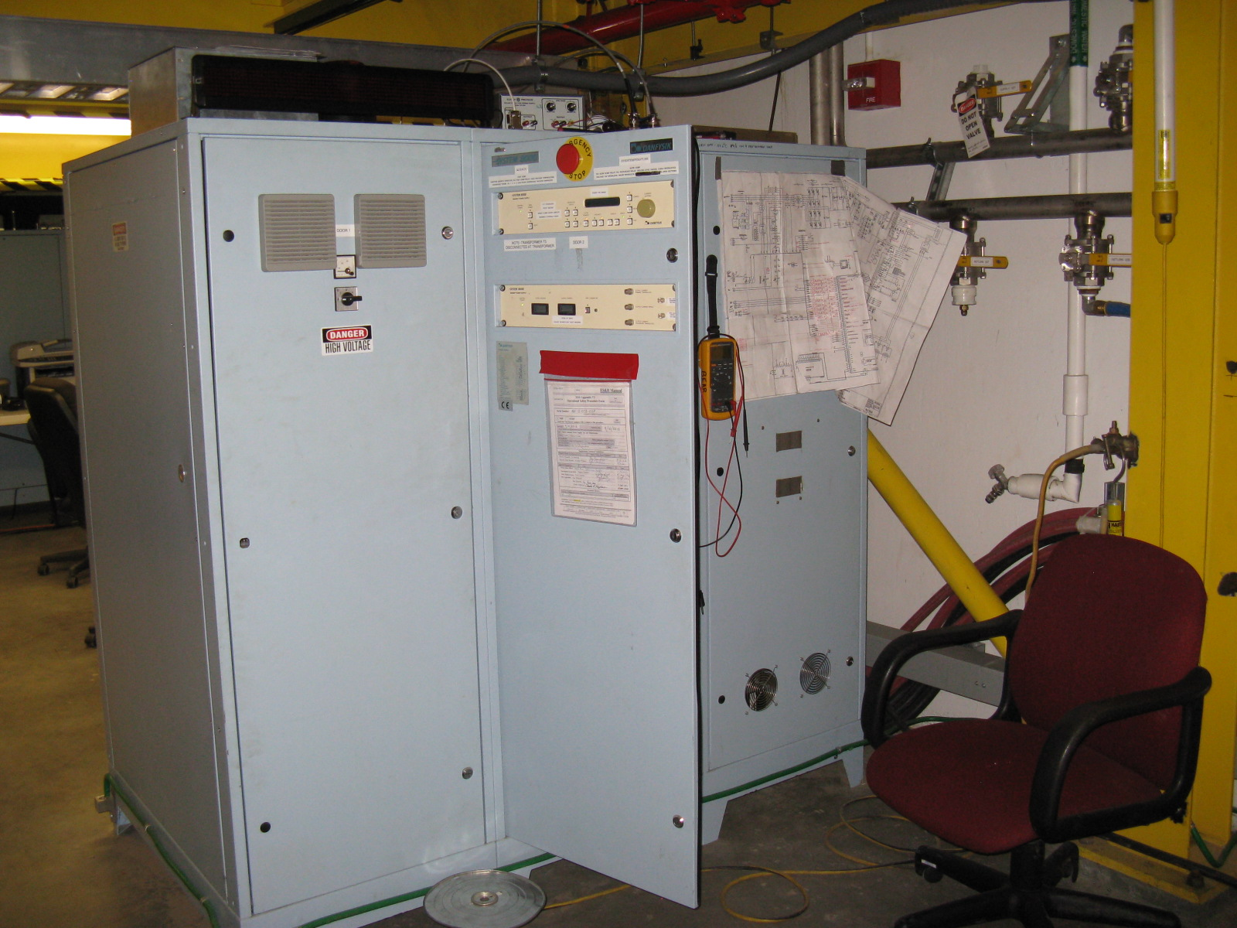

Slide 36
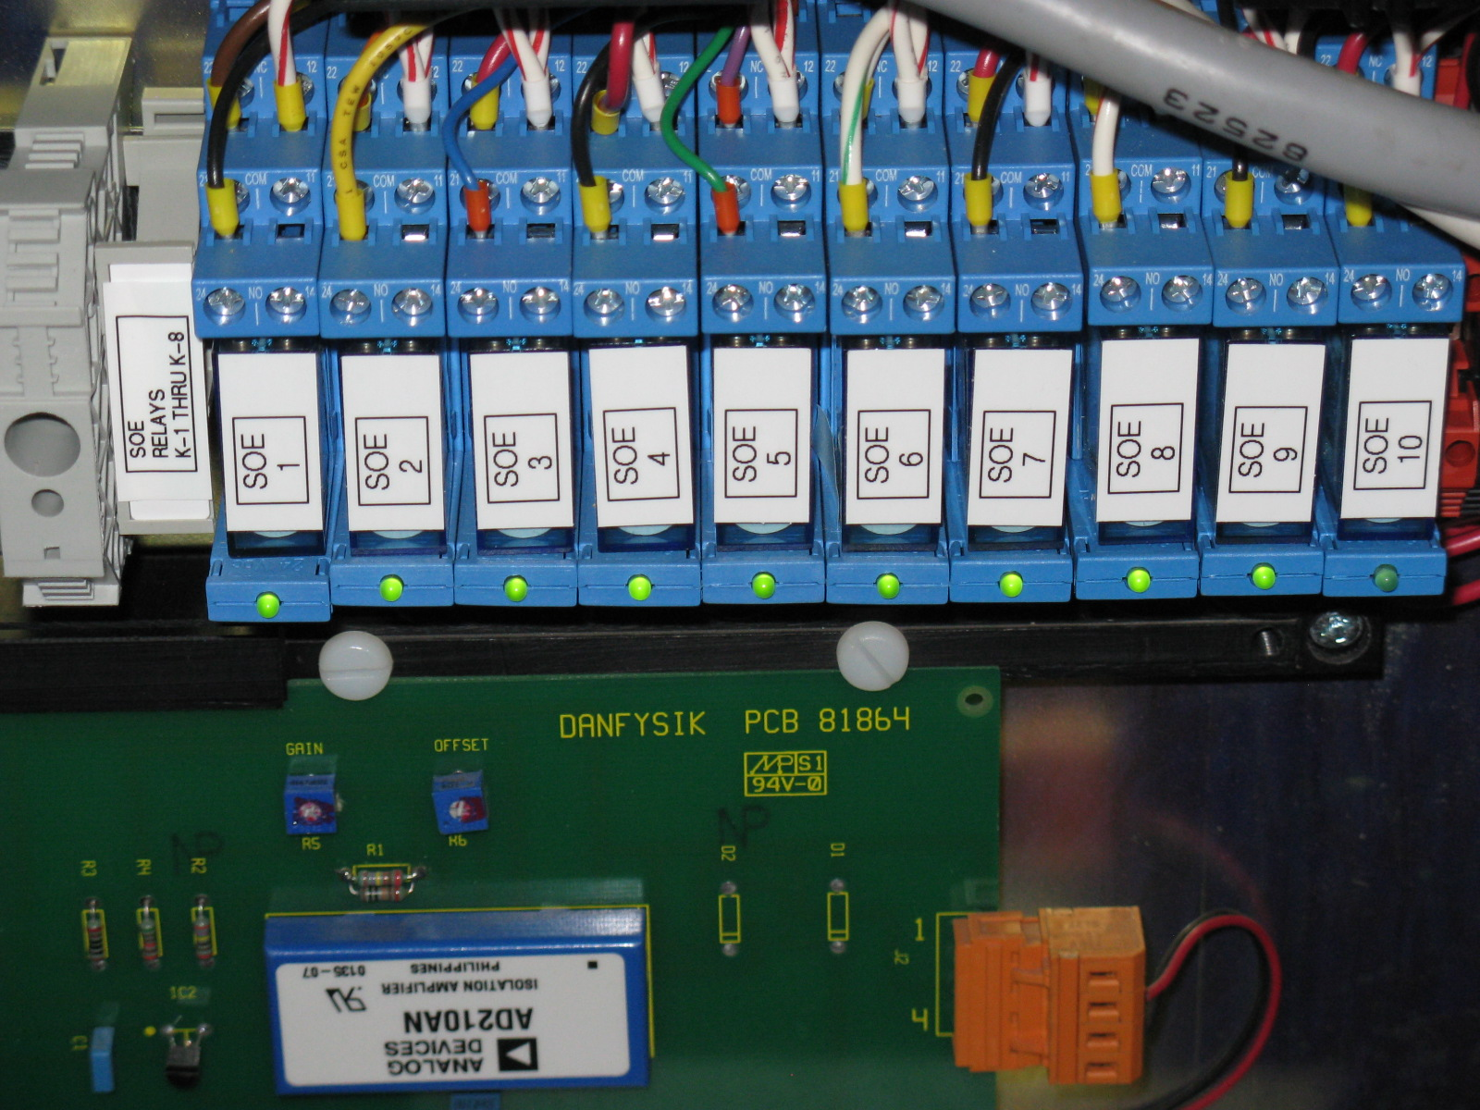

Slide 37
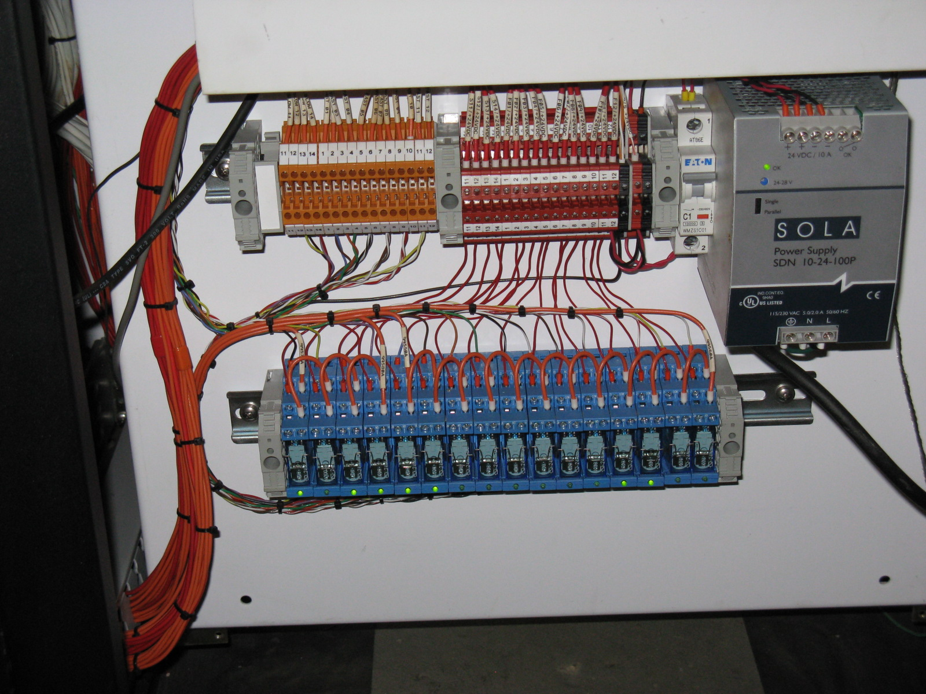

Slide 38
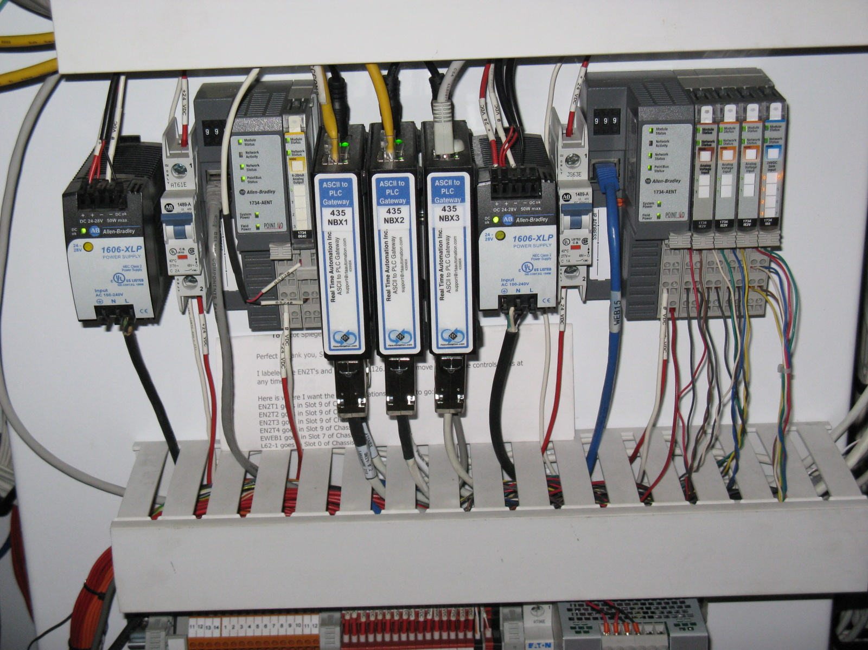

Slide 39
Elog
Developed by Accelerator Div
Many requirements from halls
Expected to be eventually used by all four halls
Prototype used for Solenoid test
So far so good, but needs many improvements
Should be at least as good as CLAS elog

Slide 40
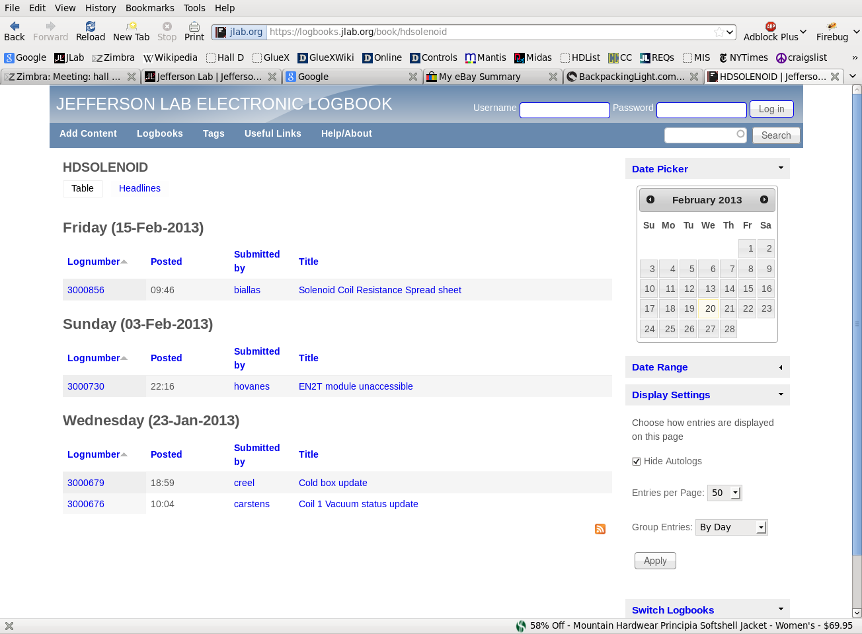

Slide 41
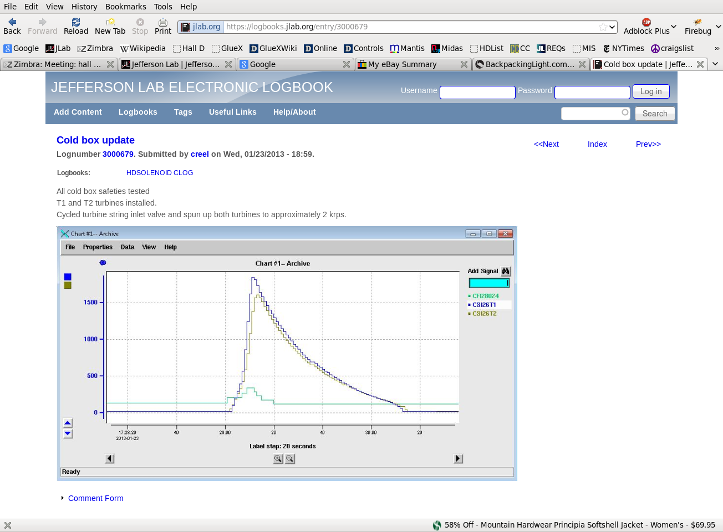

Slide 42
JInventory
Up to date for PLC and some other controls equipment
222 entries so far, many more to go
Includes basic info, maintenance and other history
Full benefit when much more equipment added
Critical to keep up-to-date
Integrate with barcode system
Have portable barcode readers
Getting barcode labels
Original version from Hall B
Now joint development
Other halls interested

Slide 43
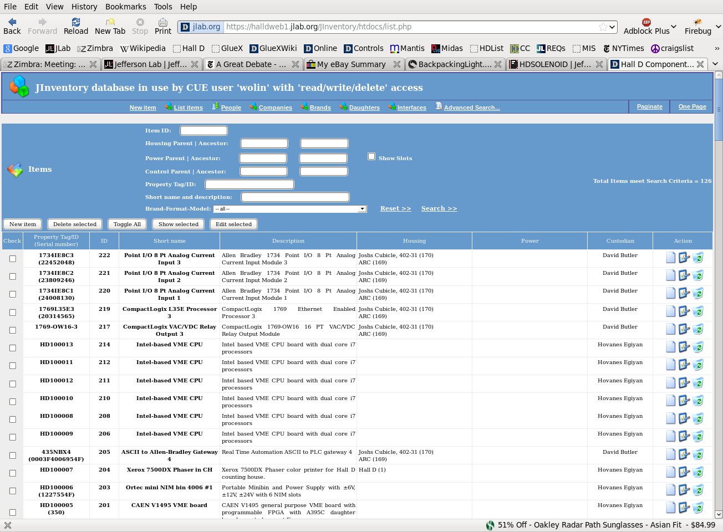

Slide 44
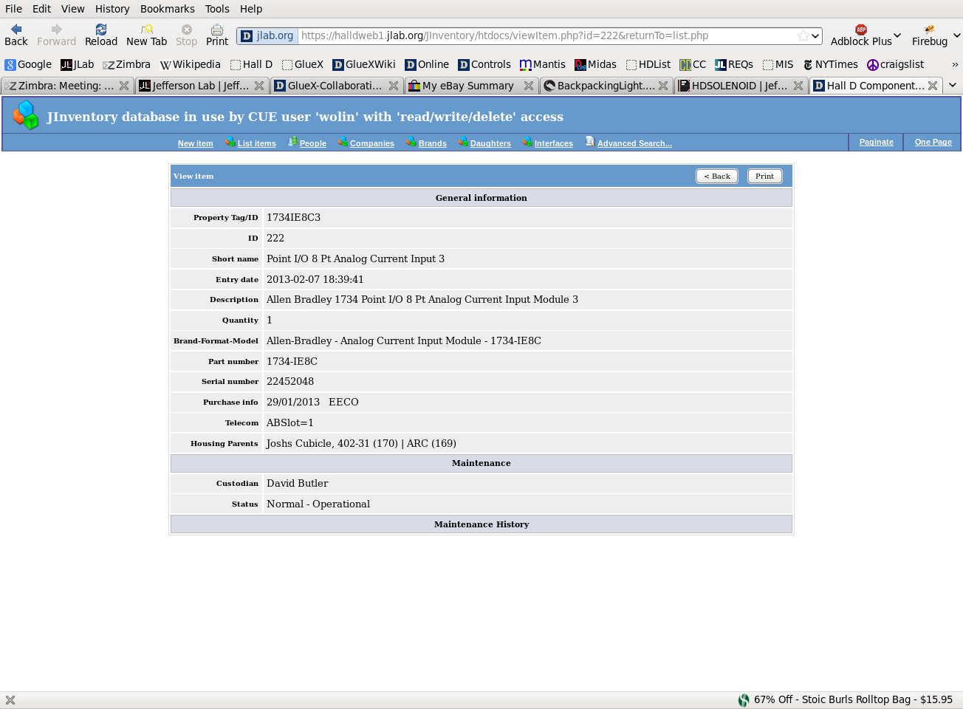

Slide 45
Future Plans
Switch to Hall D networks when Solenoid test complete
Currently using general JLab networks
Purchase remaining computer equipment in May
Will have to return some borrowed equipment in June
Set up and run test DAQ system in Rack room
Dave Abbott and Bryan Moffit
Continue testing as long equipment available and results useful
Set up DAQ systems in hall
As needed during detector installation (FCAL, BCAL coming soon?)
Will need temporary networking
Main fibers installed in Fall (?)
Use CODA3 (or CodaLite?)
Develop production DAQ system
ROL’s, scripts, COOL configuration files, databases, etc.

Slide 46
Future Plans
Continue development/testing Monitoring/L3 farm
Detector monitoring histograms, RootSpy, histogram archiving
Read EVIO raw and compressed formats
Implement translation table
Connect and commission control systems as needed
FCAL dark room coming soon (Fall?)
BCAL monitoring
Second version of Elog maybe by this summer
Should have many improvements
Run UPS power to hall if cost effective
Giles will do cost/benefit analysis

Slide 47
Future Plans
Make big effort to fill JInventory database
Include all crates, boards, controls equipment, etc.
Put barcode labels on everything
Keep up to date concerning maintenance/repair
Mantis bug/issue tracking system
Begin using in a serious way
Midas database
One-stop shopping for all Online documents
Manuals and procedures
Many manuals already in there
Critical to keep up to date

