Slide 1
Start Counter Update
W. U. Boeglin, L. Guo, E. Pooser

Slide 2
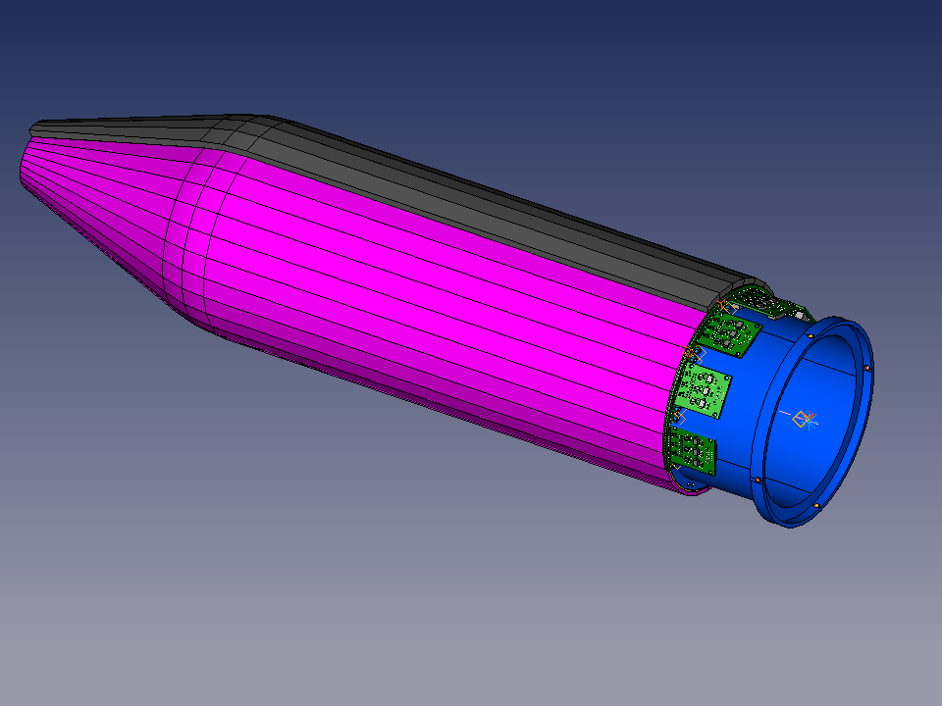
Outer cover (for light tightness)
Readout electronics
Upstream support
Scintillator elements
(covered reflective material)

Slide 3
Inner support

Slide 4
ST 1
3 groups of SiPM
Signal sum for each group
Bias for each group
ST 2
Preamp
Buffer to ADC
X5 amp to TDC
Temperature regulation
Thermo couple

Slide 5
Micro coax ribbon cable

Slide 6
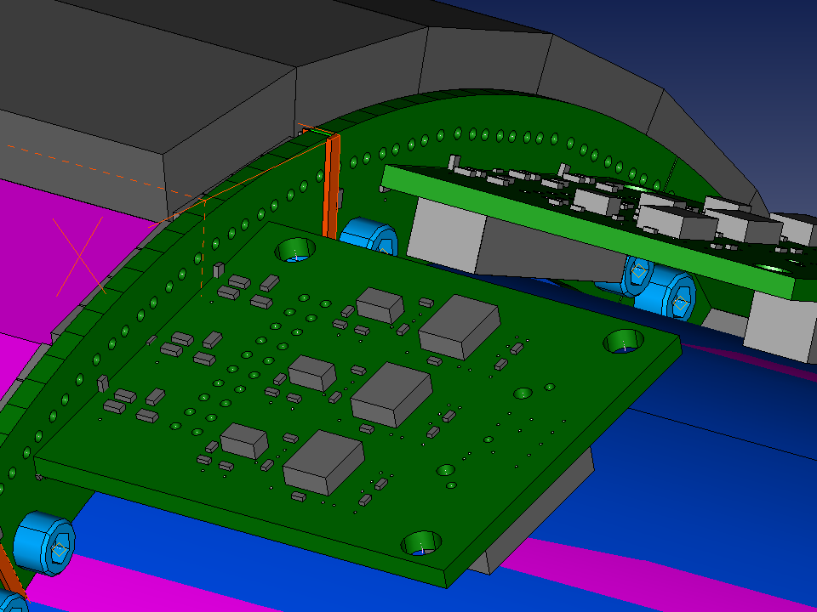

Slide 7
Recent Developments
Contract with Jefferson Lab signed
Scintillator manufacturing
Production test stand design
Assembly setup design

Slide 8
Scintillator Manufacturing
Eljen is bending scintillator bars
  Turned out to be more difficult than expected
  New protective material for machining
  Expect better protection
McNeal is machining the edges
  Detailed handling instructions
  Expect better result
  New batch of 5 scintillators to arrive next week

Slide 9
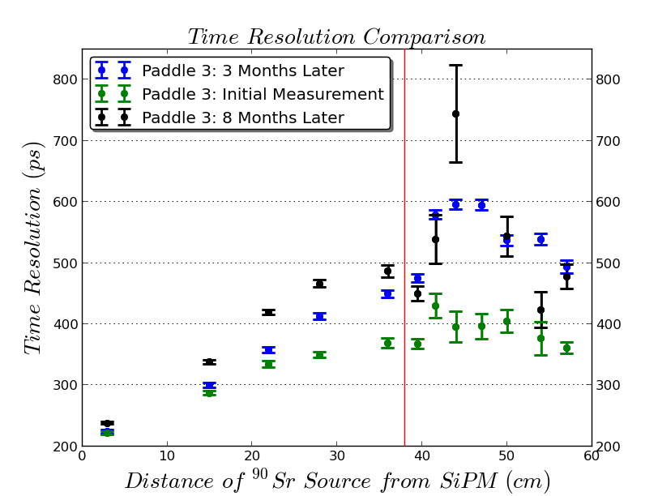
Scintillator Bar Aging
Expected Results
No more performance deterioration
Imporved performace
Bent Region

Slide 10
Beam Bunch Separation
<1%
3%
achievable
7%
13%

Slide 11
Test Stand
Notes:
Backup slide of test stand design for SC fabrication

Slide 12
Assembly Setup
Notes:
Backup slide of SC assembly setup for SC construction.

Slide 13
Plans
Perform timing studies on new Eljen/McNeal paddles
Construct production test stand
Order materials
Construct assembly setup
Start Production

