Slide 1
Online Update
Elliott Wolin
JLab
4-Oct-2013

Slide 2
Outline
Online Data Challenges
Networking
DAQ
JInventory System
Farm Manager
Counting House, Computers, Databases
System Software
Computer System Monitoring
Controls
ELog
UPS Power
Summary

Slide 3
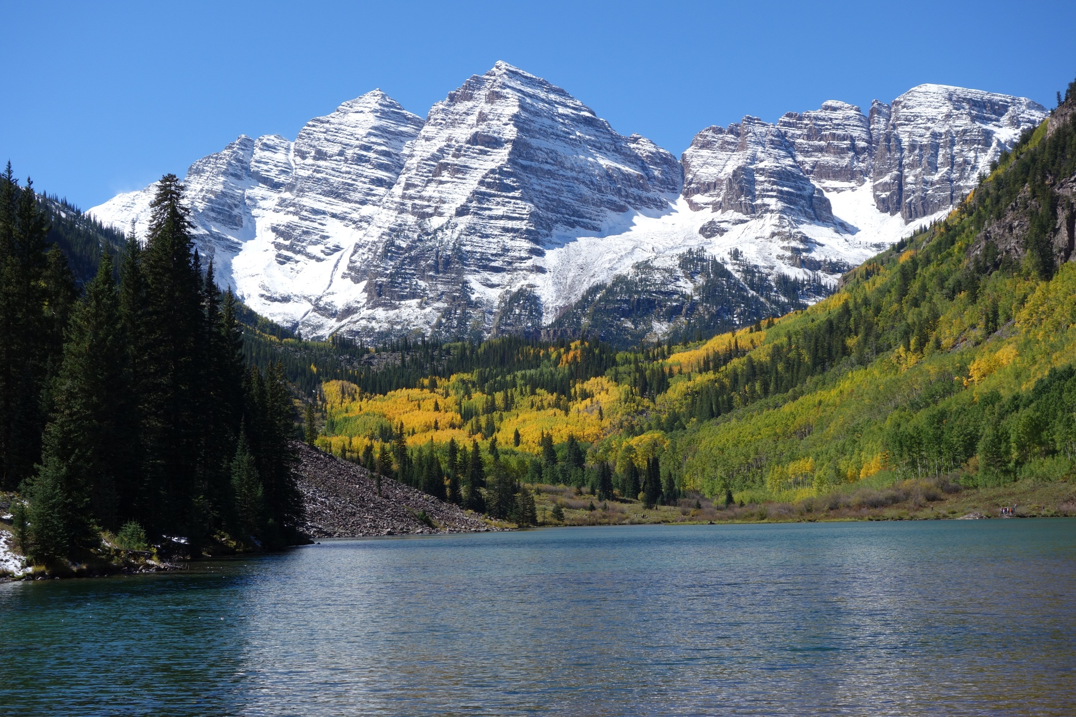
Maroon Bells

Slide 4
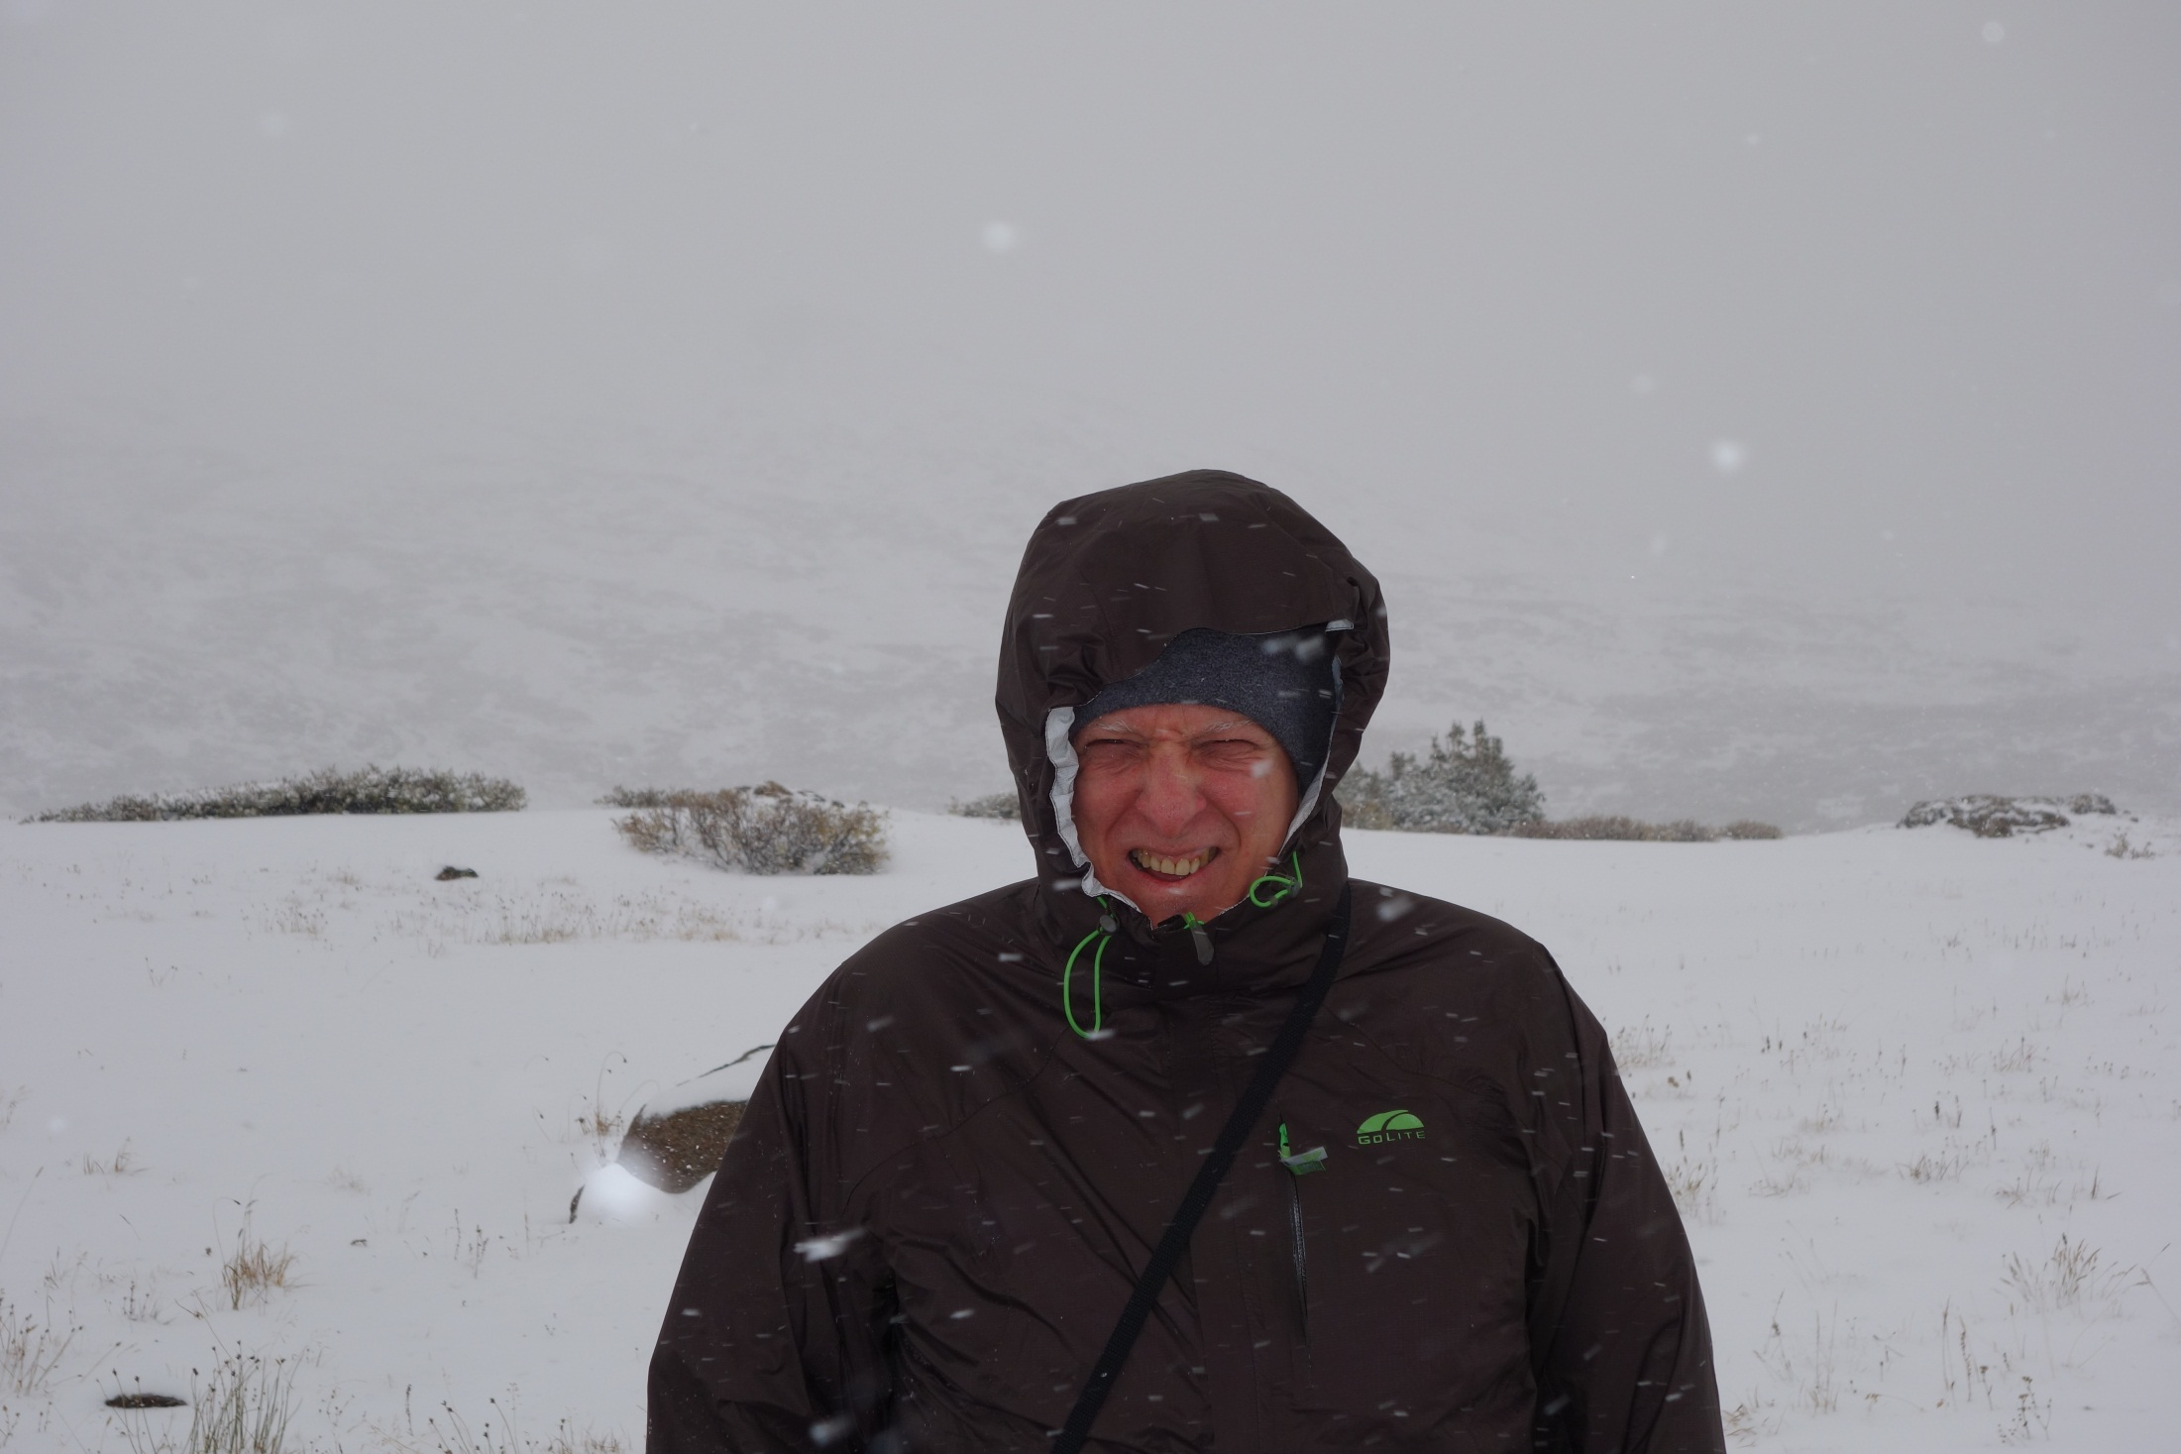

Slide 5
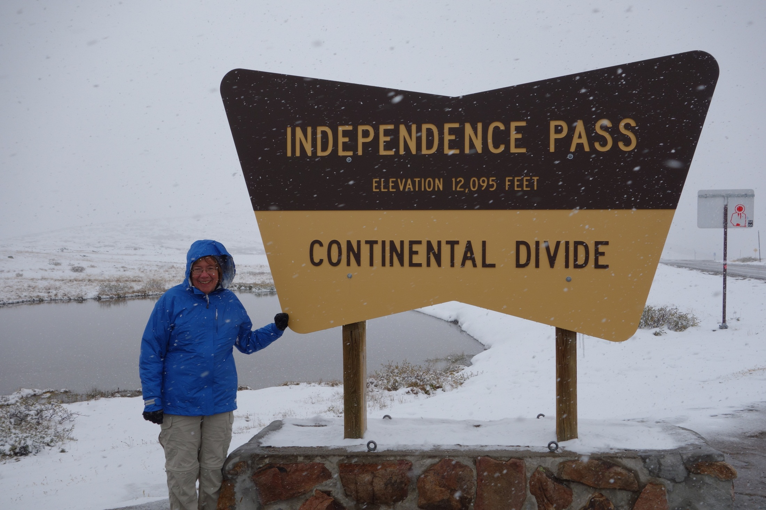

Slide 6
Networking
Trigger fiber installation separate contract (Chris C)
Installing final networking
Tagger almost done
Mark and I optimizing fiber/switch distribution in the hall
No sooner than many weeks from now
Interim networking installed
Low bandwidth
Run copper cables to interim switch as needed
Adequate for near-term needs

Slide 7
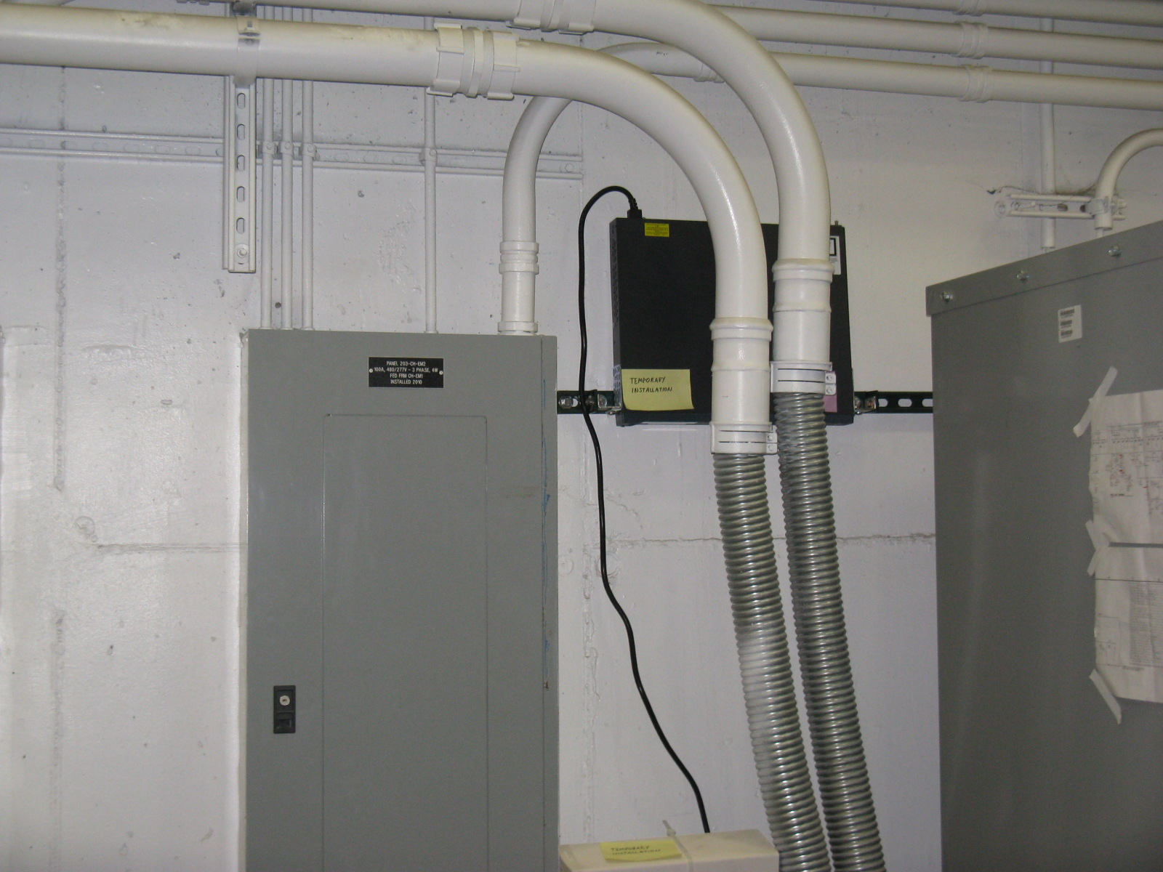
North Wall

Slide 8
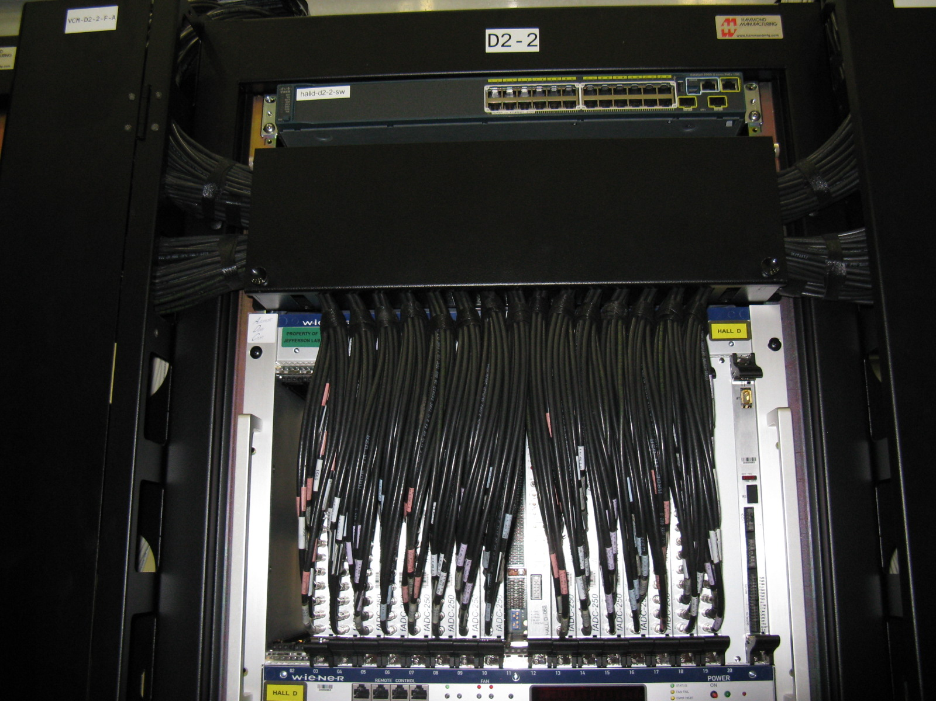
FCAL Switch

Slide 9
DAQ (from Dave A)
DAQ test stand down to 8 crates incl. TS, no GTP/SSP crate
Summer testing led to important improvements in robustness, error handling and debug-ability
Many firmware and driver updates
Many improvements in auxiliary programs
Gui’s, editors, diagnostic programs, etc.
CODA3 version ready for release
Supports multiple users
Implemented new byte-swapping policy
17 Gen 3 Core I7 ROCS just arrived
Need to order ~40 more, 10-12 week lead time
Ready to order if money available

Slide 10
DAQ, con’t
To do:
More high-speed testing w/two-stage event building
More integration with Global Trigger Crate and driver development
Continue debugging
Eventually move operations out of Counting House into Hall

Slide 11
JInventory System
Serguei Pozdniakov (contract) working diligently on this
Moving on to other stuff soon
Database fully implemented, ready for production use
~1000 items entered
backed-up regularly by Computer Center
Item custodians get email if location or condition changes
Still to do:
Complete entering electronics and control items
Complete barcode labeling
Implement power hierarchy information
Add electronics maintenance component
For Fernando et al.
Add more consistency checking
Implement handheld scanner API

Slide 12
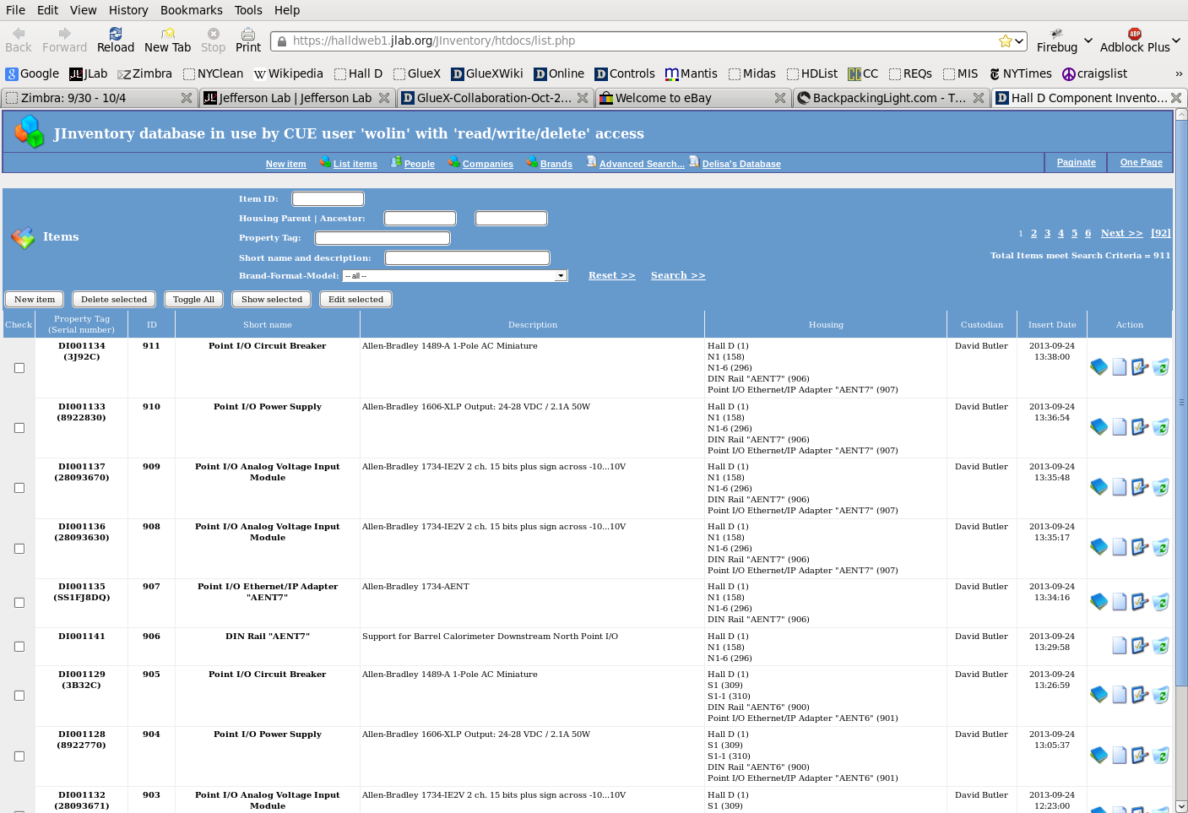

Slide 13
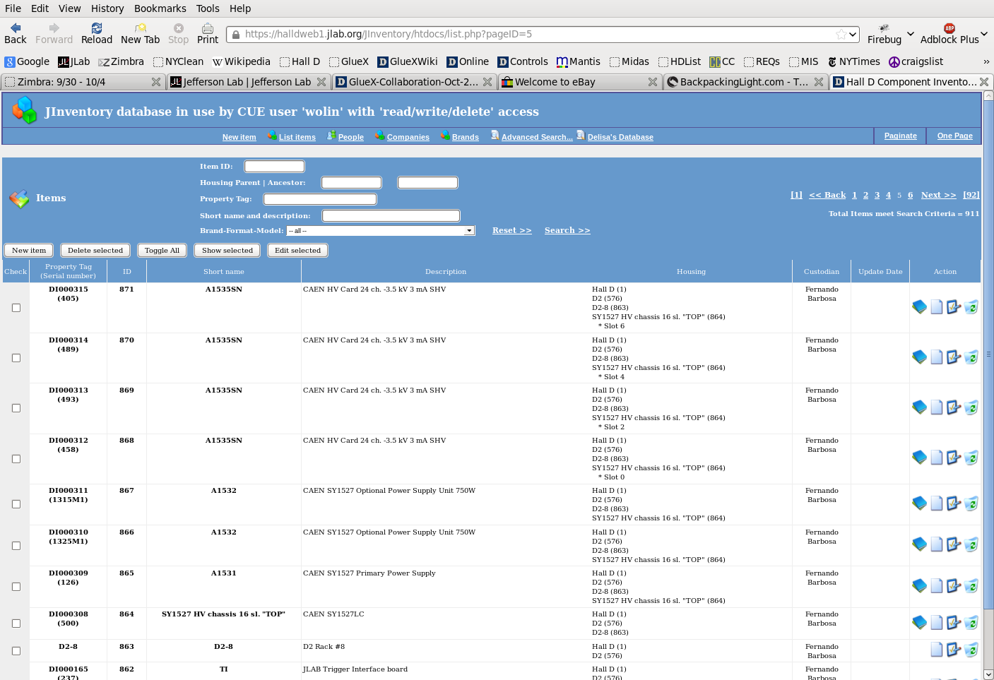

Slide 14
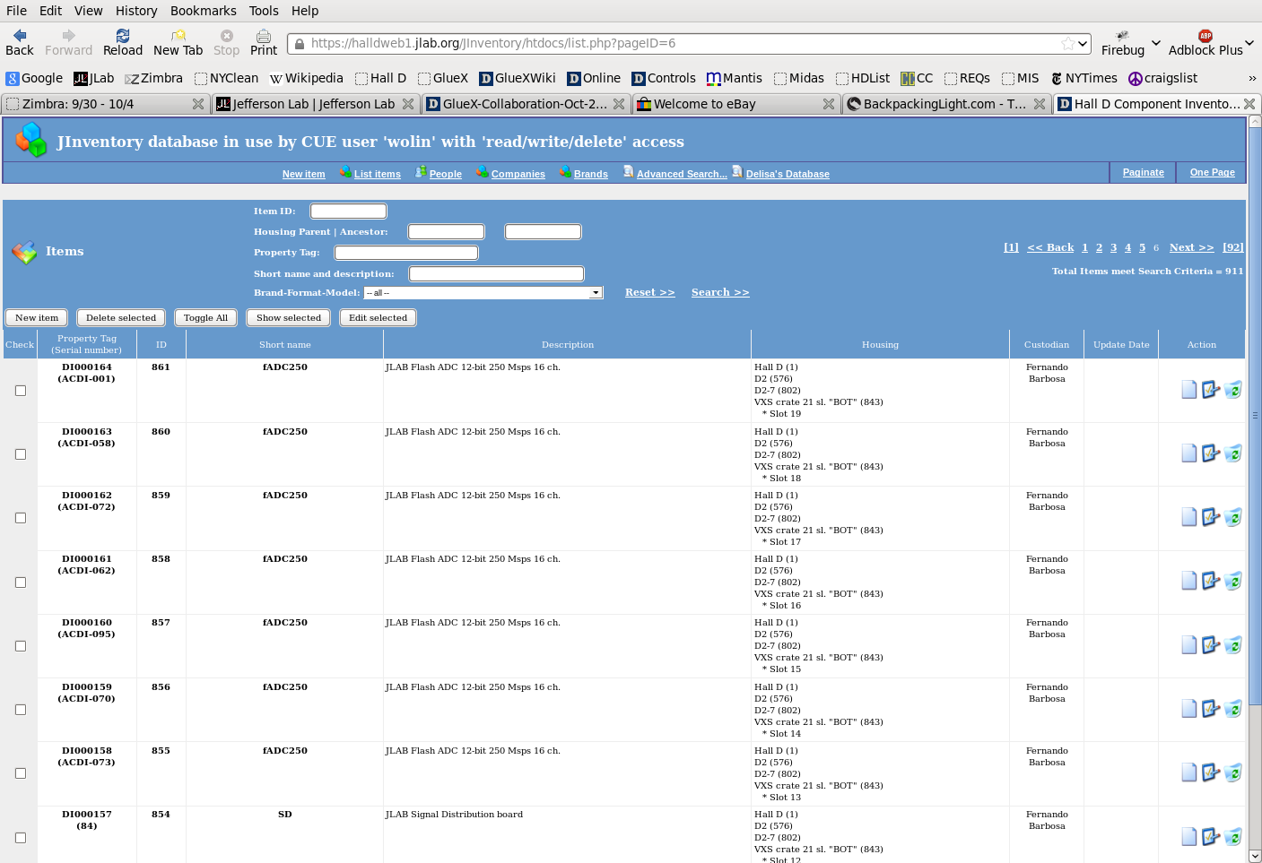

Slide 15
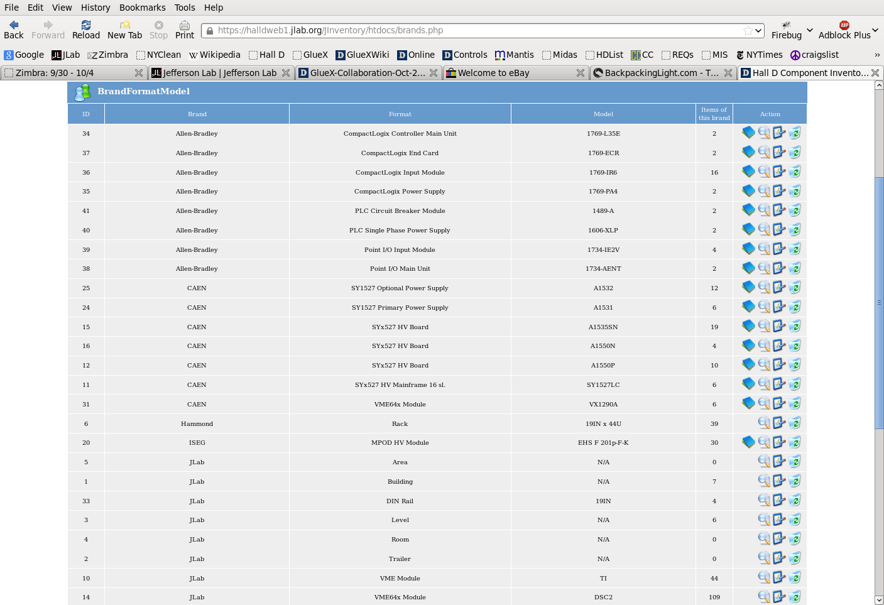

Slide 16
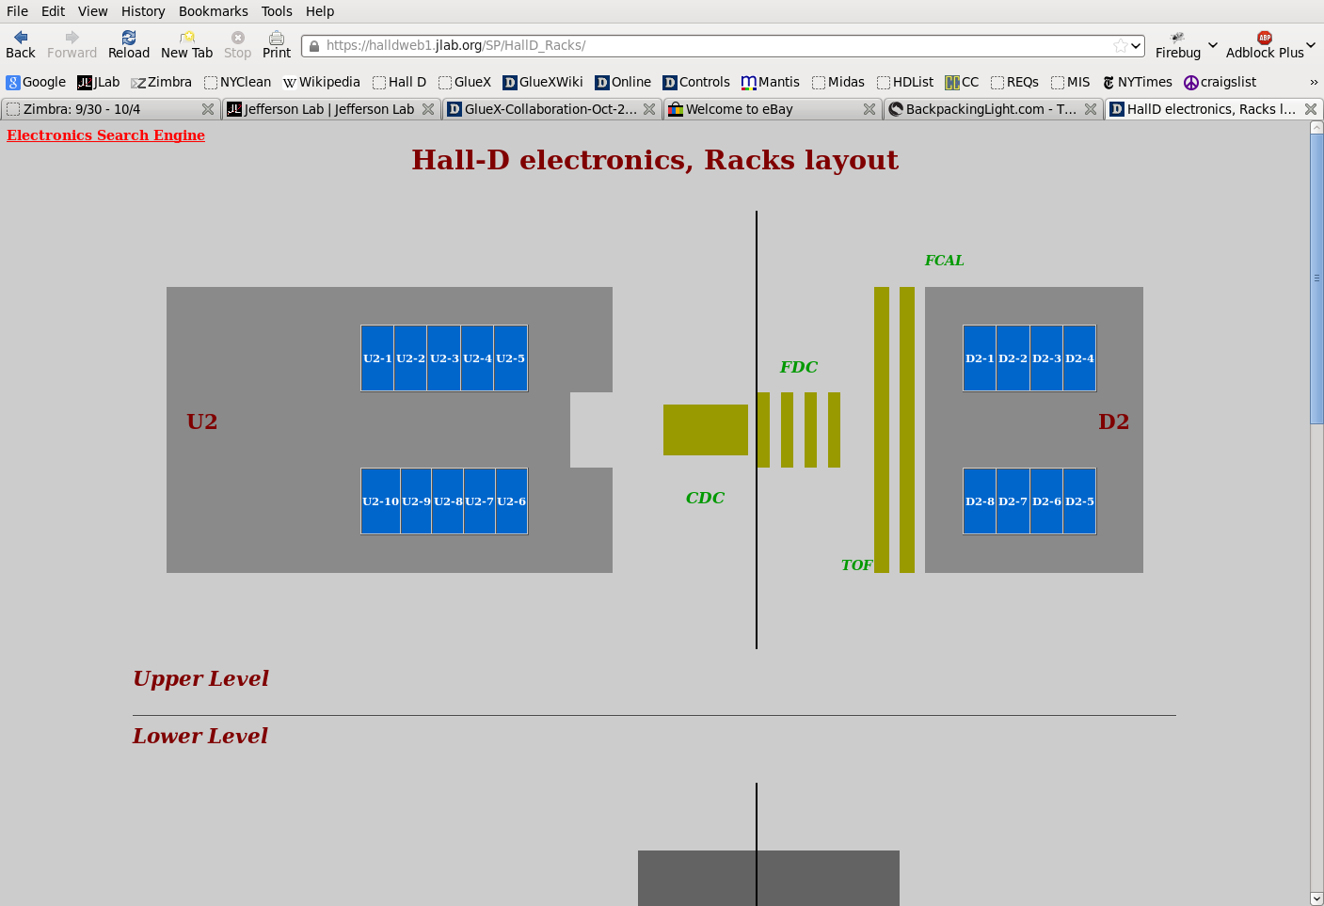

Slide 17
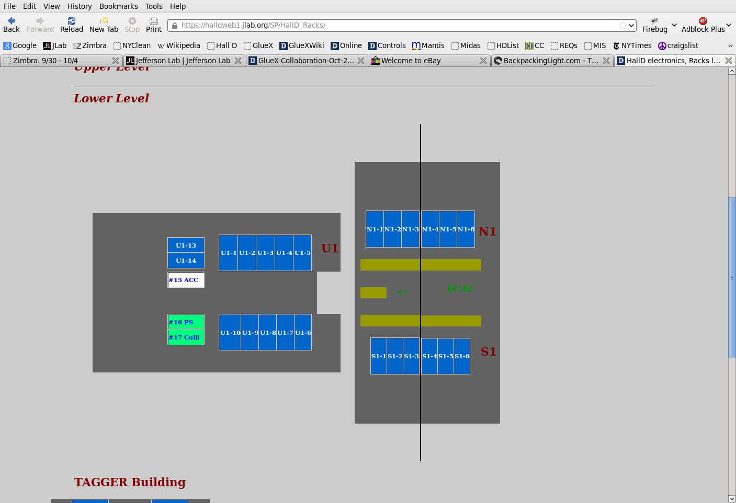

Slide 18
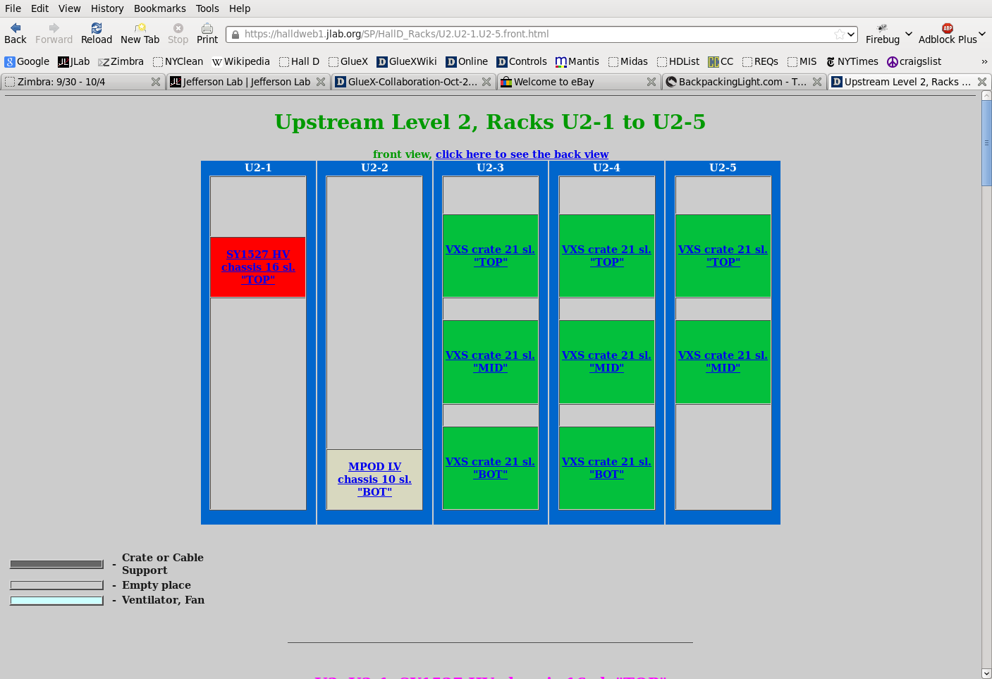

Slide 19
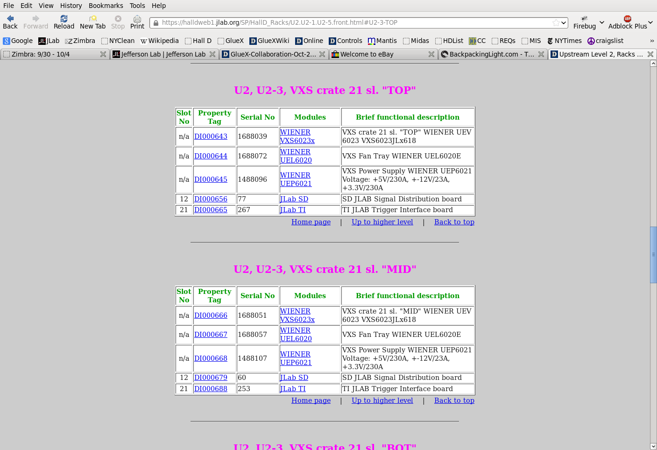

Slide 20
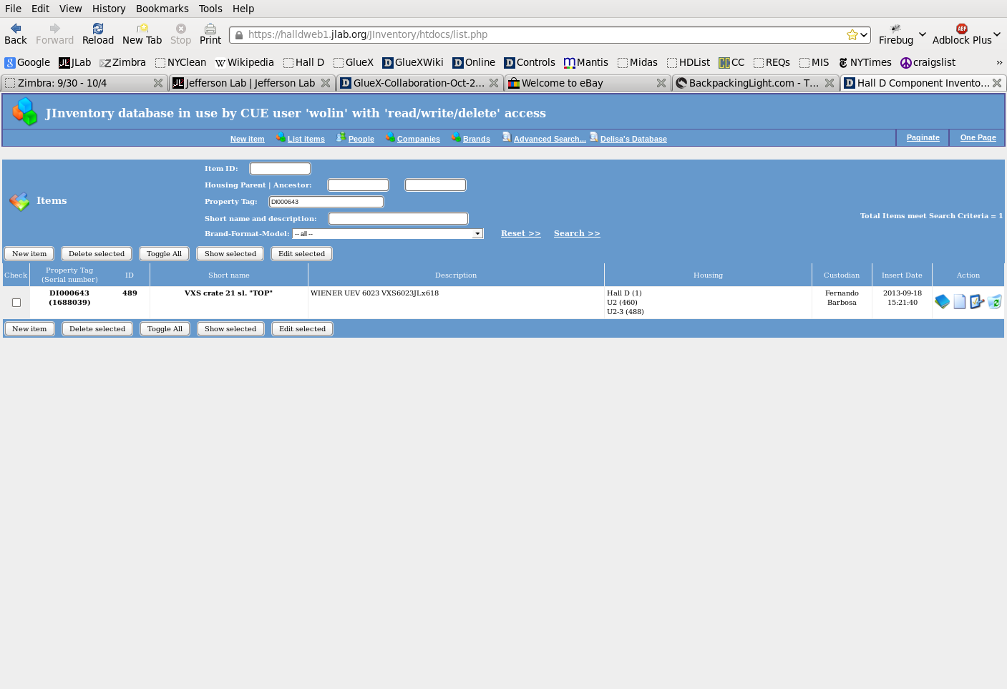

Slide 21
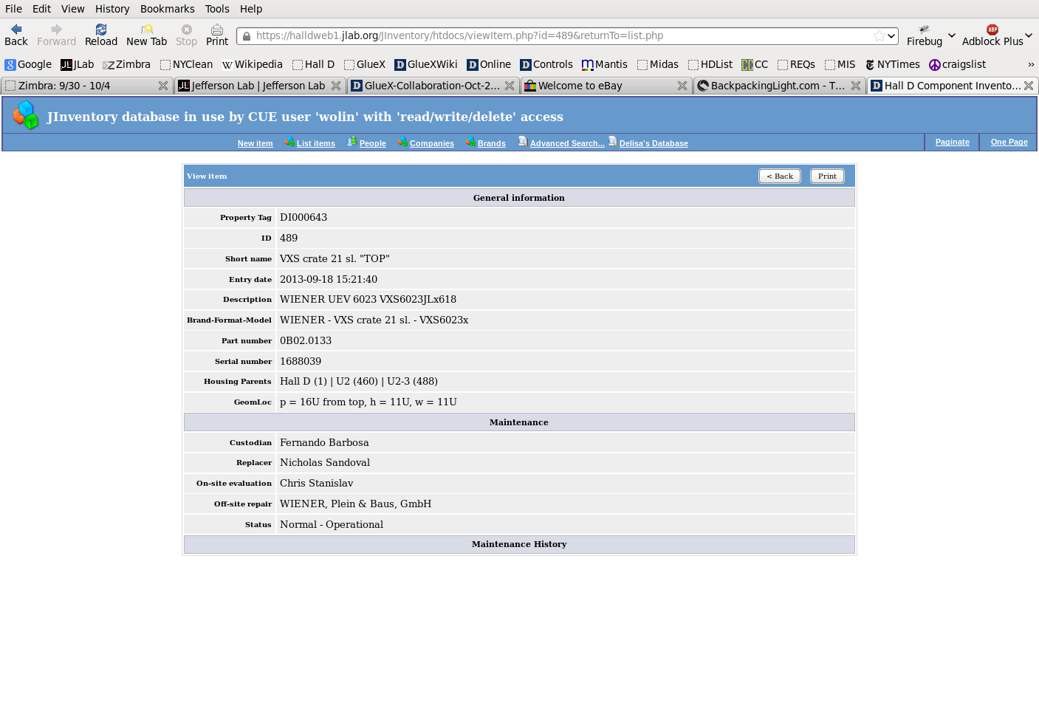

Slide 22
Farm Manager
CODA component that manages farm processes
Farm Manager listed in run control (COOL) configuration file
Farm processes are not CODA components
Farm processes do not respond to run control commands
E.g. a farm process can die but DAQ continues
Vardan (DAQ group) writing Farm Manager
Farm process tested in recent data challenge
hd_online (Dave L)
Communication layer and state machine (me)

Slide 23
Hall-D Farm Control System
RCS - Run Control System supervisor
ECS - Experiment Control System supervisor
SCS - Slow Control System supervisor
FCS - Farm Control System supervisor
HCAn - Hardware Control Agent
PCAn - Process Control Agent
IPMI - Hardware control protocol
JPn - Jana Process
RCS
ECS
SCS
PCA States | State Machine Actions
connected | start
disconnected | stop
configured | configure
active | go
ended | end
paused | pause
warning | getState
error | getStatus
Control Node
FCS
HCA1
HCAn
PCA1
PCAn
IPMI
JP1
JPn
IPMI
Processing Node 1
Processing Node n

Slide 24
Counting House, Computers, Databases
Counting House done except few punch-list items
Computers ordered, should arrive any day now
Combined order with HPCC
Paul Letta (system manager) will install everything
Maybe by the end of the month
Working out MySQL database backup strategy
Will back up from replicated database
May depend on level and type of offline access needed

Slide 25
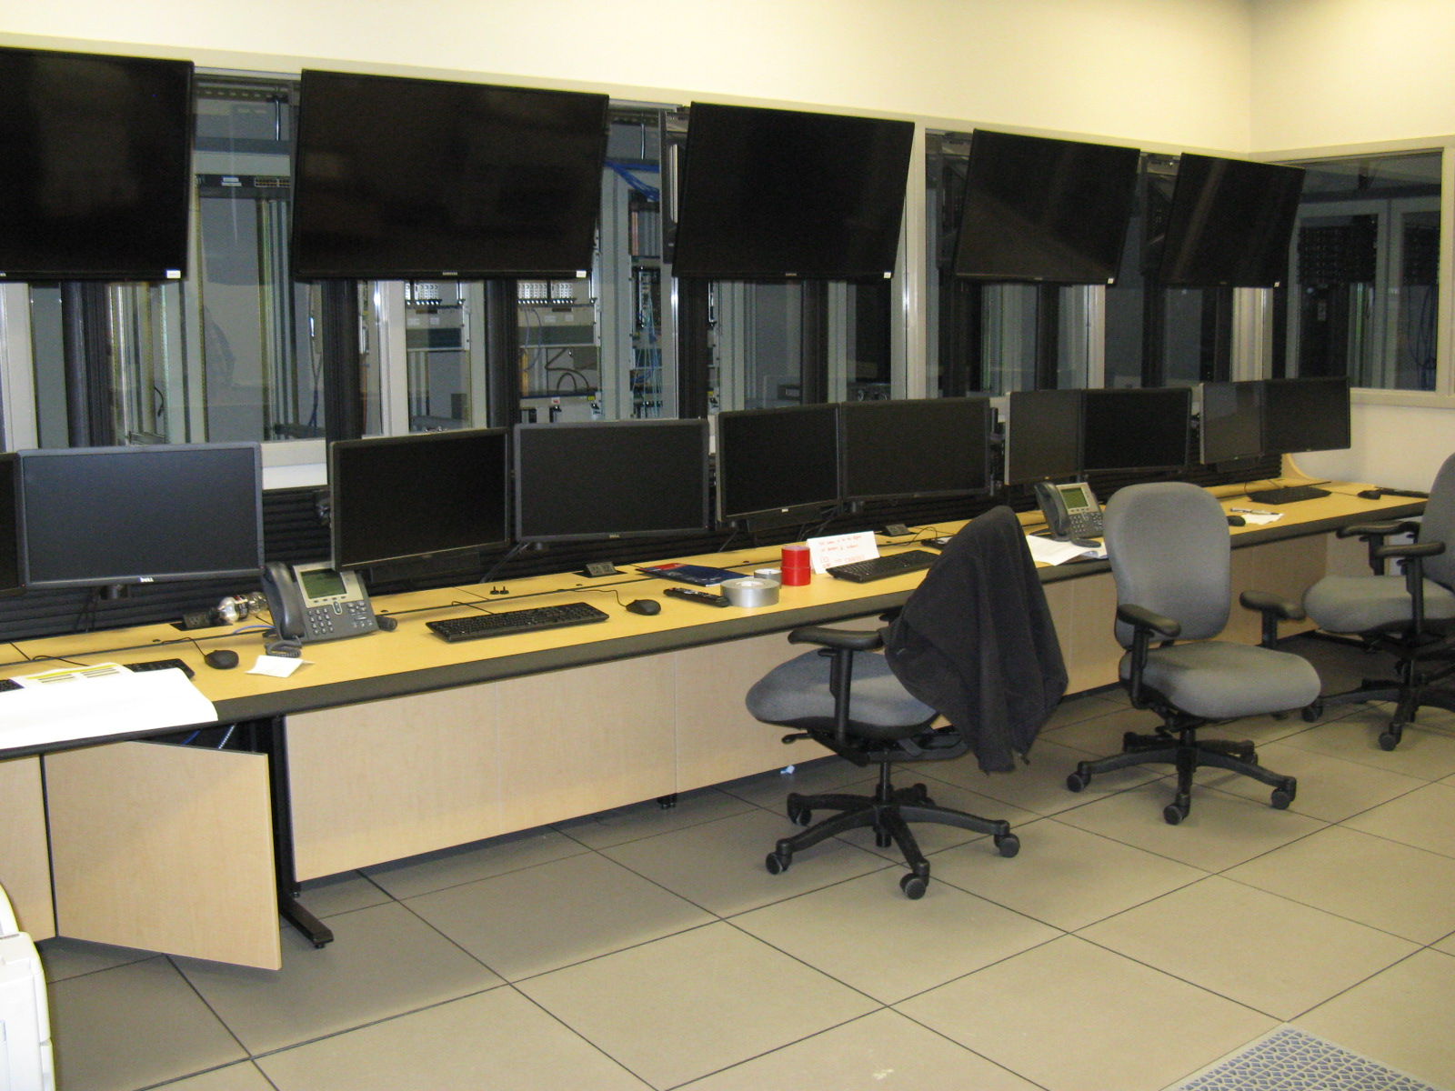
Counting Room

Slide 26
System Software
Will install locally in /gapps (not in /apps)
Should not rely on /apps, /site or /group
Moved to GCC 4.8.1
C++11 “language complete”
Missing some libs (esp. regex)

Slide 27
Computer System Monitoring
Will use Ganglia for the forseeable future
Used during data challenge
Used by Computer Center
AFECS controls framework (from DAQ group) includes hardware monitoring component

Slide 28
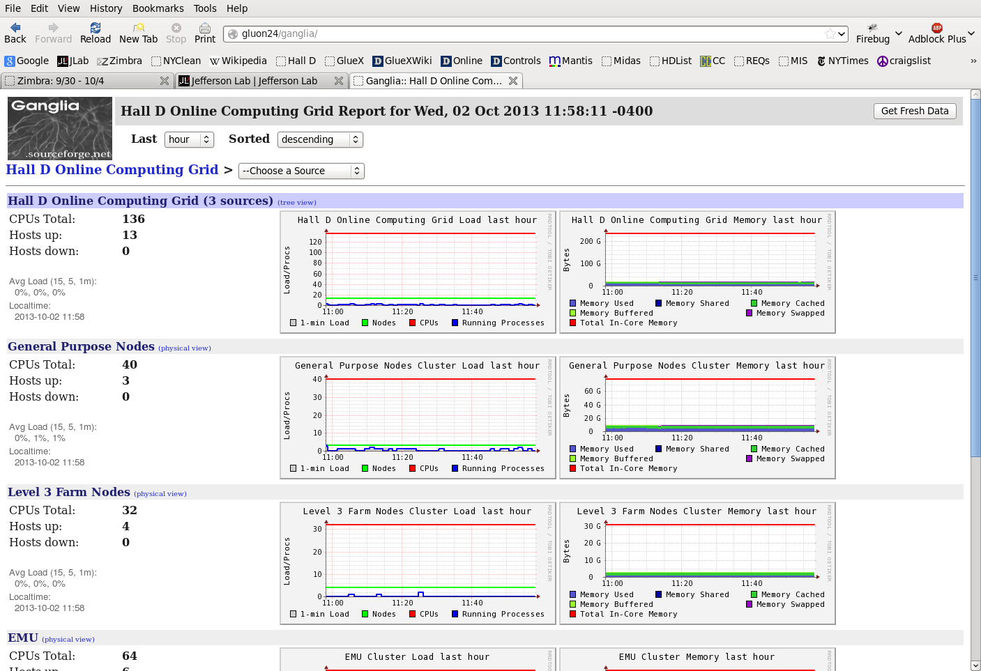

Slide 29
Controls
Dave Butler beginning installation of controls equipment
Everything we know about is here or on order
Rack space becoming an issue
Detector groups need more space than planned
Fernando is the rack-space czar!
Solenoid control system being upgraded
Based on experience during Solenoid test

Slide 30
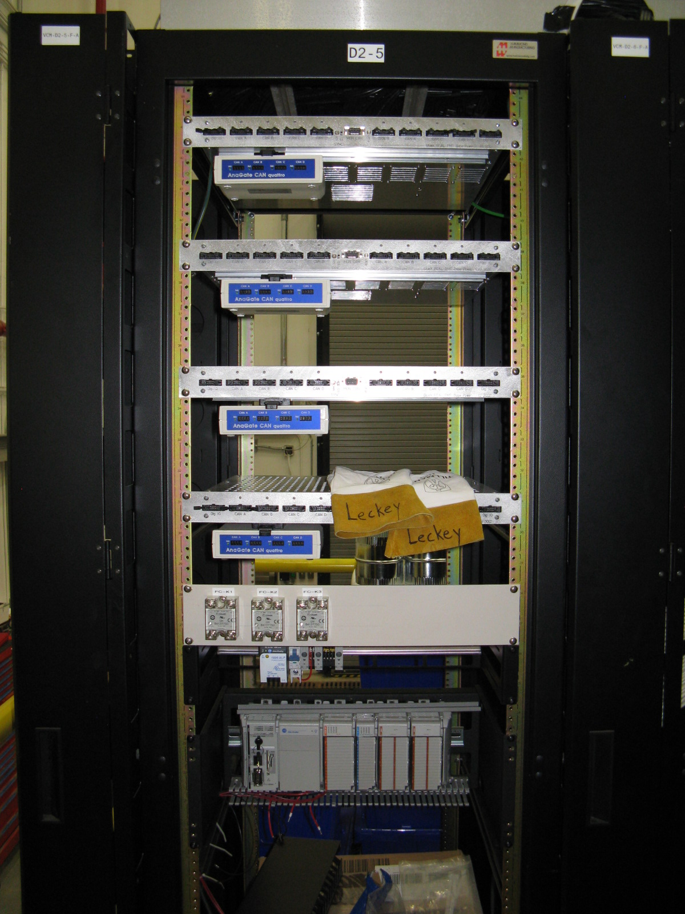
FCAL
Darkroom
Controls
IU Stuff
Allen-Bradley
CompactLogix
PLC

Slide 31
ELog
Used Accelerator ELog for Solenoid test
Worked ok, many improvements needed
Requirements document developed by four halls
Accelerator thinks it’s mostly done…
Underlying database on ACC managed computers
New ELog from EPICS community?

Slide 32
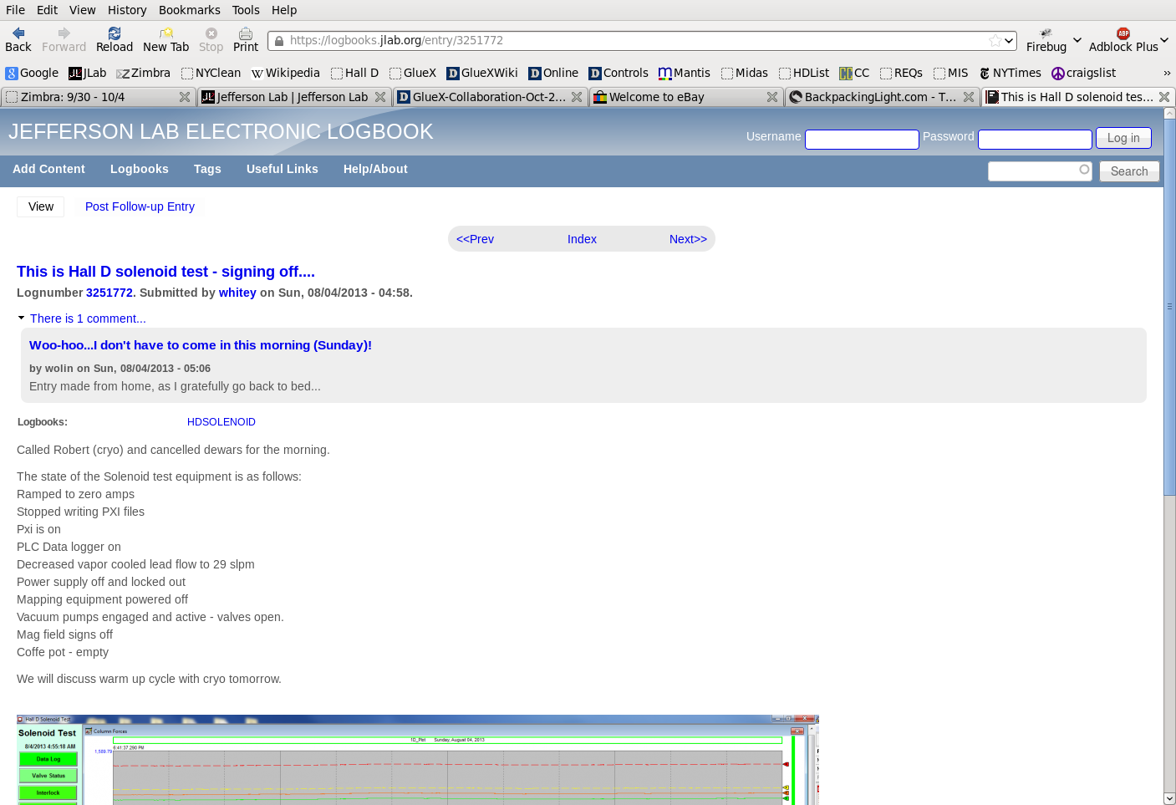

Slide 33
UPS Power
Plan to run filtered power from big UPS to hall
Then run branch circuits where needed
Giles will do the planning
After regular power installed in hall

Slide 34
Summary
Summer online data challenge very useful
Next one late Fall will include almost all DAQ/L3/monitoring components
Final networking being installed
Interim system can accommodate all low-bandwidth needs
Summer DAQ testing by DAQ group very useful
Led to many CODA improvements
JInventory ready to use
Almost all DAQ and controls equipment entered and barcode labeled
Farm manager being developed
Counting House and computers almost ready
Software installation, backup strategies, compilers, accounts, etc.
Accelerator ELog needs work
UPS power coming to the hall eventually

