Slide 1
01100 01100 10010 0000 10010 11111 011011 11010
Hall D Slow Controls
Dave Butler

Slide 2
Agenda
PLC Overview
RSLogix5000 Software
Ladder Logic
Structured Text
Function Block
Communications
HMI System
Detector Controls
Solenoid Controls/Improvements
Slow Controls Progress

Slide 3
Programmable Logic Controllers
ControlLogix (1756)
4 Mbyte memory
Can be redundant
Chassis based
We use 10-slot chassis
CompactLogix (1769)
1.5 Mbyte memory
No redundancy available
No chassis
L35E Controllers can talk to 32 I/O Modules
Power
Supply
Power
Supply
I/O Modules
Controller
Chassis
Comm
Controller

Slide 4
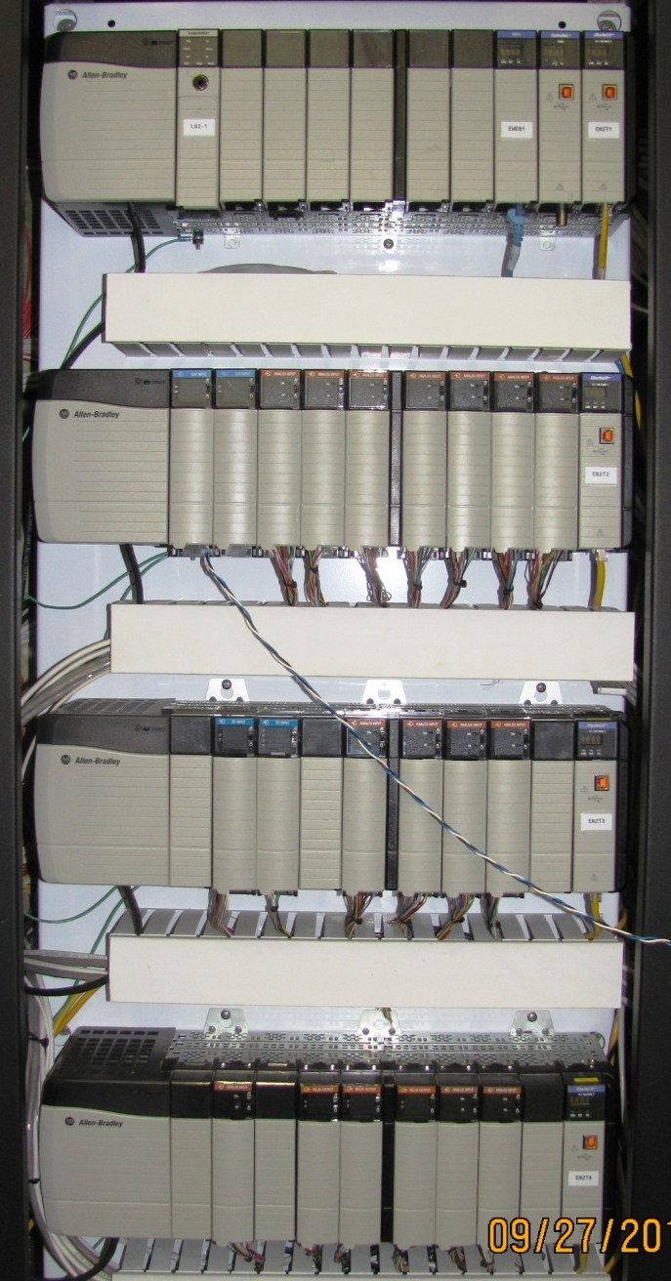
I/O (Local vs Remote)
Local I/O
Any modules in the same chassis as the controller
Remote I/O
Modules NOT in the same chassis as the controller
Can be Point IO
Point IO is available for ControlLogix and CompactLogix
Solenoid Controls
Controller
Comm
Local
Remote

Slide 5
Point IO (always remote)
Modular IO modules
Ideal for mounting on remote panels where small IO counts are required
Communicate via any standard protocol
We use Ethernet/IP
ControlNet, DeviceNet, Profibus all available
Snap together on DIN rail
No chassis required
24 VDC powered
Communication Module
Output Module

Slide 6
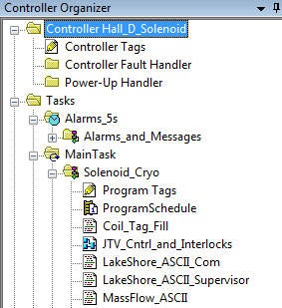
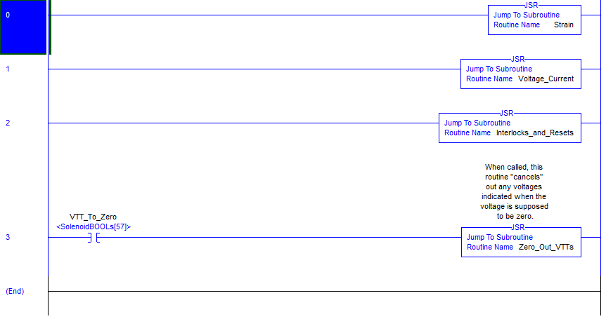
RSLogix5000 Software
Ladder Logic

Slide 7
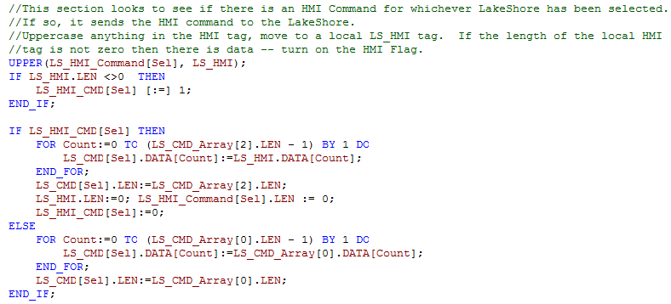
RSLogix5000 Software
Structured Text

Slide 8
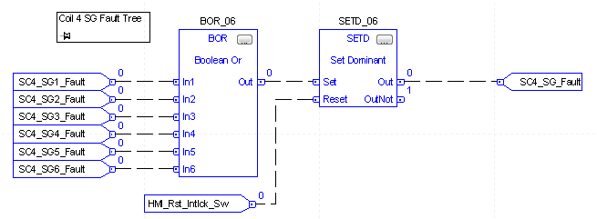
RSLogix5000 Software
Function Block

Slide 9
Communications
All Allen Bradley equipment networked with Ethernet/IP
Uses standard CC-configured Ethernet hardware (switches, cables, etc)
Proven to be very reliable
Three methods for PLC to PLC connections
Produced/Consumed Tags
Messages
EPICS (reads from one and writes to another)
Serial Communications (RS232, RS485, TCP) use a Real Time Automation gateway
435NBX for RS232/485 to PLC
490NBX for TCP to PLC

Slide 10
Human Machine Interface (HMI)
Networked applications provide many services
FactoryTalk View Studio
Create HMI screens and manage HMI application
Datalogging
Screen prints for auto log-entry
Create & manage RSLinx Enterprise FactoryTalk View SE
Client for viewing HMI displays
FactoryTalk Network Directory Server
Backbone of FactoryTalk Network – directs client computers to servers
FactoryTalk HMI Server
Hosts HMI screens to be served to clients
Can be redundant (requires another HMI license)
RSLinx Enterprise
Gathers tag data from the PLC for display in the HMI
Can be redundant (does not require additional licensing)
Alarms and Events (screen alarms)
*Alarm pages come from PLC and are independent of the PC’s running the Alarms and Events services

Slide 11
Solenoid Test HMI Schematic
MySQL Server for FactoryTalk Datalogging
gluon01
Ethernet
halldsc6
halldsc7
halldsc8
Network Directory Server
HMI Server
FactoryTalk View Studio
FactoryTalk View SE
ODBC connection to MySQL database (hosted on gluon01)
RSLinx Enterprise Server (Primary)
FactoryTalk View Studio
FactoryTalk View SE
RSLinx Enterprise Server (Redundant)
FactoryTalk View Studio
FactoryTalk View SE

Slide 12
Hall Operations HMI Schematic
Hall D
MySQL Server for FactoryTalk Datalogging
gluon01
Ethernet
TEDF
Counting
House
halldsc8
halldsc6
halldsc7
RSLinx Enterprise Server (Redundant)
FactoryTalk View Studio
FactoryTalk View SE
Network Directory Server
HMI Server
FactoryTalk View Studio
FactoryTalk View SE
ODBC connection to MySQL database (hosted on gluon01)
RSLinx Enterprise Server (Primary)
FactoryTalk View Studio
FactoryTalk View SE

Slide 13
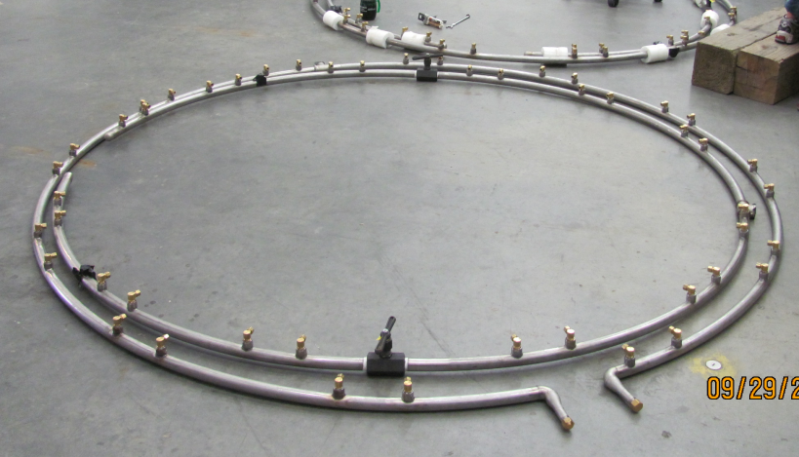
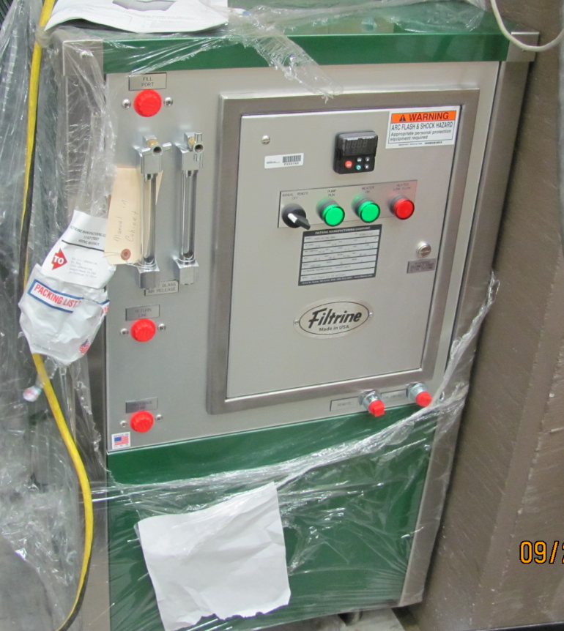
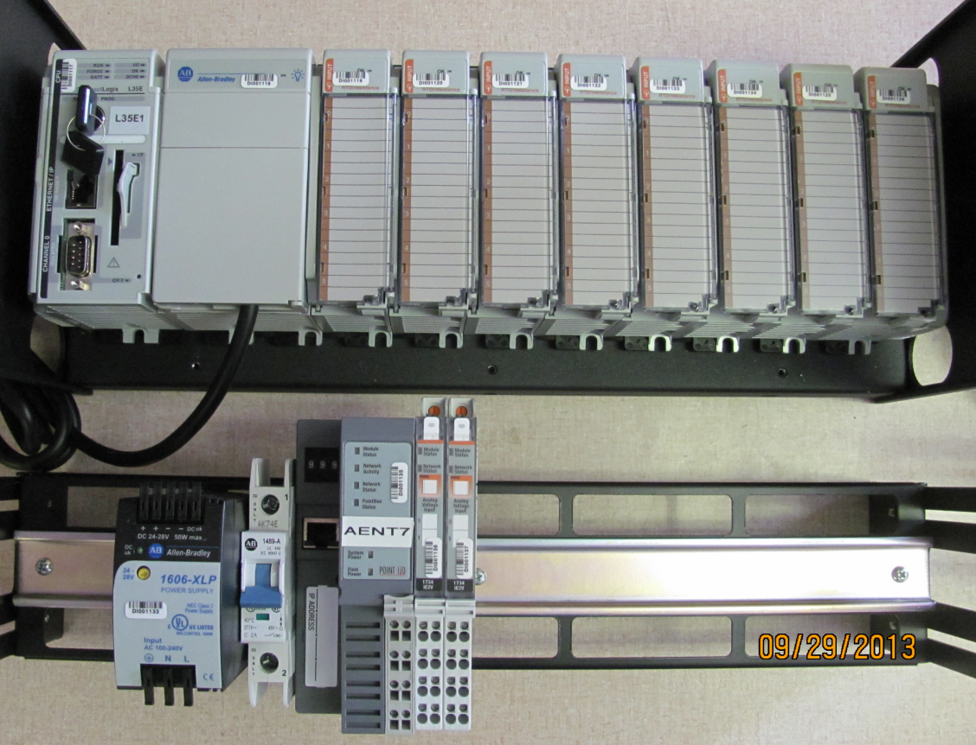
BCAL Controls
Module Qty | Name | PN | Total Channels
1 | Ethernet Processor, 1.5 Mbyte Memory | 1769-L35E | --
1 | Power Supply 120/240 VAC Input | 1769-PA4 | --
16 | 6 Channel RTD /Resistance Input Module | 1769-IR6 | 96
2 | Pressure Transducer | Point I/O | 4
2 | Temperature | Point I/O | 4

Slide 14
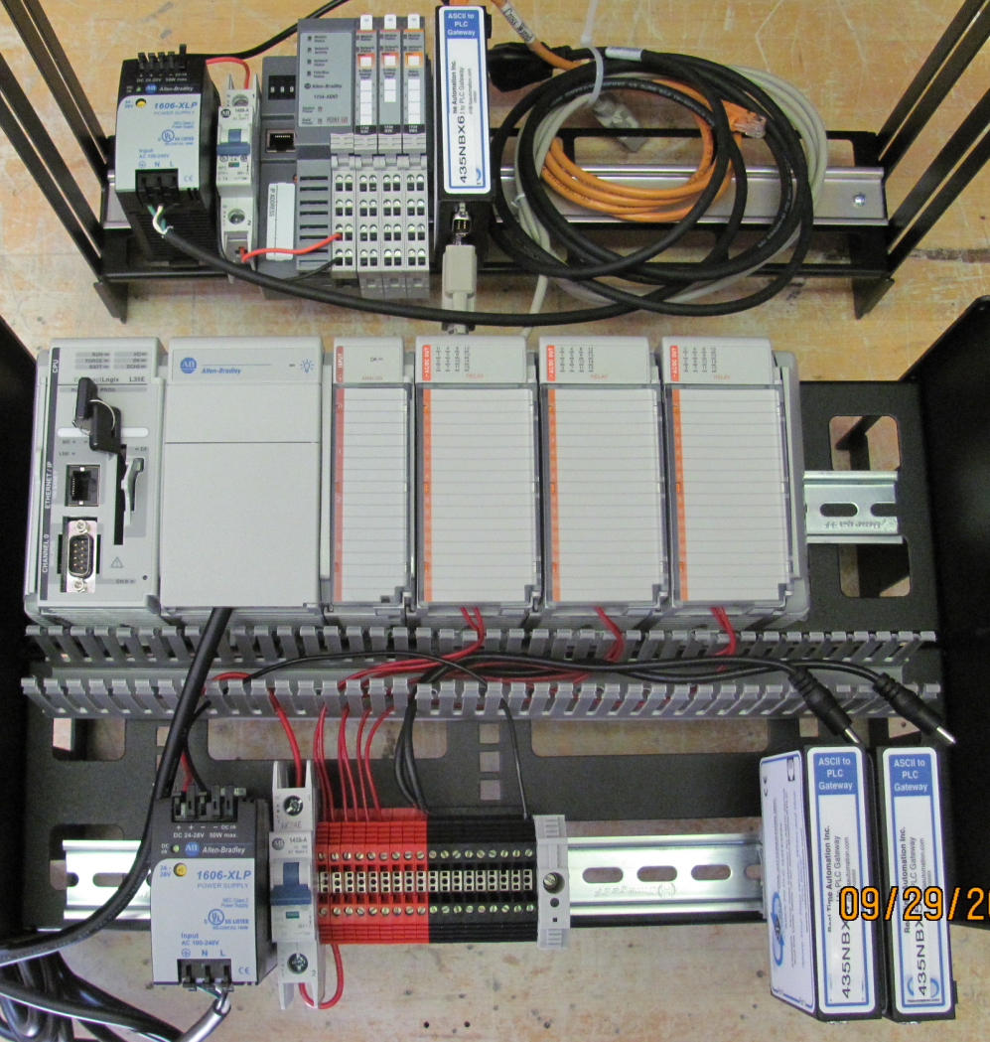
FDC/CDC Controls
Gas Shed:
Qty | Name | PN | Total Channels
1 | 24VDC Ethernet Adapter | 1734-AENT | --
1 | 24 VDC 8 Ch Analog Input | 1734-IE8C | 8
1 | 24 VDC 2 Ch Analog Current Input | 1734-IE2C | 2
1 | 24 VDC 4 Ch Relay Module (NO) | 1734-OW4 | 4
1 | ASCII to PLC Gateway | 435NBX | 2
Hall D:
Qty | Name | PN | Total Channels
1 | Ethernet Processor, 1.5 Mbyte Memory | 1769-L35E | --
1 | Power Supply 120/240 VAC Input | 1769-PA4 | --
3 | 16 Ch Relay Output | 1769-OW16 | 48
1 | 4 Ch Analog Current/Voltage Input | 1769-IF4 | 4
2 | ASCII to PLC Gateway (PR 327905) | 435NBX | 4
3 | Chiller (FDC/BCAL) | RS485 | 1
2 | Thermocouples (CDC) | 1769-IT6 | 12

Slide 15
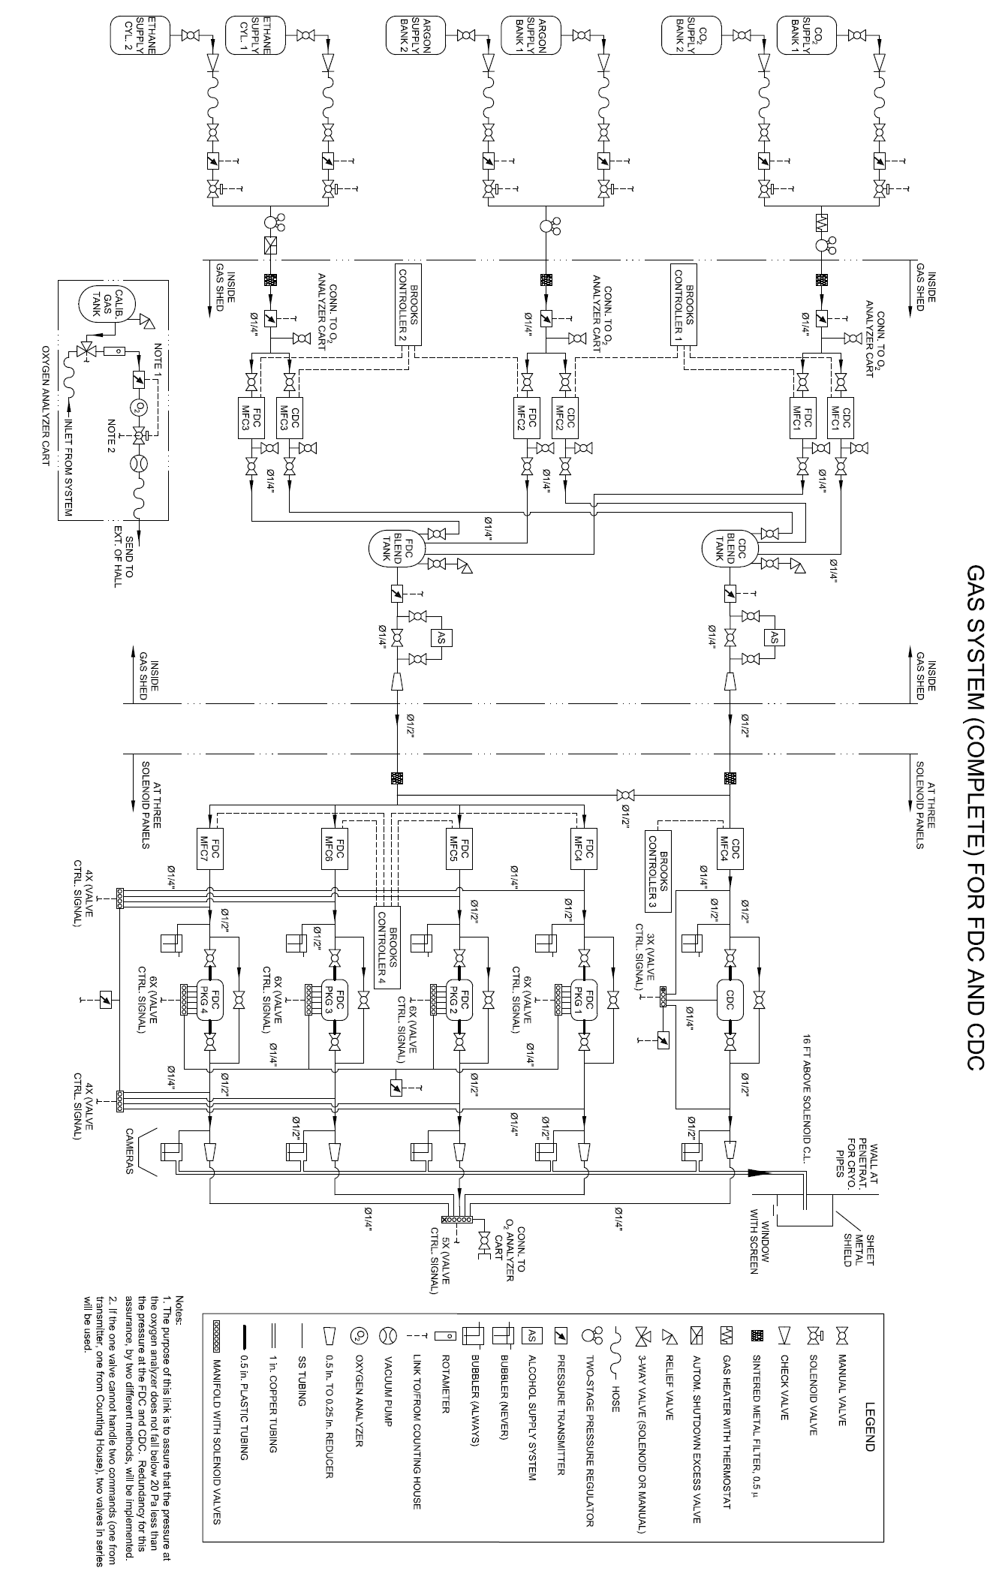

Slide 16
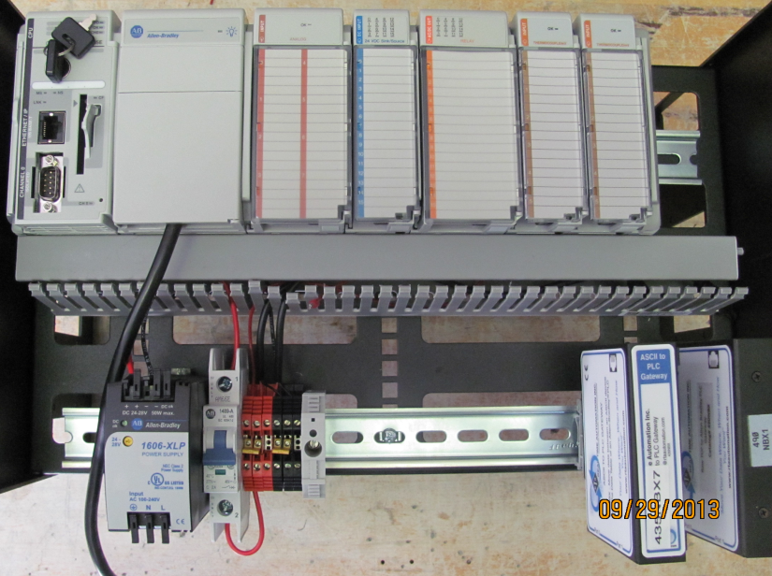
Target/Start Counter Controls
Qty | Sensory Name | Signal Type
1 | H2 Supply Pressure | 4-20 mA
1 | H2 Return Pressure | 4-20 mA
1 | Coarse Vacuum Gauge | 0-10 V
1 | High Vacuum Gauge | 1-9 V
1 | Lakeshore 336 | TCP
1 | Lakeshore 218 | RS232
1 | PTR Compressor | RS232
3 | Relay | Relay Contact
Layout
LakeShore 218
Qty | Name | PN | Total Channels
1 | TCP to ControlLogix Gateway (in 2012) | 490NBX | --
1 | Ethernet Processor, 1.5 Mbyte Memory | 1769-L35E | --
1 | Power Supply 120/240 VAC Input | 1769-PA4 | --
1 | 8 Ch Analog Input Module | 1769-IF8 | 8
1 | 16 Ch 24 VDC Sinking/Sourcing Input | 1769-IQ16 | 16
1 | ASCII to CompactLogix Gateway PR#327842 | 435NBX | 2
2 | 6 Channel Thermocouple Modules | AB1769IT6 | 12
435NBX
RS232
490NBX
PTR Compressor
L35
PA4
IF8
IQ16
OW16
IT6
IT6
LakeShore 336
CompactLogix
Ethernet

Slide 17
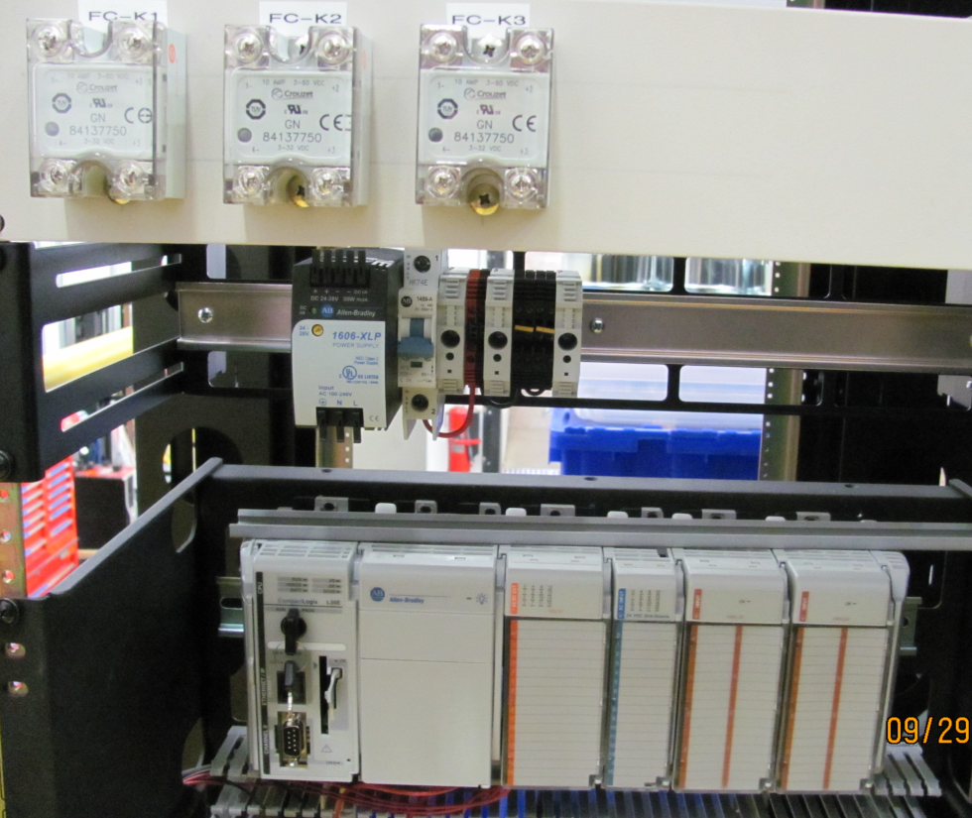
FCAL / Pair Spectrometer Control
Qty | Sensory Name | Signal Type
2 | Magnetic Door Lock Power | Relay Out
2 | Temperature | Analog In
2 | Humidity Sensor | Analog In
4 | Photosensor | Analog In
1 | Crash Button | Digital In
1 | Outer Door Button | Digital In
1 | Inner Door Button | Digital In
1 | PMT Base Power Relay | Relay Out
1 | Trip Switch for Fault Reset | Digital In
4 | Thermocouples (PS) | Thermocouple In
Qty | Name | PN | Total Channels
1 | Ethernet Processor, 1.5 Mbyte Memory | 1769-L35E | --
1 | Power Supply 120/240 VAC Input | 1769-PA4 | --
1 | 16 Channel AC/DC Relay Module | 1769-OW16 | 16
1 | 16 Channel 24 VDC sink/source Input | 1769-IQ16 | 16
1 | 8 Channel Voltage/Current Analog Input | 1769-IF8 | 8

Slide 18
Solenoid Controls
EN2T1
Chassis 0
Solenoid Analog/Digital
Controls
(Strain, Valves, Temp, etc)
Vacuum Chassis
EN2T2
Valve 6
Chassis 1
Chassis 2
EN2T3
Chassis 3
EN2T4
AENT3
AENT1
Ethernet
Windows PC’s:
Programming Terminal
HMI Services
Datalogging (logs exist on gluon01)
Alarms & Events
EPICS
435NBX1
435NBX2
435NBX3
halldsc6
Archiving
HMI Displays
Alarms
RS232
halldsc7
RS232
RS232
LakeShore 3 & Mass Flow
LakeShore 1 & 2
Danfysik
halldsc8

Slide 19
Solenoid Controls Improvements
Upgraded the Software Quench Detectors
Added dynamic Current vs Inductance calculation
Added a 200ms timer to eliminate erroneous trips
Integrated the PXI watchdog timer into the software Quench detector
Solenoid Current vs Bath Pressure
Ramp Profiles

Slide 20
Notes:
Each voltage tap has and individual curve applied and for the 3 Channel QD the were summed

Slide 21
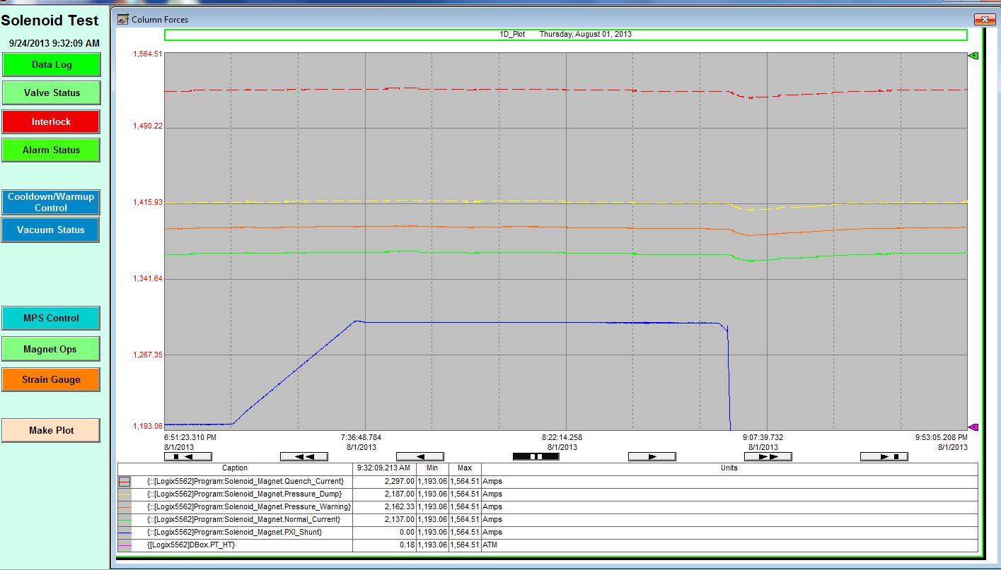
Solenoid Current vs Bath Pressure

Slide 22
Slow Controls Progress
 | Order Hardware | Assemble Hardware | Installed In Hall | Code | Cabling | Testing/Debug | Commissioning
Solenoid | 100% | 100% | No | 90% | 0% | 90% | 90%
FCAL/PS | 100% | 100% | Yes | 90% | 50% | 0% | 0%
FDC/CDC | 100% | 80% | No | 10% | 0% | 0% | 0%
BCAL US | 100% | 90% | No | 80% | 20% | 0% | 0%
BCAL DS | 100% | 90% | No | 80% | 10% | 0% | 0%
Target/Start Counter | 100% | 100% | No | 10% | 0% | 0% | 0%

Slide 23
Questions?
Rhetorical
Coffee waiting
Coffee waiting
Rhetorical
It’s been a long day
Coffee waiting
Rhetorical
Rhetorical
It’s been a long day
Do you need to stretch you’re legs?
Do you need to stretch you’re legs?
It’s been a long day
Rhetorical
It’s been a long day

