Slide 1
Measuring the charged pion polarizability in the γγ → π⁺π⁻ reaction
David Lawrence, JLab
Rory Miskimen, UMass, Amherst
Elton Smith, JLab

Slide 2
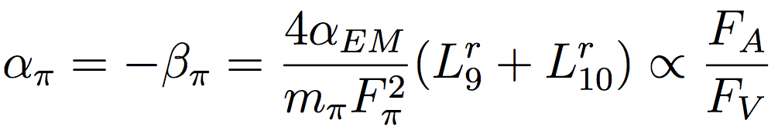
Motivation
Electro (α_{π}) and Magnetic (β_{π}) Polarizabilities represent fundamental properties of the charged pion in the low-energy sector of QCD
α_{π} and β_{π} are related to the charged pion weak form factors F_{V} and F_{A} :
where the low-energy constants L^{r}₁₀ and L^{r}₉ are part of the Gasser-Leutwyler effective Lagrangian
Measuring the polarizabilities of the charged pion can be used to test the even-parity part of the Chiral Lagrangian
(as opposed to the odd-parity sector which is tested via anomalous processes such as πº->γγ)
Improved measurement of α_{π}−β_{π} would reduce uncertainty contribution of hadronic light-by-light scattering to SM prediction of anomalous magnetic moment of the μ: (g_{μ}-2)/2
(see K. Engel, H. Patel, M. Ramsey-Musolf, arXiv:1201.0809v2 [hep-ph]
and arXiv:1309.2225 [hep-ph])

Slide 3
LO O(p⁴) ChPT calculations give:
α_{π} - β_{π} = 5.6 ± 0.2 x 10⁻⁴ fm³
with
α_{π} + β_{π} = 0.0 fm³
NLO O(p⁶) corrections are relatively small
α_{π} - β_{π} = 5.7 ± 1.0 x 10⁻⁴ fm³
with
α_{π} + β_{π} = 0.16 ± 0.1 x 10⁻⁴ fm³
Dispersion Relations have been used to as well, but do not agree:
α_{π} - β_{π} = 13.0 x 10⁻⁴ fm³
α_{π} - β_{π} = 5.7 x 10⁻⁴ fm³
Donoghue and Holstein, 1989
Bürgi 1996,
Gasser et al. 2006
+2.6
-1.9
Fil’kov et al. 2006*
Pasquini et al. 2008

Slide 5
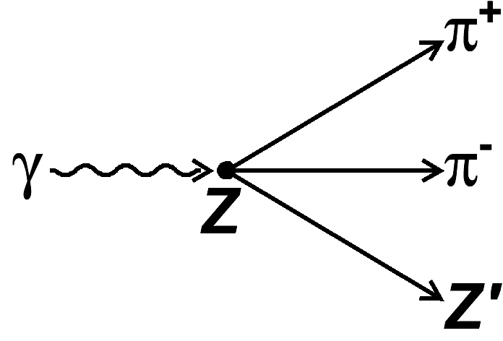
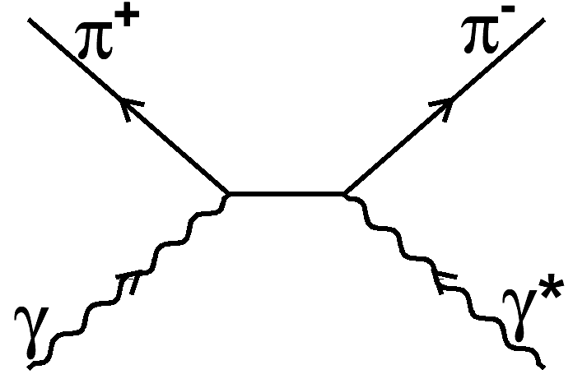
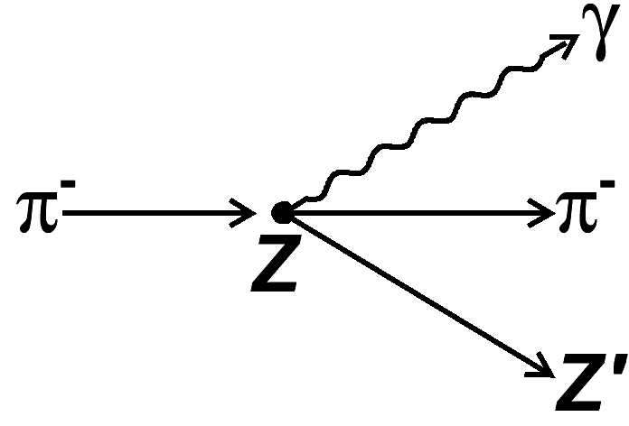
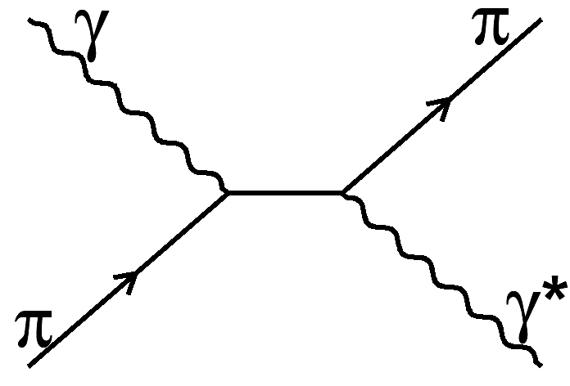
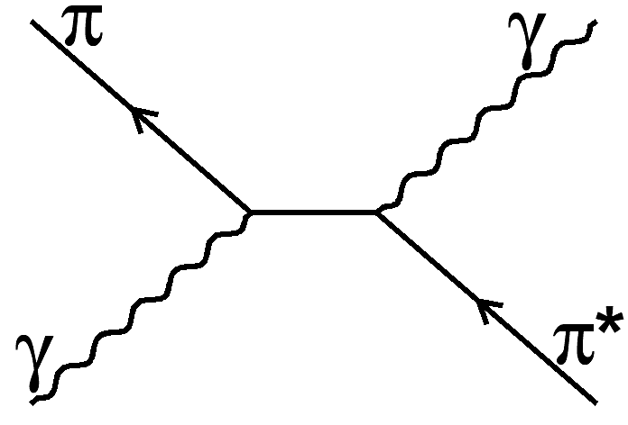
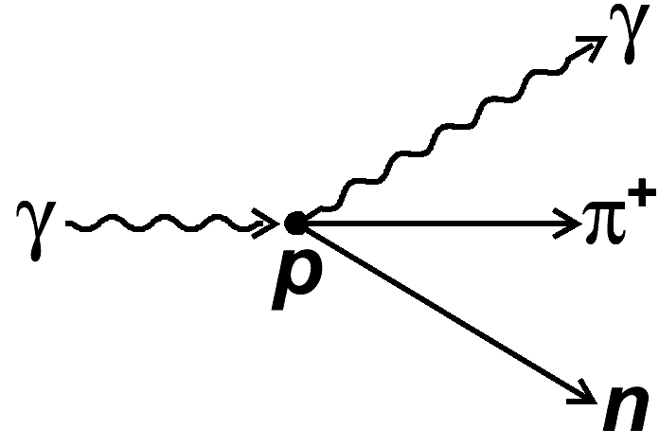
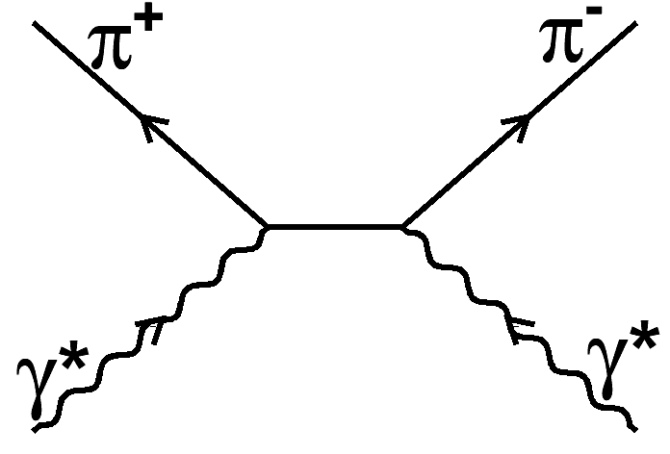
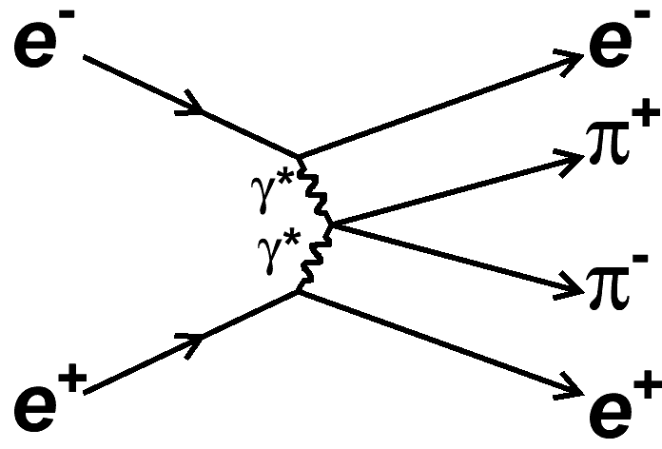
Experimental Access
=
This experiment
Primakoff effect
=
SIGMA
=
Radiative pion photo-production
MAMI
PACHRA
Light by light scattering
(by crossing symmetry)
=
PLUTO
DM1
DM2
MARK-II

Slide 6
Experimental Setup
Signal reaction
All occur via the Primakoff effect (interaction with the Coulomb field of nucleus)
All result in very forward going particles
Low t (-t < 0.005 GeV²)
Normalization
Beam polarization
Solenoid High Field Region
Muon Detector
FDC
TOF
FCAL
Target

Slide 7
Kinematics of Experiment
φ_{ππ} is angle between ππ system and incident photon polarization vector in CM frame
ψ_{ππ} is angle between ππ scattering plane and polarization vector in helicity frame

Slide 8
Backgrounds
Experiment will measure reaction:
γ Sn¹¹⁶-> Sn¹¹⁶ π⁺π⁻
Primary backgrounds will be:
  coherent ρº production followed by ρ->ππ decay
    Will use angular distributions to separate Primakoff from coherent ρº production (see later slides)
  Electromagnetic μ⁺μ⁻ production
    Will use dedicated detector to identify hadron showers
Other potentially relevant backgrounds include:
  σ meson production (angular distributions same as Primakoff)
  incoherent π⁺π⁻ production
  …

Slide 9
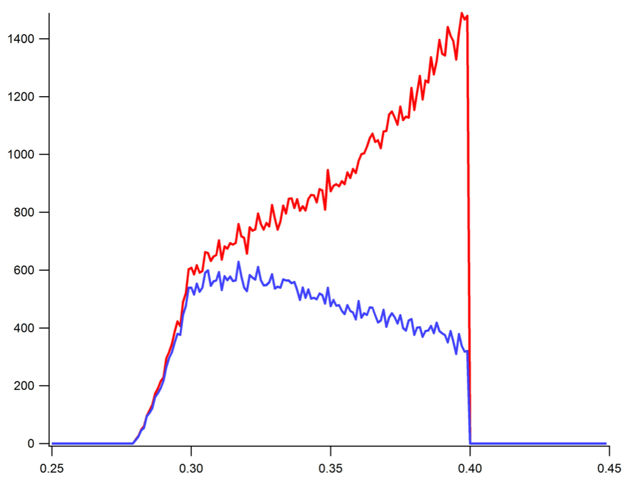
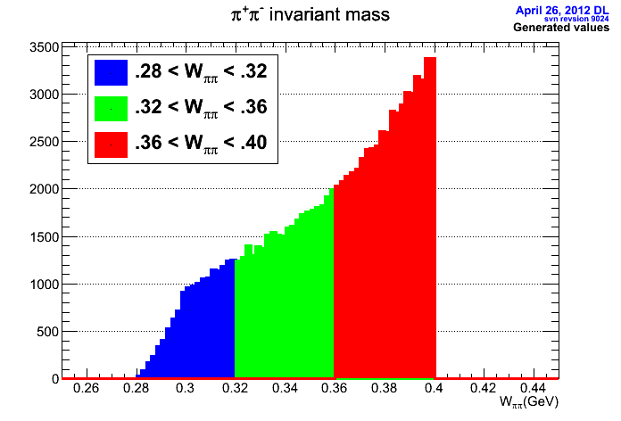
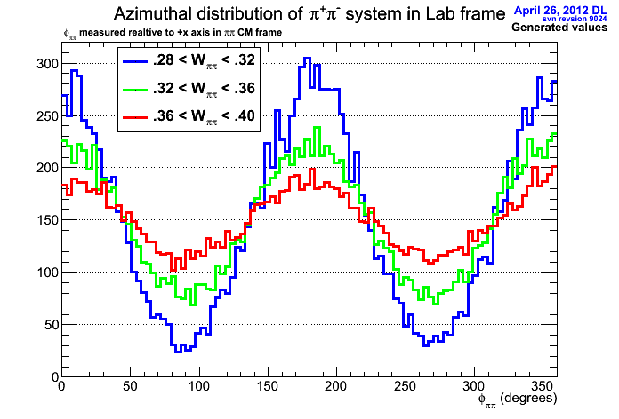
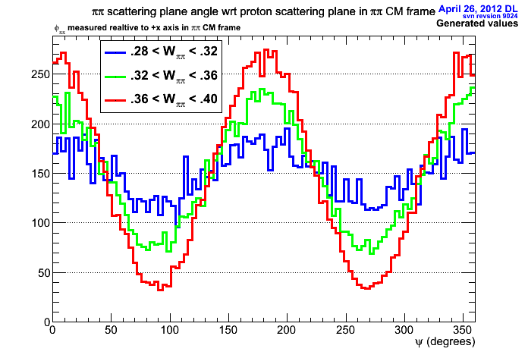
Linear Polarization of incident photon beam helps distinguish Primakoff from coherent ρº production
Primakoff + ρº
Primakoff only
W_{ππ}(GeV/c²)
(invariant mass of π⁺π⁻ system)
(invariant mass of π⁺π⁻ system)
φ_{ππ}
ψ_{ππ}

Slide 10
Relating cross-section to α_{π}−β_{π}
Curves from figure 5. from Pasquini et al. Phys. Rev. C 77, 065211 (2008)
γγ -> π⁺π⁻
Cross-section for γγ -> π⁺π⁻ calculated based on two values of α_{π}−β_{π}:
α_{π}−β_{π} = 13.0 x 10⁻⁴ fm³ (top, dotted line)
α_{π}−β_{π} = 5.7 x 10⁻⁴ fm³ (solid and dashed lines)
Cross-section varies by ~10% for factor of 2 variation in α_{π}−β_{π}
Need measurement of σ(γγ -> π⁺π⁻ ) at few percent level
α_{π}−β_{π} = 13.0 x 10⁻⁴ fm³
α_{π}−β_{π} = 5.7 x 10⁻⁴ fm³
Black data points from MARK-II
Red data points projected for approved Jlab experiment*
Invariant mass of π⁺π⁻
dotted: subtracted DR calculation with α_{π}−β_{π} = 13.0
dashed: subtracted DR calculation with α_{π}−β_{π} = 5.7
solid: unsubtracted DR calculation with α_{π}−β_{π} = 5.7
*statistical only

Slide 11
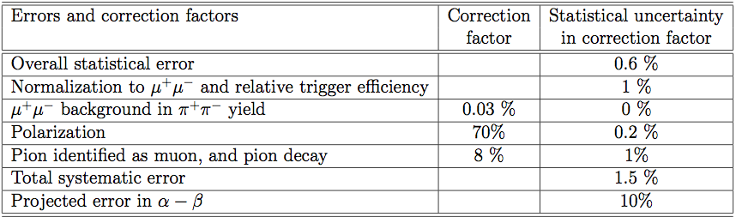
Rates/Acceptance/Errors
500 hours of running
  10⁷ tagged photons/second on 5% radiation length ¹¹⁶Sn target
    PAC approved 25 days (20 for production, 5 calibration)
W_{ππ} acceptance down to ~320 MeV/c²
Estimated ~36k Primakoff events
(not including detector acceptance)
Error Budget

Slide 12
Summary
Next to leading order ChPT prediction of α_{π}-β_{π} is 5.7 ± 1.0 x 10⁻⁴ fm³
Previous measurements of α_{π}-β_{π} range from 4.4 - 52.6 x 10⁻⁴ fm³
A newly approved experiment to measure the charged pion polarizability α_{π}-β_{π} via the γγ*->π⁺π⁻ reaction will be done using the GlueX detector at Jefferson Lab
  PR12-13-008
Total estimated uncertainty in α_{π}-β_{π} measurement is 10%
An improved measurement of α_{π}-β_{π} would improve the SM prediction of the anomalous magnetic moment of the μ: (g_{μ}-2)/2

Slide 13

Backups

Slide 14
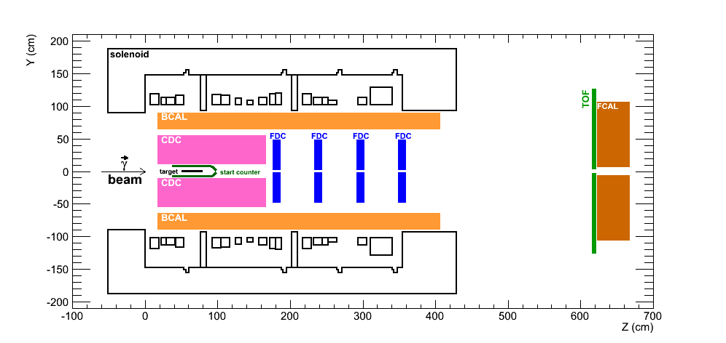
The GlueX Detector in Hall-D
New Proposal will use GlueX detector in Hall-D:
  Linearly polarized photon source (~9GeV)
  2T solenoidal magnetic field (δp/p = few %)
  Drift chambers
  High resolution Time-of-flight detector
Modifications to standard GlueX setup:
  Replace LH2 target with thin Pb target
  Move target upstream to improve low-angle acceptance
  Alternate start-counter?

Slide 15
Anomalous magnet moment of the μ: (g_{μ}-2)/2
Experimental uncertainty of ~ 63 x 10⁻¹¹
SM calculation has uncertainty of ~ 49 x 10⁻¹¹
  Hadronic light-by-light (HLBL) scattering is one of two major contributors to SM uncertainty
  (other is hadronic vacuum polarization)
  π polarizability is potentially significant contribution to HLBL that is currently omitted from current SM calculation
g-2 collaboration at Fermilab is preparing a measurement that will reduce experimental uncertainty by a factor of 4
A measurement of the π polarizability could help reduce the SM uncertainty significantly
For detailed info on planned Fermi-lab experiment, see http://gm2.fnal.gov/public_docs/proposals/Proposal-APR5-Final.pdf

