Slide 1
Monitoring Update
David Lawrence, JLab
Feb. 20, 2014

Slide 2
(Data flows from left to right)
*n.b. all L3 machines connected via InfiniBand

Slide 3
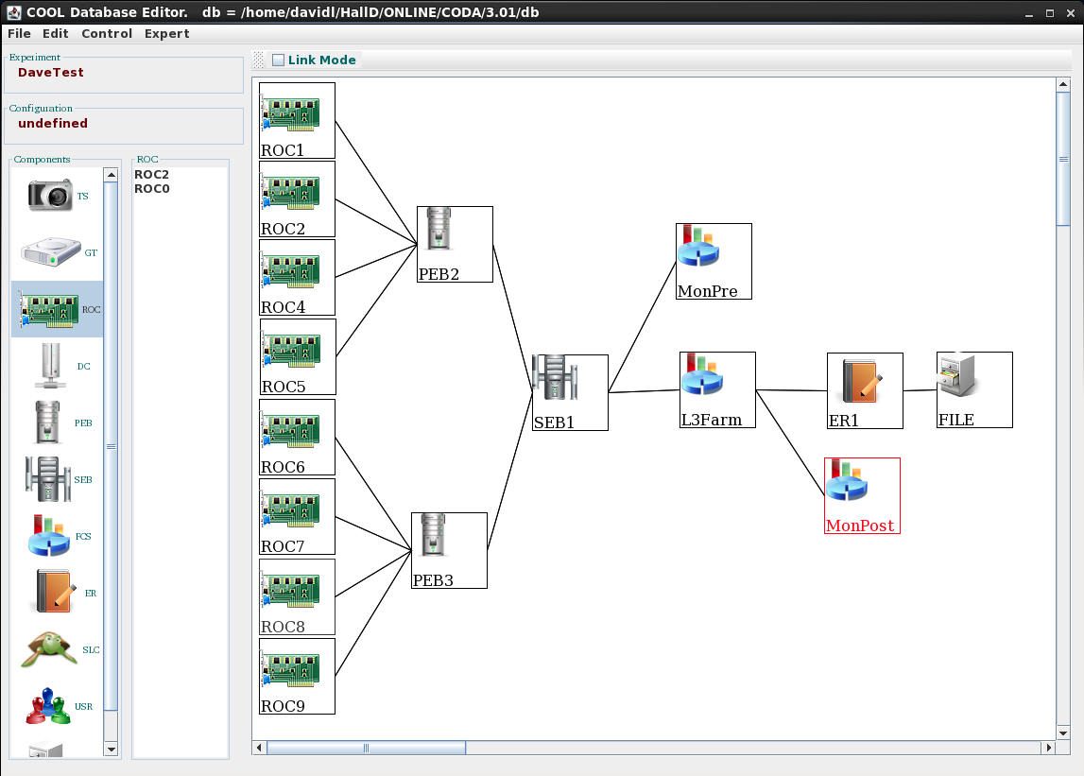
Farm Controller CODA Component
Farm Manager process will be a full CODA component (i.e. required component of the DAQ system)
Individual farm processes will not be CODA components
Farm Manager will (re)launch farm processes as needed via ssh
System allows processes to come
and go during run so long as minimum number of processes are active
Status: Farm manager is written but not fully tested by DAQ Group and not yet released to us for testing

Slide 4
hdlog
------- hdlog starting: Mon Feb 17 07:36:56 2014 ----------
Factory List
-------------------------
DBCALDigiHit
DBCALTDCDigiHit
…
DMCTrigger
DL3Trigger
125 factories registered
------- hdlog ending: Mon Feb 17 07:36:56 2014 ----------
user time: 0.09753 sec
system time: 0.029359 sec
max. mem usage: 25436 kB
------- hdlog starting: Mon Feb 17 07:37:37 2014 ----------
Factory List
-------------------------
DBCALDigiHit
DBCALTDCDigiHit
…
Farm processes output will be captured to log files using hdlog utility
hdlog hd_ana --config=$HDCONFIG/mon_pre.conf
Output is automatically appended to log file in directory specified by HDLOG environment variable
File name based on program name and node name (e.g. hdmon_gluon100.log)
File is automatically truncated as needed to limit size.
(truncation is done at newline boundary)
Markers indicating start and end times as well as resource usage are recorded into log file
example log file obtained by running “hd_dump –L” multiple times

Slide 5
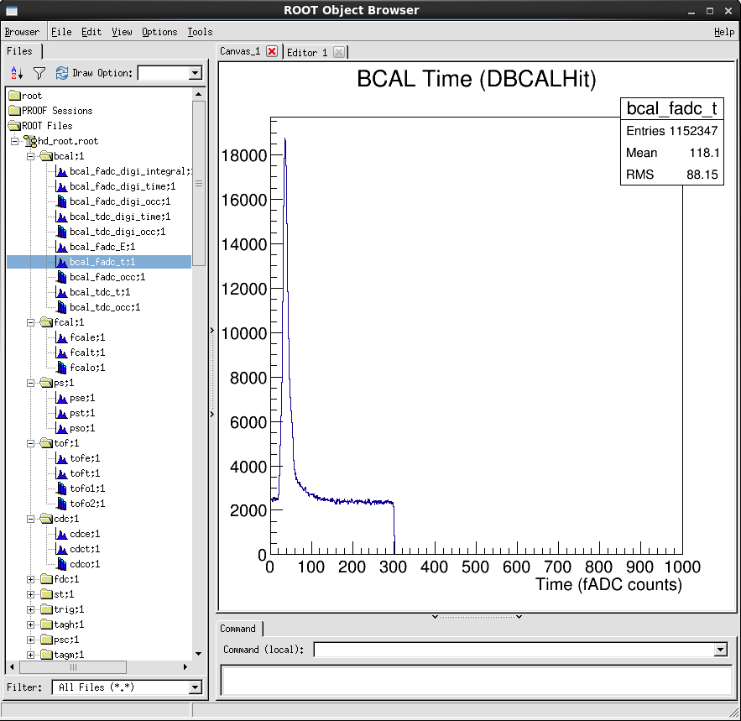
Online monitoring plugins
Each monitoring process will attach a set of plugins to produce histograms for all detector systems
Existing PLUGINS
  BCAL_online
  CODA_online
  FCAL_online
  L3_online
  PS_online
  TAGH_online
  TOF_online
  CDC_online
  EVNT_online
  FDC_online
  PSC_online
  ST_online
  TAGM_online
  TRIG_online
plugins created and tested by Elliott Wolin
https://halldweb1.jlab.org/wiki/index.php/Monitoring_plugins_in_offline_environment

Slide 6
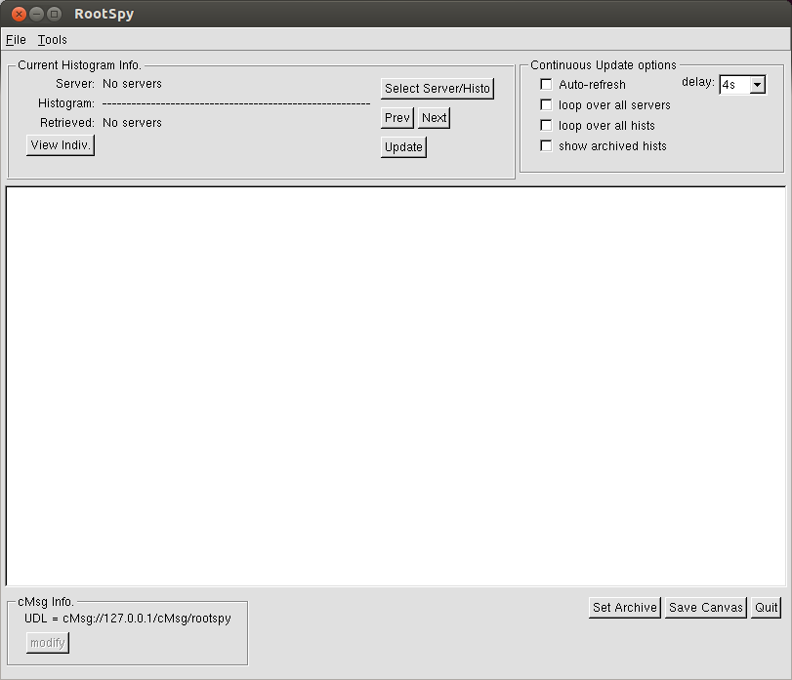
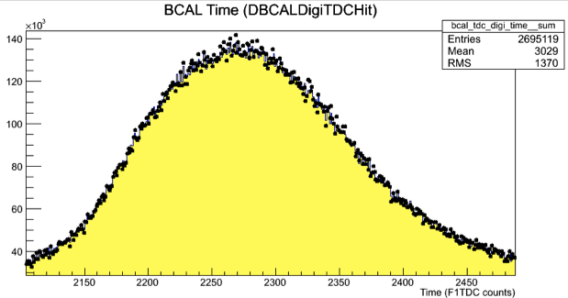
ROOTSpy
ROOTSpy: System for reading histogram definitions from global memory and publishing them to the network
JANA programs and plugins are written to produce histograms in the standard way
The rootspy plugin is attached and will automatically find all defined histograms (including ROOT directory structure)
Histograms published to network via cMsg*
Central process gathers histograms from all nodes and automatically sums similar histograms.
GUI allows users to overlay live histograms on top of reference histogram for easy visual comparison
Users can view histograms from individual nodes
Currently maintained and developed by Northwestern (Sean Dobbs)
*cMsg is a publish/subscribe network messaging package written by JLab DAQ group and used extensively in the DAQ and online systems

Slide 7
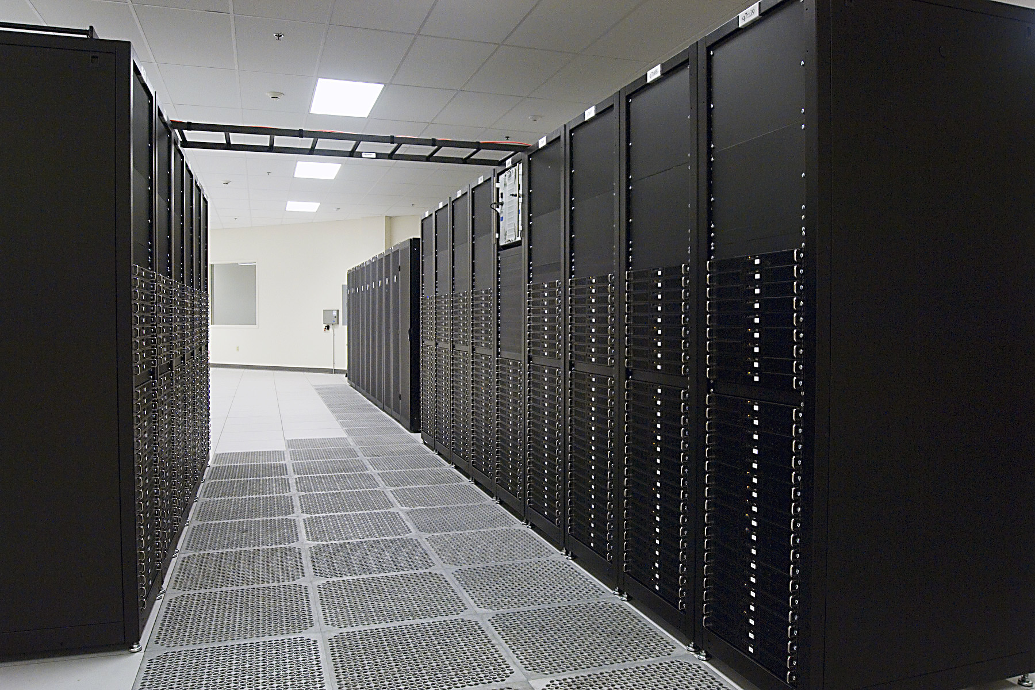
ROOTSpy Archiver
Archiver is command-line program that continuously records histograms to file
from ROOTSpy system
Output ROOT files from archiver will be available on computers in counting house but will also be copied to tape library for permanent storage alongside raw data
Configuration done via file (NEW!)
“Final Event” mechansim has been deigned, but no testing done yet
[main]
rootspy_udl = cMsg://127.0.0.1/cMsg/rootspy
daq_udl = cMsg://127.0.0.1/cMsg
#session_name = ## empty by default
poll_delay = 60
min_poll_delay = 10
output_filename = current_run.root
archive_pathname = <nopath>
[output]
html_output = false
pdf_output = false
html_base_dir = <nopath>

Slide 8
Remaining work
Finish implementation and testing of “last event” paradigm
Fill in detector system plugins with appropriate histograms (detector groups)
Test farm-manager CODA component

Slide 9
Monitoring Summary
Data flow design including pre-L3 and post-L3 monitoring passed initial test (ODC2013)
Farm Manager CODA Component is written, (by DAQ group) but not yet tested
hdlog logging utility completed
Protoypes for detector system histogram plugins exist, but need review by detector groups
ROOTSpy system, including prototype archiver, tested and working (ODC2013). Additional feature testing will be done during ODC2014
Solutions exist and have been tested for all major aspects of the monitoring system. Remaining items have been identified and are on track for completion well in advance of detector commissioning.

