Slide 1
Online Monitoring Status
David Lawrence JLab
Oct. 2, 2014

Slide 2
Monitoring architecture (no L3 rejection)
gluon40
halldraid1
EB
ET
ET
ER
RootSpy GUI
Mon
Mon
Mon
Mon
Mon
Mon
Mon
Mon
RSArchiver
Mon
Mon
Mon
Mon
gluon100 – gluon111

Slide 3
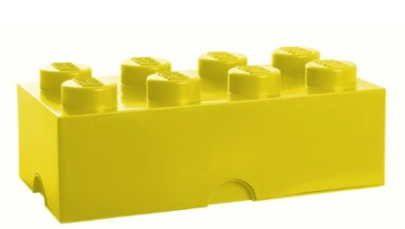
Monitoring Plugins
CDC_online
Each detector system provides 1 or more plugins that create histograms
for monitoring
All plugins are
attached to a
Common DANA
process (hdmon)
A “rootspy” plugin
publishes all
histograms
to the network
BCAL_online
DAQ_online
TAGH_online
FCAL_online
hdmon
TAGM_online
FDC_online
TOF_online
PS_online
ST_online
rootspy

Slide 4
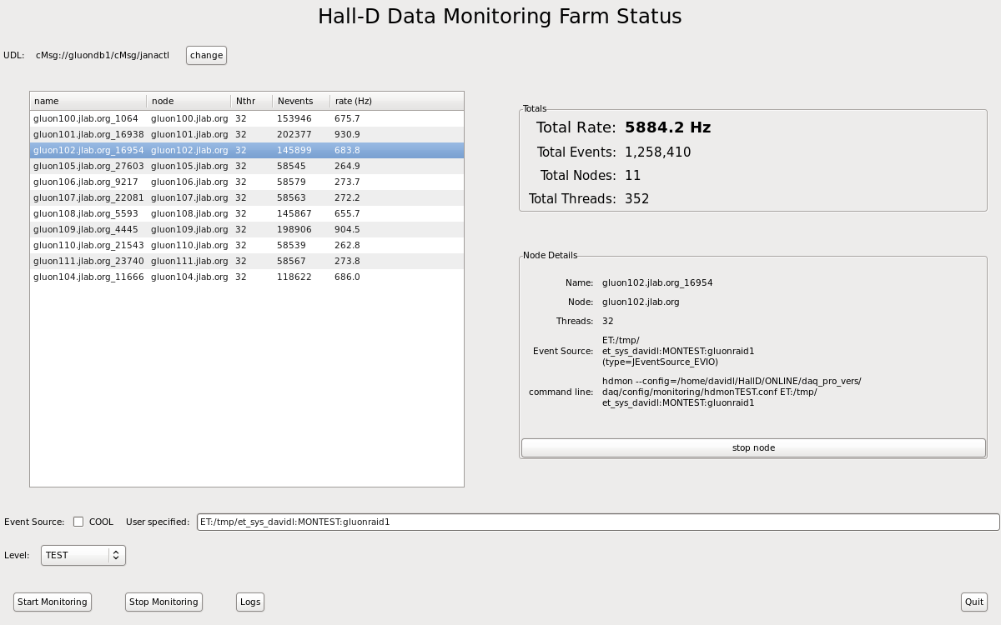
hdmongui
processes run multi-threaded
multiple “levels” supported

Slide 5
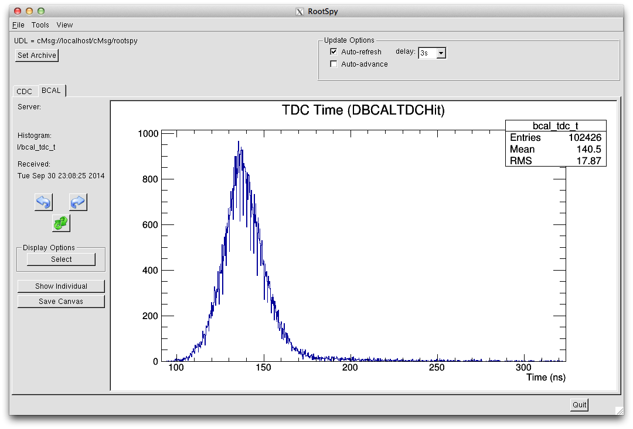

Slide 6
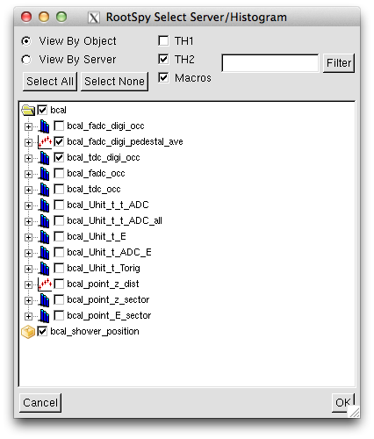
Detectors should place their histograms inside a folder to avoid namespace conflicts
RootSpy supports histograms with any depth of directory structure
Plugins may supply macros for drawing more complex displays using summed histograms

Slide 7
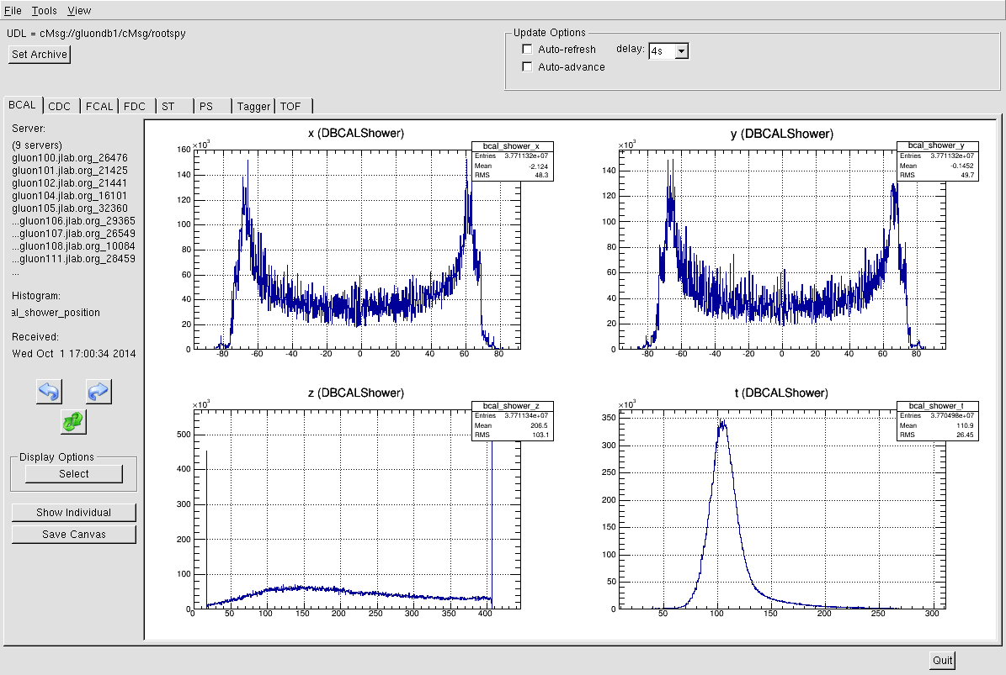

Slide 8
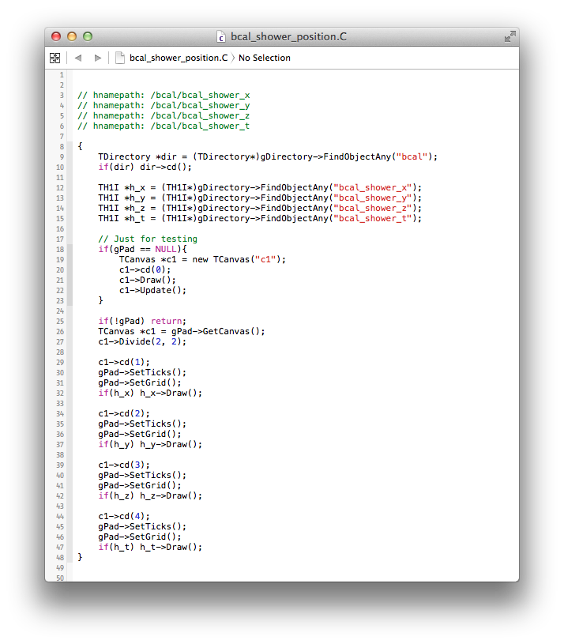
Macros
Special comments allow instructions to be passed to RootSpy. In this case, which histograms this macro needs
Macro starts in TDirectory mirroring structure of plugin(s), but containing summed histograms from all servers
Testing outside of RootSpy will need a TCanvas
Main macro content.
Files ending with a “.C” suffix are automatically detected by build system and compiled as strings into plugins. They are automatically transported to RootSpy at run time.

Slide 9
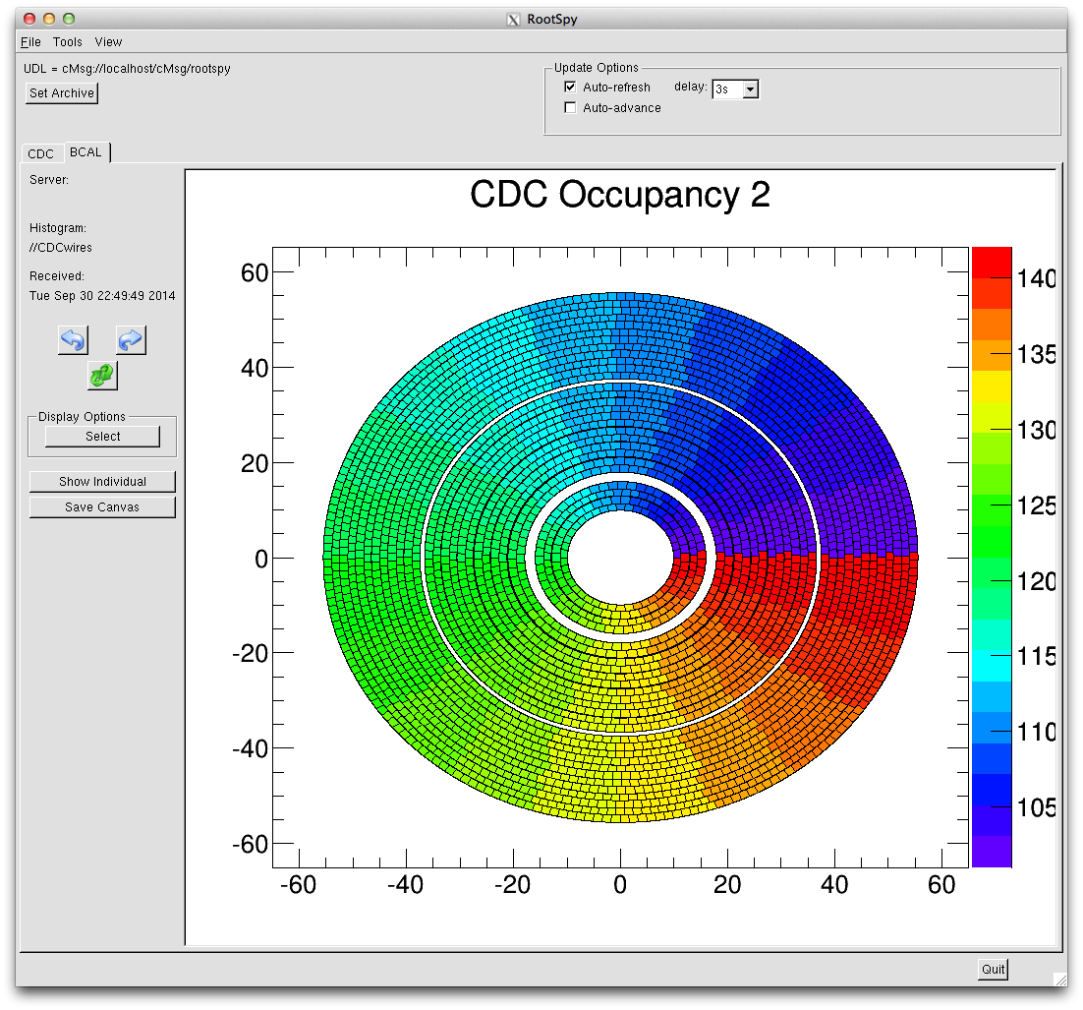

Slide 10
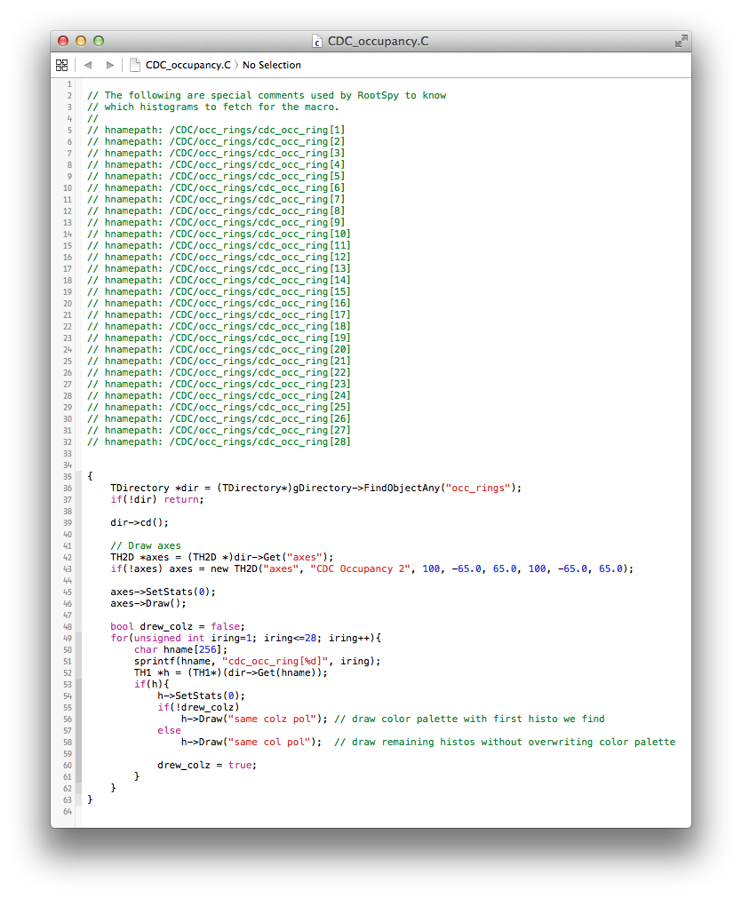
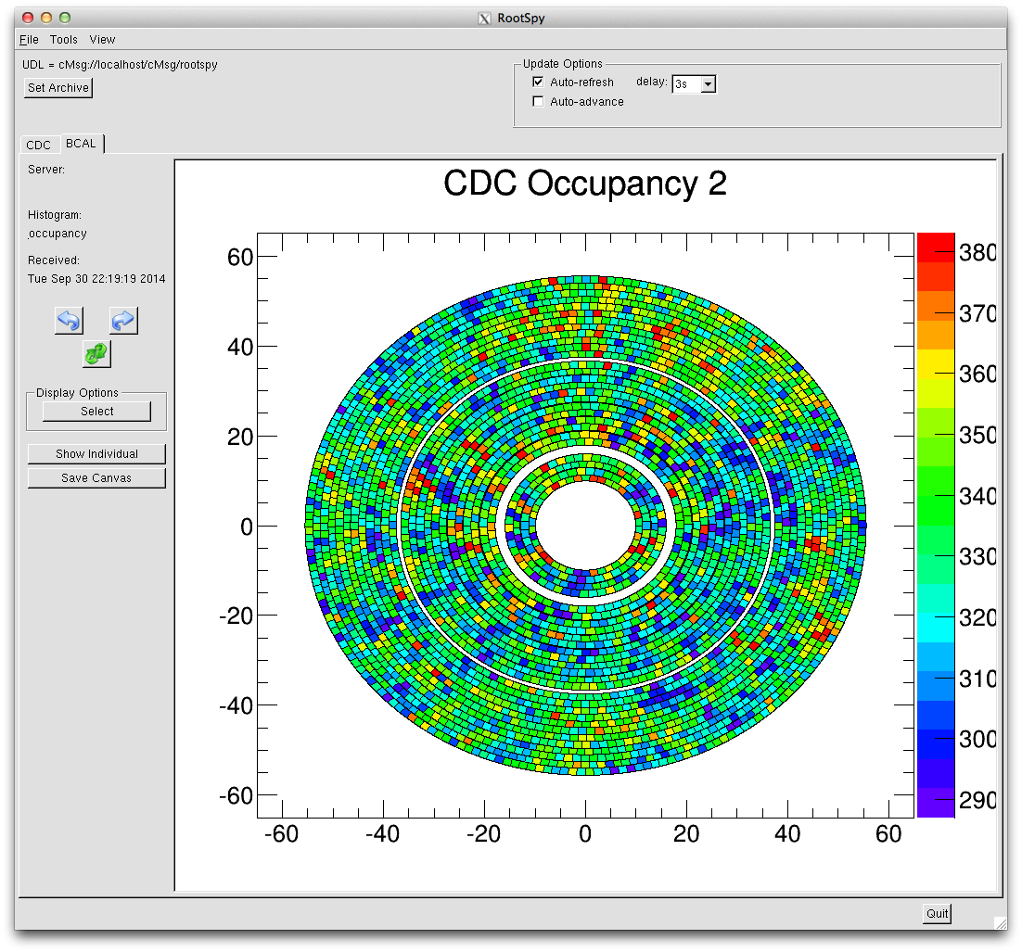
Another macro example

Slide 11
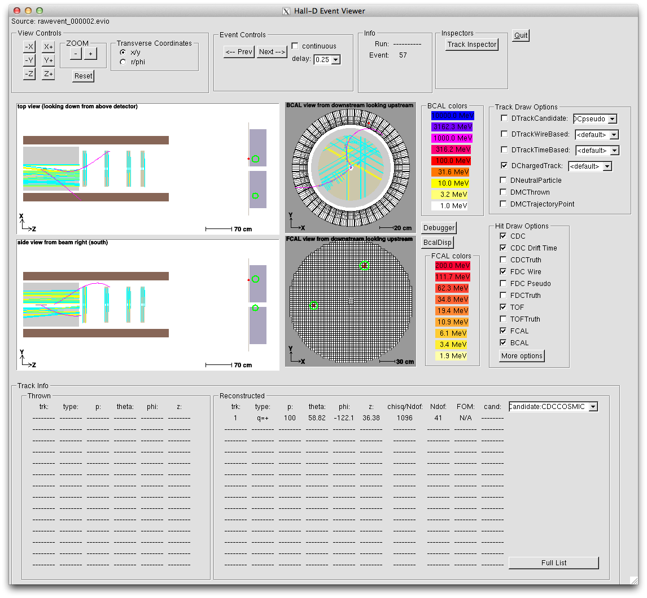
hdview2
Single event viewer able to read from EVIO file or ET system via DAQ and TTab plugins

Slide 12
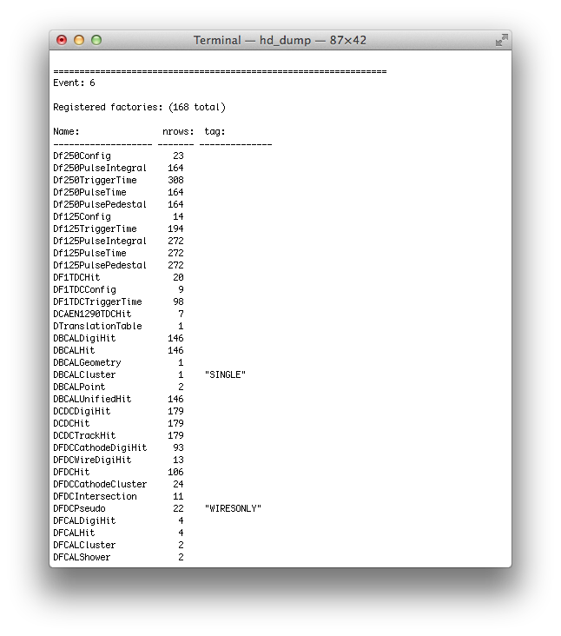
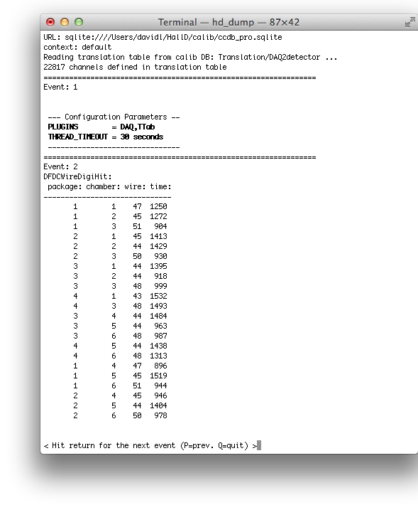
hd_dump

Slide 13
Summary
Automated system for starting/stopping monitoring processes from CODA exists, but needs more testing
Initial set of plugins exist and detector groups are starting to fill them in (BCAL, CDC are pioneers)
All DANA programs can attach to ET system and read events online including hdview2 and hd_dump
RSArchiver program will be used to archive all monitoring histograms to tape.

Slide 14
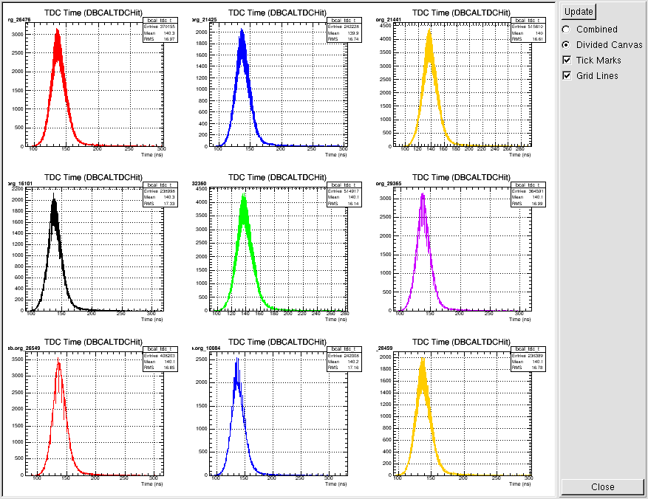

Slide 15
