Slide 1
Figure of Merit for Exclusive vs Missing Proton Analyses
D. Mack
2/12/15

Slide 2
Figure of Merit
Neglecting polarization, the statistical error on an observable can be written in terms of signal and background counts as
ΔO^{stat}/O = ( (√N_{s})² + (√N_{b})² )/N_{s}
(Note: even if we accurately estimate <N_{b}> with a model, side-band fits, etc,
the background statistical fluctuations +-√N_{b} in the signal window are inescapable.)
The error bar is the ultimate arbiter of the quality of a dataset. But it’s often useful/insightful to define a Figure of Merit (FOM) which is linearly proportional to the relative statistical weight. In this case the FOM is
FOM = (O/ΔO^{stat})² = N_{s}²/( N_{s}+ N_{b} )
which can be written as
FOM = N_{s}/(1 + N_{b}/N_{s} )
or
= ( N_{s}+ N_{b} ) x Purity²
More counts are obviously better. All other things being equal, FOM ~ time.
Large backgrounds are very bad. High N_{b}/N_{s} (or low Purity) degrades the FOM.
My mnemonic is
“signal statistics Ns times a demerit factor (1+Nb/Ns)”.

Slide 3
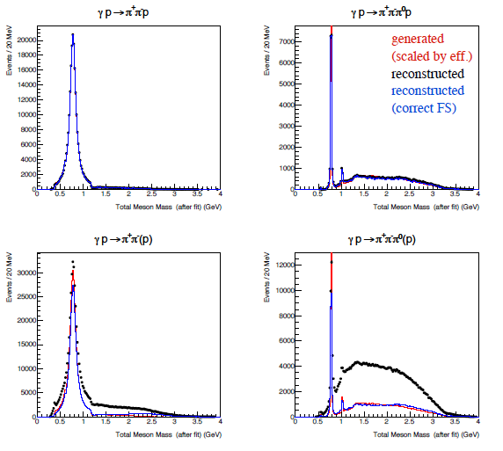
Exclusive vs Missing Proton: Qualitative
Ryan Mitchell surveyed a wide range of states from the 2nd data challenge at
http://argus.phys.uregina.ca/cgi-bin/private/DocDB/ShowDocument?docid=2587
On his slides 29 and 30 he compared
reconstruction efficiency and purity
for a few channels.
In one case, the proton was detected
and used in the reconstruction. (top)
In the other case, the proton was not
used in the reconstruction. (bottom)
The background in the inclusive/bottom
analysis isn’t too bad in the ρ and ω
peak regions. But the majority of the
continuum is predicted to be
background dominated. That should be
kept in mind when trying to understand
Justin’s (inclusive) bump hunt plots at
http://argus.phys.uregina.ca/cgi-bin/private/DocDB/ShowDocument?docid=2628
Exclusive Analysis
Inclusive Analysis

Slide 4
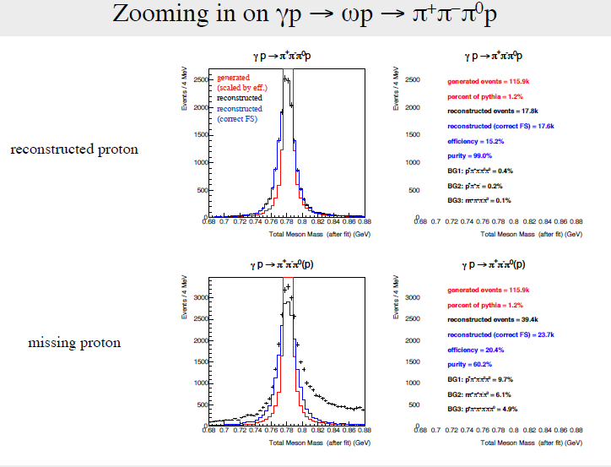
What About the Peak Regions?
When Ryan saw a draft of these slides, he wondered what the results would look like for the peak regions where the S/B is high. So he zoomed in on the ρ, ω, η, and φ regions so those could be included in the tables. (Example below from his “few additional slides” to
http://argus.phys.uregina.ca/cgi-bin/private/DocDB/ShowDocument?docid=2587 .)

Slide 5
Exclusive vs Missing Proton Analyses
I was curious about the relative FOM of the data with and without the recoil proton.
In the latter, more mesons are reconstructed, but there’s more background. Which is more important?
Taking Ns and Nb from Ryan’s slide 30 (a copy is in my backup slides), the FOM is in the last column:
Channel | Ns = Reconstructed(correctFS) Exclusive Analysis (Inclusive Analysis) | Nb = Reconstructed(total-correctFS) Exclusive Analysis (Inclusive Analysis) | FOM = Ns/(1+Nb/Ns) Exclusive Analysis (Inclusive Analysis)
γ+p→π⁺π⁻p | 233.0K (341.3K) | 2.2K (244.8K) | 230.8K (198.7K)
“” ρ peak region | 206.2K (275.7K) | 0.8K (102.6K) | 205.4K (200.9K)
γ+p→π⁺π⁻π⁰p | 67.8K (112.5K) | 5.1K (302.3K) | 63.1K (30.5K)
“” ω peak region | 17.6K (23.7K) | 0.2K (15.7K) | 17.4K (14.3K)
“” η peak region | 0.090K (0.125K) | 0.003K (0.981K) | 0.087K (0.014K)
γ+p→K⁺K⁻p | 5.4K (8.2K) | 23.2K (876.3K) | 1.0K (0.08K)
“” φ peak region | 3.0K (3.5K) | 0.4K (25.9K) | 2.6K (0.4K)
The FOM for the inclusive analysis is always lower, though the reduction is small near ρ, ω peaks.
But how can the FOM decrease from the exclusive to the (higher statistics) inclusive analysis?!
The FOM is positive definite, and the total FOM must increase monotonically as we add events.

Slide 6
Reorganizing Ryan’s Numbers a Bit
There is no paradox on the previous slide: the FOM of the inclusive analysis was indeed lower because FOM was discarded when events with good recoil protons were analyzed inclusively.
It’s a simple point, but important so let me drive it home with some cartoons:
This figure represents the dataset. Events inside the circle/egg are the subset with detected recoil protons.
Ryan’s exclusive analysis
(green indicates which
events were used)
Exclusive events for which I will determine the FOM
Inclusive events (missing proton) for which I will determine the FOM.
Ryan’s inclusive analysis
Gotten by subtracting Inclusive analysis events – Exclusive events

Slide 7
Exclusive vs Missing Proton Datasets
I have separated Ryan’s exclusive and inclusive analyses into exclusive events (with proton) and inclusive events (missing proton). The FOM is in the last 2 columns:
 | Exclusive Data |  | Inclusive Data |  | FOM
Channel | Ns = Reconstructed (correctFS) | Nb = Reconstructed (total-correctFS) | Ns = Reconstructed (correctFS) | Nb = Reconstructed (total-correctFS) | Exclusive Events | Inclusive Events
γ+p→π⁺π⁻p | 233.0K | 2.2K | 108.3K | 242.6K | 230.8K | 33.4K
“” ρ peak region | 206.2K | 0.8K | 69.5K | 101.8K | 205.4K | 28.2K
γ+p→π⁺π⁻π⁰p | 67.8K | 5.1K | 44.7K | 297.2K | 63.1K | 5.8K
“” ω peak region | 17.6K | 0.2K | 6.1K | 15.5K | 17.4K | 1.7K
“” η peak region | 0.090K | 0.003K | 0.035K | 0.978K | 0.087K | 0.001K
γ+p→K⁺K⁻p | 5.4K | 23.2K | 2.8K | 853.1K | 1.0K | 0.01K
“” φ peak region | 3.0K | 0.4K | 0.5K | 25.5K | 2.6K | 0.02K
The events with a missing proton have low FOM compared to exclusive events, generally lower by 1 order of magnitude, but lower by 2 orders of magnitude for K⁺K and η peak.

Slide 8
Discussion
While the statistically optimal average for an observable is in principle the weighted average of the exclusive dataset and the missing proton dataset, the undoubtedly larger systematic errors for the inclusive data should give one pause. Given the low weight of the inclusive data , it’s not clear how useful they will be.
If part of the GlueX physics program leads to a neutron recoil, detecting that recoil neutron could be important: it might lead to increased FOM even if the neutron detection efficiency is low.

Slide 9
Summary
The total error bar is the ultimate arbiter of the quality of a dataset. But it’s often insightful to define a Figure of Merit (FOM) which is linearly proportional to the relative statistical weight.
I don’t yet have a deep understanding of how GlueX will pull out its signals, but fairly general arguments suggest the FOM without polarization is
FOM = N_{s}/(1 + N_{b}/N_{s} )
This is a big deal: it’s easy to waste time and money by using a pseudo-FOM which doesn’t wholly reflect the statistical weight of a dataset (like purity alone, or the number of properly reconstructed events alone, etc.)
Generally speaking, the modest increase in signal events in an inclusive analysis is more than offset by an enormous increase in background events. However, the large signal in the ρ and ω peak regions makes an inclusive analysis not much lower in FOM than an exclusive analysis (for M. Staib’s ω photoproduction analysis for example).
The majority of FOM resides in events with recoil proton detection analyzed exclusively
(~90% for the ρ and ω peak regions, but ~99% for some poorer S/B channels Ryan examined).
Recoil proton detection must be critical for extracting any weak physics signals from the continuum.
I personally don’t see much value in events with missing protons. For strong signals where one is not usually statistics limited, the gain in FOM might be 12%. For weak signals where systematic errors from backgrounds are worrisome even for exclusive events, the gain in FOM might be ~1% at the cost of even bigger worries about systematic errors.
(Maybe I’ll change my tune if the recoil proton detection efficiency is much lower than we expect.)

Slide 10
extras

Slide 11
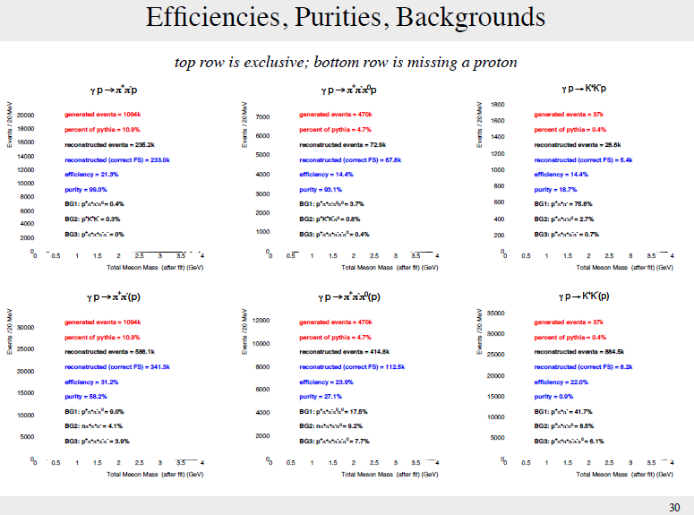
Ryan Mitchell Survey, Oct 4, 2014

