Slide 1
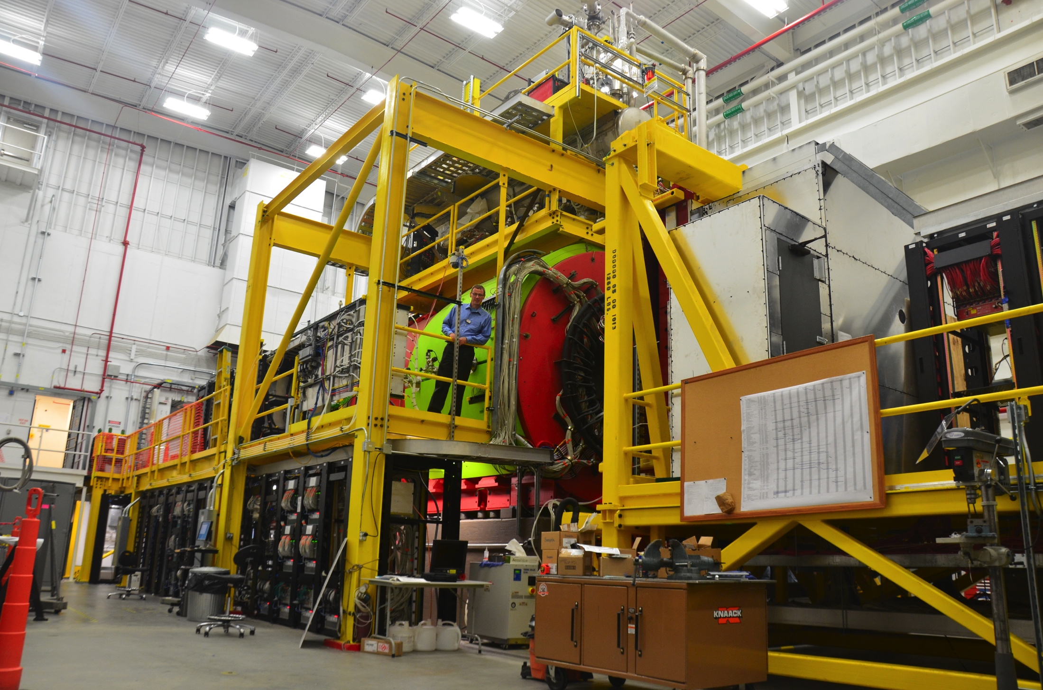
Introduction and Project Overview
Curtis A. Meyer
GlueX Spokesperson

Slide 2
Presentations
Introduction and Project Overview (40’+20’)
  Curtis Meyer, Carnegie Mellon
Focusing Box Prototype Studies (30’+15’)
  Mike Williams, MIT
Mechanical Design, Integration and Transport (30’+15’)
  Matt Shepherd, Indiana University
Project Management, Cost, and Schedule (40’ + 20’)
  Justin Stevens, Jefferson Lab

Slide 3
Outline
The GlueX physics program.
The GlueX Experiment.
The Need for forward kaon identification.
Summary

Slide 4
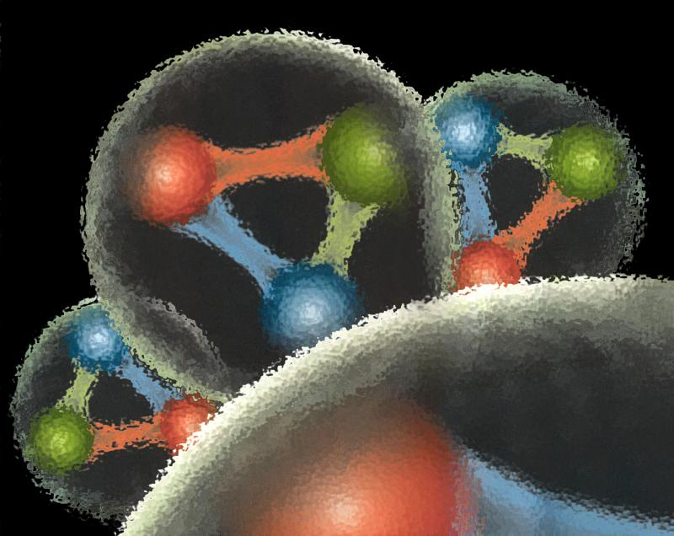
Quantum Chromo Dynamics
QCD describes the interactions of quarks and gluons and should predict the spectrum of bound-state baryons ( ) and mesons ( ).
There should also be mesons in which the gluonic field contributes directly to the J^{PC} quantum numbers of the states --- hybrid mesons. Some are expected to have ``exotic’’ quantum numbers.
Lattice QCD calculation of the light-quark meson spectrum.
``Constituent gluon’’: J^{PC} = 1⁺⁻ mass of 1-1.5 GeV.
The lightest hybrid nonets
1⁻⁻, (0⁻⁺,1⁻⁺, 2⁻⁺)
2.5Gev
2.0GeV
0⁺⁻
1⁻⁺
2⁺⁻
Notes:
What are gluonic excitations and why are we looking for them? Lattice QCD predictions for the mesons and in particular, a class of mesons with non-quark-antiquark quantum numbers. Also not that mixing angles are predicted. GlueX needs to measure particle J(PC), masses, widths and decay modes to be able to map these out.

Slide 5
Lattice QCD
Light-quark Mesons (u,d,s)
Dudek, et. al, Phys. Rev. D83, 111502 (2011)

Slide 6
Lattice QCD
Light-quark Mesons (u,d,s)
2⁻⁺
1⁻⁺
States with non-trivial gluonic fields.
Supermultiplet
1⁻⁻
1⁻⁻, 0⁻⁺ , 1⁻⁺ , 2⁻⁺
0⁻⁺

Slide 7
Nonet Mixing
Experimental results on mixing:
Ideal Mixing:
θ = 35.3º
Lattice QCD suggests the lightest hybrids don’t have ideal mixing:
Measure through decay rates:
f₂(1270) → KK / f₂(1270) → ππ ~ 0.05
f’₂(1525) → ππ / f’₂(1525) → KK ~ 0.009
GlueX needs to observe the ss & ll states See their decays to strange final states.
0⁻⁺ ground state and radial
1⁻⁻ ³D₁ ground state.
1⁺⁺ ground state
1⁻⁺ exotic

Slide 8

QCD Exotics
Lattice QCD suggests 5 nonets of mesons with exotic quantum number:
1 nonet of 0⁺⁻ exotic mesons
2 nonets of 1⁻⁺ exotic mesons
2 nonets of 2⁺⁻ exotic mesons
Lattice shows two nonets here.
Experimental evidence exists for π₁ states.
π₁ I^{G}(J^{PC})=1⁻(1⁻⁺)
K₁ I^{G}(J^{PC})= ½ (1⁻)
``Constituent gluon’’ behaves like J^{PC} = 1⁺⁻ with a mass of 1-1.5 GeV
The lightest hybrid nonets:
1⁻⁻, (0⁻⁺,1⁻⁺, 2⁻⁺)
η’₁ I^{G}(J^{PC})=0⁺(1⁻⁺)
η₁ I^{G}(J^{PC})=0⁺(1⁻⁺)

Slide 9
Photoproduction Mechanisms
Simple quantum number counting for production: (I^{G})J^{PC} up to L=2
P = Pomeron exchange
ρπ,ρω π₁
ωω,ρρ η₁
ωω,ρρ,φω η’₁
ρP b₀
ωP h₀
ωP, φP h’₀
ωπ,ρη,ρP b₂
ρπ,ωη,ωP h₂
ρπ,ωη,φP h’₂
ρπ is charge-exchange only
Can couple to all the lightest exotic hybrid nonets through photoproduction and VMD.
Linear polarization is a filter on the naturality of the exchanged particle.

Slide 10
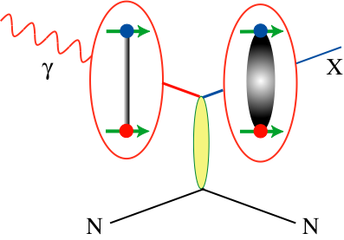
Decay Modes of Exotic Hybrids
π₁ → πρ, πb₁ , πf₁,πη’, ηa₁
η₁ → ηf₂,a₂π,ηf₁, ηη’,π(1300)π, a₁π,
η₁’→ K*Κ, Κ₁(1270)Κ, Κ₁(1410)Κ , ηη’
b₂ → ωπ, a₂π, ρη, f₁ρ, a₁π, h₁π, b₁η
h₂ → ρπ,b₁π,ωη, f₁ω
h’₂ → Κ₁(1270)Κ, Κ₁(1410)Κ, K₂*Κ, φη, f₁φ
b₀ → π(1300)π , h₁π, f₁ρ, b₁η
h₀ → b₁π , h₁η
h’₀ → K₁(1270)Κ, Κ(1460)Κ, h₁η
Models suggest narrower states are in the spin-1 and spin-2 nonets, while the spin-0 nonets are broad.
Early Reach With Statistics Hard
Hybrid kaons do not have exotic QN’s
We need good kaon identification separate the mixed states

Slide 11
GlueX Analysis
Reconstruct exclusive final states.
Kinematical fitting of events possible.
Event identification relies on global analysis.
All detectors contribute to event analysis.
In GlueX physics, pions outnumber kaons by a factor of 10.
Better suppression of pions in kaonic final states is needed for the full GlueX program.

Slide 12
GlueX Analysis
An amplitude analysis is used to identify partial waves (of given spin and parity) and ultimately exotic hybrids.
The sensitivity of the amplitude analysis is approximately at the level of the background contamination in the sample.
Kaon identification is a crucial handle to reduce backgrounds in kaonic final states where misidentified pions dominate the background.

Slide 13
The GlueX Experiment
12 GeV e⁻ beam up to 2.2 μA.
Linearly polarized photons (P_{ɣ}≈40%) from coherent bremsstrahlung on diamond radiator
Design intensity of 10⁸ ɣ/s in coherent peak (E_{ɣ} = 8.4-9 GeV)

Slide 14
The GlueX Experiment
BaBar DIRC Bars
Physics in 2016
Photo Production of Hybrids,
Light-quark Mesons
and Strangeonium States

Slide 15
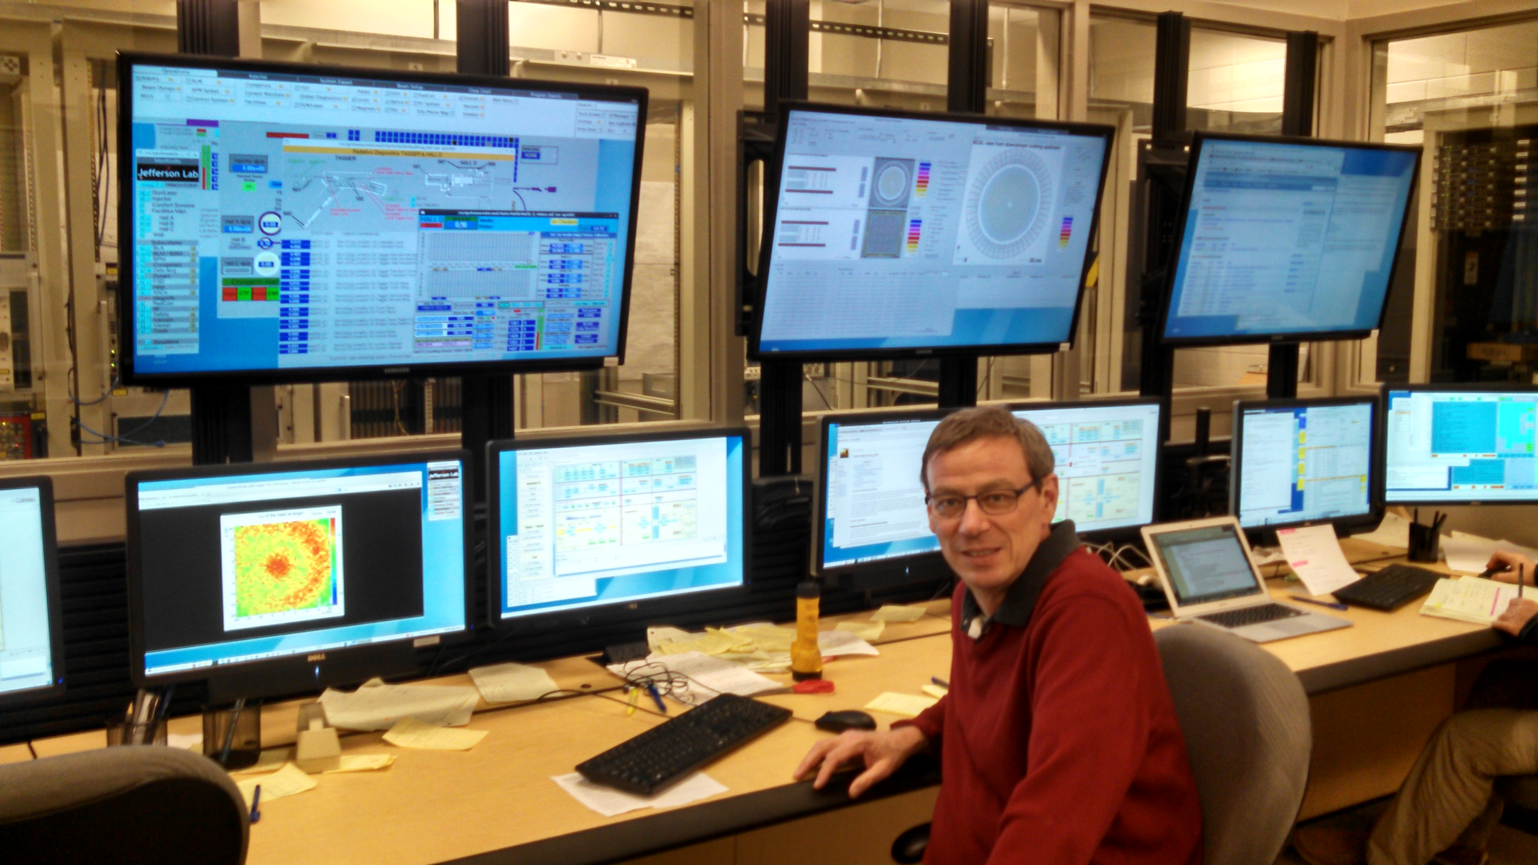
GlueX Commissioning Runs
Late October to mid December 2014 with 10 GeV electrons. No polarized photons, and solid GlueX targets.
All systems worked, all detectors recorded data using multiple triggers. 120TB of data collected,
930M events.
April 2015 ran for a few days with 6GeV electrons producing linearly-polarized photons on the liquid-hydrogen GlueX target.
Better DAQ and triggering led to higher-quality data. 74TB of data collected, 1285M events.
Many detector systems at design specs, all detector systems are within 30% of design specs.
Data are fully processed every two weeks. We are extracting physics from GlueX.

Slide 16
Polarization transfer to the ρ
P=Linear Polarization
Σ=Beam Asymmetry~1.0
A few hours of beam

Slide 17
Detector Systems for PID
Start counter, RF timing and TOF/BCAL provide flight times.
CDC & FDC provide track path lengths and momentum.
CDC & FDC provide dE/dx information.
FCAL provides E/p data.

Slide 18
Timing Calibrations
Electron bunches every ~4 ns
Accelerator provides RF time
Select “correct” RF bunch using tracks matched fast timing detectors
  Start Counter σ_{t} ≈ 300 ps better than design goal!

Slide 19
Tracking and Calorimeter Performance

Slide 20
Particle Identification

Slide 21
Forward Kaon Identification
Decays of mesons to kaonic final states are necessary to map out the nonet structure of any found states.
KK to ππ decay ratios measure the flavor content of mesons.
Cascade and hyperon baryons are a key part of the GlueX program. Good kaon identification is needed to fully carry out this program.
The normal strangeonium spectrum is also of interest, especially given the XYZ states in charm.

Slide 22
Forward Kaon Identification
Four of the BaBar DIRC bar boxes will be installed in front of the TOF wall.
This combined with the other PID systems in GlueX will allow us to fully study final states with strange quarks.
Strangeonium mesons and hybrids can be studied.
Hyperon and cascade baryons can be studied.
Expected late 2017/ 2018

Slide 23
DIRC Performance
Kaon efficiency as a function of momentum for three different pion misidentification fractions.
Dashed curves use 2.5mrad resolution assumed in PAC proposal and achieved by BaBar.
Solid curves show performance achieved by current design simulations.

Slide 24
Decay Modes of Exotic Hybrids
π₁ → πρ, πb₁ , πf₁,πη’, ηa₁
η₁ → ηf₂,a₂π,ηf₁, ηη’,π(1300)π, a₁π,
η₁’→ K*Κ, Κ₁(1270)Κ, Κ₁(1410)Κ , ηη’
b₂ → ωπ, a₂π, ρη, f₁ρ, a₁π, h₁π, b₁η
h₂ → ρπ,b₁π,ωη, f₁ω
h’₂ → Κ₁(1270)Κ, Κ₁(1410)Κ, K₂*Κ, φη, f₁φ
b₀ → π(1300)π , h₁π, f₁ρ, b₁η
h₀ → b₁π , h₁η
h’₀ → K₁(1270)Κ, Κ(1460)Κ, h₁η
Models suggest narrower states are in the spin-1 and spin-2 nonets, while the spin-0 nonets are broad.
Early Reach With Statistics Hard
Hybrid kaons do not have exotic QN’s

Slide 25
Detector Systems for PID
Baseline GlueX provides K/p separation up to about 2 GeV/c.
The addition of the DIRC pushes this up to 4.5 GeV/c.
Global analysis of event is used, so we are not limited by one piece of information.

Slide 26
DIRC Performance
Global event-identification schemes.
Exclusive final state, 4C-kinematic fitting possible.
Globally examine all variables that can classify the event: KinFit Prob., Individual detector PID information, topology information, ….
Use machine-learning tools to develop a classifier. For GlueX, we have been using a Boosted Decision Tree (BDT).
Optimize on purity and efficiency.

Slide 27
DIRC Performance
Using Amplitude Analysis, we expect to be able to decompose a sample of events from a given final state into a coherent sum of partial waves.
Partial waves can be interpreted in terms of particles, and lead to identification of exotic hybrids.
The technique sensitivity is (approximately) limited by the level of the background. 99% purity, lets us access physics details that are not possible to study with 90% purity.

Slide 28
Global Particle Identification
46% Eff.
67% Eff.
20%
61%
32% Eff.
31% Eff.
15%
16%
Request 90% purity in the event sample.
The baseline GlueX detector can provide pure kaonic event samples with good efficiency.
Request 95% purity in the event sample.

Slide 29
Global Particle Identification
46% Eff. > 65%
67% Eff. > 74%
20% > 55%
61% > 68%
28%
38%
32% Eff. > 48%
31% Eff. > 49%
15% > 33 %
16% > 33%
5%
8%
Request 90% purity in the event sample.
The DIRC will significantly kaon identification and enable the full GlueX Physics program.
Request 95% purity in the event sample.
Request 99% purity in the event sample.

Slide 30
JLab PAC Approval
The Jefferson Lab PAC has given an A rating to the physics program of GlueX including parts of the BaBar DIRC as a forward kaon-identification system.
Recommendation: Approve
GlueX is the flagship experiment in Hall D; the physics motivation for the proposed running is very sound. The motivation for the hardware extension is very obvious to reach the physics goals of the experiment and is strongly supported by the PAC.

Slide 31
Project Overview
GlueX will receive 4 BaBar DIRC boxes.
GlueX plans to use the CLAS-RICH readout and electronics.
Key Tasks for GlueX
Transportation of DIRC boxes to JLab.
Designing Focusing Box for GlueX.
Instrumentation and integration of the detector readout.
Design frame and the installation of the detector in GlueX.
Getting the physics out of the DIRC.

Slide 32
Project Overview
Project profile allows us to install ½ of the system in summer 2017, and remainder in summer 2018.
The early installation of ½ of the system allows for early integration of the DIRC into GlueX simulation and analyses with realistic performance numbers.
Sufficient manpower from MIT, IU, JLAB and GSI is associated with the project to complete it on schedule.

Slide 33
Summary
GlueX is installed and well into its commissioning with all detector systems are approaching design specifications in performance.
The DIRC-based kaon identification system is needed to carry out the full GlueX physics program.
The 2.5mrad resolution achieved by BaBar is sufficient for GlueX Physics needs. Current simulations suggest that we can do better than this in the GlueX geometry.
The DIRC timeline is consistent with the broader physics goals of the experiment and provides an opportunity for early integration.

Slide 35
The GlueX Collaboration
Arizona State, Athens, Carnegie Mellon, Catholic University, Univ. of Connecticut, Florida International, Florida State, George Washington, Glasgow, Indiana University, ITEP, Jefferson Lab, U. Mass Amherst, MIT, MePhi, Norfolk State, North Carolina A&T, Univ. North Carolina Wilmington, Northwestern, Santa Maria, University of Regina and Yerevan Physics Institute.
Over 100 collaborators from 22 institutions. Others planning to join over the next 6 months and more are welcome.

Slide 36
Experiments using GlueX
GlueX—Hybrid mesons/spectroscopy
PR-06-102, PR-12-002 & PR-13-003
GlueX—PrimEx-eta
PR-10-011
(calorimeter plug)
GlueX—Pion polarizability
PR-13-008
(forward muon detector)
GlueX—JEF: Rare eta decays
PR14-004
(calorimeter upgrade)
A rating
340-540 PAC days
A- rating
79 PAC Days
A- rating
25 PAC Days
Conditionally
Approved

