Slide 1
Hall-D Online Systems Status
L1 trigger
DAQ
Controls
Counting House Operations
Monitoring
Oct. 8, 2015
David Lawrence JLab

Slide 2
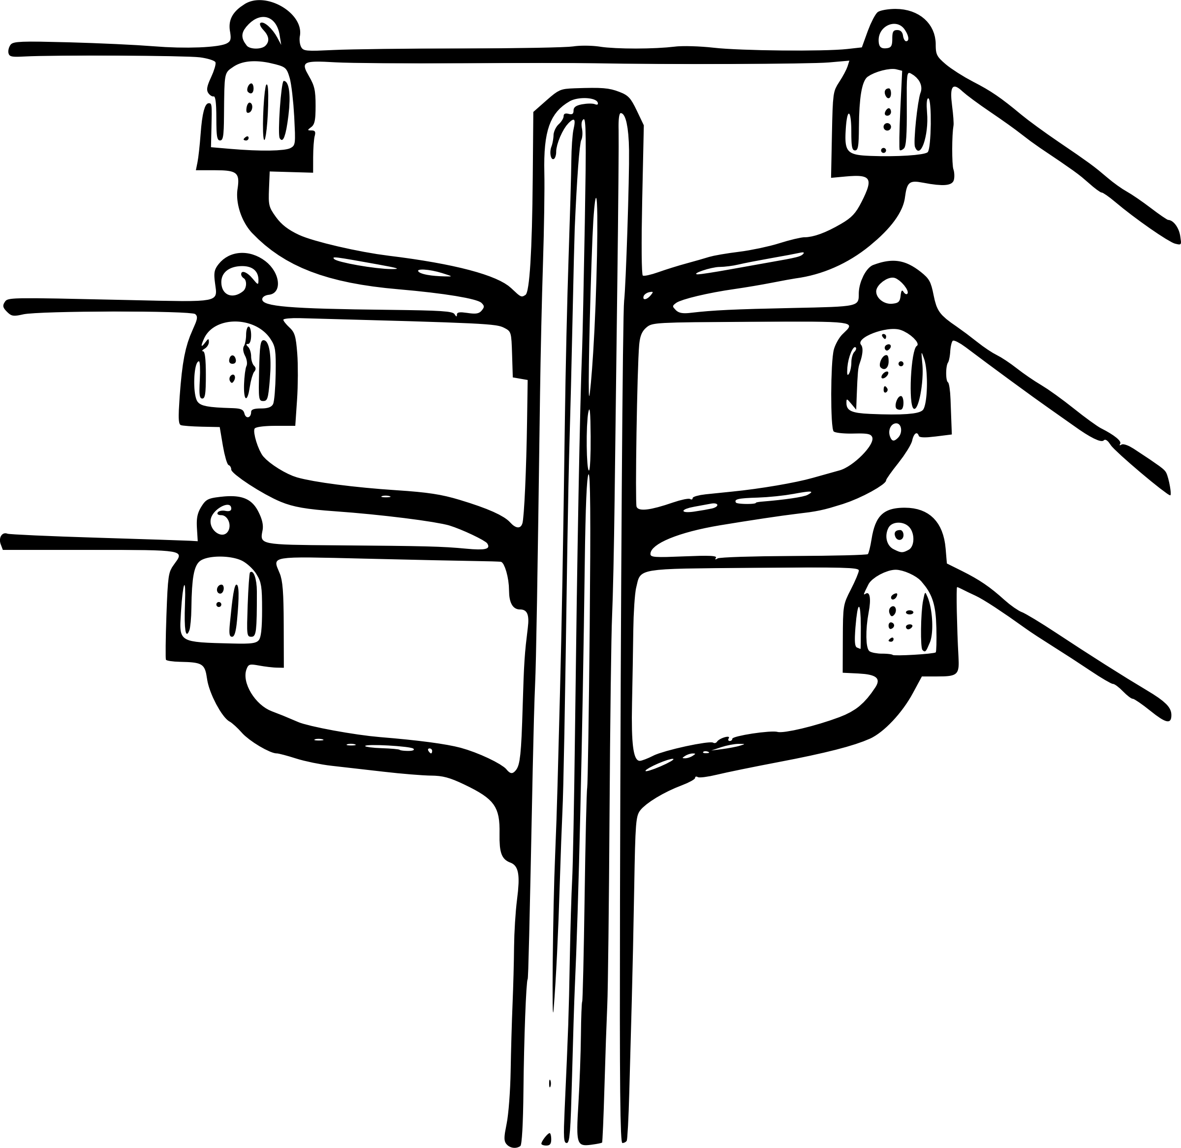
Power Outage
Power to Hall-D (including Counting House) went down unexpectedly on June 15, 2015 for ~4hours
Large UPS powered most computers long enough for us to shut them down cleanly
Always notify Tom Carstens (Hall-D Work Coordinator) or Tech on-call as well as Run Coordinator immediately if such an event occurs again.
Some Desktops found to be plugged into line power rather than UPS (hopefully fixed now)
One computer indicated error when powered up (gluonweb). Motherboard replaced.

Slide 3
Counting House Computers
RHEL7 Upgrade deferred (re-evaluate next summer)
Motivations:
Fix “maximum clients reached” problem
CCDB requires Python 2.7 (argparse)
Fix spontaneous reboots
Fix rise-up menus in CODA
Default compiler C++11 support
Currently, gluon01, gluon24, and gluon46 have RHEL7 installed. All other have RHEL6.
Nodes | CPU | Full Cores | Purpose
gluon01-gluon05 hdguest0-hdguest3 | Intel i5-3570 @ 3.2GHz | 4 | Human Interface
gluon24-gluon31 | Intel E5-2420 @1.9GHz | 6/12 | Servers
gluon40-gluon43 | AMD Opteron 6380 | 16 | DAQ (data concentrators)
gluon46-gluon49 gluon100-gluon111 | Intel E5-2650 @2.6GHz | 16 | DAQ Farm
gluonraid1-gluonraid2 | Intel E5-2630 v2 @2.6GHz | 6 | RAID
https://halldweb1.jlab.org/wiki/index.php/HallD_Counting_House_Computer_Systems

Slide 4
Cyber Security
“White Hat” cyber security review in July
SQL injection vulnerability found (Justin fixed)
Passwords posted on whiteboards
Anyone can request a tour
Hall-A breached due to outward facing computer
No Hall-D breach (2-factor authentication)
Hall-D Operations password must now be obtained via word of mouth (contact Run Coordinator if needed)
--- WRITE DOWN WHAT I SAY NOW ---
DB passwords in scripts maintained in publically accessible repositories (subversion, or git)
Weekly scans of webservers, internal and external
Semi-annual scans of entire Hall-D network
First scheduled to happen next week

Slide 5
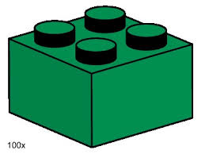
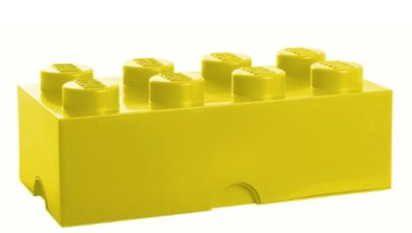
Monitoring Plugins
plugin | # hists
BCAL_Eff | 35
BCAL_inv_mass | 8
BCAL_online | 85
CDC_drift | 3
CDC_expert | 290
CDC_online | 42
DAQ_online | 106
FCAL_online | 47
FDC_online | 171
PSC_online | 91
PSPair_online | 91
PS_online | 66
RF_online | 90
ST_online_lowlevel | 201
ST_online_tracking | 14
TAGH_online | 61
TAGM_online | 1024
TOF_TDC_shift | 7
TOF_online | 24
TPOL_online | 2
TRIG_online | 6
BCAL_online
CDC_online
DAQ_online
TAGH_online
hdmon
FCAL_online
TAGM_online
FDC_online
TOF_online
PS_online
ST_online
rootspy
Each detector system provides 1 or more plugins (~25 total) that create histograms for monitoring
>20 plugins exist defining XX histograms
Moved from “Online” subversion repository to sim-recon Git repository

Slide 6
L3/Event Tagging Infrastructure
Software written to reconstitute single events in EVIO format for writing to L3
Format is smaller due to dropping unneeded header and filler words
Verification still needed to ensure no information loss
Run:
Beam current:
Radiator:
Solenoid:
2391
100nA
Amorphous
800A

Slide 7
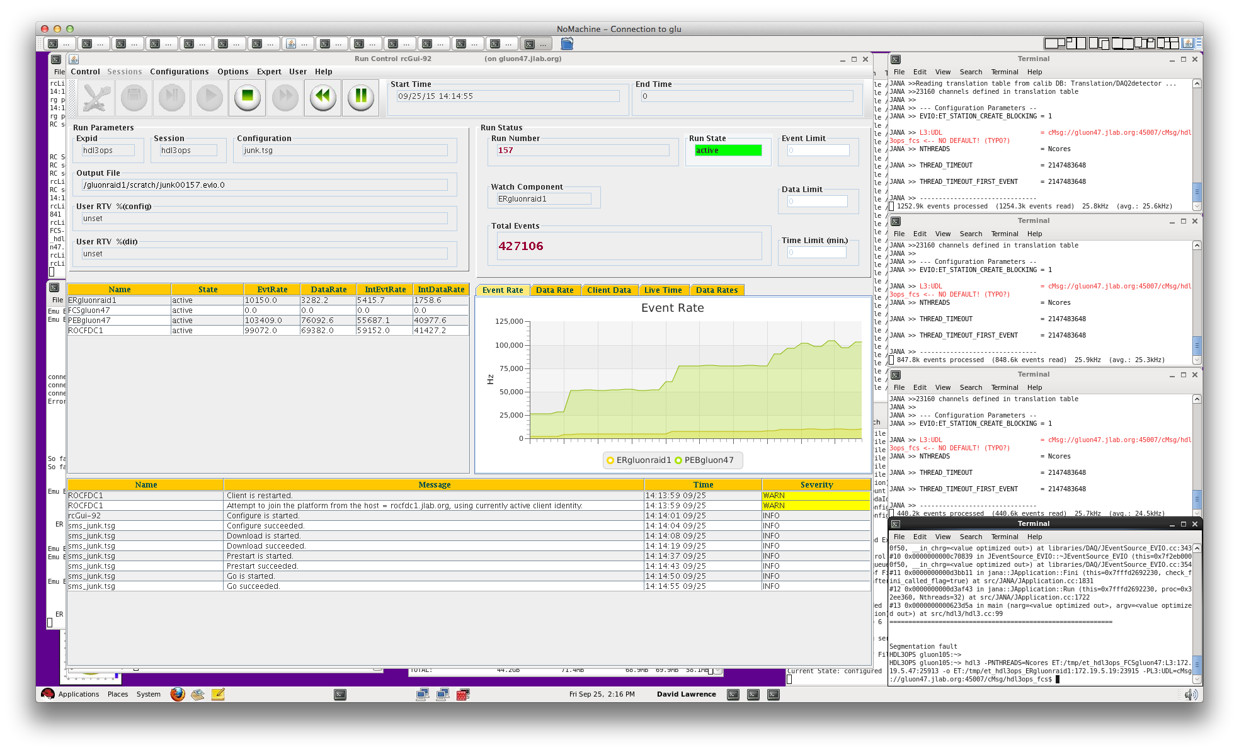
L3/Event Tagging Infrastructure
Single ROC (rocFDC1 = TDC)
Self triggering (no TS)
1,2,3, and 4 L3 farm nodes

Slide 8
Orphan Online Projects
Translation Table Maintenance tools
fADC emulation: infrastructure and algorithms
If you have an interest in taking one of these on, please contact davidl@jlab.org

