Slide 1
Hall-D Online Systems Status
(special guest appearance by L3 trigger status)
David Lawrence JLab
May 9, 2016

Slide 2
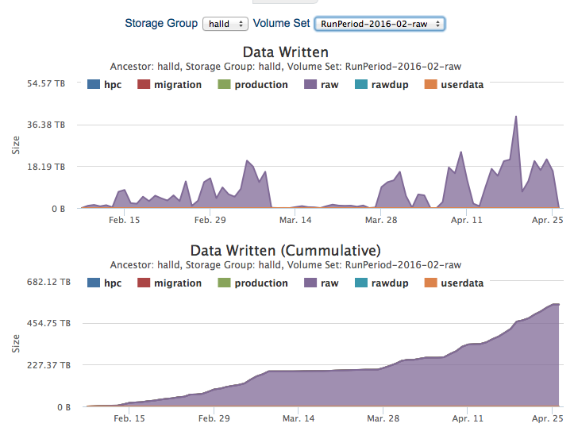
554.3TB

Slide 3
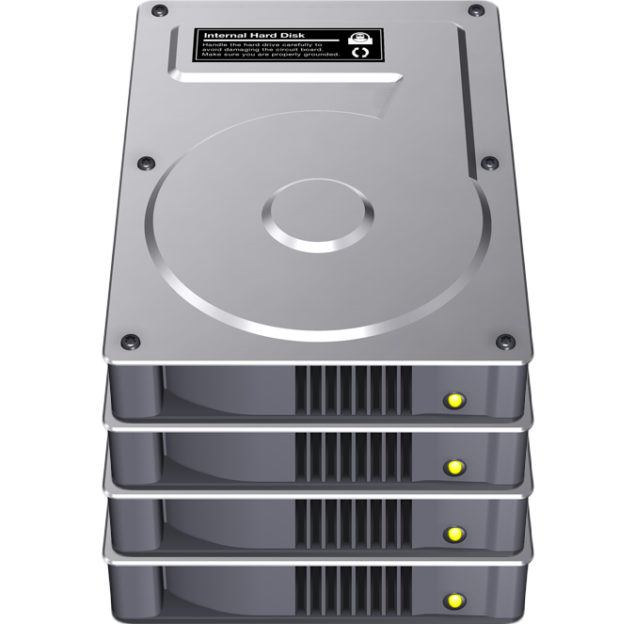
Data Rates
“Tested” means with actual data while it was being acquired. In some cases, offline testing has achieved significantly higher rates.
ROC
Spec: 100MB/sec
Tested: ~30MB/sec
ROC
125.9TB in 147,355 files written to tape in 2014 commissioning run
ROC
Event Builder
ROC
Tape Library
ROC
Spec: 3000MB/sec
Tested: 600MB/sec
(L3 farm)
800MB/sec
ROC
Event Recorder
ROC
72TB x2
RAID disk
ROC
Spec: 300MB/sec
Tested: 450MB/sec
Spec: 300MB/sec
Tested: 600MB/sec
2000MB/sec
800MB/sec

Slide 4
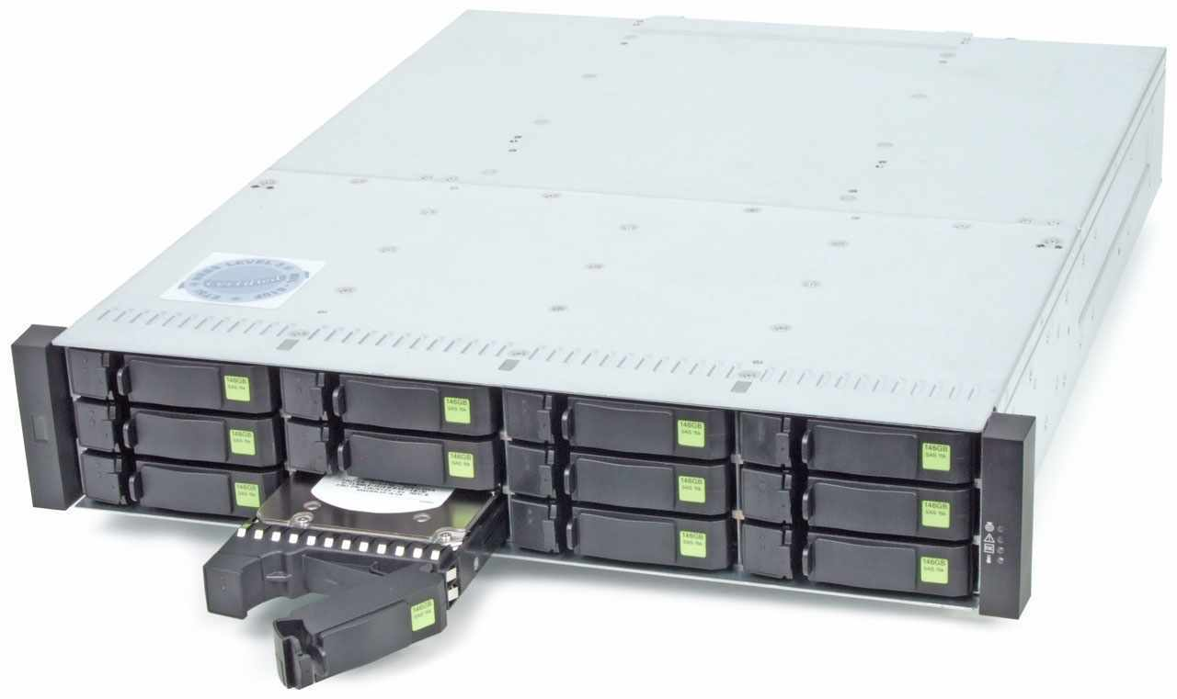
Online Storage Capacity
Two RAID disks with 72TB each of usable space
Maintain some portion of recent data
~100TB effective space total for new data
Need 72hr buffer in case of issue with link to tape library
100TB ÷ 800MB/s = 35hr
Need additional 100TB of RAID
Will purchase this summer

Slide 5
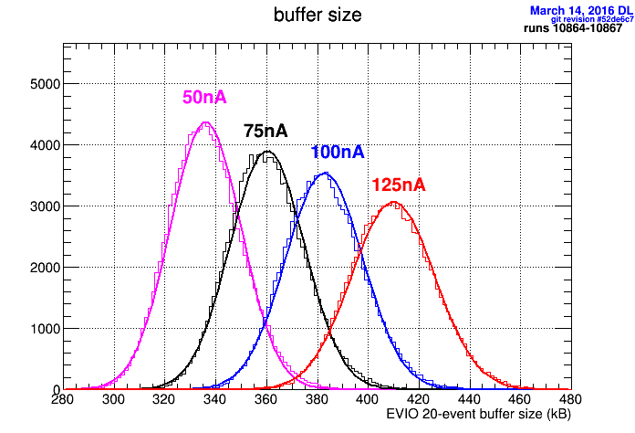
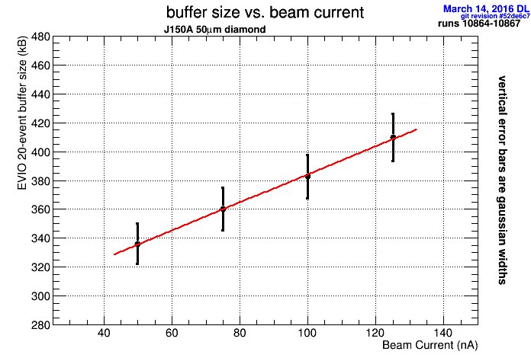
Event Size vs. Beam Current
5.0mm collimator
Slope = 1kB/nA
Event Size: ~19kB
extrapolate to I_{beam}= 0 → 14.25kB/event
Accidental data fraction (by volume):
(0.05kB/nA)(I_{beam} nA)
100nA: 26% of data is due to accidentals
(0.05kB/nA)(I_{beam} nA) + (14.25kB)
200nA: 41% of data is due to accidentals

Slide 6
L3 Testing
gluon100
L3
gluonraid1
ET
L3
ET
EB
L3
ER
(Goal: Reduce data volume by factor of 10)
Spring 2016 L3 Testing
Primarily infrastructure testing done
Limited by 12 node farm to ~200MB/s parsing rate
(~10kHz input rate)

Slide 7
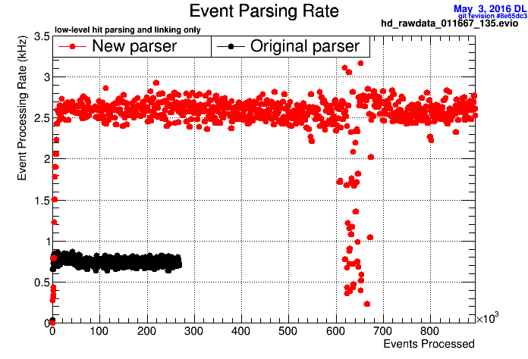
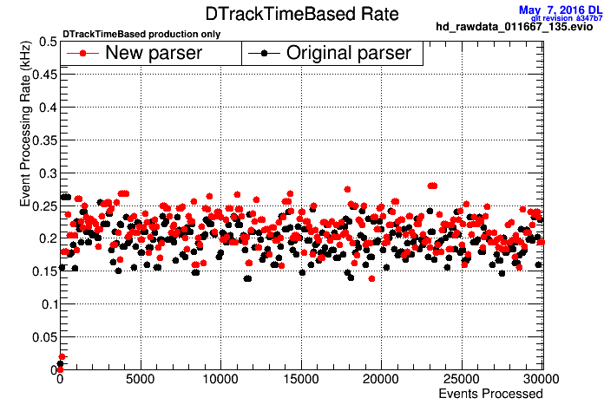
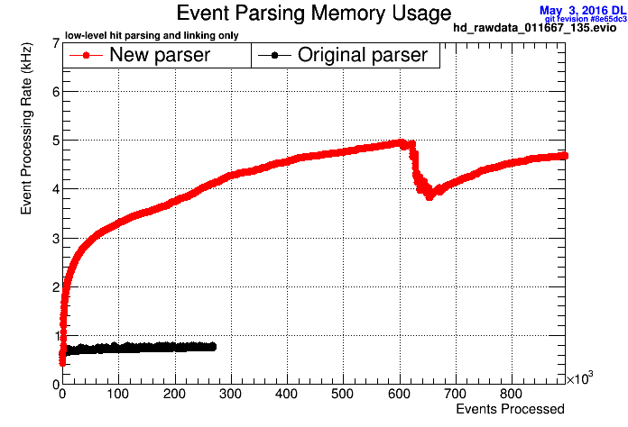
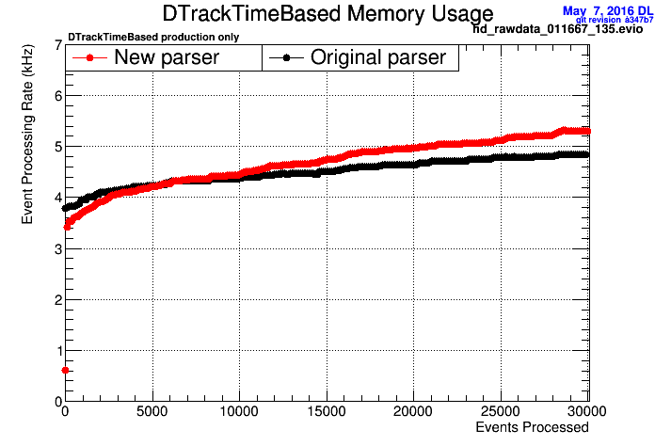
32 parsing threads
32 processing threads
4 parsing threads
32 processing threads

Slide 8
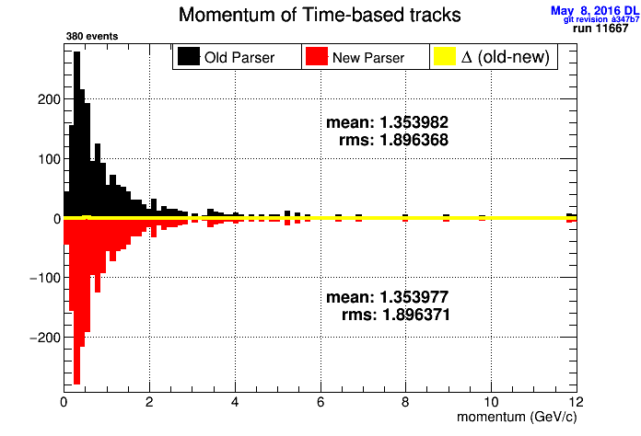
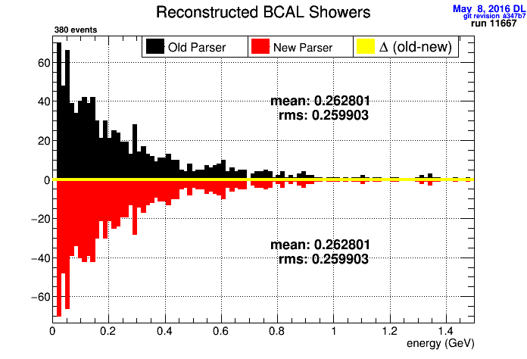
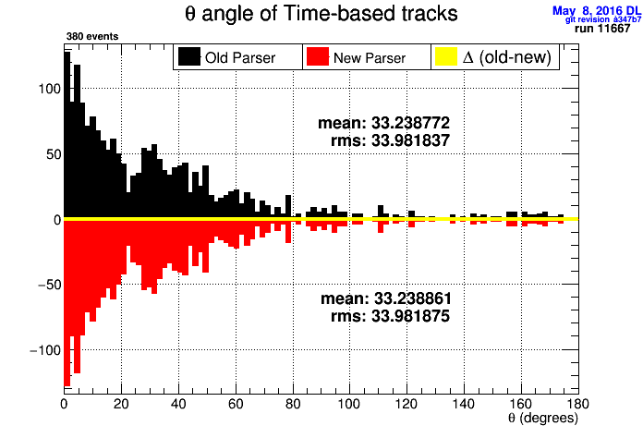
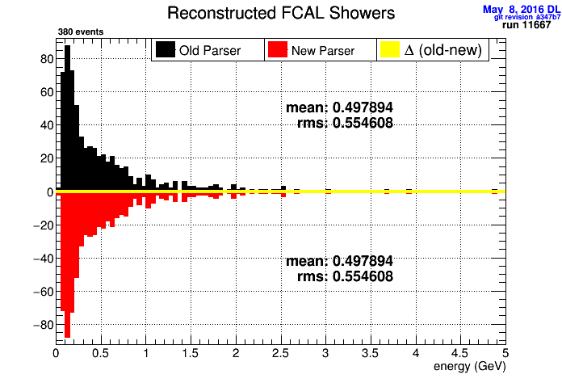
Reconstructed parameters for old and new parsers

Slide 9
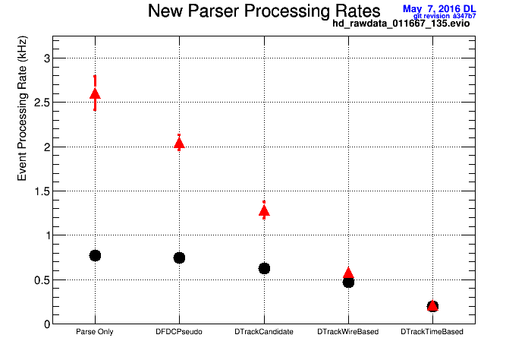
Will be purchasing additional 8 farm nodes this year which should be roughly 2x as fast as existing ones
(farm capacity will increase roughly 2.3x)

Slide 10
Will be purchasing additional 8 farm nodes this year which should be roughly 2x as fast as existing ones
(farm capacity will increase roughly 2.3x)

Slide 11
Will be purchasing additional 8 farm nodes this year which should be roughly 2x as fast as existing ones
(farm capacity will increase roughly 2.3x)

Slide 12
Online Monitoring
RootSpy system crushed under weight of successful campaign to create histograms
O(10⁴) histograms being filled and passed around
Non-responsive interface resulted in unusable online monitoring system
Replaced all plugins with single plugin that defines <40 histograms
Added HDMONITOR e-log and button to make logbook entry

Slide 13
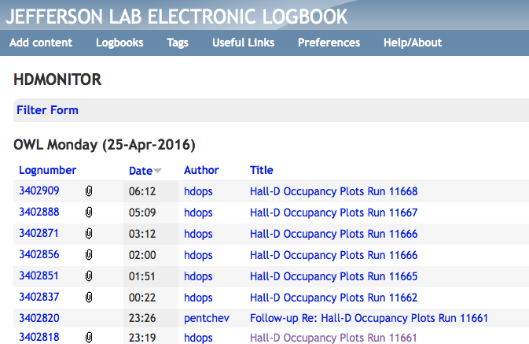

Slide 14
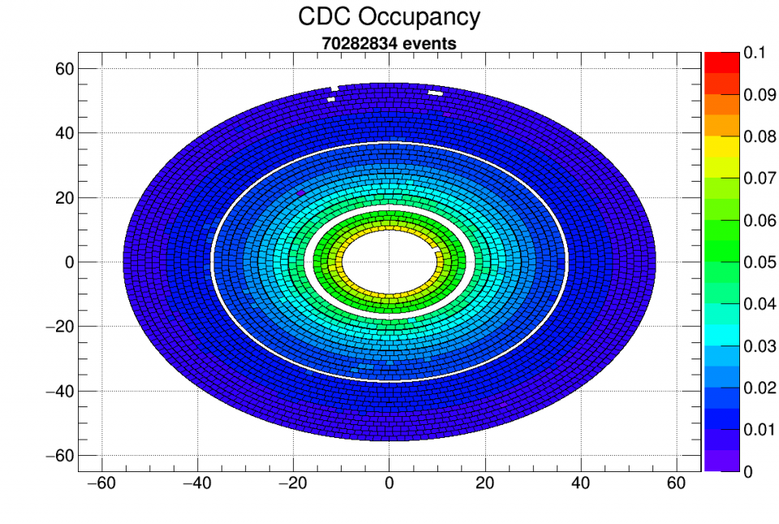
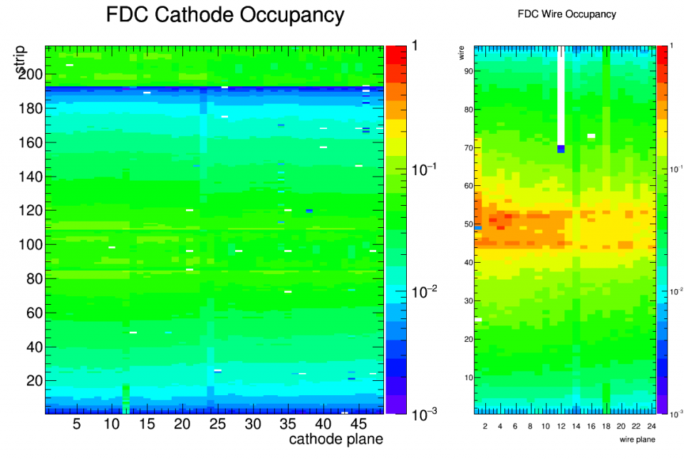
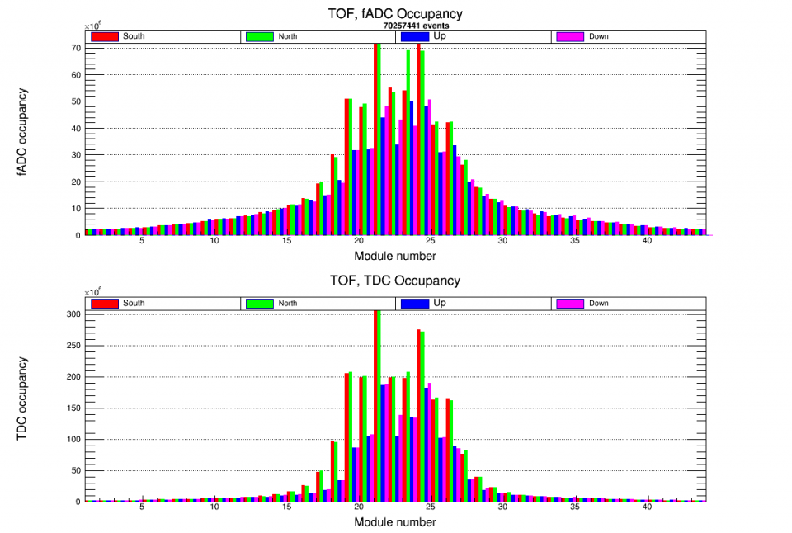
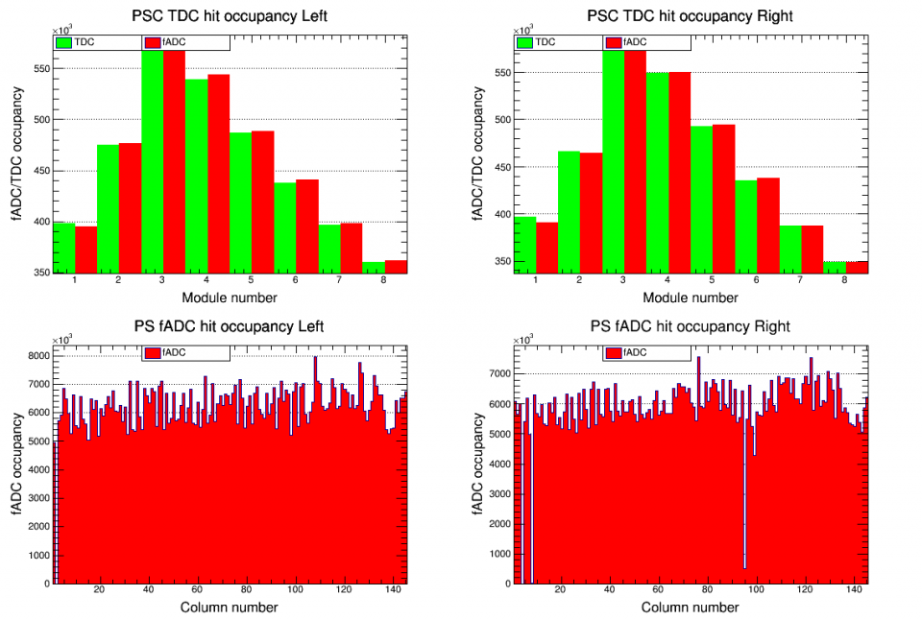
Example Plots from RootSpy

Slide 15
Password for Hall-D Operations Account
Do not write passwords on whiteboards
Do not send passwords in e-mails
Do not write passwords in scripts (especially ones kept in repositories that can be seen from web)
Do not write passwords on wiki (or any other web page)
Hall-D Operations password must be obtained via word of mouth (contact Run Coordinator if needed)

Slide 16
Backups

Slide 17
