Slide 1
The GlueX Start Counter & Beam Asymmetry $Σ$ in Single $π^{0}$ Photoproduction Eric Pooser Dissertation Defense Advisor: Werner Boeglin 03/25/2016

Slide 2
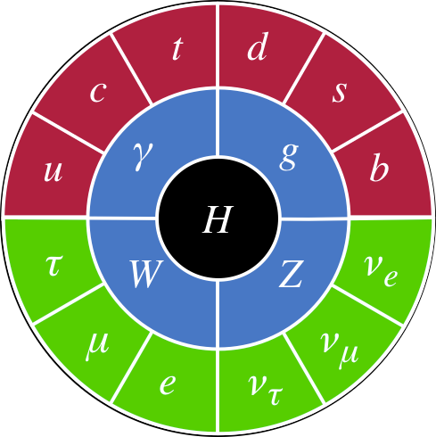
Nuclear & Particle Physics
Primary goals:
Study the structure of matter in the universe
Study the fundamental forces existing in nature
Standard Model: explains how the basic building blocks of matter interact, governed by four fundamental forces
Elementary particles: building blocks of matter
Quarks: building blocks of hadrons
Leptons: substructure unknown
Force carriers: quanta of gauge fields
Electromagnetic: γ
Strong nuclear: g
Weak nuclear: W⁺, W–, Z
Higgs boson: Higgs field excitation
Particle masses arise from field interaction
FERMIONS
BOSONS
MATTER
FORCE CARRIERS
QUARKS
GAUGE BOSONS
LEPTONS
HIGGS BOSON
Dissertation Defense
March 25, 2016
Eric Pooser

Slide 3
Hadronic Matter
Hadrons: Particles comprised of quarks bound by gluons
Baryons (Antibaryons): $qqq$ $\left(\overline{q}\overline{q}\overline{q}\right)$
$p, n, Λ, Σ, Ξ, Δ, Ω, etc…$
Mesons: $q\overline{q}$
$π, η, ρ, ω, ϕ, K, etc …$
Tetraquarks (Or bound mesons?):
Recent candidates: Z_{C}(3900), Z(4430) ...
Hybrid mesons?
Several candidates, none unambiguous
Pentaquarks? Glueballs?
$$u$$
$$u$$
$$u$$
$$\overline{d}$$
$$d$$
$$proton$$
$$π^{+}$$
$$d$$
$$\overline{u}$$
$$c$$
$$\overline{c}$$
$$Z(4430)$$
$$q$$
$$g$$
$$g$$
$$g$$
$$\overline{q}$$
$$g$$
Dissertation Defense
March 25, 2016
Eric Pooser

Slide 4
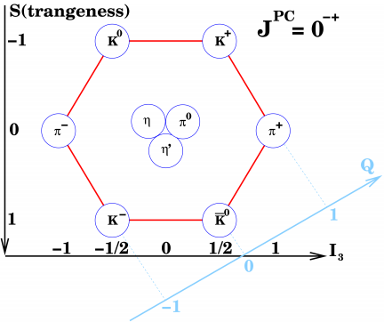
Classification of Mesons
General properties: mass, charge, quark flavor
Grouped by quantum numbers: $J^{PC}$
Total angular momentum: $\vec{J}=\vec{L}+\vec{S}$
Parity: Spatial inversion
$\hat{Π} ψ\left(\vec{x}\right)=ψ\left(−\vec{x}\right)=P ψ\left(\vec{x}\right)$
$P={(−1)}^{L+1}$
Charge: Charge conjugation
$\hat{C} ψ=\overline{ψ}=C ψ$
$C={(−1)}^{L+S}$
Allowed $J^{PC}$ for $q\overline{q}$ system:
$J^{PC}=0^{−+},1^{−−}$, $1^{+−}$, $2^{−+}$, $2^{++}$, …
$$q$$
$$\overline{q}$$
$$0^{−+}$$
Dissertation Defense
March 25, 2016
Eric Pooser

Slide 5
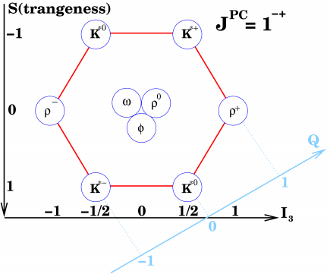
Classification of Mesons
General properties: mass, charge, quark flavor
Grouped by quantum numbers: $J^{PC}$
Total angular momentum: $\vec{J}=\vec{L}+\vec{S}$
Parity: Spatial inversion
$\hat{Π} ψ\left(\vec{x}\right)=ψ\left(−\vec{x}\right)=P ψ\left(\vec{x}\right)$
$P={(−1)}^{L+1}$
Charge: Charge conjugation
$\hat{C} ψ=\overline{ψ}=C ψ$
$C={(−1)}^{L+S}$
Allowed $J^{PC}$ for $q\overline{q}$ system:
$J^{PC}=0^{−+},1^{−−}$, $1^{+−}$, $2^{−+}$, $2^{++}$, …
$$q$$
$$\overline{q}$$
$$1^{−−}$$
Dissertation Defense
March 25, 2016
Eric Pooser

Slide 6
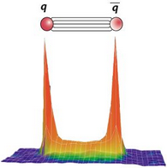
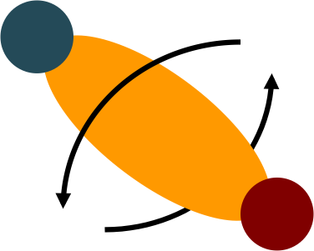
Hybrid & Exotic Hybrid Mesons
Conventional light mesons (π, K, η, ρ, ω, φ, …)
$q\overline{q}$ system (q = u, d, or s)
Gluonic degrees of freedom do not contribute
Non-exotic quantum numbers: $J^{PC}= 0^{− +},1^{−−}, 1^{+−}, …$
Hybrid Mesons: Resonances with gluonic field excitations
Gluons behave as constituent particle
Provide access to gluonic degrees of freedom in the confinement regime
Exotic Hybrid Mesons: Hybrid mesons with non-permissible quantum numbers
Exotic quantum numbers: $J^{PC}= 0^{−−}, 0^{+−}, 1^{−+}, 2^{+−}, …$
$$q$$
$$g$$
$$\overline{q}$$
$$q$$
$$\overline{q}$$
Dissertation Defense
March 25, 2016
Eric Pooser

Slide 7
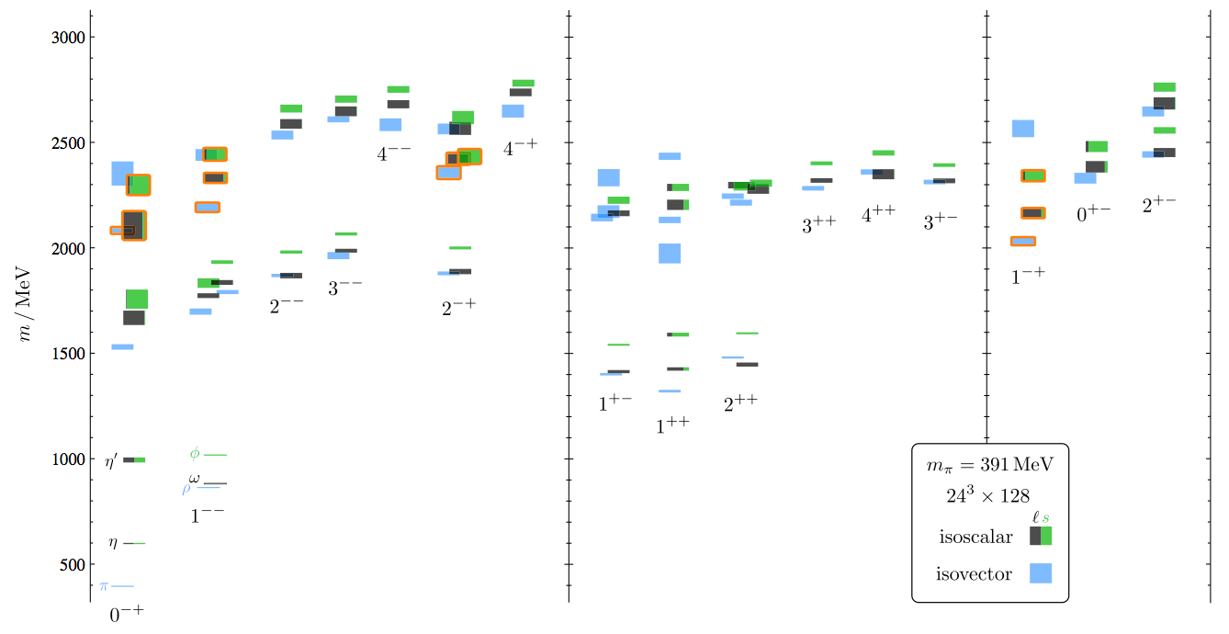
Lattice QCD Predictions
Rich spectrum of light quark & quark-gluon hybrid (exotic) mesons
Negative Parity
Positive Parity
Exotics
π₁
Lightest Hybrid Mesons
J. Dudek, et al., Phys. Rev. D 88, 094505 (2013)
Dissertation Defense
March 25, 2016
Eric Pooser

Slide 8
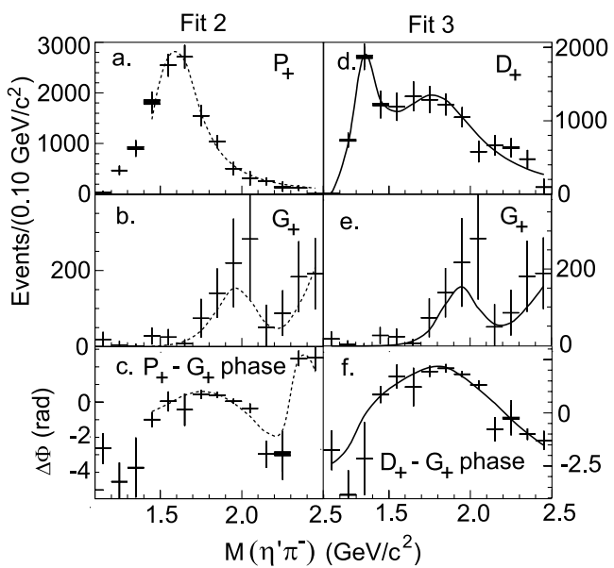
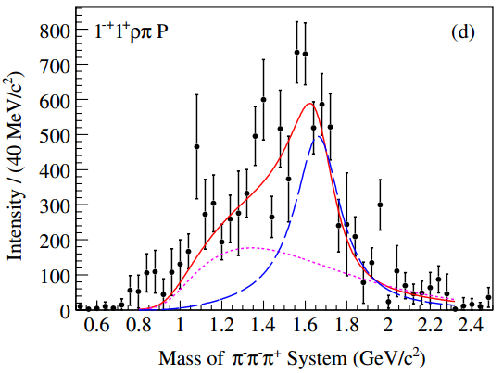
Hints of Exotic Mesons
E852 Collaboration (BNL)
18 GeV/c π⁻ beam, LH₂ target
$π_{1}(1600)→η^{′}π^{−}$
$M_{π_{1}}=1.597±0.010 {GeV}/{c^{2}}$
$Γ_{π_{1}} =0.340±0.040 {GeV}/{c^{2}}$
COMPASS (CERN)
190 GeV/c π beam, Pb target
$π_{1}(1600)→ρπ^{−}$
$M_{π_{1}}=1.660±0.010 {GeV}/{c^{2}}$
$Γ_{π_{1}} =0.269±0.021 {GeV}/{c^{2}}$
Exotic π₁(1600)
E.I. Ivanov, et al., PRL 86, 3977 (2001)
M.G. Alekseev, et al., PRL 104, 241803 (2010)
Dissertation Defense
March 25, 2016
Eric Pooser

Slide 9
Jefferson Lab & GlueX
Dissertation Defense
March 25, 2016
Eric Pooser

Slide 10
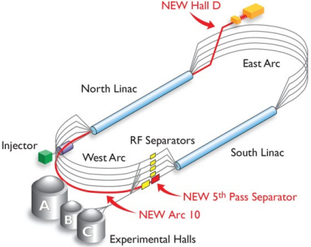
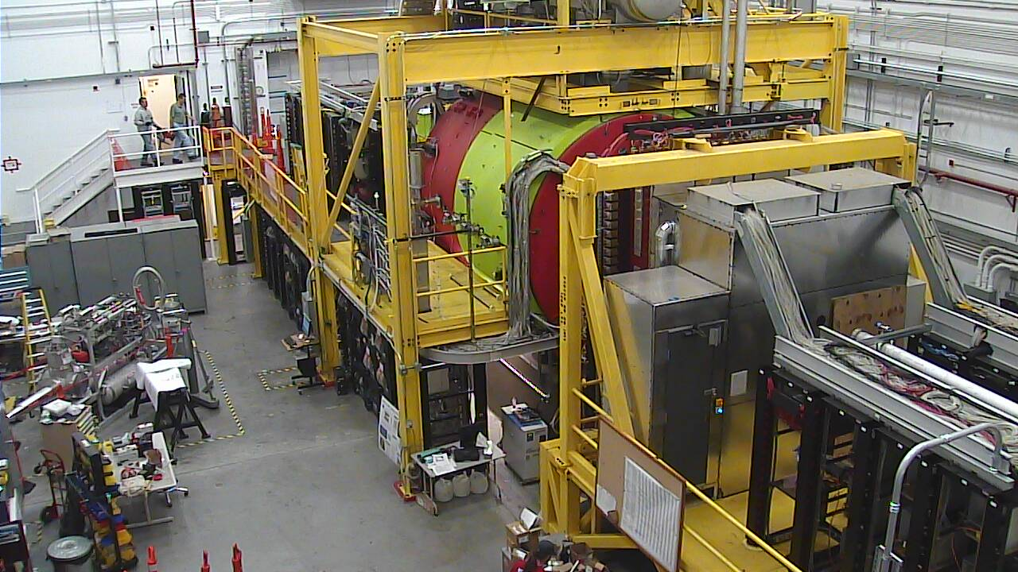
Jefferson Lab & GlueX
Jefferson Lab CEBAF Accelerator
Injector: 3 independent 500 MHz polarized electron beams
e– beam: Upgraded from 6 to 12 GeV
Up to 5.5 passes through 2 superconducting linacs (∼1500 MHz at $2^{°}$K )
Parallel delivery of beams to 3 Halls
GlueX experiment: New experimental hall D, designed to search for hybrid & exotic mesons
GlueX collaboration: ~110 members, 23 institutions
Other physics: Map baryon spectra, charged pion polarizability, rare eta decay, etc.
Commissioning: Fall 2014 – April 2016
First physics running: Fall 2016
Full intensity: 2017+: ~5 years
Dissertation Defense
March 25, 2016
Eric Pooser

Slide 11
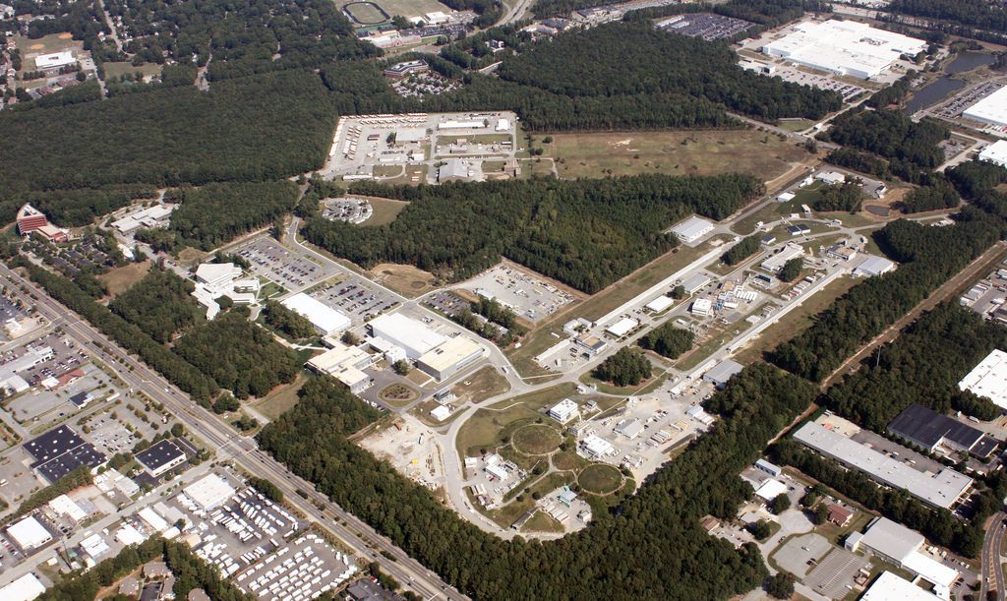
CEBAF at Jefferson Lab
CHL
D
A
B
C
Dissertation Defense
March 25, 2016
Eric Pooser

Slide 12
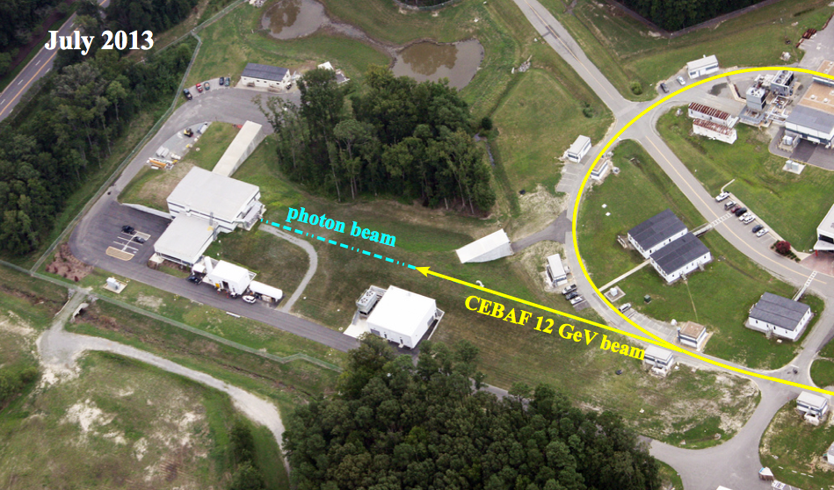
Experimental Hall D
Dissertation Defense
March 25, 2016
Eric Pooser

Slide 13
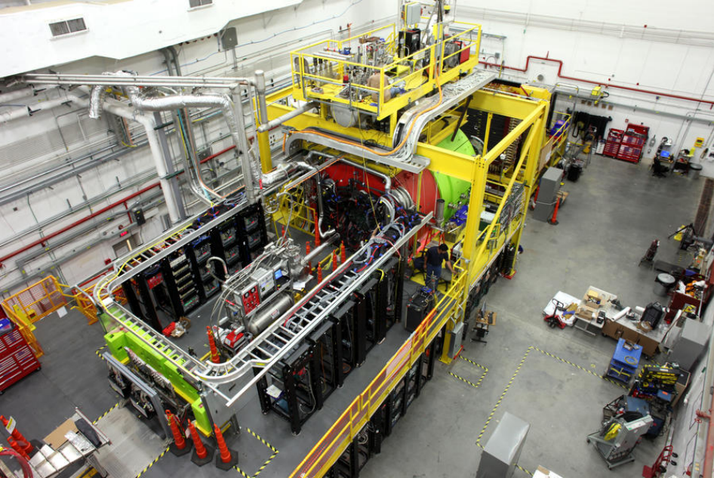
Hall D
Dissertation Defense
March 25, 2016
Eric Pooser

Slide 14
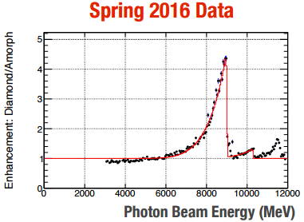
GlueX Beamline
12 GeV e⁻ beam (0.05 – 2.2 μA)
20 μm thick diamond radiator
8.4-9.0 GeV γ’s in the coherent peak
3.0-11.8 GeV tagged
~40% linearly polarized γ’s
Collimated r < 1.8 mm at ~80 m
100 MHz γ’s at 2.2 μA
9 GeV Coherent Peak
Dissertation Defense
March 25, 2016
Eric Pooser

Slide 15
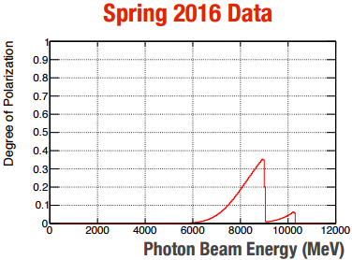
GlueX Beamline
12 GeV e⁻ beam (0.05 – 2.2 μA)
20 μm thick diamond radiator
8.4-9.0 GeV γ’s in the coherent peak
3.0-11.8 GeV tagged
~40% linearly polarized γ’s
Collimated r < 1.8 mm at ~80 m
100 MHz γ’s at 2.2 μA
~35% Peak Polarization
Dissertation Defense
March 25, 2016
Eric Pooser

Slide 16
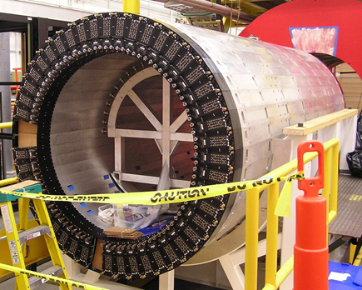
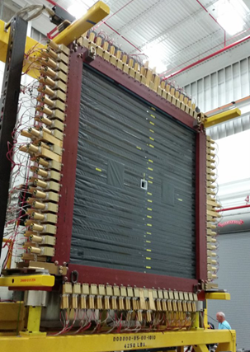
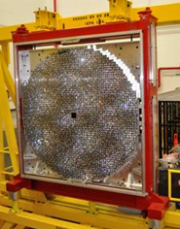
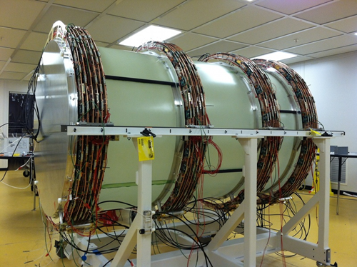
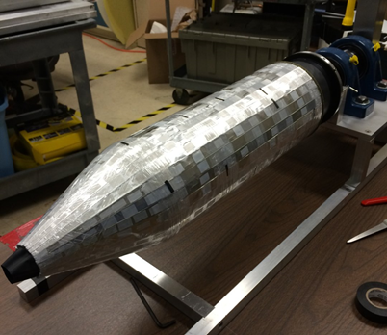
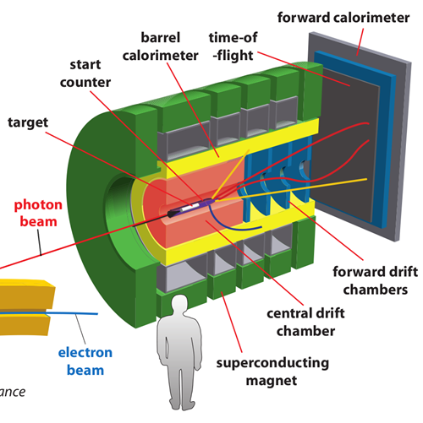
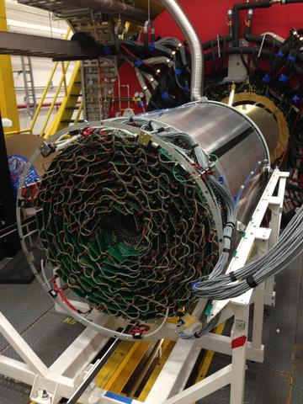
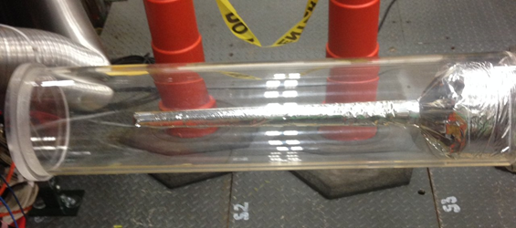
GlueX Spectrometer
Dissertation Defense
March 25, 2016
Eric Pooser

Slide 17
The GlueX Start Counter
Dissertation Defense
March 25, 2016
Eric Pooser

Slide 18
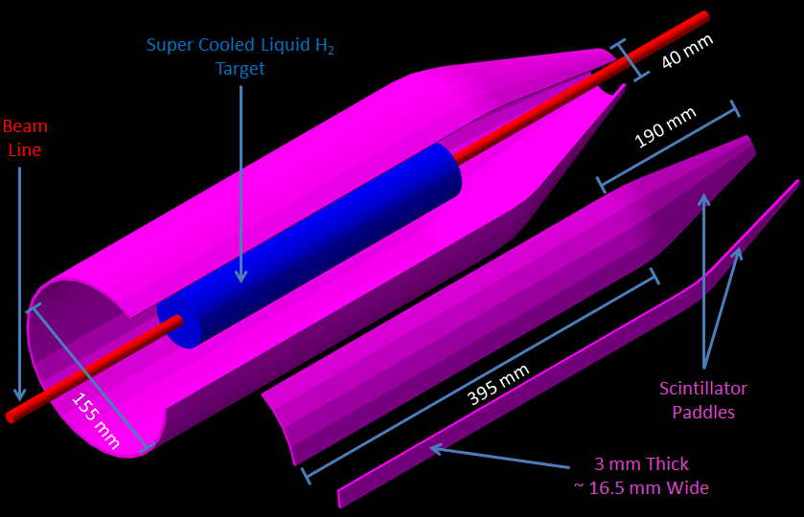
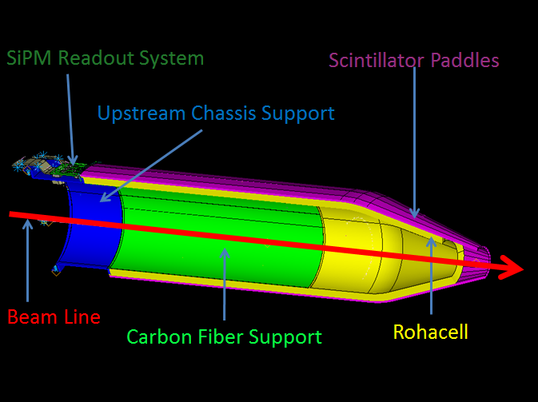
Start Counter with Beam Line & Target
EJ-200 scintillator material with a decay time of 2 ns and a long attenuation length
Magnetic field insensitive SiPM detectors comprise the readout system
In coincidence with the tagger the ST identifies accelerator beam buckets ~ 4 ns apart
Designed to operate at tagged photon rates of up to ${10}^{8} γ/s$
$σ≈300 ps$ to successfully identify beam buckets with a high degree of accuracy
${12}^{°}$segmentation for background rejection
Dissertation Defense
March 25, 2016
Eric Pooser

Slide 19
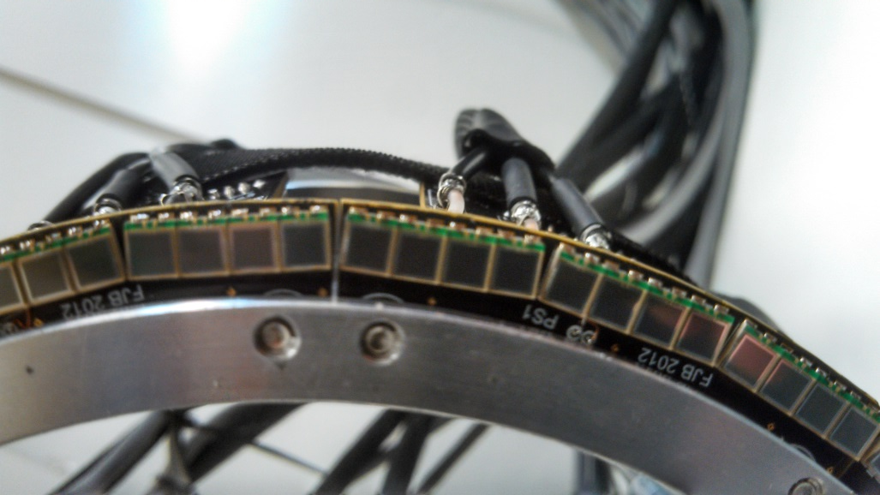
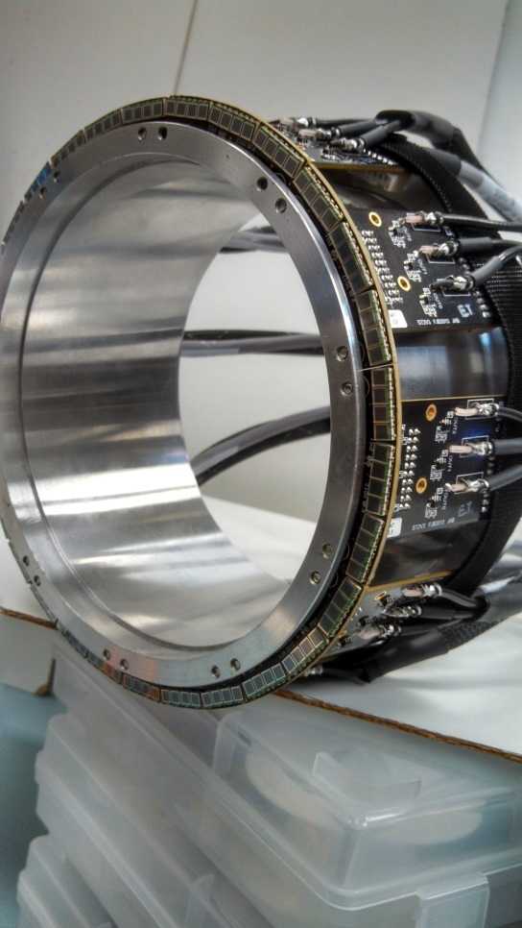
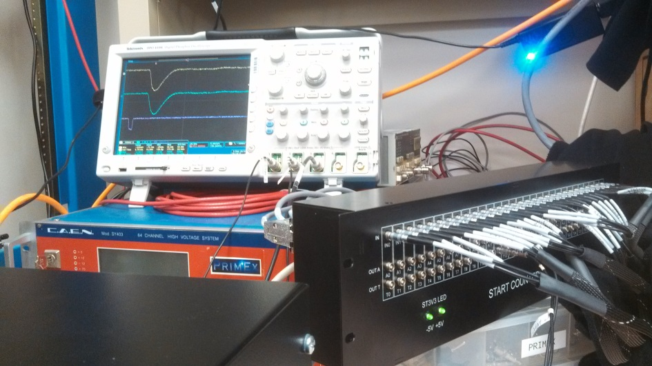
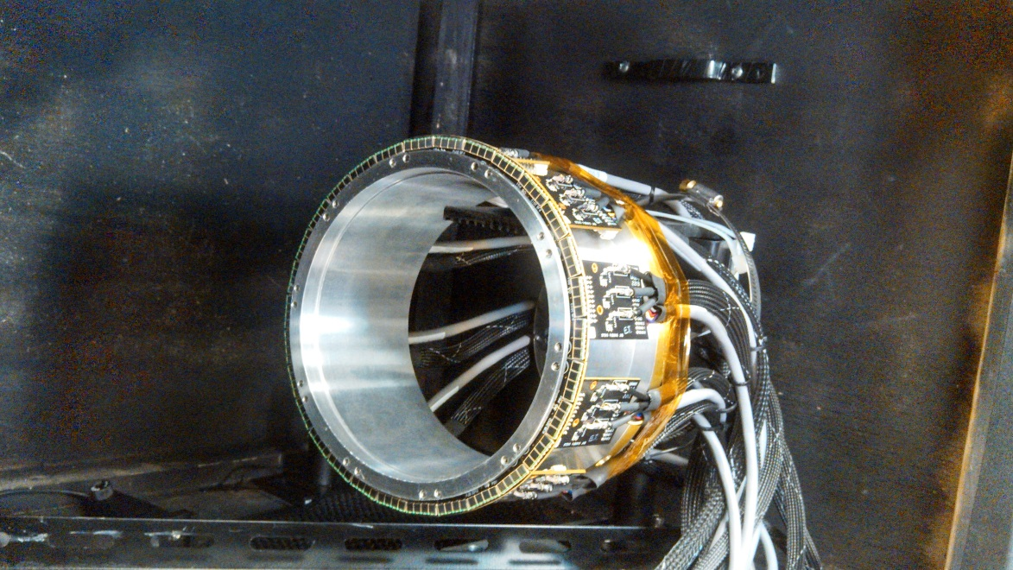
Start Counter Readout System
Support Hub
ST1 & SiPMs
ST3
ST2
Fully Assembled Readout System
10 ST1 Boards, houses 30 groups of 4, 3x3 mm² SiPMs
Read out 30 scintillator paddles
3 x 12 mm² active area
≈72 % of scintillator area is readout at upstream end
Dissertation Defense
March 25, 2016
Eric Pooser

Slide 20
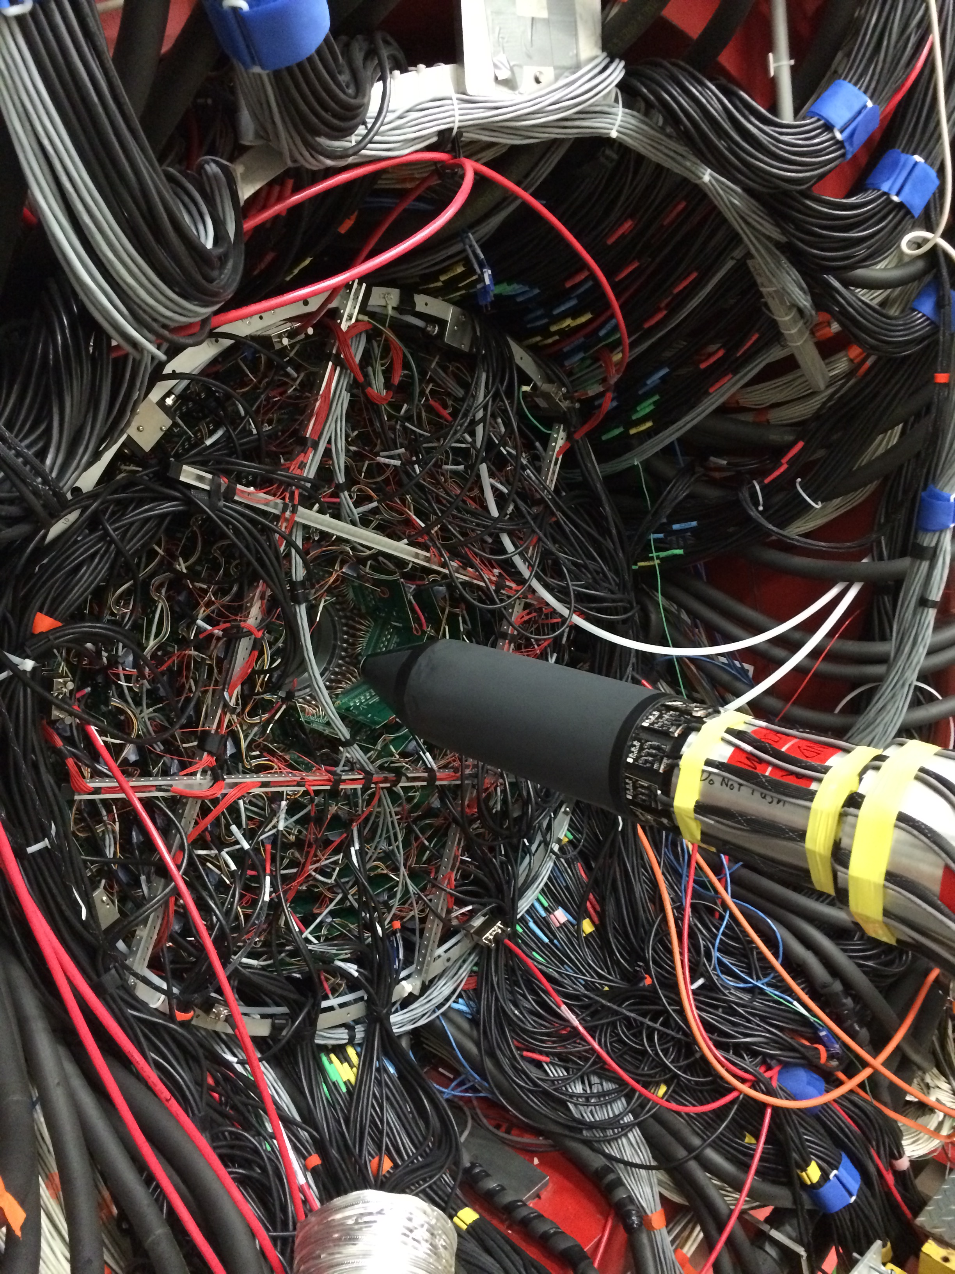
Start Counter Detector System
Dissertation Defense
March 25, 2016
Eric Pooser

Slide 21
Testing Machined Scintillators
Dissertation Defense
March 25, 2016
Eric Pooser

Slide 22
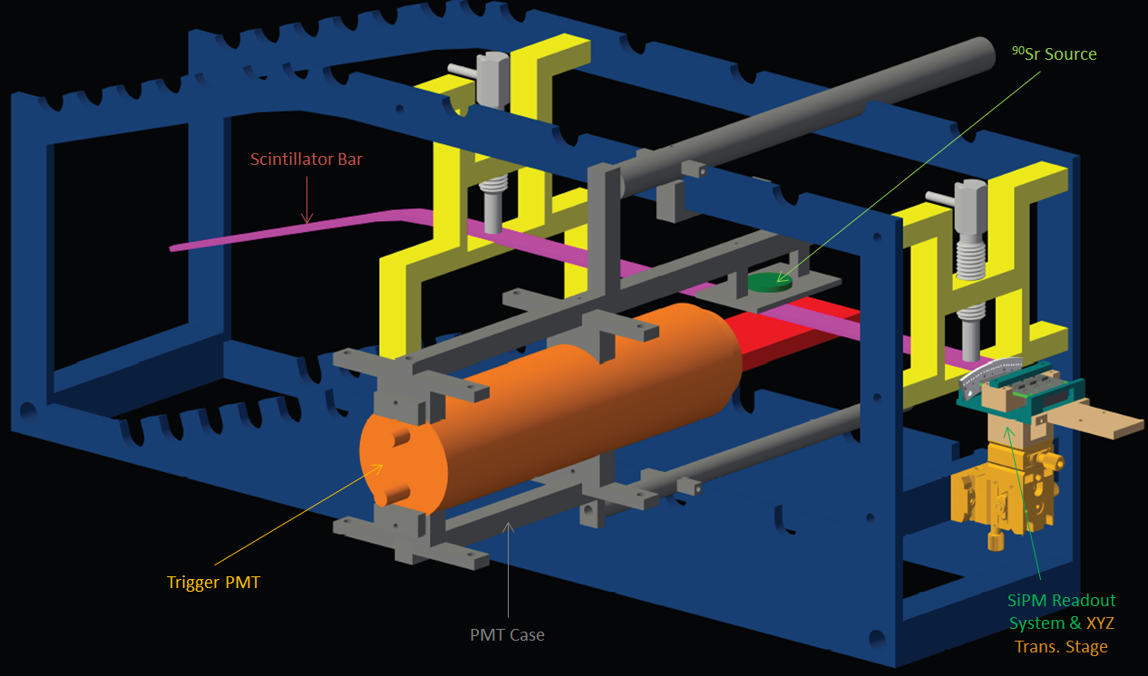
Test Stand
Dissertation Defense
March 25, 2016
Eric Pooser

Slide 23
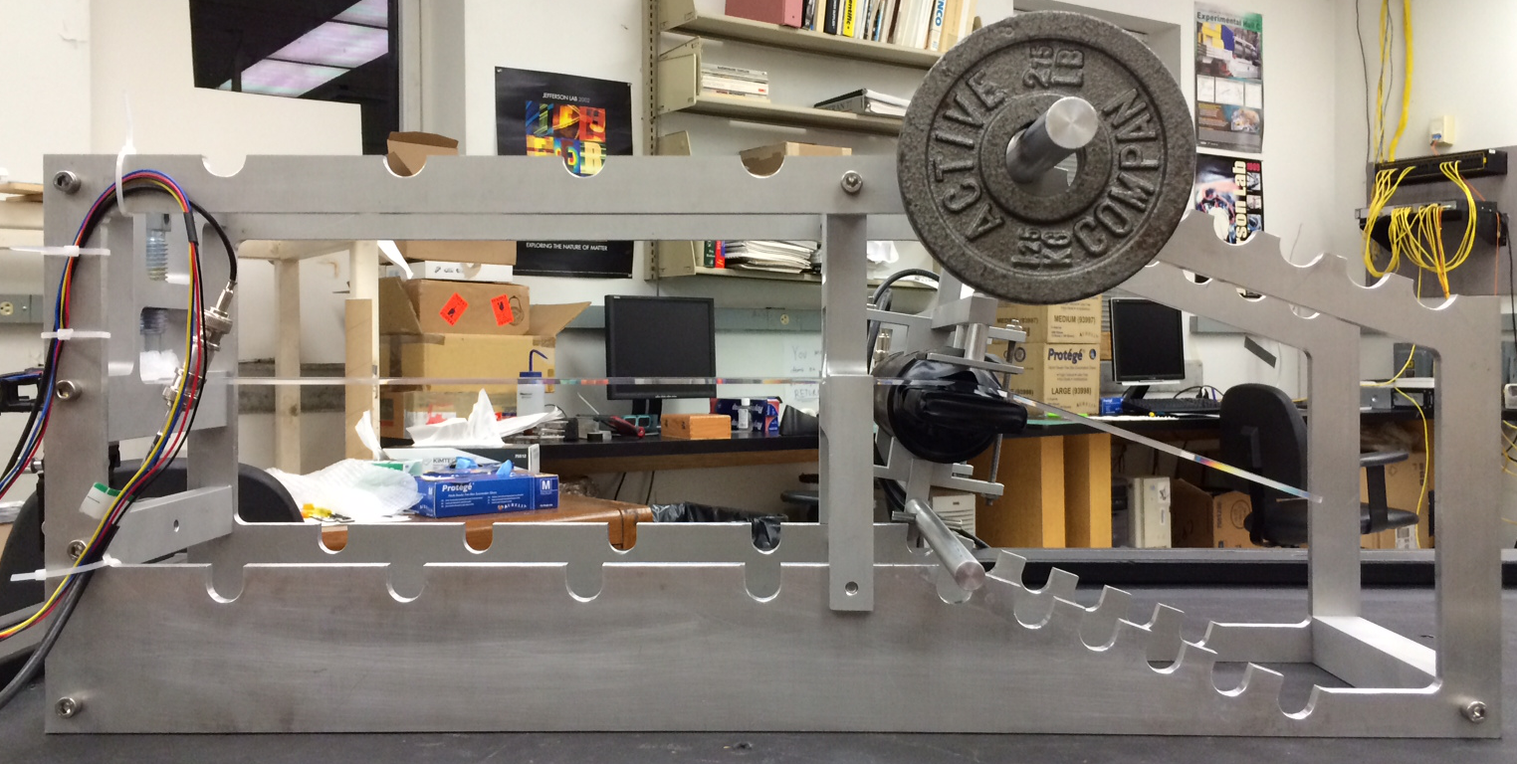
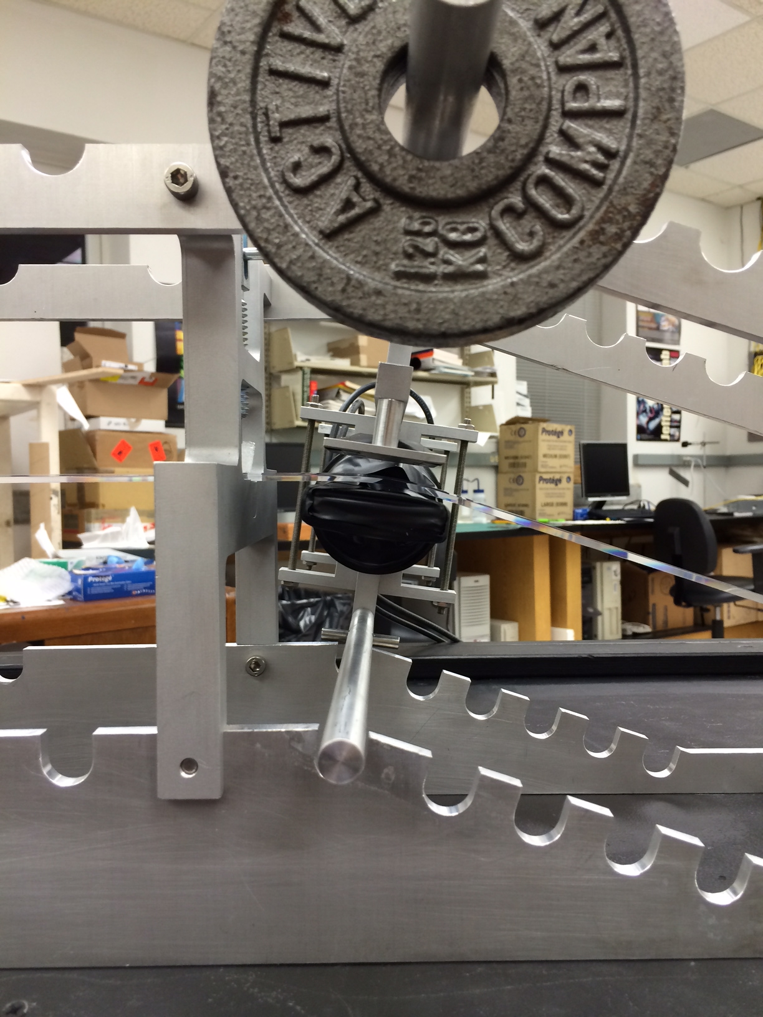
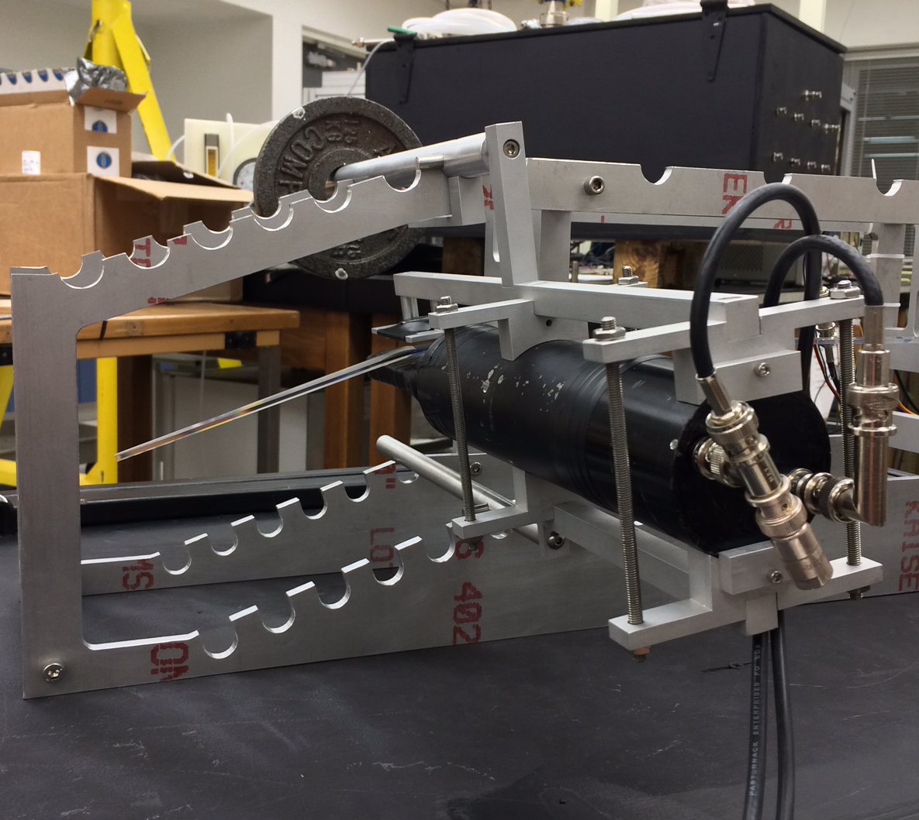
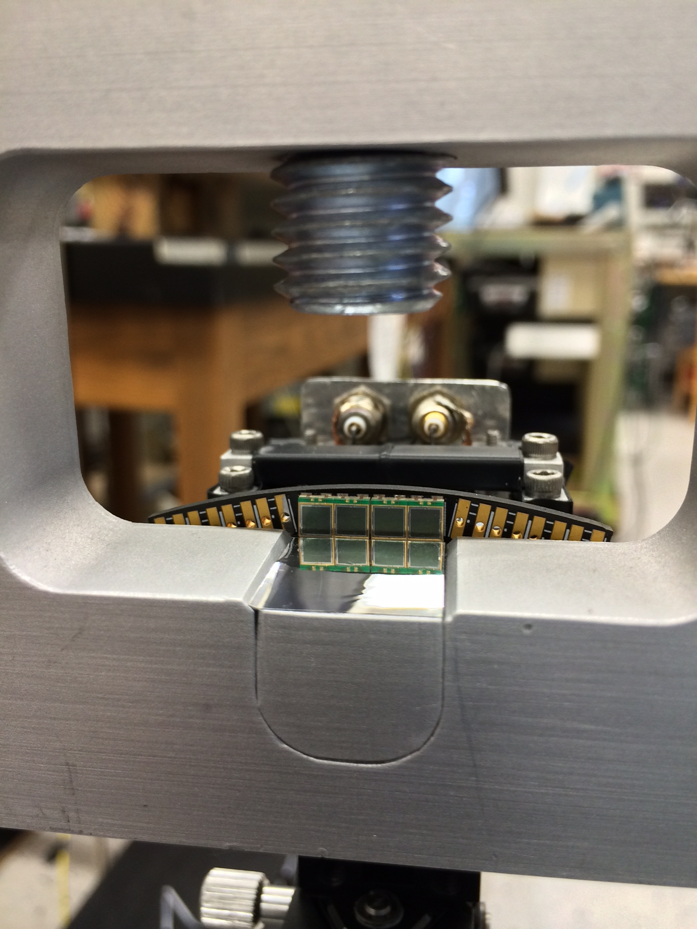
Test Stand
Dissertation Defense
March 25, 2016
Eric Pooser

Slide 24
Polishing Machined Scintillators
Dissertation Defense
March 25, 2016
Eric Pooser

Slide 25
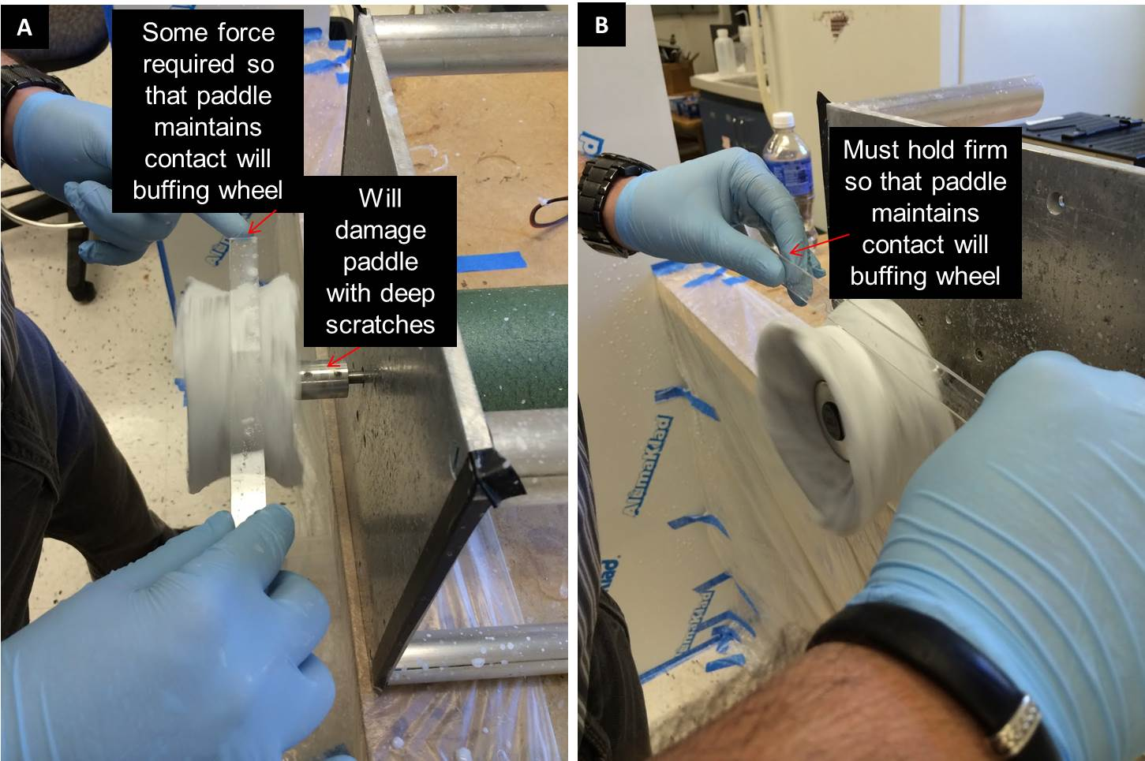
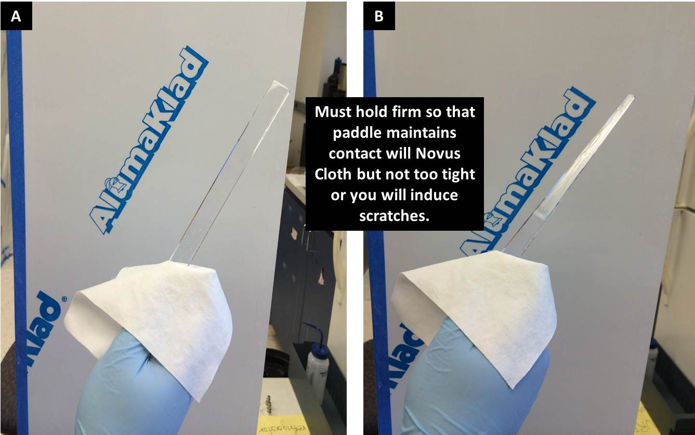
Polishing Methods
Workers at McNeal Enterprises badly damaged scintillator surfaces
Buehler Micropolish II de-agglomerated Alumina suspension (0.3 μm)
Polishing times were ~1 hr per paddle
With the combination of wet, cold buffing, and hand polishing, the scintillators were made void of virtually all scratches and surface defects
Polishing procedures greatly improved the performance of the scintillators
Dissertation Defense
March 25, 2016
Eric Pooser

Slide 26
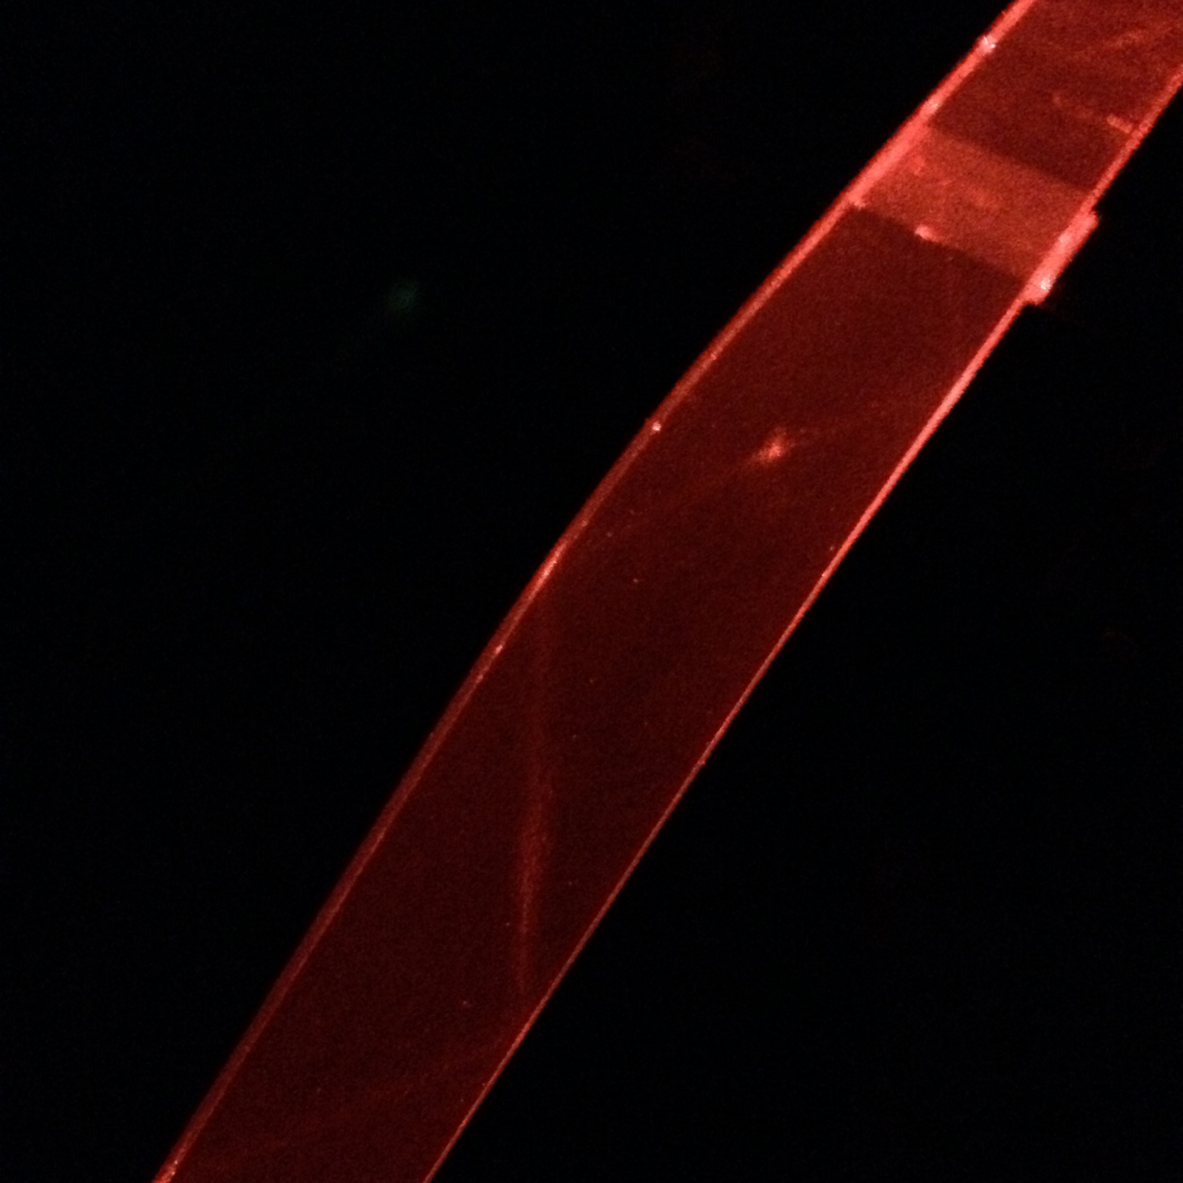
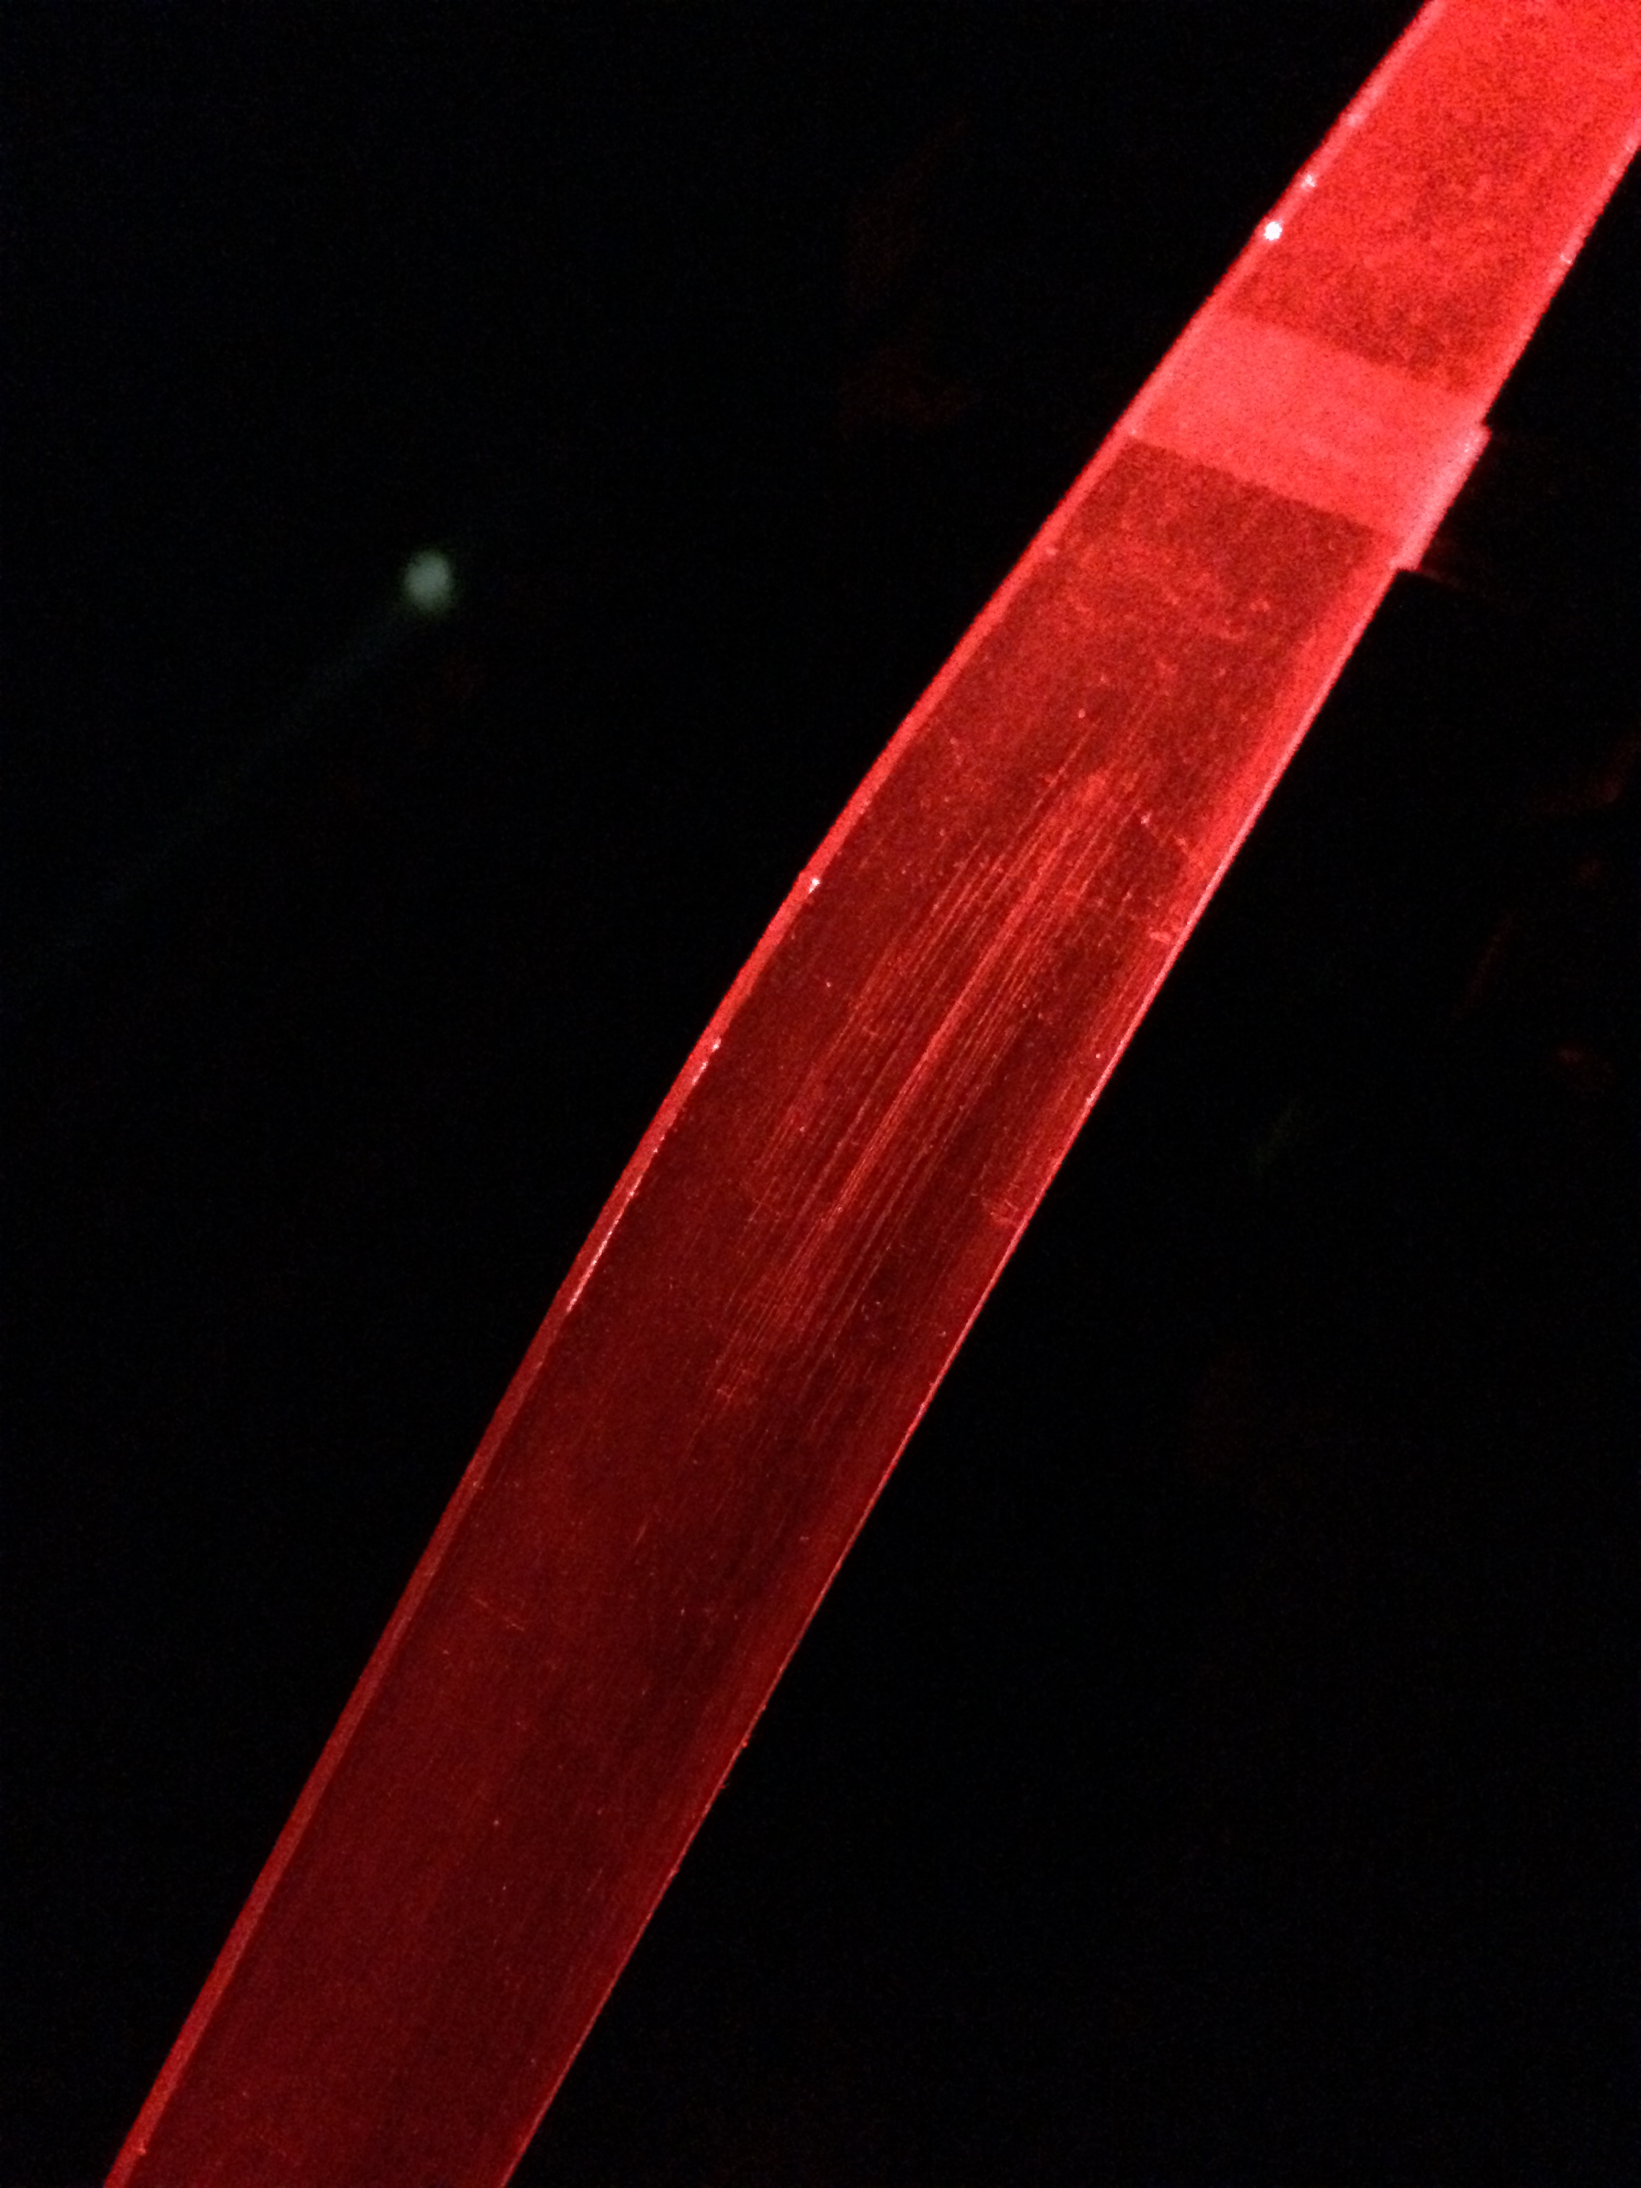
Effects of Polishing Scintillators
Dissertation Defense
March 25, 2016
Eric Pooser

Slide 27
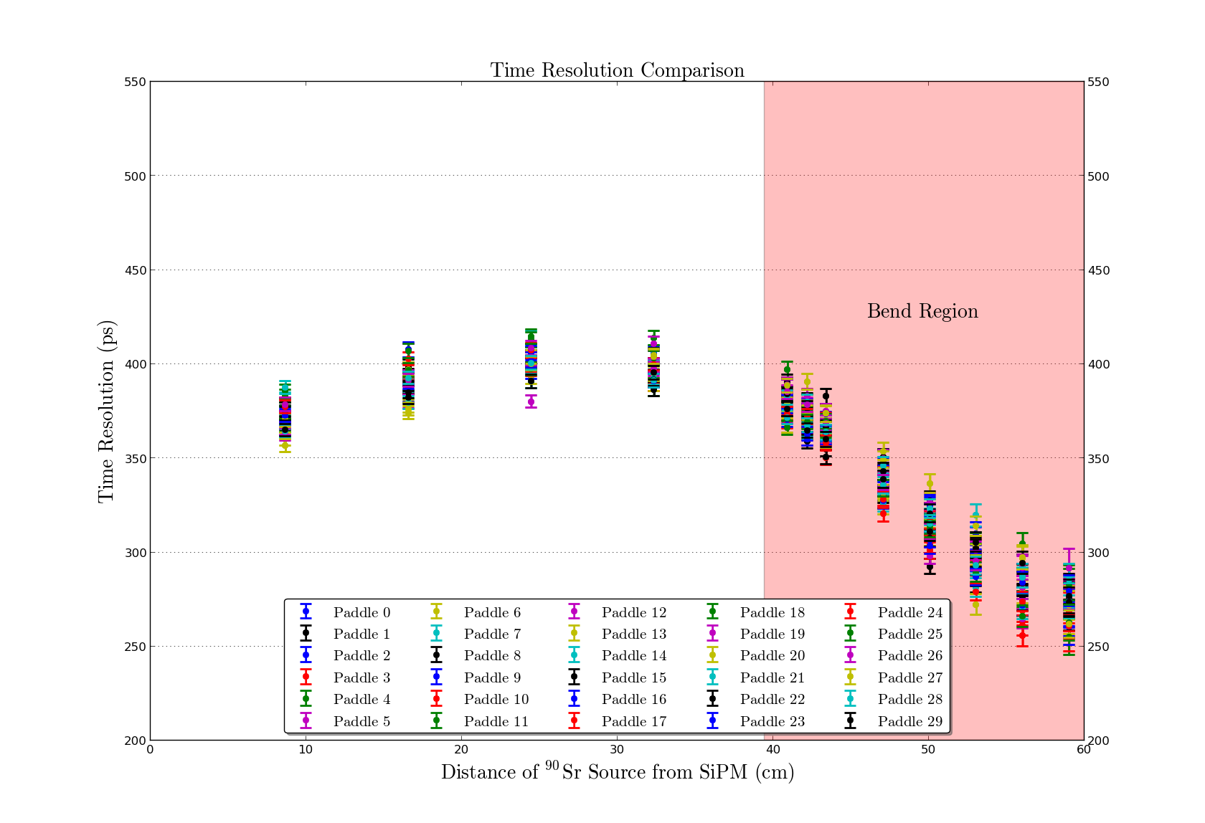
Start Counter Paddle Results (Wrapped)
Dissertation Defense
March 25, 2016
Eric Pooser

Slide 28
GEANT4 Simulations
Dissertation Defense
March 25, 2016
Eric Pooser

Slide 29
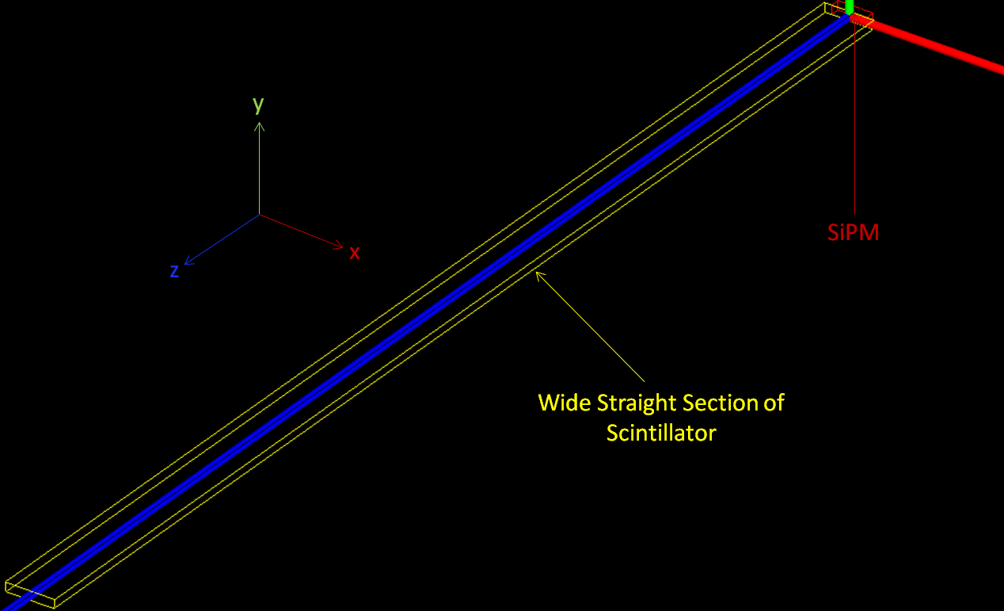
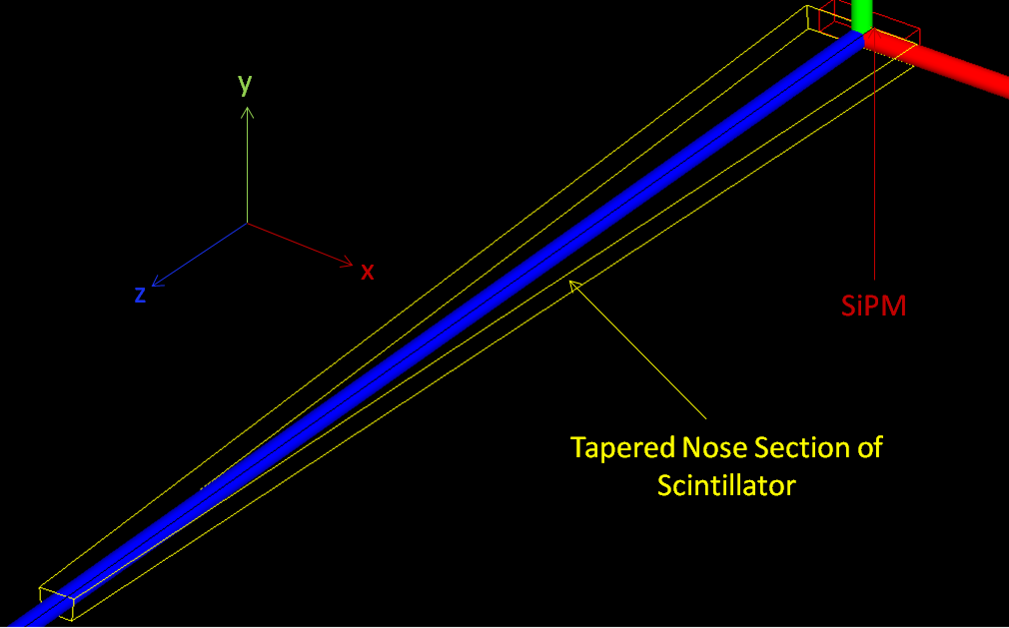
Experimental Setup
Goal was to understand the light collection in the nose region
The two trapezoidal regions of machined scintillator were modelled
Wide straight sections & tapered nose section
EJ200 scintillator material was modelled with only one parameter
Reflectivity of G4LogicalSkinSurface = 98%
SiPM constructed as G4SensitiveDetector made of Silicon with 100% detection efficiency
Dissertation Defense
March 25, 2016
Eric Pooser

Slide 30
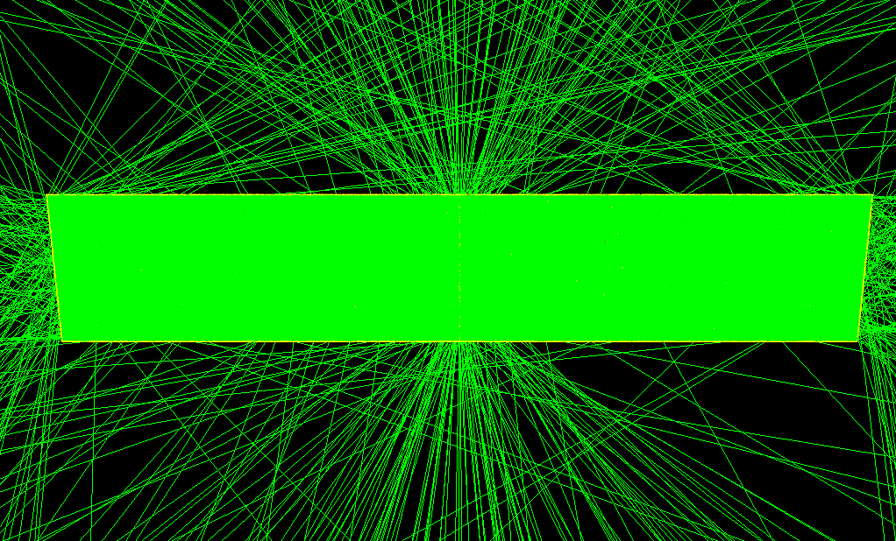
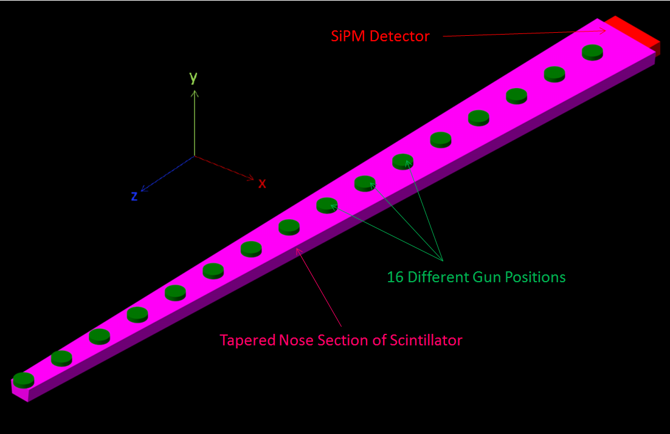
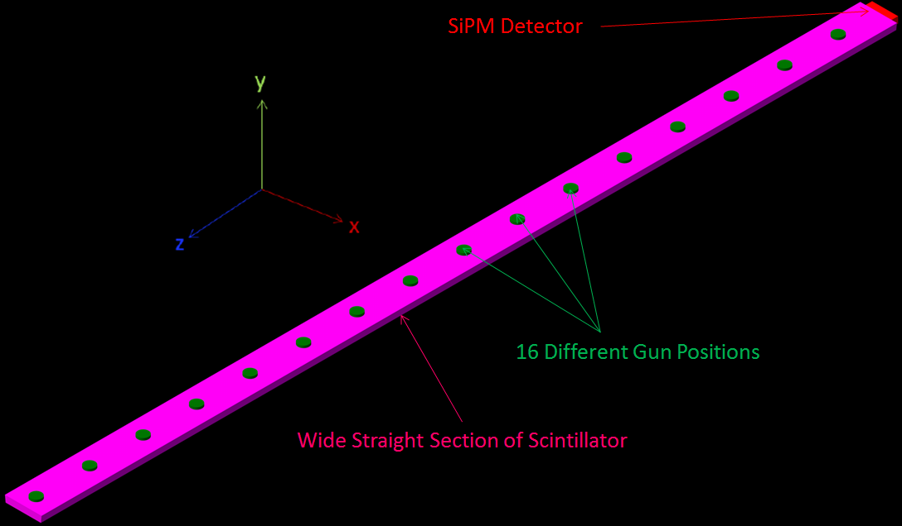
Experimental Setup
10K Optical photons were generated
16 Different locations inside the scintillator medium
Energies between 0.5 eV – 3.0 eV
Generated randomly in 4$π$ along a 3 mm path (y-axis)
Orthogonal to wide surface of the scintillator
Dissertation Defense
March 25, 2016
Eric Pooser

Slide 31
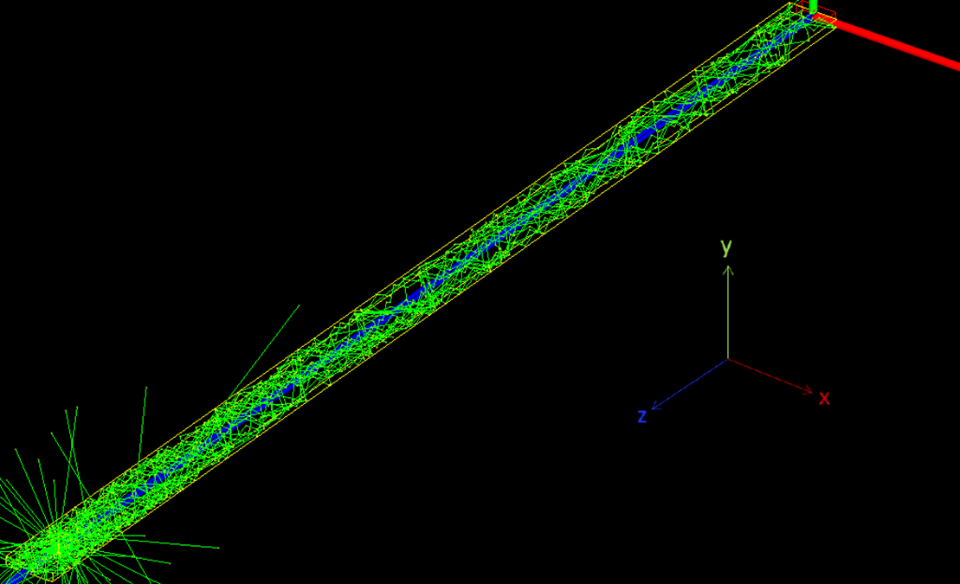
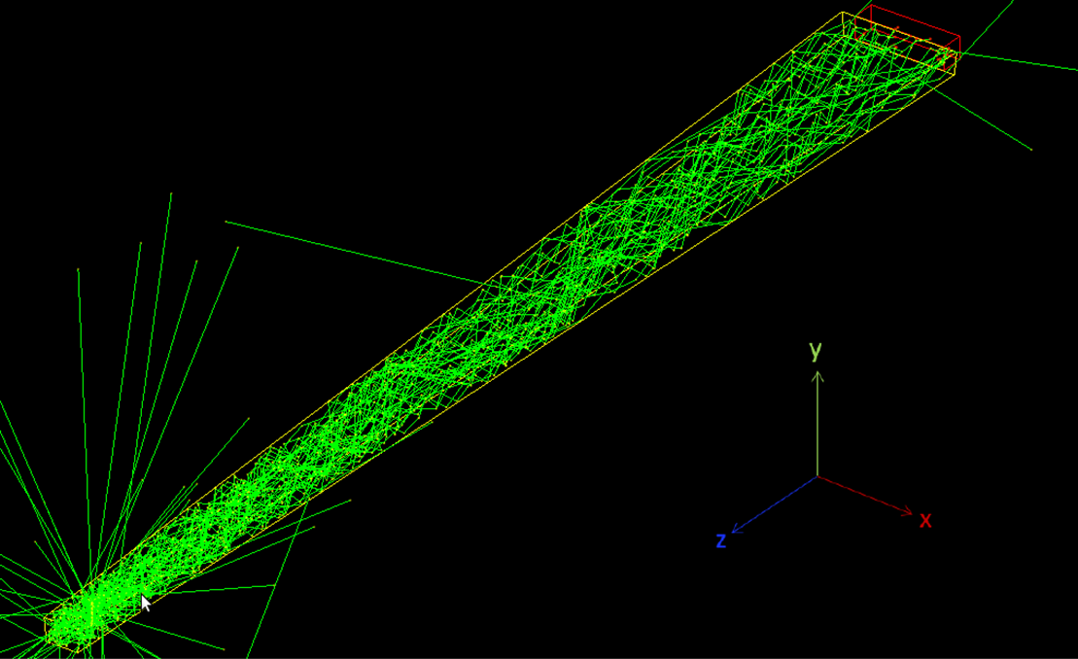
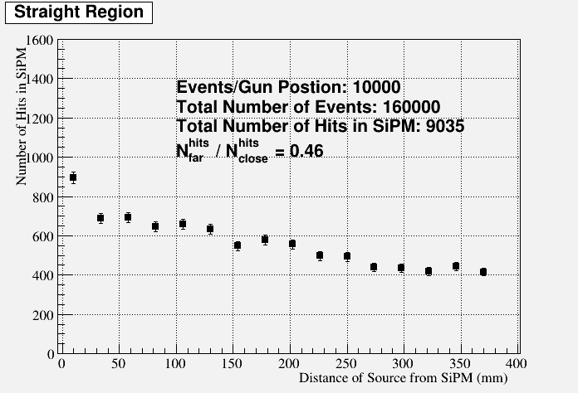
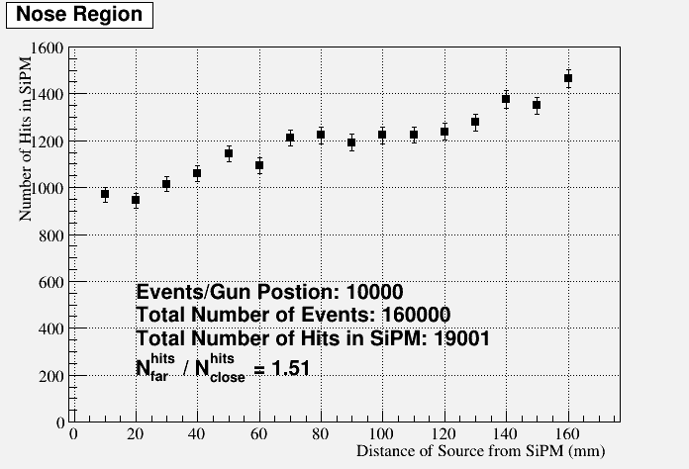
Results
Factor 3/2 light gain
Factor 1/2 light loss
Dissertation Defense
March 25, 2016
Eric Pooser

Slide 32
Start Counter Assembly
Dissertation Defense
March 25, 2016
Eric Pooser

Slide 33
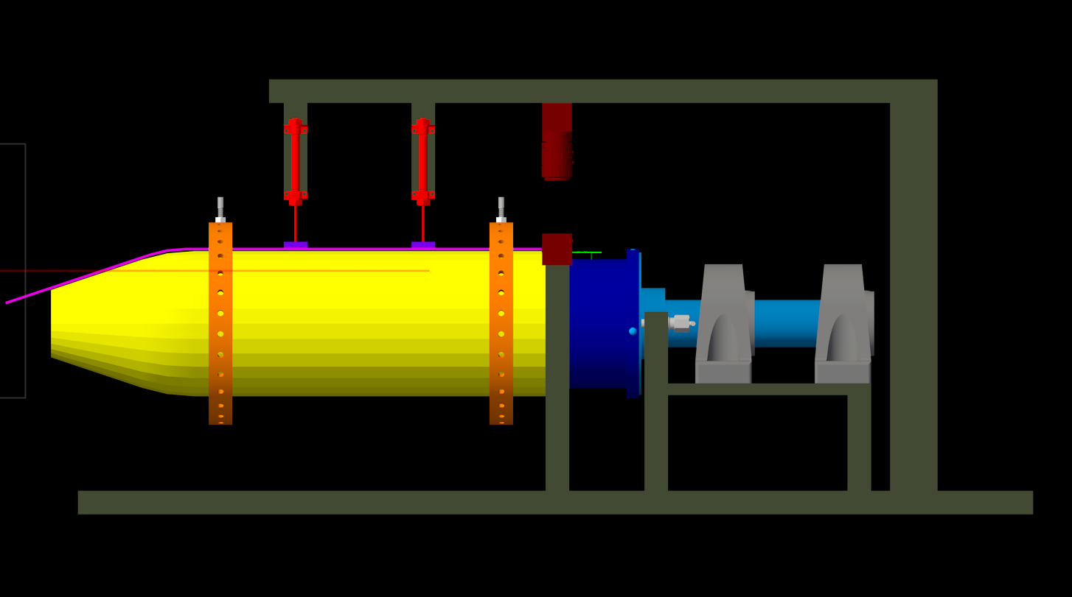
Assembly Jig
Pneumatic Cylinder (x2)
Swivel Screw (x60)
SiPM (x30)
Scintillator
12 deg Locking Rotation Device
Rohacell
Foam (x62)
Locking Plunger
Support Hub
Mounted Steel Ball Bearings (x2)
Acrylic Ring (x2)
CMOS Color Camera
Dissertation Defense
March 25, 2016
Eric Pooser

Slide 34
Assembly Jig
Dissertation Defense
March 25, 2016
Eric Pooser

Slide 35
Shimming Procedure
Both the scintillator and the active area of the SiPM are 3 mm
Proper alignment was required to maximize light collection
SiPM’s were positioned so that all paddles would require 30 mils (762 μm) of radial shimming
Material utilized was Kapton polyimide heavy duty film (type HN ρ = 1.42 g/cc), cut into 0.5 x 12 in² strips
5, 10, & 20 mil Kapton sheets were utilized
The required shimming height varied from paddle to paddle
20 mil < shim < 40 mil
Utilizing a calibrated camera we were able to measure distances with very high precision (< 10 μm)
Dissertation Defense
March 25, 2016
Eric Pooser

Slide 36
Shimming Procedure
Rings & Swivel Screws
Hub
0.8 mil Bundling Wrap
Camera
Scintillator
Rohacell
Dissertation Defense
March 25, 2016
Eric Pooser

Slide 37
Calibration Measurement (3.02 mm)
SiPM
Rohacell
1 pixel = 1 mil
Dissertation Defense
March 25, 2016
Eric Pooser

Slide 38
No Shimming (786 μm Needed)
Scintillator
Bundling Wrap
1 pixel = 1 mil
Dissertation Defense
March 25, 2016
Eric Pooser

Slide 39
10 mil Shimming (507 μm Needed)
1 pixel = 1 mil
Dissertation Defense
March 25, 2016
Eric Pooser

Slide 40
20 mil Shimming (254 um,1 pixel = 1 mil)
1 pixel = 1 mil
Dissertation Defense
March 25, 2016
Eric Pooser

Slide 41
25 mil Shimming (152 um,1 pixel = 1 mil)
1 pixel = 1 mil
Dissertation Defense
March 25, 2016
Eric Pooser

Slide 42
30 mil Shimming (Best Possible Alignment)
1 pixel = 1 mil
Dissertation Defense
March 25, 2016
Eric Pooser

Slide 43
Scintillator & SiPM Air Gap (1.9 mm)
Scintillator
SiPM
1 pixel = 40.5 μm
Dissertation Defense
March 25, 2016
Eric Pooser

Slide 44
Scintillator & SiPM Air Gap (Spacer Thickness ≈ 150 μm)
Spacer Material
Dissertation Defense
March 25, 2016
Eric Pooser

Slide 45
Scintillator & SiPM Air Gap (162 μm)
1 pixel = 40.5 μm
Dissertation Defense
March 25, 2016
Eric Pooser

Slide 46
Fully Assembled Start Counter (EEL 126)
Dissertation Defense
March 25, 2016
Eric Pooser

Slide 47
Time Walk Corrections
Dissertation Defense
March 25, 2016
Eric Pooser

Slide 48
Time Walk Corrections
Pulse peak is utilized to characterize the leading edge
$f_{i}^{w}\left(a/{a_{i}^{thresh}}\right)$≡ time walk correction function
$f_{i}^{w}\left(a/{a_{i}^{thresh}}\right)={c0}_{i}+ \frac{{c1}_{i}}{{\left(a/{a_{i}^{thresh}}\right)}^{{c2}_{i}}}$
$a$≡ pulse amplitude
$a_{i}^{0}$ ≡ most typical pulse height for i^{th} paddle
$a_{i}^{thresh}$ ≡ discriminator threshold (converted to ADC units)
$T_{}^{w}=T_{}^{hit}−f_{i}^{w}\left(a/{a_{i}^{thresh}}\right)+f_{i}^{w}\left(a_{i}^{0}∕a_{i}^{thresh}\right)$
Spring 2015 runs 2931-2934 (≈ 81.5 M events)
50 nA, 5.5 GeV, 800 A, LH₂, 5.0 mm collimator
50 $μm$Diamond radiator
Dissertation Defense
March 25, 2016
Eric Pooser

Slide 49
Time Walk Corrections
For each pulse peak bin ranging from 50 to 2100 channels, the corresponding δt ($t_{TDC}−t_{FADC}$) projection is fit with a Gaussian
μ $±$ FWHM*σ
Each $μ_{δt}$, with errors determined from the fit, are then plotted against its respective pulse peak value
ROOT’s $χ^{2}$ minimization library Minuit is then utilized to perform the fit
Projection
Dissertation Defense
March 25, 2016
Eric Pooser

Slide 50
Attenuation Corrections
Dissertation Defense
March 25, 2016
Eric Pooser

Slide 51
Attenuation Corrections (Bench Data)
The ADC peak & pedestal were isolated by cutting on the TDC spectrum
In time: Peak
Out of time: Pedestal
For each ${}_{}^{90}{Sr}$ source location the ADC peak & pedestal were fit
The means are extracted and subtracted to obtain the true ADC values for each source location
ADC Pedestal
ADC Peak
Channel 1
z = 32.36 cm
CFD
Channel 1
z = 32.36 cm
ADC Pedestal
Channel 1
z = 32.36 cm
Dissertation Defense
March 25, 2016
Eric Pooser

Slide 52
Attenuation Corrections (Bench Data)
Pedestal corrected ADC means are then plotted vs. ⁹⁰Sr source distance along paddle
The data are fit to two different regions of each paddle
Straight section: ${f_{S}\left(z\right)= A}_{S}e^{B_{S}∗z}$
Bend/Nose Section: $f_{BN}\left(z\right)= A_{BN}e^{B_{BN}∗z} +C_{BN}$
The correction is calculated by the following method:
Straight Section: ${dE}_{corr} = {dE}_{hit}∗R_{S}$
Where: $R_{S}= {f_{S}\left(0.0\right)}/{f_{S}\left(z\right)}= {1.0}/{e^{B_{S}∗z}}$
Nose Section: ${dE}_{corr} = {dE}_{hit}∗R_{BN}$
Where: $R_{BN}= {f_{S}\left(0.0\right)}/{f_{BN}\left(z\right)}= {A_{S}}/{\left(A_{BN}e^{B_{BN}∗z} +C_{BN}\right)}$
Dissertation Defense
March 25, 2016
Eric Pooser

Slide 53
Attenuation Corrections (Bench Data)
$$f_{S}\left(z\right)∗R_{S}= A_{S}$$
$$f_{BN}\left(z\right)$$
$$f_{S}\left(0.0\right)=A_{S}$$
$$f_{S}\left(0.0\right)=A_{S}$$
$$f_{BN}\left(z\right)∗R_{BN}= A_{S}$$
$$f_{S}\left(z\right)$$
Dissertation Defense
March 25, 2016
Eric Pooser

Slide 54
Attenuation Corrections (Bench Data)
Uncorrected dE/dx vs. P in the Start Counter
p
π, e, K
Dissertation Defense
March 25, 2016
Eric Pooser

Slide 55
Attenuation Corrections (Bench Data)
Corrected dE/dx vs. P in the Start Counter
p
π, e, K
Dissertation Defense
March 25, 2016
Eric Pooser

Slide 56
Propagation Time Corrections
Dissertation Defense
March 25, 2016
Eric Pooser

Slide 57
Propagation Time Corrections (Beam Data)
Developed method for acquiring a reference time that is external of the ST
Event Selection (Run 2931)
Charged tracks with best tracking FOM (FOM > 3σ)
50.0 cm < z_{vertex} < 80.0 cm
r_{vertex} < 3.745 cm (scattering chamber radius)
Track matched to the TOF
Does not also have a match to the ST
π- tracks with p > 0.5 GeV
Calibrated TOF hit time is propagated back to the vertex and corrected for the RF time
Serves as single reference time for all tracks matched to the ST in that event
Tracks matched to the ST
Hit times are time-walk & flight time corrected
Time difference (TOF & ST) and z intersection with ST are recorded
Dissertation Defense
March 25, 2016
Eric Pooser

Slide 58
Propagation Time Corrections (Beam Data)
Only 5 mm wide bins in z that have more than 65 entries were considered
Gaussian fit, mean and error extracted
Functional forms are fit to the straight, bend, & nose regions
Initial round of fits are performed to offset all values so the y-intercept of the straight section is 0.0
This allows one to calculate the time difference explicitly
$f_{i}\left(z\right)= A_{i}+B_{i}∗z$
Clear deviation from constant effective velocity correction
The corrections are as follows
$t_{corr}=t_{hit}−$ $f_{i}\left(z\right)$
$$f_{B}\left(z\right)$$
$$f_{N}\left(z\right)$$
$$f_{S}\left(z\right)$$
$$f_{C}\left(z\right)=15.0$$
Dissertation Defense
March 25, 2016
Eric Pooser

Slide 59
Time Resolution Measurements
Dissertation Defense
March 25, 2016
Eric Pooser

Slide 60
Time Resolution Measurements
To calculate time resolution of the Start Counter one must calculate the time difference of two quantities:
Calibrated ST measure of the target time: $t_{target}=t_{hit}− t_{flight}$
Shifted RF time (corrected for photon propagation to vertex of track) matched to ST hit time
Total
Straight
Nose
Bend
Dissertation Defense
March 25, 2016
Eric Pooser

Slide 61
Propagation Time Corrections (Beam Data)
All Sections
Average Performance Resolution
0.290 $±$ 0.001 ns
Design Performance Resolution
0.350 ns
ST Section | σ_{all} | σ_{straight} | σ_{bend} | σ_{nose}
σ_{avg} | 290 ps | 299 ps | 292 ps | 264 ps
Overall Improvement in the Nose
Dissertation Defense
March 25, 2016
Eric Pooser

Slide 62
Beam Asymmetry $Σ$ in Single $π^{0}$ Photoproduction
Dissertation Defense
March 25, 2016
Eric Pooser

Slide 63
Outlook
Aim to measure the polarization observable $Σ$ (beam asymmetry) by investigating the photoproduction of $π^{0}$ mesons utilizing 2.5 – 3.0 GeV linearly polarized photons and the $ϕ$-bin method technique
Single polarization observables aid in determining the properties of the nucleon resonance spectrum [1]
Offer important constraints on photoproduction reactions [1]
$Σ$ can be extracted as the amplitude of the $ϕ$ modulation of the $π^{0}$ meson, corrected for the degree of polarization
$P_{∥}$ is determined from a fit to the coherent peak
The $ϕ$dependence of $Σ$arises from the partial wave expansion of the helicity amplitudes
[1] = M. Dugger, et. al. (CLAS): PRC 88, 065203 (2013)
Dissertation Defense
March 25, 2016
Eric Pooser

Slide 64
$γp→π^{0}p$ Event Selection
$0^{th}$order event selection
Combos of 2 $q^{0}$’s and 1 $q^{+}$ were reconstructed
Reject all beam photons that match to a different RF bunch
$E_{shower}$ > 100 MeV in FCAL & BCAL
1st order event selection
PID $Δt$ cuts (Detector measure of track/shower vertex time)
Proton candidates
$Δt$ = $±$1.0 ns in BCAL & TOF
$Δt \text{ =}±2$.0 ns in FCAL
$γ$candidates
$Δt$ = $±$1.5 ns in BCAL
$Δt \text{ =}±2$.0 ns in FCAL
Dissertation Defense
March 25, 2016
Eric Pooser

Slide 65
$γp→π^{0}p$ Event Selection
PID dE/dx cuts in CDC
Empirical exponential function utilized to minimize $π$/e/K contamination
Better at maximizing number of “good” proton candidates rather than imposing a horizontal (constant) dE/dx cut
BEFORE
AFTER
Dissertation Defense
March 25, 2016
Eric Pooser

Slide 66
$γp→π^{0}p$ Event Selection
Vertex cuts
Require that recoil proton have vertex contained within target geometry
$R≤$ 5 mm 50 cm $≤z≤$ 80 cm
Dissertation Defense
March 25, 2016
Eric Pooser

Slide 67
$γp→π^{0}p$ Event Selection
Kinematic Cuts
$\left|δϕ\left(π^{0}p\right)−{180}^{°}\right|≤5^{°}$
$\left|ME\right|≤200 MeV$
$\left|{MM}^{2}\right|≤20 MeV$
Dissertation Defense
March 25, 2016
Eric Pooser

Slide 68
$γp→π^{0}p$ Event Selection
$\left|m_{π^{0}}\right|≤35 MeV$
Dissertation Defense
March 25, 2016
Eric Pooser

Slide 69
Coherent Peak & Beam Polarization
Coherent peak cut (PARA Orientation)
$2.5 ≤E_{γ}≤3 GeV$
Fit to enhancement spectrum yields a measure of both the maximum and average beam polarization
Determined by K. Livingston in which he fit the coherent peak for runs 3185 & 3186
$$𝒫_{max}≈65\%$$
$$𝒫_{avg}≈47\%$$
Dissertation Defense
March 25, 2016
Eric Pooser

Slide 70
$γp→π^{0}p$ Azimuthal Asymmetry
$ϕ$ distribution of the $π^{0}$ is fit with the following function:
$A\left(1−Bcos\left(2φ\right)\right)$ where $B=P_{∥}Σ$
Cross section is given by:
$\frac{dσ_{||}}{dΩ}=\frac{dσ_{a}}{dΩ}\left(1−P_{∥}Σcos\left(2φ\right)\right)$
$ϕ$ distribution of $π^{0}$ shows no asymmetry for amorphous runs
Run 3180 (~41 M events)
$ϕ$ distribution of $π^{0}$ shows clear modulation for PARA runs
Runs 3185 & 3186 (~33 M events)
$$P_{∥}Σ=0.005±.04$$
$$P_{∥}Σ=0.49±.03$$
Dissertation Defense
March 25, 2016
Eric Pooser

Slide 71
$γp→π^{0}p$ Azimuthal Asymmetry
Measured $Σ=B/P_{||}$ in 3 bins of Mandelstam t
Similar measurements were conduced by Bellenger et al. at MIT 46 years prior at CEA
PRL 23, 240 (1969)
$Σ=$ $\frac{dσ_{⊥}− dσ_{||}}{dσ_{⊥}+ dσ_{||}}$
8 bins in $|t|$
This comprises the world data set
Dissertation Defense
March 25, 2016
Eric Pooser

Slide 72
$γp→π^{0}p$ Beam Asymmetry
After only two hours of physics production data the GlueX data is remarkably similar to that of the CEA data set
Errors in $Σ$ do not take into account the error in the avg. polarization
Possibly a ~10% effect
$$\overline{q}$$
Dissertation Defense
March 25, 2016
Eric Pooser

Slide 73
Summary
The GlueX Start Counter has performed well under design resolution during the commissioning runs (Fall 2014 – Present)
No signs of deterioration have been observed to date
The world data set of the beam asymmetry polarization observable $Σ$in single $π^{0}$photoproduction was matched utilizing the GlueX spectrometer
Only 2 hours of physics production data were collected
GlueX will provide a wealth of physics for the next 10+ yrs
Dissertation Defense
March 25, 2016
Eric Pooser

Slide 74
Backup Slides
Dissertation Defense
March 25, 2016
Eric Pooser

Slide 75
Current Hall-D Physics Program
Slide Courtesy of E. Chudakov
Dissertation Defense
March 25, 2016
Eric Pooser

Slide 76
Approved Experiments in Hall D
Charged-π Polarizability in$γγ→π^{+}π^{−}$
$α_{π}$: Electric Polarizability
$β_{π}$: Magnetic Polarizability
Measure: $\left(α_{π}−β_{π}\right)$
$σ\left(γγ→π^{+}π^{−}\right)$ via. Primakoff production
$Γ\left(η→γγ\right)$ via. the Primakoff Method
Determination of the light quark mass ratio
Measure $η−η^{′}$ mixing angle
$$α_{π}={−β}_{π}∝{F_{A}}/{F_{V}}$$
Dissertation Defense
March 25, 2016
Eric Pooser

Slide 77
Fall 2014 GlueX Commissioning Status
~10.1 GeV e⁻ beam, 50 - 200 nA
CH2 target
800-1200A solenoid current
~ 19 days of integrated beam (post-beam tune)
GlueX Commissioning Goals:
Tune CW beam to tagger 
Create unpolarized γ beam and tune through collimator, target, and photon beam dump 
Checkout trigger, DAQ, and all detector subsystems 
Collect data for initial detector calibration & DC alignment 
Dissertation Defense
March 25, 2016
Eric Pooser

Slide 78
Fall 2014 GlueX Physics Results
A few reconstructed decays:
$K_{s}^{0}→π^{+}π^{−}$
$φ→K^{+}K^{−}$
$ω→$ $π^{+}π^{−}π^{0}$
$$K_{s}^{0}$$
$$ϕ$$
$$ω$$
Dissertation Defense
March 25, 2016
Eric Pooser

Slide 79
Spring 2015 GlueX Commissioning Status
~5.5 GeV e⁻ beam, 5 - 200 nA
800-1300A solenoid current
~10 days of beam (post-beam tune)
Commissioning Goals
Polarized γ beam (goniometer & diamonds) 
LH₂ cryotarget & verify alignment 
Run DAQ in block-mode at high rates 
Optimize triggers 
Beam stability feedbacks ~ (more work is needed)
Accelerator RF timing 
Solenoid was stable at 1200A for ~3 weeks
1 day of running at 1300A caused a quenched
Reviewed by Physics Division on July 14, 2015
No obvious cause of the quench has been identified
Support plans to run at 1300A again
All equipment for the baseline GlueX detector has been commissioned!
Dissertation Defense
March 25, 2016
Eric Pooser

Slide 80
Polarized Photons
50 & 100 μm (Hall-B) thick diamonds were scanned and aligned
Photon polarization is understood and can be controlled
Both produced coherent radiation!
$$E_{γ}$$
Coherent Edge
Dissertation Defense
March 25, 2016
Eric Pooser

Slide 81
Photon Beam Diagnostics
Pair Spectrometer
Tagger Microscope
Tagger Hodoscope
$$𝒫_{max}≈65\%$$
Triplet Polarimeter
Dissertation Defense
March 25, 2016
Eric Pooser

Slide 82
Track/Vertex Reconstruction
Reconstruction of charged track vertices during Spring run
Target, scattering chamber, & start counter geometries can be observed
Particle tracking and reconstruction is at a mature level
$$σ_{z} \sim 4 mm$$
Target Empty
Target Full
Dissertation Defense
March 25, 2016
Eric Pooser

Slide 83
Event Display/Track Reconstruction
BCAL
CDC
FDC
BCAL
CDC
FDC
Slide Courtesy of P. Mattione
Dissertation Defense
March 25, 2016
Eric Pooser

Slide 84
Event Display/Track Reconstruction
BCAL
BCAL
CDC
CDC
FDC
BCAL
TOF
CDC
FDC
FCAL
Slide Courtesy of P. Mattione
Dissertation Defense
March 25, 2016
Eric Pooser

Slide 85
Offline/Online Monitoring
Bi-weekly “launches” run over all available data on tape and reconstructed data is written to disk for physics analyses
Web run browser provides ability to browse and download ROOT files:
https://halldweb.jlab.org/cgi-bin/data_monitoring/monitoring/runBrowser.py
Dissertation Defense
March 25, 2016
Eric Pooser

Slide 86
PID Capabilities
TOF
TOF
CDC
FCAL
Dissertation Defense
March 25, 2016
Eric Pooser

Slide 87
Tracking & Calorimetry Performance
Dissertation Defense
March 25, 2016
Eric Pooser

Slide 88
Mass Peaks in Exclusive Reactions
$$π^{0}$$
$$η$$
$$ω$$
$$ω$$
Dissertation Defense
March 25, 2016
Eric Pooser

Slide 89
Polarization Transfer in ρ Production
$$ρ^{0}$$
Dissertation Defense
March 25, 2016
Eric Pooser

Slide 90
Future GlueX PID Upgrade (FY18)
Improved π/K separation (up to 4 GeV) extends physics program to study mesons and baryons containing strange quarks
Received approval from SLAC to use BaBar DIRC components
48 fused silica bars contained in 4 boxes
Implementing a compact, focusing optics system
Synergy with CLAS12 RICH MaPMT readout and electronics
~15K readout channels integrated into standard Hall D DAQ system
Dissertation Defense
March 25, 2016
Eric Pooser

Slide 91
Backup Slides
Dissertation Defense
March 25, 2016
Eric Pooser

Slide 92
GlueX Detector System
Dissertation Defense
March 25, 2016
Eric Pooser

Slide 93
Lattice QCD Predictions
Negative Parity
Positive Parity
Exotics
π₁
Lightest Hybrid Mesons
J. Dudek, et al., Phys. Rev. D 88, 094505 (2013)
Dissertation Defense
March 25, 2016
Eric Pooser

Slide 94
Exotic Hybrid Meson Decay Channels
GlueX designed to reconstruct all of these decay channels
P. R. Page, E. S. Swanson and A. P. Szczepaniak, Phys. Rev. D 59, 034016 (1999). m_{π} = 396 MeV/c²
Dissertation Defense
March 25, 2016
Eric Pooser

Slide 95
Approved Experiments in Hall D GlueX
Map spectrum of light quark & quark-gluon hybrid (exotic) mesons
Study meson & baryon decays to strange final states
GlueX: 21 Institutions, ~110 Scientists
Exotic Hybrid Mesons
Dissertation Defense
March 25, 2016
Eric Pooser

Slide 96
DAQ
GlueX (now): DAQ 20 kHz, 300 MB/s $⇒$tape
GlueX (physics running): DAQ 100 kHz, 1500 MB/s $⇒$ L3 20 kHz $⇒$tape
Issues left to resolve:
CODA: difficult to start, network issues
Firmware: fADC-125 MHz, CAEN TDCs
Long events due to low thresholds and noise issues
Spring 2015 results
Stable at buffer/block level = 1 $⇒$ 3 kHz at 50% live time, 200 MB/s
Tests at buffer = 4 / block = 40 $⇒$ 30 kHz at 97% live time, 600 MB/s
Still unstable, crashes in approximately one minute
DAQ is still a work in progress
Slide Courtesy of E. Chudakov
Dissertation Defense
March 25, 2016
Eric Pooser

Slide 97
Approved Experiments in Hall D Charged Pion Polarizability in$γγ→π^{+}π^{−}$
Precise measurement of the charged pion polarizability $α_{π}−β_{π}$ will be conducted by measuring $σ\left(γγ→π^{+}π^{−}\right)$ via. Primakoff production
ChPT predicts that the electric ($α_{π}$) & magnetic ($β_{π}$) charged pion polarizabilities are related to their respective weak form factors $F_{V}$& $F_{A}$
Tests fundamental symmetries in the intrinsic even-parity sector of QCD
Reduces uncertainty in the SM prediction of ${\left(g_{μ}−2\right)}/2$
$$γ$$
$${}_{}^{116}{Sn}$$
Dissertation Defense
March 25, 2016
Eric Pooser

Slide 98
Approved Experiments in Hall D $Γ\left(η→γγ\right)$ via. the Primakoff Method
Extract $η−η^{′}$ mixing angle
Determination of the light quark mass ratio
$𝒬^{2}=\frac{m_{s}^{2}−\hat{m^{2}}}{m_{d}^{2}−m_{u}^{2}}$
$\hat{m}=\frac{1}{2}\left(m_{u}+m_{d}\right)$
Dissertation Defense
March 25, 2016
Eric Pooser

Slide 99
Approved Experiments in Hall D GlueX
Map spectrum of light quark & quark-gluon hybrid (exotic) mesons
Study meson & baryon decays to strange final states
GlueX: 21 Institutions, ~110 Scientists
Hall D: 13 Staff Scientists, 1 Post Doctorial Fellow
Exotic Hybrid Mesons
$$π_{1}\left(1600\right)$$
Dissertation Defense
March 25, 2016
Eric Pooser

Slide 100
$η′$(958) Photoproduction $$γp→η^{′}p$$ $η′$ $→$ $π^{+}π^{−}γ$ $BR=29.1±0.5$ %
Dissertation Defense
March 25, 2016
Eric Pooser

Slide 101
$γp→π^{+}π^{−}γ$ Event Selection
Aim to isolate the $η′(958)→$ $ρ^{0}γ$ decay channel
Including non-resonant $η′→π^{+}π^{−}γ$
Spring 2015 data (golden runs): 2931, 3079, 3179, 3180, 3182, 3185, 3186
Many studies were conducted utilizing “poor-man” kinematic cuts
Virtually impossible to isolate $η′$ production with Spring 2015 Data
$0^{th}$order event selection
Combos of 2 $q^{+}$’s, 1 $q^{−}$, and 1 $q^{0}$ were reconstructed
Reject all beam photons that match to a different RF bunch
$E_{shower}$ > 100 MeV in FCAL & BCAL
Loose pre-kinematic fit cuts
Fiducial PID $Δ$t cuts $∀$ final state q’s
Empirical exponential CDC dE/dx cut
$\left|t_{q_{i}}−t_{q_{j}}\right|<2.0 ns$
$\left|{MM}^{2}\right|≤0.5 GeV$
Cut on kinematic fit confidence level > 0.1
$$\overline{q}$$
Dissertation Defense
March 25, 2016
Eric Pooser

Slide 102
$γp→π^{+}π^{−}γ$ Event Selection
Require exactly 1 reconstructed shower in each event
$$η′$$
$$ρ, ω$$
$$η$$
$$\overline{q}$$
Dissertation Defense
March 25, 2016
Eric Pooser

Slide 103
$$γp→π^{+}π^{−}γ$$
$$\overline{q}$$
Dissertation Defense
March 25, 2016
Eric Pooser

Slide 104
$$γp→π^{+}π^{−}γ$$
$$2.9 GeV<E_{γ}<5.5 GeV$$
$$\overline{q}$$
Dissertation Defense
March 25, 2016
Eric Pooser

Slide 105
$$γp→π^{+}π^{−}γ$$
$$1.4 GeV<E_{γ}<2.9 GeV$$
$$η′$$
$$ρ, ω$$
$$η$$
$$\overline{q}$$
Dissertation Defense
March 25, 2016
Eric Pooser

Slide 106
$$γp→π^{+}π^{−}γ$$
$$\overline{q}$$
Dissertation Defense
March 25, 2016
Eric Pooser

Slide 107
$$γp→π^{+}π^{−}γ$$
$$0.0 {GeV}^{2}<\left|t\right|<0.25 {GeV}^{2}$$
$$\overline{q}$$
Dissertation Defense
March 25, 2016
Eric Pooser

Slide 108
$$γp→π^{+}π^{−}γ$$
$$0.25 {GeV}^{2}<\left|t\right|<0.5 {GeV}^{2}$$
$$\overline{q}$$
Dissertation Defense
March 25, 2016
Eric Pooser

Slide 109
$$γp→π^{+}π^{−}γ$$
$$0.5 {GeV}^{2}<\left|t\right|<1.5 {GeV}^{2}$$
$$η′$$
$$ρ, ω$$
$$η$$
$$\overline{q}$$
Dissertation Defense
March 25, 2016
Eric Pooser

Slide 110
Current Hall-D Physics Program
Slide Courtesy of E. Chudakov
Dissertation Defense
March 25, 2016
Eric Pooser

Slide 111
Approved Experiments in Hall D
Charged-π Polarizability in$γγ→π^{+}π^{−}$
$α_{π}$: Electric Polarizability
$β_{π}$: Magnetic Polarizability
Measure: $\left(α_{π}−β_{π}\right)$
$σ\left(γγ→π^{+}π^{−}\right)$ via. Primakoff production
$Γ\left(η→γγ\right)$ via. the Primakoff Method
Determination of the light quark mass ratio
Measure $η−η^{′}$ mixing angle
$$α_{π}={−β}_{π}∝{F_{A}}/{F_{V}}$$
Dissertation Defense
March 25, 2016
Eric Pooser

Slide 112
Initial Scintillator Performance (Unwrapped)
Average, Middle of Bend (42 cm), Tip of Nose (59 cm)
Dissertation Defense
March 25, 2016
Eric Pooser

Slide 113
Polished Scintillator Performance (Unwrapped)
Average, Middle of Bend (42 cm), Tip of Nose (59 cm)
Dissertation Defense
March 25, 2016
Eric Pooser

Slide 114
Start Counter Paddle Results (Wrapped)
Weighted Average σ_{tr}, Worst σ_{tr}, Best σ_{tr}
Dissertation Defense
March 25, 2016
Eric Pooser

Slide 115
Time Walk Corrections
Custom fit produces slightly better self timing resolutions than default ROOT fitter
Fitting algorithms can be easily modified to adjust fitting procedures without much overhead
Dissertation Defense
March 25, 2016
Eric Pooser

Slide 116
Attenuation Corrections (Bench Data)
For each location the ADC spectrum and pedestal are fit
The means are extracted and subtracted to obtain the true ADC values for each source location
ADC Pedestal
ADC Peak
Channel 1
z = 32.36 cm
Dissertation Defense
March 25, 2016
Eric Pooser

Slide 117
Attenuation Corrections (Bench Data)
The ADC peak & pedestal were isolated by cutting on the TDC spectrum
In time: Peak
Out of time: Pedestal
For each ${}_{}^{90}{Sr}$ source location the ADC peak & pedestal were fit
The means are extracted and subtracted to obtain the true ADC values for each source location
ADC Peak
Channel 1
z = 32.36 cm
Channel 1
z = 32.36 cm
ADC Pedestal
Channel 1
z = 32.36 cm
Dissertation Defense
March 25, 2016
Eric Pooser

Slide 118
Attenuation Corrections (Bench Data)
Bench data taken at FIU utilizes a custom test stand which allows for a ⁹⁰Sr source to be placed at 12 discrete locations along the path in the scintillator
4 locations in the straight section (~ 10 cm apart)
3 locations in the bend section (~ 1.3 cm apart)
5 locations along the nose section (~ 3 cm apart)
⁹⁰Sr produces minimum ionizing electrons (0.5 – 2.5 MeV)
Trigger PMT provides reference time
QADCs & CFDs were utilized
Both ADC and TDC data were collected for all 30 paddles with the ⁹⁰Sr source in the same 12 precise locations
Dissertation Defense
March 25, 2016
Eric Pooser

Slide 119
Attenuation Corrections (Bench Data)
Example where the 5th order polynomial “explodes” for z < 10 cm
For this reason, two piecewise exponential functions are used
Over Correction
Under Correction
Dissertation Defense
March 25, 2016
Eric Pooser

Slide 120
Start Counter Detector System
Wrapped Scintillator
Painted Rohacell
Tedlar
Assembly Jig
Dissertation Defense
March 25, 2016
Eric Pooser

