Slide 1
GlueX Data Analysis
Paul Mattione (JLab)

Slide 2
Outline
Offline data processing:
Calibration, monitoring, & reconstruction
GlueX analysis software
Coordinating collaboration analysis efforts

Slide 3
Offline Data Processing
Offline data processing team:
Paul Mattione (JLab), Sean Dobbs (NWU),
Alex Austregesilo (JLab), Thomas Britton (JLab)

Slide 4
Calibration Automation
Batch farm calibration train (SWIF)
Run plugins & scripts to automatically calibrate data
Timing offsets, drift time-to-distance, tagger time-walk, SC, etc.
Multiple passes: Dependencies
Calibration constants published once human-verified
Notes:
Machine learning? MPI?

Slide 5
Calibration Automation
Batch farm calibration train (SWIF)
Run plugins & scripts to automatically calibrate data
Timing offsets, drift time-to-distance, tagger time-walk, SC, etc.
Multiple passes: Dependencies
Calibration constants published once human-verified
Some (complex) procedures not finalized/automated yet
E.g. TOF, π⁰, Tagger/PS calibrations
Skims created to speed up calibrations
Notes:
Machine learning? MPI?

Slide 6
Calibration Automation
Batch farm calibration train (SWIF)
Run plugins & scripts to automatically calibrate data
Timing offsets, drift time-to-distance, tagger time-walk, SC, etc.
Multiple passes: Dependencies
Calibration constants published once human-verified
Some (complex) procedures not finalized/automated yet
E.g. TOF, π⁰, Tagger/PS calibrations
Skims created to speed up calibrations
Prompt calibrations:
Spring 2016: ~Weekly calibration trains, 1st recon. ~3 weeks after start
Fall 2016: Calibrate as data hits the tape
Future: Run calibrations online
Notes:
Machine learning? MPI?

Slide 7
Production Overview (SWIF)
Raw Data Spring 2016
554 TB, ~20 Billion Events
First 5 Files
Of Each Run
REST: Reconstructed data
(tracks, showers, etc.)
Offline
Monitoring
REST Files +
Histograms

Slide 8
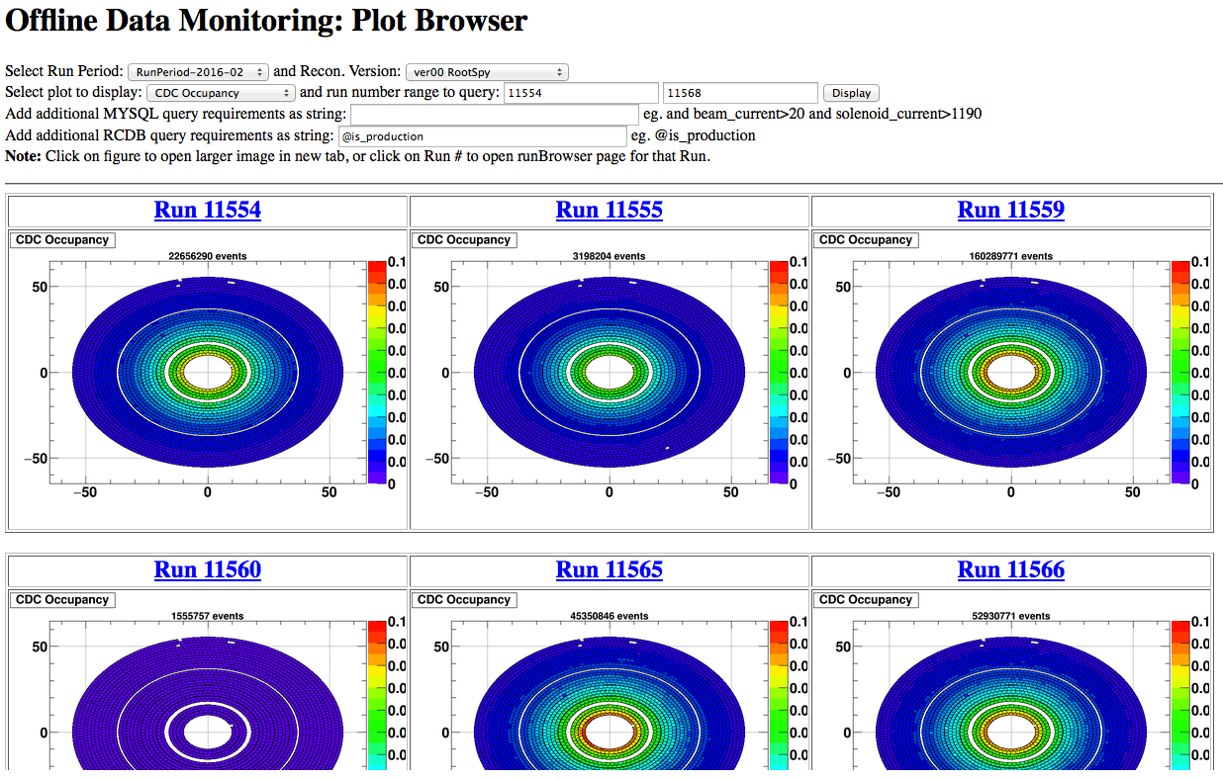
Offline Monitoring (SWIF)
Run 40 JANA plugins: Occupancies, calibrations, reconstruction
Incoming data (cron), + every ~2 weeks (as changes come in)
Notes:
Machine learning? MPI?

Slide 9
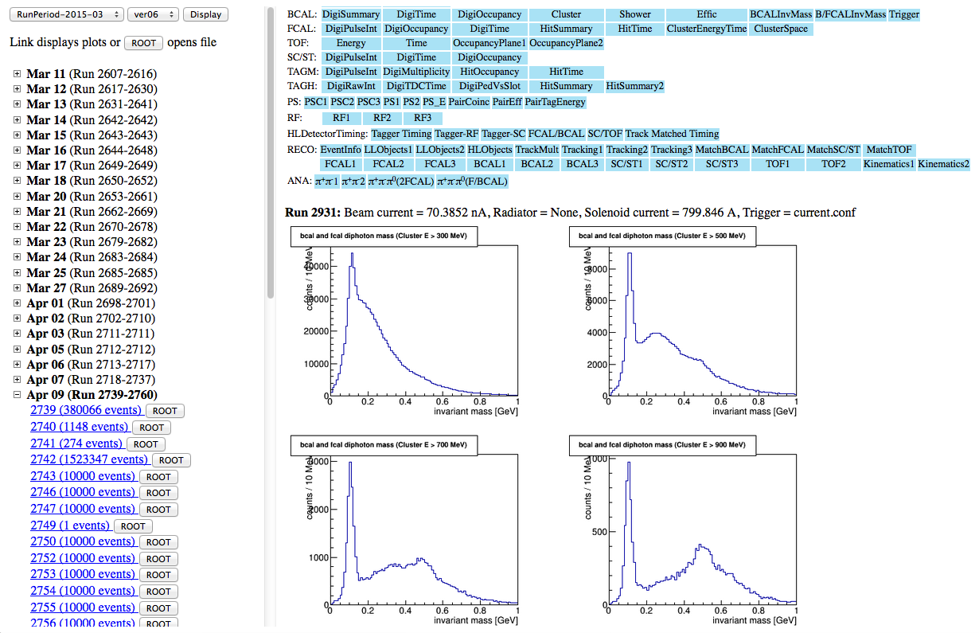
Offline Monitoring (SWIF)
Web browse plots, can browse (& download) ROOT files

Slide 10
Monitoring Rate (April)
Issues with multi-threaded scaling: 24 threads: 5x scaling 24 Hz
Fixed how locking was handled: 24 threads: 108 Hz, 23x scaling
24 threads: ~108 Hz
24 core node + hyperthreads

Slide 11
Monitoring Rate (April)
Issues with multi-threaded scaling: 24 threads: 5x scaling 24 Hz
Fixed how locking was handled: 24 threads: 108 Hz, 23x scaling
24 threads: ~108 Hz
April Monitoring: ~4.5Hz/thread
24 core node + hyperthreads

Slide 12
Monitoring Rate (April)
Issues with multi-threaded scaling: 24 threads: 5x scaling 24 Hz
Fixed how locking was handled: 24 threads: 108 Hz, 23x scaling
Current reconstruction: ~10Hz/thread
24 threads: ~108 Hz
April Monitoring: ~4.5Hz/thread
24 core node + hyperthreads

Slide 13
Production Overview (SWIF)
Raw Data Spring 2016
554 TB, ~20 Billion Events
First 5 Files
Of Each Run
REST: Reconstructed data
(tracks, showers, etc.)
Offline
Monitoring
REST
Production
REST Files +
Histograms
REST Data
37 TB

Slide 14
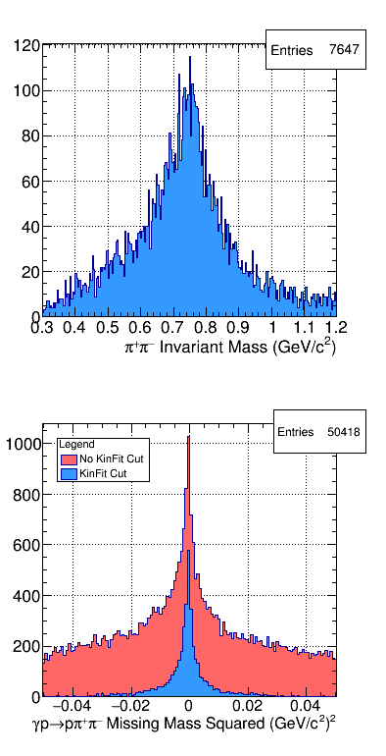
REST Production (SWIF)
Full reconstruction (tracks, showers, etc.)
Reconstruction ver01

Slide 15
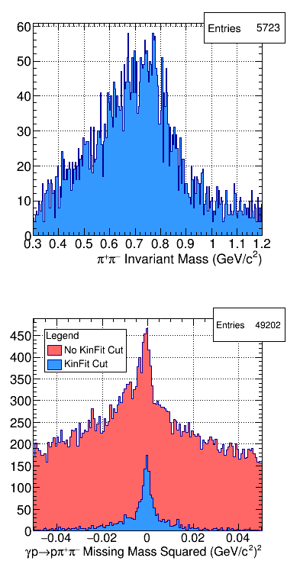
REST Production (SWIF)
Full reconstruction (tracks, showers, etc.)
Ver02 problem:
- Track timing overhauled
- Lingering issues
Didn’t notice before launch
- Not in existing monitoring
- Noticed after ~ 1 week
Reconstruction ver01
Reconstruction ver02

Slide 16
REST Production (SWIF)
Full reconstruction (tracks, showers, etc.)
Ver02 problem:
- Track timing overhauled
- Lingering issues
Didn’t notice before launch
- Not in existing monitoring
- Noticed after ~ 1 week
Remedy:
- New ρ, ω monitoring
- New reconstruction tests:
- Cron every 3 days
- 1–to–1 comparison
Reconstruction ver01
Reconstruction ver02

Slide 17
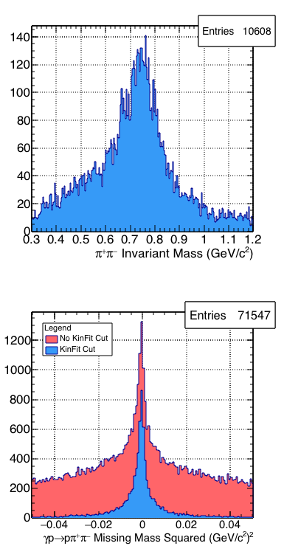
REST Production (SWIF)
Full reconstruction (tracks, showers, etc.)
Reconstruction ver01
Reconstruction ver02
Current
Reconstruction now better than ever!

Slide 18
GlueX Analysis Software

Slide 19
JANA Analysis Library (C++)
Library overview (30+ active users):
Provide: Best-practices, efficient, validated, user-friendly code
GlueX program: > 100 channels to study: Must be easy, scalable
Built on JANA: Multi-threaded, factory-based, EVIO or REST

Slide 20
JANA Analysis Library (C++)
Library overview (30+ active users):
Provide: Best-practices, efficient, validated, user-friendly code
GlueX program: > 100 channels to study: Must be easy, scalable
Built on JANA: Multi-threaded, factory-based, EVIO or REST
User plugin: 15 – 30 minutes:
Run perl script: Generates user plugin with example code
In plugin, user specifies their reaction, sets control settings
Optionally apply built-in/custom cuts, histogram

Slide 21
JANA Analysis Library (C++)
Library overview (30+ active users):
Provide: Best-practices, efficient, validated, user-friendly code
GlueX program: > 100 channels to study: Must be easy, scalable
Built on JANA: Multi-threaded, factory-based, EVIO or REST
User plugin: 15 – 30 minutes:
Run perl script: Generates user plugin with example code
In plugin, user specifies their reaction, sets control settings
Optionally apply built-in/custom cuts, histogram
Run with plugin: Automatically:
Find all combos of reconstructed particles match the reaction
Kinematic fit the reaction: Hypothesis test
Runs user-selected cuts, histograms
Save analysis data to ROOT trees for further analysis

Slide 22
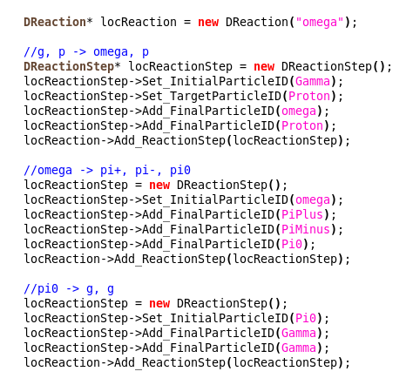
γp → ωp: Setup Reaction
DReaction: Collection of DReactionSteps
Example code is auto-generated: Uncomment, modify
DReactionSteps
γp → ωp
ω → π⁺π–π⁰
π⁰ → γγ
Notes:
Live: Code this up

Slide 23
Particle Combinations
γp → ωp
ω → π⁺π–π⁰
π⁰ → γγ
Want to isolate a channel:
GlueX detects: Beam-γ, final-state: pπ⁺π–γγ
Build combinations of detected particles that match our channel

Slide 24
Particle Combinations
γp → ωp
ω → π⁺π–π⁰
π⁰ → γγ
Want to isolate a channel:
GlueX detects: Beam-γ, final-state: pπ⁺π–γγ
Build combinations of detected particles that match our channel
For example:
Need: 2 q⁺, 1 q–, 2 q⁰
Measure: 2 q+, 1 q–, 4 q⁰
Beam: 3 in-time γ’s

Slide 25
Particle Combinations
γp → ωp
ω → π⁺π–π⁰
π⁰ → γγ
Want to isolate a channel:
GlueX detects: Beam-γ, final-state: pπ⁺π–γγ
Build combinations of detected particles that match our channel
Test each q⁺ as p (2x), π⁺ (1x)
Test each q– as π–: 1x
Test each neutral as γ: 6x
Beam: 3x
Total: 36
For example:
Need: 2 q⁺, 1 q–, 2 q⁰
Measure: 2 q+, 1 q–, 4 q⁰
Beam: 3 in-time γ’s

Slide 26
Particle Combinations
γp → ωp
ω → π⁺π–π⁰
π⁰ → γγ
Want to isolate a channel:
GlueX detects: Beam-γ, final-state: pπ⁺π–γγ
Build combinations of detected particles that match our channel
Cuts reduce #-combos: Particle ID, missing mass, kinematic fit, etc.
Test each q⁺ as p (2x), π⁺ (1x)
Test each q– as π–: 1x
Test each neutral as γ: 6x
Beam: 3x
Total: 36
For example:
Need: 2 q⁺, 1 q–, 2 q⁰
Measure: 2 q+, 1 q–, 4 q⁰
Beam: 3 in-time γ’s

Slide 27
Histogram, Cut Actions
Analysis actions: Particle ID, invariant mass histograms, etc.
Share common base class
Are executed in order on particle combos
If a combo fails a cut, it will stop executing actions on it

Slide 28
Histogram, Cut Actions
Analysis actions: Particle ID, invariant mass histograms, etc.
Share common base class
Are executed in order on particle combos
If a combo fails a cut, it will stop executing actions on it
Below: PID section performed before kinematic fit
Fit not performed until needed (when results are requested)
Can reject background before fitting

Slide 29
Run the Analyses
Tell JANA to run the analyses:
Code is pre-generated for you: Just uncomment

Slide 30
OR: Run, Save to ROOT
Or: Tell JANA to run the analyses, AND save to ROOT TTree:
DReaction:
DEventProcessor:
Code is auto-generated: Just uncomment

Slide 31
OR: Run, Save to ROOT
Or: Tell JANA to run the analyses, AND save to ROOT TTree:
TTree contents (PART format):
Event info (Run #, event #, etc.) & metadata (your channel)
Particles (beam, charged, neutral, MC thrown)
Surviving combos for your channel
DReaction:
DEventProcessor:
Code is auto-generated: Just uncomment

Slide 32
DSelector
ROOT TSelector class: Helps you work with TTrees
Can generate code (TSelector) to read TTree, analyze data
Knows nothing about GlueX data format

Slide 33
DSelector
ROOT TSelector class: Helps you work with TTrees
Can generate code (TSelector) to read TTree, analyze data
Knows nothing about GlueX data format
DSelector (GlueX):
Inherits from TSelector: Can use in same way
Provides C++ interface classes to TTree data (for particles, combos)

Slide 34
DSelector
ROOT TSelector class: Helps you work with TTrees
Can generate code (TSelector) to read TTree, analyze data
Knows nothing about GlueX data format
DSelector (GlueX):
Inherits from TSelector: Can use in same way
Provides C++ interface classes to TTree data (for particles, combos)
DSelector has knowledge of your analysis:
Generates starting, example code for analyzing your channel
Analysis actions: Similar to JANA
Cut PID, histogram masses, cut kinematic fit, etc.

Slide 35
DSelector Usage
Make a custom DSelector with:
Run with:

Slide 36
DSelector Usage
Make a custom DSelector with:
Run with:
PROOF-Lite: Run multi-threaded over TChain on a node
No change to DSelector code needed
Already setup for users
Run with:

Slide 37
Coordinating
Collaboration Efforts
Analysis Coordinators:
Paul Mattione (JLab), Justin Stevens (W&M)

Slide 38
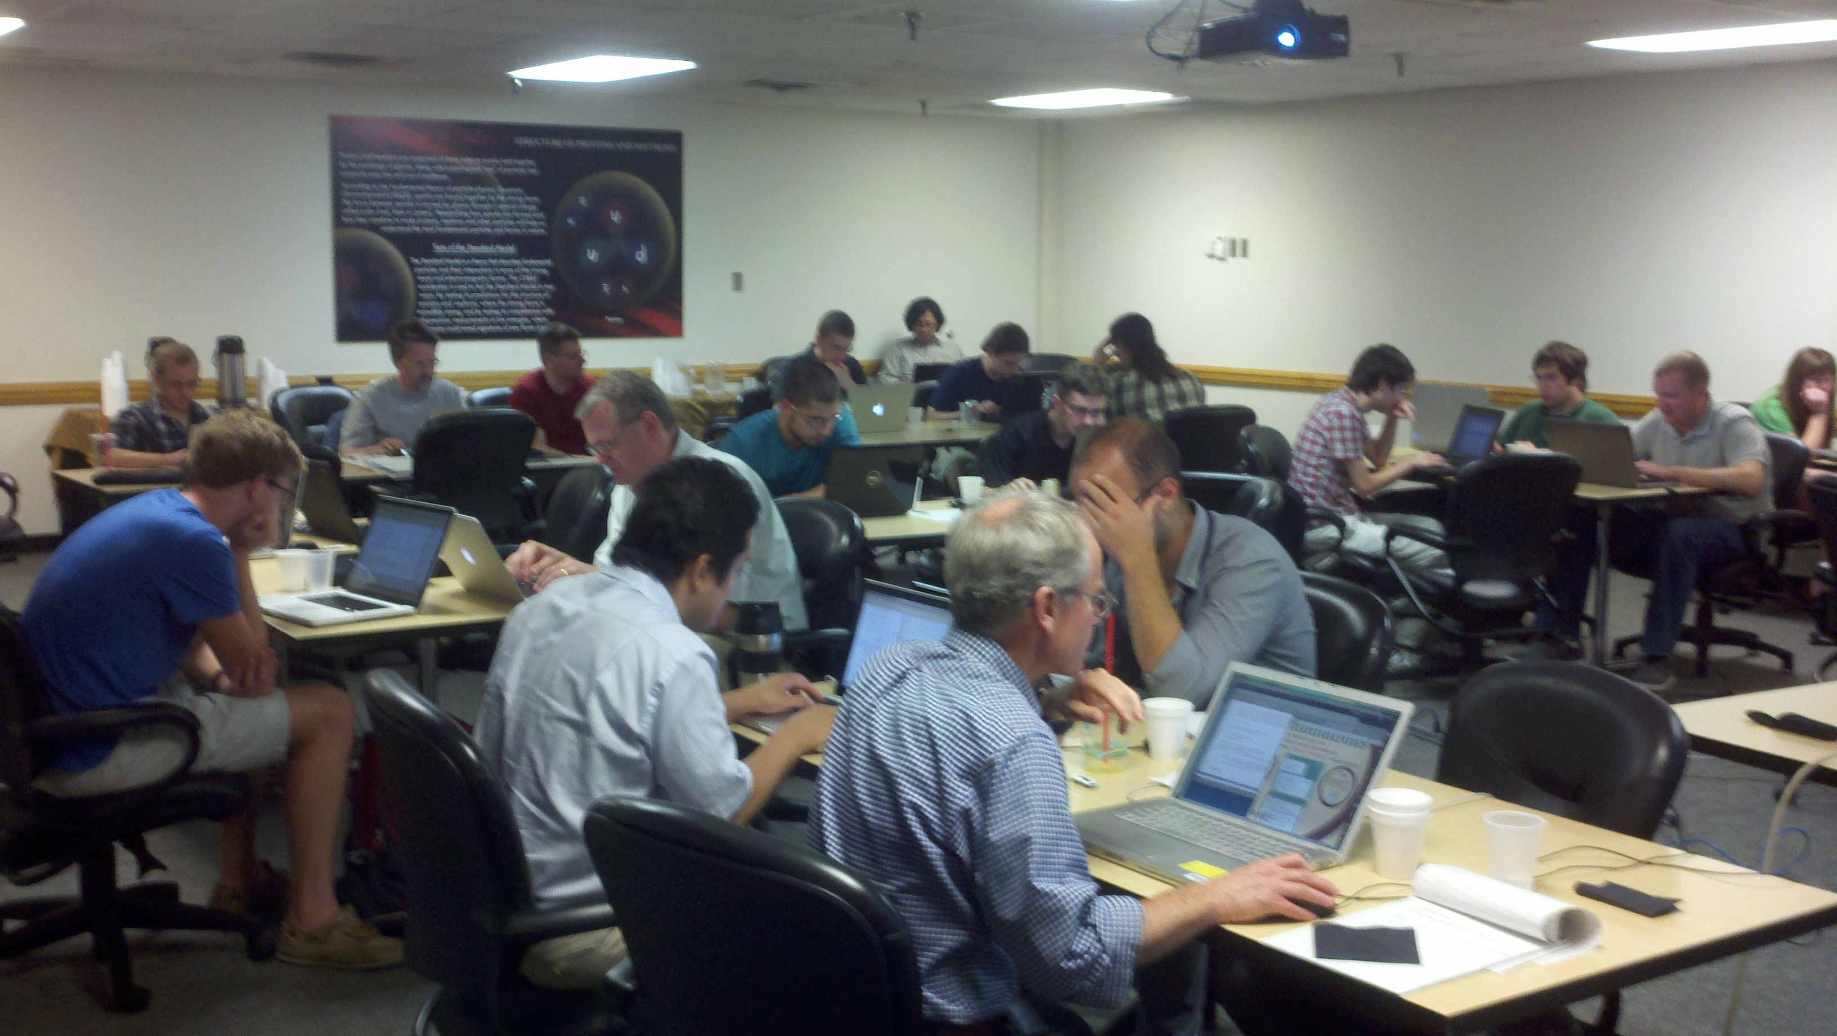
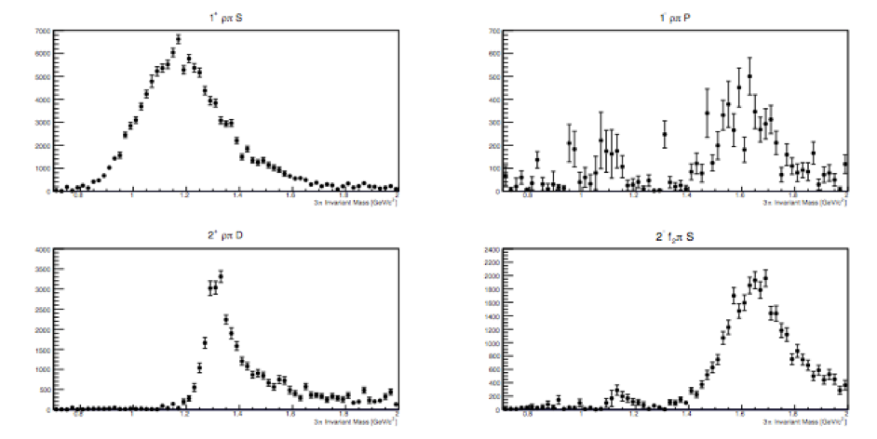
Physics & Analysis Workshops
2013: 35 registered participants, ~25 on-site
Talks & exercises: Extracting π₁(1600) hybrid in γp → π⁺π⁺π– (n)
2016: 57 registered participants, ~45 on-site
Talks & exercises: Measuring γp → ωp polarization observables
a₁(1260)
π₁(1600)
a₂(1320)
π₂(1670)
Notes:
Machine learning? MPI?

Slide 39
Physics & Analysis Workshops
2013: 35 registered participants, ~25 on-site
Talks & exercises: Extracting π₁(1600) hybrid in γp → π⁺π⁺π– (n)
2016: 57 registered participants, ~45 on-site
Talks & exercises: Measuring γp → ωp polarization observables
Some software topics covered:
Simulation, analysis library, ROOT analysis, batch farm, etc.
All sessions recorded (audio + screen): New user startup
a₁(1260)
π₁(1600)
a₂(1320)
π₂(1670)
Notes:
Machine learning? MPI?

Slide 40
Production Overview (SWIF)
Raw Data Spring 2016
554 TB, ~20 Billion Events
First 5 Files
Of Each Run
REST: Reconstructed data
(tracks, showers, etc.)
Offline
Monitoring
REST
Production
REST Files +
Histograms
REST Data
37 TB
Simulated
REST Data
820 GB
Analysis
Trains
Analysis
Trains
ROOT Trees (Data)
10 TB
ROOT Trees (Simulation)
14 GB

Slide 41
Analysis Trains (SWIF)
Analysis train: Run user JANA analysis plugins on REST data
Produce ROOT trees for further analysis
Run every ~month on reconstructed data
Large collaboration participation: ~15 Users, ~50 Plugins
Notes:
Machine learning? MPI?

Slide 42
Analysis Trains (SWIF)
Analysis train: Run user JANA analysis plugins on REST data
Produce ROOT trees for further analysis
Run every ~month on reconstructed data
Large collaboration participation: ~15 Users, ~50 Plugins
Wide variety of channels:
Single meson: π⁰, π⁺ , η, ρ, ω , η’, φ
Multi-meson: 2π, 3π, 4π, 2η, ηη’, πω, φη, KK, KKππ
Strangeness studies: K*’s, Λ, Σ’s, Σ*’s, Λ*’s, Ξ–
Charm physics: J/ψ, D⁰Λ_{c}
Other: Antiproton, B-boson, multi-γ
Notes:
Machine learning? MPI?

Slide 43
Analysis Trains (SWIF)
Analysis train: Run user JANA analysis plugins on REST data
Produce ROOT trees for further analysis
Run every ~month on reconstructed data
Large collaboration participation: ~15 Users, ~50 Plugins
Wide variety of channels:
Single meson: π⁰, π⁺ , η, ρ, ω , η’, φ
Multi-meson: 2π, 3π, 4π, 2η, ηη’, πω, φη, KK, KKππ
Strangeness studies: K*’s, Λ, Σ’s, Σ*’s, Λ*’s, Ξ–
Charm physics: J/ψ, D⁰Λ_{c}
Other: Antiproton, B-boson, multi-γ
ROOT trees saved to cache/tape: Available for everyone’s use
Notes:
Machine learning? MPI?

Slide 44
Early GlueX Physics: DNP
DNP Physics:
Asymmetries: π⁰, η, ρ, ω , η’
Peaks: a₀(980), b₁(1235), J/ψ,…
4 months after end of run
Analysis software: Success!
Many users, channels studied
_
J/ψ
J/ψ
Blue: Preparing for publication
Notes:
Machine learning? MPI?

Slide 45
Documentation
Extensive documentation:
Monitoring: https://halldweb.jlab.org/wiki/index.php/Data_Monitoring_Procedures
Analysis: https://halldweb.jlab.org/wiki/index.php/GlueX_Analysis_Software
How-To’s: https://halldweb.jlab.org/wiki/index.php/Offline_HOWTO_List
Etc. etc.
Tracking collaboration analysis activities:
https://halldweb.jlab.org/wiki-private/index.php/GlueX_Physics_Analyses
Workshops:
2016: https://halldweb.jlab.org/wiki/index.php/GlueX_Physics_Workshop_2016
2013: https://halldweb.jlab.org/wiki/index.php/GlueX_Analysis_Workshop_2013
YouTube channel (2016 Workshop): “Jefferson Lab Hall-D”
https://www.youtube.com/channel/UCjI87hRy7U60CdkGpMSk2Fw

Slide 46
Summary

Slide 47
Summary
Offline data processing
Many calibrations automated (SWIF, still improving)
Monitoring, reconstruction, & analysis: SWIF
Software tests: Simulation, experiment, nightly build, etc.

Slide 48
Summary
Offline data processing
Many calibrations automated (SWIF, still improving)
Monitoring, reconstruction, & analysis: SWIF
Software tests: Simulation, experiment, nightly build, etc.
Analysis software
Easy to use, best-practices analysis framework
Built-in actions for common tasks: No re-inventing the wheel
Mature: Library since 2012, 30+ active users

Slide 49
Summary
Offline data processing
Many calibrations automated (SWIF, still improving)
Monitoring, reconstruction, & analysis: SWIF
Software tests: Simulation, experiment, nightly build, etc.
Analysis software
Easy to use, best-practices analysis framework
Built-in actions for common tasks: No re-inventing the wheel
Mature: Library since 2012, 30+ active users
Collaboration
2013, 2016 Workshops: Software, physics, & analysis
Many early results shown at DNP
First publication under collaboration review

Slide 50
Reference Slides

Slide 51
Data Flow
DAQ
Analysis
Reconstruction
+ Monitoring
Monitoring
L3 Trigger
Disk
Calibration
Prompt
Calibration
RAID
Disk
Tape
CCDB
CCDB
Counting House
Computing Center

Slide 52
REST Production (ver01)
Planned for May 31th, started June 8th
Included number of plugins for performance studies
(detector efficiency, track reconstruction)
Split the Data into 4 priority periods
III
I
II
IV
Slide courtesy
Alex Austregesilo
Intermittent with periods waiting for detector calibration
Successfully completed July 10th, 21d net processing time
Failure rate after resubmissions: ~0.1%

Slide 53
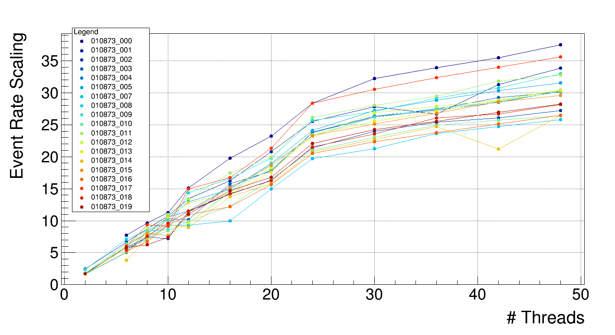
Multi-threaded Scaling: April
Compartmentalized histogram locks
At 24 threads, ~23x scaling: 450% improvement, within 5% of max
24 threads: ~23x Scaling
24 core node + hyperthreads

Slide 54
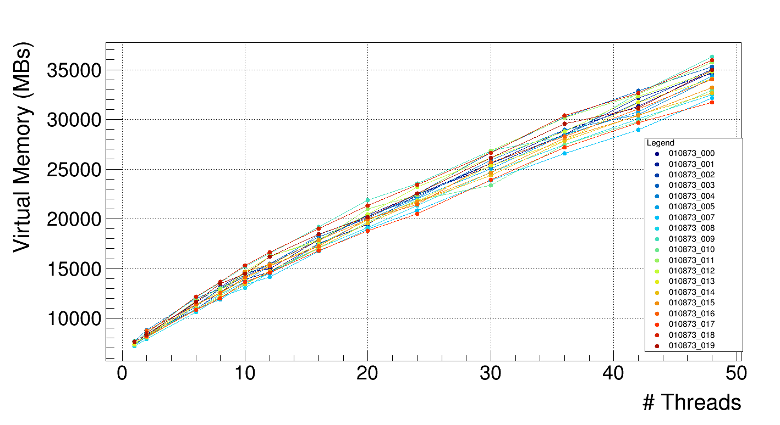
Virtual Memory
Virtual memory: Max allowed is node-RAM / 0.7
Scaling: ~612 MB / thread

Slide 55
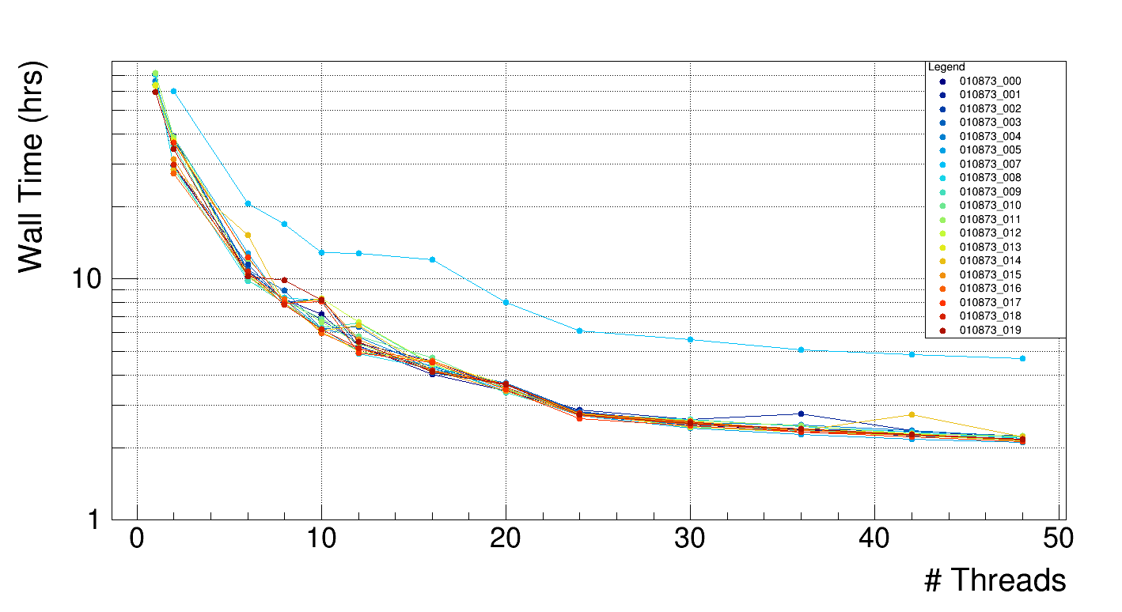
Wall Time
At 24 threads, takes < 3 hrs
At 1 thread, many jobs timeout!!

Slide 56
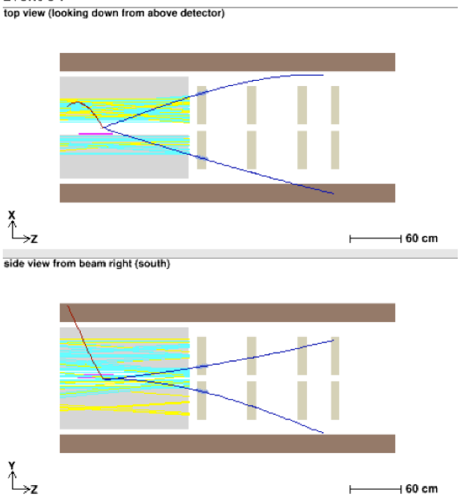
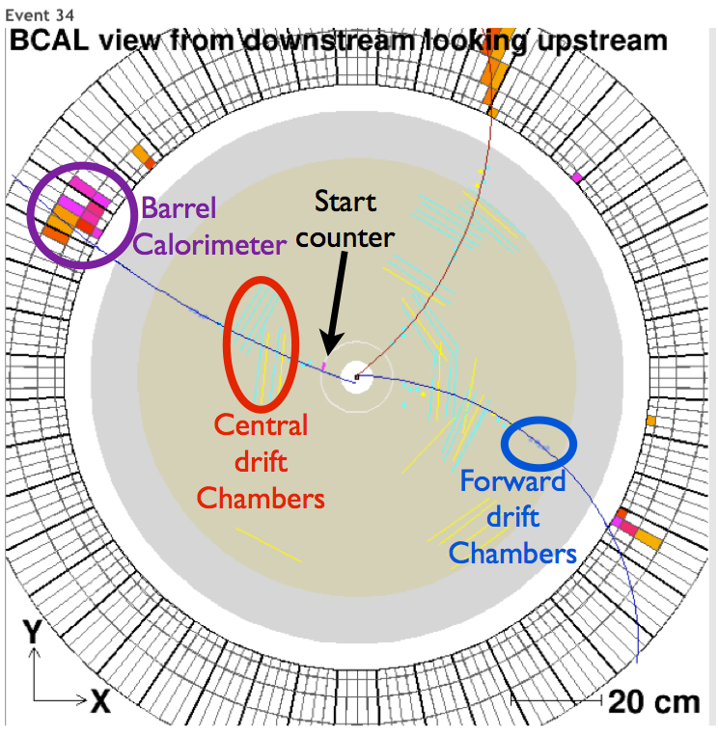
Example Reconstructed Event
Tracks, calorimeter showers reconstructed, correlated
Central
drift
chambers
Forward
drift
chambers
Barrel calorimeter

Slide 57
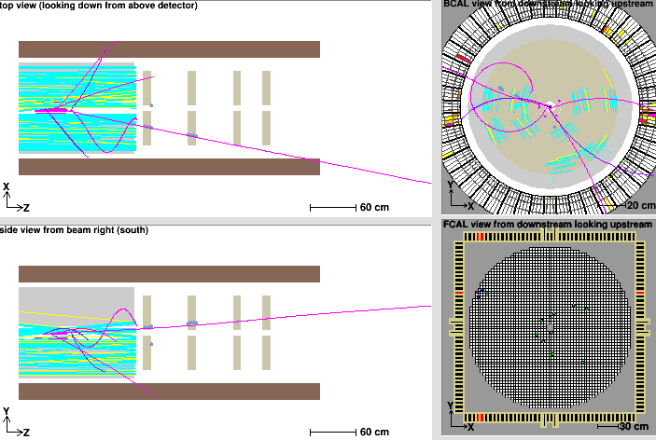
Reconstructed Events
Detector correlation: Tracks, calorimeter showers reconstructed
From online reconstruction, first few days of beam
BCAL
BCAL
CDC
CDC
FDC
BCAL
TOF
CDC
FDC
FCAL

Slide 58
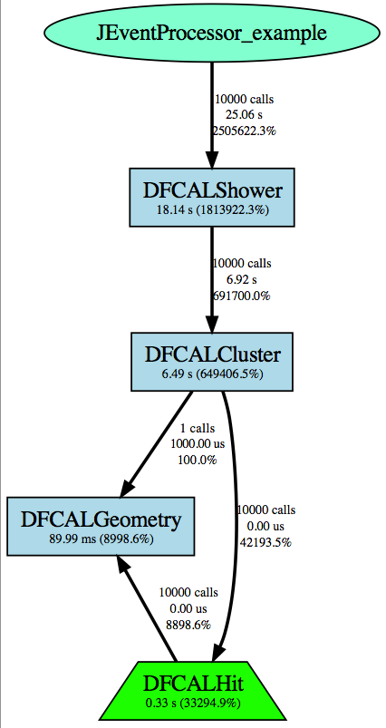
JANA
JANA: Multithreaded, factory-based, plugin-driven
Factory: Dedicated code for creating objects of that type
User writes plugin to drive reconstruction/analysis
Perl script generates template code
E.g. Plugin for FCAL reconstruction (called every event)
- Factory calls on right (DFCALHit from file)

Slide 60
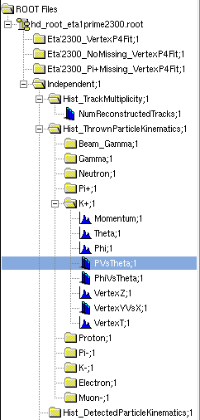
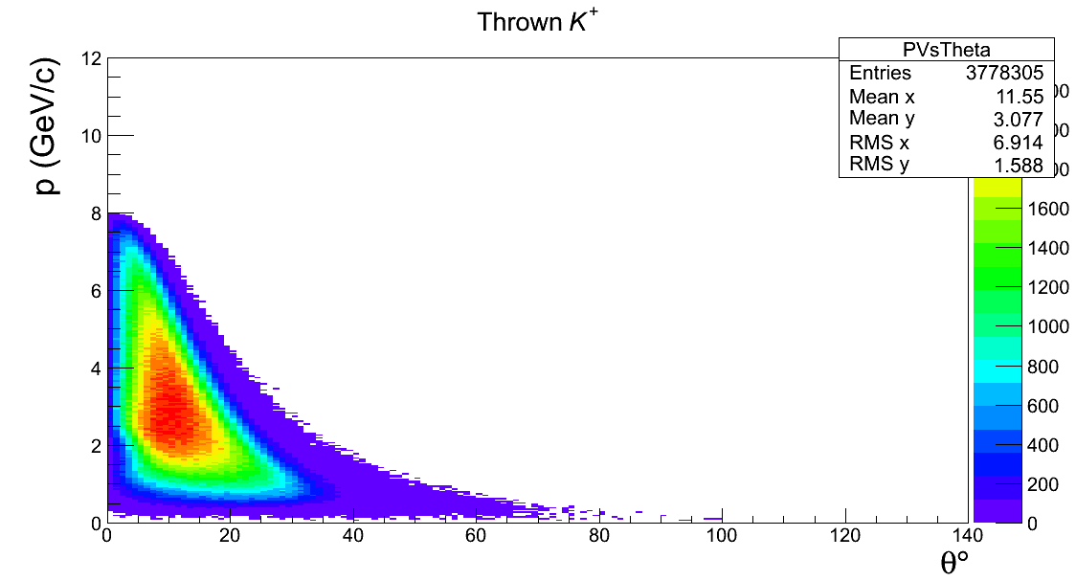
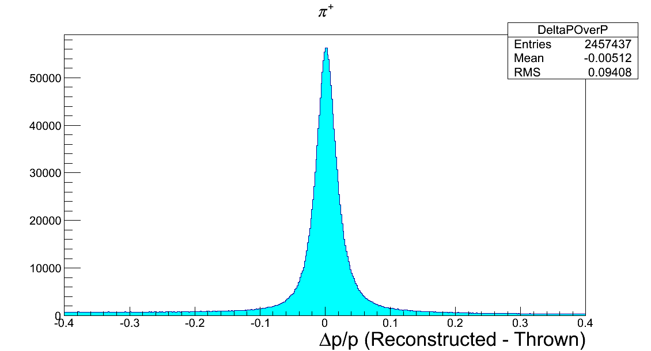
Example Histogram Actions

Slide 61
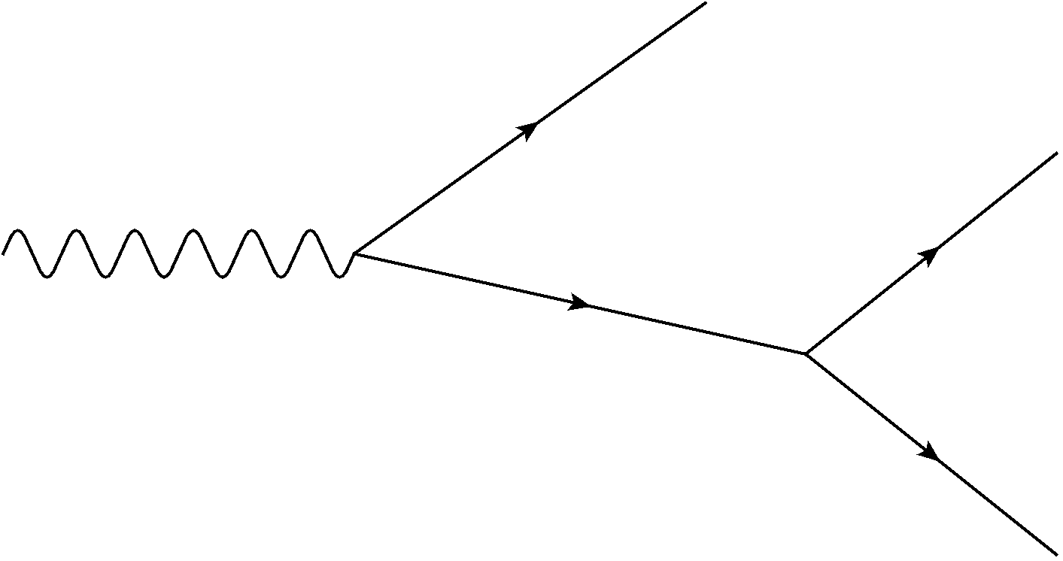
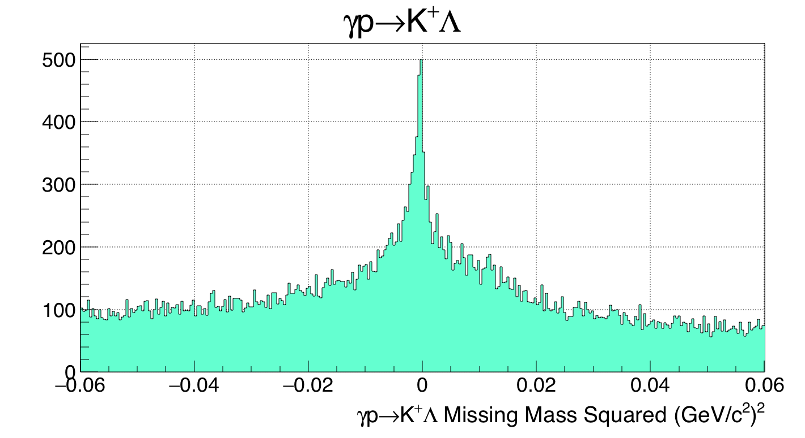
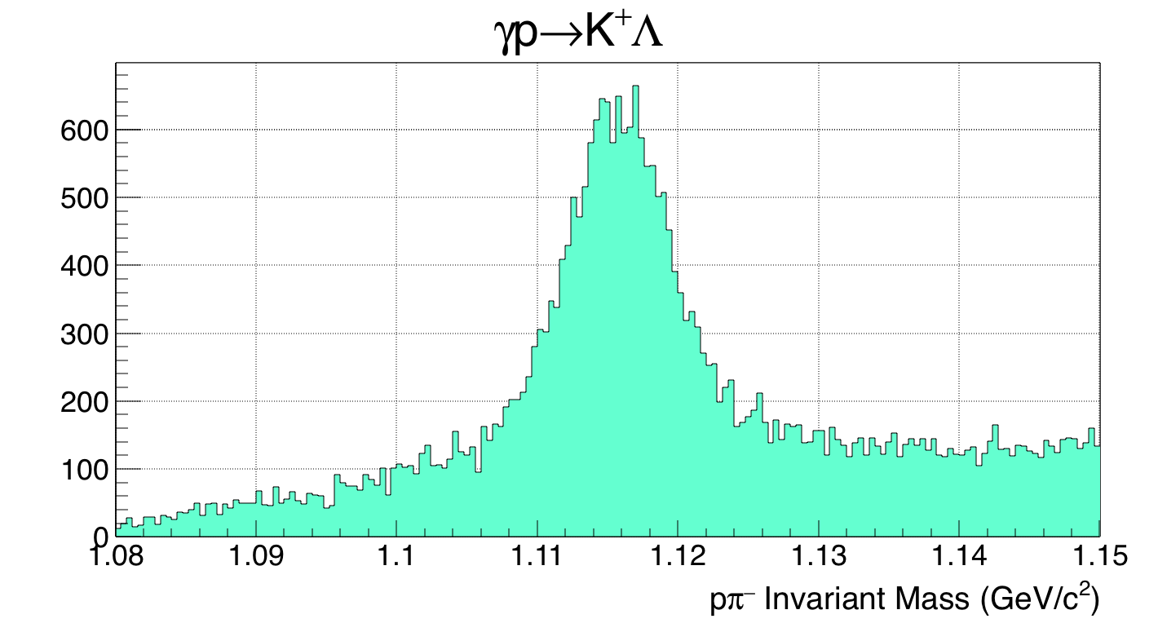
Kinematic Fitting (C++)
Want to do strange-quark (Λ) physics
Backgrounds, e.g. γp → pπ⁺π–
Hypothesis test: Fit the data
Was this event the reaction I want?
Constrain the data to match your reaction (minimize χ²)
Powerful: Apply many constraints simultaneously
No missing
particles

Slide 62
Λ Reconstruction
Constraints:
E & p conservation
Production vertex, decay vertex
Over-constrained: 6 DF
Confidence level: Cut near zero
Clean Λ peak (mass not constrained)
Background
Signal
Very low background: Clean Λ selection!!
Notes:
Confidence level, lambda mass

Slide 63
Λ Reconstruction
Constraints:
E & p conservation
Production vertex, decay vertex
Over-constrained: 6 DF
Confidence level: Cut near zero
Clean Λ peak (mass not constrained)
Background
Signal
Very low background: Clean Λ selection!!
Notes:
Confidence level, lambda mass

Slide 64
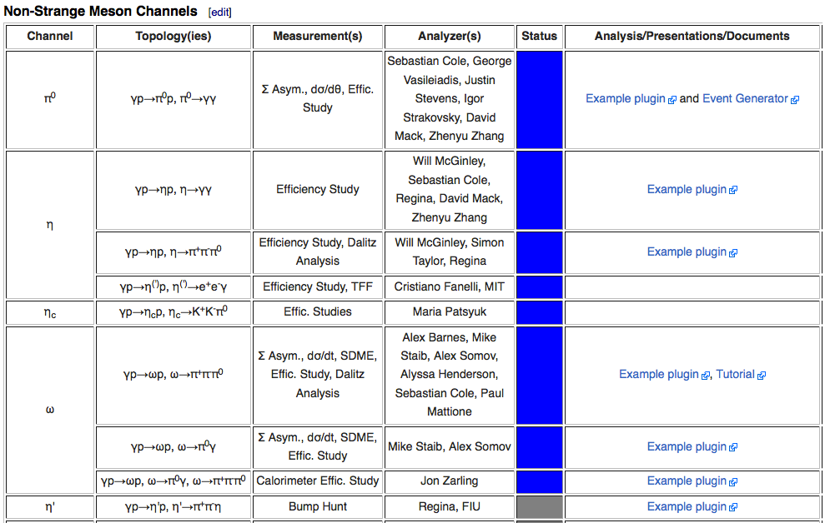
Analysis Tracking
Coordinate collaboration efforts for understanding data
Notes:
Machine learning? MPI?

Slide 65
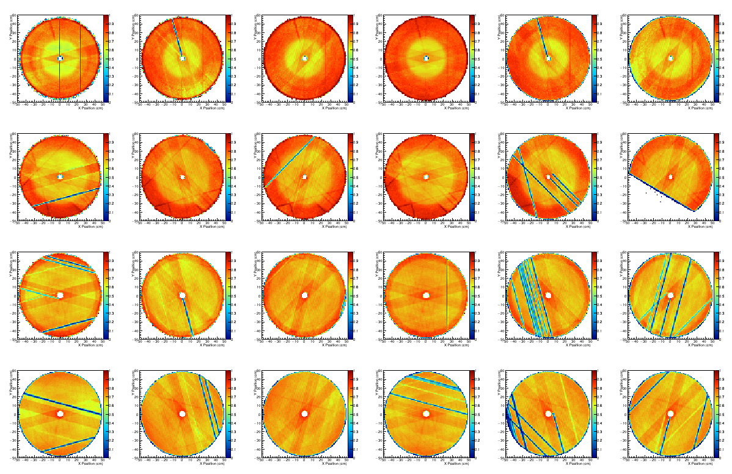
FDC Hit Efficiencies (Alex A.)
Pseudo hit = wire position + clusters in both cathodes (position along wire)
Requires matching position perpendicular to wire and timing
Efficiency ≈70%

Slide 66
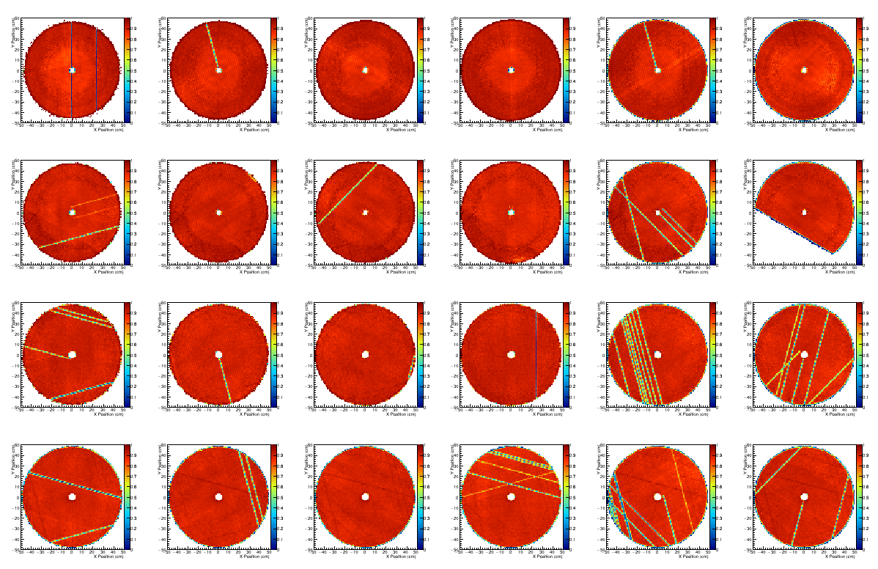
FDC Hit Efficiencies (Alex A.)
Pseudo hit = wire position + clusters in both cathodes (position along wire)
Requires matching position perpendicular to wire and timing
Efficiency ≈90%
+10% reconstructed tracks
Notes:
HV Sector: 1% of active area

Slide 67
Detector/Reconstruction Studies
Beam:
Beam Polarization (Talks by Justin & Mike D.)
Beam Energy (Talk by Alex D.)
Beam Flux (Talk by Justin)
Tracking
CDC Hit Efficiency (Mike S.)
FDC Hit Efficiency (Alex A.)
Track Reconstruction (Talk by Simon)
Track Resolution & Efficiency (Paul M.)
TOF/SC:
TOF Efficiency (Beni)
SC Efficiency (Mahmoud)

Slide 68
Detector/Reconstruction Studies
BCAL:
Neutral Energy & Efficiency
Hadronic Energy & Efficiency (Elton)
Covariance Matrix (Mark D., testing soon)
FCAL:
Neutral Energy & Efficiency (Jon Z.)
Hadronic Energy & Efficiency
Covariance Matrix (Mark D., testing soon)
Channel reconstruction, triggering, & acceptance:
Triggering (Talk by Alex S.)
Magnetic field comparison
ρ (Alex A.), 4π (Alex A.), ω (Mike S.), φ (Alex B., see his talk)

Slide 69
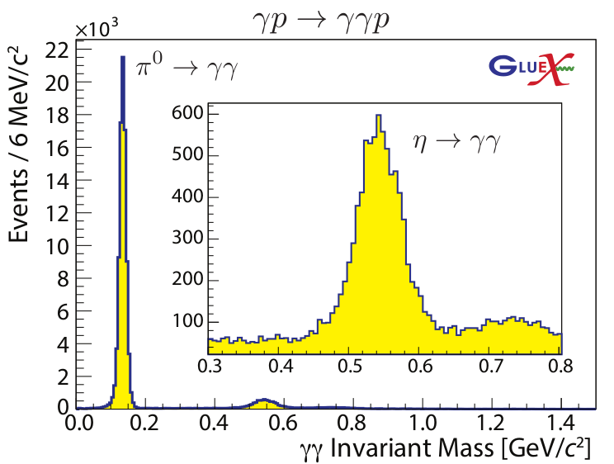
Reconstructed Meson Peaks

Slide 70
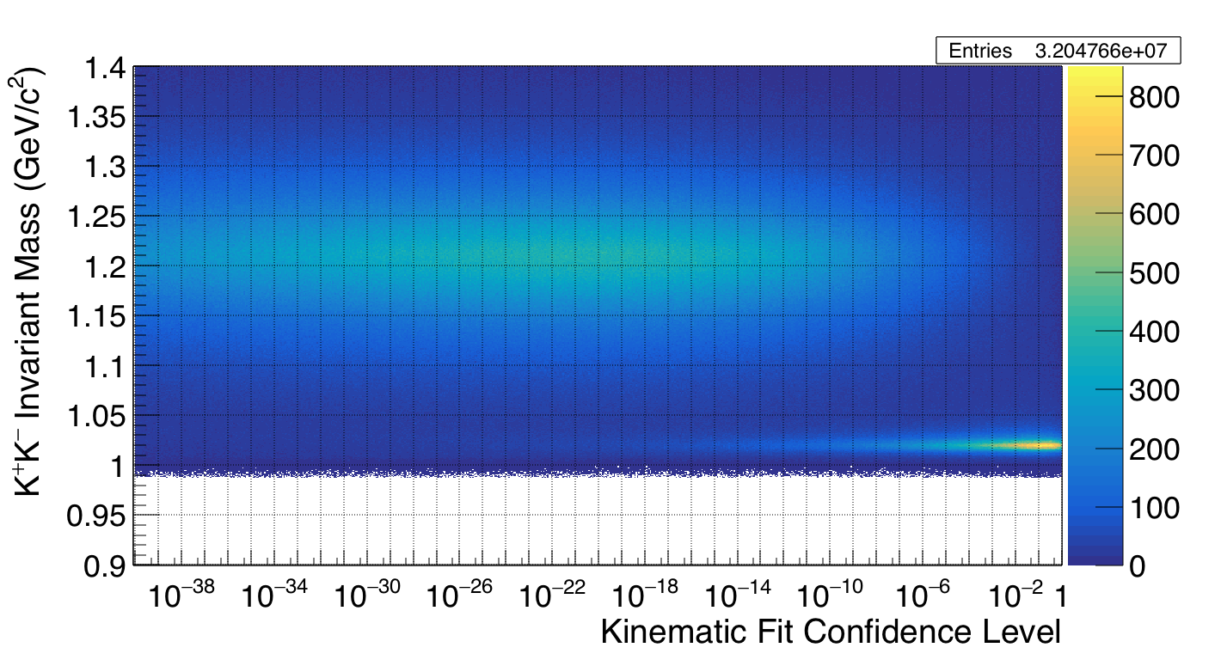
γp → pK⁺K–
Use KinFit cut to ~remove ρ
ρ
ρ
φ
φ

