Slide 1
Hall-D Online Systems Status
(with special L3 memoriam)
David Lawrence JLab
May 16, 2017

Slide 2
Raw Data Flow
1
Cron jobs
3
Cron jobs are run from hdsys account (not hdops). These are used so that we don’t rely on CODA ending cleanly.
gluonraid3
2
/data1
Tape Library
/gluex/data/rawdata/prev ->
/data2
/gluex/data/rawdata/curr ->
/data3
gluonraid2
/gluex/data/rawdata/next ->
/data4
first 3 files of each run copied
(links updated by CODA every run)
264TB (66TB/partition)
4
Each partition has same directory structure
/…/active
/…/volatile
/…/staging
Data written to “active”
Data moved to “volatile” once partition is inactive
Data hard linked in “staging” for copy to tape
5
Disk mapping + auto-deletion
Map files to temporary sqlite DB when data moved to volatile (via cron)
Auto-delete files from volatile to ensure 20% (=16.4TB) is free
Data stays on on RAID 3-5 days

Slide 3
Spring 2017 Data Volume
Total data: ~900TB
Instantaneous rate during production:
500MB/s-900MB/s
LT04 tapes: 98 (11TGB)
LT05 tapes: 0
LT06 tapes: 186 (800TB)
Compression:
LT04: 69% of original
LT06: 58% of original

Slide 5
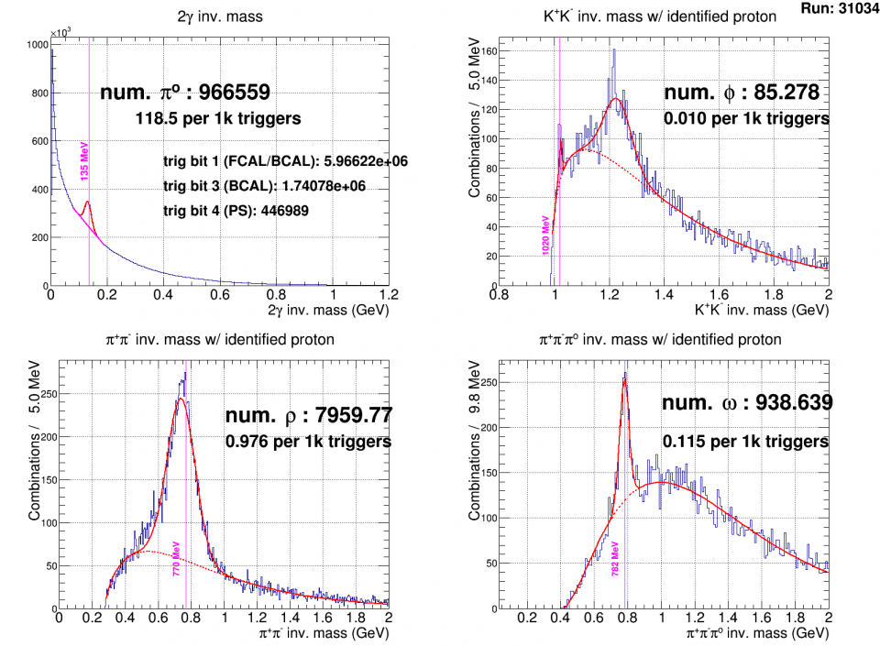
Online Monitoring
Full Reconstruction:
~2kHz
Occupancy only:
~16kHz
These plots were taken at ~1.5hr into run
Monitoring Farm:
8-2 = 6 Broadwell
36core +36HT
12-1 = 11 Ivy Bridge
16core+16HT

Slide 7
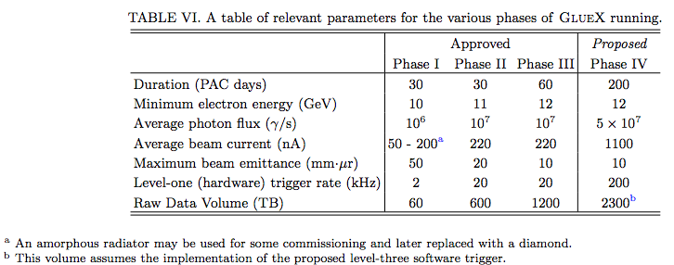
Requirements
From PR12-13-003 (GlueX strangeness proposal)
… we propose a gradual increase in the photon flux towards the GlueX design of 10⁸ γ/s in the peak of the coherent bremsstrahlung spectrum (8.4 GeV < Eγ < 9.0 GeV). Yield estimates, assuming an average flux of 5 × 10⁷ γ/s, are presented.

Slide 8
L1 Trigger Threshold
BEFORE (Spring 2016)
AFTER (Spring 2017)
10FCAL + 2BCAL > 1800
10FCAL + 0.4BCAL > 1800
fADC counts
fADC counts
fADC counts
fADC counts
5x more energy from BCAL required

Slide 9
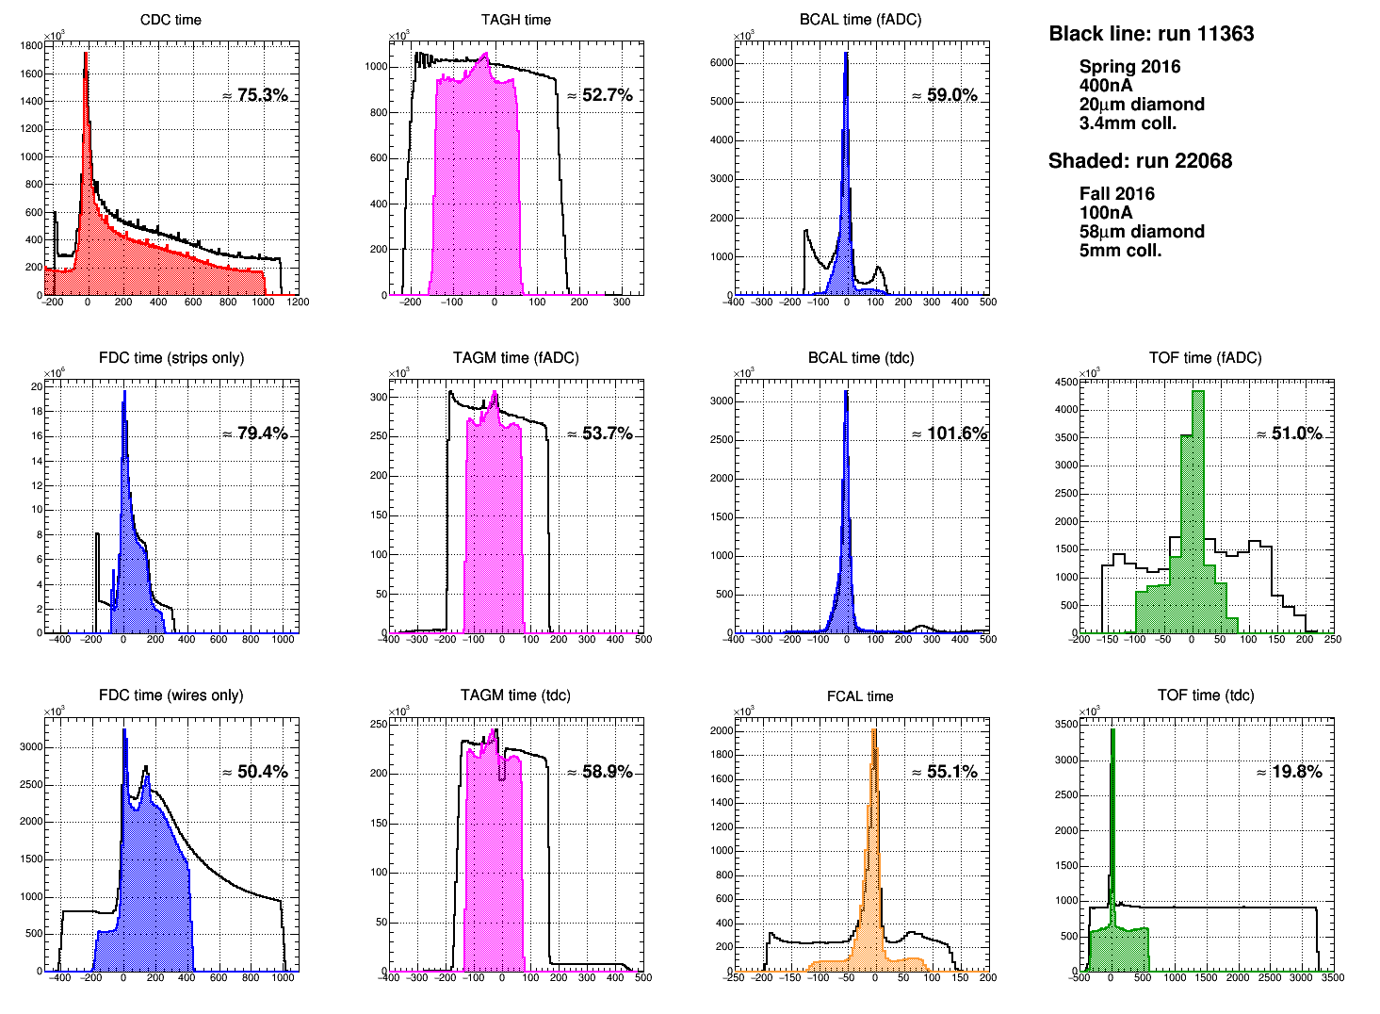

Slide 10
Important Numbers
All numbers for 5x10⁷ γ/s
 | Proposal | July 2016 estimate | May 2017 estimate
L1 trigger rate | 100kHz | 150kHz | 90kHz
Average Event Size | 15kB/event | 52kB/event | 17kB/event
Data rate (from EB) | 1.5GB/s | 9GB/s | <2GB/s
Date rate to tape (uncompressed) | 0.15GB/s | 2.25GB/s | <2GB/s
Data volume on tape (Yearly) | 0.42PB/y | 6.75PB/y | 4.8PB/y
Data volume on tape (Total) | 2.3PB | 37PB | 26PB
Num. crates exceeding 1Gbit | - | >35 | <=3**
Numbers previously supplied to Computer Center based on assumption that rate to tape was same for low intensity and high intensity due to L3
Nov 11, 2016 spreadsheet indicated ~3.6PB/yr for FY17 and FY18
Yearly data volume assumes 5.5 calendar years to run full 200 PAC days
** 3 crates if ST is NOT used in L1 trigger. No crates above limit if it is.

Slide 11
Summary
(from High Intensity Review)
Front end hardware limits maximum event rate to 90kHz instead of 200kHz
L1 trigger optimization allows us to meet 5 x 10⁷ γ/s requirement with 90kHz event rate
Four crates will have network upgraded to 10Gbit to give additional margin
Will write to RAID at <2GB/s (closer to 1.5GB/s)
will need another RAID disk
Required tape volume will be ≤5PB/yr
Online L3 no longer required for high rate running

Slide 13
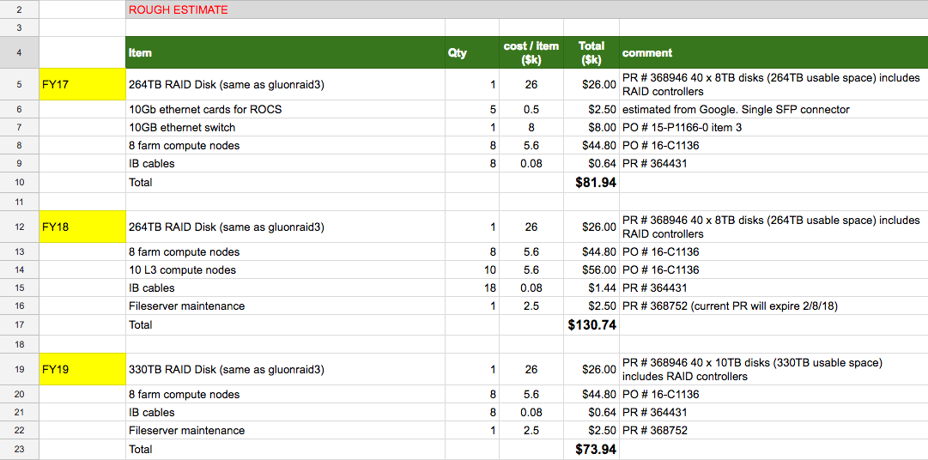
Estimated Online Equipment Budget
$74.74

Slide 14
Future
Planned Hardware upgrades:
Add RAID Capacity
10Gbit cards in selected crates
Additional farm nodes
Online Monitoring Strip Charts
Integrate calibration (where possible) into online monitoring

Slide 15
My Hypothesis
Gen-Xers
Millennials
Boomers

Slide 16
Backup Slides

Slide 17
System Rate Capabilities
Detectors
Not currently known.
Initial look showed little difference in reconstructed particles per trigger between 1.5x10⁷γ/s and 2.5x10⁷γ/s
Front end electronics
CAEN1290 TDC: <90kHz
All other modules: >100kHz w/ 93% livetime
Network
1Gbit links for most ROCs. Plan to upgrade Tagger crates to 10Gbit
~3GB/s aggregate to two EBs demonstrated with current hardware
Event Building
~3GB/s aggregate for two EBs
Disk
~1GB/s for single partition
CODA requires 2 RAID servers to maintain rate (second planned for purchase FY18)
Tape
2GB/s over two 10Gbit fibers demonstrated during Spring 2016 run
2 additional fibers available

Slide 18
Estimating Storage Volume
Snippet from spreadsheet maintained and updated by GlueX once or twice a year. fy17 and fy18 numbers were presented to CC Nov. 2016
~4.8 PB/yr for 5.5 years

Slide 19
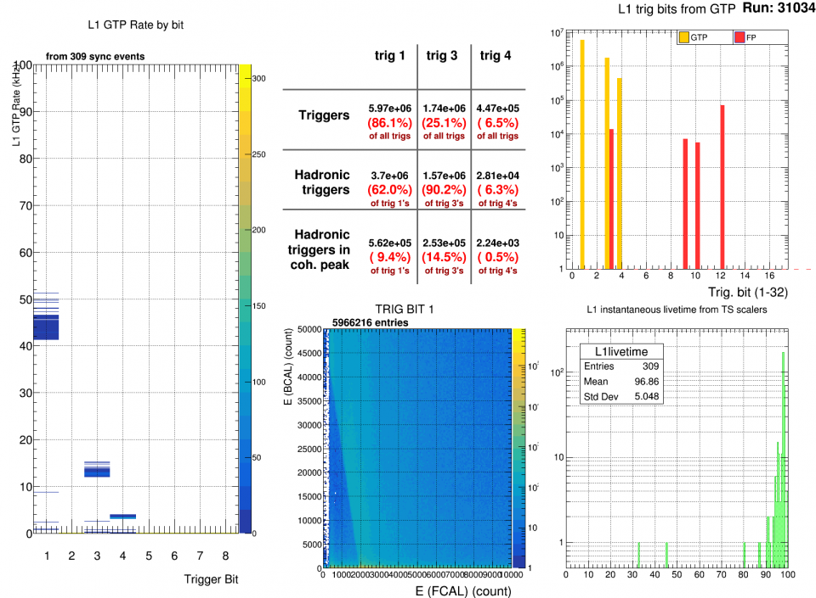
Online Monitoring

Slide 20
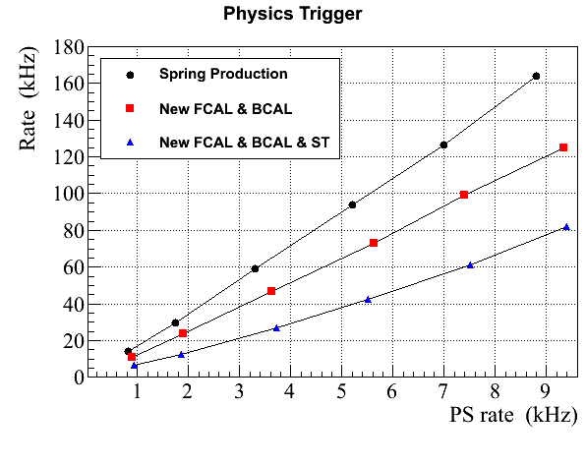
Trigger Rates
2016
This run, Spring 2017
2016
Commissioning
FCAL & BCAL
1.4
2017
5 x 10⁷ γ/s
2017
Proposed for high-lumi
1.5
2017
50 nA
100 nA
200 nA
300 nA
400 nA
500 nA
FCAL & BCAL is a simple trigger, but not optimal for high luminosity
FCAL & BCAL & ST seems to be a good trigger candidate for production at high lumi
( it was originally proposed)
- we need to study impact of coincidental hits in the ST (is estimated to be less than 10 % now)
and adjust trigger parameters

Slide 21
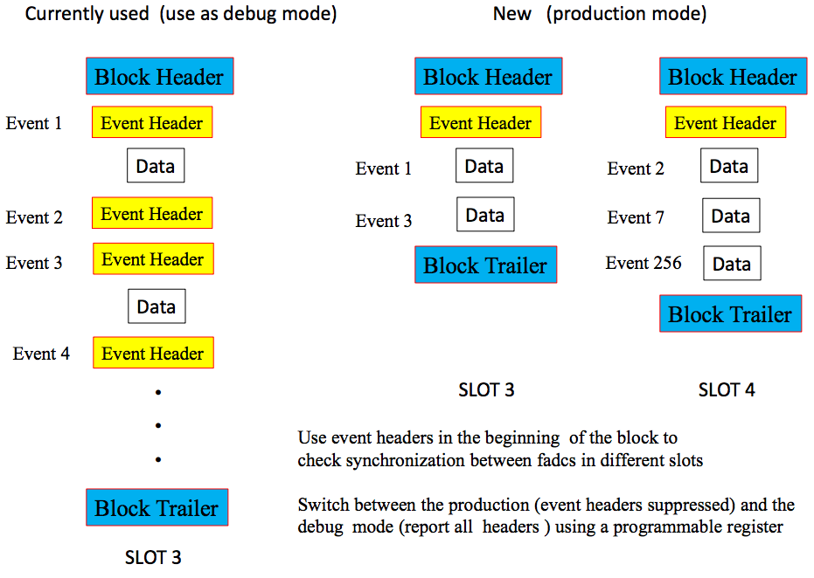
fADC Header Suppression
From GlueX-doc-2776-v3
Reduction of file size by ~20%

Slide 22
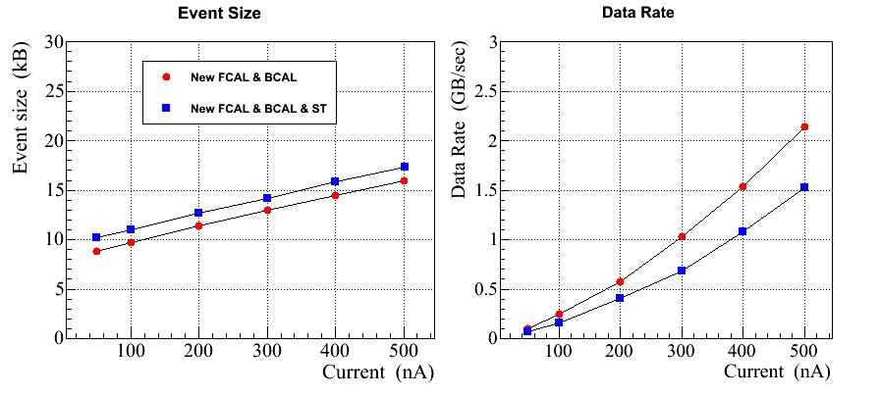
Event Size and Data Rate
58μm diamond 5mm coll.
58μm diamond 5mm coll.
5 x 10⁷ γ/s
5 x 10⁷ γ/s
Average event size (no coincidental hits ):
FCAL & BCAL (+ 7.5 % PS): 8 kB
FCAL & BCAL & ST (+ 12 % PS): 9.2 kB
+ 0.015kB/nA
+ 0.015kB/nA
Slightly larger event size for the FCAL & BCAL & ST trigger
(the data rate is smaller for this trigger type as the L1 rate is smaller)
Header suppression mode

Slide 23
Backup slide describing Important Numbers table
Proposal:
100kHz based on proposal number of 200kHz corresponding to 10⁸ running. For 5x10⁷ assume half of that
15kB/event from proposal text section V.A
1.5GB/s data rate from multiplying above 2 numbers
2.3PB from table VI
2016 estimate
150kHz based on 30kHz corresponding to 1x10⁷ shown on slide 3 of July 2016 presentation. Just multiplied by 5 to get 5x10⁷
52kB/event comes from slide 4: 14.25kB + 0.05*750nA. The 750nA comes from looking at plot on slide 5
9GB/s comes directly from plot on top of slide 5. Note that this is not consistent with 150kHz*52kB/event = 7.8GB/s mainly because the 150kHz is low and should be closer to 175kHz
37.1PB comes from multiplying 9GB/s by 200 PAC days and dividing by 4. The factor of 4 comes from the estimated fraction of “good” events that L3 would keep.
2017 estimate
90kHz based on Alex S. statements regarding trigger studies
17kB/event rounded up from 16.8kB/event based on run 22103 taken during Alex rate study with prescaling and FCAL10 off.
<2GB/s from Alex S. plots, but confirmed by David L. estimates from separate analysis. Alex estimates something close to 1.5GB/s and David gets something closer to 2GB. The product of two numbers above gives 1.44GB/s
25PB comes from multiplying the 90kHz rate and 16.8kB event size by 200 PAC days. Without L3, this comes out about 10 times bigger than the proposal number which assumed similar L1 rate and event sizes.

Slide 24
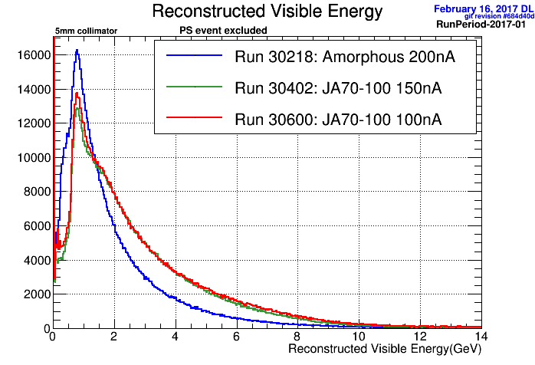
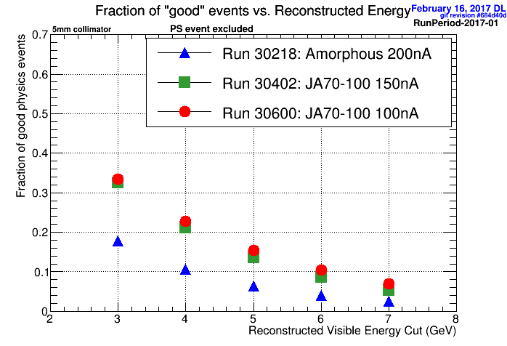
Reconstructable Events
Using fully reconstructed events, add up all visible energy from all DChargedTrack (best tracking FOM) and DNeutralShower objects
events with >1 PS hit are excluded

Slide 25
Response to recommendations from June 2016 review
fADC125 Performance issues at high rates needs to be addressed
Firmware upgrades have been implemented and tested to work at 100kHz with 93% livetime
Understand L1 trigger and optimize
Numerous L1 trigger studies completed. Report available on GlueX DocDB as doc 3239
10Gbit link from crate must be tested with full DAQ rate to ensure adequate CPU
Card installed and tested with CODA to operate above 1Gbit link rate with no issues. (Tested at ~160MB/s vs. 115MB/s 1Gbit link rate) Full rate tested with iperf and no issues observed
Impact of higher data volumes for offline analysis. Discuss with IT.
<see spreadsheet>
L3 specific
Are timing algorithms understood for high intensity events with greater multiplicity
Are algorithms that reduce event size being considered (in addition to just filtering events)
Prediction of rates per farm node and reduction factor by extrapolating Spring 2016 data. (How many nodes for 9GB/s?)
Are alternatives to original design being considered given parameters have changed (estimated data rate and potential reduction factor)
Should L3 farm be housed in Computer Center?
Changes to parameters have made L3 rejection no longer a requirement

Slide 26
Report on the 12 GeV Software and Computing Review
Nov. 2016
Recommendations
The extrapolations from early engineering runs show that the overall and per-crate data rates are higher than the available bandwidths, which are typically 1Gb/s uplinks from the crates. A test is planned if an upgrade to 10Gb/s links would actually increase the throughput or merely expose the next-in-line bottleneck. To address the problem more generally, a Level-3 trigger will be run to trim the data rate down below the limits.
We recommend to explore the possibility of trading CPU power used for data reduction for data compression. Data files on disk were found to be gzip-compressible by about a factor of 2, so substantial gains could be realized by compressing the data stream at an early stage with an efficient algorithm. In this way, more data could get through the bottlenecks, which will increase the statistics for physics processes for which no fast trigger algorithm can be developed, and in general relax the demands for the L3 reduction factors.
While it was noted that this will not reduce the tape usage because the tape drives already perform what amounts to a late-stage compression, the compression at an early stage will
12 GeV Software Review, Jefferson Lab, Nov. 10-11 2017 11
reduce the overall throughput upstream. Other experiments have found that the reduced data sizes per event speed up the later analysis, because I/O is usually a major component of the overall analysis time. Savings here usually overcompensate the penalty for having to decompress the data.

Slide 27
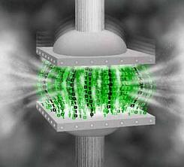
Compression of Data Stream
EVIO files (20GB) can be compressed by factor of ~2 using gzip
BUT: to compress at ROC level one must compress smaller buffers which is less efficient
Tested by using LZ4 compression on individual ROC buffers in file from run 11667 (Spring 2016)
Overall file size reduced by 20% when compressing in a way that could be done at ROC stage with sufficient CPU
DAQ group tested compression rate using fast algorithm (snappy)
Maximum of 300MB/s for single core
Will implement as option for output of Event Recorder

