Slide 1

Detector Design Aided By Machine Learning
A case study of the Charged Pion Polarizability Experiment at Jefferson Lab
David Lawrence, JLab
Robert Johnson, UMass
Ilya Larin, UMass
Oct. 25, 2017
Notes:
Title Page

Slide 2

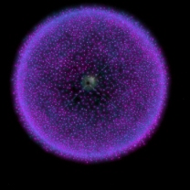
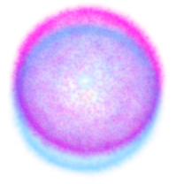
Charged Polarizability
π
Polarizability: Ease in which an external field may induce a dipole moment in a particle
Property which reflects nature of internal structure of particle
E=0
E>0
+ + + + + + + + + + + + + + + + +
- - - - - - - - - - - - - - - - -
Notes:
Interior Page Design 1

Slide 3
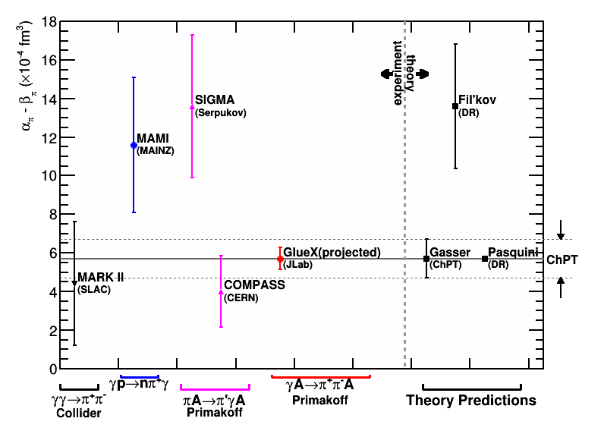
Experimental/Theoretical Landscape
Notes:
Interior Page Design 1

Slide 4
Relating cross-section to
α_{π} − β_{π}
Curves from figure 5. from Pasquini et al. Phys. Rev. C 77, 065211 (2008)
γγ -> π⁺π⁻
Cross-section for γγ -> π⁺π⁻ calculated based on two values of α_{π}−β_{π}:
α_{π}−β_{π} = 13.0 x 10⁻⁴ fm³ (top, dotted line)
α_{π}−β_{π} = 5.7 x 10⁻⁴ fm³ (solid and dashed lines)
Cross-section varies by ~10% for factor of 2 variation in α_{π}−β_{π}
Need measurement of σ(γγ -> π⁺π⁻ ) at few percent level
α_{π}−β_{π} = 13.0 x 10⁻⁴ fm³
α_{π}−β_{π} = 5.7 x 10⁻⁴ fm³
Black data points from MARK-II
Red data points projected for approved Jlab experiment (stat. only)
Invariant mass of π⁺π⁻
dotted: subtracted DR calculation with α_{π}−β_{π} = 13.0
dashed: subtracted DR calculation with α_{π}−β_{π} = 5.7
Notes:
Interior Page Design 1

Slide 5
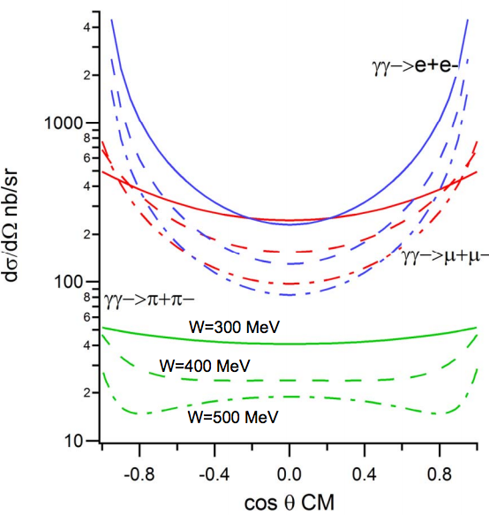
The Problem
μ+μ- (background) are produced ~10x more often than π+π- (signal)
To measure cross section to few percent means reducing a 10x bigger background to less than a few 1/10 of a percent
GlueX detector has no way of distinguishing between μ+μ- and π+π- events at this level
A new detector that works in tandem with GlueX is required
Notes:
Interior Page Design 1

Slide 6

Experimental Setup
Signal reaction
All occur via the Primakoff effect (interaction with the Coulomb field of nucleus)
All result in very forward going particles
Low t (-t < 0.005 GeV²)
Normalization
Beam polarization
Solenoid High Field Region
μ/π Detector
FDC
TOF
FCAL
Target
Notes:
Interior Page Design 2

Slide 7

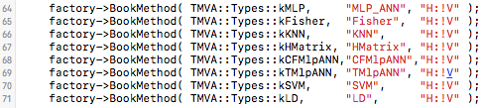
First Attempt
FCAL
(45cm Pb-glass)
μ/π detector
(MWPC + 20cm Iron blocks)
Simulate single 2GeV particles with simple geometry
4 nucl. Interaction lengths ➔ ~2% of πs make it through
1.5λ_{I}
λ_{I}
λ_{I}
λ_{I}
μ⁺ or π⁺
E_{FCAL}
N₁
N₂
N₃
N₄
Tell TMVA what input variables to use
Tell TMVA what methods to use
Notes:
Interior Page Design 2

Slide 8
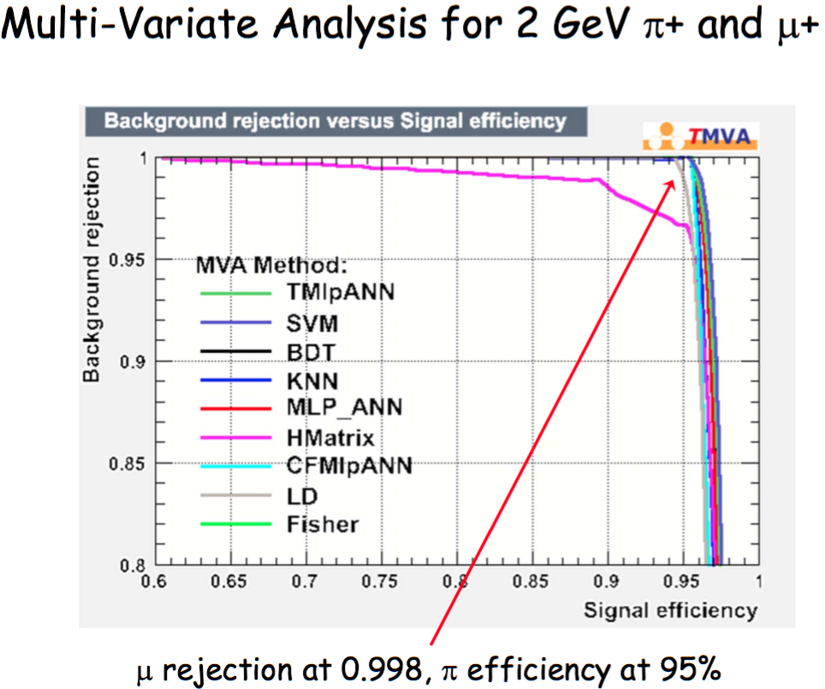
Notes:
Interior Page Design 1

Slide 9
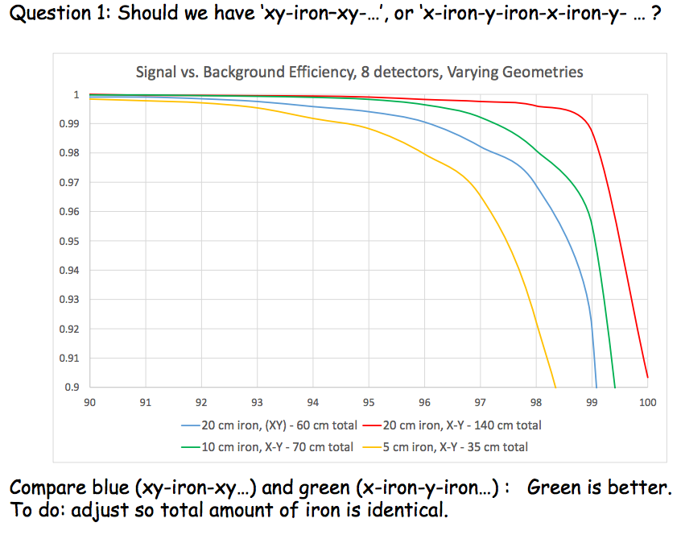
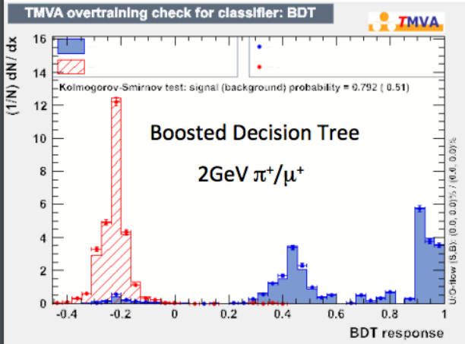
More Iron Is Better
Realistic simulation with both particles present and distribution of incident photon energies
An MVA can be biased by your choice of inputs, but not by your interpretation
background rejection
example response distributions
signal
background
signal acceptance
Study done by UMass undergrad. Bobby Johnston
Notes:
Interior Page Design 1

Slide 10
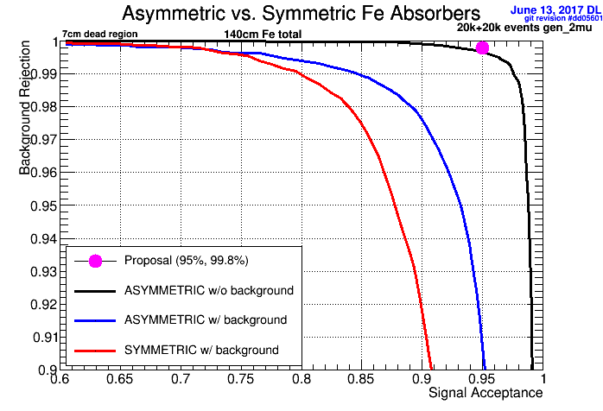
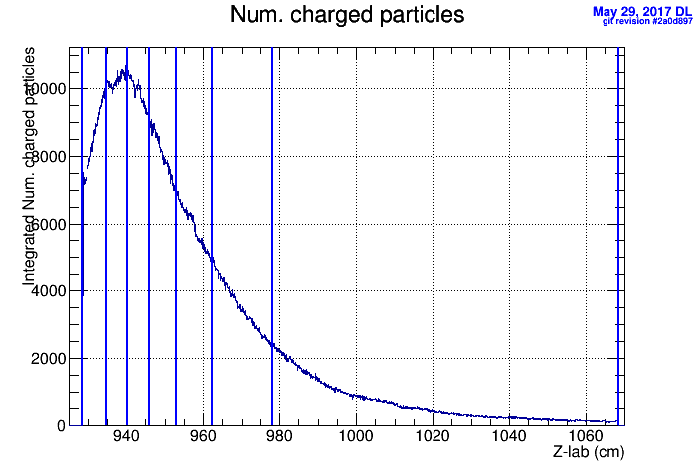

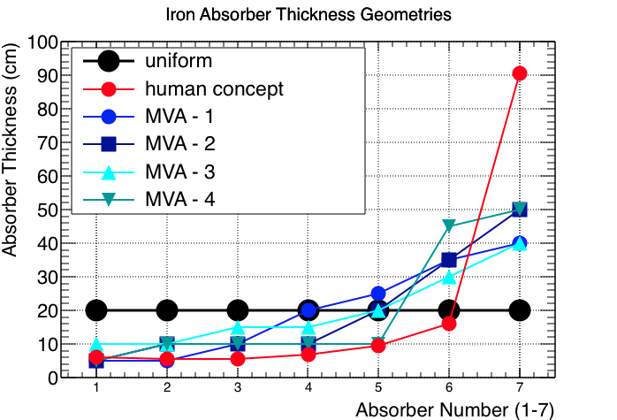
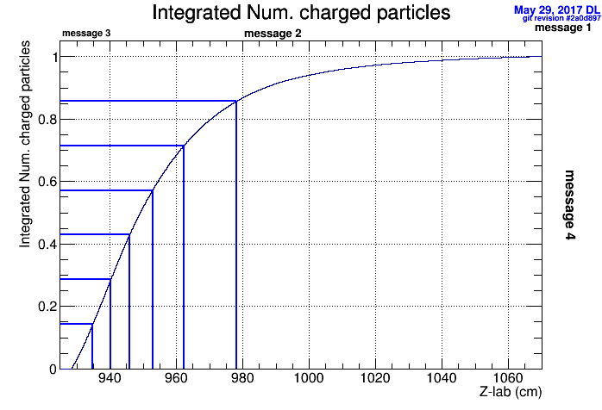
Symmetry of Iron Absorber Thickness
Human Derived Concept
Confirmation by MVA
Integrate number of particles as function of depth in Iron for π± showers
Split Iron so sections contain equal number of particles
(human)
Top 4 MVA results of 741 geometries tested
Notes:
Interior Page Design 1

Slide 11
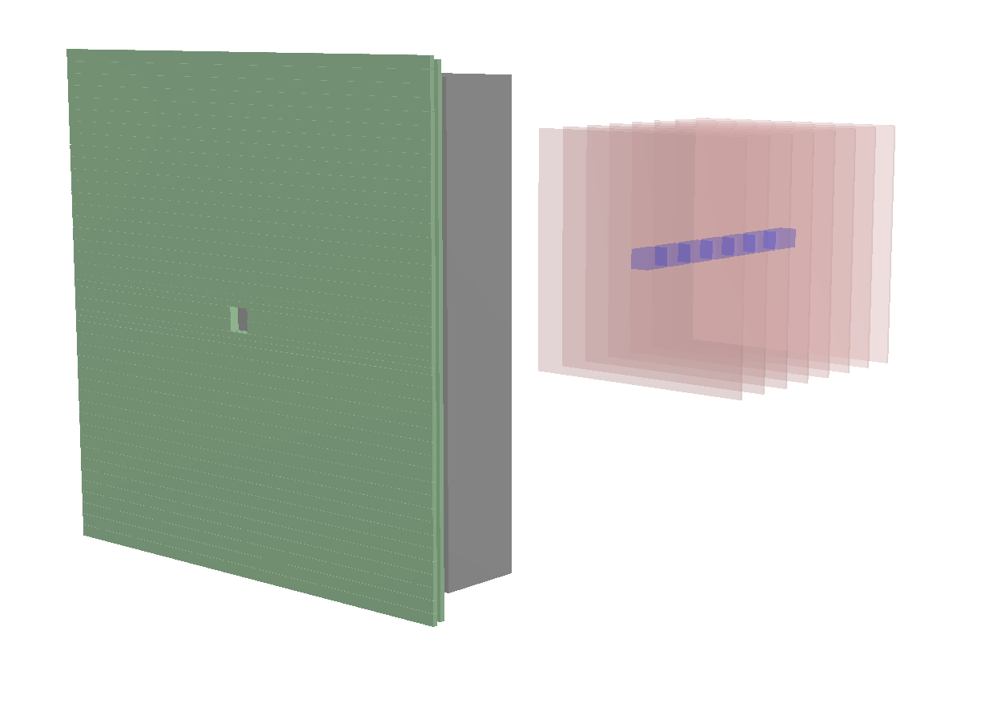
Beam Hole / Dead Region Geometry
Primary photon beam passes through square holes in center of FCAL and TOF detectors
Natural geometry of beam is round
Should hole in Iron absorbers be square to match FCAL or round to match beam? Does it matter?
What size should it be?
What about dead region in chambers?
Notes:
Interior Page Design 1

Slide 12
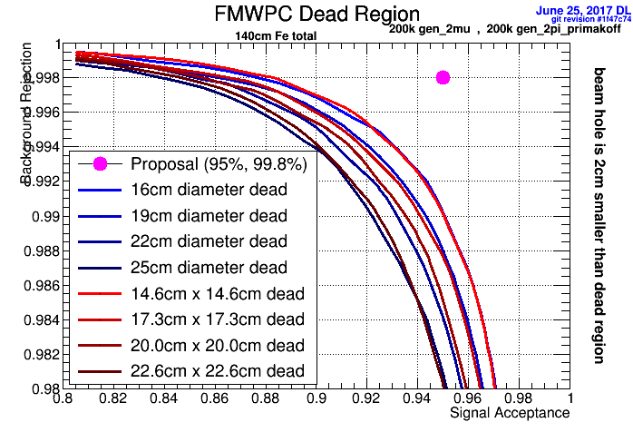

Slide 13
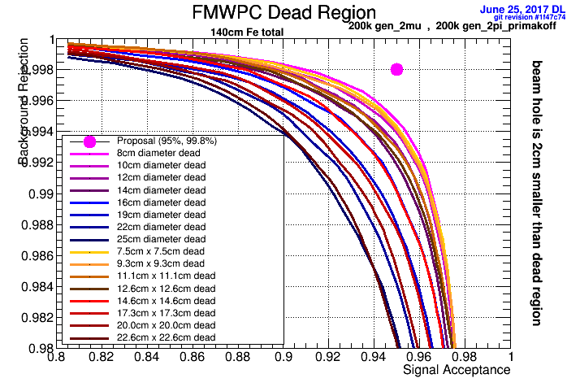

Slide 14
An MVA surprise
In 2013 we had a software tutorial for GlueX
  γp -> pπ⁺π⁺π⁻
  Signal: specialized generator with selected amplitudes
    5343 events
  Background: pythia + selected reactions at low energy with uniform sampling in phase space
    8527 events
Notes:
Interior Page Design 1

Slide 15
An MVA surprise
Original Exercise
Added extra variable “just for fun”
: --------------------------------------------------------
: Rank : Variable : Variable Importance
: --------------------------------------------------------
: 1 : PV_r : 1.129e-01
: 2 : MissingNeutron_PT : 9.881e-02
: 3 : PiPlus1__Timing_FOM : 7.881e-02
: 4 : PiMinus__Timing_FOM : 7.325e-02
: 5 : Unused__Max_KPlus_FOM : 7.313e-02
: 6 : Unused__Max_Proton_FOM : 6.612e-02
: 7 : FOM_KinFit : 6.467e-02
: 8 : PiPlus2__Timing_FOM : 6.264e-02
: 9 : PiPlus1__NDF_Tracking : 5.885e-02
: 10 : PiPlus2__NDF_Tracking : 5.744e-02
: 11 : PiPlus2__DCdEdx_FOM : 5.722e-02
: 12 : Unused__Max_KMinus_FOM : 5.641e-02
: 13 : PiMinus__NDF_Tracking : 5.075e-02
: 14 : PiMinus__DCdEdx_FOM : 5.054e-02
: 15 : PiPlus1__DCdEdx_FOM : 3.848e-02
: --------------------------------------------------------
: --------------------------------------------------------
: Rank : Variable : Variable Importance
: --------------------------------------------------------
: 1 : PV_r : 9.909e-02
: 2 : Entry$ : 9.189e-02
: 3 : MissingNeutron_PT : 9.053e-02
: 4 : PiPlus1__Timing_FOM : 8.114e-02
: 5 : PiMinus__Timing_FOM : 7.219e-02
: 6 : Unused__Max_KPlus_FOM : 6.512e-02
: 7 : Unused__Max_Proton_FOM : 6.133e-02
: 8 : PiPlus2__NDF_Tracking : 5.963e-02
: 9 : FOM_KinFit : 5.823e-02
: 10 : PiPlus2__Timing_FOM : 5.629e-02
: 11 : PiPlus1__NDF_Tracking : 5.361e-02
: 12 : Unused__Max_KMinus_FOM : 5.358e-02
: 13 : PiMinus__NDF_Tracking : 4.415e-02
: 14 : PiMinus__DCdEdx_FOM : 4.318e-02
: 15 : PiPlus2__DCdEdx_FOM : 3.784e-02
: 16 : PiPlus1__DCdEdx_FOM : 3.221e-02
: --------------------------------------------------------
Notes:
Interior Page Design 1

Slide 16
Some advice
Any variable could be useful. Just give it to the MVA and let it decide
Avoid variables that are strongly correlated with a quantity you’re trying to measure
(e.g. inv. mass of a resonance you’re trying to search for)
Make any obvious cuts before handing over to MVA so it doesn’t have to waste discriminating power on the obvious
Notes:
Interior Page Design 1

Slide 17
Summary
Using multiple MVA algorithms can allow quick insight into design decisions without much expertise
in machine learning
  The TMVA package in ROOT is a great way to get started with machine learning and gives easy access to several algorithms using a single input format and API
MVA is a great way to make relative comparisons between different detector designs
The Charged Pion Polarizability experiment at Jefferson Lab Hall-D has used TMVA to refine several of the π/μ detector design aspects
Notes:
Interior Page Design 1

Slide 18
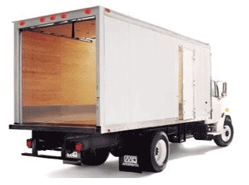
Backups
Notes:
Interior Page Design 1

Slide 19



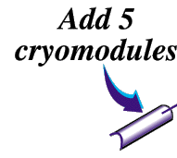


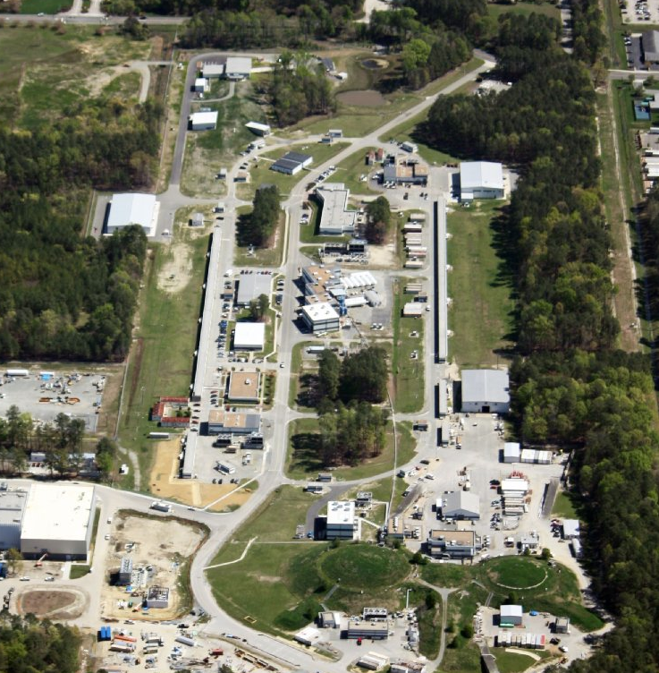
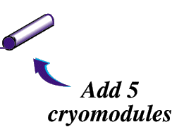
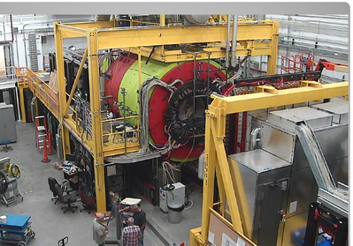
Hall-D at Jefferson Lab
(home of GlueX)
12GeV CW(2-4ns) electron beam
Only high energy photons enter Hall-D
Notes:
Interior Page Design 1

Slide 20
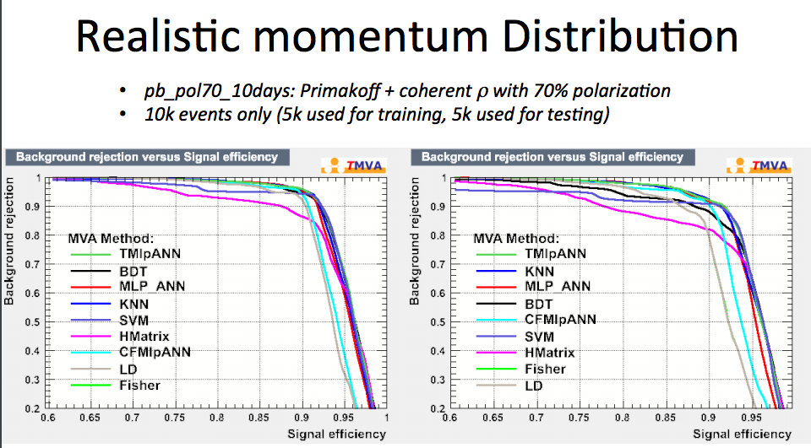
Notes:
Interior Page Design 1

Slide 21
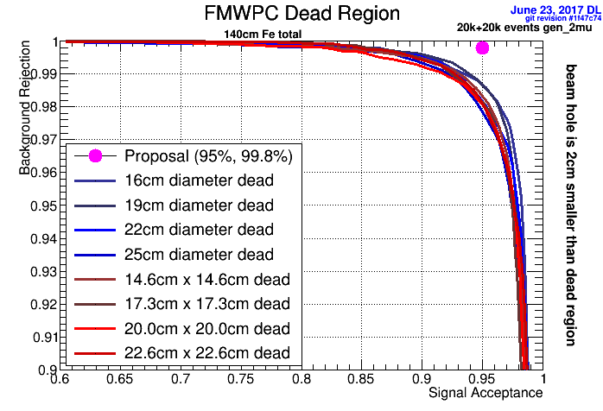
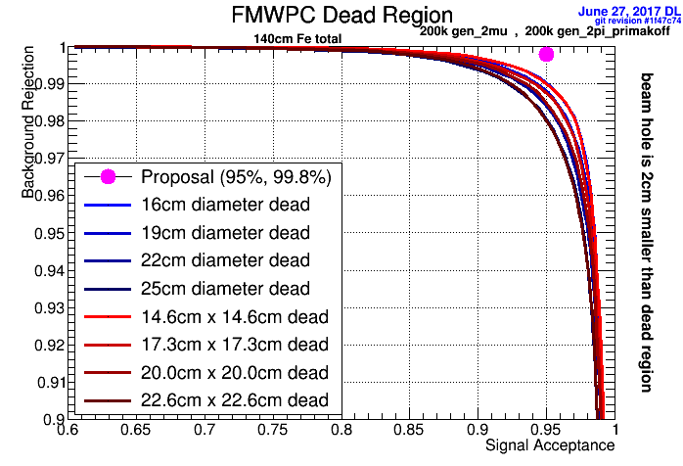
20k -> 200k
20k + 20k events
200k + 200k events

Slide 22
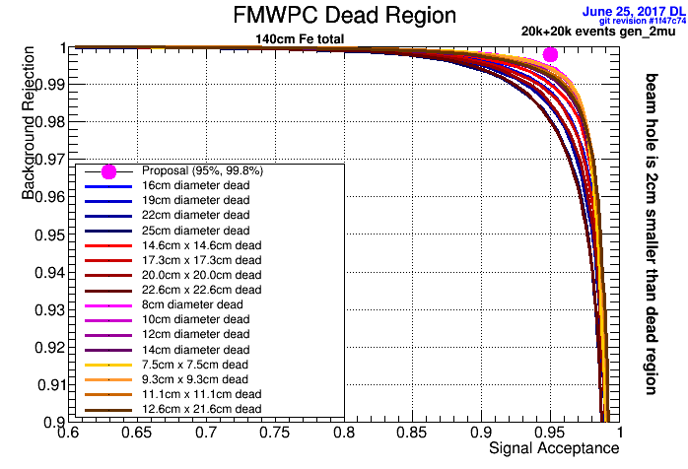

Slide 23
Title Here
Text goes here
Notes:
Interior Page Design 2

