Slide 1
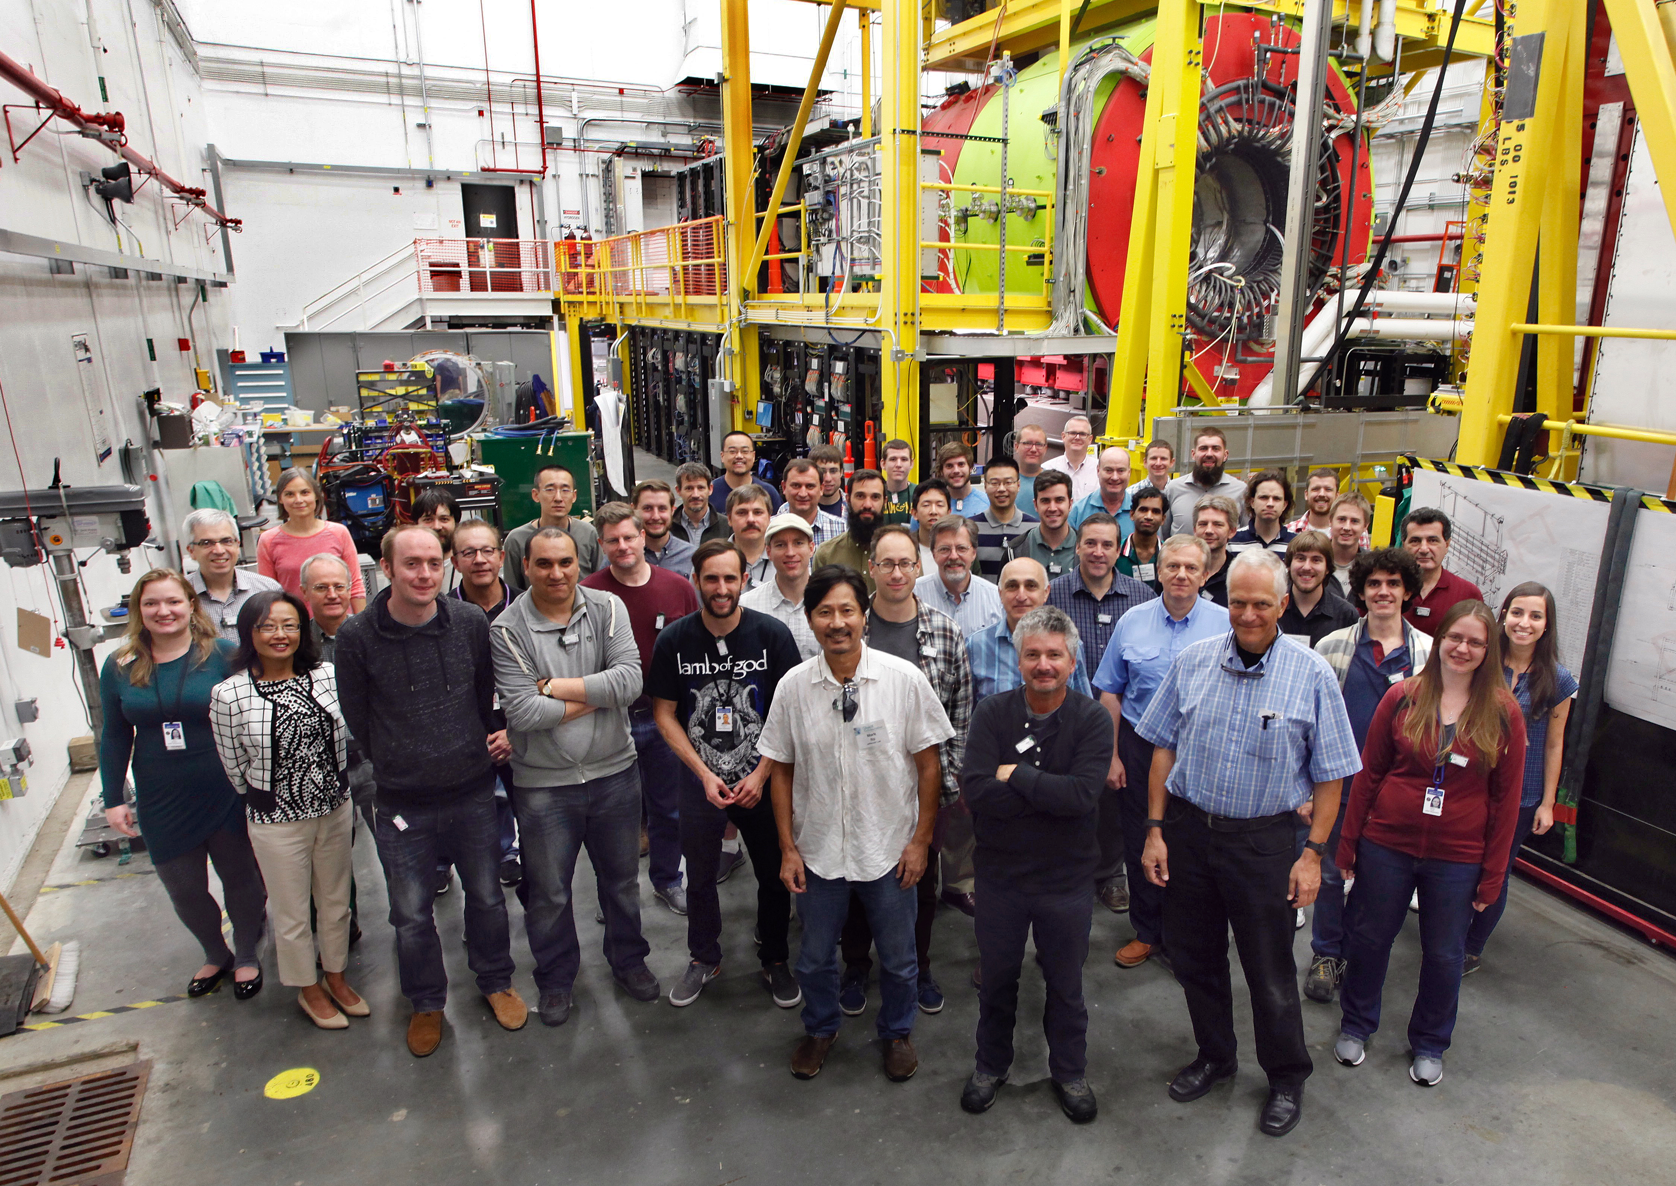
The GlueX Experiment
Curtis A. Meyer, GlueX Spokesperson
The Gluonic eXcitations Experiment

Slide 2
Outline
All about gluons and GlueX Physics.
The GlueX Experiment.
Physics from GlueX.

Slide 3
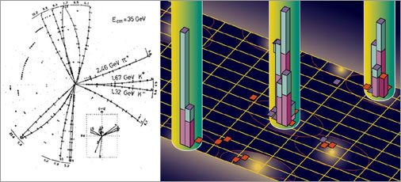
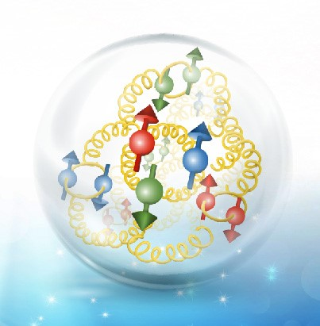
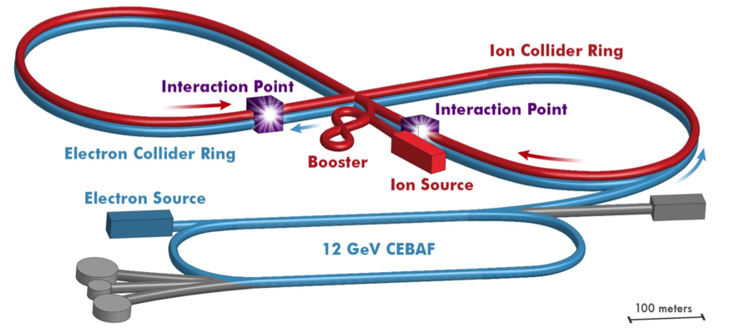
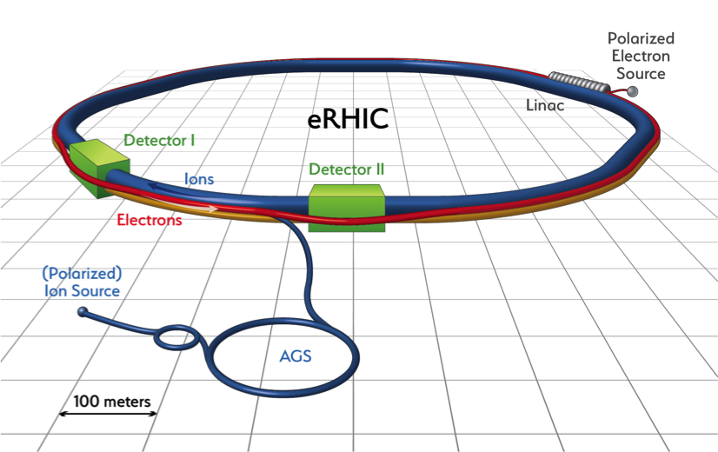
The Role of Glue.
Three-jet events in e⁺e⁻ collisions demonstrated the existence of gluons.
3-jet event from PETRA (1979)
Glue is now recognized as a significant part of hadronic matter, making major contributions to the mass and spin of the proton.
The Electron-Ion Collider, or EIC will collide electrons with nuclei and look deep inside the nucleus to reveal the role of gluons, the carriers of the strong force.
Understanding the role of glue in hadronic matter is a central theme of nuclear physics.

Slide 4
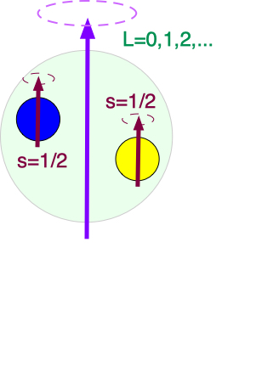
The Role of Glue.
Lattice QCD calculation of meson spectrum.
J^{PC}
We know that mesons and baryons can be accurately described by constituent quarks being underlying degrees of freedom.
Experimentally known meson states
States whose assignment is not clear.
LQCD: Phys. Rev. D88, 094505 (2013).

Slide 5
The Role of Glue.
Lattice QCD calculation of meson spectrum.
J^{PC}
We know that mesons and baryons can be accurately described by constituent quarks being underlying degrees of freedom.
Large gluonic fields
Does glue manifest itself as an underlying degree of freedom in the hadronic spectrum?

Slide 6
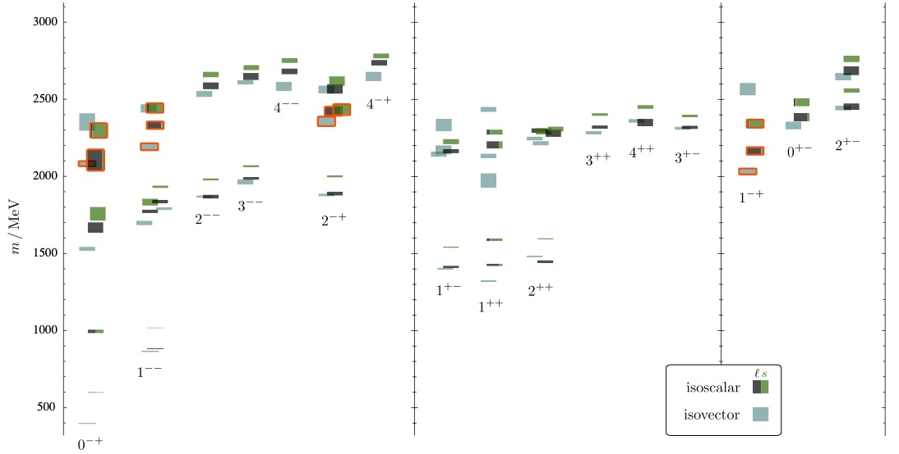
The Role of Glue.
Lattice QCD
2.5GeV
2.0GeV
0⁺⁻
1⁻⁺
2⁺⁻
LQCD: Phys. Rev. D83, 111502 (2011)
Does glue manifest itself as an underlying degree of freedom in the hadronic spectrum?

Slide 7
Exotic Hybrid Mesons
Lattice QCD suggests 5 nonets of mesons with exotic quantum numbers:
1 nonet of 0⁺⁻ exotic mesons
2 nonets of 1⁻⁺ exotic mesons
2 nonets of 2⁺⁻ exotic mesons
Lattice QCD
2.5GeV
2.0GeV
Lattice QCD results are consistent with the gluonic field behaving like a J^{PC}=1⁺⁻ constituent with a mass ~1-1.5 GeV/c².
0⁺⁻
1⁻⁺
2⁺⁻
Non quark-antiquark J^{PC} , Exotic Quantum Numbers!
Does glue manifest itself as an underlying degree of freedom in the hadronic spectrum?

Slide 8
Exotic Hybrid Mesons
Experimental evidence for a single state:
π₁(1600)
Reported in several experiments in several decay modes. Strongest signal in
      π₁(1600) → η’π
Lattice QCD
2.5GeV
2.0GeV
0⁺⁻
1⁻⁺
2⁺⁻
Where are the other states?
J^{PC}=0⁺⁻ : b₀, h₂, h₀’
J^{PC}=1⁻⁺ : π₁, η₁, η₁’
J^{PC}=2⁺⁻ : b₂, h₂, h₂’
Does glue manifest itself as an underlying degree of freedom in the hadronic spectrum?

Slide 9
The GlueX Experiment
GlueX is a discovery experiment for the photoproduction of hybrid mesons.
Unique photon beam.
Hermetic detector.
High statistics.
2019
Physics Running started in 2017

Slide 11
The GlueX Experiment
Polarimeter
The Hall-D photon facility has unique capabilities.
12GeV electrons produce coherent bremsstrahlung on a 50 μm thick diamond wafer. Photons in the coherent peak are linearly polarized.
The beam is energy tagged, has its polarization measured, and the flux is determination close to the GlueX detector.

Slide 12
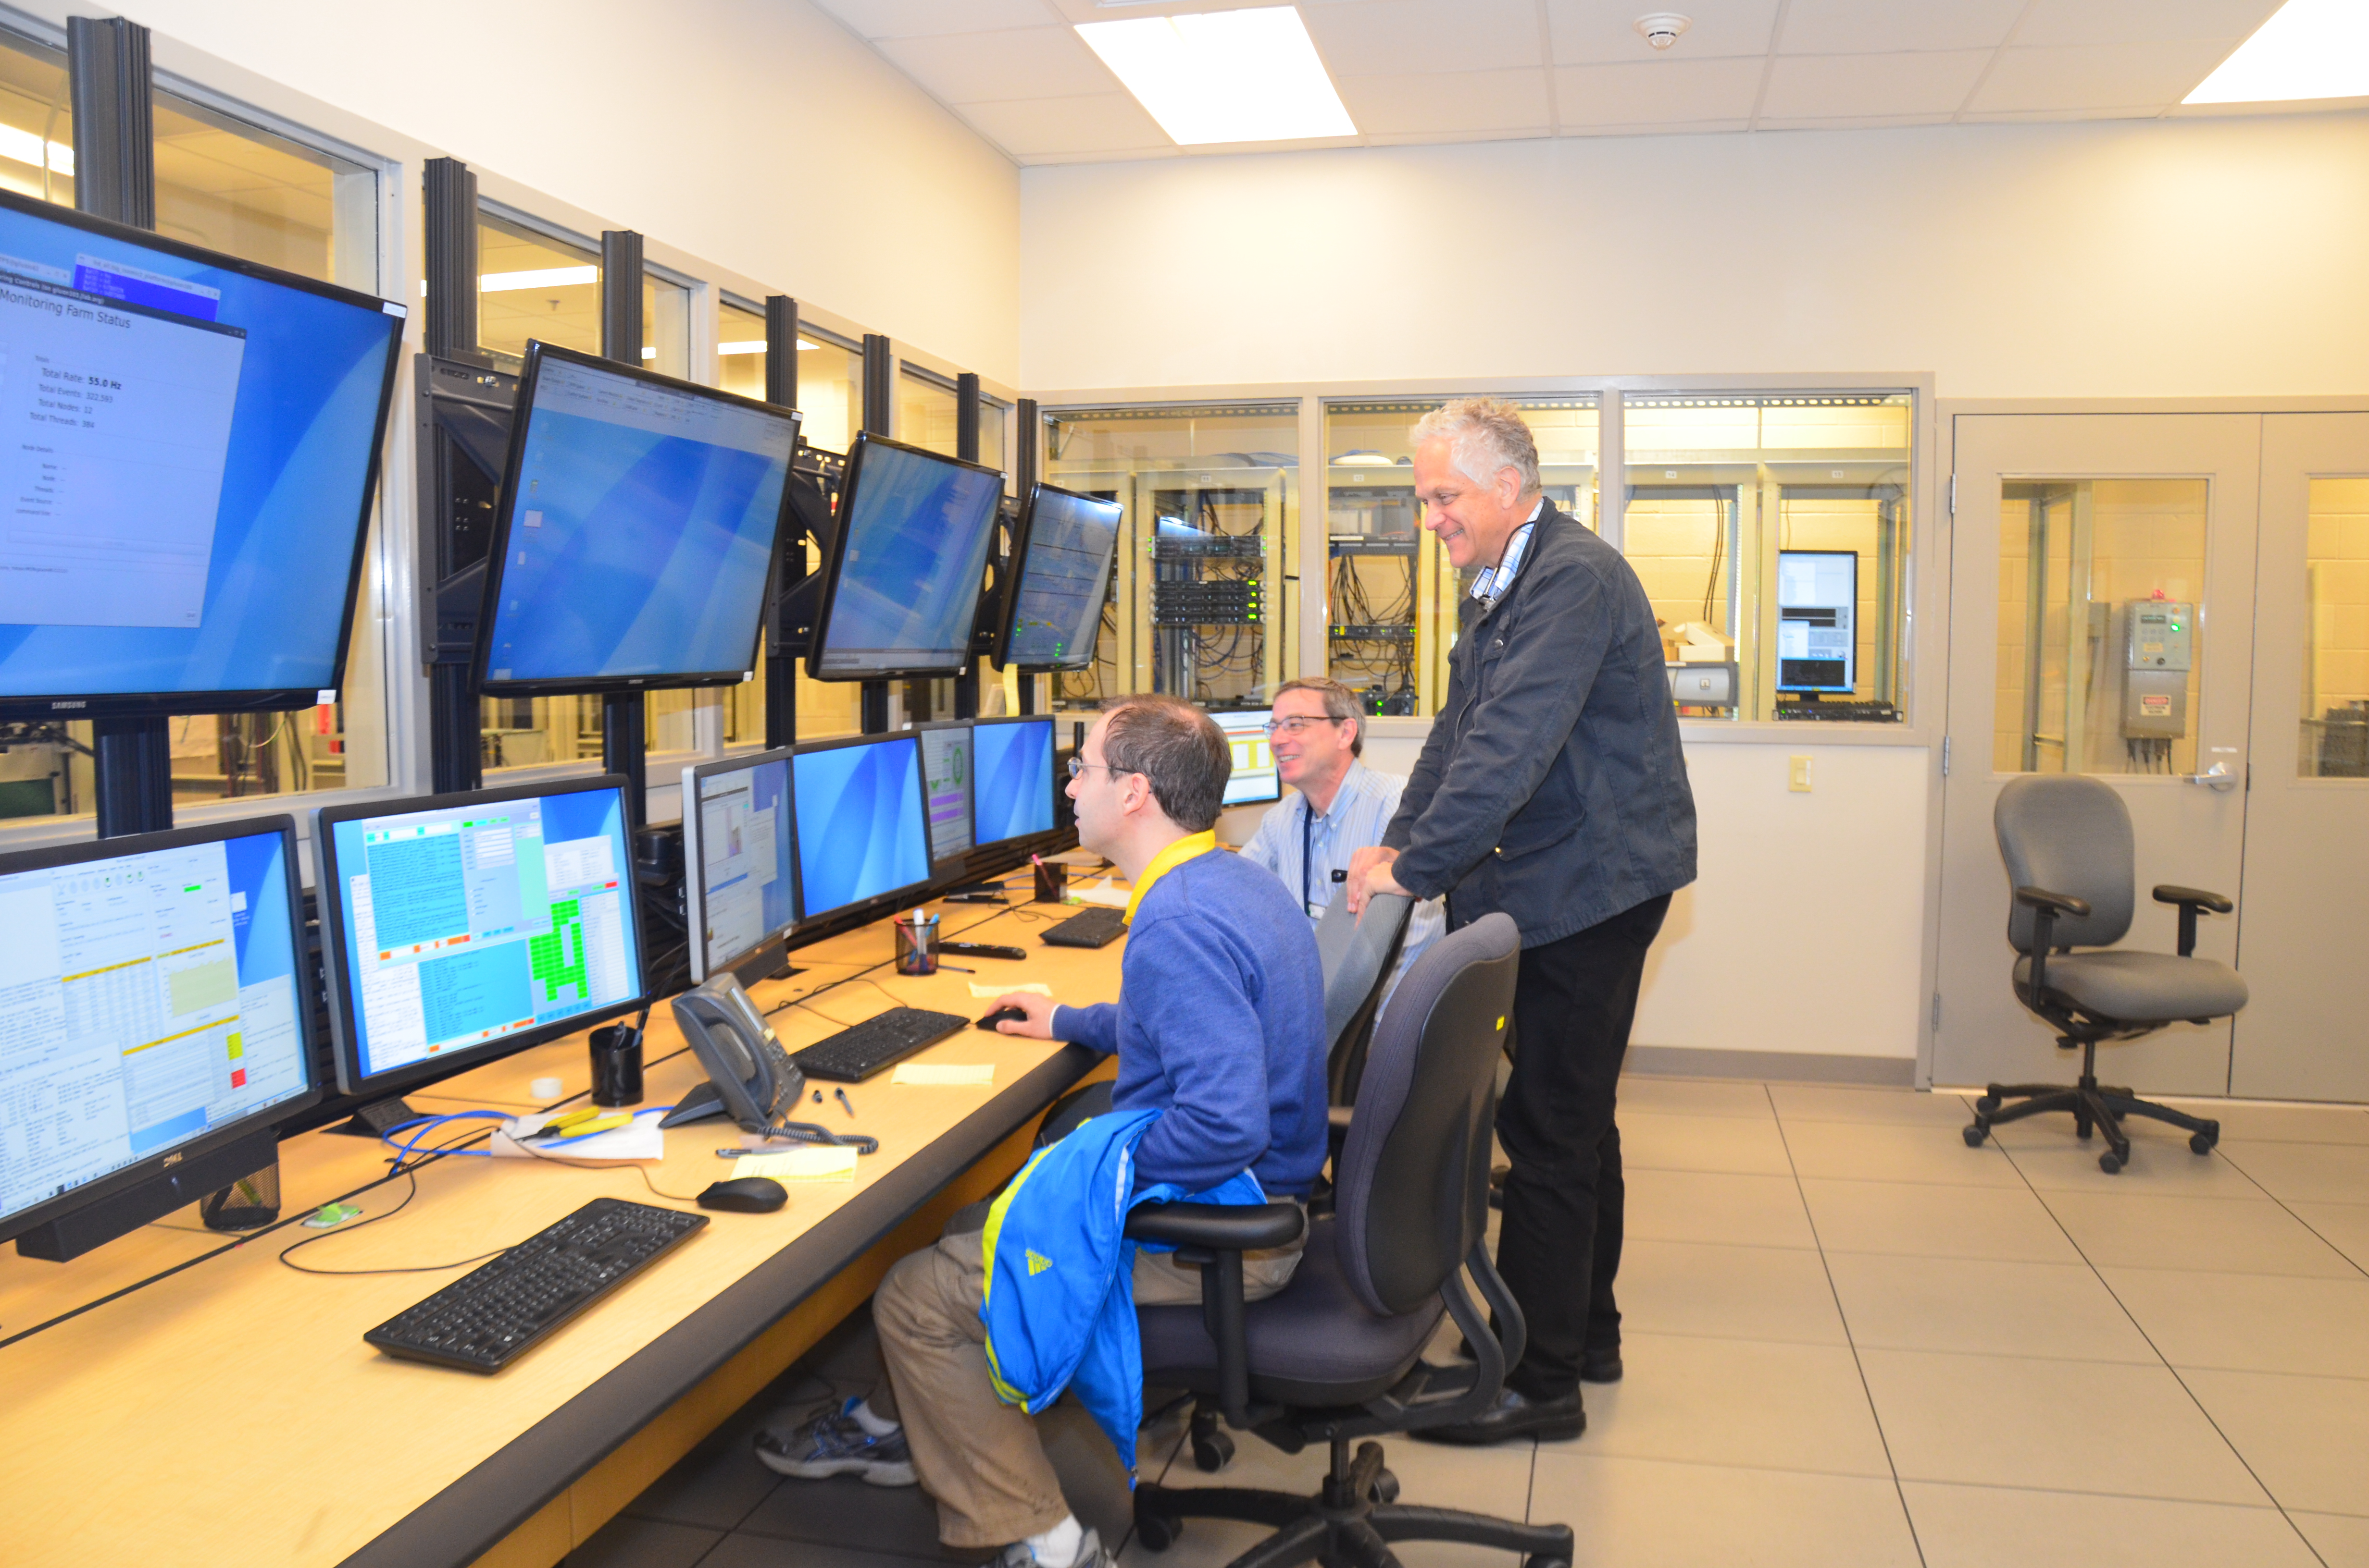
GlueX Running
Fall 2014 to Spring 2015: Detector & Beamline Commissioning
Phase I Running: 90 PAC days of physics
Spring 2016: Engineering Run
80 Hours of Physics-quality data
Spring 2017 to Fall 2018 – GlueX Physics (5PB)
20% of Phase I in Spring 2017
50% of Phase I in Spring 2018
30% of Phase I in Fall 2018
2019 and Beyond – GlueX Physics
Addition of forward kaon identification (DIRC) 2019
Phase II High-intensity running. Fall 2019
All detector systems are at or better than design specifications.
12 GeV Beam 1st delivered to Hall D, December 2015
Notes:
0.627 PB in spring 2016 (most is engineering data)
0.915 PB in spring 2017
1.917 PB in spring 2018
1.151 PB in fall 2018

Slide 13
GlueX Data Processing
Spring 2016 & Spring 2017 (20% of data): active physics analysis.
Full Phase I data set available by Sept. 2019.
Data taken through 2017 has been processed at JLab.
2018 Raw data are being processed at NERSC: 5PB -> 750 TB.
  44M hours at NERSC this year (almost enough for Spring 18 data).
Processed data is skimmed at JLab to provide physics samples.
  Users analyze physics samples at home institutions or JLab.
Monte Carlo requested by web interface and automatically deployed on Open Science Grid (OSG).
  GlueX Institutions are contributing compute resources to OSG.

Slide 14
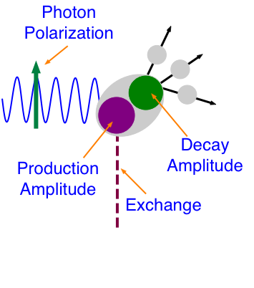
Physics with GlueX
Production Amplitude produces a state X with J^{PC} quantum numbers and some polarization (density matrix, ρ).
Decay Amplitude describes the decay of X to final state particles. It is related to ρ and the spin and orbital angular momentum of the final-state particles.
Observables are the angular distributions of the final-state particles.
J^{PC}
l_{i},s_{i}
j^{pc}
p
p

Slide 15
Physics with GlueX
Production Amplitude produces a state X with J^{PC} quantum numbers and some polarization (density matrix, ρ).
Decay Amplitude describes the decay of X to final state particles. It is related to ρ and the spin and orbital angular momentum of the final-state particles.
Observables are the angular distributions of the final-state particles.
J^{PC}
l_{i},s_{i}
j^{pc}
p
p

Slide 16
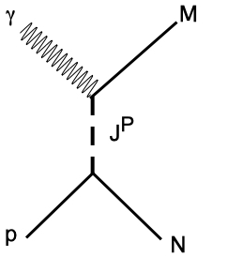
Beam Asymmetry Measurements
γp → NM
Σ is sensitive to the exchange J^{P}.
Effectively
Published π⁰ and initial η results.
More precise η, first η’, π⁻ Δ⁺⁺ and K⁺Σ⁰ are under collaboration review

Slide 17
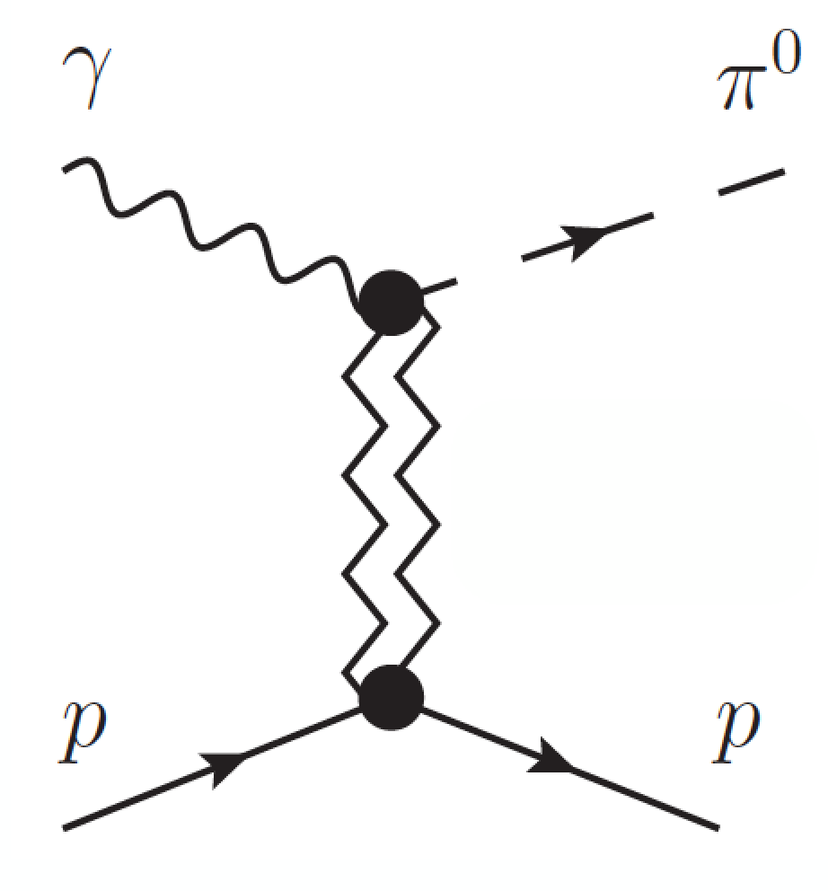


Beam Asymmetry Measurements
Exchange J^{PC}
Impacts extraction of baryon resonances from low-energy photo production experiments.
Understanding the meson production mechanisms at 9GeV is needed for our hybrid searches.
Phys. Rev. C95, 042201 (2017)

Slide 18

Beam Asymmetry Measurements
γp → pη and γp → pη’
η,η’
η’/η→ π⁺π⁻π⁰
η’/η→ π⁰π⁰π⁰
η’/η→ γγ
Vector mesons dominate the exchanges. Σ_{η} = Σ_{η’} implies no
exchanges.
Theory input is very important.
JPAC References:
Phys. Rev. D92, 074013 (2015). Phys. Lett B774, 362 (2017).
Under Collaboration Review for Publication

Slide 19
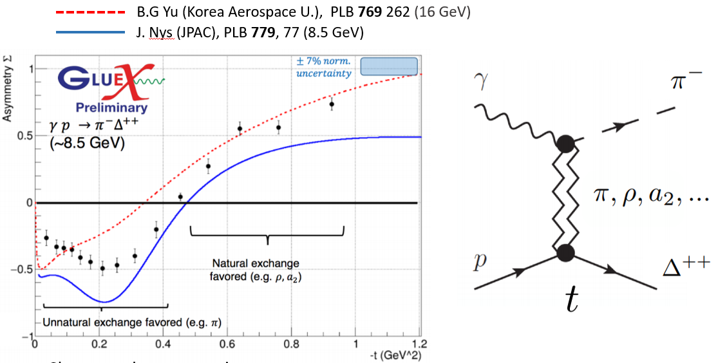
Beam Asymmetry Measurements
γp → Δ⁺⁺π⁻
Under Collaboration Review for Publication

Slide 20
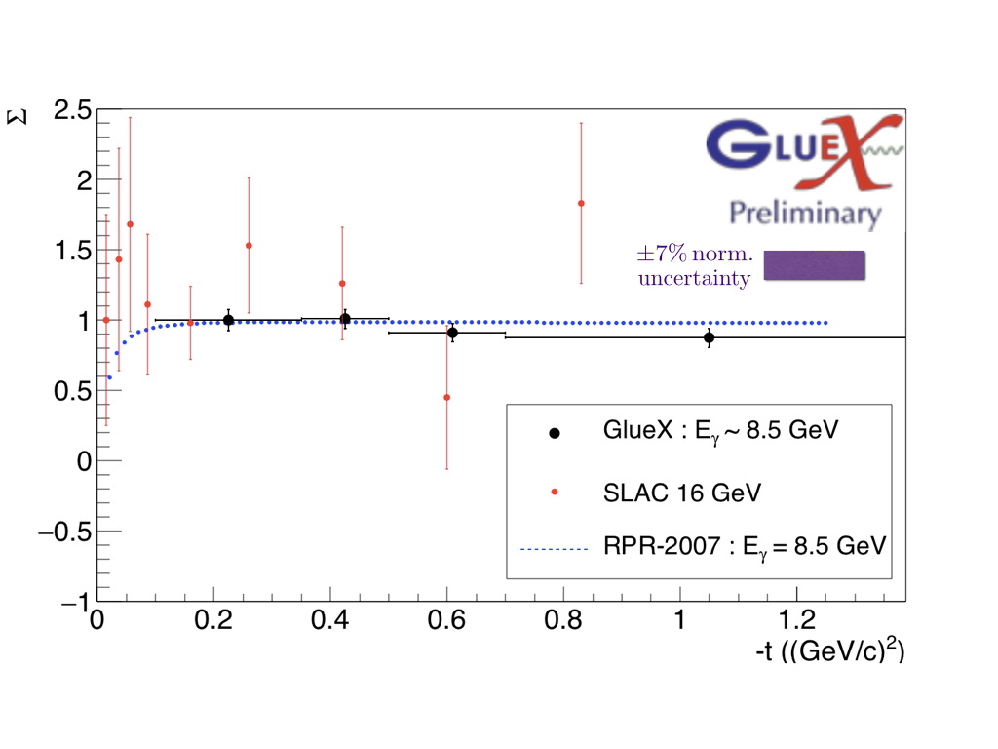
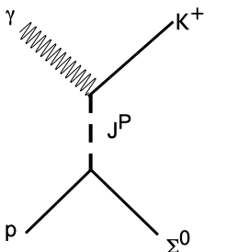
Beam Asymmetry Measurements
γp → Σ⁰Κ⁺
Appears that both t- and u-channel exchanges are involved.
Σ=1 implies natural parity exchange
RPR-2007:Phys. Rev. C75, 045204 (2007)
Under Collaboration Review for Publication

Slide 21

Opportunistic Physics
The polarized photon beam, acceptance and data-rate capabilities of GlueX combined with an open trigger lead to many opportunistic physics topics beyond spectroscopy. GlueX data is wide open for exploration.
Photoproduction of antibaryons:
Ξ photoproduction (uss) and (dss) states appear as bumps.
J/ψ cross section at threshold under collaboration review.

Slide 22
Cascade Baryons
The spectrum of Ξ baryons is poorly known, with only 5 well determined states.
High acceptance of GlueX allows the reconstruction of exclusive final states. This allows for determination of quantum numbers.
Could potentially double our knowledge of these baryons.
The Ξ⁻(1820) would be the first observation of an excited Ξ in photoproduction.
γp→ K⁺K⁺pπ⁻π⁻
Ξ⁻(1320)
Ξ⁻(1820)?
γp→ K⁺K⁺K⁻Λ
Ξ⁻* → K⁻Λ
Need the full GlueX statistics

Slide 23
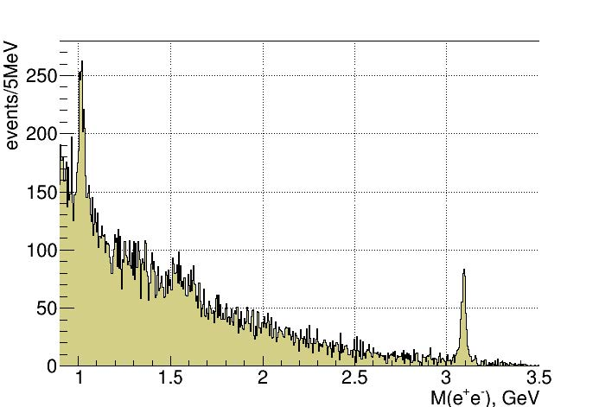
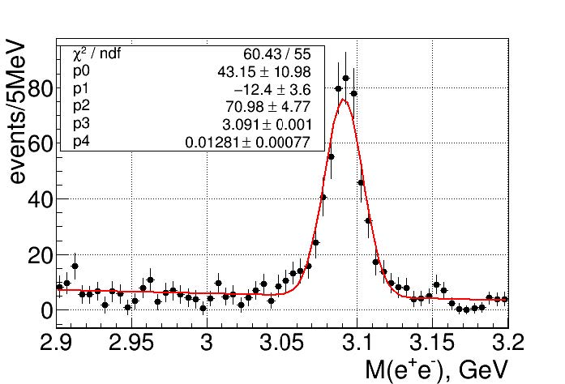
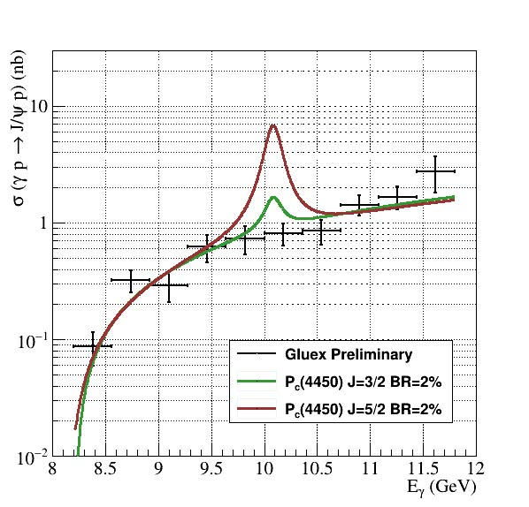
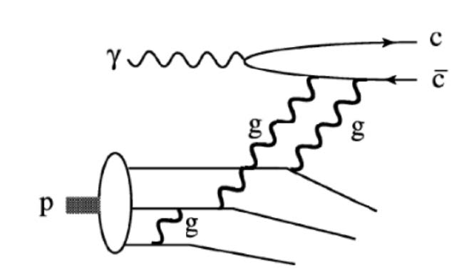
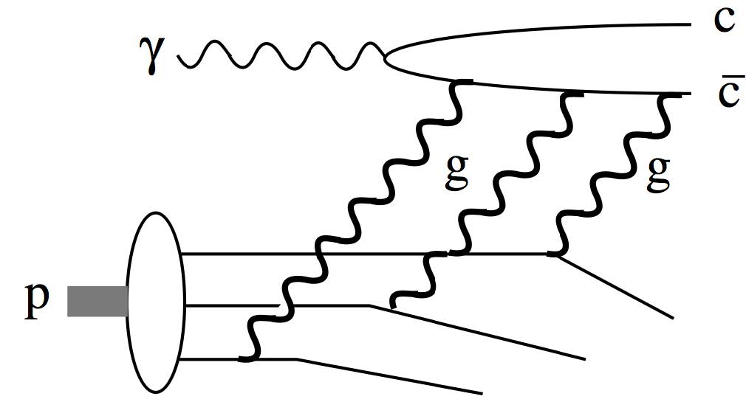
J/ψ Photoproduction
Detect J/ψ through its e⁺e⁻ decay
464±25 J/ψ
Upper limit on LHCb Pentaquark(s)
The two mechanisms have different energy dependences near threshold.
Final Stages of Collaboration Review

Slide 24
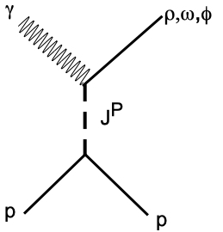
Vector Meson Photoproduction
γp → p(ρ,ω,φ)
Spin-density matrix, ρ, describes the polarization of the produced vector meson.
Extracted from the decay angular distributions.
With linearly polarized photons, we can measure 9 of the 36 real values.
All observables are linear combinations of the SDME elements. P_{σ} is the difference of two ρ elements and measures the degree of natural parity exchange.
ρ⁰ → π⁺π⁻
ω → π⁺π⁻π⁰
φ → Κ⁺Κ⁻
P_{σ}
SLAC: Phys. Rev. D7, 3150 (1973).
JPAC: Phys. Rev. D97 094003 (2018).

Slide 25
The Search for Hybrids
GlueX is a discovery experiment utilizing a unique beam, hermetic detector, very sophisticated analyses.
GlueX will produce very large statistics in unexplored reactions.
A detailed understanding of the detector performance is crucial.
Full GlueX statistics are necessary.
Most exotic hybrid mesons could be photoproduced. GlueX can exclusively reconstruct many relevant final states.
Initial Searches:
π₁(1600) → η’π (known state)
π₁(1600) → ρπ
η₁ → ηππ (isospin partner)
η’₁ → Κ∗Κ (isospin partner)
b₂ → ηππ (other nonet)
b₂ → ωπ (other nonet)
b₂ → ρπ (other nonet)
Preliminary studies of these channels indicate interesting signals are present.

Slide 26
The Search for Hybrids
GlueX is a discovery experiment utilizing a unique beam, hermetic detector, very sophisticated analyses and generating very large data sets.
A detailed understanding of the detector performance is crucial.
Full GlueX statistics are necessary.
Photoproduction in GlueX could produce most exotic hybrid mesons and GlueX can exclusively reconstruct relevant final states.
Initial Searches:
π₁(1600) → η’π (known state)
π₁(1600) → ρπ
η₁ → ηππ (isospin partner)
η’₁ → Κ∗Κ (isospin partner)
b₂ → ηππ (other nonet)
b₂ → ωπ (other nonet)
b₂ → ρπ (other nonet)
From preliminary studies of these channels, we expect sufficient statistics.

Slide 27
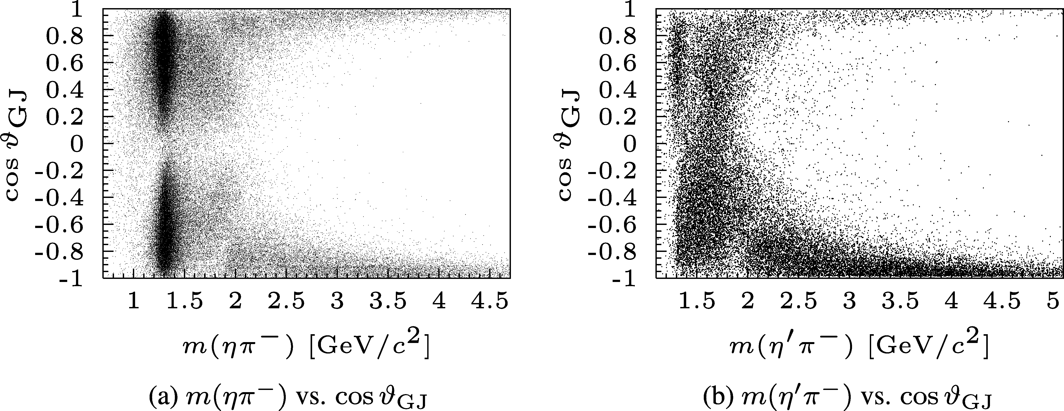
Interesting Hybrid Channels
π⁻p → p ηπ⁻
π⁻p → p η’π⁻
JPAC: Extracted the pole position of the π₁(1600) from the COMPASS amplitudes.
Mass: 1564 +/- 24 +/- 86 MeV
Width: 492 +/- 54 +/- 102 MeV
Highest statistics on π₁(1600) → η’π from COMPASS
ηπ⁻
η’π⁻
116,000 Events
39,000 Events
COMPASS: strong exotic wave in the η’π⁻, but not in the ηπ⁻ data.
a₂(1320)
π₁(1600)
a’₂(1700)
COMPASS: Phys. Lett. B 740, 303 (2015).
JPAC: Phys. Rev. Lett. 122, 042002 (2019).

Slide 28
Interesting Hybrid Channels
First GlueX Hybrid Search
γp → pηπ⁰
γp → pη’π⁰
cos(θ_{J})
cos(θ_{J})
a₀
a₂
ηπ⁰ Invariant Mass [GeV/c²]
η’π⁰ Invariant Mass [GeV/c²]
In same decay modes as COMPASS, GlueX will have 280,000 ηπ⁰ and 52,000 η’π⁰ events in the full data set (versus COMPASS with 116,000 & 39,000).
γp → Δ⁺⁺ηπ⁻
These analyses are underway, but will need the full data set.
Charge exchange reaction is also being studied.
γp → Δ⁺⁺η’π⁻

Slide 29
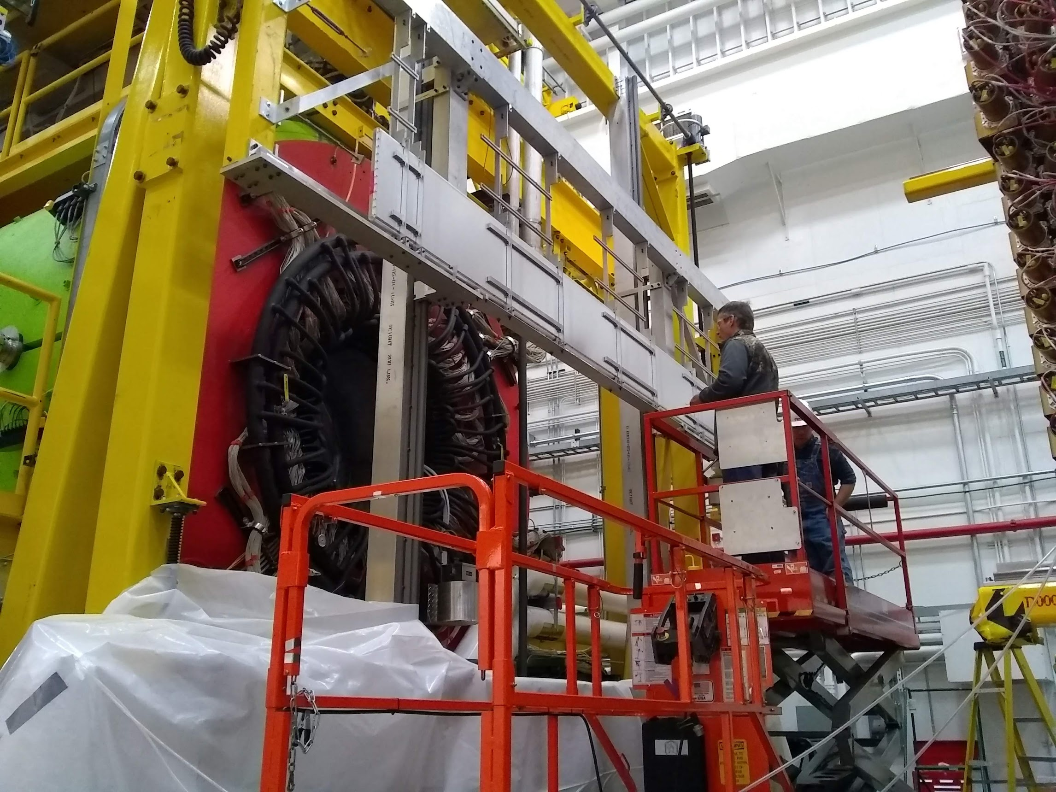
GlueX Phase II
GlueX Phase II starts in fall 2019
A factor of 2 in approved beam time.
Three times the event rate.
The GlueX DIRC: enhanced kaon identification.
This opens the full GlueX program to include strange particles and mixing angles.
Exotic Hybrids
Normal Mesons
Cascade and Hyperon Baryons
2.5GeV
2.0GeV
0⁺⁻
1⁻⁺
2⁺⁻

Slide 30
Moving Forward
Current GlueX data sets are several orders of magnitude larger and significantly higher quality than earlier data.
GlueX is poised to conduct comprehensive searches for exotic hybrid mesons.
GlueX data are proving very interesting for opportunistic physics, and discoveries beyond exotics.
With the GlueX DIRC and higher rate capability, the reach of GlueX will expand significantly.

