Slide 1
The GlueX Experiment
Curtis A Meyer
Carnegie Mellon University

Slide 2
The GlueX Experiment
GlueX is a discovery experiment for the photoproduction of hybrid mesons.
Unique photon beam.
Hermetic detector.
High statistics.
2019
Physics Running started in 2017

Slide 4
The GlueX Experiment
Polarimeter
The Hall-D photon facility has unique capabilities.
12GeV electrons produce coherent bremsstrahlung on a 50 μm thick diamond wafer. Photons in the coherent peak are linearly polarized.
The beam is energy tagged, has its polarization measured, and the flux is determination close to the GlueX detector.

Slide 5
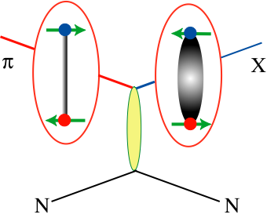
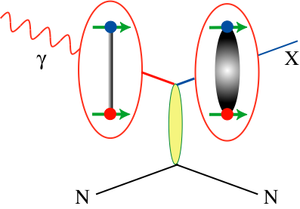
Photoproduction
Over the last 15 years, low-energy (E_{γ} < 4 GeV) photoproduction experiments have helped to rewrite our understanding of baryon resonances.
Almost no high-energy (E_{γ} > 7.5GeV) photoproduction data exist. This is the regime where where t-channel processes dominate the production mechanisms.
Linearly-polarized photons act as a filter on the naturality of the exchange mechanism.
Photon beams are unique in that they have J=1, and through VMD are effectively beams of ρ, ω and φ mesons.
Photon beams may be a good way to produce strangeonium states.

Slide 6
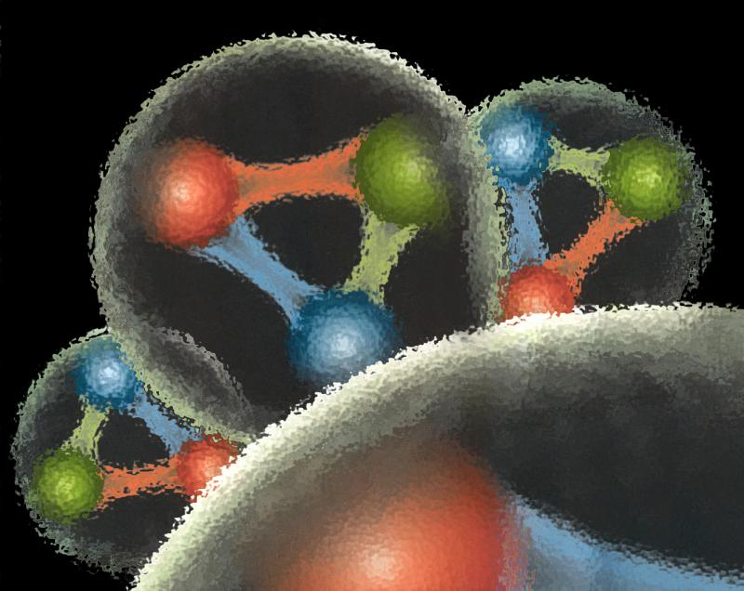

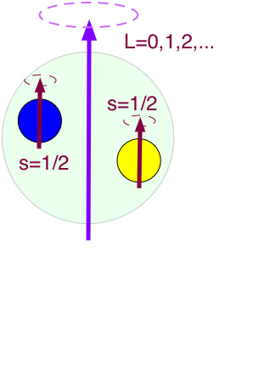
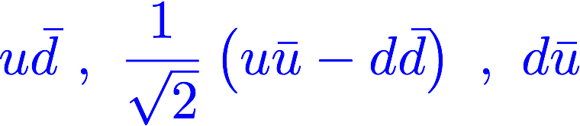

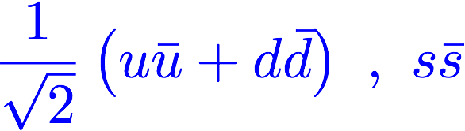
Quantum Chromo Dynamics
L=3, S=1, J^{PC}=4⁺⁺
J^{PC}=3⁺⁺
J^{PC}=2⁺⁺
L=3, S=0, J^{PC}=3⁺⁻
Each J^{PC} corresponds to nine quark-antiquark states, nonets .
L=2, S=1, J^{PC}=3⁻⁻
J^{PC}=2⁻⁻
J^{PC}=1⁻⁻
L=2, S=0, J^{PC}=2⁻⁺
L=1, S=1, J^{PC}=2⁺⁺
J^{PC}=1⁺⁺
J^{PC}=0⁺⁺
L=1, S=0, J^{PC}=1⁺⁻
L=0, S=1, J^{PC}=1⁻⁻
L=0, S=0, J^{PC}=0⁻⁺
Can mix
Notes:
What are gluonic excitations and why are we looking for them? Lattice QCD predictions for the mesons and in particular, a class of mesons with non-quark-antiquark quantum numbers. Also not that mixing angles are predicted. GlueX needs to measure particle J(PC), masses, widths and decay modes to be able to map these out.

Slide 7






Quantum Chromo Dynamics
L=3, S=1, J^{PC}=4⁺⁺
J^{PC}=3⁺⁺
J^{PC}=2⁺⁺
L=3, S=0, J^{PC}=3⁺⁻
Each J^{PC} corresponds to nine quark-antiquark states, nonets .
L=2, S=1, J^{PC}=3⁻⁻
J^{PC}=2⁻⁻
J^{PC}=1⁻⁻
L=2, S=0, J^{PC}=2⁻⁺
L=1, S=1, J^{PC}=2⁺⁺
J^{PC}=1⁺⁺
J^{PC}=0⁺⁺
L=1, S=0, J^{PC}=1⁺⁻
L=0, S=1, J^{PC}=1⁻⁻
L=0, S=0, J^{PC}=0⁻⁺
Notes:
What are gluonic excitations and why are we looking for them? Lattice QCD predictions for the mesons and in particular, a class of mesons with non-quark-antiquark quantum numbers. Also not that mixing angles are predicted. GlueX needs to measure particle J(PC), masses, widths and decay modes to be able to map these out.

Slide 8
Quantum Chromo Dynamics
L=3, S=1, J^{PC}=4⁺⁺
J^{PC}=3⁺⁺
J^{PC}=2⁺⁺
L=3, S=0, J^{PC}=3⁺⁻
Each J^{PC} corresponds to nine quark-antiquark states, nonets .
0⁻⁻ , 0⁻⁺ , 0⁺⁻ , 0⁺⁺
1⁻⁻ , 1⁻⁺ , 1⁺⁻ , 1⁺⁺
2⁻⁻ , 2⁻⁺ , 2⁺⁻ , 2⁺⁺
3⁻⁻ , 3⁻⁺ , 3⁺⁻ , 3⁺⁺
L=2, S=1, J^{PC}=3⁻⁻
J^{PC}=2⁻⁻
J^{PC}=1⁻⁻
L=2, S=0, J^{PC}=2⁻⁺
L=1, S=1, J^{PC}=2⁺⁺
J^{PC}=1⁺⁺
J^{PC}=0⁺⁺
L=1, S=0, J^{PC}=1⁺⁻
Exotic Quantum Numbers
L=0, S=1, J^{PC}=1⁻⁻
L=0, S=0, J^{PC}=0⁻⁺
Notes:
What are gluonic excitations and why are we looking for them? Lattice QCD predictions for the mesons and in particular, a class of mesons with non-quark-antiquark quantum numbers. Also not that mixing angles are predicted. GlueX needs to measure particle J(PC), masses, widths and decay modes to be able to map these out.

Slide 9
Lattice QCD
Light-quark Mesons (u,d,s)
PRD83, 111502 & PRD88, 094505

Slide 10
Lattice QCD
Light-quark Mesons (u,d,s)
Kaon observed
Kaon observed
Observed States
PRD83, 111502 & PRD88, 094505

Slide 11
Lattice QCD
Light-quark Mesons (u,d,s)
2⁻⁺
1⁻⁺
States with non-trivial gluonic fields.
Supermultiplet
1⁻⁻, 0⁻⁺ , 1⁻⁺ , 2⁻⁺
1⁻⁻
0⁻⁺
PRD83, 111502 & PRD88, 094505

Slide 12
QCD Exotics
Lattice QCD suggests 5 nonets of mesons with exotic quantum number:
1 nonet of 0⁺⁻ exotic mesons
2 nonets of 1⁻⁺ exotic mesons
2 nonets of 2⁺⁻ exotic mesons
2.5Gev
2.0GeV
0⁺⁻
1⁻⁺
2⁺⁻
Experimental evidence exists for π₁ states.
π₁ I^{G}(J^{PC})=1⁻(1⁻⁺)
K₁ I^{G}(J^{PC})= ½ (1⁻)
``Constituent gluon’’ behaves like J^{PC} = 1⁺⁻ with a mass of 1-1.5 GeV
The lightest hybrid nonets:
1⁻⁻, (0⁻⁺,1⁻⁺, 2⁻⁺)
η’₁ I^{G}(J^{PC})=0⁺(1⁻⁺)
η₁ I^{G}(J^{PC})=0⁺(1⁻⁺)
Kaon states do not have exotic QNs
PRD84, 074023

Slide 13
QCD Exotics
2.5Gev
??
Experimental Evidence for Exotics?
π₁(2015)
The π₁(1600) has been observed by several experiments, mostly in pion-beam experiments. It has been seen in a number of decay modes, some of which are controversial.
The π₁(2015) has been observed by a single low-statistics experiment. Confirmation is needed.
2.0GeV
?
π₁(1600)
0⁺⁻
1⁻⁺
2⁺⁻
Not observed:
η₁ ,η₁’
b₀ , h₀ , h₀’
b₂ , h₂ , h₂’
Prog. Part. and Nucl. Phys. B82, 21, (2015).

Slide 14
Exotic Hybrid Photoproduction Mechanisms
Simple quantum number counting for production: (I^{G})J^{PC} up to L=2
P = Pomeron exchange
ρπ,ρω → π₁
ωω,ρρ → η₁
ωω,ρρ,φω → η’₁
ρP → b₀
ωP → h₀
ωP, φP → h’₀
ωπ,ρη,ρP → b₂
ρπ,ωη,ωP → h₂
ρπ,ωη,φP → h’₂
ρπ is charge-exchange only
Can couple to all the lightest exotic hybrid nonets through photo- production and VMD.
Linear polarization is a filter on the naturality of the exchanged particle.

Slide 15
Decay Modes of Exotic Hybrids
π₁ → πρ, πb₁ , πf₁, πη’, ηa₁
η₁ → ηf₂, a₂π, ηf₁, ηη’, π(1300)π, a₁π,
η₁’ → K*Κ, Κ₁(1270)Κ, Κ₁(1410)Κ , ηη’
b₂ → ωπ, a₂π, ρη, f₁ρ, a₁π, h₁π, b₁η
h₂ → ρπ, b₁π, ωη, f₁ω
h’₂ → Κ₁(1270)Κ, Κ₁(1410)Κ, K₂*Κ, φη, f₁φ
b₀ → π(1300)π , h₁π, f₁ρ, b₁η
h₀ → b₁π , h₁η
h’₀ → K₁(1270)Κ, Κ(1460)Κ, h₁η
Early Reach With Statistics Hard
Models suggest narrower states are in the spin-1 and spin-2 nonets, while the spin-0 nonets are broad.
Hybrid kaons do not have exotic QN’s

Slide 16
Decay Modes of Exotic Hybrids
π₁ → πρ, πb₁ , πf₁, πη’, ηa₁
η₁ → ηf₂, a₂π, ηf₁, ηη’, π(1300)π, a₁π,
η₁’ → K*Κ, Κ₁(1270)Κ, Κ₁(1410)Κ , ηη’
b₂ → ωπ, a₂π, ρη, f₁ρ, a₁π, h₁π, b₁η
h₂ → ρπ, b₁π, ωη, f₁ω
h’₂ → Κ₁(1270)Κ, Κ₁(1410)Κ, K₂*Κ, φη, f₁φ
b₀ → π(1300)π , h₁π, f₁ρ, b₁η
h₀ → b₁π , h₁η
h’₀ → K₁(1270)Κ, Κ(1460)Κ, h₁η
Early Reach With Statistics Hard
Models suggest narrower states are in the spin-1 and spin-2 nonets, while the spin-0 nonets are broad.
Hybrid kaons do not have exotic QN’s

Slide 17
Strangeonium
With simple (pomeron or pseudoscalar) exchanges, can couple to
J^{PC} = 1⁻⁻ , 2⁻⁻ , 3⁻⁻ , 1⁺⁻ , 3⁺⁻
φ₁ , φ₂ , φ₃ , h’₁ , h’₃
The known states are:
φ(1020) , φ₁(1680) , φ₁(2170) , φ₃(1850) , h’₁(1380)
Including vector exchanges, we can couple to the remaining states:
f’₁ f’₂ η’ η’₂
This is part of Phase II GlueX starting fall 2019

Slide 18
Photoproduction of Ξ Baryons
Little is known about Ξ barons:
Ground State Octet (1/2⁺) Ξ⁻(1322), Ξ⁰(1315)
Ground State Decouplet (3/2⁺) Ξ(1530)
GlueX reconstructs exclusive final states (charged and neutral). Can not only identify Ξ states, but determine J^{P}.
There should be a Ξ state for each N* and Δ state.
Excited States (all ***)
Ξ(1690) J^{P} = ??
Ξ(1820) J^{P} = 3/2⁻
Ξ(1950) J^{P} = ??
Ξ(1230) J^{P} = >5/2?

Slide 19
Other Approved Programs
PrimEx-η: Radiative width of the η.
  First run in spring 2019.
Pion Polarizability
  To be scheduled.
Rare decays of the η.
  Upgrade the forward calorimeter
Possible other Physics
Nuclear targets.
Polarized target
  GDH sum rule
  N* physics
K_{L} Program

Slide 20
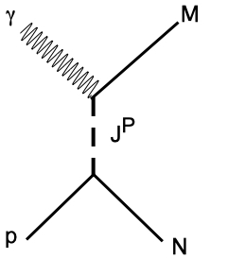
Beam Asymmetry Measurements
γp → NM
Σ is sensitive to the exchange J^{P}.
Effectively
Published π⁰ and initial η results.
More precise η, first η’, π⁻ Δ⁺⁺ and K⁺Σ^{0.}

Slide 21
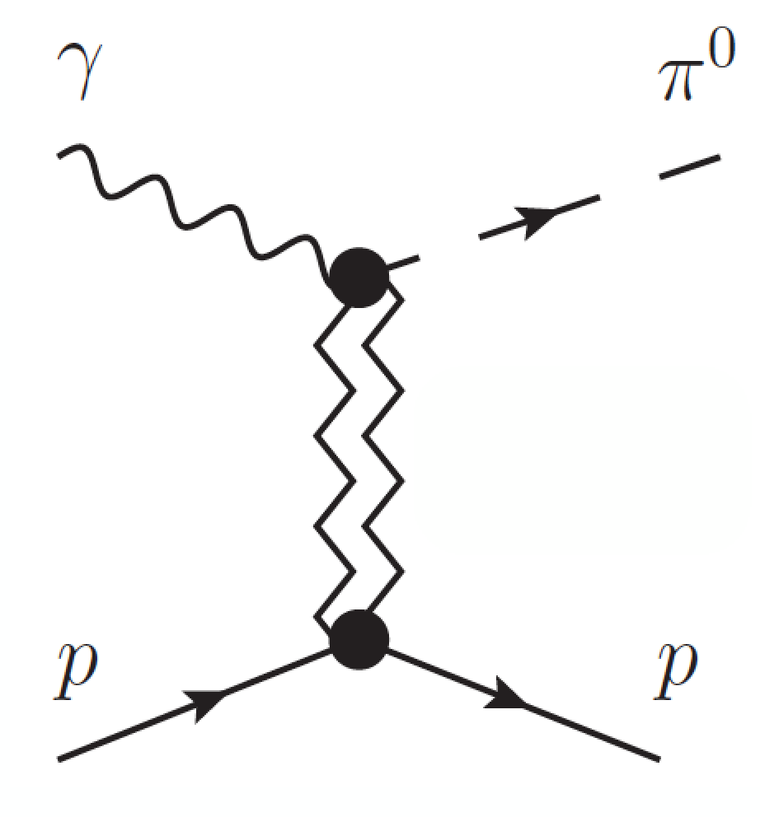


Beam Asymmetry Measurements
Exchange J^{PC}
Impacts extraction of baryon resonances from low-energy photo production experiments.
Understanding the meson production mechanisms at 9GeV is needed for our hybrid searches.
Phys. Rev. C95, 042201 (2017)

Slide 22

Beam Asymmetry Measurements
γp → pη and γp → pη’
η,η’
η’/η→ π⁺π⁻π⁰
η’/η→ π⁰π⁰π⁰
η’/η→ γγ
Vector mesons dominate the exchanges. Σ_{η} = Σ_{η’} implies no
exchanges.
Theory input is very important.
JPAC References:
Phys. Rev. D92, 074013 (2015). Phys. Lett B774, 362 (2017).

Slide 23
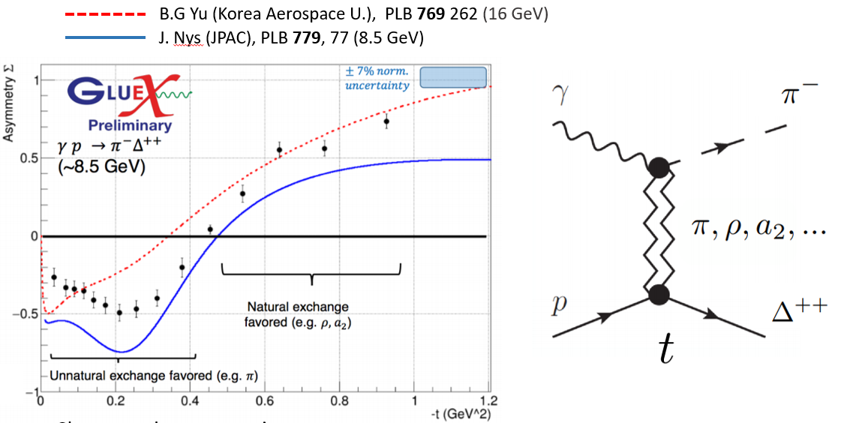
Beam Asymmetry Measurements
γp → Δ⁺⁺π⁻

Slide 24
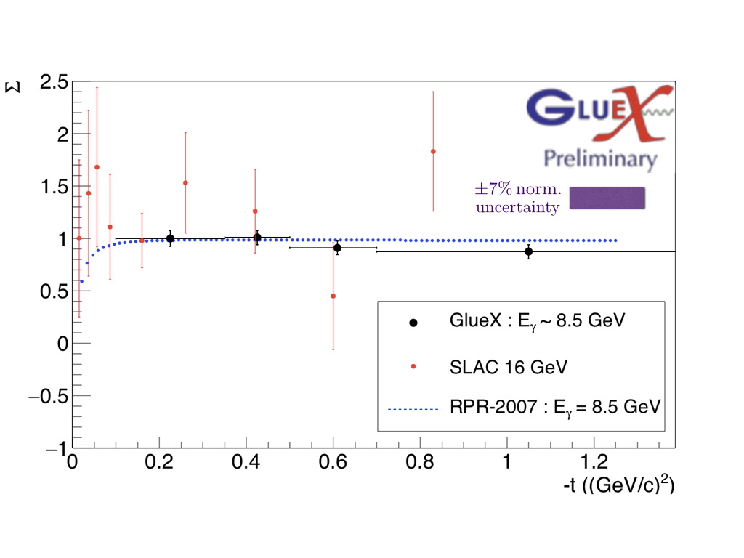
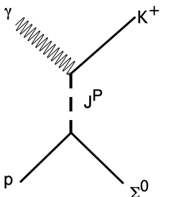
Beam Asymmetry Measurements
γp → Σ⁰Κ⁺
Appears that both t- and u-channel exchanges are involved.
Σ=1 implies natural parity exchange
RPR-2007:Phys. Rev. C75, 045204 (2007)

Slide 25

Opportunistic Physics
The polarized photon beam, acceptance and data-rate capabilities of GlueX combined with an open trigger lead to many opportunistic physics topics beyond spectroscopy. GlueX data is wide open for exploration.
Photoproduction of antibaryons:
Ξ photoproduction (uss) and (dss) states appear as bumps.
J/ψ cross section at threshold under collaboration review.

Slide 26
Cascade Baryons
The spectrum of Ξ baryons is poorly known, with only 5 well determined states.
High acceptance of GlueX allows the reconstruction of exclusive final states. This allows for determination of quantum numbers.
Could potentially double our knowledge of these baryons.
The Ξ⁻(1820) would be the first observation of an excited Ξ in photoproduction.
γp→ K⁺K⁺pπ⁻π⁻
Ξ⁻(1320)
Ξ⁻(1820)?
γp→ K⁺K⁺K⁻Λ
Ξ⁻* → K⁻Λ
Need the full GlueX statistics

Slide 27
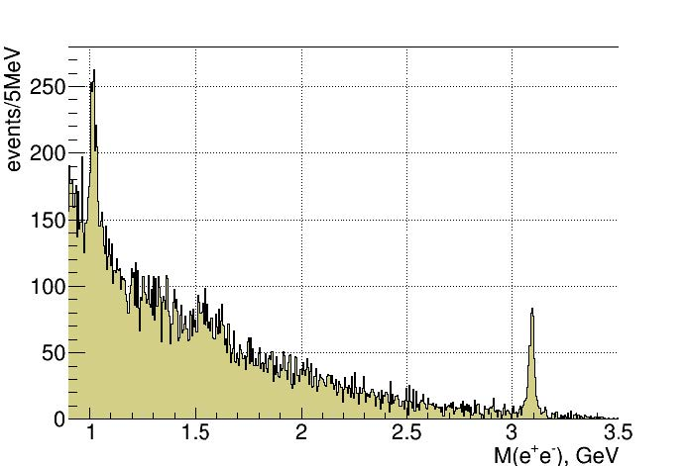
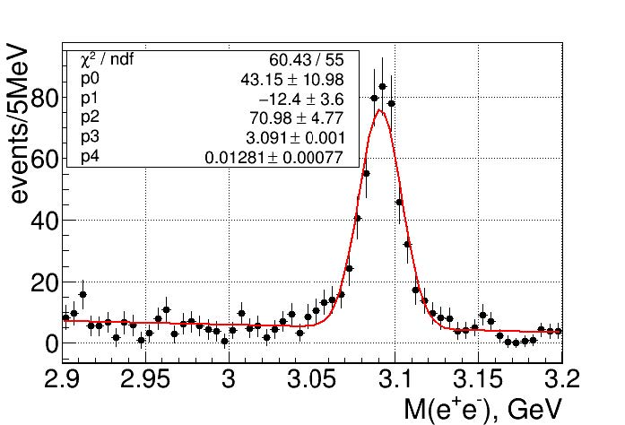
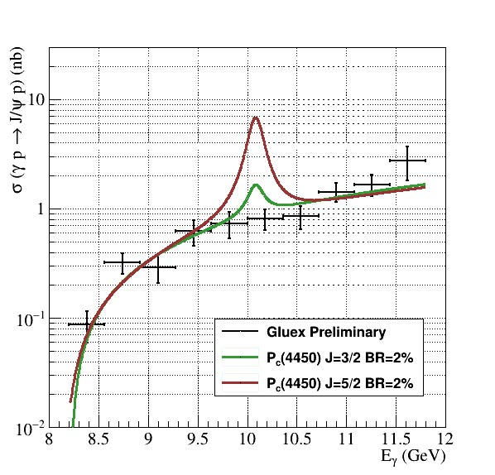
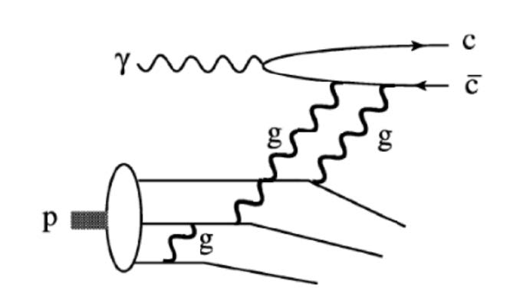
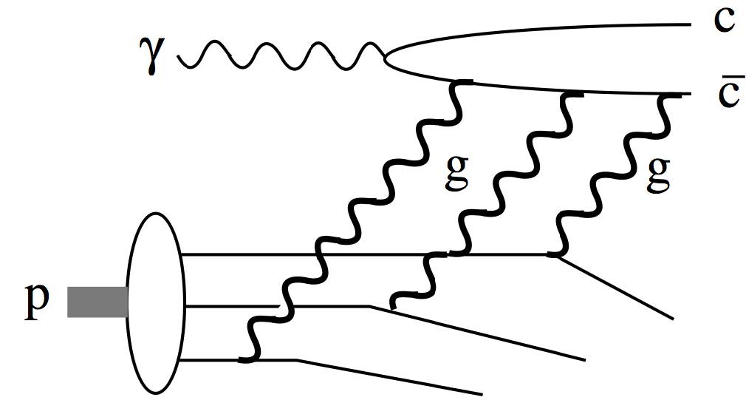
J/ψ Photoproduction
Detect J/ψ through its e⁺e⁻ decay
464±25 J/ψ
Upper limit on LHCb Pentaquark(s)
The two mechanisms have different energy dependences near threshold.

Slide 28
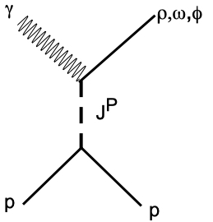
Vector Meson Photoproduction
γp → p(ρ,ω,φ)
Spin-density matrix, ρ, describes the polarization of the produced vector meson.
Extracted from the decay angular distributions.
With linearly polarized photons, we can measure 9 of the 36 real values.
All observables are linear combinations of the SDME elements. P_{σ} is the difference of two ρ elements and measures the degree of natural parity exchange.
ρ⁰ → π⁺π⁻
ω → π⁺π⁻π⁰
φ → Κ⁺Κ⁻
γp → pρ
P_{σ}
SLAC: Phys. Rev. D7, 3150 (1973).
JPAC: Phys. Rev. D97 094003 (2018).

Slide 29
Spin-Density Matrix Elements
γp → pρ
Two of the elements, ρ¹₁₋₁ & Im(ρ²₁₋₁), are very sensitive to the transfer of spin from the photon to the ρ meson.
s-channel helicity would give us +½ and –½. We see ∼0.45 and −0.45.
ρ¹₁₋₁
Im(ρ²₁₋₁)
SLAC: Phys. Rev. D7, 3150 (1973).
JPAC: Phys. Rev. D97 094003 (2018).

Slide 30
Spin-Density Matrix Elements
Two of the elements are very sensitive to the transfer of spin from the photon to the ω meson.
If the exchange is pure “pomeron”, +½ and –½. If it is pure pion exchange, -½ and +½. We see ~.35 and -.35.
M. Staib CMU Ph.D. Thesis 9/17

Slide 31
The Search for Hybrids
GlueX is a discovery experiment utilizing a unique beam, hermetic detector, very sophisticated analyses.
GlueX will produce very large statistics in unexplored reactions.
A detailed understanding of the detector performance is crucial.
Full GlueX statistics are necessary.
Most exotic hybrid mesons could be photoproduced. GlueX can exclusively reconstruct many relevant final states.
Initial Searches:
π₁(1600) → η’π (known state)
π₁(1600) → ρπ
η₁ → ηππ (isospin partner)
η’₁ → Κ∗Κ (isospin partner)
b₂ → ηππ (other nonet)
b₂ → ωπ (other nonet)
b₂ → ρπ (other nonet)
Preliminary studies of these channels indicate interesting signals are present.

Slide 32
The Search for Hybrids
GlueX is a discovery experiment utilizing a unique beam, hermetic detector, very sophisticated analyses.
GlueX will produce very large statistics in unexplored reactions.
A detailed understanding of the detector performance is crucial.
Full GlueX statistics are necessary.
Most exotic hybrid mesons could be photoproduced. GlueX can exclusively reconstruct many relevant final states.
Initial Searches:
π₁(1600) → η’π (known state)
π₁(1600) → ρπ
η₁ → ηππ (isospin partner)
η’₁ → Κ∗Κ (isospin partner)
b₂ → ηππ (other nonet)
b₂ → ωπ (other nonet)
b₂ → ρπ (other nonet)
Preliminary studies of these channels indicate interesting signals are present.

Slide 33
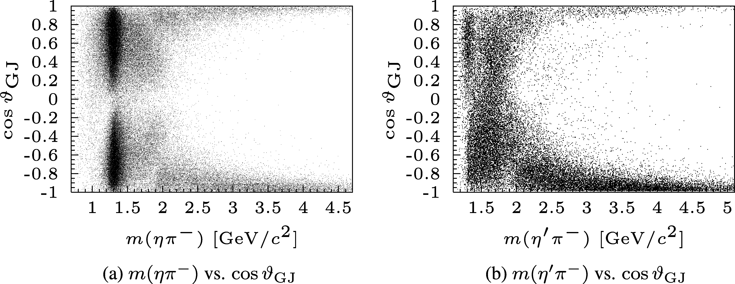
Interesting Hybrid Channels
π⁻p → p ηπ⁻
π⁻p → p η’π⁻
JPAC: Extracted the pole position of the π₁(1600) from the COMPASS amplitudes.
Mass: 1564 +/- 24 +/- 86 MeV
Width: 492 +/- 54 +/- 102 MeV
Highest statistics on π₁(1600) → η’π from COMPASS
ηπ⁻
η’π⁻
116,000 Events
39,000 Events
COMPASS: strong exotic wave in the η’π⁻, but not in the ηπ⁻ data.
a₂(1320)
π₁(1600)
a’₂(1700)
COMPASS: Phys. Lett. B 740, 303 (2015).
JPAC: Phys. Rev. Lett. 122, 042002 (2019).

Slide 34
Interesting Hybrid Channels
First GlueX Hybrid Search
γp → pηπ⁰
γp → pη’π⁰
cos(θ_{J})
cos(θ_{J})
a₀
a₂
ηπ⁰ Invariant Mass [GeV/c²]
η’π⁰ Invariant Mass [GeV/c²]
In same decay modes as COMPASS, GlueX will have 280,000 ηπ⁰ and 52,000 η’π⁰ events in the full data set (versus COMPASS with 116,000 & 39,000).
γp → Δ⁺⁺ηπ⁻
These analyses are underway, but will need the full data set.
Charge exchange reaction is also being studied.
γp → Δ⁺⁺η’π⁻

Slide 35



Interesting Hybrid Channels
γp → pη₁ γp → pb₂
ρ → ππ
f₂ → ππ
a₂ → ηπ
η₁ → ηf₂, a₂π
b₂ → ηρ, a₂π
η’(958)
Look for these
f₁(1285)
several known
states
Hybrid regime
80 hours of beam
2016 Engineering Run

Slide 36
Interesting Hybrid Channels
m²(ηπ)
a₀(980)
a₂(1320)
m²(ππ)
m(ηπ)
ρ(770)
Clear signals for
f₂(1270)?
Weak signal for
m(ππ)
m(ππ)

Slide 37
Summary
GlueX Phase-I completed data taking in 2018.
  About 20% of that data is currently available for physics analysis.
  We expect the remaining 80% to be available in summer 2019.
Phase-I data will allow us to carry out initial hybrid searches.
  π₁(1600) → η’π , ρπ
  η₁ → f₂η, a₂π
  b₂ → ρη, a₂π, ωπ
  h2 → ρπ
A large physics program beyond exotic hybrids with Phase-I data.
Phase-II program with GlueX DIRC and higher flux starts in fall 2019.

