Slide 1
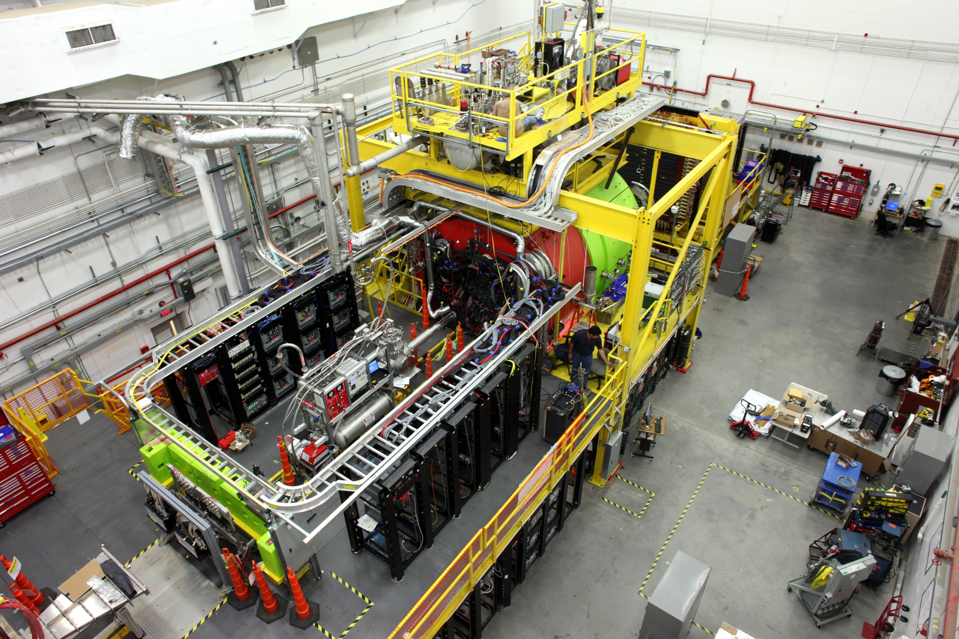
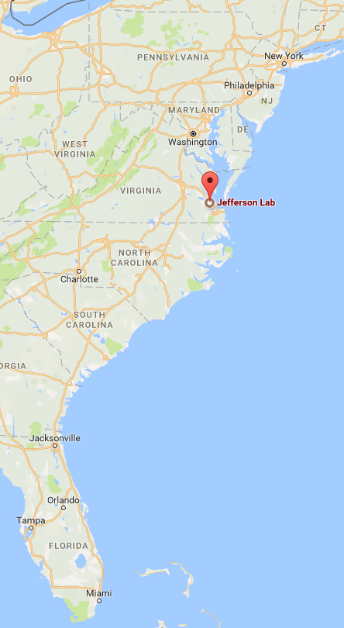
Selected Light Meson Results from GlueX
D. Mack, TJNAF
for the GlueX Collaboration
August 18, 2019 16:15

Slide 2
Overview
GlueX principal motivation: hybrid meson searches
Synergies with light meson studies ( < 1.05 GeV/c² )
Beam asymmetry Σ measurements of π⁰, η, and η’ photo-production
Spin Density Matrix Element (SDME) measurements of vector meson photo-production

Slide 3
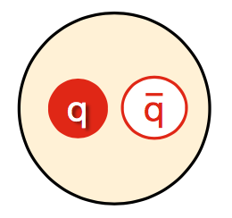
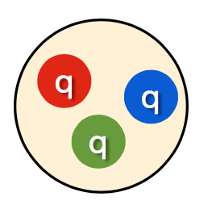
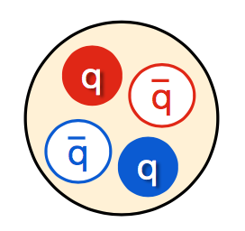
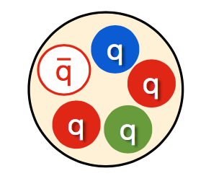
GlueX Principal Motivation
Idea: study QCD through spectrum of bound states
  Static properties of known hadrons well described by first- principals calculations
  Modern experiments provide wealth of data to push boundaries of our knowledge
Open questions:
  What is the origin of confinement?
  Which color-singlet states exist in nature?
  Do gluonic degrees of freedom manifest themselves in the bound states that we observe?
mesons
baryons
tetraquark
pentaquark
q
g
q
g
g
hybrid meson
glueball

Slide 4
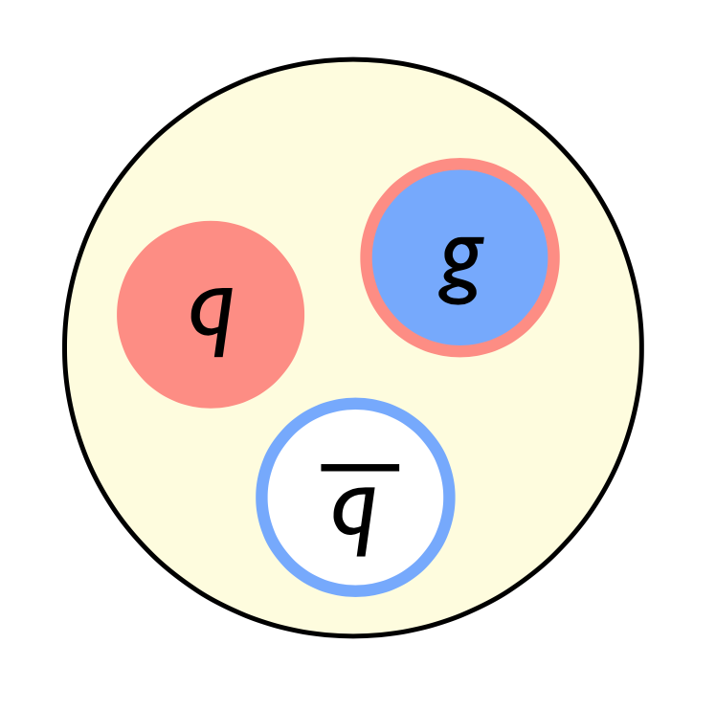
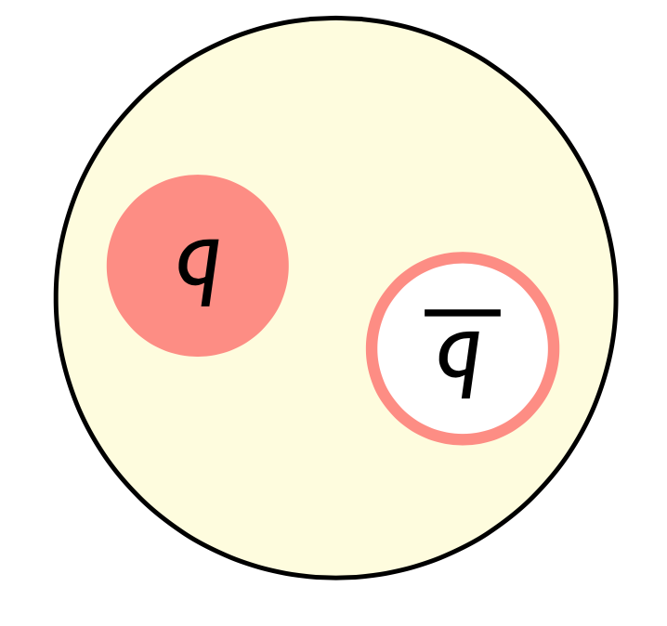
Search Filter for Hybrid Mesons: “Exotic” Quantum Numbers
Mesons are arranged in groups of 9 (“nonets”) with same J^{PC}
gluonic field excitation →
“constituent gluon” (J^{PC}) = 1⁺⁻
J=L+S P=(-1)^{L+1} C=(-1)^{L+S}
“Normal” Meson
“Hybrid” Meson
Allowed J^{PC} : 0⁻⁺, 0⁺⁺, 1⁻⁻, 1⁺⁻, 2⁺⁺, 2⁻⁺,…
Forbidden J^{PC}: 0⁻⁻, 0⁺⁻, 1⁻⁺, 2⁺⁻, …
Allowed J^{PC} : 0⁻⁺, 0⁺⁻, 1⁻⁻, 1⁻⁺,
2⁻⁺, 2⁺⁻, …
Mesons with exotic quantum numbers of 0⁺⁻, 1⁻⁺, 2⁺⁻ would be suggestive of constituent gluon content.
From LQCD, nominal hybrid mass search range is 1.5 – 2.5 GeV/c².

Slide 5
Hybrid Meson Production Via Photo-production
A wide variety of I^{G} J^{PC} states can be produced, including all expected hybrids.
Existing relevant photo-production data are sparse. Barely explored territory.
Photon polarization provides an additional constraint on the production mechanism.
A broad survey requires a large acceptance detector with good PID for both charged particles and photons.

Slide 6
Exotic Meson Production Via Photo-production
π₁ → πρ, πb₁ , πf₁,πη’, ηa₁
η₁ → ηf₂,a₂π,ηf₁, ηη’,π(1300)π, a₁π,
η₁’ → K*Κ, Κ₁(1270)Κ, Κ₁(1410)Κ , ηη’
b₂ → ωπ, a₂π, ρη, f₁ρ, a₁π, h₁π, b₁η
h₂ → ρπ,b₁π,ωη, f₁ω
h’₂ → Κ₁(1270)Κ, Κ₁(1410)Κ, K₂*Κ, φη, f₁φ
b₀ → π(1300)π , h₁π, f₁ρ, b₁η
h₀ → b₁π , h₁η
h’₀ → K₁(1270)Κ, Κ(1460)Κ, h₁η
A wide variety of I^{G} J^{PC} states can be produced, including all expected hybrids.
Existing relevant photo-production data are sparse. Barely explored territory.
Photon polarization provides an additional constraint on the production mechanism.
A broad survey requires a large acceptance detector with good PID for both charged particles and photons.

Slide 7
Synergy Between Light Meson Studies and Exotic Hybrid Search
Consider the η’→ η π⁺π⁻ → 2γ π⁺π⁻ branch for which I’ll show Σ asymmetry results today.
The exotic hybrid meson candidate η₁ is expected to decay as
η₁ → η f₂ → η (2π) _{84%}
→ π a₂ → π (ηπ) _{15%}
where both η2π⁰ and η π⁺π⁻ can be searched for signals.
As for the exotic hybrid meson candidate b₂
b₂ → η ρ → η (π⁺π⁻) _{100%}
only the charged channel is useful since there is no ρ → 2π⁰ .
η’

Slide 8
Synergy Between Light Meson Studies and Exotic Hybrid Search
Consider the η’→ η π⁺π⁻ → 2γ π⁺π⁻ branch for which I’ll show Σ asymmetry results today.
The exotic hybrid meson candidate η₁ is expected to decay as
η₁ → η f₂ → η (2π) _{84%}
→ π a₂ → π (ηπ) _{15%}
where both η2π⁰ and η π⁺π⁻ can be searched for signals.
As for the exotic hybrid meson candidate b₂
b₂ → η ρ → η (π⁺π⁻) _{100%}
only the charged channel is useful since there is no ρ → 2π⁰ .
η’
Σ asymmetry studies of η⁽‘⁾ production have allowed us to develop cuts and study backgrounds while surveying higher masses.
SDME studies of the vector mesons ρ, ω, and ϕ , as well as cross-section studies, are testing our acceptance corrections.
The building blocks for nearly all the hybrid meson candidates on the previous slide have now been studied in GlueX.

Slide 9
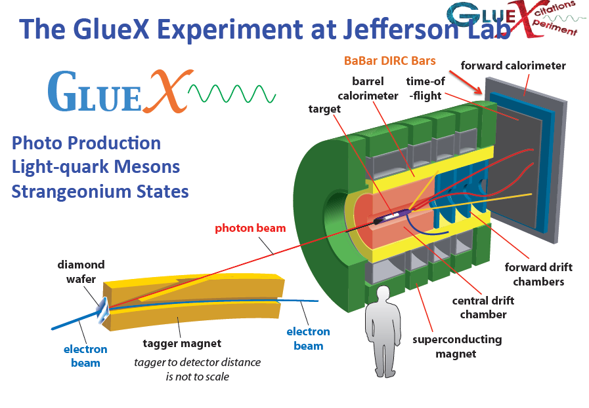
Salient features for the field of meson spectroscopy:
    Intense beam of 3-12 GeV photons of known energy
    40% linear polarization in the coherent peak near 9 GeV.
Sparse bubble chamber data from SLAC were all that existed for photons of this energy.

Slide 10
Polarimetry, Flux, and W = sqrt(s)
Using oriented diamond radiator, the peak polarization is near 40%.
Precision beam polarimetry (+-1.5% uncertainty) is provided by theTriplet POLarmeter (TPOL):
NIM A867 (2017) 115-127 https://arxiv.org/abs/1703.07875
Flux also peaks near 8.8 GeV.
In the coherent peak,
W = sqrt(s) ~ 4 GeV/c², well above the baryon resonance region.

Slide 11
The Beam Asymmetry, Σ, for γ+p→p+PS
Tests the reaction mechanism for photo-production.
See also W. McGinley MENU 2019: https://registration.mcs.cmu.edu/event/1/contributions/145/

Slide 12
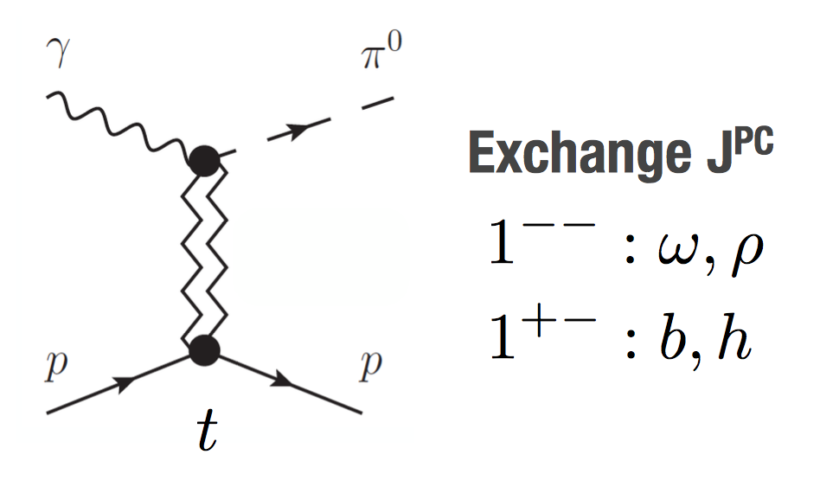
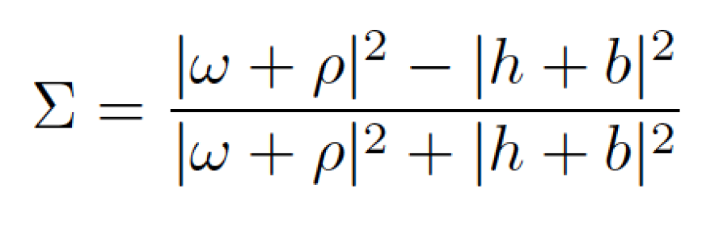
Beam Asymmetries: γ + p → p + π⁰ / η⁽‘⁾
Aids in understanding the reaction mechanism for photo-production of pseudo-scalar mesons.
“Production of the lightest multiplet of exotic mesons with J^{PC} = 1⁻⁺ involves the same Regge exchanges that appear in the production of ordinary pseudoscalar mesons, like π⁰, η, and η’. “ https://arxiv.org/abs/1704.07684v2
Understanding the production mechanisms will assist in building a hybrid PWA model to describe the data.
Through Finite Energy Sum Rules, data at high energy described by exchange of meson Regge poles can constrain models at lower energy in the baryon resonance region. https://arxiv.org/abs/1708.07779
Σ ~ 1 means dominance of vector (natural parity) exchange.
Σ ~ -1 means dominance of axial vector (unnatural parity) exchange
JPAC: Mathieu et al., PRD 92, 074013
https://arxiv.org/abs/1505.02321

Slide 13
Cancellation of Instrumental Asymmetries
With ϕ the angle of the meson production plane, and ϕ_{s} the angle in which the linear polarization lies, the ϕ dependent yield is given in terms of the cross section and the beam asymmetry, Σ:
Y_{pol}(ϕ) = σ₀[1 - PΣcos{2(ϕ-ϕ_{s})}]
In principle, for one ϕ_{s} setting we could fit PΣ . But there’s usually a scale-type instrumental asymmetry of O(1)%, so in practice
Y_{pol}(ϕ) = σ₀[1-PΣcos{2(ϕ-ϕ_{s})}] A(ϕ)
To avoid having to correct for A(ϕ), we combine measurements at two values of ϕ_{s} ,
for ϕ_{s} = 0° (Parallel), Y_{Para}(ϕ) = σ₀[1 - PΣcos(2ϕ)] A(ϕ)
for ϕ_{s} = 90° (Perpendicular), Y_{Perp}(ϕ) = σ₀[1 + PΣcos(2ϕ)] A(ϕ)
Then
Y_{perp}(ϕ) - Y_{Para}(ϕ)
--------------------- = PΣcos(2ϕ)
Y_{perp}(ϕ) - Y_{Para}(ϕ)
which can be fitted to obtain PΣ .

Slide 14
Cancellation of Instrumental Asymmetries
With ϕ the angle of the meson production plane, and ϕ_{s} the angle in which the linear polarization lies, the ϕ dependent yield is given in terms of the cross section and the beam asymmetry, Σ:
Y_{pol}(ϕ) = σ₀[1 - PΣcos{2(ϕ-ϕ_{s})}]
In principle, for one ϕ_{s} setting we could fit PΣ . But there’s usually a scale-type instrumental asymmetry of O(1)%, so in practice
Y_{pol}(ϕ) = σ₀[1-PΣcos{2(ϕ-ϕ_{s})}] A(ϕ)
To avoid having to correct for A(ϕ), we combine measurements at two values of ϕ_{s} ,
for ϕ_{s} = 0° (Parallel), Y_{Para}(ϕ) = σ₀[1 - PΣcos(2ϕ)] A(ϕ)
for ϕ_{s} = 90° (Perpendicular), Y_{Perp}(ϕ) = σ₀[1 + PΣcos(2ϕ)] A(ϕ)
Then
Y_{perp}(ϕ) - Y_{Para}(ϕ)
--------------------- = PΣcos(2ϕ)
Y_{perp}(ϕ) - Y_{Para}(ϕ)
which can be fitted to obtain PΣ .
As long as the inefficiency doesn’t
change with time, it cancels exactly.

Slide 15
How the Beam Asymmetry is Measured
π⁰ region:
negligible bkg from missing a bachelor photon from ω→π⁰γ_{B .}
η
η region:
Small bkg from missing a photon from the π⁰ in ω→π⁰γ_{B .}
π⁰
M(2γ)

Slide 16
How the Beam Asymmetry is Measured
π⁰ region:
negligible bkg from missing a bachelor photon from ω→π⁰γ_{B .}
η
η region:
Small bkg from missing a photon from the π⁰ in ω→π⁰γ_{B .}
π⁰
M(2γ)
Y_{perp}(ϕ)
And
Y_{Para}(ϕ)
Y_{perp}(ϕ) - Y_{Para}(ϕ)
--------------------
Y_{perp}(ϕ) - Y_{Para}(ϕ)

Slide 17
How the Beam Asymmetry is Measured
π⁰ region:
negligible bkg from missing a bachelor photon from ω→π⁰γ_{B .}
η
η region:
Small bkg from missing a photon from the π⁰ in ω→π⁰γ_{B .}
π⁰
M(2γ)
Y_{perp}(ϕ)
And
Y_{Para}(ϕ)
Y_{perp}(ϕ) - Y_{Para}(ϕ)
--------------------
Y_{perp}(ϕ) - Y_{Para}(ϕ)
In practice, we fit Σ allowing for P_{perp} ≠ P_{para} as well as a small azimuthal offset between
ϕ of the detector and ϕ_{s} of the diamond.
Y_{perp}(ϕ) - Y_{Para}(ϕ) P_{ave}Σcos[2(ϕ-ϕ₀)]
--------------------- = --------------------------
Y_{perp}(ϕ) - Y_{Para}(ϕ) 1 + ΔP Σcos[2(ϕ-ϕ₀)]/2

Slide 18
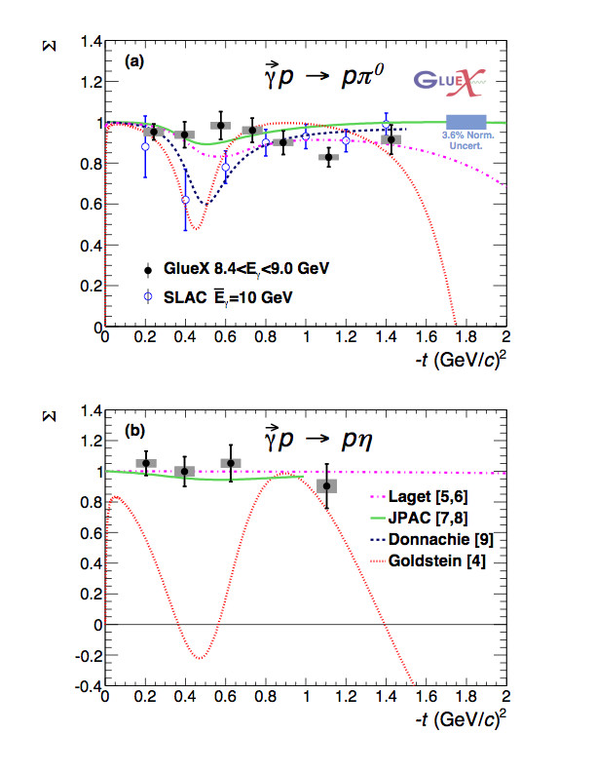
Beam Asymmetries from Commissioning Run: γ + p → p + π⁰ / η
Our first GlueX physics publication!
PRC 95, 042201 (2017)
https://arxiv.org/abs/1701.08123
Sabbatical project of Zhenyu “Jane” Zhang, Wuhan U.
Asymmetry Σ
Exclusive, very low bkg measurements of γ+p→p+2γ:
Σ ≈ 1 indicates vector exchange dominates this beam energy and –t range.
The η measurement was the first in this beam energy range.
Asymmetry Σ

Slide 19
Updated Beam Asymmetries with 8x More Data: γ + p → p + π⁰ / η
π⁰ results have been updated (in black).
High statistics π⁰ data allowed us to explore fit systematics at the sub-percent level.
Asymmetry Σ
η results have been updated (in blue).
Asymmetry Σ
For both π⁰ and η, these much more precise results elucidate the higher order contributions from axial vector meson exchange such as the b₁(1235).
Paper draft under internal review.
Thesis work of Will McGinley (CMU)

Slide 20
A New Beam Asymmetry for GlueX: γ + p → p + η‘
First beam asymmetry measurements of the η’ in this energy range.
Uses our cleanest, highest yield η’ channel: η’ → η π⁺π⁻ → 2γ π⁺π⁻
All 5 final state particles (including the recoil proton) are detected with an acceptance of ~10%.
Σ
With these limited η’ statistics, all we can say with confidence is that the η’ results are dominated by vector meson exchange.
η’
Thesis topic of Tegan Beattie (U. Regina)

Slide 21
A New Beam Asymmetry for GlueX: γ p → p + η‘
First beam asymmetry measurements of the η’ in this energy range.
Uses our cleanest, highest yield η’ channel: η’ → η π⁺π⁻ → 2γ π⁺π⁻
All 5 final state particles (including the recoil proton) are detected with an acceptance of ~10%.
Σ
With these limited η’ statistics, all we can say with confidence is that the η’ results are dominated by vector meson exchange.
The ratio of η’/η asymmetries should be exactly 1 without hidden strangeness (eg, ϕ exchange). With expected levels of N→Nϕ , the ratio should be less 1.01 . https://arxiv.org/abs/1704.07684
η’
The 4x larger 2018 dataset would allow a more convincing check that η and η’ photoproduction are similar as expected.
Thesis topic of Tegan Beattie (U. Regina)

Slide 22
Spin Density Matrix Elements (SDME’s) for Vector Meson Photo-production
Also tests the reaction mechanism for photo-production, but now including the richer information provided by decay of a vector meson.
See also A. Austregesilo MENU 2019: https://registration.mcs.cmu.edu/event/1/contributions/41/

Slide 23
JPAC SDME Model
In the JPAC Regge model of vector meson photo-production,
the leading trajectories are
Natural parity exchange from the Pomeron is also included.
Meson-nucleon and meson radiative decay widths are taken from literature or estimated.
SLAC data at 9.3 GeV are used for constraints, the ρ data having significantly smaller statistical errors than the others.
PRD 97, 094003 (2018)
https://arxiv.org/abs/1802.09403

Slide 24
JPAC SDME Model
In the JPAC Regge model of vector meson photo-production,
the leading trajectories are
Although these vector mesons have the same J^{PC}, the predicted SDME’s are quite different in this example for E_{γ} = 8.5 GeV:
ω ρ ϕ
Natural parity exchange from the Pomeron is also included.
Meson-nucleon and meson radiative decay widths are taken from literature or estimated.
SLAC data at 9.3 GeV are used for constraints, the ρ data having significantly smaller statistical errors than the others.
PRD 97, 094003 (2018)
https://arxiv.org/abs/1802.09403

Slide 25
Coordinate Systems
In the Σ asymmetry slides, we saw the beam spin asymmetry was extracted from the yield variation proportional to cos[2(ϕ-ϕ_{s})] where
ϕ is the meson production plane, and
ϕ_{s} is the polarization plane.
The decay contains no information for spin 0.
Lab Frame

Slide 26
Coordinate Systems
In the Σ asymmetry slides, we saw the beam spin asymmetry was extracted from the yield variation proportional to cos[2(ϕ-ϕ_{s})] where
ϕ is the meson production plane, and
ϕ_{s} is the polarization plane.
The decay contains no information for spin 0.
Because the decay distribution of spin 1 particles depends on the final polarization, it makes sense to transfer into the helicity frame. There are two additional decay angles and some potentially confusing nomenclature overlaps:
Σ | SDME’s | Description
ϕ |  | Meson production plane
ϕ_{s} |  | Linear Polarization plane
ϕ - ϕ_{s} | Φ | Difference between production and polarization planes.
--- | ϕ | Azimuthal decay angle in helicity frame
--- | θ | Polar decay angle in helicity frame
Lab Frame
Helicity Frame

Slide 27
How the SDME’s are Measured: ω example
The SDMEs describe the polarization of the vector meson.
The angular distribution for the vector decay in the helicity frame is
where
Assuming only linear polarization,
Pγ^{vec} = Pγ (-cos2Φ – sin2Φ, 0)
Then for the hadronic ω decay:
There are 9 linearly independent parameters; 6 require beam polarization.

Slide 28
How the SDME’s are Measured: ω example
Plots like this for each bin in -t.
M. Staib, PhD thesis,
Sept 2017, CMU
The SDMEs describe the polarization of the vector meson.
The angular distribution for the vector decay in the helicity frame is
Φ
where
Although there is cancellation of some instrumental asymmetries when we combine data for Para and Perp,
the SDME’s are a bigger challenge than the Σ asymmetry because acceptance corrections are needed in ϕ and θ .
Assuming only linear polarization,
cos(θ)
Pγ^{vec} = Pγ (-cos2Φ – sin2Φ, 0)
Fit
quality
is
Good!
Then for the hadronic ω decay:
ϕ
There are 9 linearly independent parameters; 6 require beam polarization.

Slide 29
Parity Asymmetry
For the ρ, it will be particularly useful to transform to linear combinations which are Natural or Unnatural. (next slide)
The parity asymmetry has a similar physical interpretation to Σ:
ω: Unnatural parity exchange is significant even at low –t for the ω .
ρ: Natural parity dominates for the ρ at low –t.
This unnatural parity exchange may be from π⁰ exchange due in part to the large BR for ω→π⁰γ .

Slide 30
Natural and Unnatural Projections for the ρ
For the ρ, all the natural exchange terms (top) are larger than the unnatural exchange terms (bottom).
SCHC only works in –t → 0 limit.
GlueX ρ data have enormously improved statistics.
JPAC model works fairly well below –t ~ 0.5 .
Even natural exchange has unexpected behavior at –t > 0.5

Slide 31
JPAC Model vs GlueX Data for ω
For the ω, on the right are the regular SDME’s
(ie not the Natural and Unnatural linear combinations):
2016 only
SCHC only works in –t →0 limit.
GlueX ω data have significantly improved statistics
JPAC model agreement with preliminary data is only qualitative.
No breakdown of relative contributions in JPAC paper, but earlier OTL model suggests ω results are sensitive to π⁰ vs Pomeron

Slide 32
JPAC Model vs GlueX Data for ω
For the ω, on the right are the regular SDME’s
(ie not the Natural and Unnatural linear combinations):
2016 only
SCHC only works in –t →0 limit.
GlueX ω data have significantly improved statistics
JPAC model agreement with preliminary data is only qualitative.
No breakdown of relative contributions in JPAC paper, but earlier OTL model suggests ω results are sensitive to π⁰ vs Pomeron
Oh, Titov, and Lee Dotted- mostly π⁰ Dashed- Pomeron
https://arxiv.org/abs/nucl-th/0006057

Slide 33
Summary
GlueX is a fixed target, linearly polarized photo-production facility with the beam energy, acceptance, and intensity to search for hybrid mesons in the expected mass range of 1.5-2.5 GeV/c².
The detectors and beamline instrumentation are all working well: eg, exclusive η’ photo-production is reconstructed with low background by detecting 5 tracks+showers with a total efficiency of ~10%.
Σ Asymmetries:
  Our commissioning data were previous analyzed to extract beam asymmetry (Σ) measurements of π⁰ and η photo-production:
i. first Σ measurements on the η in this beam energy range (published)
ii. natural parity exchange (ie vectors) dominates for –t below 1 (GeV/c)².
  Production data with 8x our earlier statistics have now been analyzed to extract Σ (draft paper being circulated internally)
i. first Σ measurements on the η’ in this beam energy range .
ii. natural parity exchange also dominates for the η’, but a detailed comparison of η vs η’ will require much
more statistics.
iii. we have more precise results for the π⁰ and η , approaching a systematic limit of a few percent at low –t .
SDME’s:
  Preliminary SDME’s for ρ, ω, and φ have been produced.
i. For the ρ , impressive statistics and good agreement with JPAC model below –t ~ 0.5 (GeV/c)².
ii. For the ω , good statistics but only qualitative agreement with the JPAC model.

Slide 34
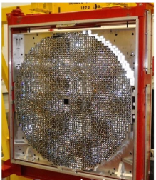
Acknowledgements
The organizers and staff of this conference for the opportunity to visit Guilin.
My GlueX collaborators, for discussions, stolen slides, and all their original work. (Thanks,Tegan, Will, Alex, and Georgios!)

Slide 35
backups

Slide 36
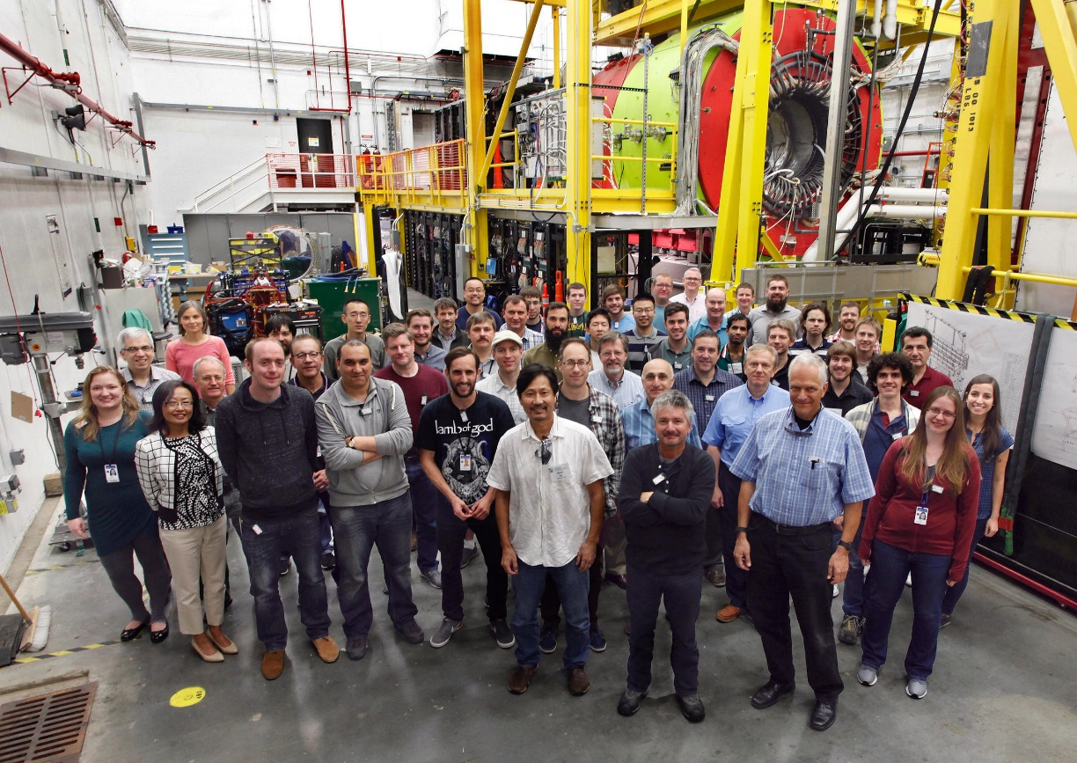
The GlueX Collaboration
Arizona State, Athens, Carnegie Mellon, Catholic University, Univ. of Connecticut, Florida International, Florida State, George Washington, Glasgow, GSI, Indiana University, IHEP, ITEP, Jefferson Lab, U. Mass Amherst, MIT, MePhi, Norfolk State, North Carolina A&T, Univ. North Carolina Wilmington, Northwestern, Old Dominion, Santa Maria, University of Regina, Tomsk, Wuhan and Yerevan Physics Institute.
Over 125 collaborators from more than 25 institutions with others joining and more are welcome.

Slide 37
GlueX References (updated 8/7/19)
Physics results: | GlueX Sigma Asymmetry on pi0, eta | Phys.Rev.C 95, 042201 (2017) | https://arxiv.org/abs/1701.08123
 | ρ SDME’s | A. Austregesilo talk at MENU 2019 | https://registration.mcs.cmu.edu/event/1/contributions/41
 | Sigma Asymmetries on pi0, eta, eta’ | W. McGinley talk at MENU 2019 | https://registration.mcs.cmu.edu/event/1/contributions/145/
NIM articles: | Triplet POLarimeter | NIM A867 (2017) 115-127 | https://arxiv.org/abs/1703.07875
 | GlueX Start Counter | NIM, A927 (2019) 330–342 | https://arxiv.org/abs/1901.02759
 | BCAL | NIM A896 (2018) 24-42 | https://arxiv.org/abs/1801.03088
PhD Theses | ω SDME’s | M. Staib, PhD thesis, Sept 2017, Carnegie Mellon U.
 | φ SDME’s | A. Barnes, PhD thesis, May 2017, U. of Connecticut
 | Eta and eta’ Σ asymmetry | T. Beattie, PhD thesis, March 2019, U. of Regina

Slide 38
Theory References (updated 8/7/19)
Oh, Titov, and Lee | Omega photoproduction | PRC 63, 025201 | https://arxiv.org/abs/nucl-th/0006057
Misc JPAC references | Pi0 Regge model | PRD 92, 074013 | https://arxiv.org/abs/1505.02321
 | High energy constraints on low energy baryon resonances | JLab report JLAB-THY-17-2539 | https://arxiv.org/abs/1708.07779
 | Eta and eta’ Regge model | PLB, 774, 10 November 2017, Pages 362-367 | https://arxiv.org/abs/1704.07684v2
 | Vector meson Regge model | PRD 97, 094003 (2018) | https://arxiv.org/abs/1802.09403

Slide 40
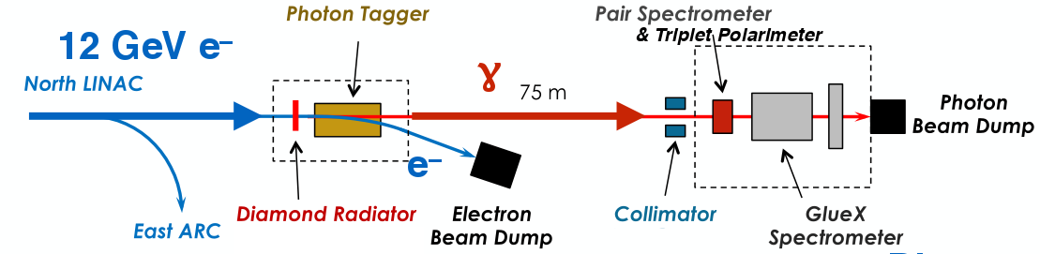
Photon Beamline

Slide 41
GlueX Detector
Solenoid, Target (blue)
Tracking (red)
beam
Calorimetry (green)
Timing (magenta)

Slide 43
M(ηπ) vs M(2π) in γ+p→pηπ⁺π⁻
M(ηππ) cut to meson masses ~ 2 GeV/c²
m²(ηπ)
Strong
π a2 signal
Bkg from π a0.
m²(ππ)
Very strong
η ρ signal
Needs a PWA!
We’re just getting started with the fairly complex event selection.

Slide 44
SDME’s of Vector Mesons
In the OTL model, the ω SDMEs are sensitive to the relative amounts of Pomeron and PS meson exchange (mostly π⁰ due to the large value of g_{πNN}) .
Blue – Pomeron Only Red – Pseudoscalar Only Green – Combined
-t dependence of ω SDMEs
Note the often very different behavior predicted for Blue/Pomeron vs Red/PS exchange.

Slide 45
SDME’s of ω Mesons
Broadly speaking, results are consistent with the dominance of Pomeron exchange at our beam energy and range of –t.
In the context of the OTL model, a small adjustment in the relative strengths of the Pomeron and π⁰ may be needed.
This SDME has
little sensitivity
to P vs PS
ω SDME’s, M. Staib, PhD thesis, Sept 2017, Carnegie Mellon U.
Strong sensitivity
to P vs PS
Dotted- mostly pi0
Dashed- Pomeron

Slide 46
Abstract Submitted to Hadron 2019
Selected

