Slide 1
Sensitivities of Rho Meson SDMEs to Parameters of the JPAC Model
Dave Mack
TJNAF
September 16, 2019
Abstract
In the JPAC model, the rho SDMEs in the helicity frame at 8.5 GeV beam energy are mainly sensitive to the f2 and Pomeron exchanges, and hence to the corresponding vertex couplings. The f2 contributions dominate the deviations from SCHC, while the Pomeron dilutes them. Since the ratio of Pomeron/f2 increases with beam energy, the deviations from SCHC become quite small by 25 GeV. The 3 unpolarized SDMEs have similar sensitivities to the 6 polarized SDMEs, so might provide useful parameter constraints over the full beam energy range of GlueX. It’s not clear to me what’s going on with the Natural versions of the SDMEs; while the unnatural versions are indeed relatively small, the natural versions don’t show the purity I was naively expecting at 8.5 GeV.

Slide 2
While working on the “light meson results” talk for Hadron 2019, I wondered what physics we can extract from Alexander A’s precise rho SDMEs at https://halldweb.jlab.org/doc-private/DocDB/ShowDocument?docid=4134 .
The JPAC paper PRD 97, 094003 (2018) is quite detailed, but there’s no plot to indicate what the dominant contributions are for the rho. There is also no simple explanation why the SDMEs are so different for the omega, rho, and phi even though they’re all J^{PC} = 1⁻⁻ mesons. (See plot on right. Different radiative decay widths at the gamma-X-Vector vertices play an important role, but are only part of the story.)
Fortunately, we have Vincent’s wonderful calculator at http://cgl.soic.indiana.edu/jpac/sdme.php#simu .
In the following slides, I’ll examine the sensitivities of the rho SDMEs at 8.5 GeV.

Slide 3
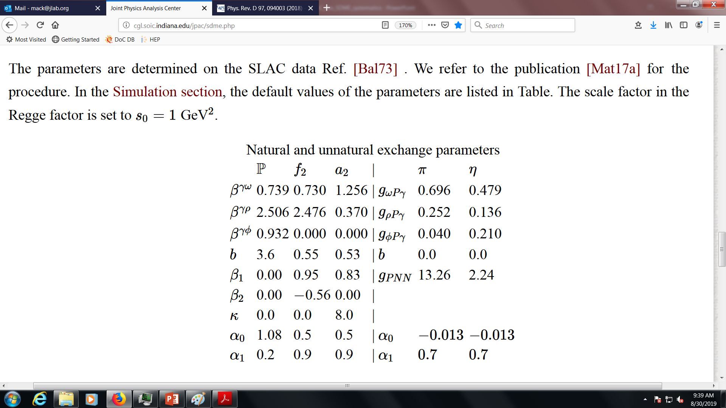
Ignoring the gamma-X-omega and gamma-X-phi vertex couplings, it looks like there are 31 parameters potentially affecting rho production.

Slide 4
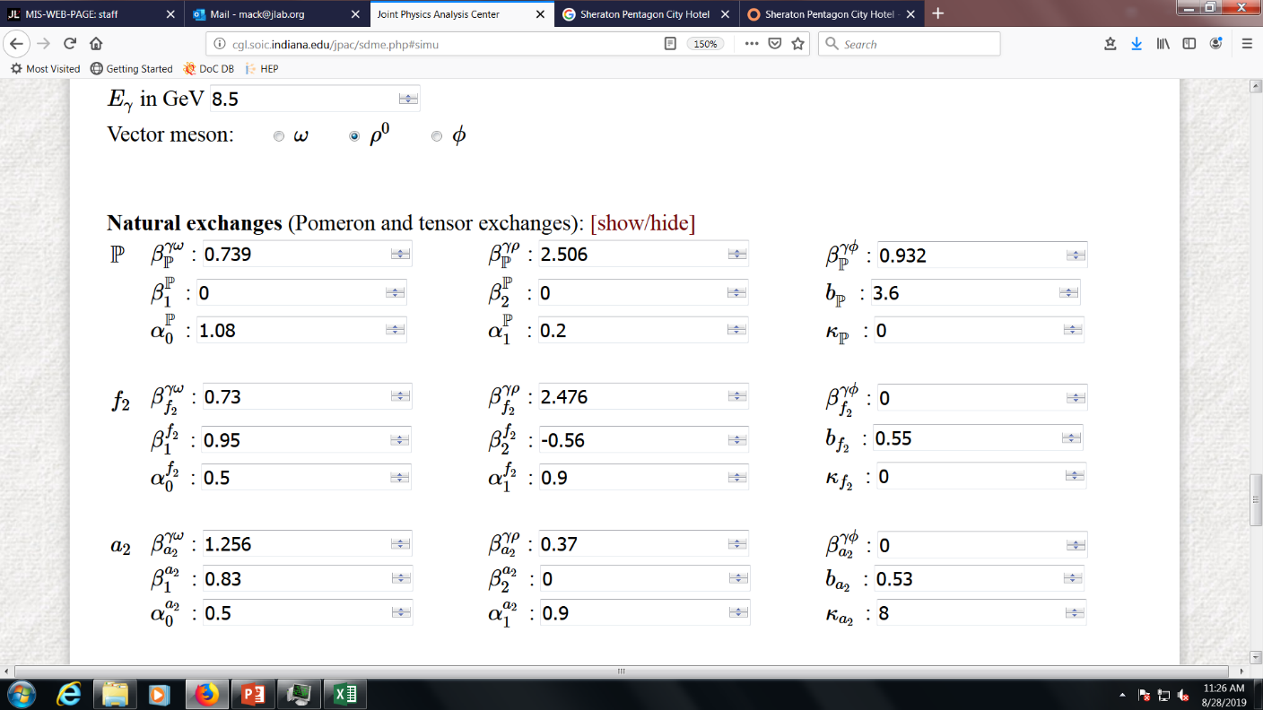
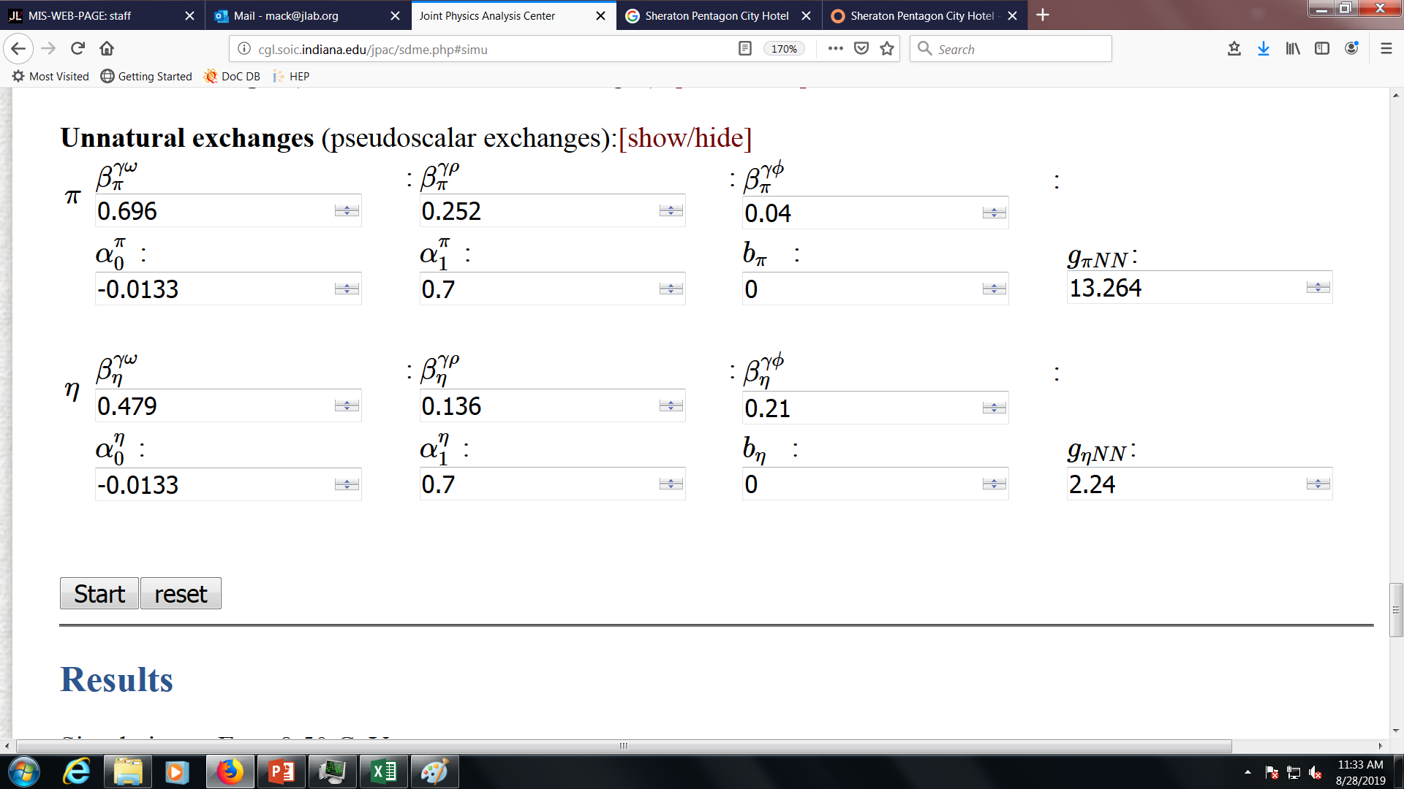
I chose not to play with any lower vertex (ie, N-N-meson) couplings, nor with any Regge trajectory parameters, nor with the b parameters that determine the slopes of the differential cross section dsigma/dt .
To see which exchanges were most important, I set the upper vertex gamma+meson→rho couplings to 0 for the each of the contributions in turn. (These are the beta parameters which have a meson subscript, marked in yellow below.)

Slide 5
This is a plot of a typical rho SDME after setting the upper vertex couplings to zero (one at a time):
SCHC
Since all SDME’s were impacted similarly, I show only one representative above. (See Backups for all the plots.) For this particular SDME, helicity conservation in the s-channel would be denoted by a horizontal line at 0 . The following statements apply to all 9 rho SDME’s:
The dominant contributions are from natural parity exchange from the Pomeron and f2 . We are very insensitive to other contributions.
The f2 exchange (see “No Pomeron” curve) tends to break SCHC much more than the Pomeron (see “No f2” curve). Under the JPAC assumptions about the helicity structure of the Pomeron, the latter’s role is to dilute the SCHC-violating effects of the f2.
One thing we can learn from rho SDME data is the relative strength of the Pomeron and f2 exchanges at this beam energy.

Slide 6
This is a plot of a typical rho SDME after setting the upper vertex couplings to zero (one at a time):
SCHC
The online calculator gives NAN when I turn off the eta couplings, so there’s no curve for “no eta”. The contribution will probably be smaller than pi exchange. I’ll compile a wish list and send it to Vincent.
Since all SDME’s were impacted similarly, I show only one representative above. (See Backups for all.) For this particular SDME, helicity conservation in the s-channel would be denoted by a horizontal line at 0 . The following statements apply to all 9 rho SDME’s:
The dominant contributions are from natural parity exchange from the Pomeron and f2 . This is a huge simplification.
The f2 exchange (see “No Pomeron” curve) tends to break SCHC much more than the Pomeron (see “No f2” curve). Under the JPAC assumptions about the helicity structure of the Pomeron, the latter’s role is to dilute the SCHC-violating effects of the f2.
One thing we can learn from rho SDME data is the relative strength of the Pomeron and f2 exchanges at this beam energy.

Slide 7
Oh, Titov, and Lee
https://arxiv.org/abs/nucl-th/0006057
For the omega total photoproduction xsect, the GlueX invariant mass region of W ~ 4 lies between the low energy dominance of pi exchange and the high energy dominance of Pomeron exchange.
I haven’t found a corresponding plot for rho photoproduction, but Donnachie and Landschoff in PLB 348 (1995) 213-218 confirm that the Pomeron contribution to the total rho cross section rises slowly with energy (s^0.08) while the meson contributions drop steeply with energy (s^-0.45).
It seems GlueX is in an interesting, transitional regime where vector meson photoproduction measurements can constrain both the dominant Regge exchanges as well as the Pomeron.
pi0
Pomeron

Slide 8
At “sufficiently high energies”, the following linear combinations of the SDMEs can project out the Natural and Unnatural
exchange contributions in 3+3 terms:
[Mat18a]
V. Mathieu, et al (JPAC),
``Vector Meson Photoproduction with Linearly Polarized Beam,'' arXiv:1802.09403 [hep-ph],
There’s a clear model prediction that
Unnatural << Natural. But since the rho SDMEs in this –t range were already dominated by Natural exchange, the sensitivities of this Natural projection to f2 and Pomeron couplings won’t be significantly better.
Here’s one Natural and it’s corresponding Unnatural example, side by side: (see Backups for all)

Slide 9
At sufficiently high energies, the following linear combinations of the SDMEs can project out the Natural and Unnatural
exchange contributions in 3+3 terms:
[Mat18a]
V. Mathieu, et al (JPAC),
``Vector Meson Photoproduction with Linearly Polarized Beam,'' arXiv:1802.09403 [hep-ph],
There’s a clear model prediction that
Unnatural << Natural. But since the rho SDMEs in this –t range were already dominated by Natural exchange, the sensitivities of this Natural projection tof2 and Pomeron couplings won’t be significantly better.
Here’s one Natural and its corresponding Unnatural example, side by side: (see Backups for all)
I’m not sure why there is any sensitivity to unnatural exchanges from a2 and pi here . Perhaps 8.5 GeV is not high enough beam energy. Unfortunately, when I set the beam energy to 25 GeV for a test, the data become highly Pomeron dominated, conserve SCHC very well, and the SDMEs become boring nearly straight lines.

Slide 10
If we’re only going to study a handful of sensitivities of the SDMEs to model parameters, we definitely want to focus on the f2 and the Pomeron parameters.
So the next test was to set the beta^f2_1 and beta^f2_2 coefficients to zero, one at a time. (These are the single and double helicity flip parameters at the top vertex, respectively.)

Slide 11
Setting either beta^f2_1 or beta^f2_2 to 0:
6 of the SDMEs behave like the example below left, where deviations from SCHC are dominated by beta^f2_1 . (See Backups for all plots.)
2 of the SDMEs are sensitive to beta^f2_2 while simultaneously being insensitive to beta^f2_1. (See example below right.)
One SDME is relatively insensitive to both beta^f2_1 and beta^f2_2 : Im(rho^2_1-1)
The good news is that it appears one could disentangle the Pomeron/f2 coupling ratio, beta^f2_1 , and beta^f2_2 . It may even be possible to do this with the 3 unpolarized SDMEs alone.
The less-good news is that these effects are small at 8.5 GeV for –t values where there is good agreement between Alexander A’s data and the JPAC model. (See https://halldweb.jlab.org/doc-private/DocDB/ShowDocument?docid=4134 . ) We would need to control errors at the level of +-0.01 .

Slide 12
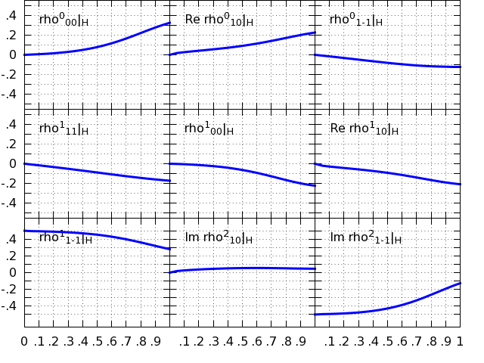
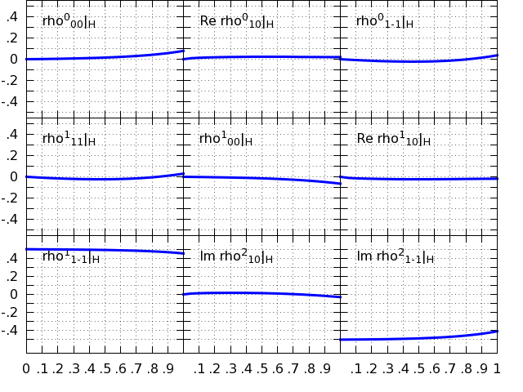
We saw earlier that the dominant contributions are f2 and Pomeron, and that the deviations from SCHC are due
to f2 since the standard Pomeron is helicity non-flip. We noted also that relative contribution from the Pomeron
increases with beam energy.
This suggests the rho SDMEs in the JPAC model should become boring at higher energies, since they will increasingly
conserve helicity in the s-channel. Indeed, this is the case.
8.5 GeV
25 GeV
A corollary is that the SDMEs should be a little larger and easier to measure at lower beam energy. That is true,
but it’s a modest effect. (Not shown.)

Slide 13
Yet another test was to increase the beta^Pomeron_1 and beta^Pomeron_2 coefficients from 0 to 0.5 , one at a time.
(Just being thorough. This would be a very non-standard Pomeron.)
See the Backups and the Excel file for plots. The results seem qualitatively similar to those on the previous slide for the f2 single- and double- helicity flip parameters. It’s not clear to me whether it’s possible to distinguish, in fits to single beam energy rho SDMEs alone, between beta^f2_1 and beta^Pomeron_1 (as well as between beta^f2_2 and beta^Pomeron_2 ).
.

Slide 14
Of the 31 parameters potentially affecting rho production, there are “only” 14 involved in the dominant Pomeron and f2 exchanges.
(dotted black box)
Discounting the Regge trajectory parameters and the b slope parameters which are probably better determined by xsect data, discounting the nucleon helicity flip kappa parameter to which the SDMEs are reportedly insensitive, then there are 6 parameters whose SDME sensitivities I thought might be interesting.
I have explored the sensitivities of all 6 of these in these slides (yellow).

Slide 15
I took a quick look at the omega and phi SDMEs in the JPAC calculator:
Vector Meson | The SDMEs are most sensitive to parameters of the following exchanges | Comment
ρ | Pomeron, f2
ω | a2 , pi0 , Pomeron (to a lesser extent than the other two, but still significant) | The sensitivity to the a2 was not super obvious from the older OTL paper.
ϕ | Highly Pomeron dominated. Next order contribution is probably eta, but can’t check until SDME calculator bug is fixed | Expected deviations from SCHC are really small. Need good acceptance corrections. Intriguing place to look for something unexpected pehaps?

Slide 16
Summary
The rho SDMEs are mainly sensitive to the Pomeron and f2 exchanges.
Relative contributions from the Pomeron increase significantly with beam energy. Since the Pomeron in the JPAC model is helicity non-flip, any f2 helicity-flip dynamics gets diluted away with increasing beam energy. By 25 GeV, the rho SDMEs would be approximately straight lines that conserve s-channel helicity.
As far as what specific physics might be gleaned:
i. one could measure the relative strength of the Pomeron and f2 exchanges versus beam energy.
ii. if errors at the level of +-0.01 can be achieved, we could constrain the helicity flip parameters of the gamma-f2-
rho vertices. (The helicity flip strengths seem to be additive, possibly making it meaningless to vary the f2 and
Pomeron versions of beta_1or2 simultaneously. Before one could search for subtle deviations from a non-
standard Pomeron, it seems one would need rho SDME data over a range of beam energies, or to include omega and/or
phi SDMEs in the fits.)
The 3 unpolarized SDMES appear to contain qualitatively similar information to the 6 polarized SDMEs. Although the redundancy and error cancellation in the polarized SDMEs is valuable, the unpolarized SDMEs are perhaps a way to constrain Pomeron and f2 parameters over the wider GlueX beam energy range 6-12 GeV.
The nominally “Natural” linear combination of SDMEs seems to contain unsuppressed contributions from the small, unnatural a2 and pi exchanges. (So either I screwed up, or the beam energy isn’t high enough for the Natural projection to work well. The Unnatural version didn’t look too bad, ie, relatively small.)

Slide 17
Backups

Slide 18
Wish list to discuss with Vincent:
There’s no output if I set eta coupling constant to 0. Can you fix? Sent 9/15/19
Can you add dsigma/dt so we can understand the complementarity between SDMEs and xsects for determining the
f2 and Pomeron parameters?
Why are the SDMEs generally so much larger in the GJ frame? Are we throwing out the baby with the bathwater by
sticking to the helicity frame?

Slide 19
Alexander A.’s data (red) show
good agreement with the JPAC
model up to –t ~ 0.4-0.5 .
This is from his MENU conference
proceedings at
https://halldweb.jlab.org/doc-private/
DocDB/ShowDocument?docid=4134 .

Slide 20
The 9 rho SDMEs
(setting the upper vertex couplings to 0, one at a time)

Slide 24
The 3+3 rho (Un)Natural SDMEs

Slide 25
I’m not sure what it means that the unnatural a2 and pi exchanges are making a small contribution to this
supposedly “Natural” linear combination. Does it mean the energy isn’t high enough, or a bug, or …?
The “Unnatural” plot is nicely small, but one can see that the Pomeron is making an unexpectedly significant contribution.

Slide 28
The 9 rho SDMEs
(setting the Beta^f2_1 or Beta^f2_2 coupling to 0)

Slide 29
Sensitive to beta1

Slide 32
The 9 rho SDMEs
(setting the Beta^Pomeron_2 coupling to 0.5)

