Slide 1
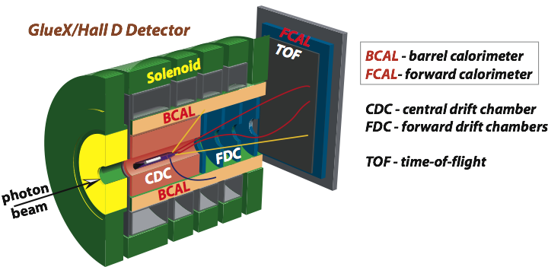
Prospects of Studying Photoproduction on
Nuclear Targets with the GlueX Detector
A. Somov (Jefferson Lab) for GlueX collaboration
SESAPS 2019, November 8 , 2019, Wrightsville Beach, NC
GlueX detector in Hall D at Jefferson Lab
Selected physics topics:
- Short-range correlations
- Color transparency
- Photoproduction of light vector mesons off nuclei

Slide 2
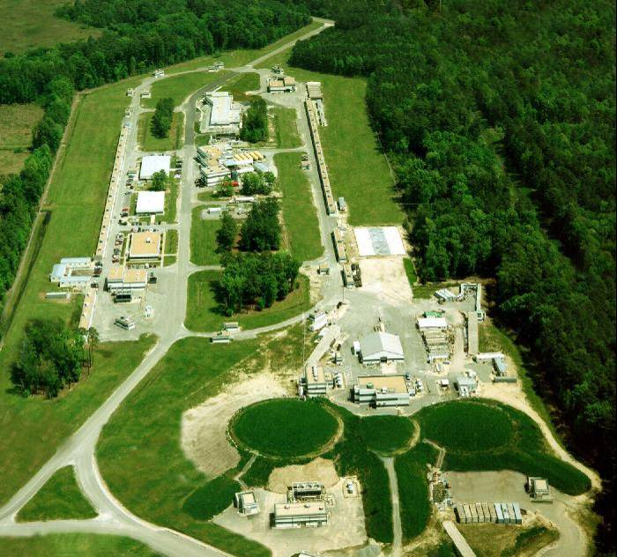
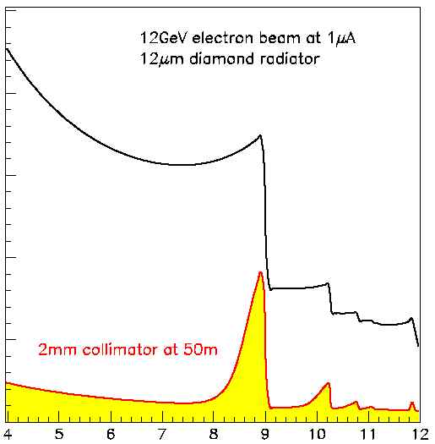
The GlueX Detector in Hall D at JLab
Photon beam produced by CEBAF
12 GeV electrons in a thin radiator via
bremsstrahlung process
Linear polarization of beam photons
Experimental Hall D with the GlueX
detector at Jefferson
Hall D
Uncollimated photons
Collimated beam
photons in Hall D
A
B
C
Photon beam energy (GeV)

Slide 3
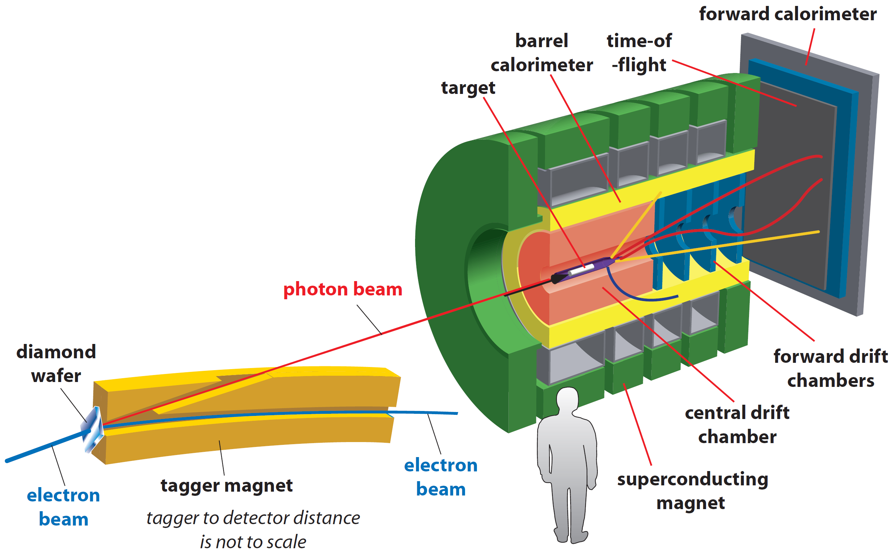
The GlueX Detector
• Optimized to detect multi-particle final states
• Hermetic, large/uniform acceptance for
charged and neutral particles, good energy
and momentum resolution
Tracks: σ_{p} / p ~ 2 – 5 %
Photons: σ_{E} / E = 6 % /√E ⊕ 1.6 %
Acceptance: 1° < θ < 120°
Target: liquid hydrogen
new PID (k/π)
Newly proposed experiments:
- install nuclear targets
- no modifications to the existing detector

Slide 4
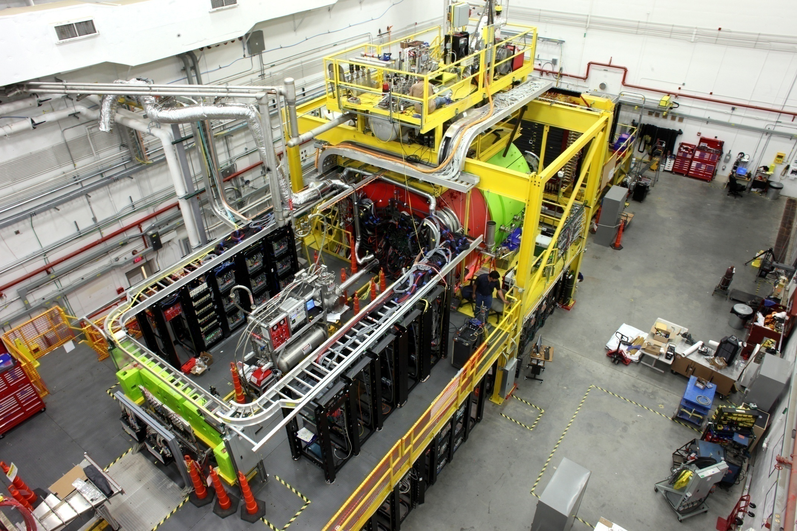
The GlueX Detector in Hall D
Beam Dump
Solenoid Magnet
Photon Beam

Slide 5
Hall D Physics Program: Approved Experiments
Name | Days | Detector Upgrade | Target
Mapping the spectrum of light quark mesons and gluonic excitations with Linearly polarized photons | 120 |  | LH₂
A study of meson and baryon decays to strange final states with GlueX in Hall D | 220 (200) | PID | LH₂
A precision measurement of the η radiative decay width via the Primakoff effect | 79 |  | LH_{2,} LHe₄
Measuring the charged pion polarizability | 25 |  | Pb
Eta decays with emphasis on rare neutral modes: The JLab Eta Factory experiment (JEF) |  | Forward Calorimeter | LH₂
Studying short range correlations with real photon beams at GlueX | 15 |  | LHe, LD, C
see talk by C. Gleason
see talk by S. Taylor, A. Gasparyan, M.Ito

Slide 6
Hall D Timeline
GlueX Phase I (low luminosity)
- Spring 2016: Initial production run 15 pb⁻¹, Eγ > 8 GeV
- Spring 2017: 53 pb⁻¹
- Spring / Fall 2018: 153 pb⁻¹ (291 pb⁻¹ in total)
Spring 2019:
- Primakoff η experiment (30 % of statistics)
- Commissioning of DIRC particle ID detector
GlueX Phase II (high luminosity)
- Start in the Fall of 2019
- Increase luminosity by a factor of two
(at least 6 times large statistics than in GlueX Phase I)
Nucler target experiment (SRC and Color Transparency) 2021 (?)

Slide 7
Physics Topics with Nuclear Targets
Color transparency
Approved experiment
Short range correlations
Photoproduction of light vector mesons off nuclei Proposal in preparation
Primakoff production (see talks by L. Gan, A. Gasparyan, and I. Larin)
Study in-medium modification effects
Heavy meson photoproduction ( open charm, J/ψ )
. . . . . .
https://halldweb.jlab.org/DocDB/0038/003870/011/gluex_future.pdf
Notes:
7

Slide 8
What are Short-Range Correlations ?
C. D. Atti, et. al. Phys Rev C53 (1996)
Nucleon momentum
distribution
V (r)
Potential between
two nucleons
N (k)
0
r ( fm)
Mean Field
~ 1 fm
K ( GeV/c )
Nucleon motion inside nucleus (k_{F} < 250 MeV) is described by the
mean-field theory
High momentum nucleons: short range interactions associated with the
tensor force and repulsive force of the nucleon-nucleon interactions

Slide 9
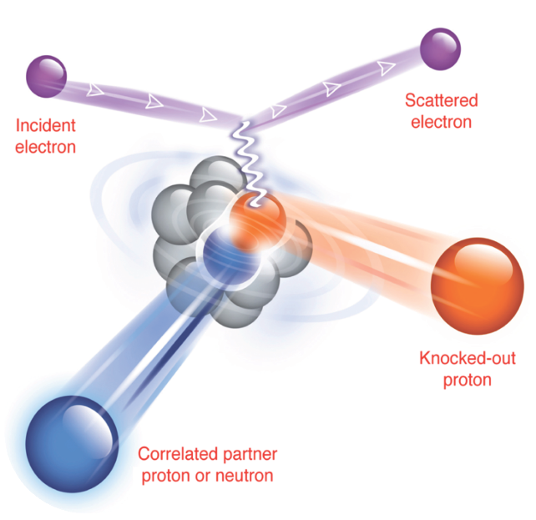
Short-Range Correlations
Localized configurations (SRC)
- nucleon pairs with the high-momentum and small c.m.
momentum compared to the Fermi momentum, K_{F}
Studied using A (e,e’ pN) and A(p, 2pn)
reactions
- two–nucleon knockout reaction
- simultaneous emission of the recoil
nucleon

Slide 10
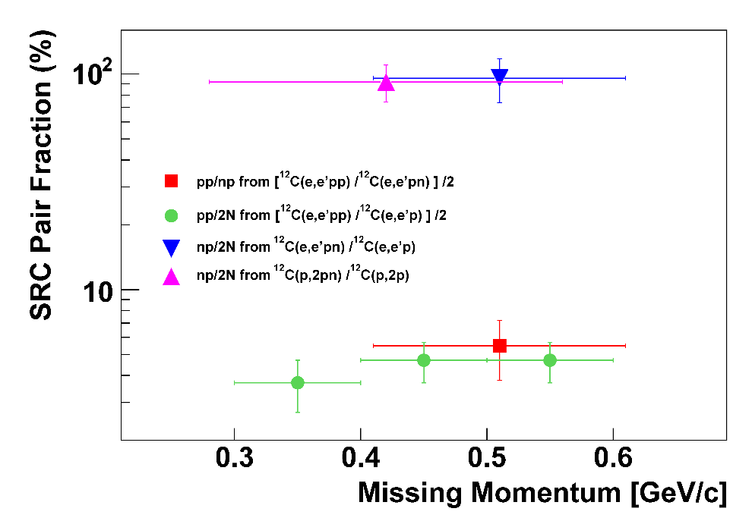
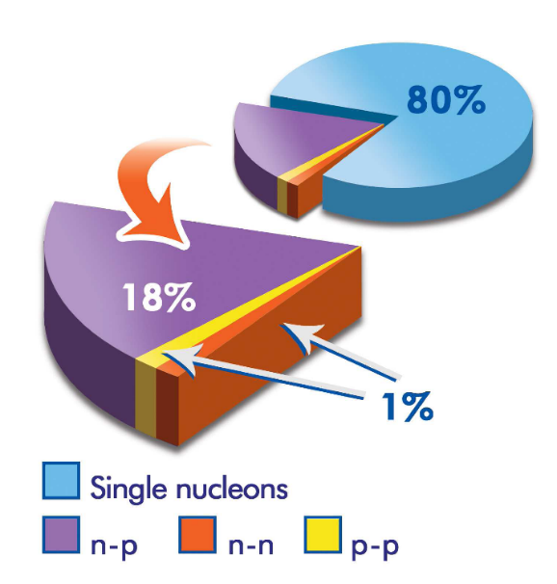
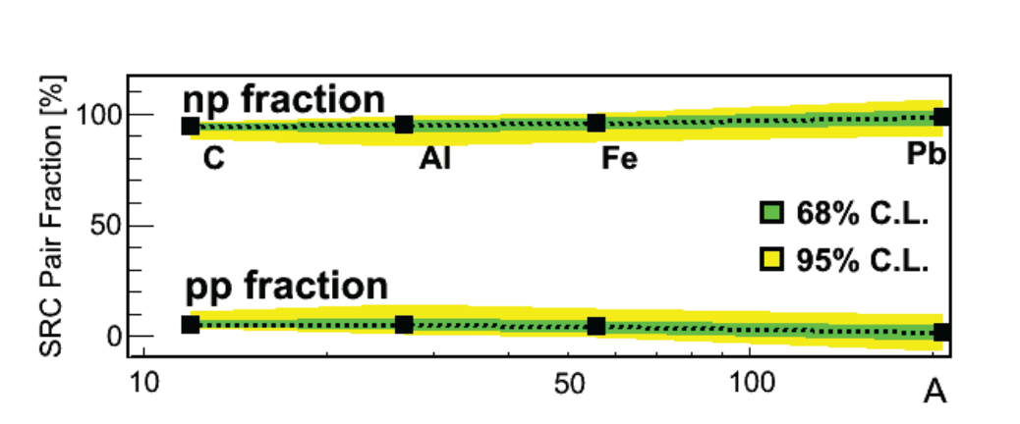
Short-Range Correlations
Sudebi et. al., Science (2008), JLab Hall A
Study reactions with two-nucleon knockout
- determine fraction of np, pp SRC pairs
Hen et. al., Science (2014), JLab Hall B
np-SRC pairs dominate
(dominance of the tensor part of the
NN interaction)

Slide 11
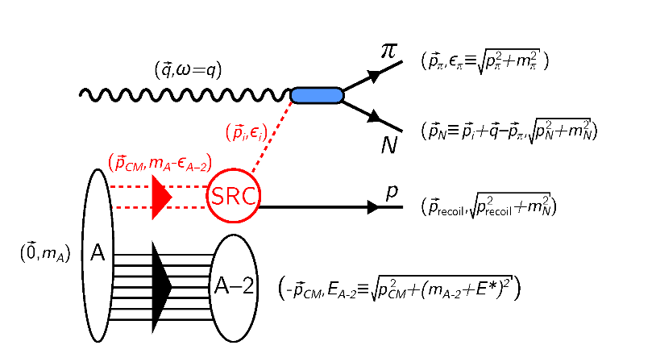
Study Short-Range Correlations using Photon Beam
Experiment approved in GlueX
γ + n → p π⁻
Recoil proton
Probe dependence of SRC on reaction mechanism
- SRCs have never been tested using a photon beam
Primary reactions: A(γ, p π⁻ p) , A(γ, ρ⁰ p p), A(γ, ρ⁻ p p)
- different kinematics, backward emitted recoil nucleon

Slide 12
Reconstruction of SRC with GlueX
Good reconstruction capability of charged tracks and photons in GlueX
Leading proton
A(γ , π ⁻ p N)
Recoil proton (SRC)
Expected number of reconstructed events for reactions with the
smallest and largest cross section
Target | A(γ , π ⁻ p N) | A(γ , ρ ⁻ p N)
D | 750 | 3000
⁴He | 420 | 1750
¹²C | 1400 | 11000

Slide 13
Color Transparency
At high transfer momenta |t| the transverse size of the produced qq
configuration is small
The small-size configuration interacts less with the nuclear medium
(fundamental predictions of QCD)
Observables:
- Increase of the medium nuclear transparency T = σ _{A} / A ⋅σ _{N}
T
Color transparency
Glauber
|t|

Slide 14
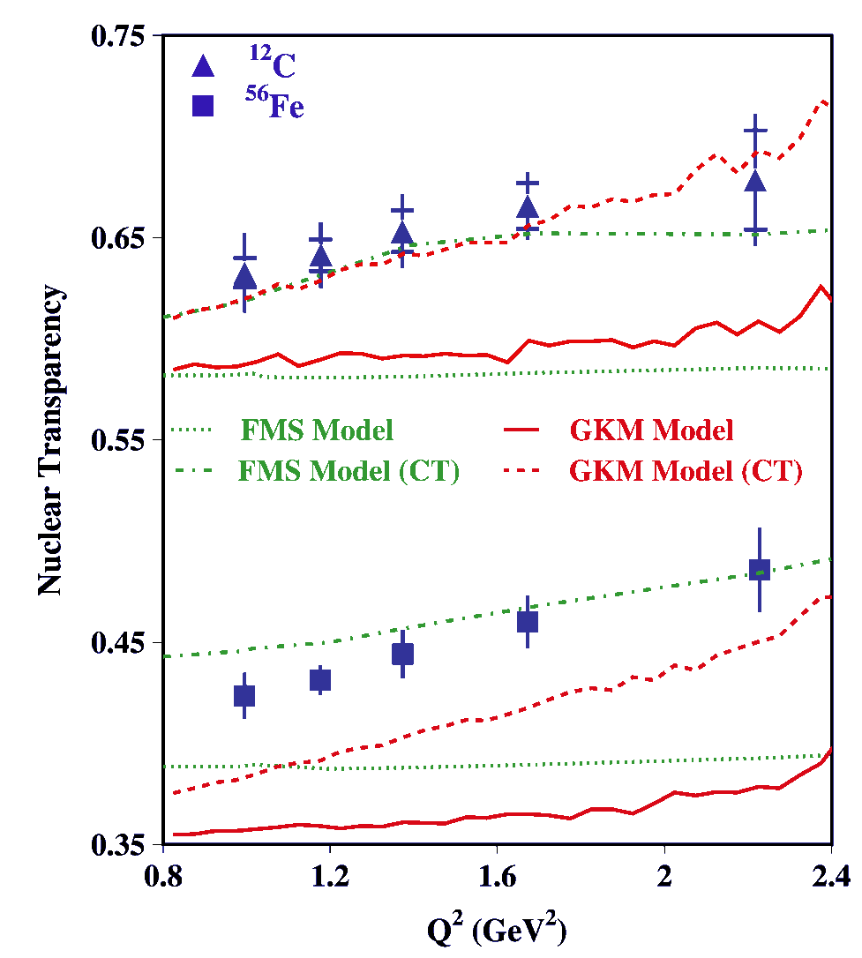
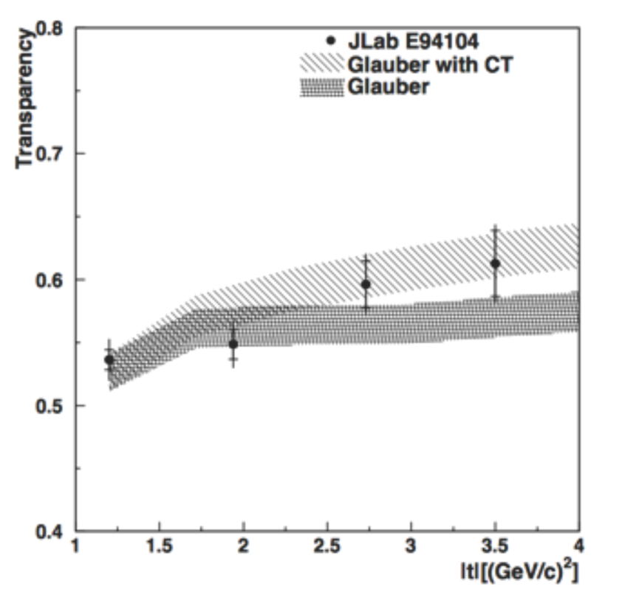
Measurement of Color Transparency at JLab
A (e,e′ ρ⁰) Hall B
⁴He (γ, π ⁻ p), Hall A
D. Dutta et al., PRC 68, 021001 (2003)
nuclear transparency is increased
at larger Q² and |t |
L. El Fassi et al., PLB 712, 326 (2012)

Slide 15
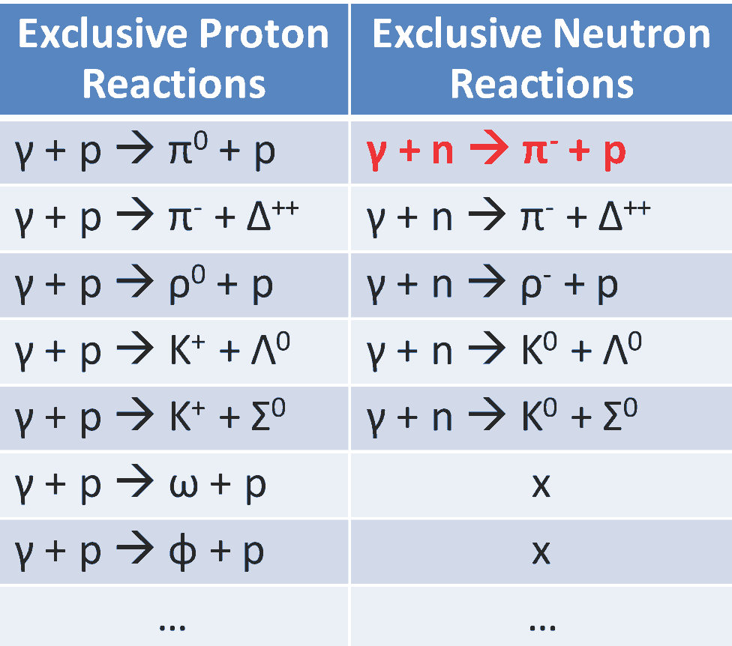
Proposed CT Measurements at GlueX
Proposed reactions to measure
Color Transparency
Measure nuclear transparency
using nuclear targets:
D, ⁴He, ¹²C
Reconstruct several final states
Large range of |t _{max}| from 2
GeV² to about 10 GeV²

Slide 16
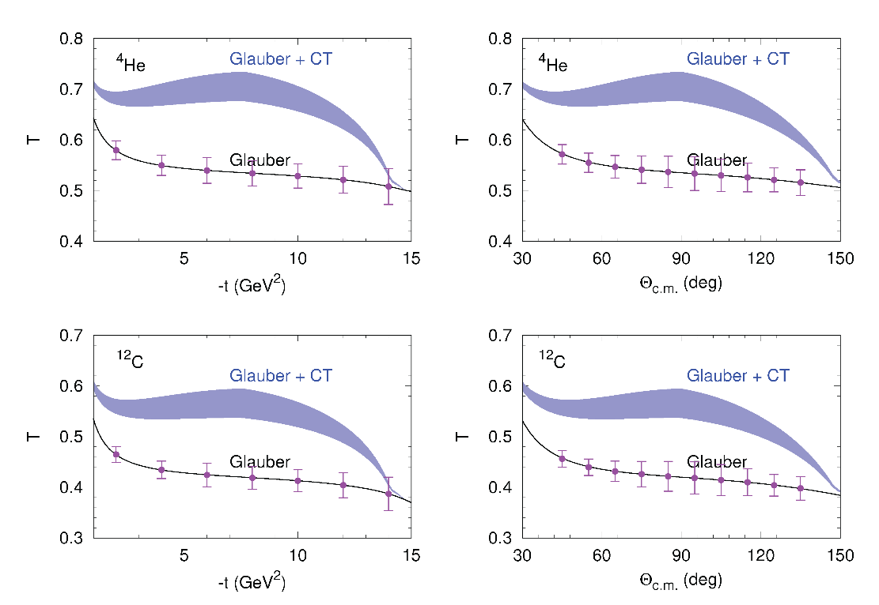
Expected Sensitivity
γ + n → π ⁻ + p
Theoretical calculations for GlueX
by A. Larionov and M. Strikman
Phys.Lett. B, 760, 753 (2016)
Quantum diffusion model for CT
Hadron-nucleon cross section,
σ_{hN} , depends on the hadron
coherence length
Color transparency effect is the
largest for production at
θ c.m. = 90 °
Number of reconstructed events
 | γ + n → π ⁻ + p | γ + n → ρ ⁻ + p
D | 13600 | 57000
⁴He | 8000 | 34000
¹²C | 4500 | 18500
Smallest yield for γ + n → π ⁻ + p

Slide 17
Photoproduction of Vector Mesons on Nuclei
with GlueX
( proposal of the new experiment )

Slide 18
Goal of the Experiment
Measure photoproduction cross sections of vector mesons ω, ρ, and φ
on C, Si, Sn and Pb targets in the energy range of 6-9 GeV with the
GlueX detector
Probing photon structure
- Extract nuclear transparency (A_{eff} = σ_{A} / σ_{N} ) at different energies
Extract cross section of longitudinally polarized ω mesons on
nucleon, σ_{L} (ω N)

Slide 19
Why is it Important ?
According to theoretical predictions, hadronic structure of
photon leads to the decrease of the nuclear transparency A _{eff}
with energy (increase of the coherence length )
- observed decrease of the nuclear transparency in
photoproduction of π⁰ mesons is smaller than theoretically
predicted. The same discrepancy takes place in ρ meson
photoproduction, where experimental data are scarce
l_{c}= $\frac{2ν}{M^{2}+Q^{2}}$
There are experimental indications that σ_{L} (VN) < σ_{T} (VN),
but there have been no direct measurements of σ_{L} (VN) so
far. Measurements of σ_{L} are important for:
- comparison between different theoretical approaches
- interpretation of the color transparency in vector meson
electroproduction

Slide 20
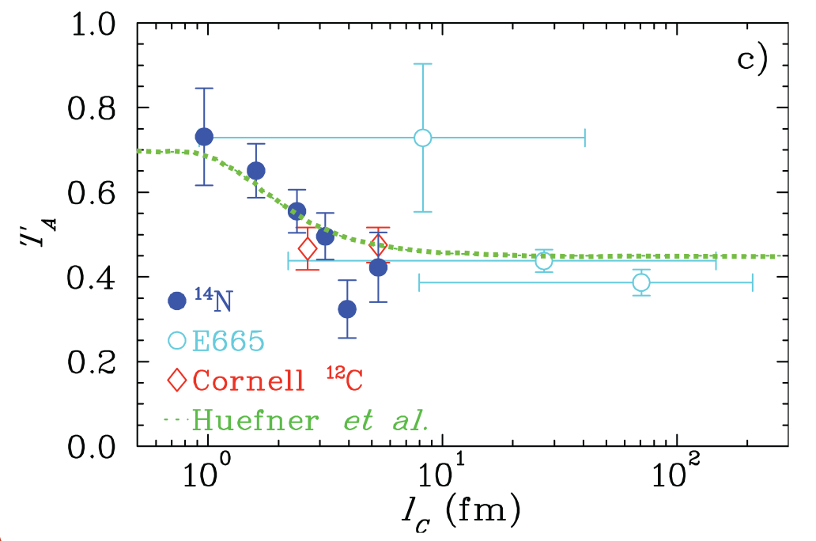
Hadronic Part of Photon: Dependence on the Coherence Length
Dependence of the nuclear transparency on the coherence length in electroproduction
K.Ackerstaff et al., Phys. Rev. Lett.,
82, 3025 (1999)
Coherence length
Hermes
e
l_{c}
ρ
A_{eff} / A
e
N
N′
e
l_{c}
ρ
e
Coherence length (fm)
N
N′
Hadronic structure of photon appears in electroproduction

Slide 21
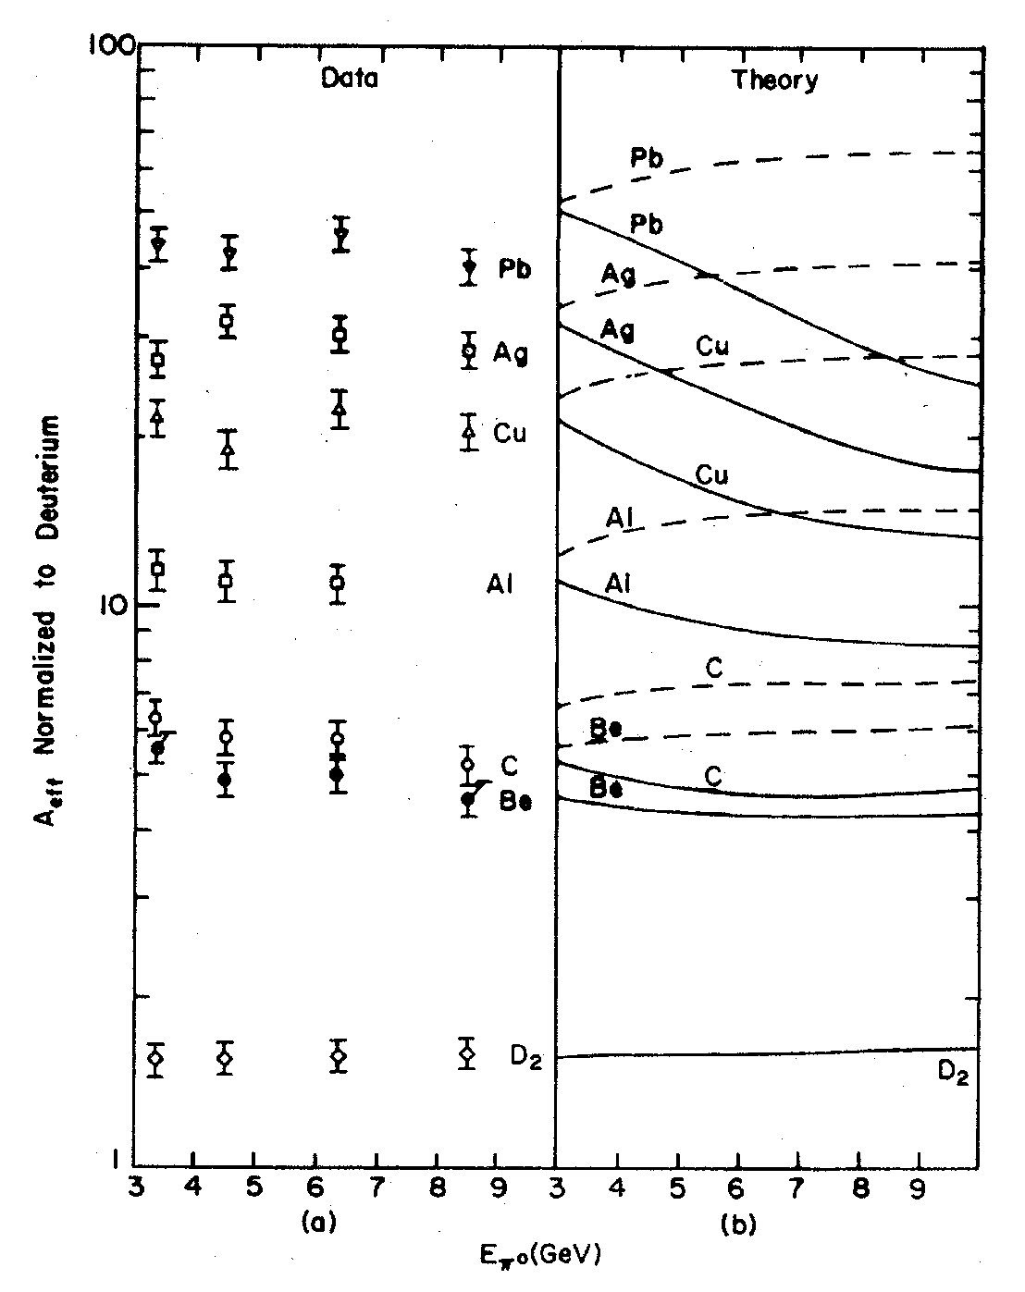
Energy Dependence: Photoproduction of π⁰ Mesons
Cornell experiment Meyer , et al. Phys. Rev. Let. 28, 1972
Data
Theory
Point-like photon
(no photon shadowing)
Hadronic component of photon
(photon shadowing)
A _{eff}
Incoherent production of π⁰ mesons
0.1 < | t | < 0.25 GeV²
The data indicate shadowing of
photon
Energy dependence weaker than
predicted
E (π⁰) (GeV)

Slide 22
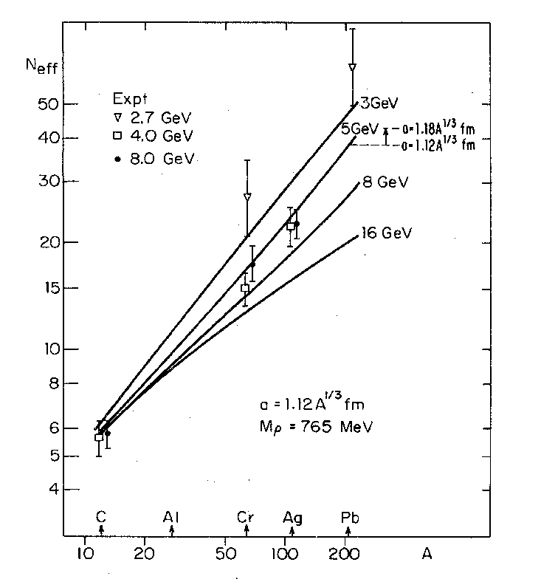
Energy Dependence: Photoproduction of ρ⁰ Mesons
Cornell: McClellan, et al. Phys. Rev. Let. 554, 1969
DESY: Asbury, et al. Phys. Rev. Let. 19, 1968
∇ 2.7 GeV
4.0 GeV
8.0 GeV
3 GeV
5 GeV
8 GeV
The existing data indicate shadowing
Weak energy dependence
Small statistics
- need more data to study energy
dependence
16 GeV
A _{eff}

Slide 23
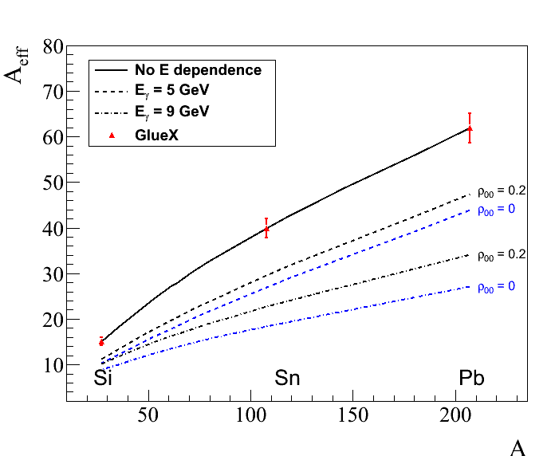
Measurements Proposed in GlueX
Predicted energy dependence of the nuclear transparency
for ρ and ω mesons Phys. Rev. C 93, 015203 (2016)
ρ-mesons ( ρ₀₀ = 0 )
Measure energy dependence
of the nuclear transparency for
ρ, ω, and φ mesons
on ¹²C, ²⁸Si, ¹²⁰Sn, and ²⁰⁸Pb
targets
Incoherent production:
0.1 < |t| < 0.5 GeV²
projected errors
5 GeV
9 GeV
(28 days of taking data)

Slide 24
Extraction of σ_{L} (ω N) from the Photoproduction
of ω Mesons
There are no beams of ρ, ω, and φ mesons. Studying interactions with nuclear matter provides a unique possibility to measure meson-nucleon cross sections
We propose to extract for the first time the ω-nucleon cross section of
longitudinally polarized ω mesons, σ_{L} (ω N), using photoproduction on
nuclei

Slide 25
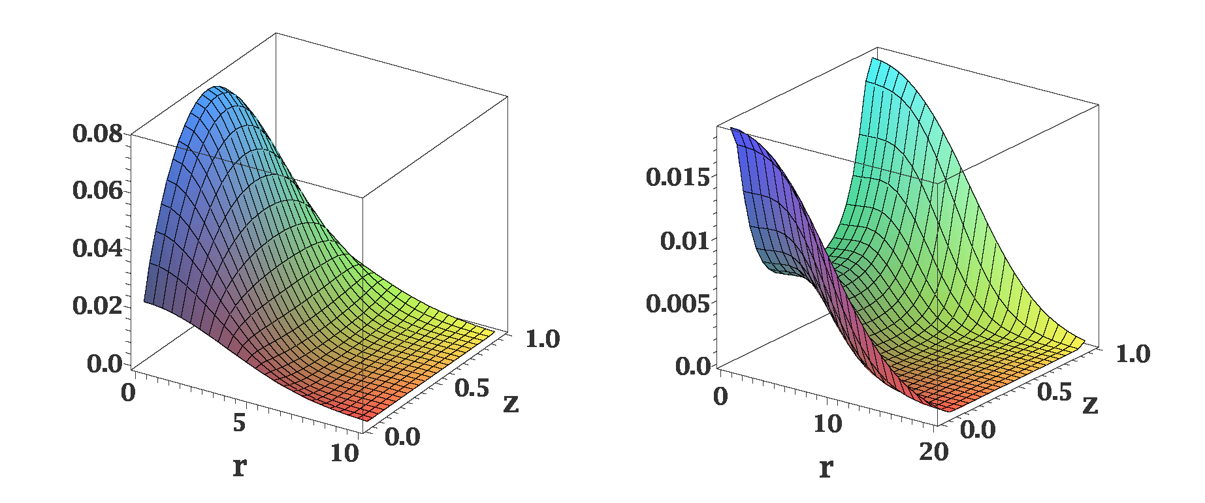
Distribution of Quarks in Vector Meson
Different distributions of quarks in the transversely and longitudinally polarized
mesons
ρ_{L}
ρ_{T}
In AdS/QCD (Brodsky & G.Teramond)
light-cone wave functions depend on
meson polarization
Light-cone wave functions for ρ mesons:
J.Forshaw and R.Sandapen
Phys.Rev. Lett. 109,081601,2012
Color dipole model of strong interaction
different cross sections for interactions of transversely and longitudinally
polarized mesons

Slide 26
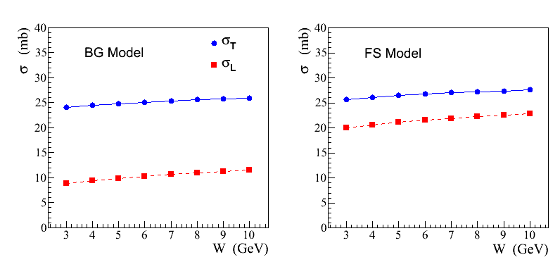
Recent Theoretical Calculations
σ_{L,T} (ρ N) cross sections predicted in a color dipole model using different
parameterizations of wave functions:
AdS / QCD holographic wave function (FS)
J.Forshaw and R. Sandopen,
Phys.Rev.Let. 109, 2012
Boosted Gaussian (BG) wave function
B.Kopeliovich et al., Phys.Rev. C65, 2002
FS model
BG model

Slide 27
Coherent and Incoherent Production of ω Mesons
In the coherent γ + A → ω + A production at JLab energies the essential
contribution of pion exchange cancels out. From the absorption of ω’s one
can extract the meson-nucleon cross section of transversely polarized mesons
σ_{T} (ω N)
- it has been measured by several experiments (σ_{T} ~ 26 mb)
In the incoherent process γ + A → ω + A′ the cross section is given by
- N (0, σ_{L}) and N (E, σ_{T}) are absorptions of the longitudinally and transversely
polarized mesons predicted by theoretical models
- Sensitivity to σ_{L} through the absorption N (0, σ_{L})
- ρ₀₀ is the spin density matrix element measured in γ p → ω p reaction

Slide 28
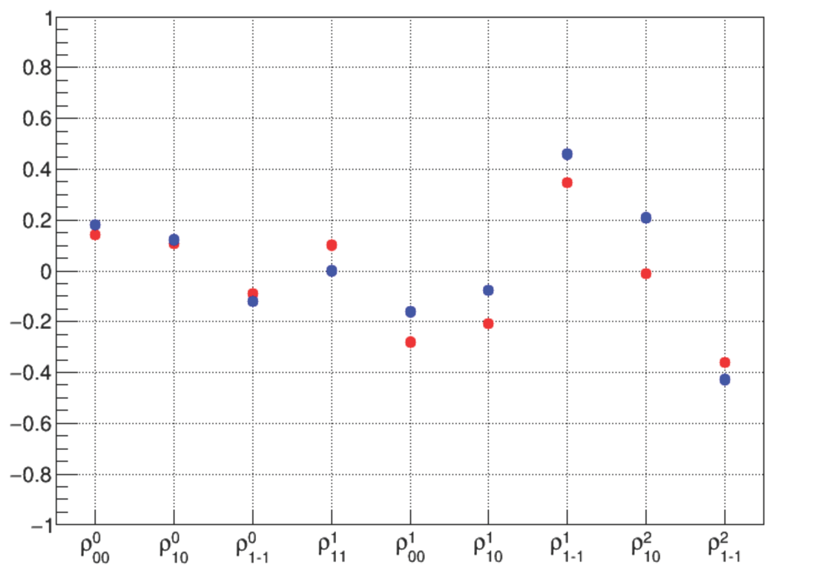
Why ω Mesons ?
Unlike ρ and φ mesons, some fraction of ω mesons is produced longitudinally
polarized at GlueX energies (6-9 GeV)
ρ₀₀ measured by SLAC is 0.2 ± 0.07
J.Ballam et al., Phys. Rev. D7, 3150 (1973)
Spin density matrix elements measured by
GlueX using a γp→ωp reaction
Preliminary GlueX results indicate
that ρ₀₀ is relatively large ( ∼ 0.2 )
GlueX preliminary
- measured in the energy range
8.4 – 9.1 GeV
- ρ₀₀ can be larger at smaller
energies (larger contribution
from pion exchange)
M. Staib, PhD tesis GlueX-doc-3357

Slide 29
How to Extract σ_{L} (ωN) ?
σ_{L} (ωN) can be extracted from the measurements of:
Method 1: Nuclear transparency ( A_{eff} )
Method 2: Spin density matrix element (ρ^{A}₀₀ )
Make use of the different absorption predicted for interactions of
longitudinally and transversely polarized mesons

Slide 30
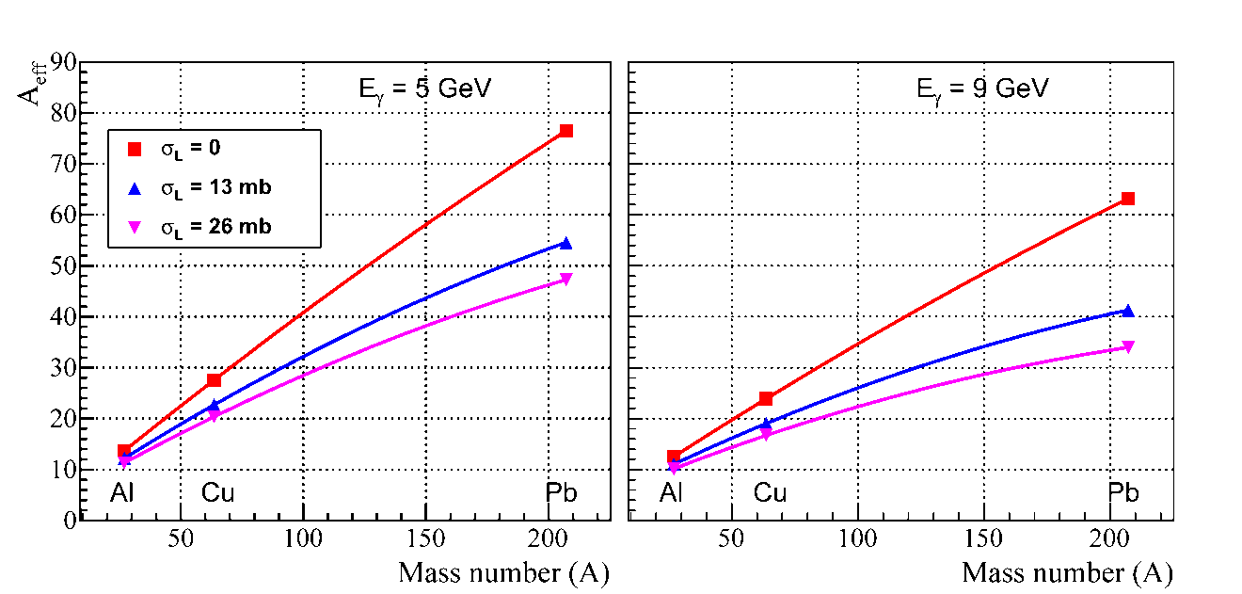
Extraction of σ_{L} (ωN): Method 1
Measure nuclear transparency A_{eff} for each nuclear target
A_{eff} depends on σ_{L} (see plot)
- N (0, σ_{L}) and N (E, σ_{T}) are predicted by theoretical models.
- N (E, σ_{T}) will be independently measured for ρ mesons
Predictions for A_{eff}
Calculations for GlueX
by S. Gevorkyan
Phys. Rev. C 93, 015203
(2016)

Slide 31
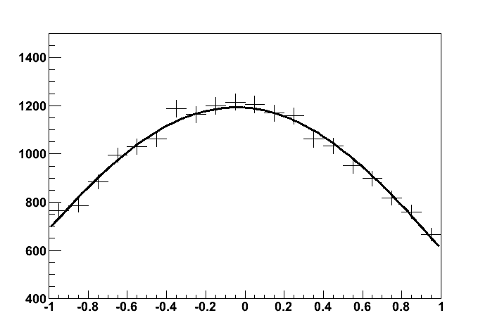
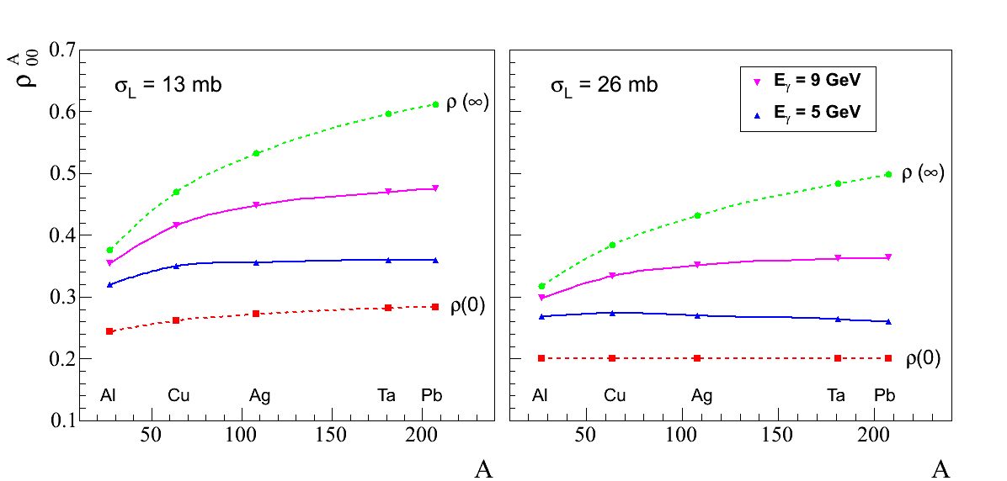
Extraction of σ_{L} (ωN): Method 2
Measure ρ^{A}₀₀ for each target from the
fit to the ω decay angular distribution
ρ^{A}₀₀ depends on σ_{L}
- extract σ_{L}
cos θ
Predictions for ρ^{A}₀₀
Phys. Rev. C 93, 015203 (2016)
Input value: ρ₀₀ = 0.2

Slide 32
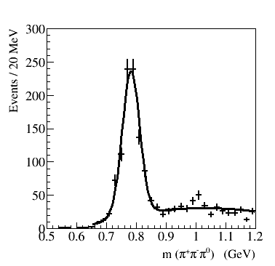
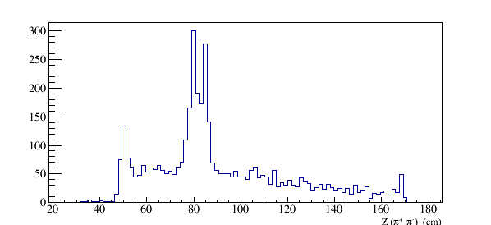
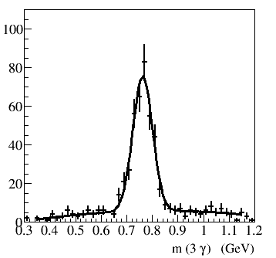
Reconstruction of ω Mesons in GlueX
Reconstruct ω mesons on walls of
the GlueX target (Kapton)
ω → π⁺ π⁻ π⁰
Production vertex for ω → π⁺ π⁻π⁰
Target cell walls
Vacuum window
Air
ω → π⁰ γ
Cold H₂ gas
Z (π⁺ π⁻) (cm)
Kapton
Kapton
Air

Slide 33
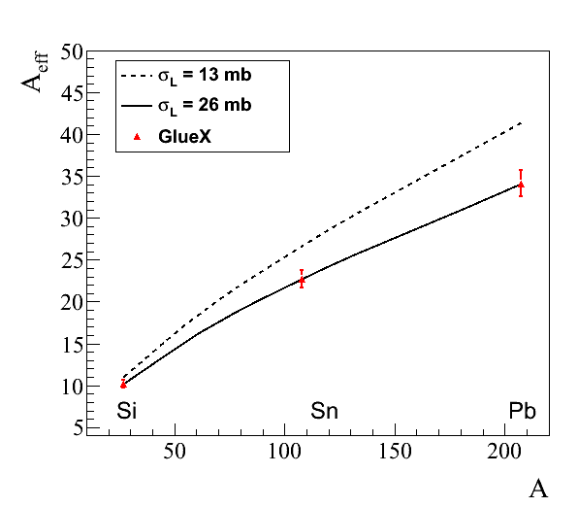
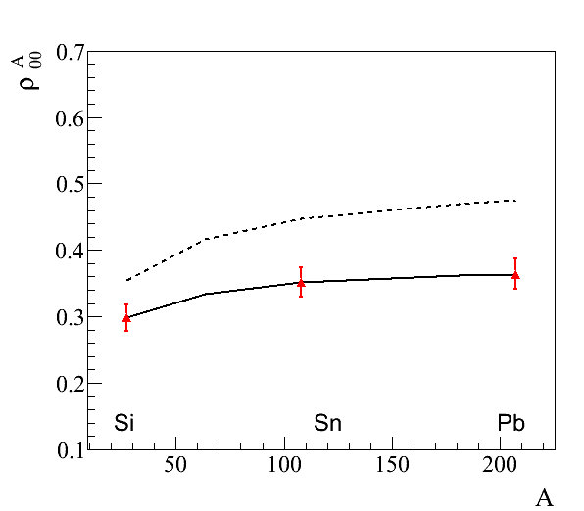
Projected Errors on Measured A_{eff} and ρ^{A}₀₀
Projected errors on measurements of A_{eff} and ρ^{A}₀₀ for ω → π⁰ γ decays
(input values: σ_{T} = 26 mb, ρ₀₀ = 0.2)
A_{eff}
ρ^{A}₀₀
9 GeV
projected errors
projected errors

Slide 34
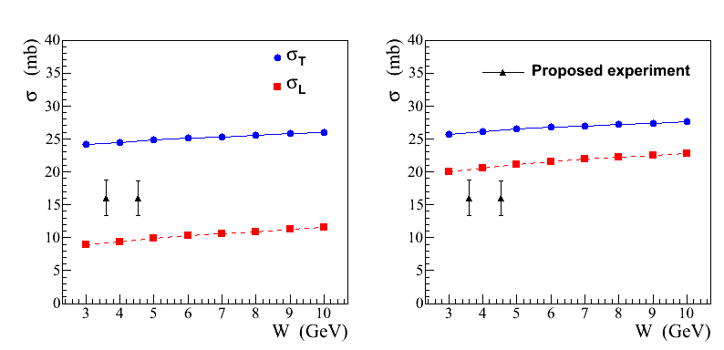
Projected Errors on σ_{L} (ωN)
FS model
BG model
ρ₀₀ = 0.2
Predicted cross section σ_{T}
is consistent with experimental
measurements (σ_{T} ∼ 26 mb)
σ_{L} extracted from the combined measurement of A_{eff} for two decay channels
ω → π⁰ γ and ω → π⁺ π⁻ π⁰
- for ρ₀₀ = 0.14 uncertainty on the extraction of σ_{L} is ∼ 3.5 mb ( 9-12 GeV )
σ_{L} will be separately extracted from the measurement of ρ^{A}₀₀

Slide 35
Summary
The GlueX detector provides a unique capability to study photoproduction on nuclear targets and extend the physics potential beyond the main spectroscopy program.
A recently approved experiment in Hall D will study short-range correlated pairing of nucleons within nuclei and search for Color Transparency at large momentum transfer.
- SRC has never been studied in photoproduction before.
- Measurement of the Color Transparency will verify recent theoretical calculations
for GlueX beam energies and will decisively test the onset of CT.
Several other physics topics are considered for GlueX, such as the study of the
hadronic structure of the photon by measuring nuclear transparency of vector
mesons, and extraction of the cross section of longitudinally polarized omega
mesons on nucleons for the first time.
- The measurement of nuclear transparency over a wide energy range is important
for understanding results from other experiments and will provide a sensitive probe
to the degree of photon shadowing in nuclear matter.

Slide 36
Backup Slides

Slide 37
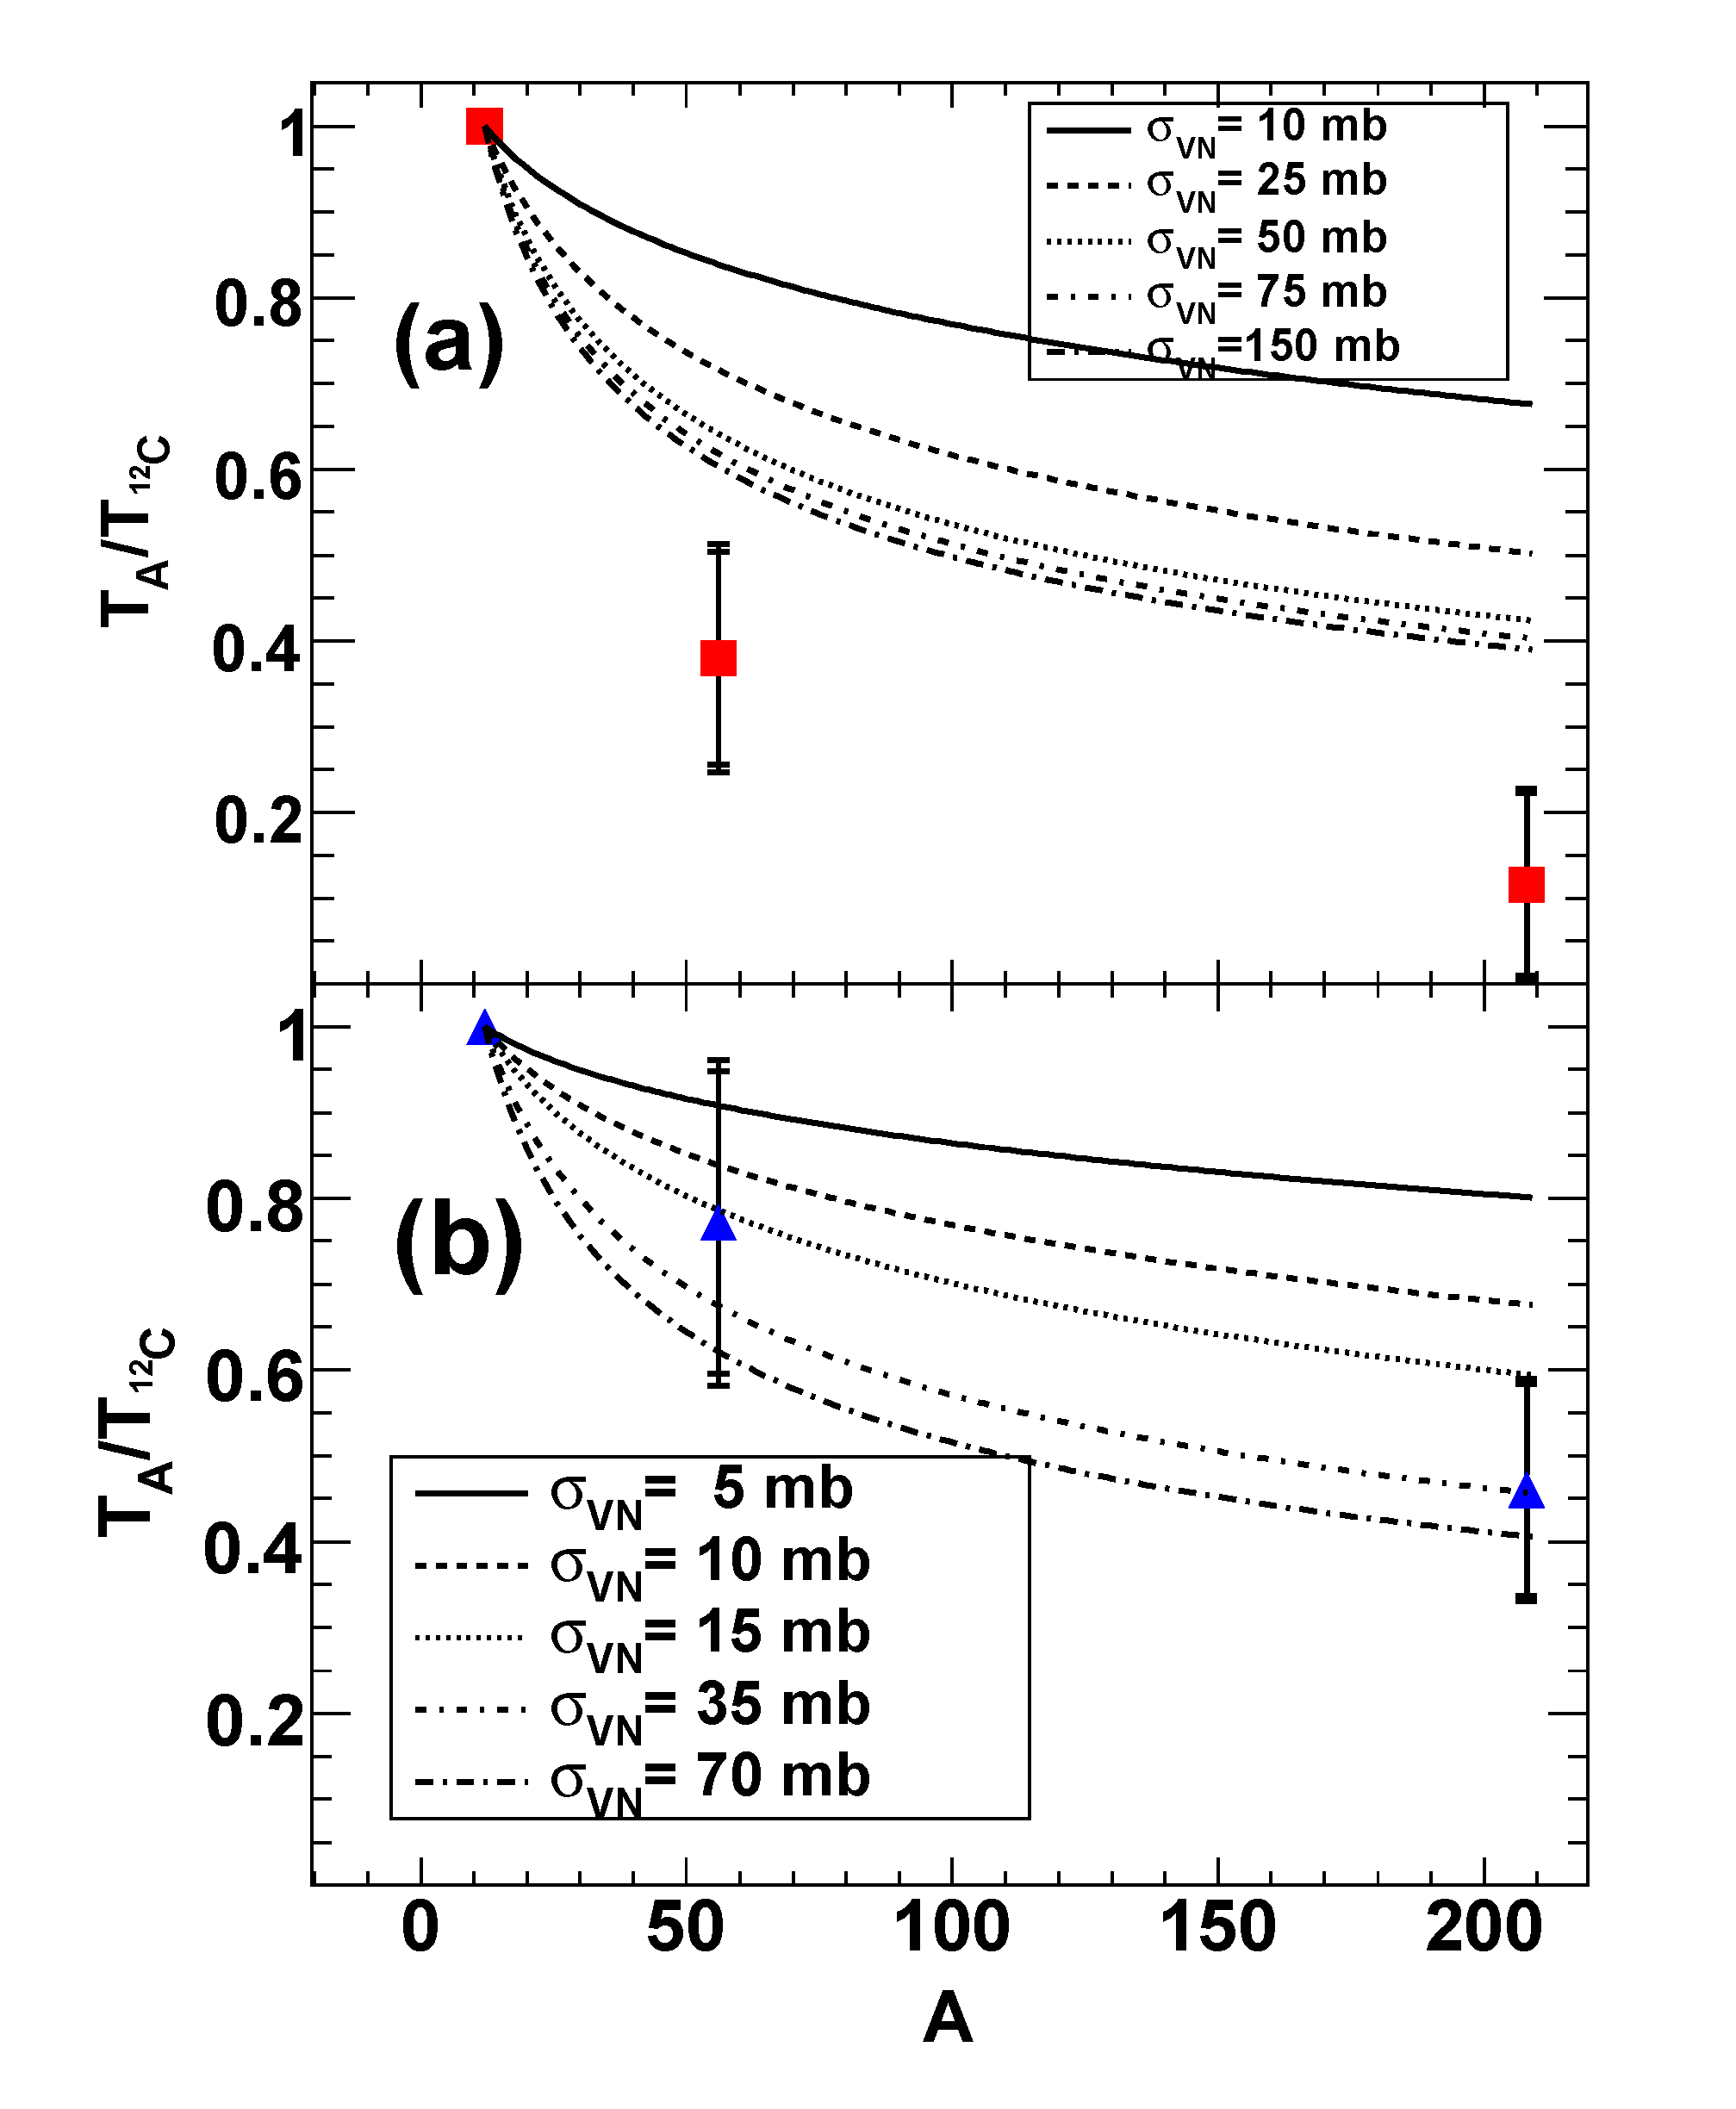
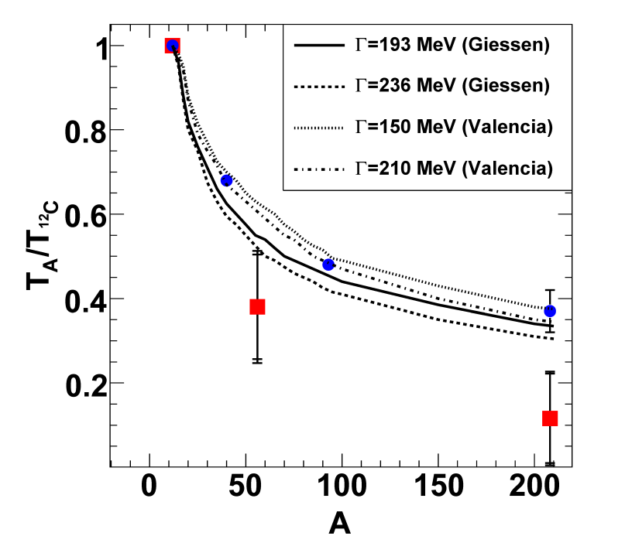
Nuclear Transparency Measured by CLAS E01-112
PRL 105, 112301 (2010)
ω mesons
φ mesons
Transparency T_{A} = σ_{A} / A σ_{N}
Large absorption observed for ω mesons
not consistent with CBELSA/TAPS results
- Interference between ω and ρ mesons
in the e⁺e⁻ decay mode (?)

Slide 38
Experimental Results on In-medium Modifications
S.Leupold, V. Metag, U. Mosel
Int. J. Mod. Phys. E 19 (2010)
Experimet | Beam GeV | P range GeV/c | ρ | ω | φ
Spring 8 | γ A 1.5 – 2.4 | p > 1 K⁺K⁻ final state |  |  | ΔΓ ~ 70 MeV p = 1.8 GeV/c
CBELSA/ TAPS | γ A 0.9 – 2.2 | p > 0 π⁰γ final state |  | ΔΓ ~ 130 MeV p = 1.1 GeV/c
CLAS E01-112 | γ A 0.6 – 3.8 | p > 0.8 e⁺e⁻ final state | Δm ~ 0 ΔΓ ~ 70 MeV p = 1.1 GeV/c
KEK-E325 | p A 12 | p > 0.6 e⁺e⁻ final state | Δm /m = -9 % ΔΓ ~ 0 | Δm /m = -9 % ΔΓ ~ 0 | Δm /m = -3.4 % ΔΓ / Γ = 3.6
GlueX | γ A 6 – 12 |  | ππ (e⁺e⁻) | π⁰γ, π⁺π⁻π⁰, (e⁺e⁻) | K⁺K⁻ (e⁺e⁻)

Slide 39
Medium Modifications of Mesons
Study modifications of meson properties by nuclear matter:
Spectroscopy of hadron line shapes
Attenuation measurements
Use vector mesons to study the mass distribution and medium absorption
(cτ = 1.3 fm, 23 fm, and 46 fm for ρ, ω, and φ)
In-medium modification measurements have been performed by several
experiments
- Experimental measurements are not completely understood
(more measurements are required)

Slide 40
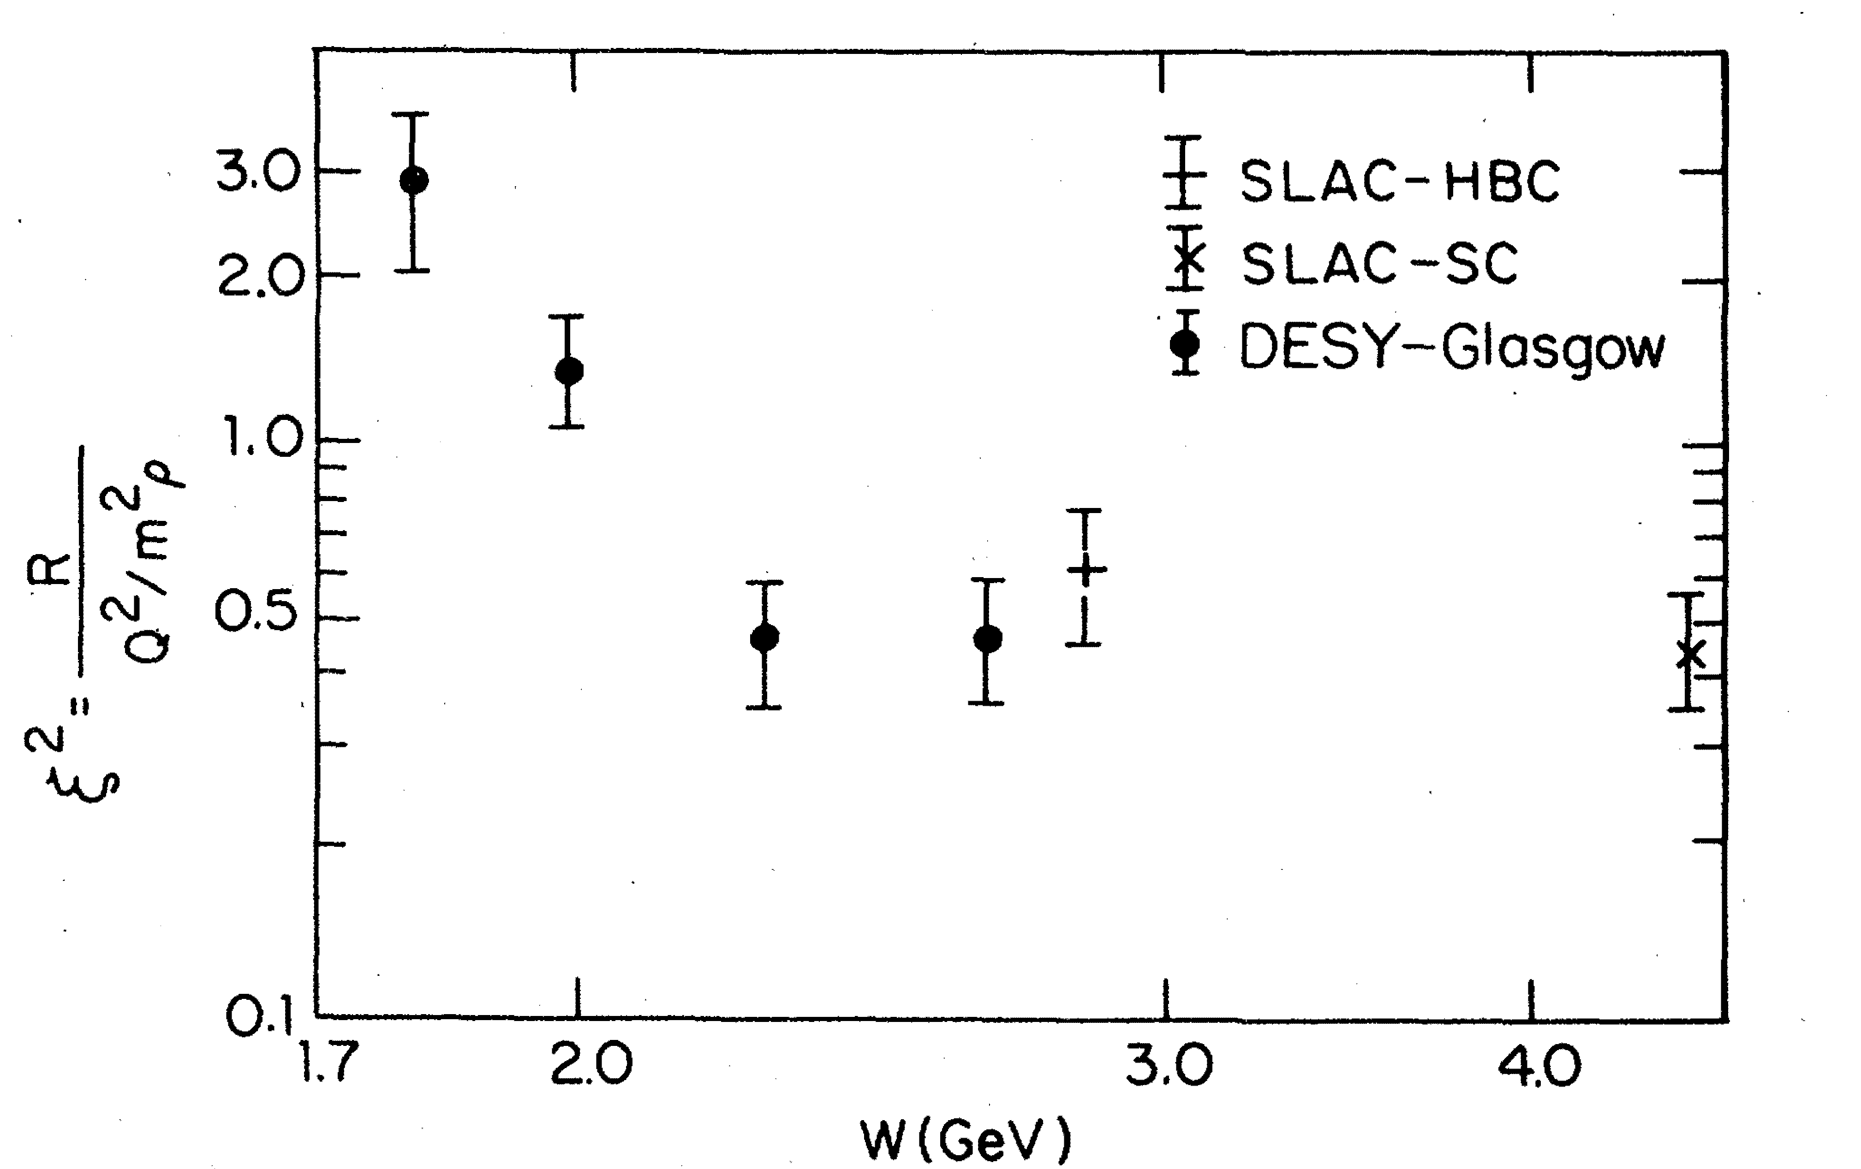
Polarization-Dependent Interactions: Experimental Observations
Hints from the electroproduction of vector mesons:
where
ρ mesons: ξ ~ 0.7 Nucl. Phys. B113, 53 (1976)
φ mesons: ξ² ~ 0.33 Phys. Rev. Let. 39, 516 (1977)
Similar observations of the polarization-dependent
interactions of deuterons with Carbon targer
- measured in Dubna and Juelich
Phys. Part. Nucl. Lett. 7, 27, 2010 Phys. Rev. Lett. 104, 2010
Measurements in the charge exchange process at Argonne:
π⁺ + Ne → ρ + Ne′
Nucl. Phys. B67, 333 (1973)
Measurements of σ_{L} are proposed for COMPASS experiments using π/K beams
(beyond 2020), letter of intent
We propose to measure σ_{L} (VN) using photoproduction on nuclei

Slide 41
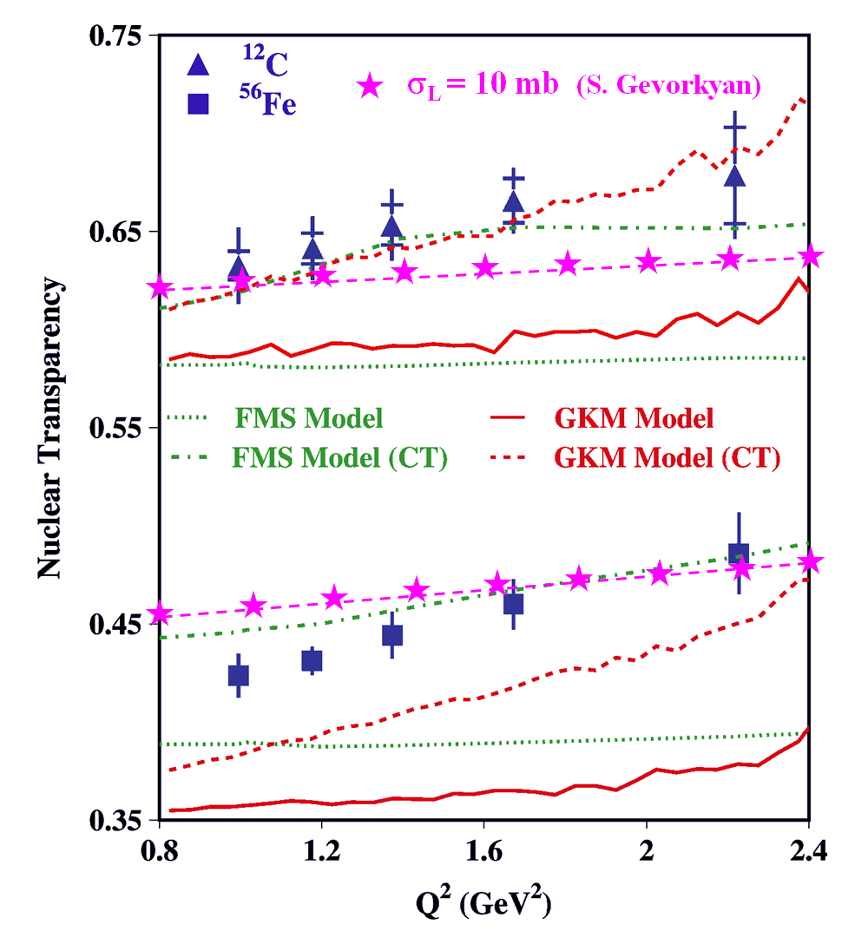
Impact of σ_{L,T} (VN) on Color Transparency
Color Transparency
measurements at CLAS
Phys. Lett. B 712 (2012)
At large Q ² photon couples to a qq
configuration with a small transverse size
The small-size configuration interacts less
with the nuclear medium
Recent theoretical calculations
σ_{L} (VN) = 10 mb
σ_{T} (VN) = 26 mb
The fraction of longitudinally polarized ρ mesons increases at larger Q²
Nuclear transparency depends on the polarization of the meson
- different absorption if σ_{L} (VN) ≠ σ _{T} (VN)
The Color Transparency effect is ‘screened ‘ if σ_{T} (VN) > σ_{L} (VN)

Slide 42
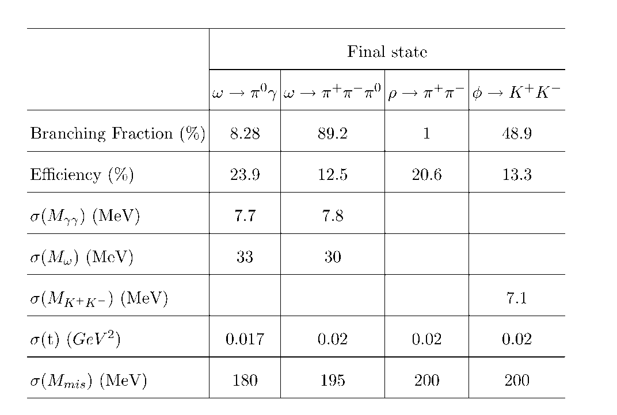
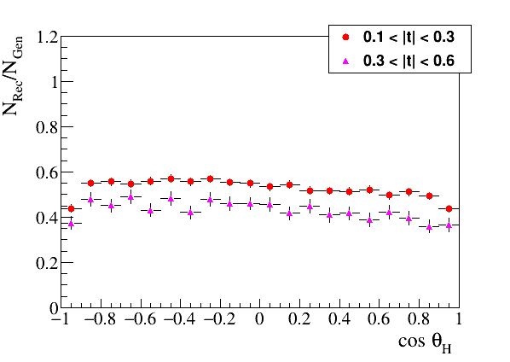
Reconstruction of Vector Mesons
Reconstruction properties of ω, ρ, and φ mesons
Reconstruction efficiency of
ω → π⁰ γ decays as a function of
the polar angle in the helicity frame
Uniform angular acceptance
- important for polarization
measurements

Slide 43
Uncertainties on Measurements of A_{eff} and Extraction of σ_{L} (ωN)
Statistical errors on A_{eff}
δ (A_{eff}) / A_{eff} = 1.4 % (6 – 9 GeV)
= 1.8 % (9 -12 GeV)
smallest data sample of ω → π⁰γ
reconstructed decays
systematic uncertainties on A_{eff}
Systematic uncertainties dominate
- conservatively assume that S/B = 1
- measure the ratio of cross section σ_{A} / σ_{N}
some uncertainties related to reconstruction
efficiencies will be canceled out
Target thickness | 1.2 %
Photon flux determination | 1.5 %
Signal yield (bg subtraction) | 5.0 %
Total measured | 5.4 %
Uncertainties on the extracted σ_{L} (for σ_{L} = 16 mb)
Polarization of | Error on σ_{L} (mb)
ω mesons | 6 – 9 GeV | 9 – 12 GeV
ρ₀₀ = 0.2 | 0.9 (stat) 3.4 (syst) | 0.9 (stat) 3.1 (syst)
ρ₀₀ = 0.1 | 1.1 (stat) 4.6 (syst) | 1.1 (stat) 4.2 (syst)
Measued by
SLAC

Slide 44
Uncertainties on Measurements of ρ^{A}₀₀ and Extraction of σ_{L} (ωN)
Obtain ρ^{A}₀₀ from the fit to the decay angular distribution in the helicity frame
Statistical errors : σ(ρ^{A}₀₀ ) = 0.011 (6 – 9 GeV)
(from the fit) = 0.014 (9 -12 GeV)
Signal yield (bg subtraction) | 0.008
Acceptance determination | 0.019
Total | 0.02
Systematic uncertainties on ρ^{A}₀₀
Uncertainties on the extracted σ_{L} (for σ_{L} = 16 mb) for ω → π⁰γ decays
Polarization | Error on σ_{L} (mb)
of ω mesons | 6 – 9 GeV | 9 – 12 GeV
ρ₀₀ = 0.2 | 3.7 | 3.6
ρ₀₀ = 0.14 | 4.8 | 4.7

