Slide 1
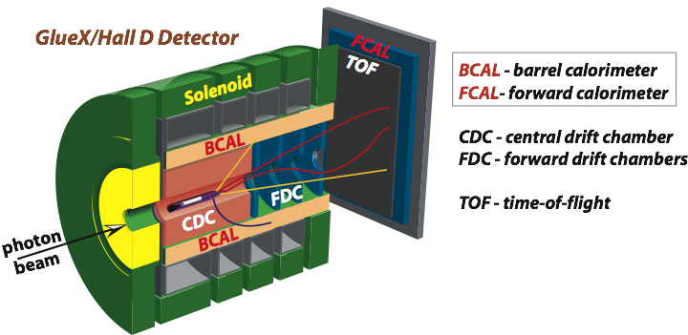
Status of the Level-1 Trigger
A. Somov, Jefferson Lab
GlueX Collaboration Meeting, February 13, 2020
Hardware problems
New FADC Firmware
Preparation for high-lumi runs
Run conditions of GlueX II

Slide 2
Hardware Problems
5 FADC modules were found dead in FCAL crates in November. All of them had the
same symptoms – problems with setting DAC (FCAL1, FCAL4, FCAL5, FCAL7, FCAL8)
In the end of November we had an accident with the FCAL1 crate
6 FADC modules were replaced with different problems
Bad FADC module found on BCAL 1 (DAC problems, later problems with 2 channels)
2 bad modules on FCAL 11 and FCAL 12 found in December and January
13 FADC modules have been replaced in total. Most problems are repairable

Slide 3
FADC250 Firmware Update
Timeline
- Install new FADC firmware (C12) on calorimeter crates in December, performed
initial tests. 4 ns time shift seems to be fixed.
- Problems with the corrupted events in the beginning of the run, happened
once in a while. Problems with setting readout thresholds in the new readout
mode 11 (pure raw mode). Ed and Hai debugged the problems.
- New version (C13) installed on calorimeter crates and subsequently other
fadc250 crates. The initial problems were fixed.
- Problem with reporting extra waveforms in mode 11 (TPOL). Switched TPOL
to the readout mode 10
- have to check TPOL data integrity, seems to be not corrupted (Sebastian)
Other problems ?

Slide 4
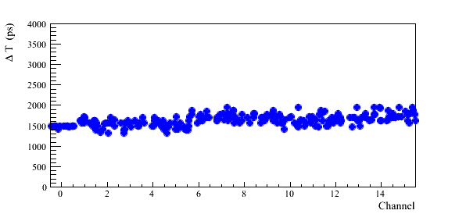
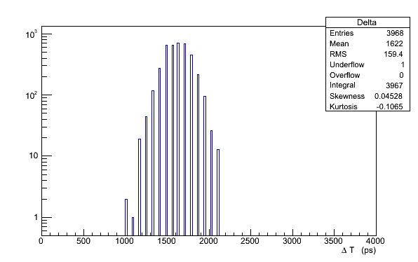
Performed a data delay scan of fadc channels, determine the time margin, where digitization errors occur, ΔT = T_{DELAY}(channel) – T_{ERROR} - currently all fadc modules have the same per-channel timing offsets
FADC250 Firmware: Test of Digitization
Tesing procedure, Ben, Hai, Ed
rocfcal1
248 fadcs modules
Large enough ( > 1 ns) margin
Need to repeat scans in different conditions (temperature)
- automatic procedure
1 ns

Slide 5
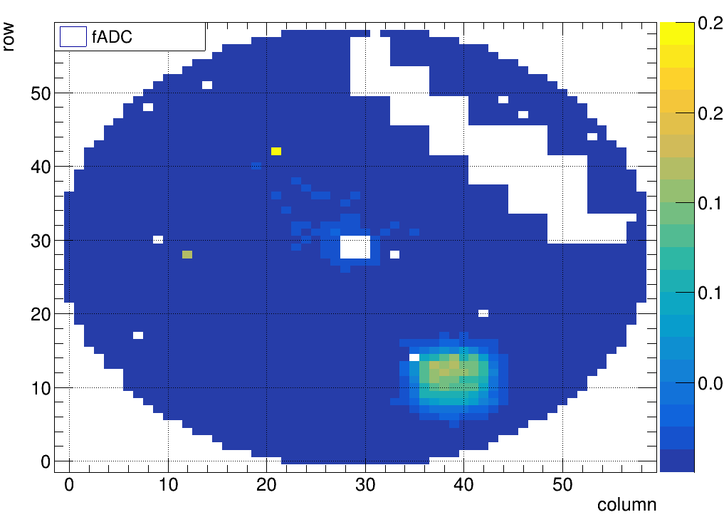
Preparations for GlueX II (High-Luminosity)
DIRC Commissioning in 2019
- Integrating DIRC to the readout (read out three SSPs)
- Integrated TRD/GEM crate to the GlueX trigger distribution
Special trigger configuration
for testing DIRC using straight
tracks in TRD/GEM
- trigger generated by FCAL
channels in the TRD/GEM region
(list of enabled channels provided
by Justeen)
Trigger Region
Split readout of TPOL
- Add two FADCs to read out TPOL (read out 32 channels using 4 FADCs)
- Reduce dead time at high rate produced by TPOL (read out in raw mode)

Slide 6
Trigger Types in Spring 2020
Main production triggers
Bit 1: FCAL & FCAL
Bit 3: BCAL
Bit 4: PS
TS Front Panel: FCAL and BCAL LED, DIRC LED, Random
TAC runs
PS & CCAL, PS & TAC PS calibration

Slide 7
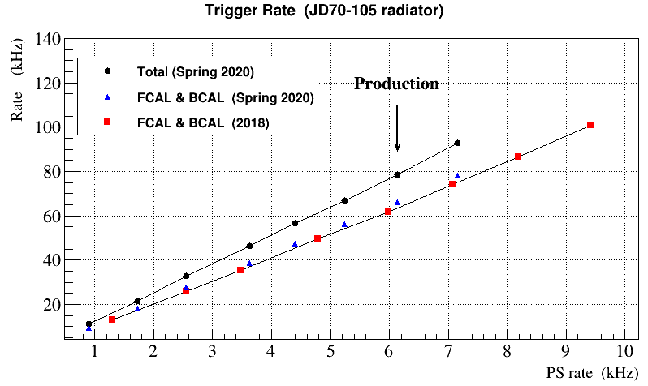
Trigger Rate Spring 2020
Trigger rate is rather similar to that in 2018
Trigger rate in production runs (350 nA, JD70-105 radiator) is about 80 kHz

Slide 8
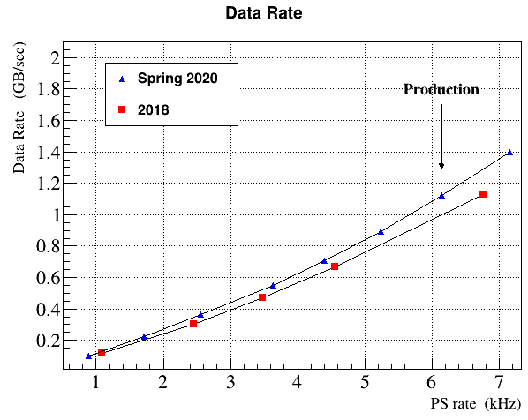
Data Rate Spring 2020
DIRC crate included to the readout
DIRC contribution to the data
rate at 350 nA -100 Mbps ( ~ 10 %)
Some reduction of the DIRC data rate is possible by removing
SSP headers (will be tested)
DIRC
350 nA (JD70-105)

Slide 9
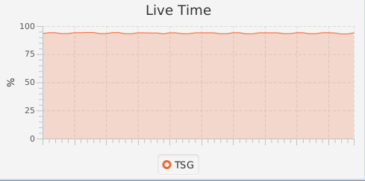
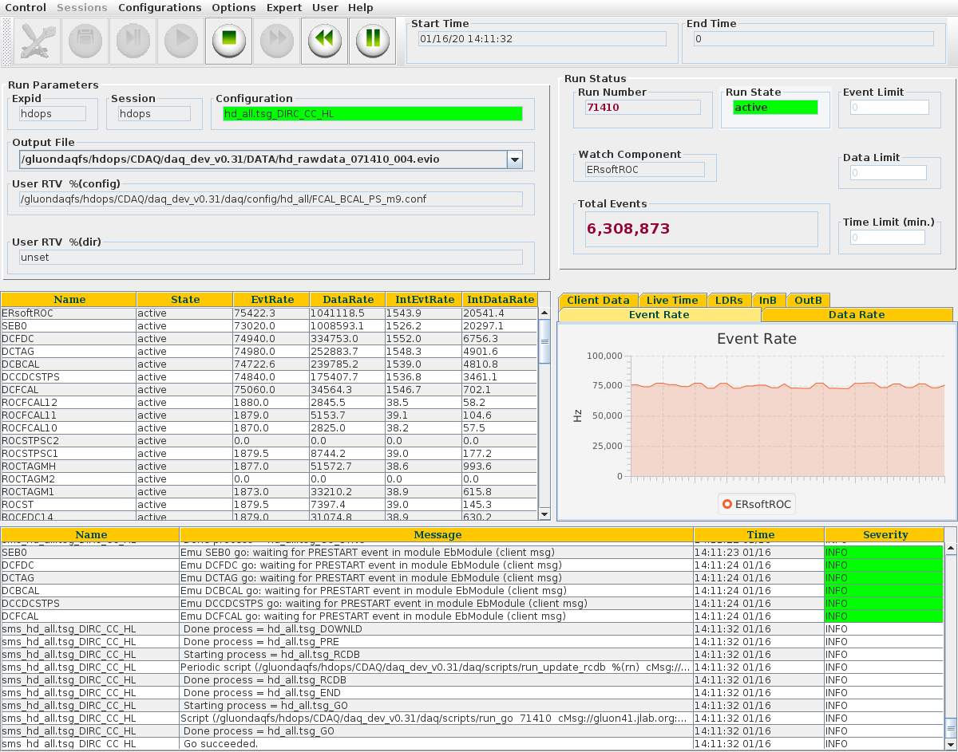
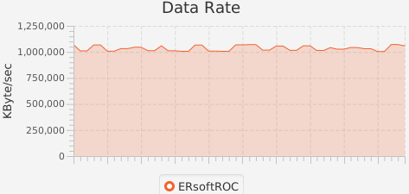
GlueX II High-Intensity
Production at 350 nA (JD70-105)
Stable run conditions at 80 kHz trigger rate
L.T. ∼ 91 %
Data Rate: 1.1 Gb/sec

Slide 10
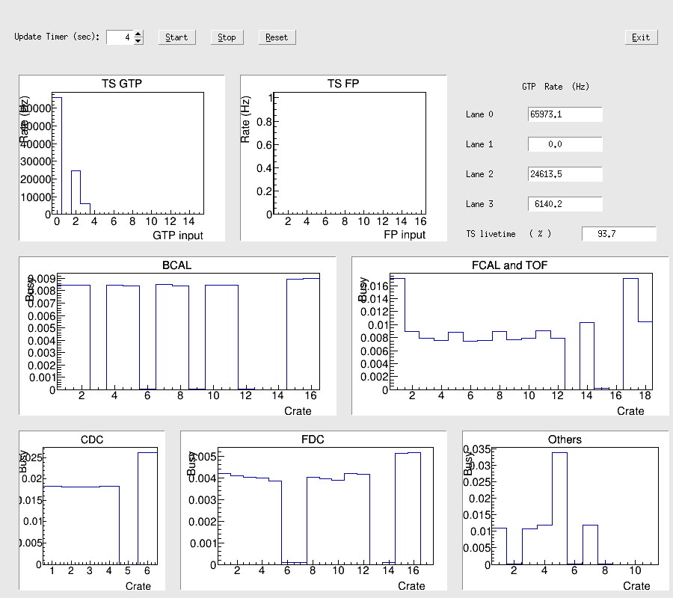
System Dead Time
Stable run condition
Live time: 91 – 93 %
Contributions to dead
time:
TPOL: 3.5 %
DIRC: 2 – 2.5 %
DIRC
TPOL

Slide 11
Summary
The new FADC250 firmware was installed on all modules. Several problems
have been fixed during the DIRC commissioning phase and in the beginning
of GlueX production.
The trigger was successfully operated at high-luminosity. The total trigger rate is
about 80 kHz, with the L.T. of 91 %. The data rate corresponds to 1.1 Gb/sec

Slide 12
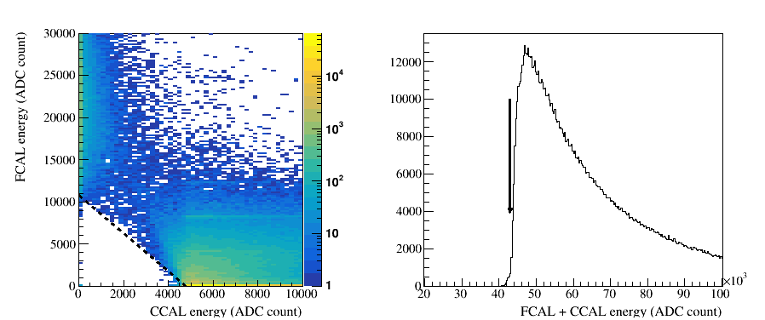
PrimEx Production: Spring 2019
CCAL & FCAL
trigger
Typical trigger rates for PrimEx production:
Total: 23 kHz Live time: 99 %
CCAL & FCAL: 17.7 kHz
FCAL: 1.2 kHz
PS: 5.5 kHz

Slide 13
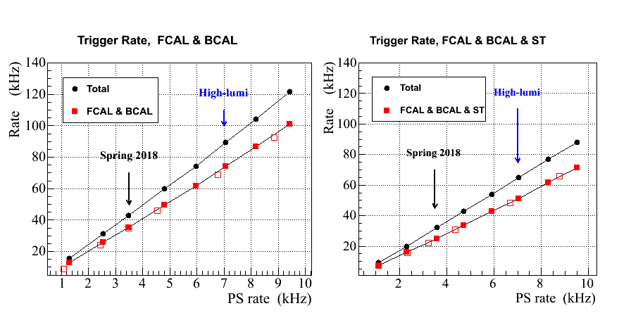
Performance at High Rate
DAQ
limitations
Expected trigger rate at high lumi:
current trigger - 90 kHz
FCAL & BCAL & ST - 70 kHz
PS trigger rate (75 μm Converter)
7 kHz
(can be prescaled by a factor of 2)

Slide 14
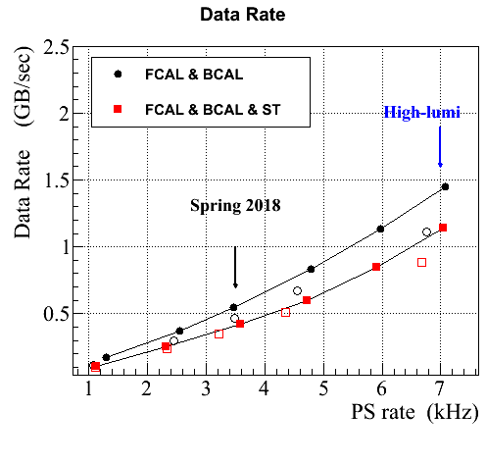
Data Rate
DAQ
limitations
Data rates Current BCAL & FCAL trigger - 1.2 (1.4 Gb/sec with DIRC)
at high liminosity FCAL & BCAL & ST trigger - 0.9 (1.1 Gb/sec with DIRC)

Slide 15
Preparation for High-Intensity Run
Operation at high rate requires adjustment of sub-detectors
(voltages, readout thresholds and window sizes)
DIRC check / implement busy distribution from the SSP,
sparsification of SSP headers (similar to FADC modules)
TPOL contributes to the dead time on the level of 5 %. New
fadc readout mode, has to be checked
TOF CAEN TDCs adjust readout thresholds and window sized
Drift Chambers: voltages, baselines, and thresholds
(make sure that there are no ‘oscillations’ )
Run FCAL & BCAL & ST trigger in parallel with the FCAL & BCAL trigger
- Adjust trigger tming parameters for the FCAL & BCAL & ST trigger
- Fix issues with the ST initialization (latency, the problem happens once in a while)

Slide 16
Firmware Updates and Test Setups
Replace GTP with the VTP module
- purchased VTP module for Hall D
- will allow to stream the GTP trigger information to the data file
- planning to set up 2 trigger crate in the counting room and test performance
(will require new firmware and software, Ben and Bryan)
Implement readout for the trigger SSP
- add SSP calculations to the data stream
- SSP readout has been tested
New version of the CTP firmware (FCAL, BCAL, PS/ST)
- improved trigger latency, similar to the firmware version install in tagger
- has to be tested in the Hall (low priority)
Install CAEN 1495 module for the PS LED pulser
(original PS module was used for the ‘random’ trigger)
- the module can be used to drive the LED system of the PWO crystal test setup

Slide 17
Short Term Plans
Finish with the test of the FADC firmware. Implement new FADC initialization
features
Power the detector up, check performance of the trigger and readout
electronics (start taking cosmic data)
Work on the preparation of test setups (PWO crystal checking, ect. )

Slide 18
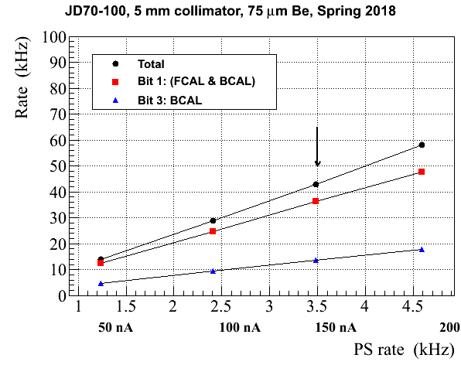
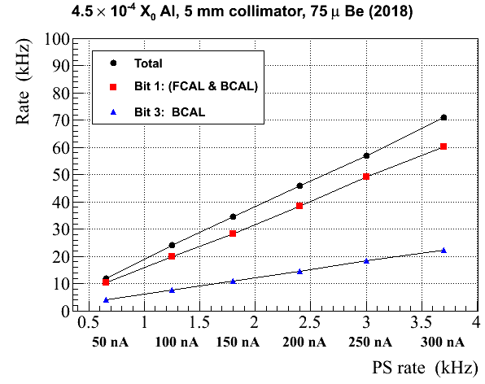
Trigger Performance in 2018
Stable performance at about 45 kHz total trigger rate
- default converter: 75 μm Be
Diamond
Amorphous
2.5 ⋅ 10⁷ γ/sec
Data were taken with a thick converter (750 μm Be) - PS rate: 35 kHz
- Total trigger rate: 70 kHz, L.T. 90 %
(largest contribution to the dead time from TPOL)

Slide 19
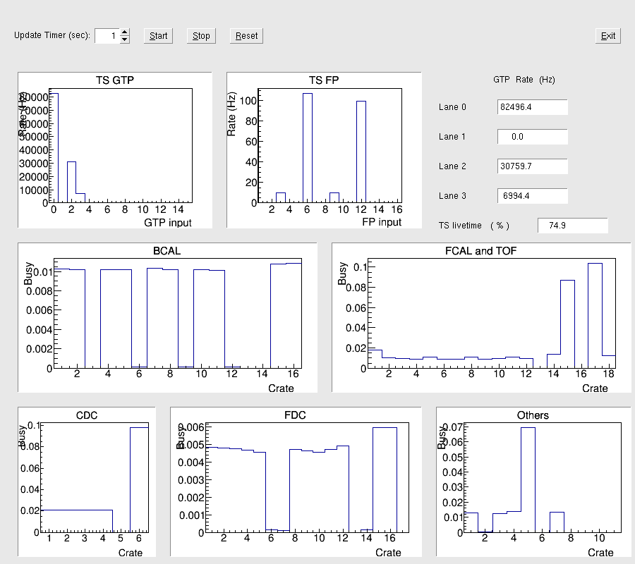
Performance at High Rate
900 nA on 17 um
diamond radiator
80 kHz trigger rate
DIRC busy – 10 %
TPOL, TOF – nothing new
fadc 250 firmware
for TPOL will be tested
DAQ saturates at
about 1 Gb/sec
Data rate from DIRC
(one half)
60 – 70 Mbps
(data size reduction is
possible)
TOF
DIRC
TPOL

