Slide 1
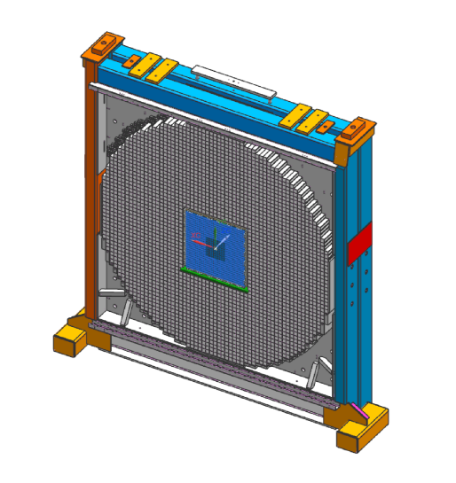
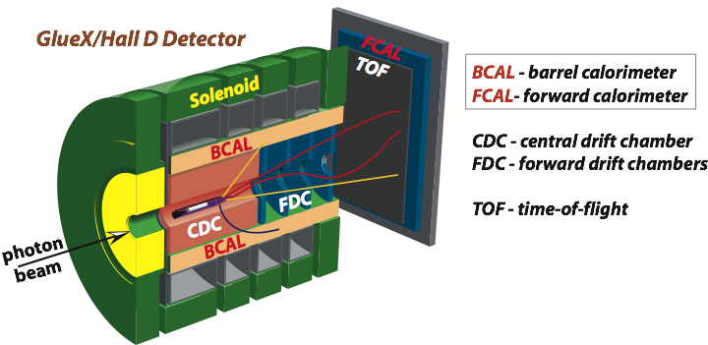
Estimates of the PMT Anode Current of the CCAL (FCAL2) Modules
Alexander Somov, Jefferson Lab
23 February 2020

Slide 2
Motivation
Estimate anode current of the FCAL 2 PWO insert
- decide on the required gain of the active base amplifier
Measure PMT anode current for CCAL modules. Extrapolate measurements to
the FCAL 2
Perform measurements for two luminosities:
- use JD70 – 105 (47 um) diamond radiator
- 350 nA (GlueX II run conditions) and 200 nA electron beam currents
Notes:
*

Slide 3
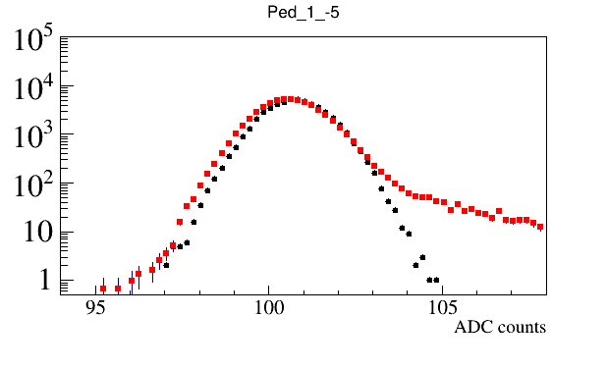
Analysis Overview
Collect CCAL FADC waveforms using random and PS triggers
- no data sparsification (no threshold applied)
- estimate current using waveforms acquired with
the random trigger
- Use PS trigger to monitor beam trips
(time difference between trigger time stamps)
Sum up FADC ampilitudes above the threshold
(1 count above the baseline) in a 400 ns window
(100 fadc samples)
Estimate anode current as follows:
FADC Pedestals
Threshold
No beam
350 nA beam
A = $\frac{5∙{10}^{−4} V}{50 Om}∙\frac{<A\left(FADC\right)>}{100 samples}∙\frac{1}{Gain(Amplifier)}$
Notes:
*

Slide 4
CCAL FADC Waveforms
Notes:
*

Slide 5
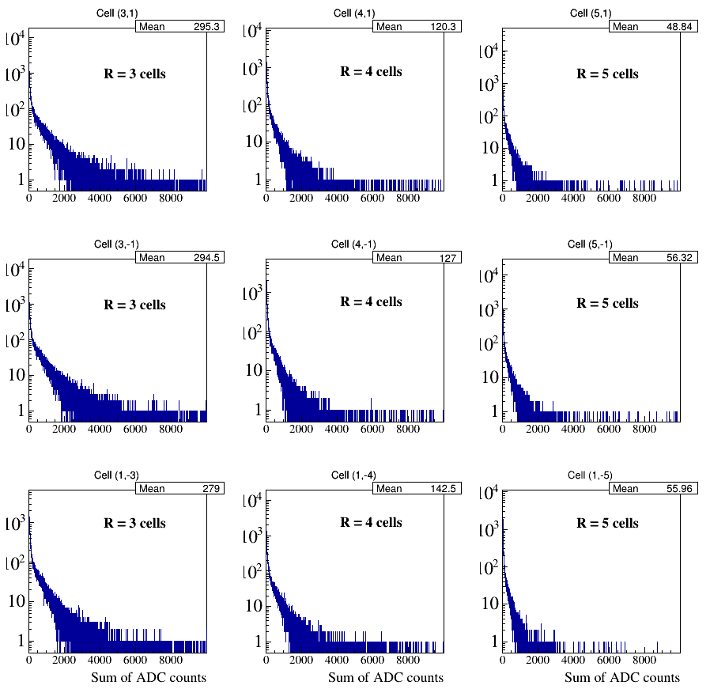
Sum of FADC Amplitudes in 400 ns Time Window
FADC amplitude sums for modules in
different CCAL layers
Notes:
*

Slide 6
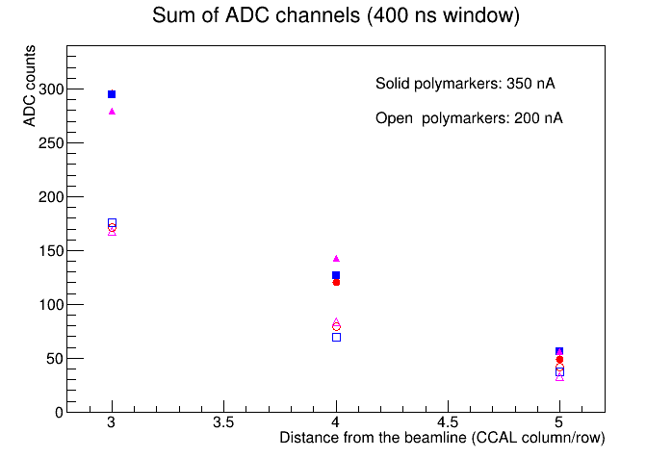
Sum of FADC Amplitudes in 400 ns Time Window
Current seen by FADC in the 3rd row: 30 μA
Current through the divider: 30 μA / 25 = 1.2 μA
Current estimates for FCAL:
- beam hole in the FCAL insert: 2x2 modules
- 1st layer covered by an absorber
- CCAL is positioned at Z _{CCAL} = 2 ⋅ Z _{FCAL}
(Z_{CCAL} ∼ 12 m)
aperture: 4th CCAL layer corresponds to
the 2nd FCAL layer
solid angle: factor 4
- FCAL current in the 3rd layer (1st after an
absorber) if no amplifier used:
5 x 4 = 20 μA
30 μA / 25
15 μA / 25
5 μA / 25
Notes:
*

Slide 7
Discussion
Can (probably) use active bases without dividers in all FCAL 2 insert modules except
the 3 – 4 layers after the absorber. The amplification factor of 3 or 6 can be used for
these modules
28 active bases were taken from the CCAL (all bases from layer 3 and 8 modules from layer 4).
Gain of these dividers will be modified (coordinated with Fernando):
- 14 bases – gain 3
- 14 bases – gain 6
Modified bases will be reinstalled on CCAL and testes in March / April
Notes:
*

Slide 8
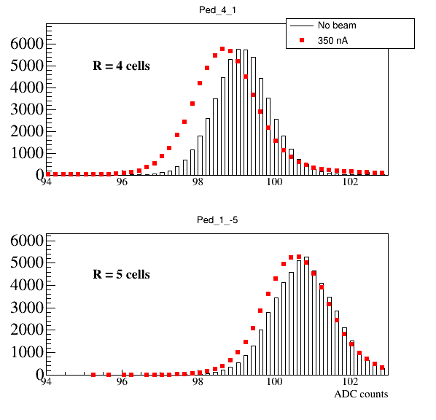
Baseline Shift as a Function of Rate
Amplifier in the active base is AC coupled
- expect some FADC baseline shift at high
rate
The shift depends on the rate
Note, if the amplifier is bypassed, the PMT
Is DC coupled
Checked the baseline shift at CCAL
(350 μA at the diamond radiator JD70-105)
The shift is about 0.5 fadc counts in the
4th layer (0.1 count in the 5th layer)
Notes:
*

