Slide 1
Status of the PS / Tagger Energy Calibration
for Spring 2020 Runs
A.Somov, JLab
May 26, 2020

Slide 2
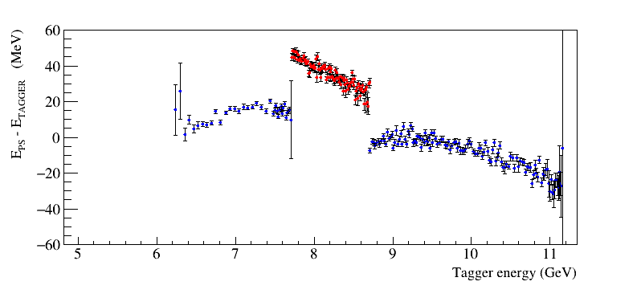
PS / Tagger Energy Before Calibration
Run 71351
Beam energy: 11.38 GeV
Beam current: 130 Na
- low-energy TAGH counters
switched on
Pair Spectrometer magnetic field restored to the nominal value after the PrimEx run
( magnet current 910 A)
Reconstruct PS/Tagger energy using default CCDB calibration constants
PS / TAGH energy discrepancy in the TAGH are relatively small, at the level of 40 MeV

Slide 3
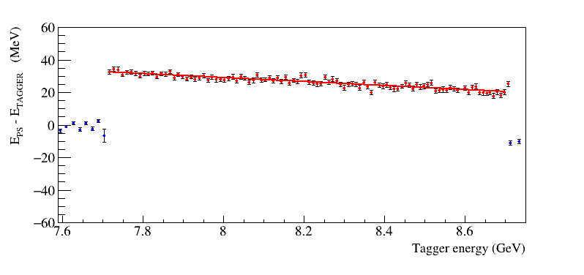
TAGM Energy
Correct Pair Spectrometer energy scale
- TAGH energy is relatively good aligned
- TAGM energy is slightly shifted
Correct TAGM energy
- use linear function to shift TAGM
energies

Slide 4
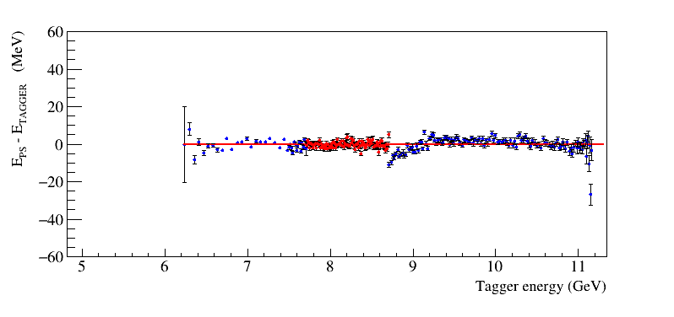
Energy Scale After Calibration
Maximum energy deviation between PS and TAGH for some counters is < 10 MeV
(negligibly small)
Energy of TAGH counters was not corrected
Some improvements in calibration are possible (plan to continue working on it), but it’s good enough
for physics analyses

Slide 5
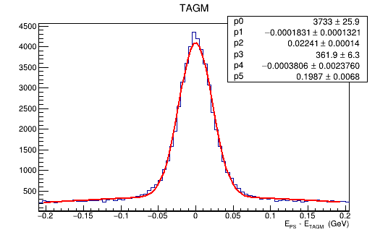
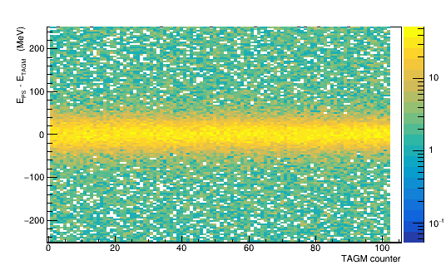
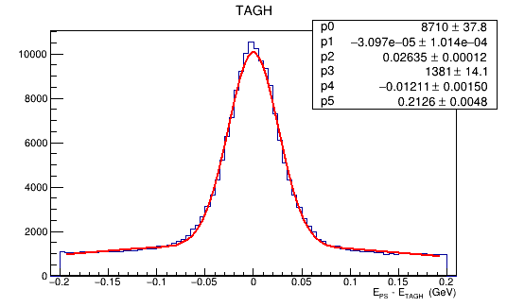
Energy Scale After Calibration
TAGM
Energy residuals, E_{PS} – E_{TAGGER} , for all counters
TAGH
Updated PS ad TAGM energies in CCDB for run periods (70001 – 79999)

