Slide 1
Status of the Luminosity Determination for PrimEx
A. Somov
Analysis Meeting, August 26, 2020

Slide 2
Improvements for PrimEx
Energy calibration of the PS, TAGH / TAGM
Implement correct beam energy in the reconstruction and MC simulation
Initial lumi number for PrimEx runs in the CCDB (since last year)
Not smooth energy dependence of the Compton cross section in the TAGM region
- Inconsistency between lumi determination and reconstruction (in DBeamPhoton)
- require TDC hit in the TAGM reconstruction

Slide 3
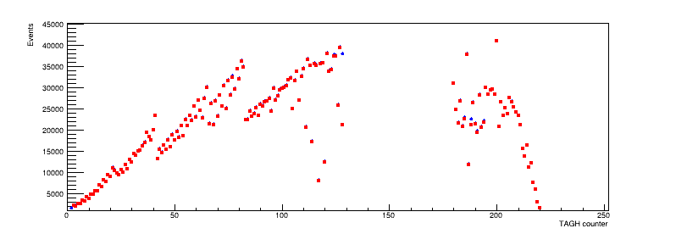
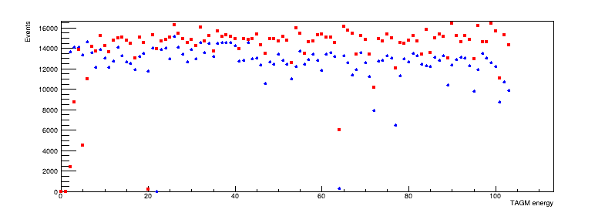
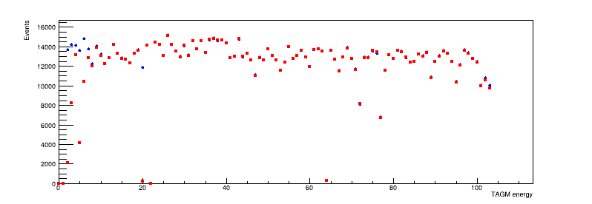
Tagged Flux for TAGH / TAGM
PS tagged flux extracted using two methods:
TAGH
Read points: Beam photon
Blue points: FADC time (require ADC and TDC hits)
TAGM (old recon)
TAGM (new recon)
New reconstruction of the TAGM: (1) Require both ADC and TDC hits, remove amplitude thresholds

Slide 4
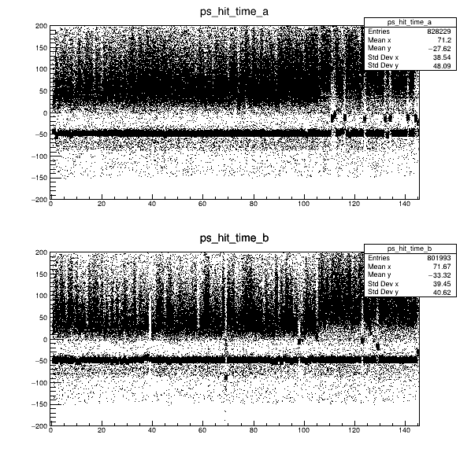
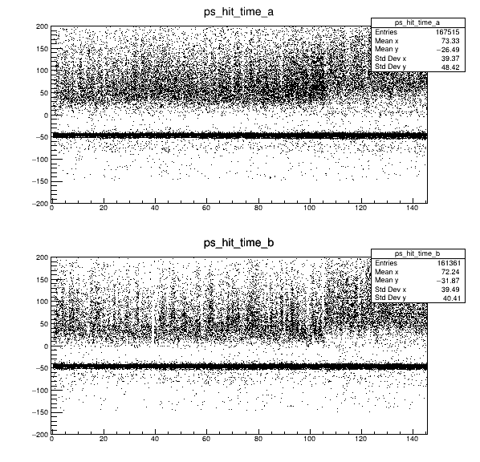
PS Timing Calibration Issues
Run 61914 (He)
Before Calibration (Calibration updated in May)
After Calibration (New)
Arm A
PS time (ns)
Arm B
PS Tile
PS Tile
Some PS hIts in Arm A and Arm B are out of time – missing PS coincidence
Recalibrate PS time for all PrimEx runs (new constants in CCDB)
https://halldweb.jlab.org/primexd/data _quality_2019/quality_check_2019.pdf
Still some minor issues with TAGH/TAGM timing for some runs

Slide 5
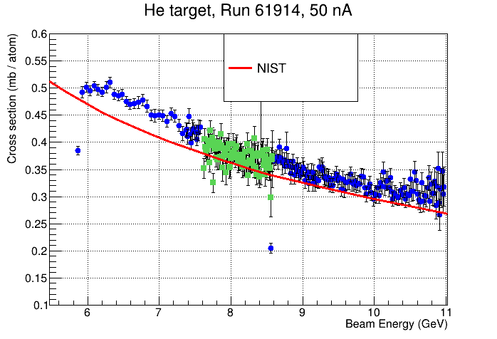
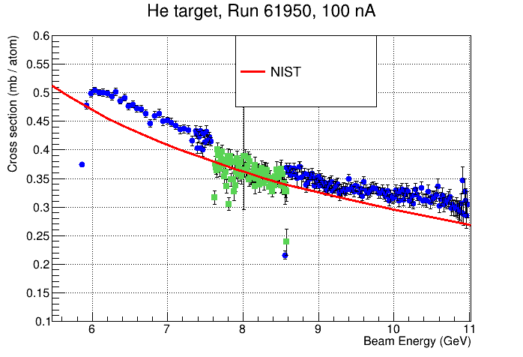
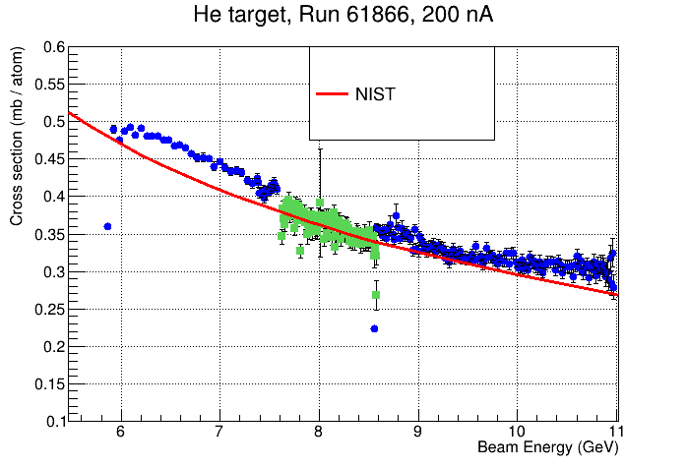
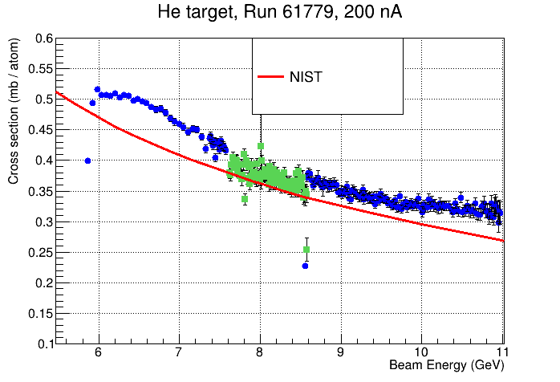
Compton Cross Section (He Runs)
Runs from the same
LHe target fill
(low intensity)
Runs from different
target fills
(high - intensity)
Still some discrepancies in
cross section shape
Checking TAGM reconstruction

Slide 6
Next Steps
Reconstruction efficiency studies
- simulation of pileup (CCAL clusters are written to HDDM for skims with random trigger)
- beam is not fiducialized for many runs (?)
Started working on accidental subtraction
Check PS acceptance for PrimEx runs
Reprocess lumi numbers

