Slide 1
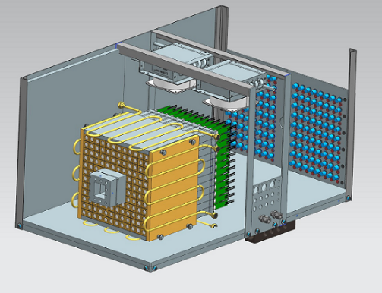
PrimEx Overview and Preparation for 2021
A. Somov
on behalf of the PrimEx group
GlueX collaboration meeting, October 22, 2020

Slide 2
Overview
PrimEx Phase I run in Spring 2019
Status of calibration
Status of data analyses
Preparation for run in 2021

Slide 3
PrimEx Phase I (Spring 2019)
LH₂ target | 40 days
LHe₄ | 30 days
Empty target | 6 days
Setup, Calibration | 3 days
Total | 79 days
Approved by PAC
Time | Beam energy | Calendar Days | PAC days
Phase I
02/21 – 03/05 03/08 – 04/15 | 11.61 GeV 11.17 GeV | 15 38 | 8 16
Total |  | 53 | 24
Efficiency 0.45
Collected data sample
 | He empty | He target |  | Be target | Be empty
Total (M) | 3288 | 40970 |  | 2789 | 643
Have to take data for 6 PAC days on He target
(no FOM corrections applied due to smaller beam ebergy)

Slide 4
PrimEx Phase II (Summer 2021)
Time | Beam energy | Calendar Days
06/21/2021 - 08/14/2020 | 10.1 GeV | 54
Significantly smaller beam energy
- about 4 times smaller photon flux in the energy range between 9.5 GeV +
(for the same rate of accidentals in the tagger)
- larger contribution from coherent nuclear background at small energies
Some overhead needed to calibrate CCAL, FCAL, and TAC run
- expect to replace about 300 bases, calibration run may be required
Have to run on Be target for target density calibration
Expect to finish taking data on 4He target

Slide 5
Status of Calibration
A lot of help received from the collaboration (thanks to Sean, Zisis, and many others).
PrimEx group members have to be deeply involved in many calibration activities:
CCAL calibration Drew (done)
FCAL time calibration Drew (done)
FCAL energy calibration Igal (final steps)
FCAL mask of dead / suspicious channels Chandra (in process)
FCAL / CCAL alignment Drew (in process)
TAGH / TAGM / PS energy calibration Sasha (done)
PS timing Sasha (done)
TAGM timing Sasha (in process)

Slide 6
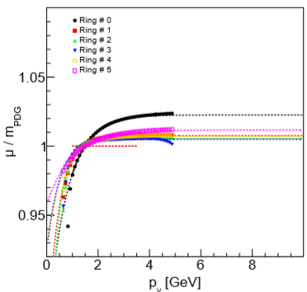
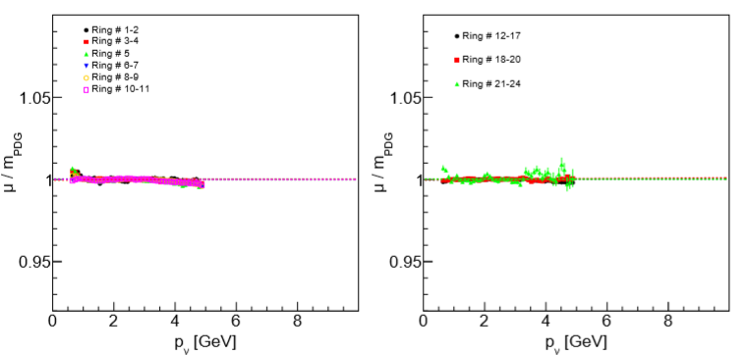
FCAL Energy Calibration
Igal
Apply energy-dependent corrections in different FCAL rings
- select symmetric photon pairs: 0.7 < p_{γ}¹ / p_{γ}² < 1.3
before corrections
after corrections
Energy calibration for 48 run periods. Stability of the π⁰ mass better than 1 %
Final calibration steps, new constants in the CCDB

Slide 7
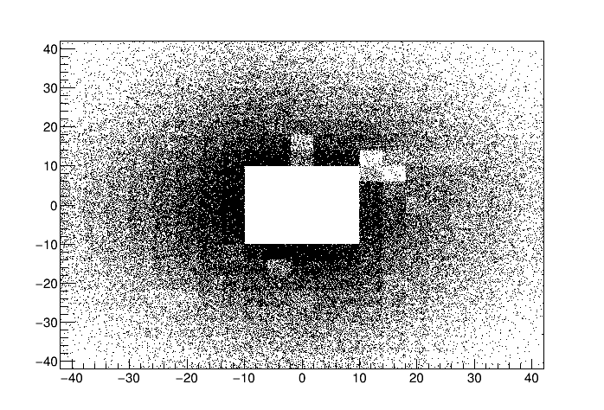
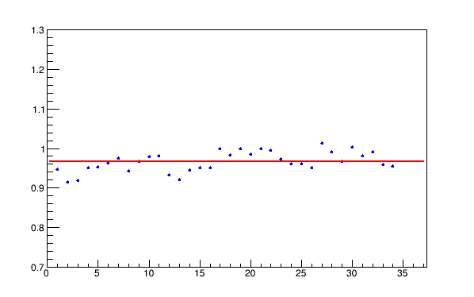
FCAL Performance and Masks of Suspicious Channels
FCAL XY of clusters
Relatively unstable behavior of the FCAL
dead PMT bases during run
(several bases were replace every week)
missing communication to the base
(channels dead for some time)
2 days
Flux normalized yield of
two-cluster events
Runs

Slide 8
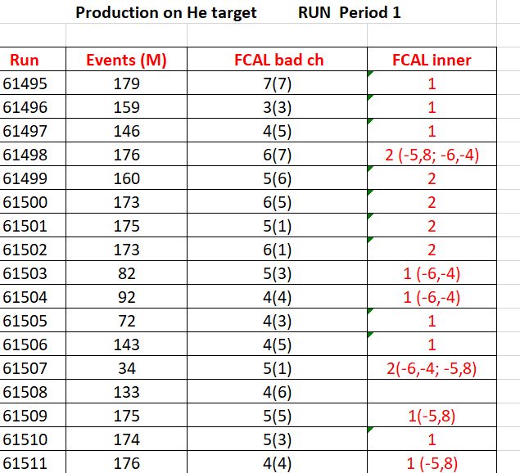
Masks of Suspicious Channels
Chandra
FCAL data quality: suspicious and dead channels
Determine mask of suspicious and
dead channels for every run.
occupancies from LED and data
FCAL masks implemented for PrimEx
GlueX-doc-4610 (A. Somov)
Masks have to be determined for
about 50% of PrimEx data
https://halldweb.jlab.org/primexd/data_quality_2019/quality_check_2019.pdf
Work in progress

Slide 9
Luminosity Determination for PrimEx
Energy calibration of the PS, TAGH / TAGM
Implement correct beam energy in the reconstruction and MC simulation
Initial lumi numbers for PrimEx runs are in the CCDB since last year
Not smooth energy dependence of the Compton cross section in the TAGM region
- require TDC hit in the TAGM reconstruction (adopted by GlueX )
Reprocess photon flux:
- PS timing calibration has been screwed in April 2020 - recalibrated
(lumi dropped compared with numbers from previous year)
- work on understanding the TAGM reconstruction. Re-calibrating TAGM
time-walk corrections

Slide 10
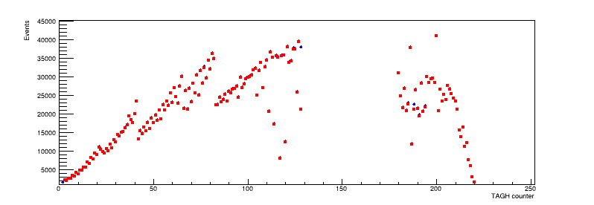
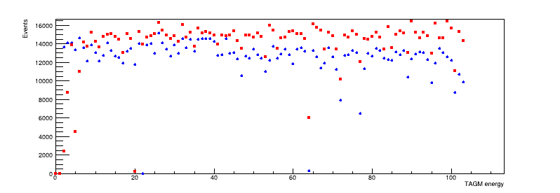
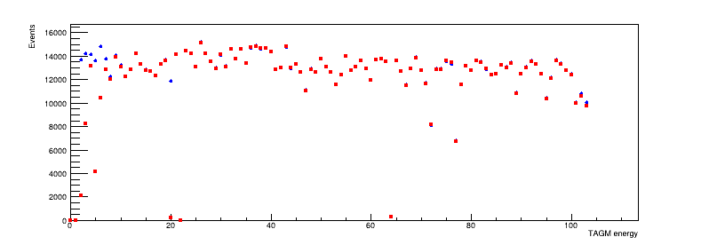
Tagged Flux for TAGH / TAGM
PS tagged flux extracted using two methods:
TAGH
Read points: Beam photon
Blue points: FADC time (require ADC and TDC hits)
TAGM (old recon)
TAGM (new recon)
New reconstruction of the TAGM: (1) Require both ADC and TDC hits, remove amplitude thresholds

Slide 11
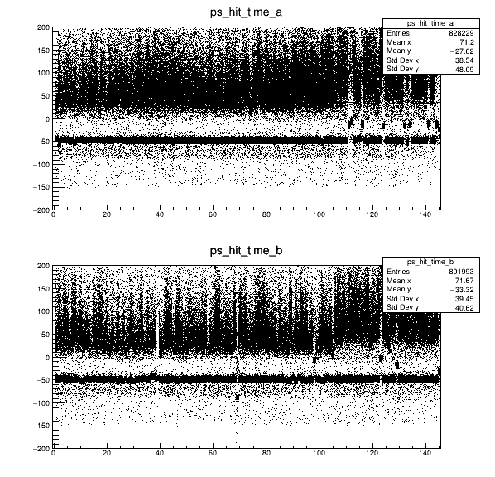
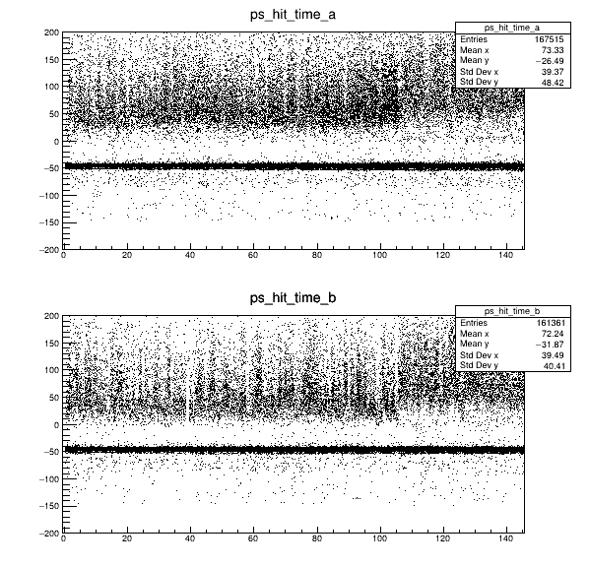
PS Timing Calibration
Run 61914 (He)
Before Calibration (Calibration updated in May)
After Calibration (New)
Arm A
PS time (ns)
Arm B
PS Tile
PS Tile
Some PS hIts in Arm A and Arm B are out of time – missing PS coincidence
Recalibrate PS time for all PrimEx runs (new constants in CCDB)
https://halldweb.jlab.org/primexd/data _quality_2019/quality_check_2019.pdf
Still some minor issues with TAGH/TAGM timing for some runs

Slide 12
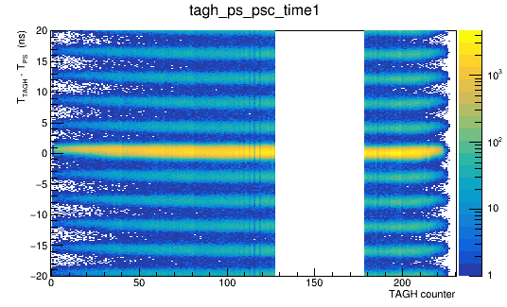
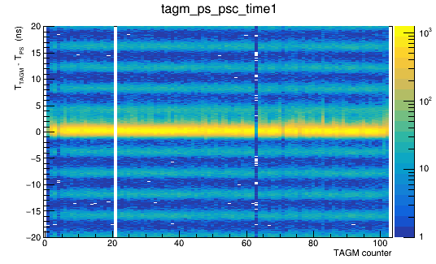
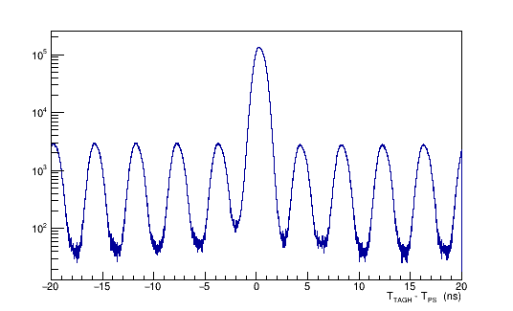
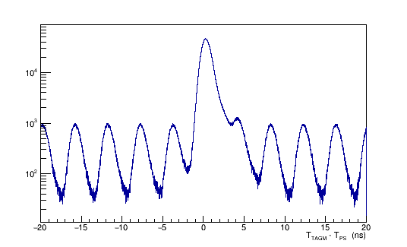
TAGM Time Calibration
Run 61321 (Be)
Sasha, October 9, 2020
T(TAGH) – T(PS)
T(TAGM) – T(PS)
T(TAGH) – T(PS)
(all counters)
T(TAGM) – T(PS)
(all counters)

Slide 13
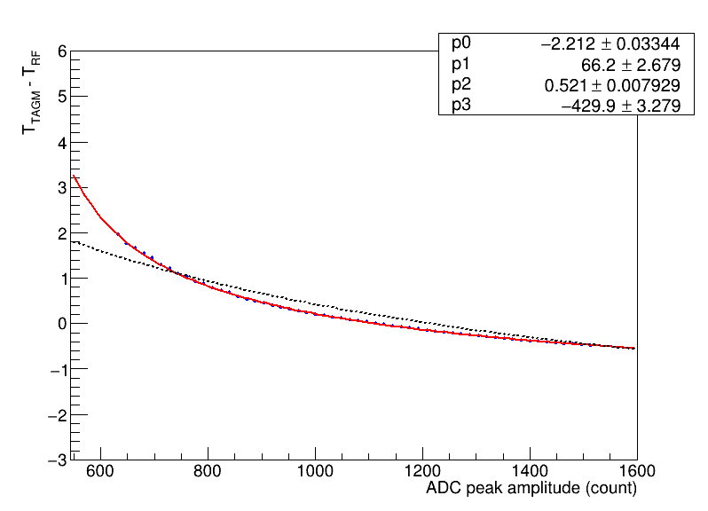
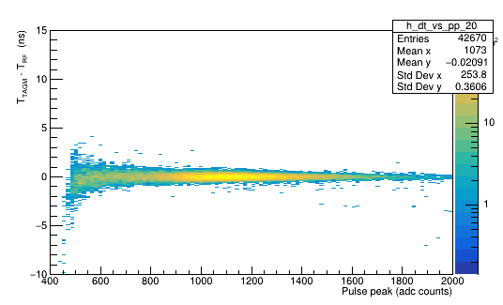
TAGM Time Walk Calibration
TAGM Counter 20
After Calibration
What we have in CCDB
Fit function
p0 + p1 / (x + p3) ** P2

Slide 14
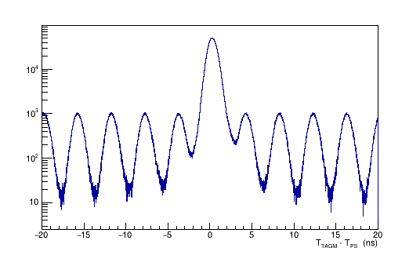
Run 61321
TAGM Time Walk Calibration Results
Before Calibration
After Calibration

Slide 15
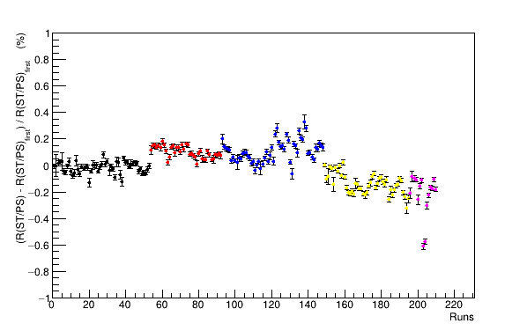
Monitoring ⁴He Target Density
Use PS and ST fadc scalers to monitor target density
PS rate – flux, ST rate – proportional to target density
- sensitivity verified with MC simulation, run in parallel with taking data
Relative density measured with scalers for
5 run periods with He target (re-filled target)
Density stability better than 1 % (have to use Compton to verify)

Slide 16
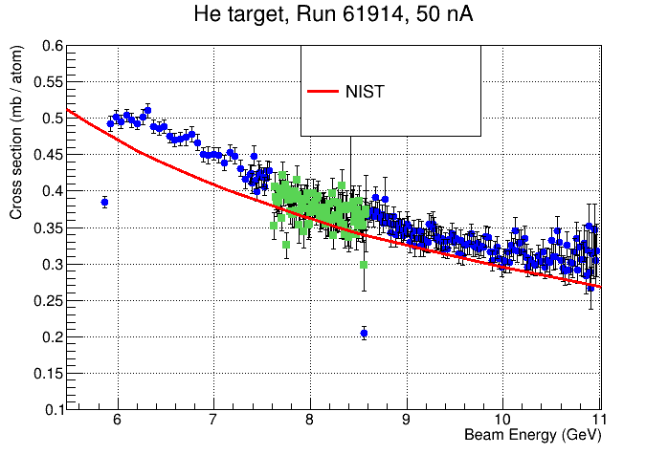
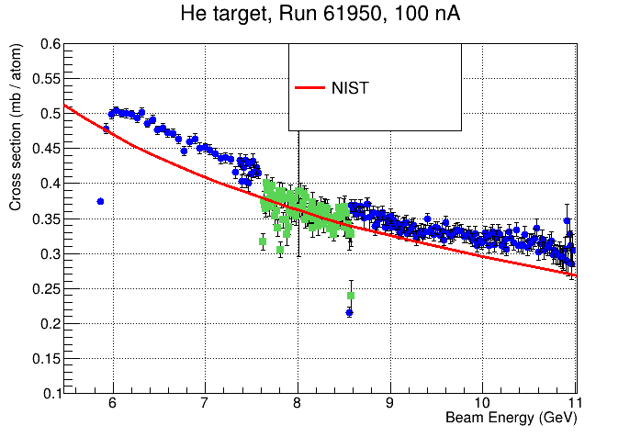
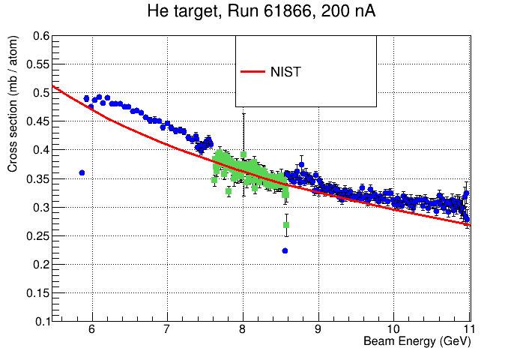
Compton Cross Section (He Runs)
Low intensity
Runs from different
target fills
Some small discrepancies in cross section shapes
Lumi for TAGM has not yet been updated
- Checking TAGM reconstruction

Slide 17
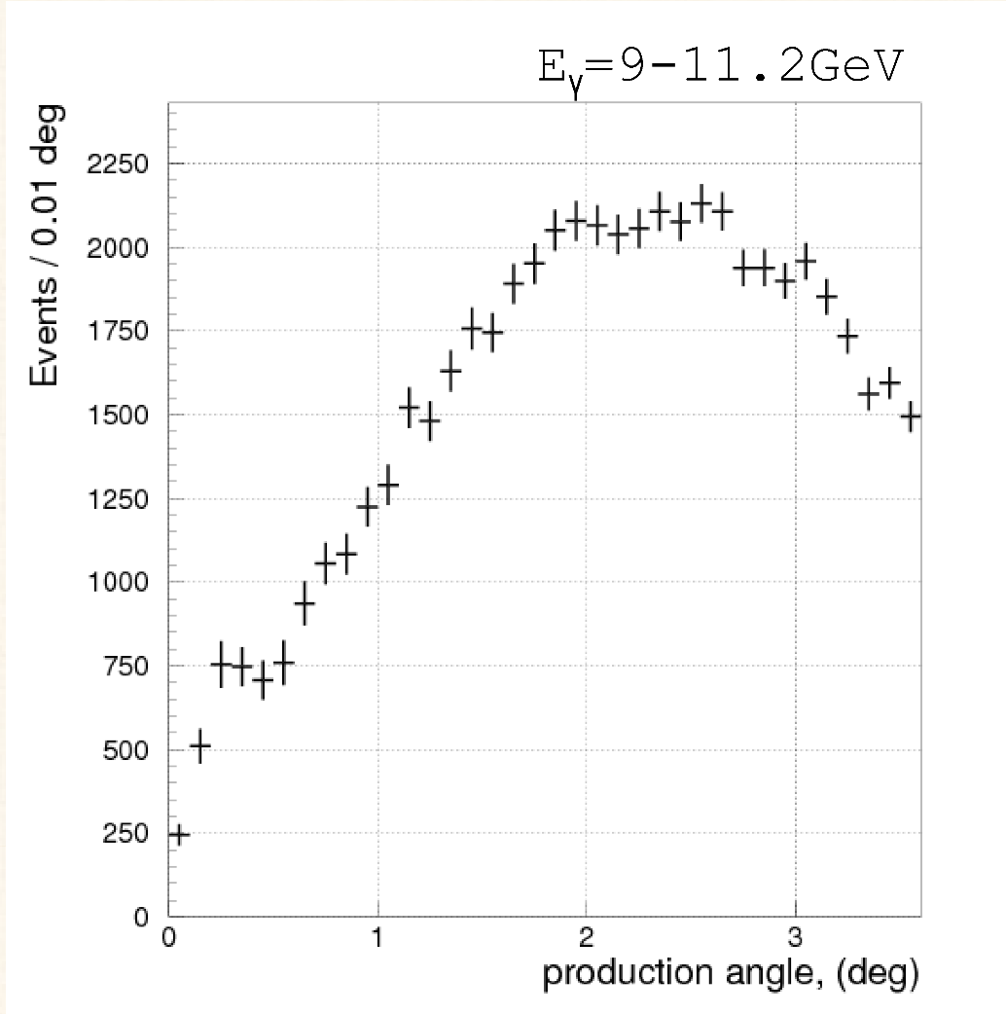
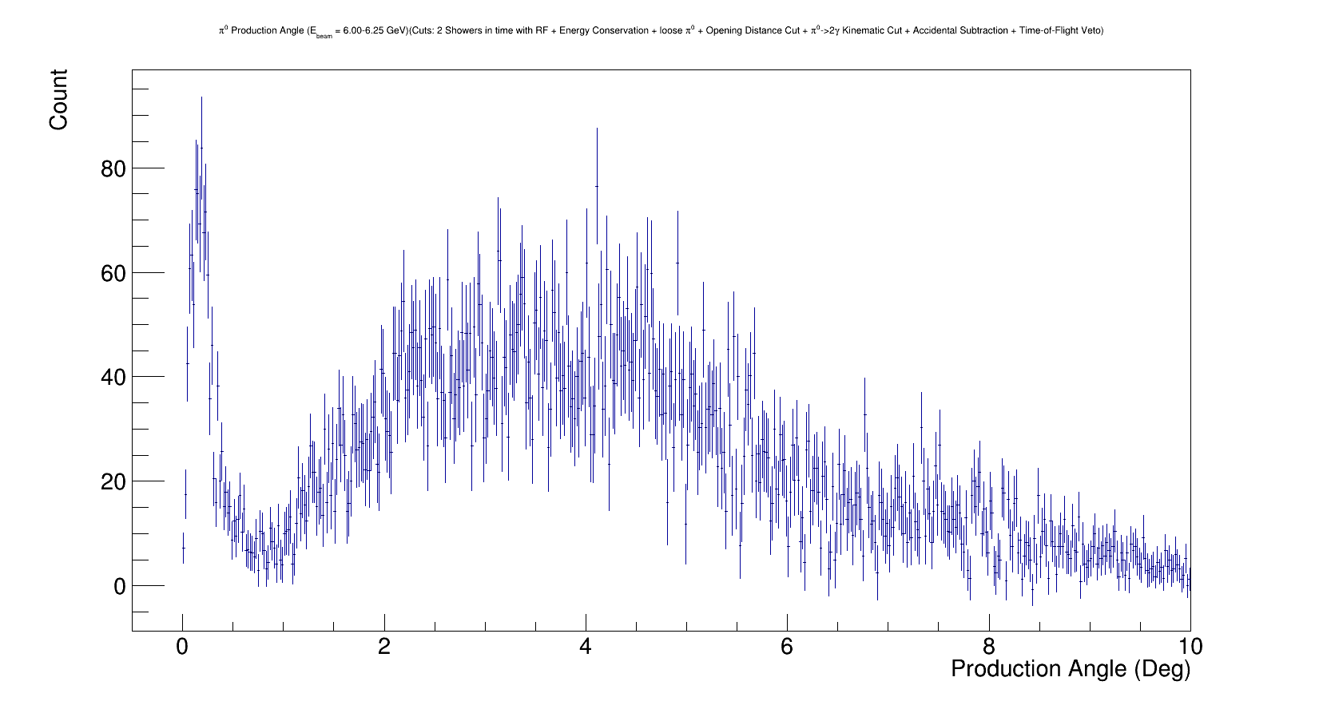
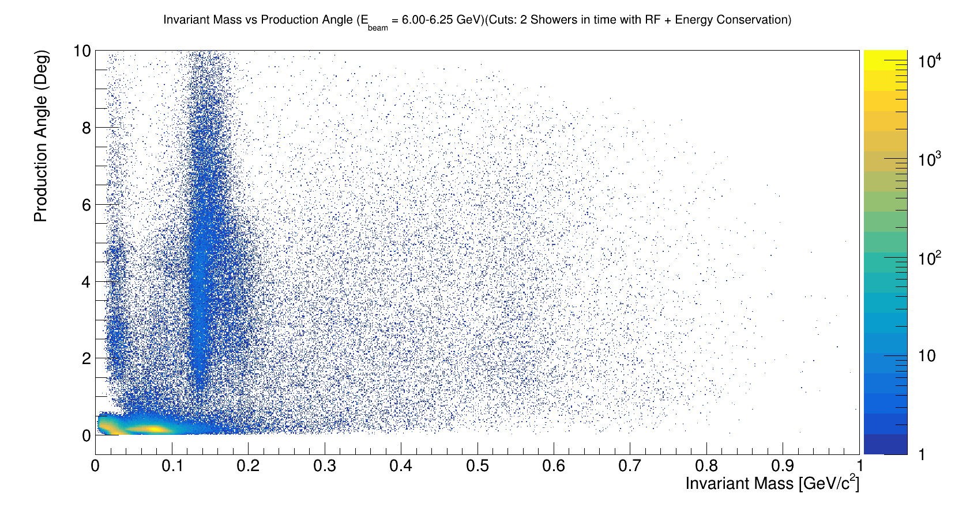
Analyses of PrimEx Data
π⁰ → γγ Angular Distribution
η → γγ Angular Distribution
Tyler
E_{γ} = 6 – 6.25 GeV
production angle (deg)
E_{γ} = 9 – 11.2 GeV
30 % of the total statistics
production angle (deg)
production angle (deg)
Invariant mass (GeV)
Several ongoing analyses:
Andrew (Compton, see next talk), Tyler ( π⁰ Primakoff )

Slide 18
Preparation for 2021 Run
Aligning FCAL in the Hall Tim
Moving FCAL platform by about 5 mm in X-direction to make sure
that the beam goes through the middle of the FCAL hole (3x3 modules).
Maintenance of FCAL PMT bases Mark, Chris, Nick, Fernando
Change dead bases and bases which draw excessive current (> 13 mA)
- There are about 200 high-current bases.
- 80 bases removed from FCAL (cleaning, change resistors on the base)
Improve firmware for handling communication to the base Ben, Mark
- Several bases can lose communication per day.
- The HV drops to zero. Power cycling is needed to recover

Slide 19
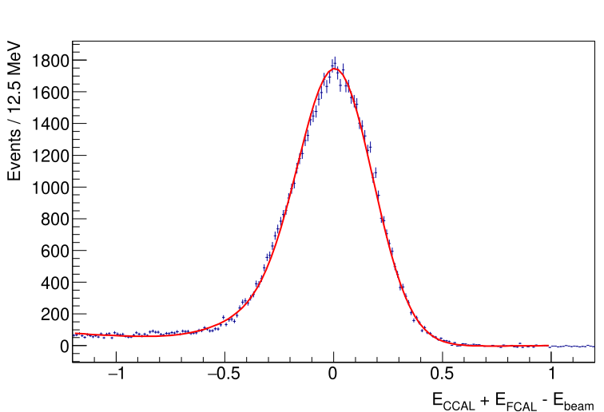
CCAL Improvements
Relatively stable performance during 2019 run
Provide clean reconstruction of Compton events
Two projects we are currently working on
I ) Replace PMT active bases (improve linearity)
- reduce gain on the active base from 24 to 3
(original divider taken from NPS)
- active base design has been slightly modified by V. Popov. Tested during Summer run
- perform a few more checks in the lab. Finalize resistor values (coordinate with Fernando)
- new active base layout prepared by Chris S.
- order new bases for CCAL (November)

Slide 20
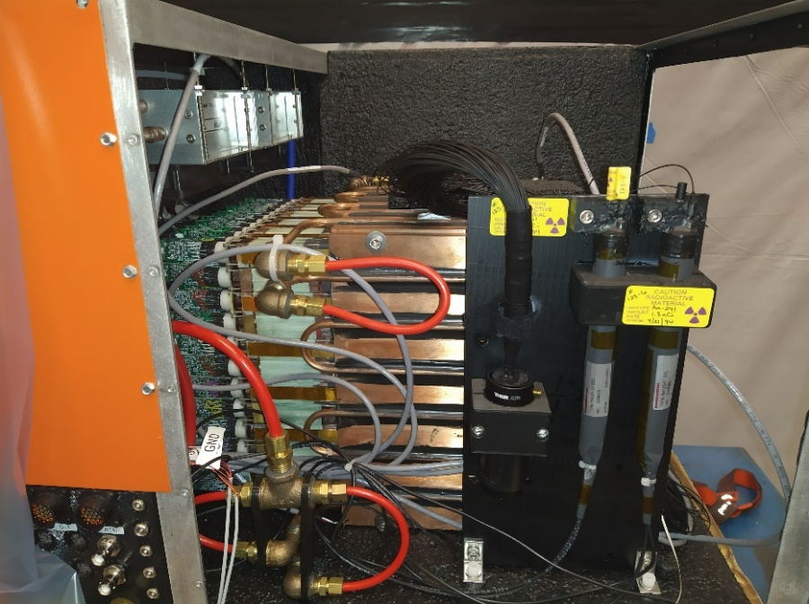
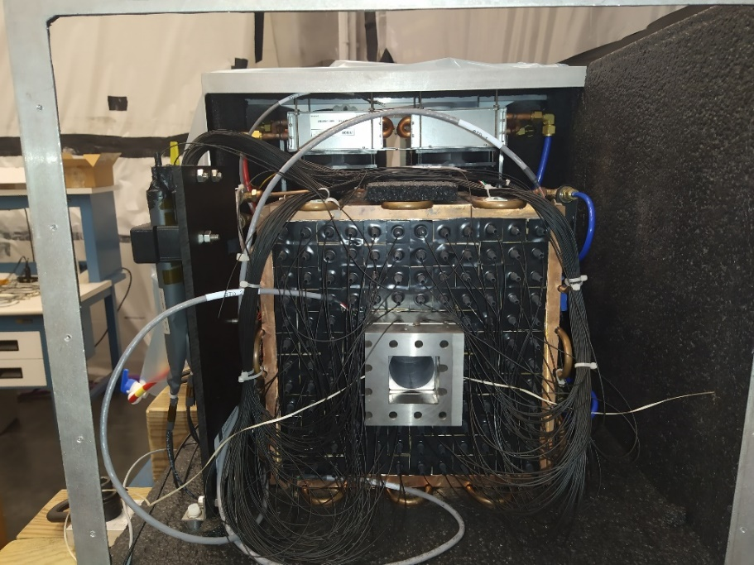
CCAL Improvements
II ) Increase light pulse in the LMS monitoring system
- typical signal pulses – a few hundred ADC counts
- new light sources, replace optical fibers
CCAL has been recently moved to TEDF

Slide 21
Summary & Discussion
Some progress has been done with the calibration of the PrimEx data and
understanding data quality. We are currently trying to finalize calibration.
We’ll need more help from collaboration to calibrate data after the new run.
Some data analyses are ongoing: Compton (see Drew’s talk), reconstruction of
Primakoff η and π⁰ (Tyler)
Preparation steps for the new run in Summer 2021
Improve FCAL performance
- align FCAL
- replace bad bases and bases, which draw an excessive current
(more than 200 bases)
- improve communication firmware with the base
Improve CCAL performance
- replace active bases
- optimize the LMS system in order to increase signal amplitudes

Slide 22
Backup Slides

Slide 23
PrimEx Phase I: Run Conditions
Beam energies: 11.6 GeV and 11.2 GeV
Radiator: 10⁻⁴ R.L. Aluminum
Beam current: 200 nA for production runs
50 nA and 100 nA for calibration runs with the CDC/FDC
< 2 nA TAC run, CCAL calibration
PS converter: 750 μm

Slide 24
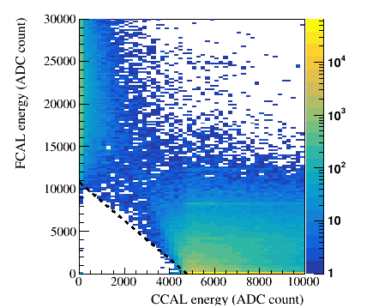
PrimEx Phase I: Run Conditions
Main production triggers
Bit 1: CCAL & FCAL E _{CCAL} + E _{FCAL} > 3 GeV
Bit 2: FCAL
Bit 4: PS
Bit 10: CCAL
TS Front Panel: CCAL LED, CCAL ALPHA, FCAL & BCAL LED, Random
Calibration
CCAL: CCAL calibration, snake scan
PS & CCAL, PS & TAC PS calibration
Efficiency Studies
TAGH & ST
Typical trigger rates for PrimEx production:
Total: 23 kHz
CCAL & FCAL: 17.7 kHz (FCAL only 1.2 kHz)
PS: 5.5 kHz

Slide 25
Active Base Tests and Optimization: Timeline
Use Hall C PWO crystals and electronics for CCAL
Test of the 3x3 PWO prototype installed behind the Pair Spectrometer, GlueX-doc-3590, May 2018
first indication of potential problems: too large amplifier gain (x25), energy resolution worse
than expected
light yield is large, an amplifier is not needed, PrimEx rate (anode current) was not measured, some
amplification may be needed. Discussions how to proceed (PrimEx group, Fernando, V. Popov,
Hall C guys) – test performance with beam
CCAL fabricated in September 2018. Beam tests in December 2018
- some non-linearities observed during calibration run (snake scan). Linearity improves when
increasing HV
PrimEx production, February 2019 (switch FADCs to 2 V range, increase HV)
- linearity tests, modified versions of divider (gains x3, x6, and x1), GlueX-doc-3998
- install bases with bypassed amplifiers (3x3 array), measure energy resolution - agrees with
the HyCal resolution. Later confirmed with the PS prototype
After PrimEx run
- modifications of the active base by V.Popov (increase divider current, change resistors in amplifier)
- more tests in the lab to check performance GlueX-doc-4076 (GlueX-doc-3272)

Slide 26
Active Base Tests and Optimization: Timeline
Bench Tests after PrimEx run
- high rate performance: no degradation of the base with bypassed amplifier up to
the anode current of 40 – 50 μA (1 V pulse amplitude)
GlueX high-intensity run in 2020
- Measure divider anode current (compare GlueX and PrimEx run conditions), GlueX-doc-4361
- 24 modified dividers (gains x3 and x6) were installed on inner rings of the CCAL.
Used CCAL in GlueX runs (data analysis is in process)
Amplifier (seems to be) is not needed for PrimEX run conditions
Small gain (x3) is recommended if we use CCAL in GlueX production runs

Slide 27
Run Plan for PrimEx Phase II
Tentative calibration plan, has to be coordinated
Condition | Scheduled Work | Total Time | Beam & Radiator (X₀)
Pre-experiment |  | 7 shifts
 | CCAL calibration (ramp magnet down) | 4 shifts | < 2 nA, 2⋅10⁻⁵
 | Install Be target: Disassemble beam pipe. Retract target. Remove Start Counter (ST). Remove vacuum snout. Remove GlueX cell. Mount Be target (survey). Attach vacuum snout. Attach ST. Target in place. Assemble beam pipe. Pump vacuum.* | 3 shifts
Detector checkout |  | 3 shifts | 10 – 300 nA, 10⁻⁴
 | Establish photon beam, FCAL mask/gain checks, trigger and DAQ test, lumi scans, check scalers
Production on Be |  | 1 day | 200 nA, 10⁻⁴
Target change | Remove target cell | 2 shifts | no beam
Empty target run no target cell |  | 0.5 days | 200 nA, 10⁻⁴
Target change | Install He cell | 3 shifts | no beam
Empty target run |  | 0.5 days | 200 nA, 10⁻⁴
Total |  | 3.2 PAC days

