Slide 1
Production and Decay of Exotic Hybrids in GlueX
GlueX-Doc 4788
Curtis A. Meyer
December 8, 2020

Slide 3
Purpose of the Document
Revisit the arguments that we make on production of exotic hybrids with an eye to being more quantitative.

Slide 4
Photoproduction Mechanisms
Simple quantum number counting for production: (I^{G})J^{PC} up to L=2
P = Pomeron exchange
ρπ,ρω π₁
ωω,ρρ η₁
ωω,ρρ,φω η’₁
ρP b₀
ωP h₀
ωP, φP h’₀
ωπ,ρη,ρP b₂
ρπ,ωη,ωP h₂
ρπ,ωη,φP h’₂
ρπ is charge-exchange only
Can couple to all the lightest exotic hybrid nonets through photo- production and VMD.
Linear polarization is a filter on the naturality of the exchanged particle.

Slide 5
Purpose of the Document
Revisit the arguments that we make on production of exotic hybrids with an eye to being more quantitative.
Revisit the potential decays of exotic hybrids with an eye to being more quantitative.

Slide 6
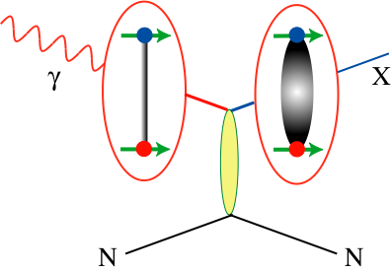
Decay Modes of Exotic Hybrids
π₁ → πρ, πb₁ , πf₁, πη’, ηa₁
η₁ → ηf₂, a₂π, ηf₁, ηη’, π(1300)π, a₁π,
η₁’ → K*Κ, Κ₁(1270)Κ, Κ₁(1410)Κ , ηη’
b₂ → ωπ, a₂π, ρη, f₁ρ, a₁π, h₁π, b₁η
h₂ → ρπ, b₁π, ωη, f₁ω
h’₂ → Κ₁(1270)Κ, Κ₁(1410)Κ, K₂*Κ, φη, f₁φ
b₀ → π(1300)π , h₁π, f₁ρ, b₁η
h₀ → b₁π , h₁η
h’₀ → K₁(1270)Κ, Κ(1460)Κ, h₁η
Models suggest narrower states are in the spin-1 and spin-2 nonets, while the spin-0 nonets are broad.
Early Reach With Statistics Hard
Hybrid kaons do not have exotic QN’s

Slide 7
Purpose of the Document
Revisit the arguments that we make on production of exotic hybrids with an eye to being more quantitative.
Revisit the potential decays of exotic hybrids with an eye to being more quantitative.
Assume vector meson dominance and look at simplest exchange mechanisms ( ρ, ω or φ beams ).
Insure conservation of strong quantum numbers I, J, P, C and G.
Consider identical bosons, and isospin Clebsch-Gordan coefficients.

Slide 8
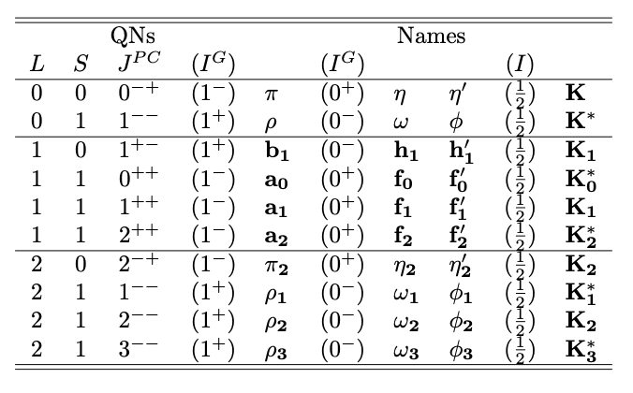
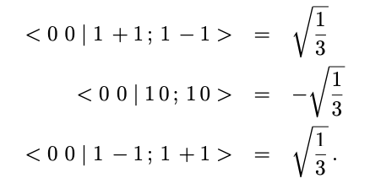
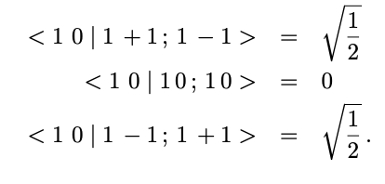
Mesons in the quark model
Normal Mesons
Exotic Hybrids
|0,0> -> |1,0> +|1,0>
|1,0> -> |1,0> + |1,0>
Identical Bosons must have even L
Production: ρ⁰ρ⁰ , ωω , φφ

Slide 9
Pion Exchange

Slide 10
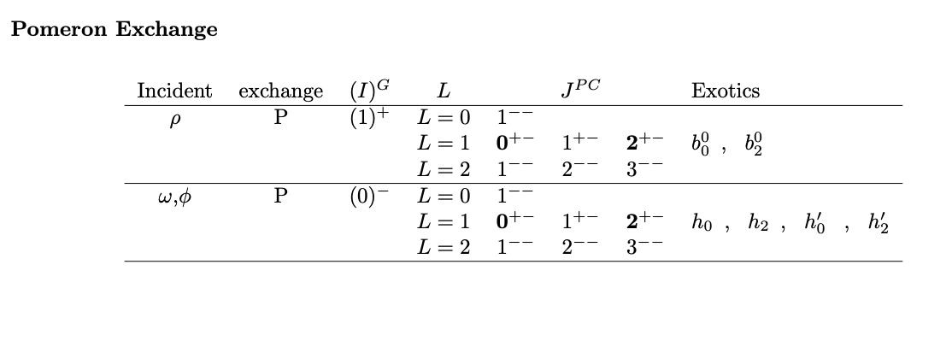
Eta/Eta-prime and Pomeron Exchange

Slide 11
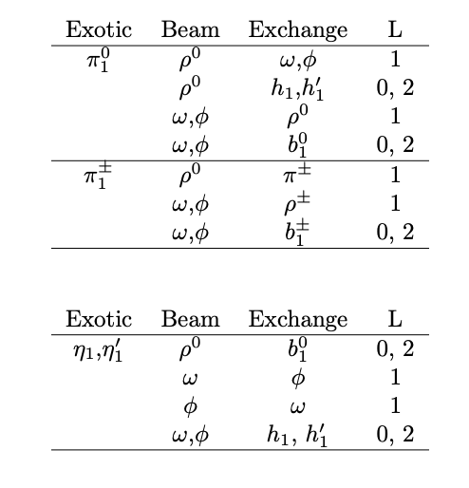
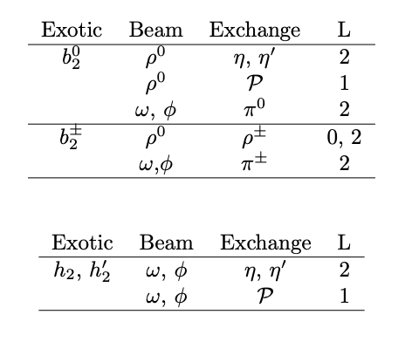
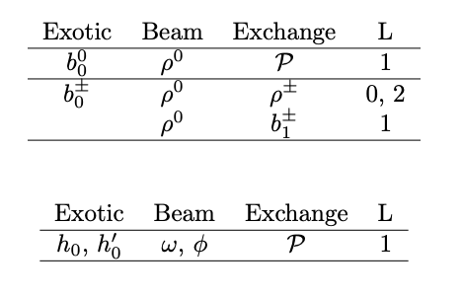
Production of Exotic Hybrids

Slide 12
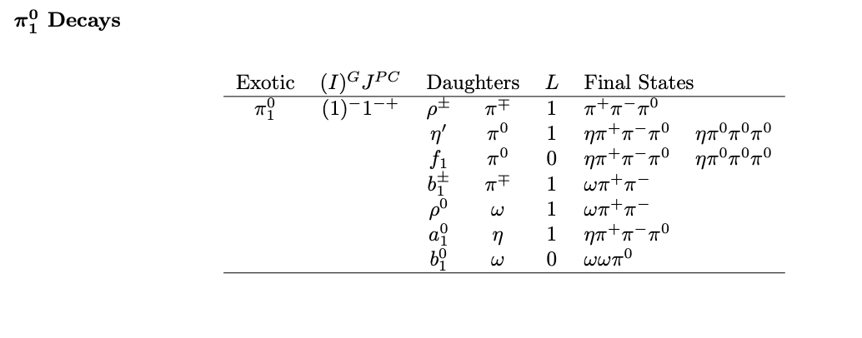
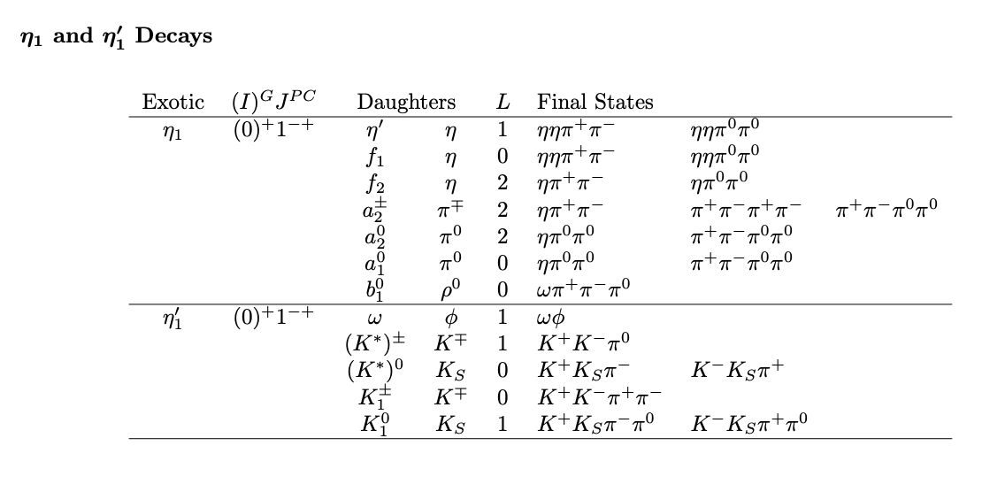
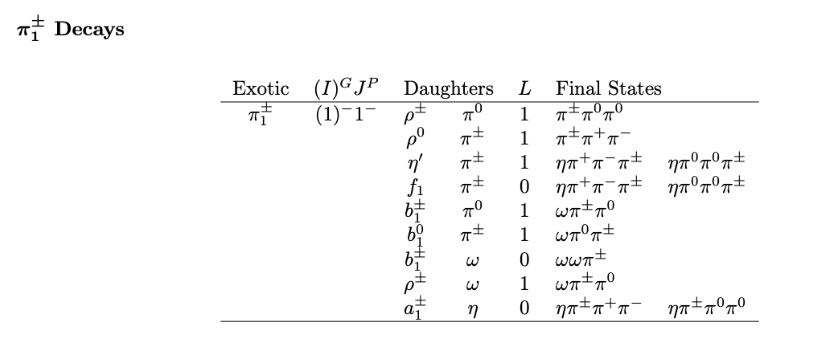
Decays of Exotic Hybrids

Slide 13
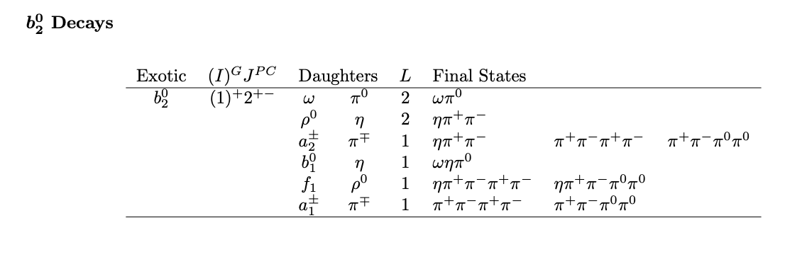
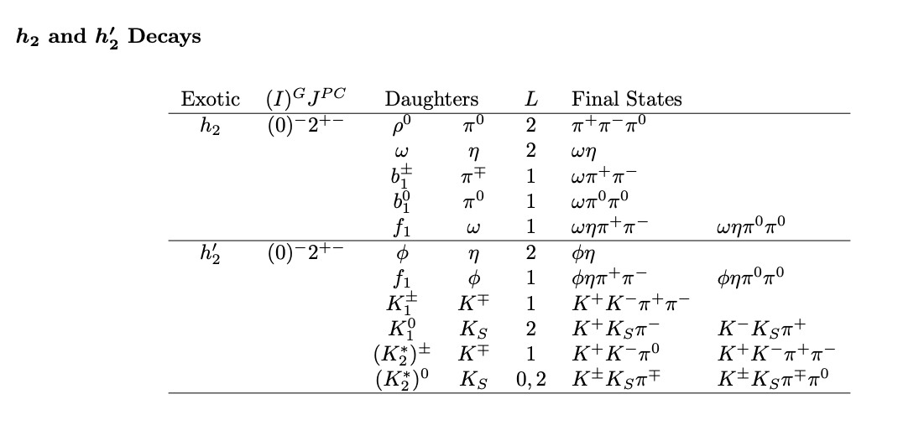
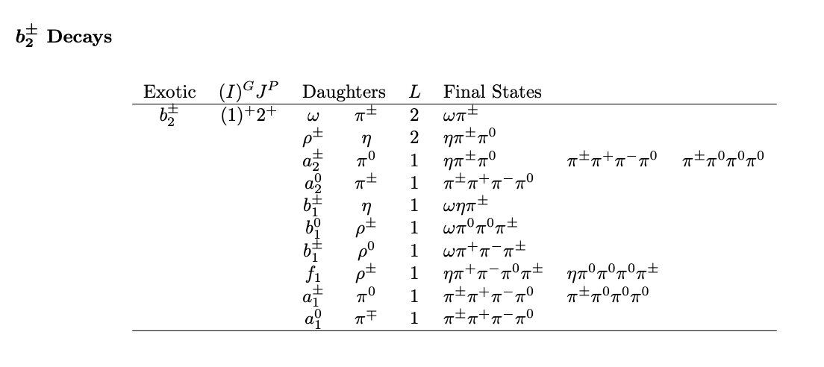
Decays of Exotic Hybrids

Slide 14
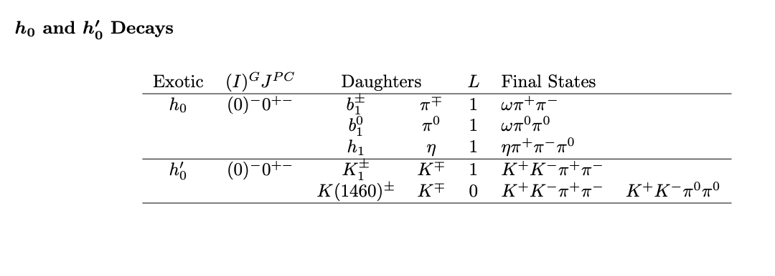
Decays of Exotic Hybrids

Slide 15
This document looks at the simplest production mechanisms, including both natural and unnatural parity exchange.
One could extend to a₀, a₁ and a₂ exchange if that is deemed interesting.
Photoproduction of charged and neutral isospin 1 states can be quite different. It is important to look for both of charged and neutral states.
I have looked at the simplest decays, others are possible, but tend to lead to even more complicated final states.

