Slide 1
“Measuring the Charged Pion Polarizability (CPP) in the γγ -> π⁺ π⁻ Reaction”
E12-13-008
Spokespersons: Mark Ito, Ilya Larin, Rory Miskimen, Elton Smith, Beni Zihlmann
“Measuring the Polarizability of the Neutral Pion with GlueX” (NPP)
E12-13-008A
Spokespersons: Ilya Larin, David Lawrence, Rory Miskimen, Elton Smith
Physics Division Liaison: Simon Taylor
Project implementation, resources and schedule
CPP-NPP Experimental Readiness Review
February 10, 2021

Slide 2
Running Conditions
ε < 10 x 10⁻⁹ rad*m
Configuration | Nominal GlueX I | Charged Pion Polarizability | Neutral Pion Polarizability
Electron Beam Energy | 11.6 GeV | 11.6 GeV | 11.6 GeV
Coherent Peak Energy | 8.4-9.0 GeV | 5.5-6 GeV | 5.5-6 GeV
Current | 150 nA | 27 nA | 27 nA
Radiator thickness | 50 μm diamond | 50 μm diamond | 50 μm diamond
Collimator aperture | 5 mm | 3.4 mm | 3.4 mm
Peak polarization | 35% | 73% | 73%
Tagging ratio | 0.6 | 0.56 | 0.56
Flux 5.5-6.0 GeV | - | 11 MHz | 11 MHz
Flux 8.4-9.0 GeV | 20 MHz | - | -
Flux 0.3-11.3 GeV | 367 MHz | 56 MHz | 56 MHz
Target Position | 65 cm | 1 cm | 1 cm
Target, length | LH2, 30 cm | ²⁰⁸Pb, 0.03 cm | ²⁰⁸Pb, 0.03 cm
Start Counter and DIRC | Nominal | Removed | Removed
Tagger microscope | Nominal for Peak at 9 GeV | Moved for Peak at 6 GeV | Moved for Peak at 6 GeV
Muon Detector | None | Installed behind FCAL | Not needed
Trigger | FCAL/BCAL (40 kHz) | TOF (30 kHz) | FCAL/BCAL (10 kHz)

Slide 3
New equipment and installations
Muon detector (UMass and Hall D Mechanical)
  Modifications to forward platform
  Modifications to FCAL dark room to allow installation
  MWPC fabrication
  Assembly of muon detector with MWPCs and iron shielding
  Electronics and DAQ modifications for MWPCs
Move tagger microscope to cover 6 GeV coherent peak
Target and modifications to target area to use solid Pb target
Development of TOF trigger
  TOF design requirement document completed
  Production trigger would include an ‘OR’ of the FCAL/BCAL trigger for NPP and the new TOF trigger for CPP + random, PS and LED calibration triggers
Documentation
This Talk:
Concentrate on items in Blue

Slide 4
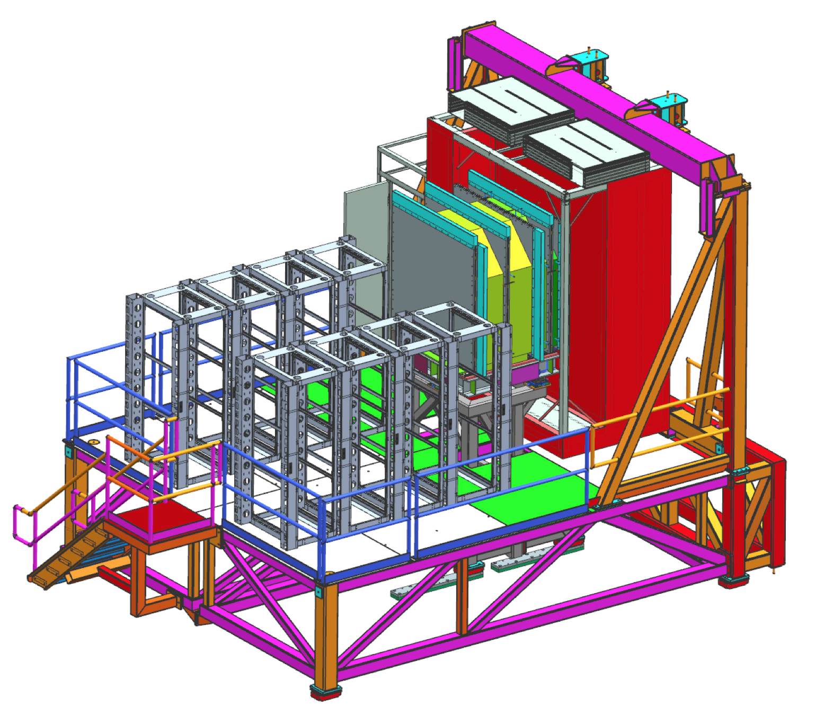
Electronics support for MWPCs
Responsibility: Jlab Electronics (Fernando and Chris)
Signal cables (new cables)
  Six MWPCs, 144 wires/MWPC, 864 wires total
  6 cables/MWPC, 24 wires/cable, 36 cables total + spares
Move crate from upstream platform to FCAL platform
  Locate a half rack on the north side of the muon detector
1 FADC signal crate (borrowed from CDC)
  864 FADC-125 channels
  12 FADC-125 modules, 72 channels/module
CAEN HV crate (additional card in Ccal crate)
  Need special transition connector (Chris)
  1 SHV cable/MWPC, 6 HV channels total
Location of new (half) rack

Slide 5
Electronics support for MWPCs (cont.)
Low voltage to power MWPC electronics
  Require two pairs +/-5 V inputs to each chamber (2x2x6 = 24 inputs)
  MWPC chambers draw 1 A from each +5 and -5 V supply.
  Need cable adaptor for connections to MWPC (Chris).
Gas system (Hall D Mechanical)
  Use the CDC gas supply to provide gas to the MWPCs
Slow controls (Hovanes)
  HV CAEN control
  LV control of MPODs
  Gas system
DAQ modifications needed to read crate in new configuration (Serguei and Sasha)
  Use name rocFMWPC1, used previously in beam test.
  There are spare optical cables on the forward platform
  All systems will be used except for DIRC, Ccal, Start, CDC

Slide 6
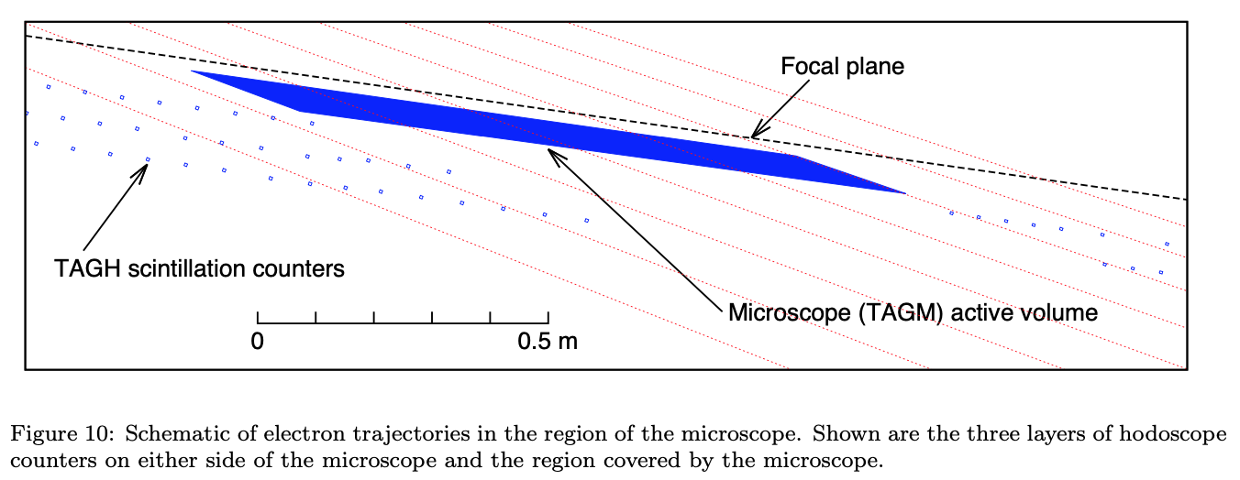
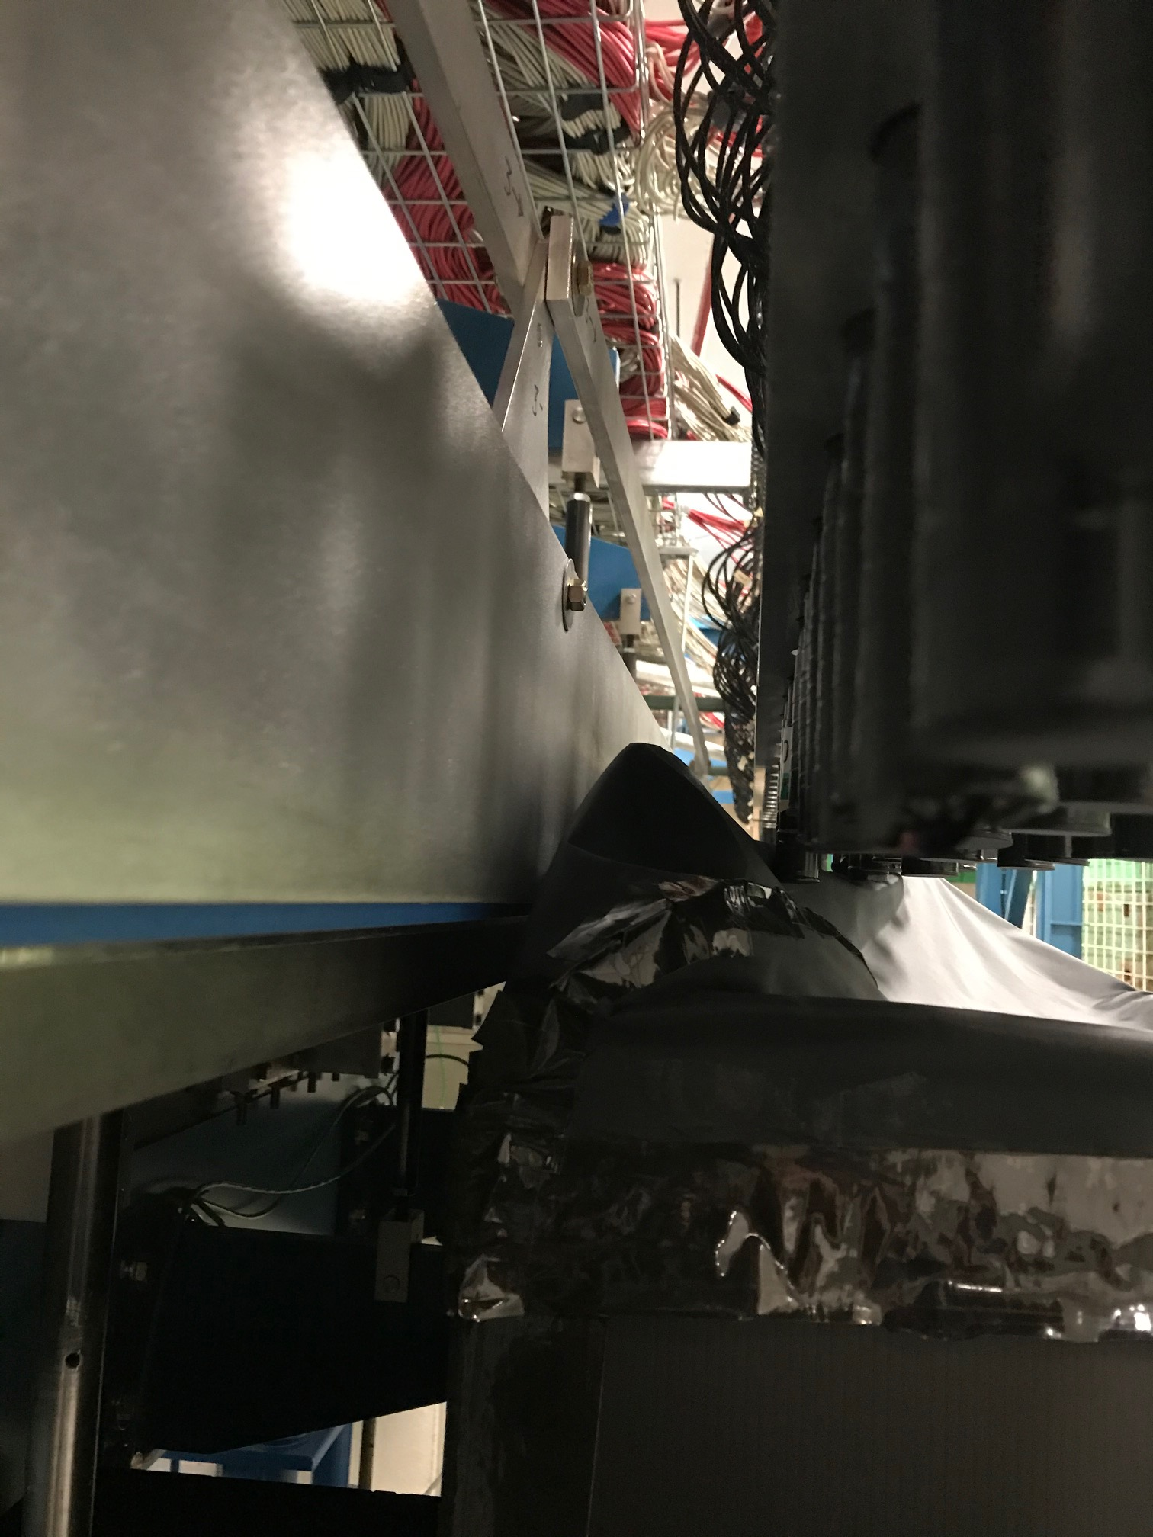
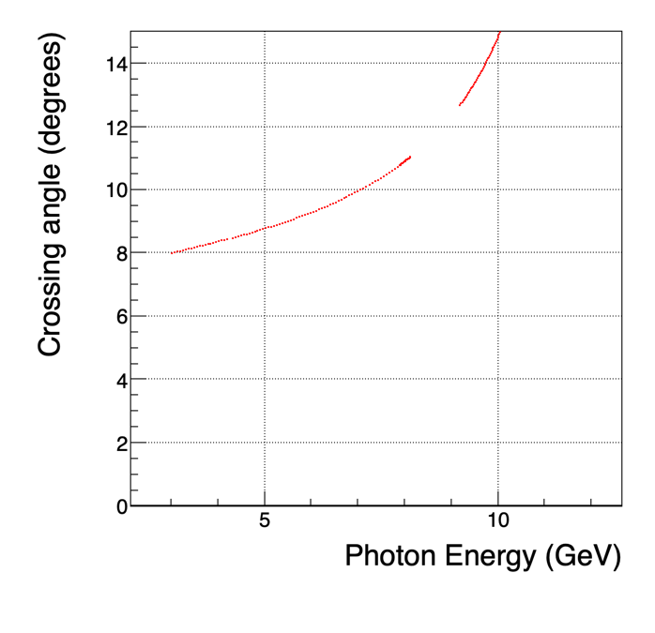
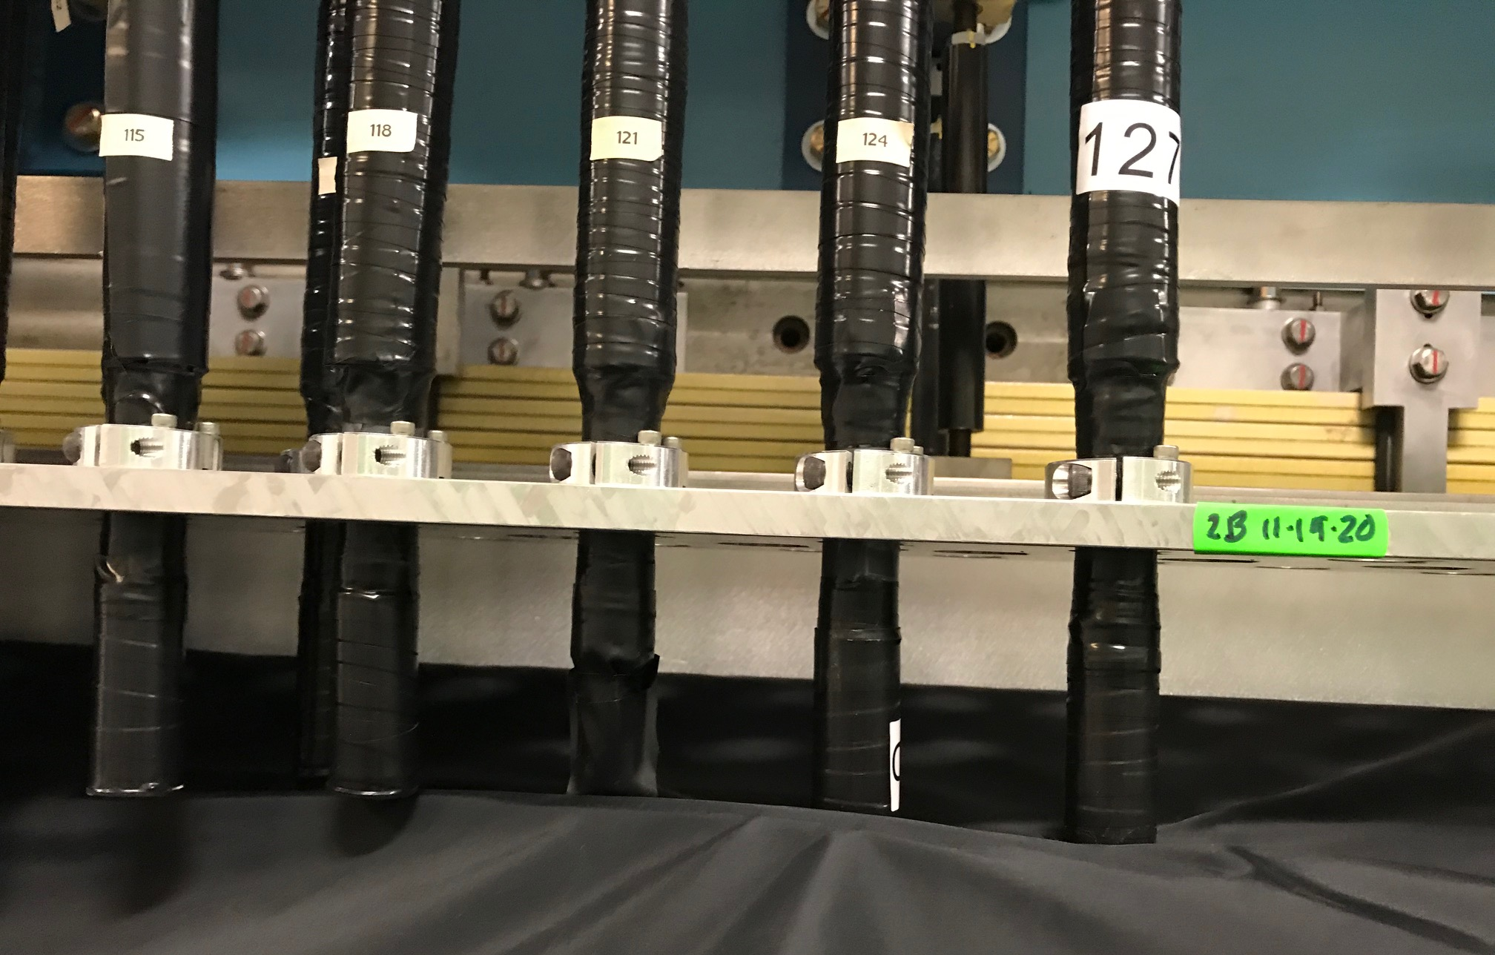
Geometry of Tagger

Slide 7
Move tagger microscope to cover 6 GeV coherent peak
Responsibility: UConn (Richard Jones)
Alignment tools and hardware
  Three pieces are needed: a). Triangular piece to set the beta angle of the first counter, b) Two pieces to set the location of the rails at 6 GeV.
  Engineering drawings are being updated by James McTyre (UConn) and parts will be ordered directly from their 3D model.
Procedure for moving microscope
  Detailed description will be documented by James McTyre and implemented by Richard with JLab assistance
Schedule for moving (~ 1-2 weeks)
Hodoscope coverage
  No change from current configuration
  Note: coverage between 8.1-9.1 GeV will be missing.
Alignment of diamond to 6 GeV during commissioning will use the hodoscope.

Slide 8
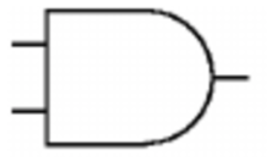
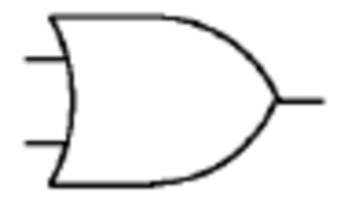
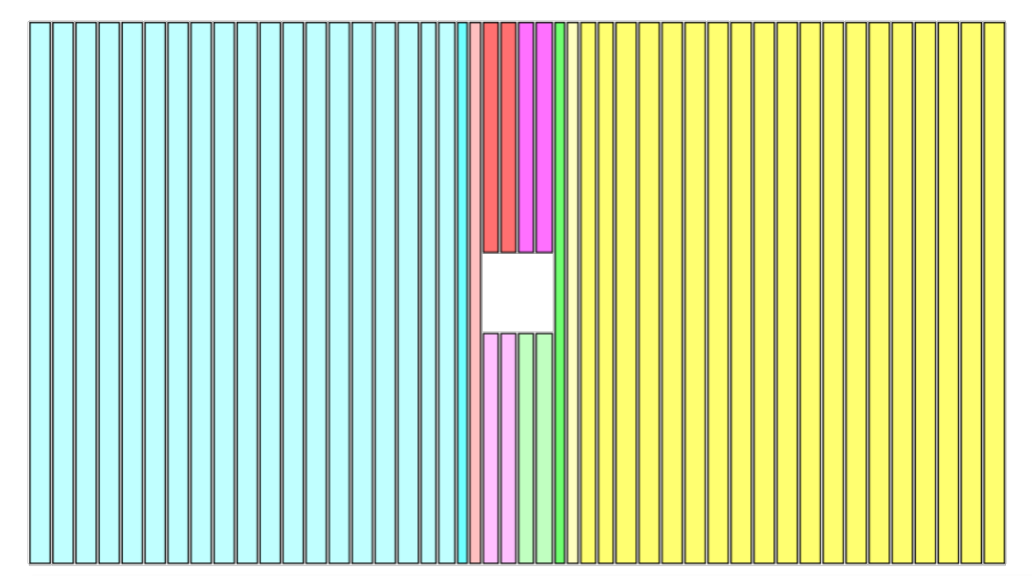
TOF trigger
CTP Hit
Bits
N
.....
1
S
1-19
Existing TOF trigger has same structure but different mapping
0
N
Graphic Representation for one plane. Repeat for second plane
19
S
20
N
1
20
S
21
2
N
21
S
22
22, 23 N
3
N
23
N
22, 23 S
22
4
S
S
23
24, 25 N
24
5
N
25
N
24, 25 S
24
6
S
S
25
26
N
7
26
S
27
N
8
27
S
N
.....
28
S
28-46
2 CTP Hit Bits vertical
9
TOF Trigger
N
2 CTP Hit Bits horizontal
46
S

Slide 9
Combined FCAL/BCAL and TOF triggers
Responsibility: Fast Electronics (Chris/Hai) and Sasha Somov
TOF trigger (CPP)
  Ilya has developed a proposal for various TOF configurations that would provide an efficient trigger for CPP
  The fast electronics group (Hai, Chris) has updated the former firmware requirement documentation
  to reflect the new TOF geometry and the new TOF trigger bit structure.
  The trigger firmware upstream is agnostic to this new TOF-CTP firmware.
FCAL/BCAL trigger (NPP)
  The neutral trigger is the same as the usual GlueX trigger with optimized thresholds.
The full experiment trigger would include the TOF and FCAL/BCAL triggers plus random, PS, and LED triggers.
Design Requirement
Done
Firmware coding and simulation
~ April
Verification (Test Stand)
~ May
Field test TOF and integration
Short beam test

Slide 10
Documentation (drafts available)
Conduct of Operations (COO)
  Minor changes required
Experimental Safety Assessment Document (ESAD)
  Muon detector will be a temporary installation that is covered by a specific OSP. A draft section for the muon detector has been drafted if needed.
Radiation Safety Assessment Document (RSAD)
  Experiment runs at 27 nA on a 5% lead target compared to 150 nA on a 3.4% hydrogen target for GlueX I.
  Pavel Degtiarenko from RadCon has provided a preliminary RSAD.
Emergency Response Guidelines (ERG)
  No changes needed

Slide 11
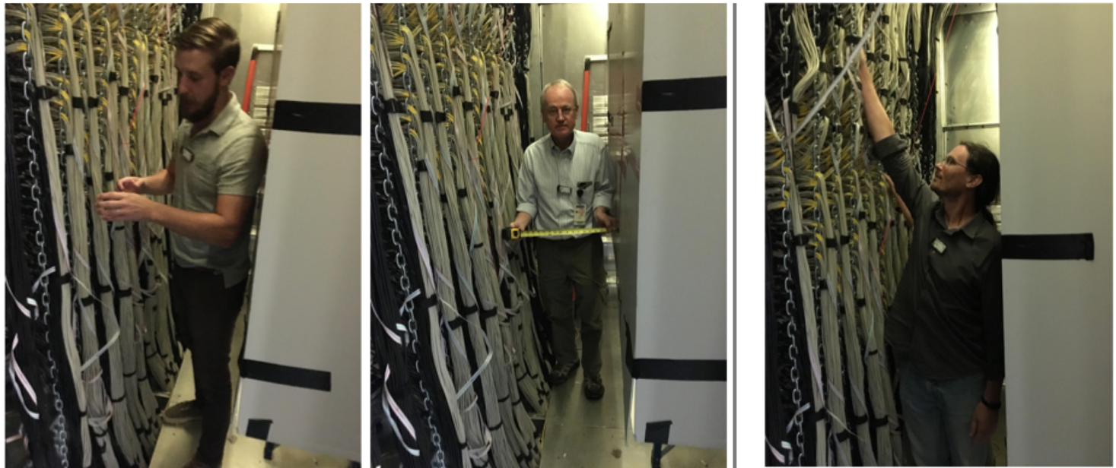
Documentation (cont.)
OSP for MWPCs
  Draft completed, feedback from Bert and Ed
HDList for Assembly of Muon Detector
Procedure for FCAL Maintenance
  Draft in progress, some questions but few modifications from existing procedure. Questions: a) Fire safety, b) “Knock-out panels” in new configuration, c) ladder and space considerations
Mockup in Fcal Dark Room

Slide 12
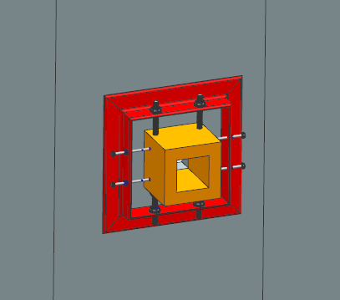
Preliminary run plan
Calibrations (5 PAC days / 10 calendar days)
  Microscope is a new position
    Align diamond to 6 GeV coherent edge
    Check rates in microscope in new position
  Check rates for two collimator configurations (5 and 3.4 mm )
    Use profiler to stabilize the beam during test
  Check radiation and backgrounds rates in Hall D with Pb target
  Check currents and hit distributions in the MWPCs
  Compare empty vs full target rates
  Adjustable Pb absorber (upstream of muon detector)
  Commission trigger
Production (20 PAC days / 40 calendar days)
  Need to schedule 2 TAC runs
  Take production data alternating the 0º/90º diamond configurations
Photon Beam

Slide 13
Coarse schedule
CY 2021
CY 2022

Slide 14
Summary
All tasks have been outlined
  Responsible parties have been identified
  Estimates for completing the jobs with the available resources, including person-power and equipment, fit within the planned timeframe
We have a preliminary beam commissioning plan to prepare for production
Drafts of the required documentation are available
We are excited to be able to include the CPP and NPP experiments on the Experimental Schedule

Slide 15
Backup Slides

Slide 16
Running Conditions
Configuration | Nominal GlueX I | Charged Pion Polarizability | Neutral Pion Polarizability
Electron Beam Energy | 11.6 GeV | 11.6 GeV | 11.6 GeV
Coherent Peak Energy | 8.4-9.0 GeV | 5.5-6 GeV | 5.5-6 GeV
Current | 150 nA | 20 nA | 20 nA
Radiator thickness | 50 μm diamond | 50 μm diamond | 50 μm diamond
Collimator aperture | 5 mm | 5 mm | 5 mm
Peak polarization | 35% | 72% | 72%
Tagging ratio | 0.6 | 0.72 | 0.72
Flux 5.5-6.0 GeV | - | 11 MHz | 11 MHz
Flux 8.4-9.0 GeV | 20 MHz | - | -
Flux 0.3-11.3 GeV | 367 MHz | 74 MHz | 74 MHz
Target Position | 65 cm | 1 cm | 1 cm
Target, length | LH2, 30 cm | ²⁰⁸Pb, 0.03 cm | ²⁰⁸Pb, 0.03 cm
Start Counter | Nominal | Removed | Removed
Tagger microscope | Nominal for Peak at 9 GeV | Moved for Peak at 6 GeV | Moved for Peak at 6 GeV
Muon Detector | None | Installed behind FCAL | Not needed
Trigger | FCAL/BCAL (40 kHz) | TOF (30 kHz) | FCAL/BCAL (10 kHz)

Slide 17
Energy, position and crossing angle of hodoscope counters
Microscope transverse size
= 17x6x0.2cm=20.4cm
Length at 8.8 GeV
= 20.4cm/sin(12º) = 98 cm
ΔE ~ 8.2 - 9.2 GeV
Length at 6 GeV
= 20.4cm/sin(9.2º) = 130 cm
ΔE ~ 4.8 – 6.3 GeV

Slide 18
Solid lead target and support
Responsibility: JLab/UMass
PRIMEX ²⁰⁸Pb target will be used
Target frame (UMass)
  Use existing PRIMEX frame for target itself
  Need additional “empty” target frame
Target cart/support (Jlab)
  Location of target is z=1cm
  Capability to remove target and insert “empty” frame
Beamline to target
  New section of vacuum pipe
Beamline from target to FDCs
  He bag

Slide 19
Simulation and Reconstruction
Simulation
  GEANT4 models of the MWPCs were developed for the proposal and need to be updated to the current design (David Lawrence)
  Simulation of tagger consists of a lookup table, which needs to be modified to the new energy range
Reconstruction (MWPCs)
  Low-level objects based on the FMWPC1 readout controller was developed for the 2018 beam test. It needs to be updated to the final detector and fed into the online analysis for monitoring (David Lawrence).
  Simple high-level objects will be instantiated to be used for muon-pion identification.
Reconstruction (Tagger)
  The tagger hodoscope is unchanged. No changes needed.
  The low level reconstruction of the microscope does not change, but the mapping to energy must be modified.

Slide 20
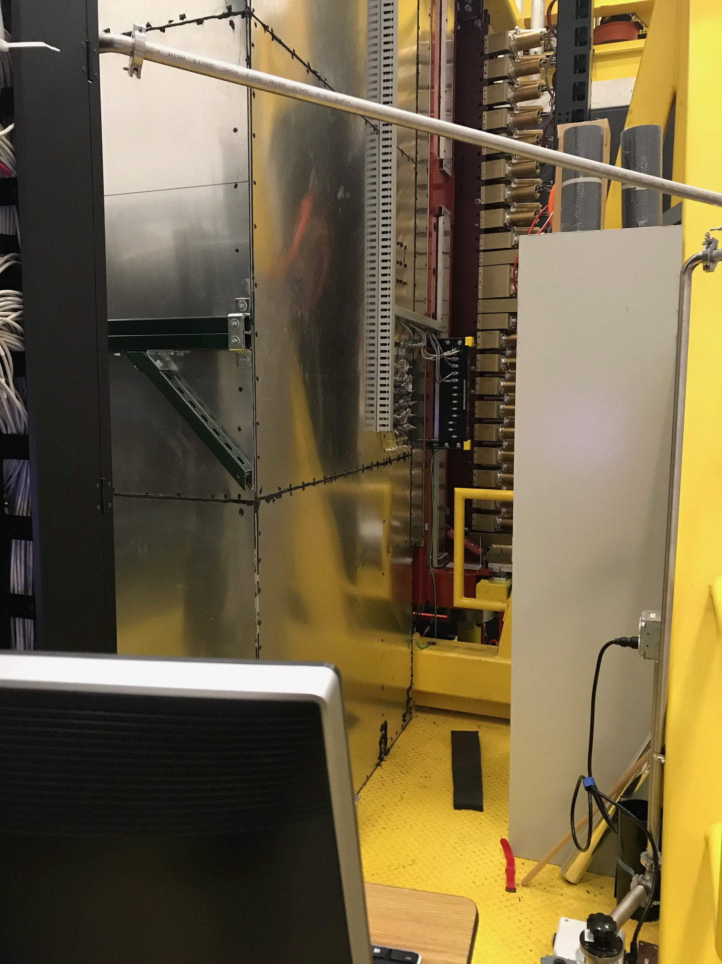
Rack position on north of detector
Interferences?
Racks completely
full
New (half) rack location?
Movable cabinet

Slide 21
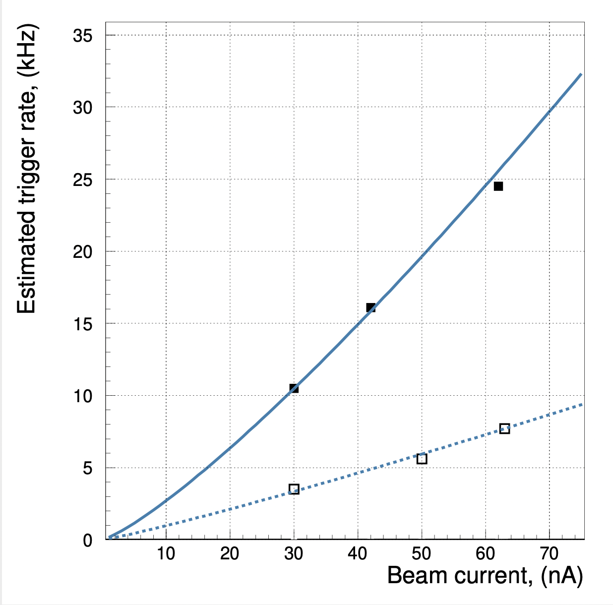
Preliminary run plan (cont.)
Commission trigger
    Desire to test TOF trigger during 2020 run to check firmware.
    Establish FCAL/BCAL trigger, set thresholds.
    Check rates for TOF trigger.
    Setup FCAL/BCAL + TOF triggers for production
    Add the random pulser, PS, and LED triggers
    Set beam current based on trigger studies
Estimated FCAL/BCAL trigger rate on LH₂ target using random trigger
Scale measured rates during test to CPP conditions:
  Current = 20 nA (5 mm collimator)
  Target = 5% Rad. Length
  FCAL/BCAL Trigger rate < 10 kHz
  TOF Trigger rate ~ 30 kHz
GlueX II runs at twice this rate

