Slide 1
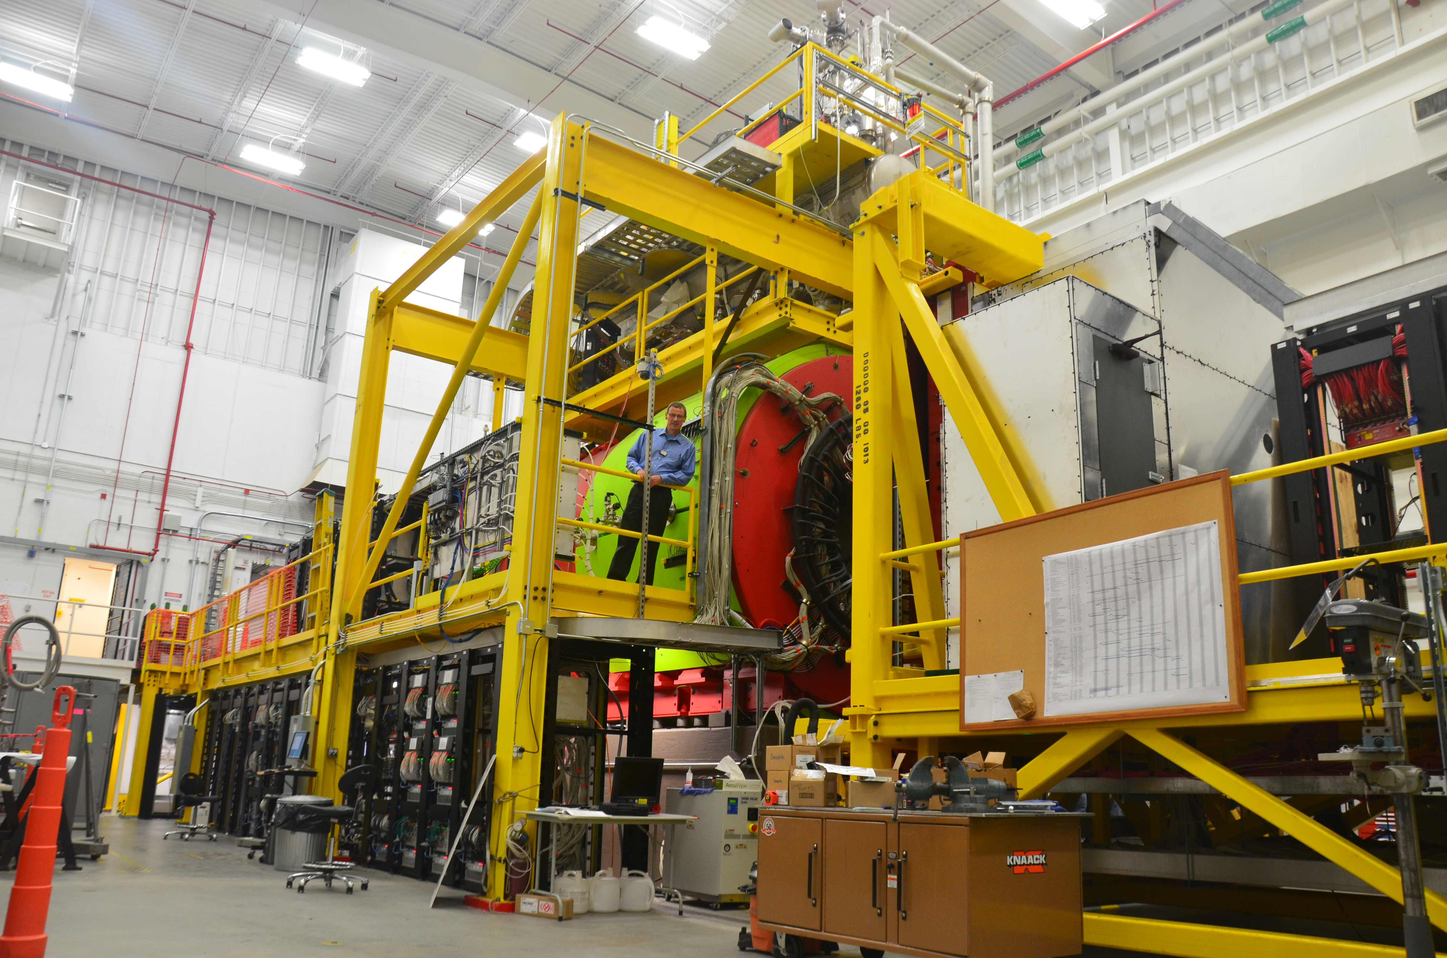
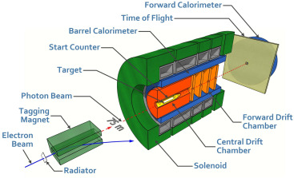
The GlueX Experiment part 2
The Photon Facility
Curtis A. Meyer
Carnegie Mellon University
February 2021

Slide 2
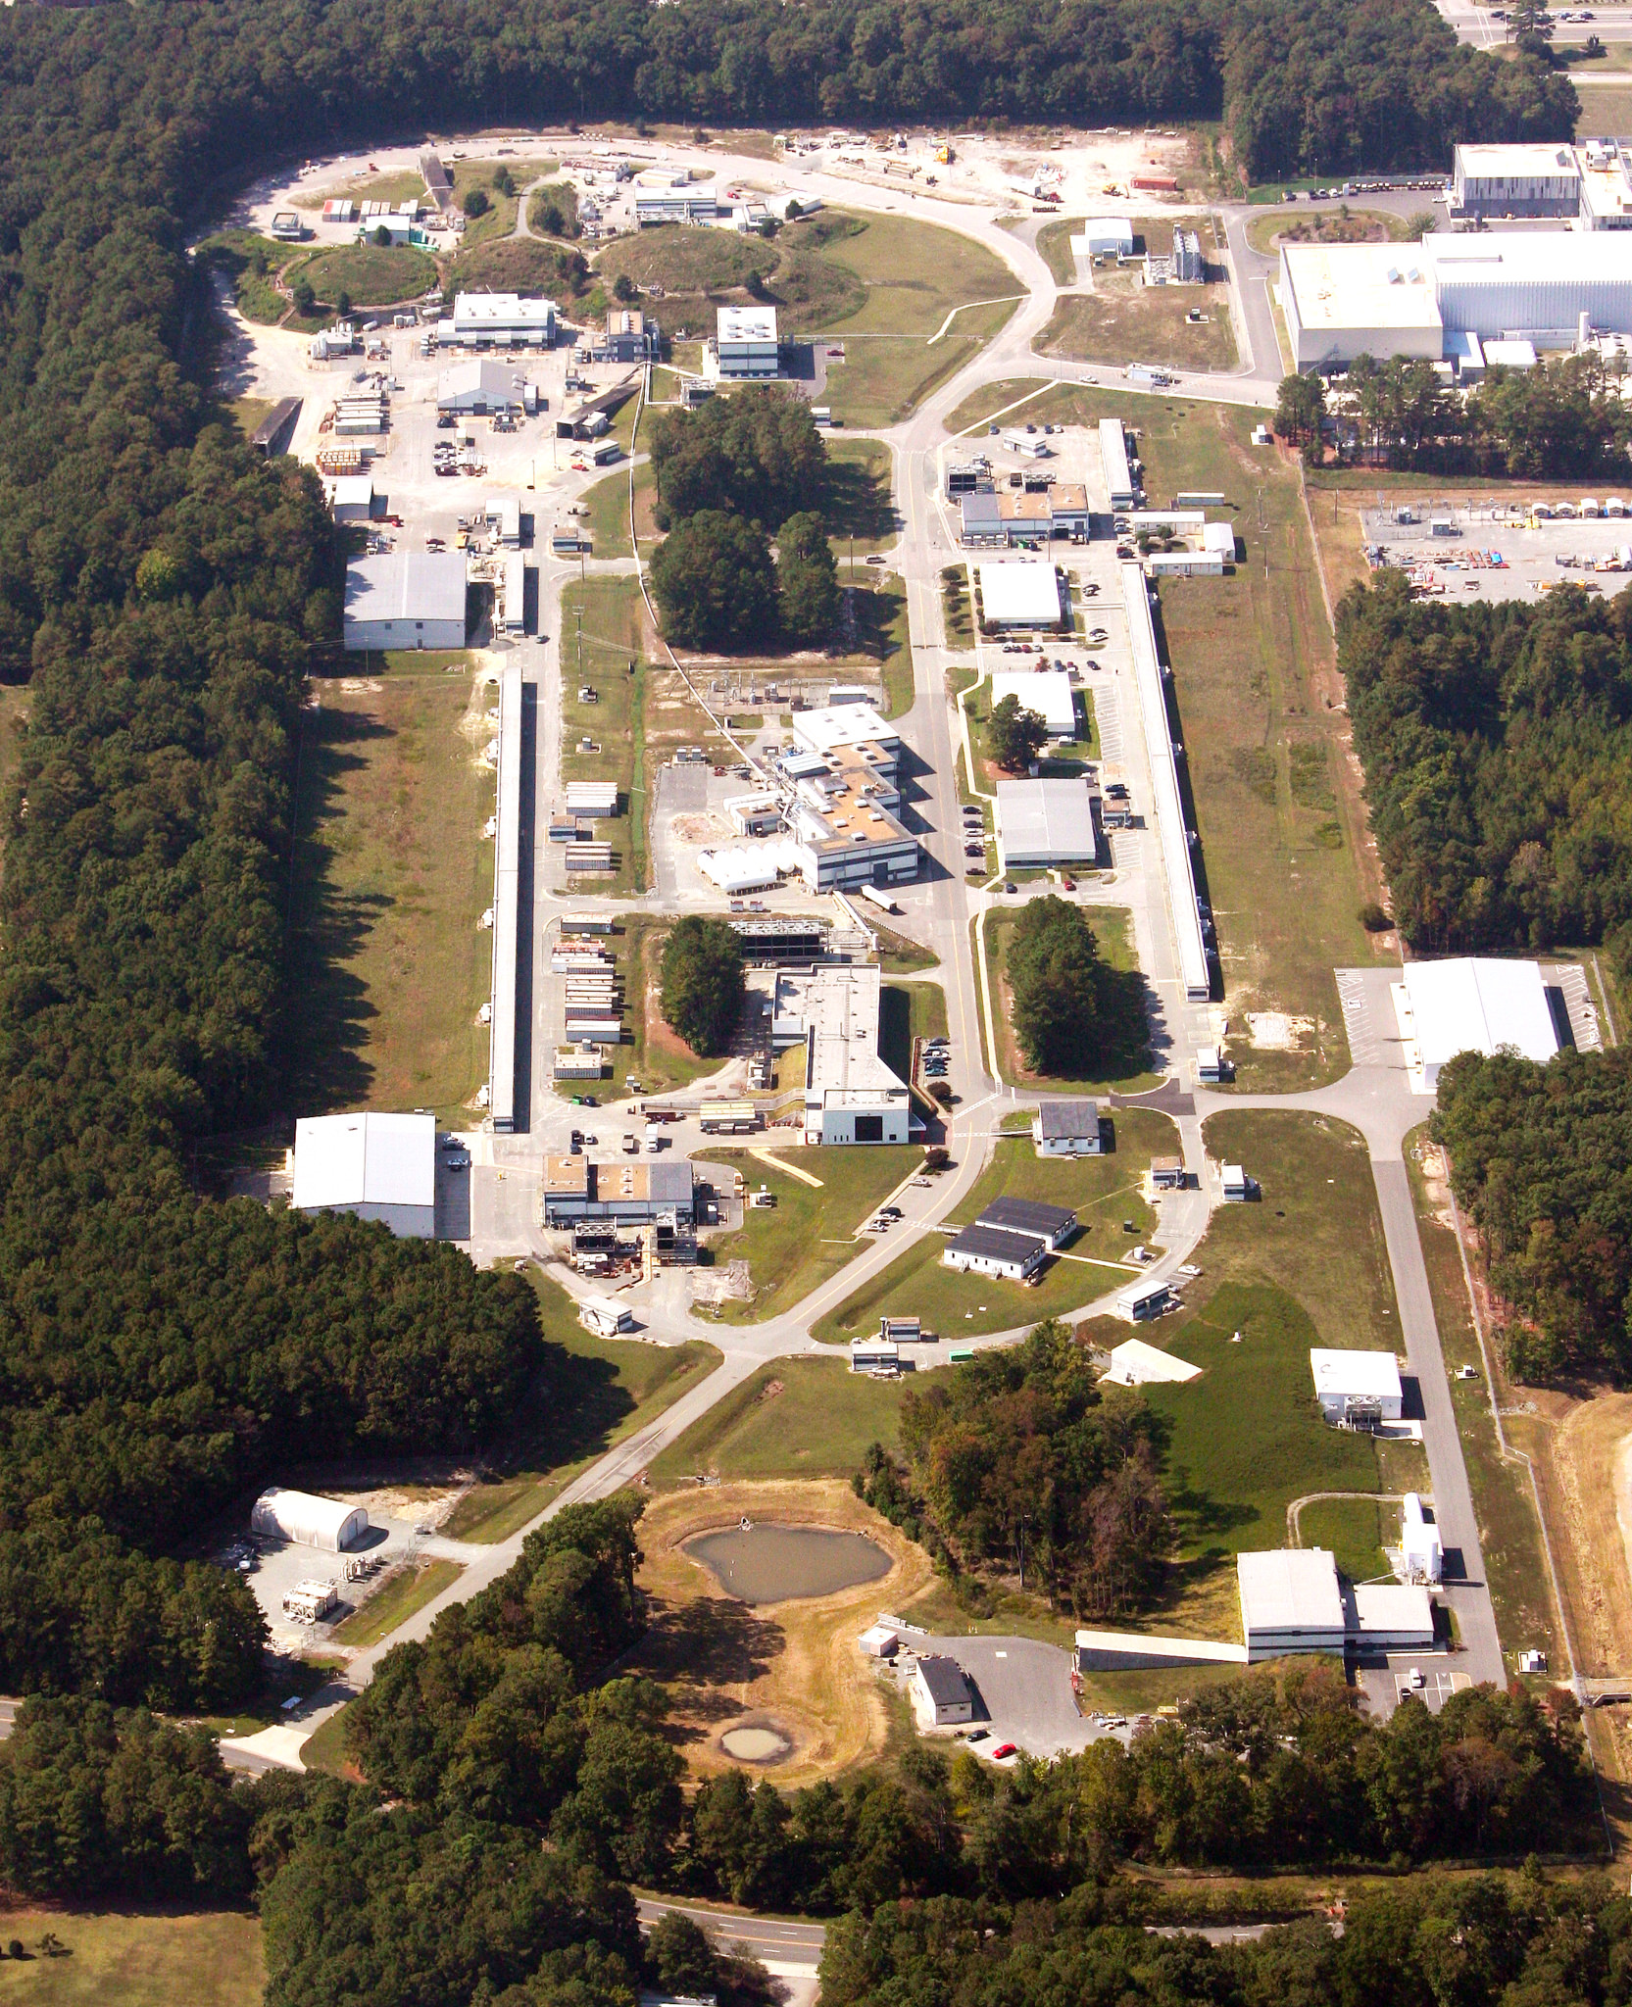
The Hall-D Photon Facility
The CEBAF accelerator delivers an electron beam of up to 12GeV energy and with a current up to 2μA to the Hall-D Photon Facility.
The accelerator is configured such that only the highest energy electrons in CEBAF can be delivered to Hall D.
Those electrons are used to produce a bremsstrahlung photon beam with a linearly-polarized coherent component where the energy of the coherent edge is about 75% of the primary electron beam.
The facility was designed so it is only possible to deliver photons to Hall D.
Photon
Hall
Hall D

Slide 3
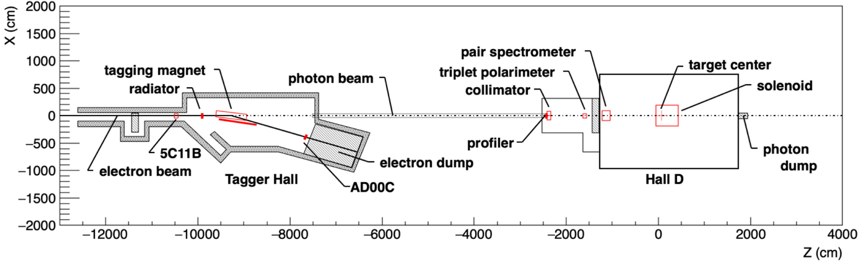
The Photon Hall
Alcove
total absorption
counter
Electrons enter the photon hall from the left where they pass through the diamond radiator and are then bent to the right towards the electron dump. To prevent the electron beam from ever reaching Hall-D, a permanent magnet has been installed down stream of the tagger magnet. The photons then travel through the photon beam to the collimator hut, and into the experimental hall.

Slide 4
Hall Design Requirements
The GlueX experiment requires a high-intensity beam of linearly polarized photons where the energy of the individual photons is known to an accuracy of about 10 MeV. In addition, the time of the photon needs to be measured precisely enough to identify which 4ns beam bucket they came from.
We accomplish the energy and time measurement by tagging the photons. This is done by using the tagging detectors to measure the energy and time of the electron that produced the photon.
The photon hall is a separate building from the experimental hall because of the long flight path (75m) needed to isolate the linearly polarized photons. This also reduces backgrounds from the electron beam dump in Hall-D.
The photons first enter the collimator alcove where about 85% of the photon beam’s energy is absorbed. The highly collimated photon beam then passes into Hall-D and GlueX.

Slide 5
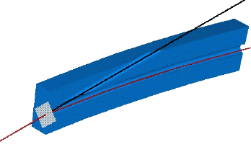
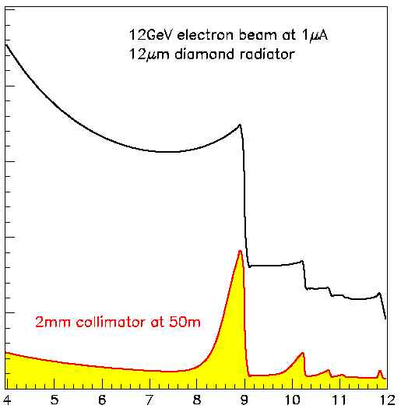
Diamond Radiator
γ
Coherent & incoherent photons
The CEBAF electron beam produces coherent and incoherent bremsstrahlung photons on the 7mm by 7mm, 50μm thick diamond radiator. On the diamond, the electron beam has a size of σ_{x}=0.7mm and σ_{y}=0.4mm.
Coherent radiation is produced by aligning crystal axes of the diamond with the electron beam. The resulting photons are linearly polarized and travel along the electron direction.
Normal bremsstrahlung radiation comes out in a cone.
When the photon beam passes through the 5mm diameter collimator 75m downstream of the diamond, much of the incoherent component is removed, leaving linearly polarized photons.
In the GlueX liquid hydrogen target, the photon beam spot has a (rms) radius of 0.7mm.
50μm
diamond
radiator
e⁻
Outgoing electron beam
e⁻
Incoherent and coherent photons
12 GeV
electron
beam
Coherent peak ~40% polarization
Collimated beam

Slide 6
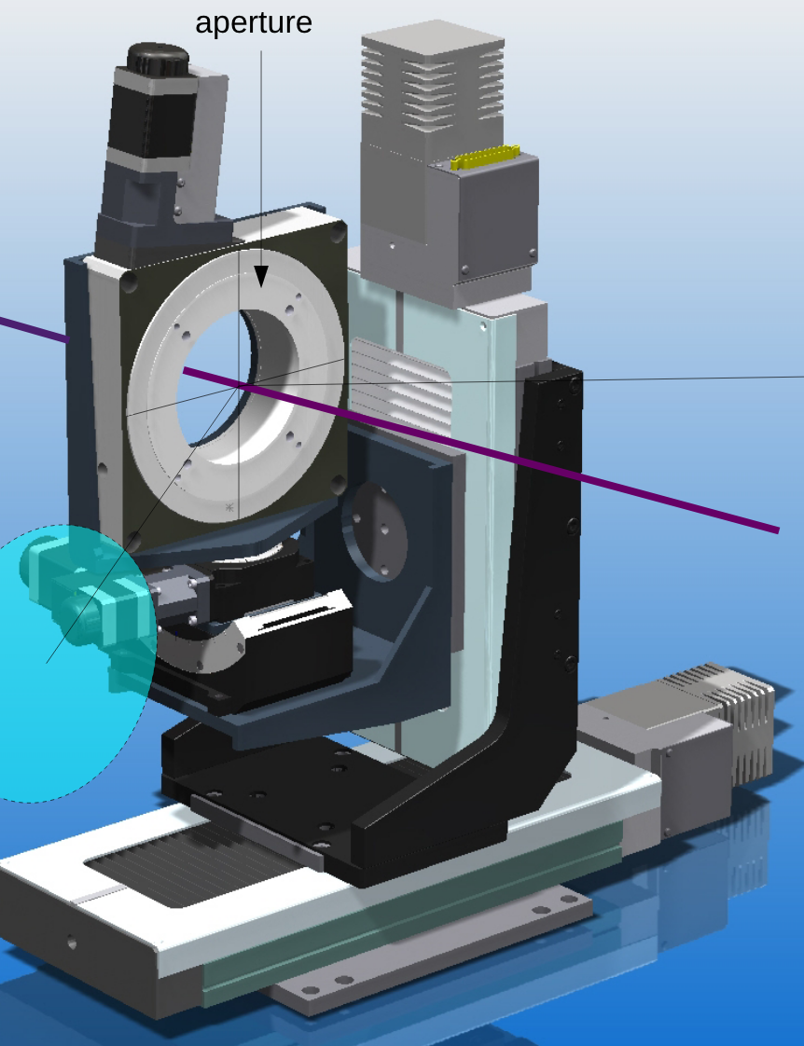
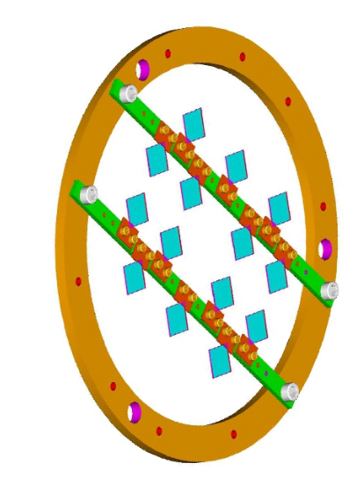
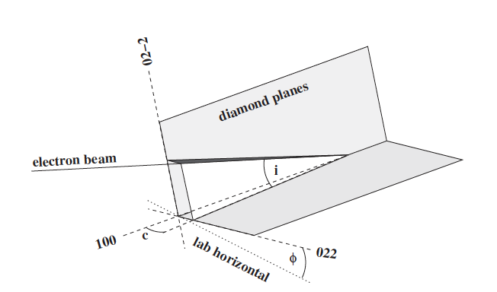
Diamond Alignment
Coherent bremsstrahlung is produced by scattering from one specific set of crystal lattice planes in the diamond& crystal, typically the 022 and 02-2 planes.
K. Livingston, NIM A603, 205 (2009)
The orientation of the diamond is set using a 3-axis goniometer. Small tilts in φ allow us to move between orthogonal polarizations. The diamond is rotated by 45º to move between the 0/90 and
-45/45 polarization configurations.
The angle of the polarization plane is fixed by φ; the azimuthal orientation of the 022 axis relative to the lab horizontal, and the position of the main coherent edge (specifically, its fractional energy x = E_{edge}/E_{beam}) is controlled by the angle c between the electron beam and the 02-2 planes. In practice c must be adjusted to position the main coherent peak at the region of interest.
& Diamond is used as the radiator both because of its crystal structure and its very high Debye temperature.

Slide 7
Beam Polarization
The GlueX photon beam has a peak linear polarization of about 40%, while the average polarization in the coherent peak region is about 33%.
The strength of the polarization is determined by at what fraction of the electron beam energy the edge of the coherent peak is placed. The polarization increases the smaller the fraction gets.
The choice of 75% of the electron beam energy was an optimization of the need for high-energy photons and as large a linear polarization as possible. The GlueX physics was optimized for a 9GeV edge, so if the electron beam energy could go above 12 GeV, GlueX would hold the edge at 9GeV and increase the linear polarization.
While operating at electron beam energies below 12 GeV, the choice has been made to maintain the same linear polarization by setting the energy of the coherent edge lower in energy.

Slide 8
Beam Rate
The GlueX experiment was originally designed to operate with a 20 μm thick diamond radiator utilizing a 3 mm diameter collimator hole and operating at 500 MHz (2 ns between electron beam bunches). Under those conditions, the experiment was designed to operate with 10⁸ γ/s in the coherent peak (E_{γ} = 8.4 to 9.0 GeV).
Actual GlueX running conditions are with a 50 μm thick diamond utilizing a 5 mm diameter collimator and operating at 250 MHz (4 ns between electron beam bunches). The experiment can operate with 5x10⁷ γ/s in the coherent peak. The current of the electron beam under these conditions is about 350nA.
In addition to the photons in the coherent peak region, there are approximately the same number of photons with energy above the coherent peak. These higher-energy photons are usually read out as part of GlueX running.
There is a substantially larger number of photons below the coherent peak, of which only a small number are read out as part of GlueX running. However, these photons do contribute to a large electromagnetic background in the experiment which ultimately limit the maximum trigger rate of the experiment.

Slide 9
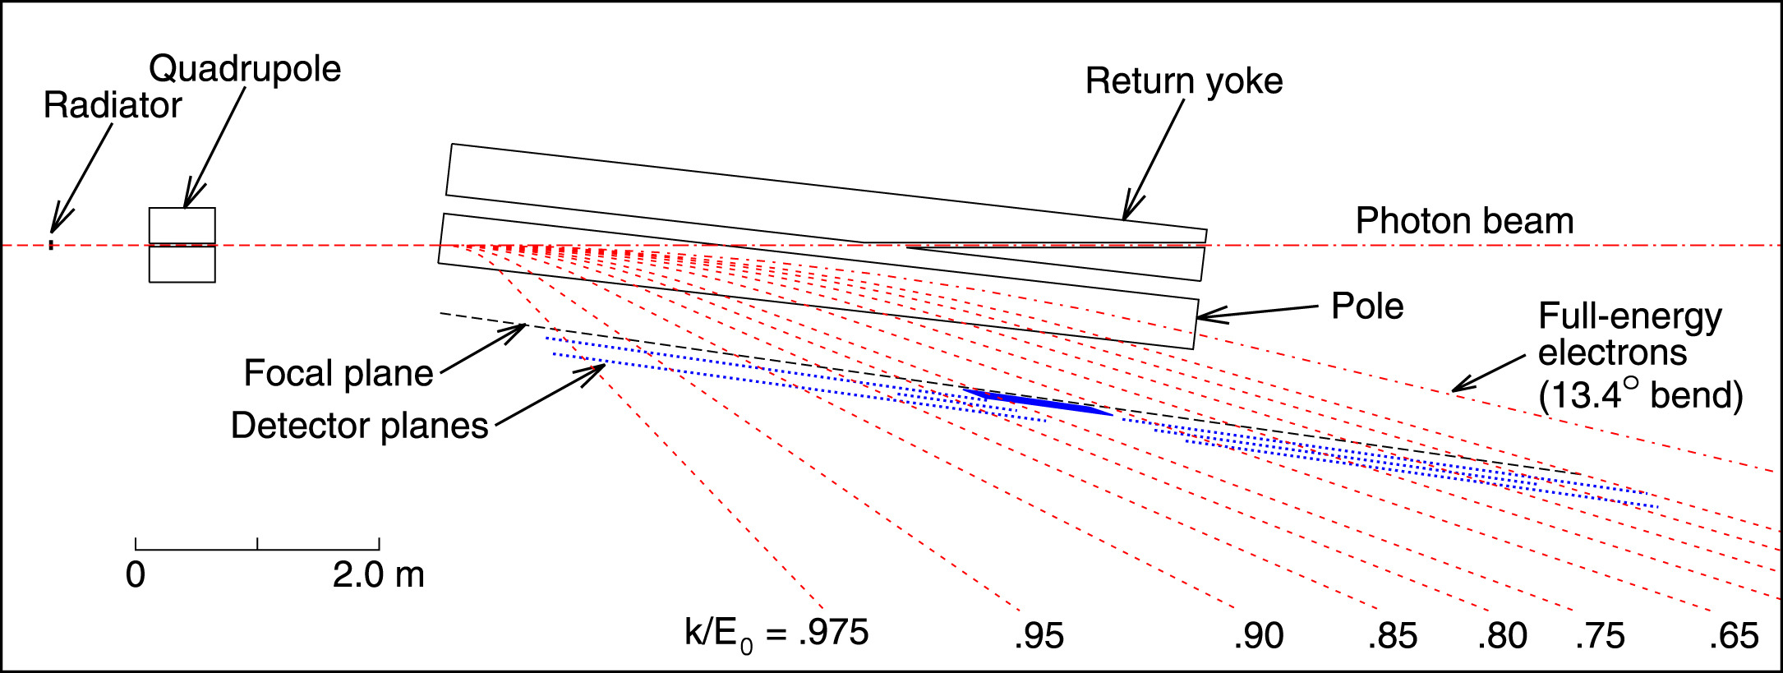
Tagger Magnet
The tagger magnet is a ~6m long conventional dipole magnet operating with a 1.5T field. The magnet bends the electron beam to the right in the horizontal plane.
The non-interacting electrons are deflected by 13.4º and go to the beam dump.
The electrons that underwent a bremsstrahlung interaction in the radiator are bent by larger angles, where the bend is inversely proportional to the electron’s momentum.
These electrons are ”tagged” by either a hodoscope or microscope detector element. The location of the tagging detector maps to the energy of the scattered electron and provides a measurement of the energy of the bremsstrahlung photon.

Slide 10
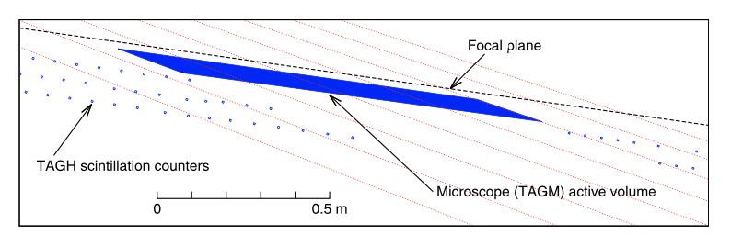
Tagger Hodoscope
The Tagger Hodoscope (TAGH) consists of 222 scintillator counters distributed over a length of 9.25 m and mounted just behind the focal plane of the tagger magnet. The counters are read out using photomultipliers. The function of this detector is to tag the full range& of photon energy from 25% to 97% of the incident electron energy.
Tagger counters cover bands of photon energy between 8.5 and 30 MeV wide, with the narrow bands corresponding to the highest-energy photons. For photons energies between about 3 and 7 GeV, only every other tagger space is instrumented. These ”low-energy” taggers are typically turned off during GlueX running. There are no tagger elements for photon energies below 3 GeV.
&Excluding that covered by the microscope.

Slide 11
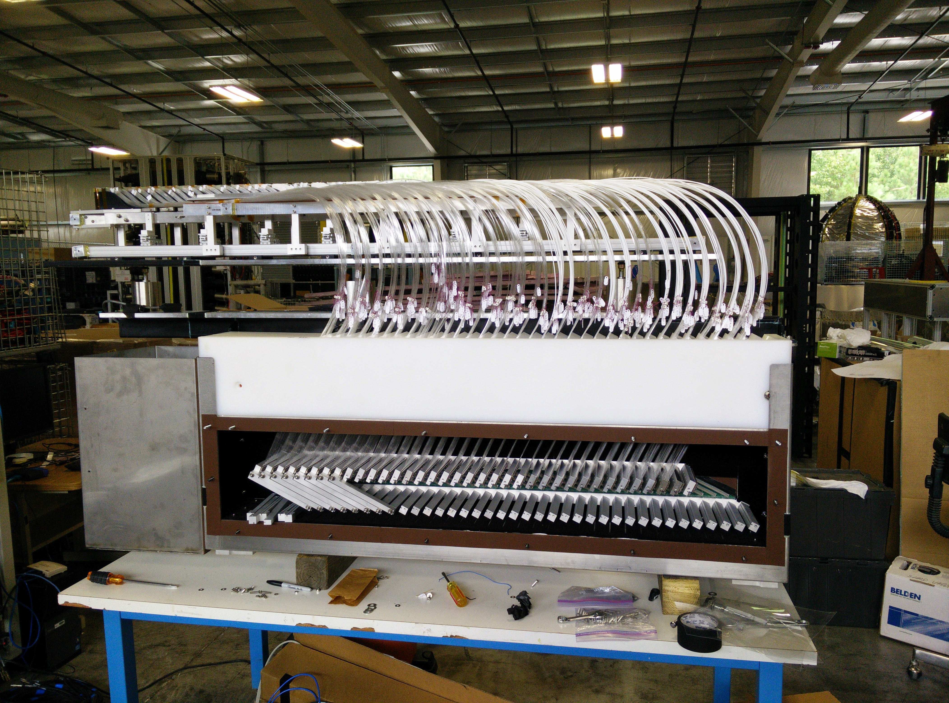
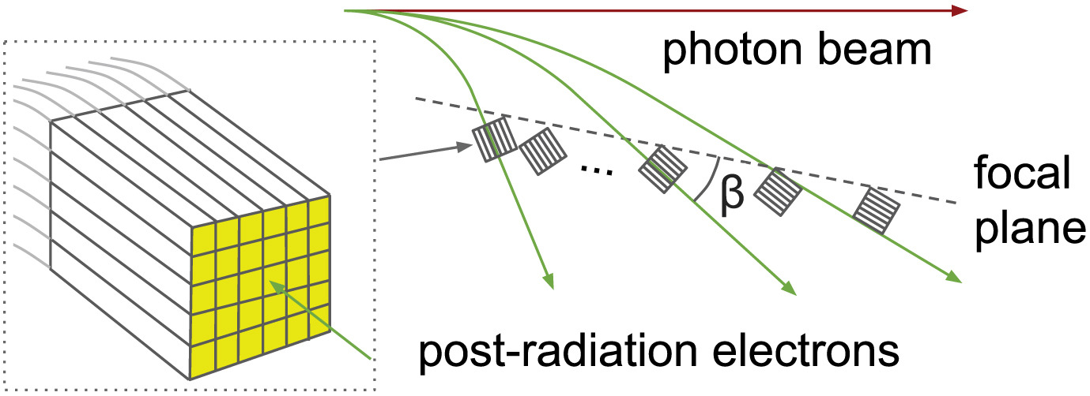
Tagger Microscope
The Tagger Microscope (TAGM) is a high-resolution hodoscope that counts post-bremsstrahlung electrons corresponding to the primary coherent peak. The TAGM is read out using silicon photomultipliers. Normally the TAGM is positioned to cover between 8.2 and 9.2 GeV in photon energy, but the TAGM is designed to be movable should a different peak energy be desired. The microscope is segmented along the horizontal axis into 102 energy bins (columns) of approximately equal width (about 10 MeV).
The TAGM is built with 17 bundles of fibers (6 wide by 5 high) that are aligned along the direction of the deflected electron.

Slide 12
Beam Position Monitors
There are several beam-position monitors used to measure the location of the electron beam . These BPMs are part of the accelerator feedback system to keep the beam stable. The most downstream of these is labeled as 5C11B. In addition, there is a monitor at the entrance to the beam dump, AD00C, which is used to monitor the beam location after the tagger magnet.
For the photon beam, the profiler near the collimator is used to monitor the photon beam location during tuning.
It is important to maintain the focus of the electron beam on the collimator. To monitor this, three sets of harps can be scanned through the electron beam. The harp scans occur every few days or if things appear to have degraded.

Slide 13
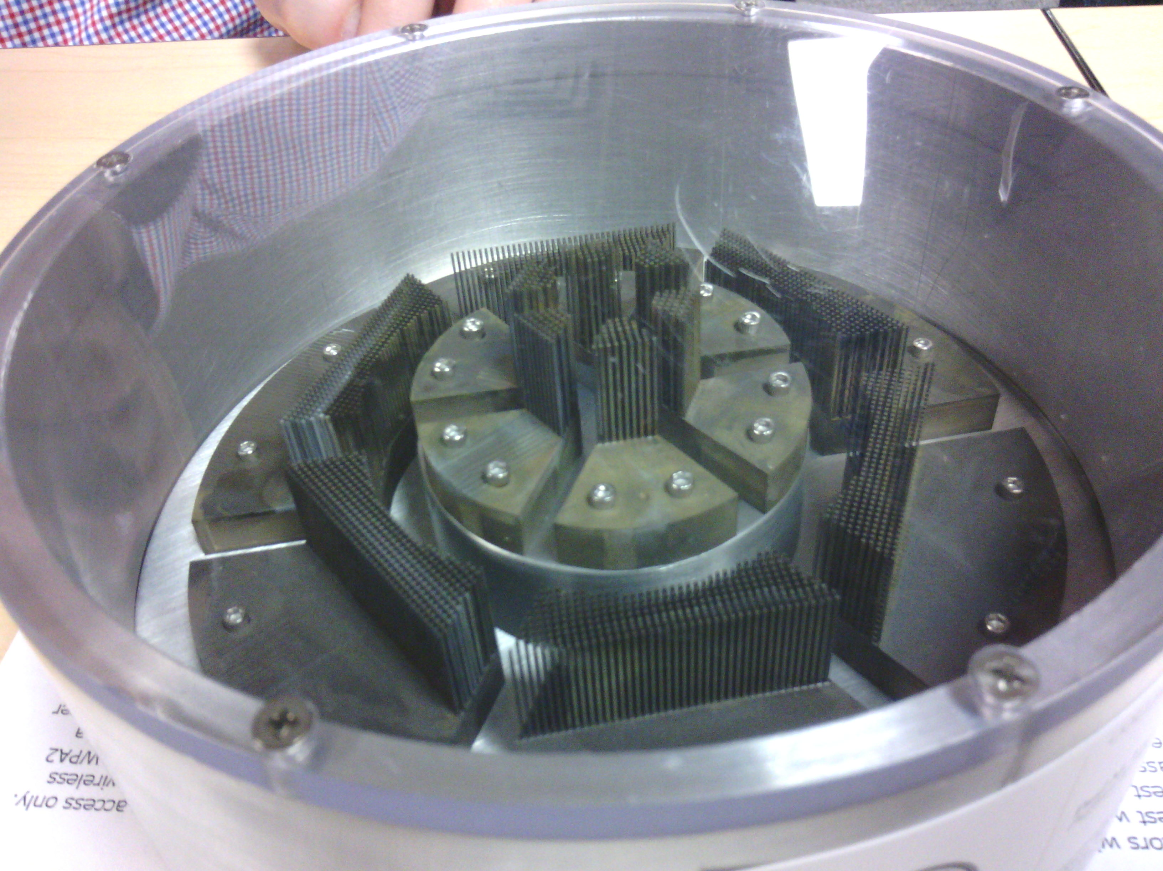
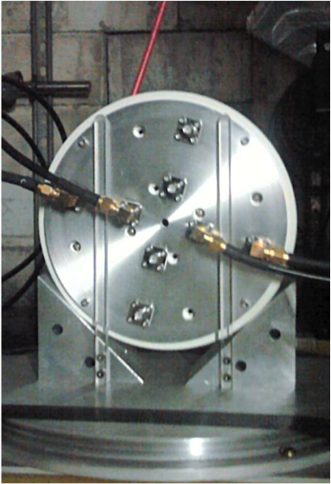
Active Collimator
In addition to the devices just mentions, the Active Collimator (AC) is used to monitor the location of the photon beam at the entrance to the collimator and is used by accelerator to keep the beam in place.
The AC consists of a dense array of tungsten pins attached to tungsten base plates. The tungsten plate intercepts off-axis beam photons before they enter the collimator, creating an electromagnetic shower that cascades through the array of pins. The tungsten plates are mounted on an insulating support, and the plate currents are monitored by a preamplifier with pA sensitivity. The device is segmented into two concentric rings, each divided into four quadrants.
G. Miller, Nucl. Instrum. Methods 117, 33 (1974).

Slide 14
Triplet Polarimeter
Measure the polarization of the photon beam using the triplet photoproduction process:
The photon (1) scatters off an atomic electron ( 0 ) in a beryllium radiator. The scattered e⁻ (4) is detected in the triplet polarimeter. The produced e⁻e⁺ pair (2 & 3) is detected in the pair spectrometer.
Measuring the azimuthal angular distribution, φ, yields a measurement of the photon polarization P.
This is a calculable QED process with 8 diagrams (one) shown.
P is the photon polarization, Σ is beam asymmetry of the process, φ is azimuthal angle of the recoil electron relative to the plane of the photon’s polarization.
The scattered electron (4) has low energy and large scattering angle. The fast e⁺e⁻ pair trigger the event in the pair spectrometer.
Nucl. Instrum. & Meth. A867, 115 (2017).

Slide 15
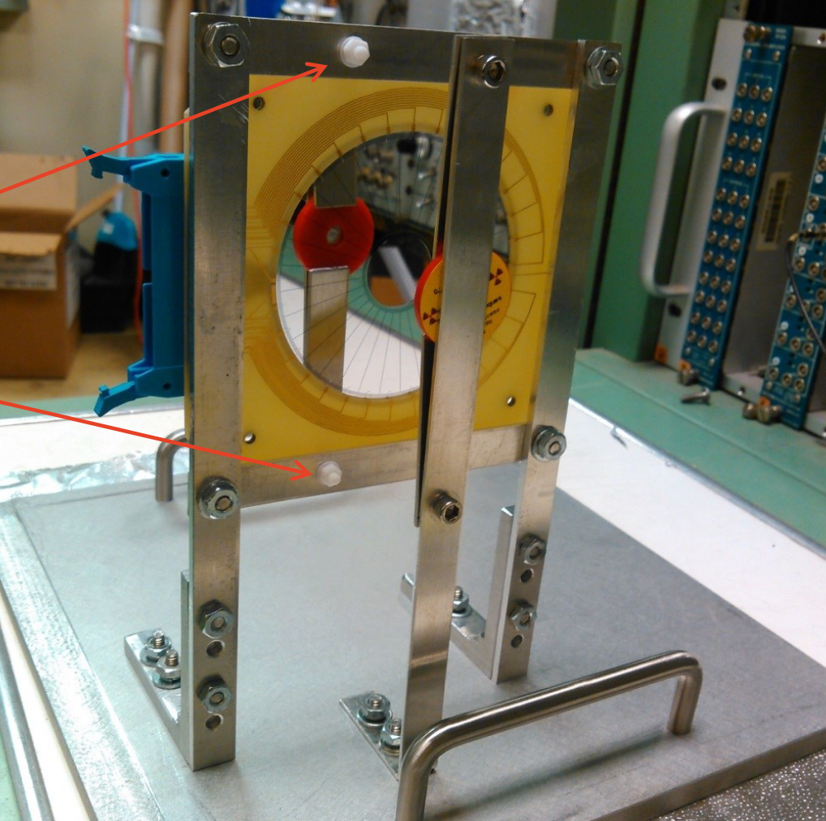
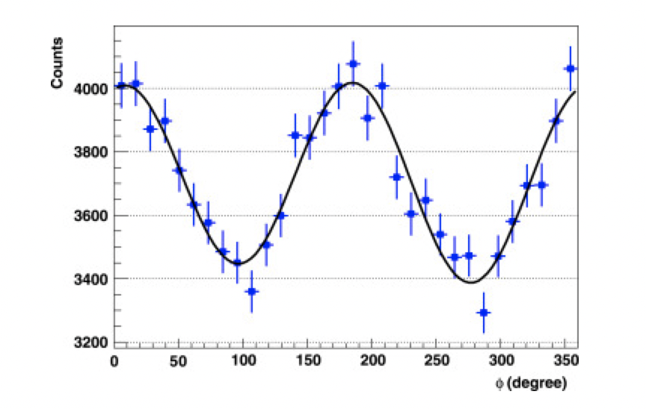
Triplet Polarimeter
A 75μm thick Be convertor is used as the electron target for the triplet scattering.
The scattered electron is detected in a silicon detector that is disc shaped and segmented into 30 wedges.
Measuring counts per azimuthal angle allows extraction of the linear polarization as a function of the beam energy.
M. Dugger, Nucl. Instrum. & Meth. A867, 115 (2017).

Slide 16
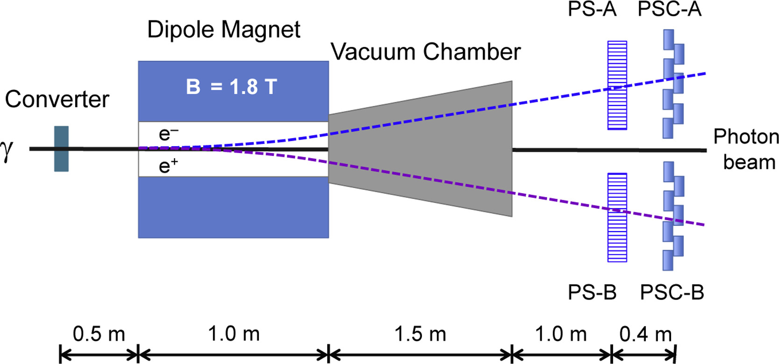
Pair Spectrometer
The pair spectrometer (PS) provides the measurement of photon flux entering the GlueX detector as well as providing a measurement of the energy spectrum of the photon beam.
It is also used to trigger the triplet polarimeter events, which are a subset of all PS events.
High-granularity counters
Course-grained
counters
The high-granularity counters, PS-A, measure the momentum of the e⁺e⁻ pair. The course-grained counters, PSC, are used to for the pair-spectrometer (PS) trigger.
The PS trigger is used as an independent GlueX trigger is about 20%& of the primary trigger rate to collect sample of events to calibrate both the flux and photon energy and contains the triplet polarimeter events.
F. Barbosa, Nucl. Instrum. & Meth. A795, 376-380 (2015).
& The rate in GlueX I.

Slide 17
Photon Beam
The photon beam now goes through the liquid hydrogen target in the GlueX detector. Those photons that do not interact in GlueX continue downstream and are stopped in the Hall-D photon dump.
Total
Absorption
Counter

Slide 18
The Total Absorption Counter
The TAC is a high-efficiency lead-glass calorimeter, used at low beam currents (<5 nA) to determine the overall normalization of the flux from the GlueX coherent bremsstrahlung facility.
This device is intended to count all beam photons above a certain energy threshold, which have a matching hit in the tagger system.
There would be a very large number of overlapping pulses in the TAC if it were used with the production photon flux, resulting in low detection efficiency and therefore large systematic uncertainties. Therefore, the TAC is only inserted into the beam during dedicated runs at very low intensities when the detector can run with near 100% efficiency.
Because of the low-current requirement, there are also issues with beam bleed through from the other experimental halls.

Slide 19


Instrumentation Publications
The GlueX Public Wiki:
https://halldweb.jlab.org/wiki/index.php/Main_Page
(The first instrumentation publication is from 1998.)

