Slide 1
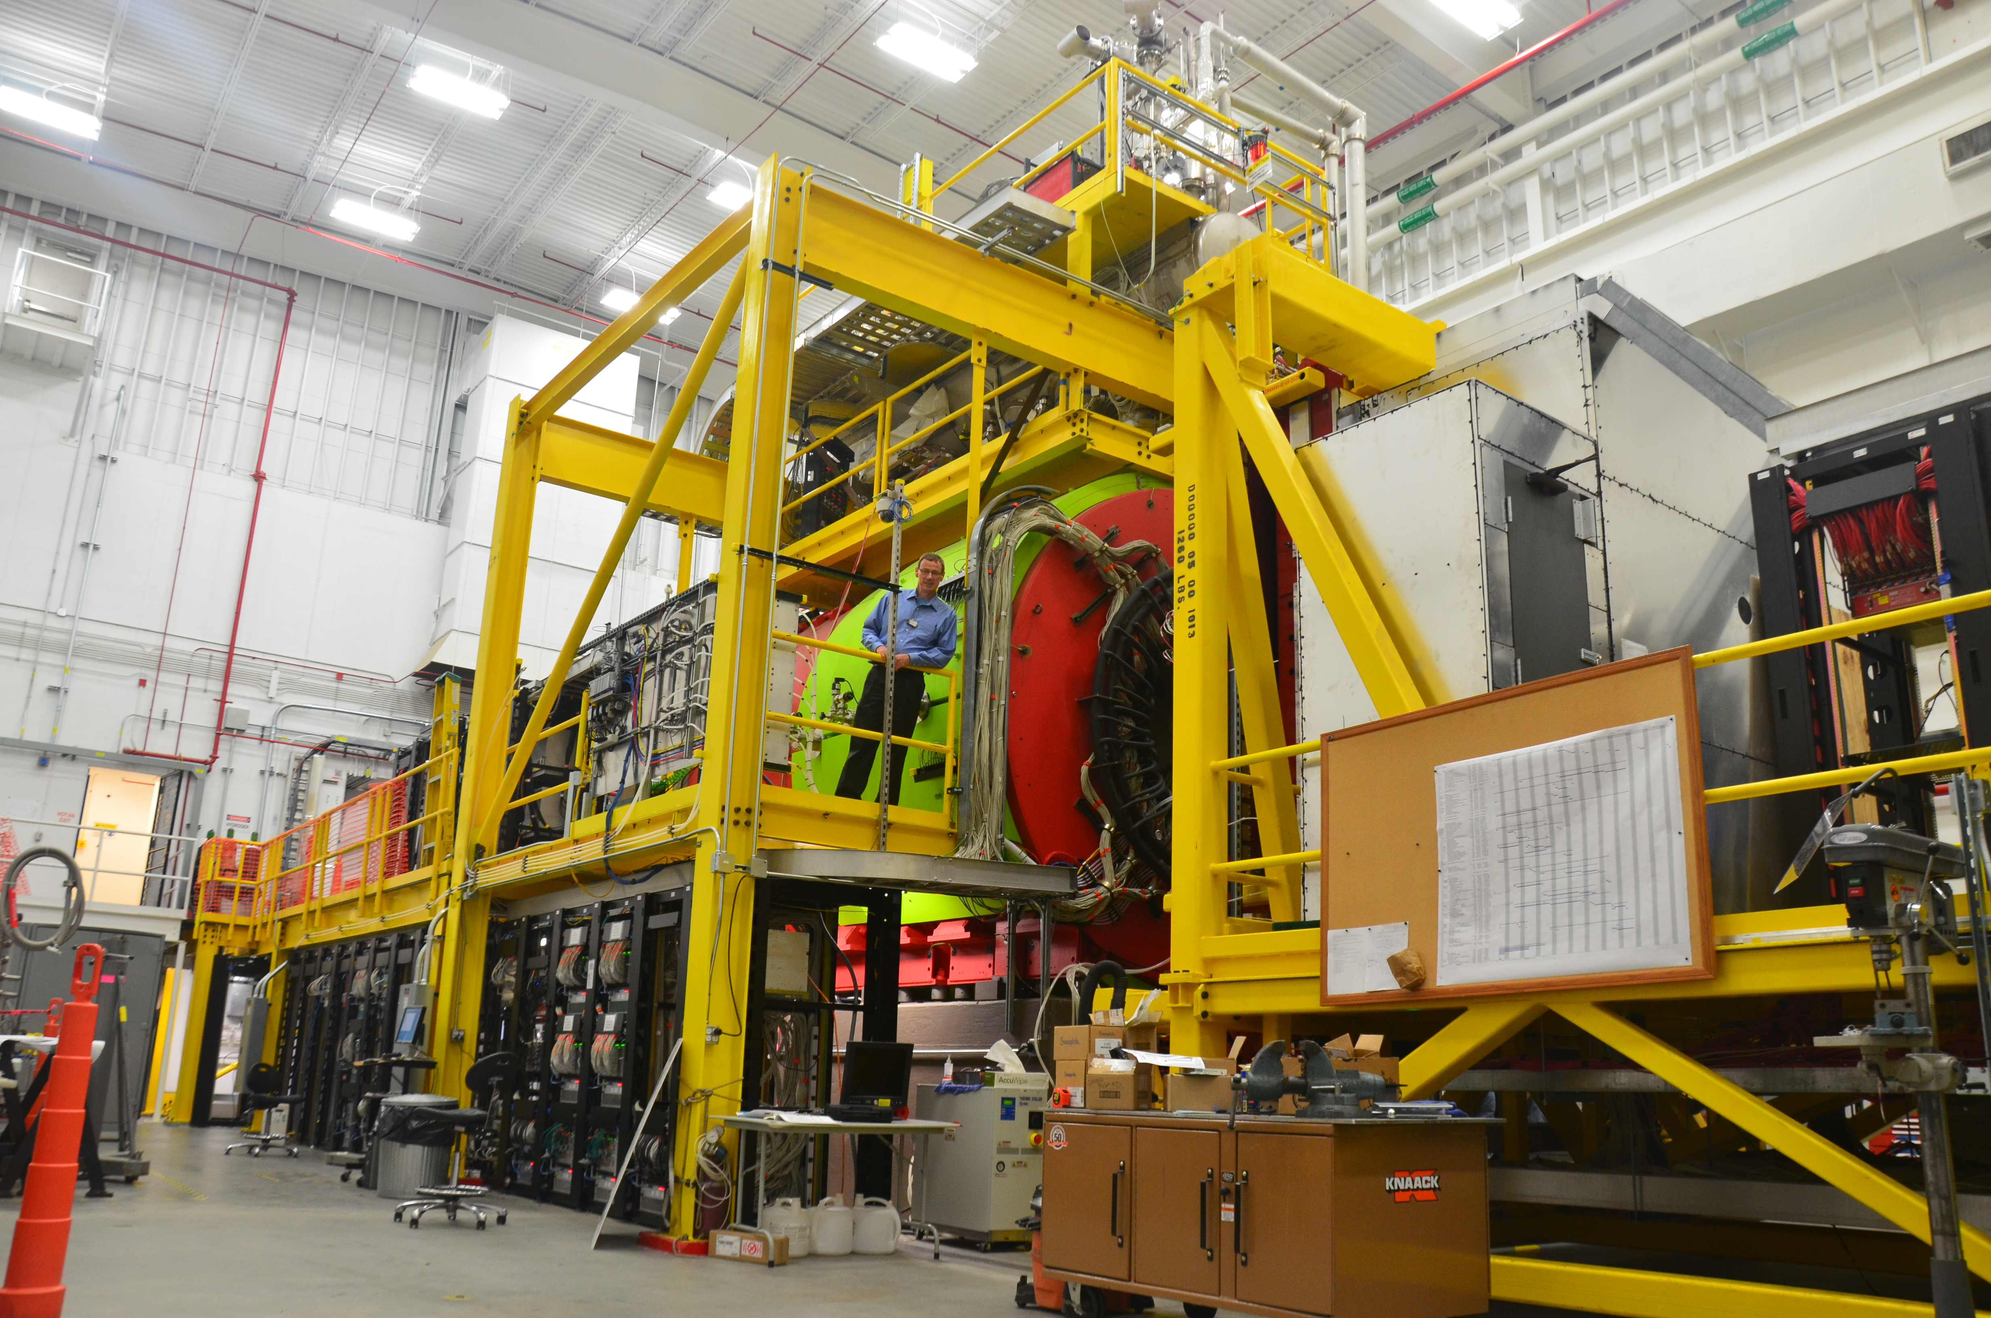
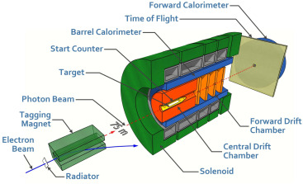
The GlueX Experiment part 3
The GlueX Detector
Curtis A. Meyer
Carnegie Mellon University
February 2021

Slide 2
The GlueX Detector
The GlueX detector was designed to reconstruct exclusive final states from photoproduction reactions on proton targets. This includes both charged particles and photons.
The detector was also built to be hermetic for these particles, with angular coverage extending to about 1º from the beam line.
The baseline detector can separate pions and protons with good efficiency, but kaon identification is limited to about 1.8 GeV/c in the forward direction. The addition of the DIRC in 2019 makes forward kaon identification possible up to about 3.5 GeV/c.
The detector was also designed to run with an open trigger, so a very broad range of physics is collected simultaneously.

Slide 3
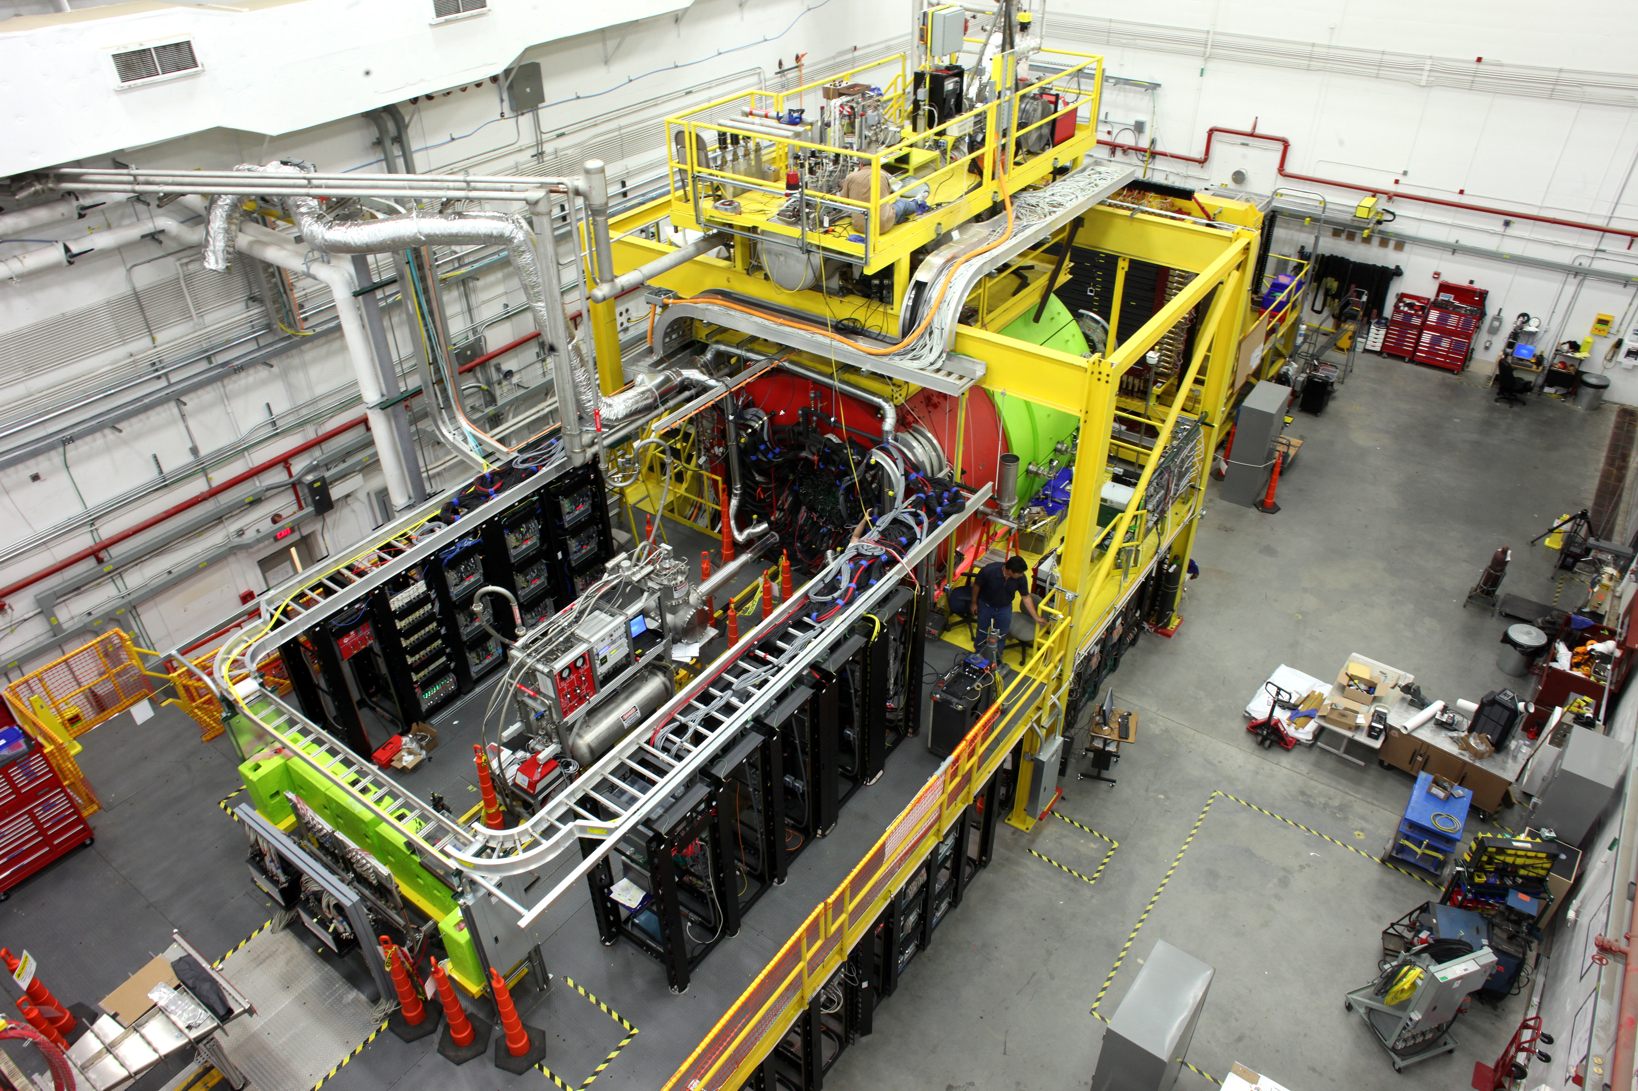
The GlueX Detector
An overhead view of the GlueX detector in Hall D. The photon beam enters from the lower left. A lower level of electronic racks is visible .
The Solenoid is visible as the bright green cylinder, while the target control system is in the center if the platform.

Slide 4
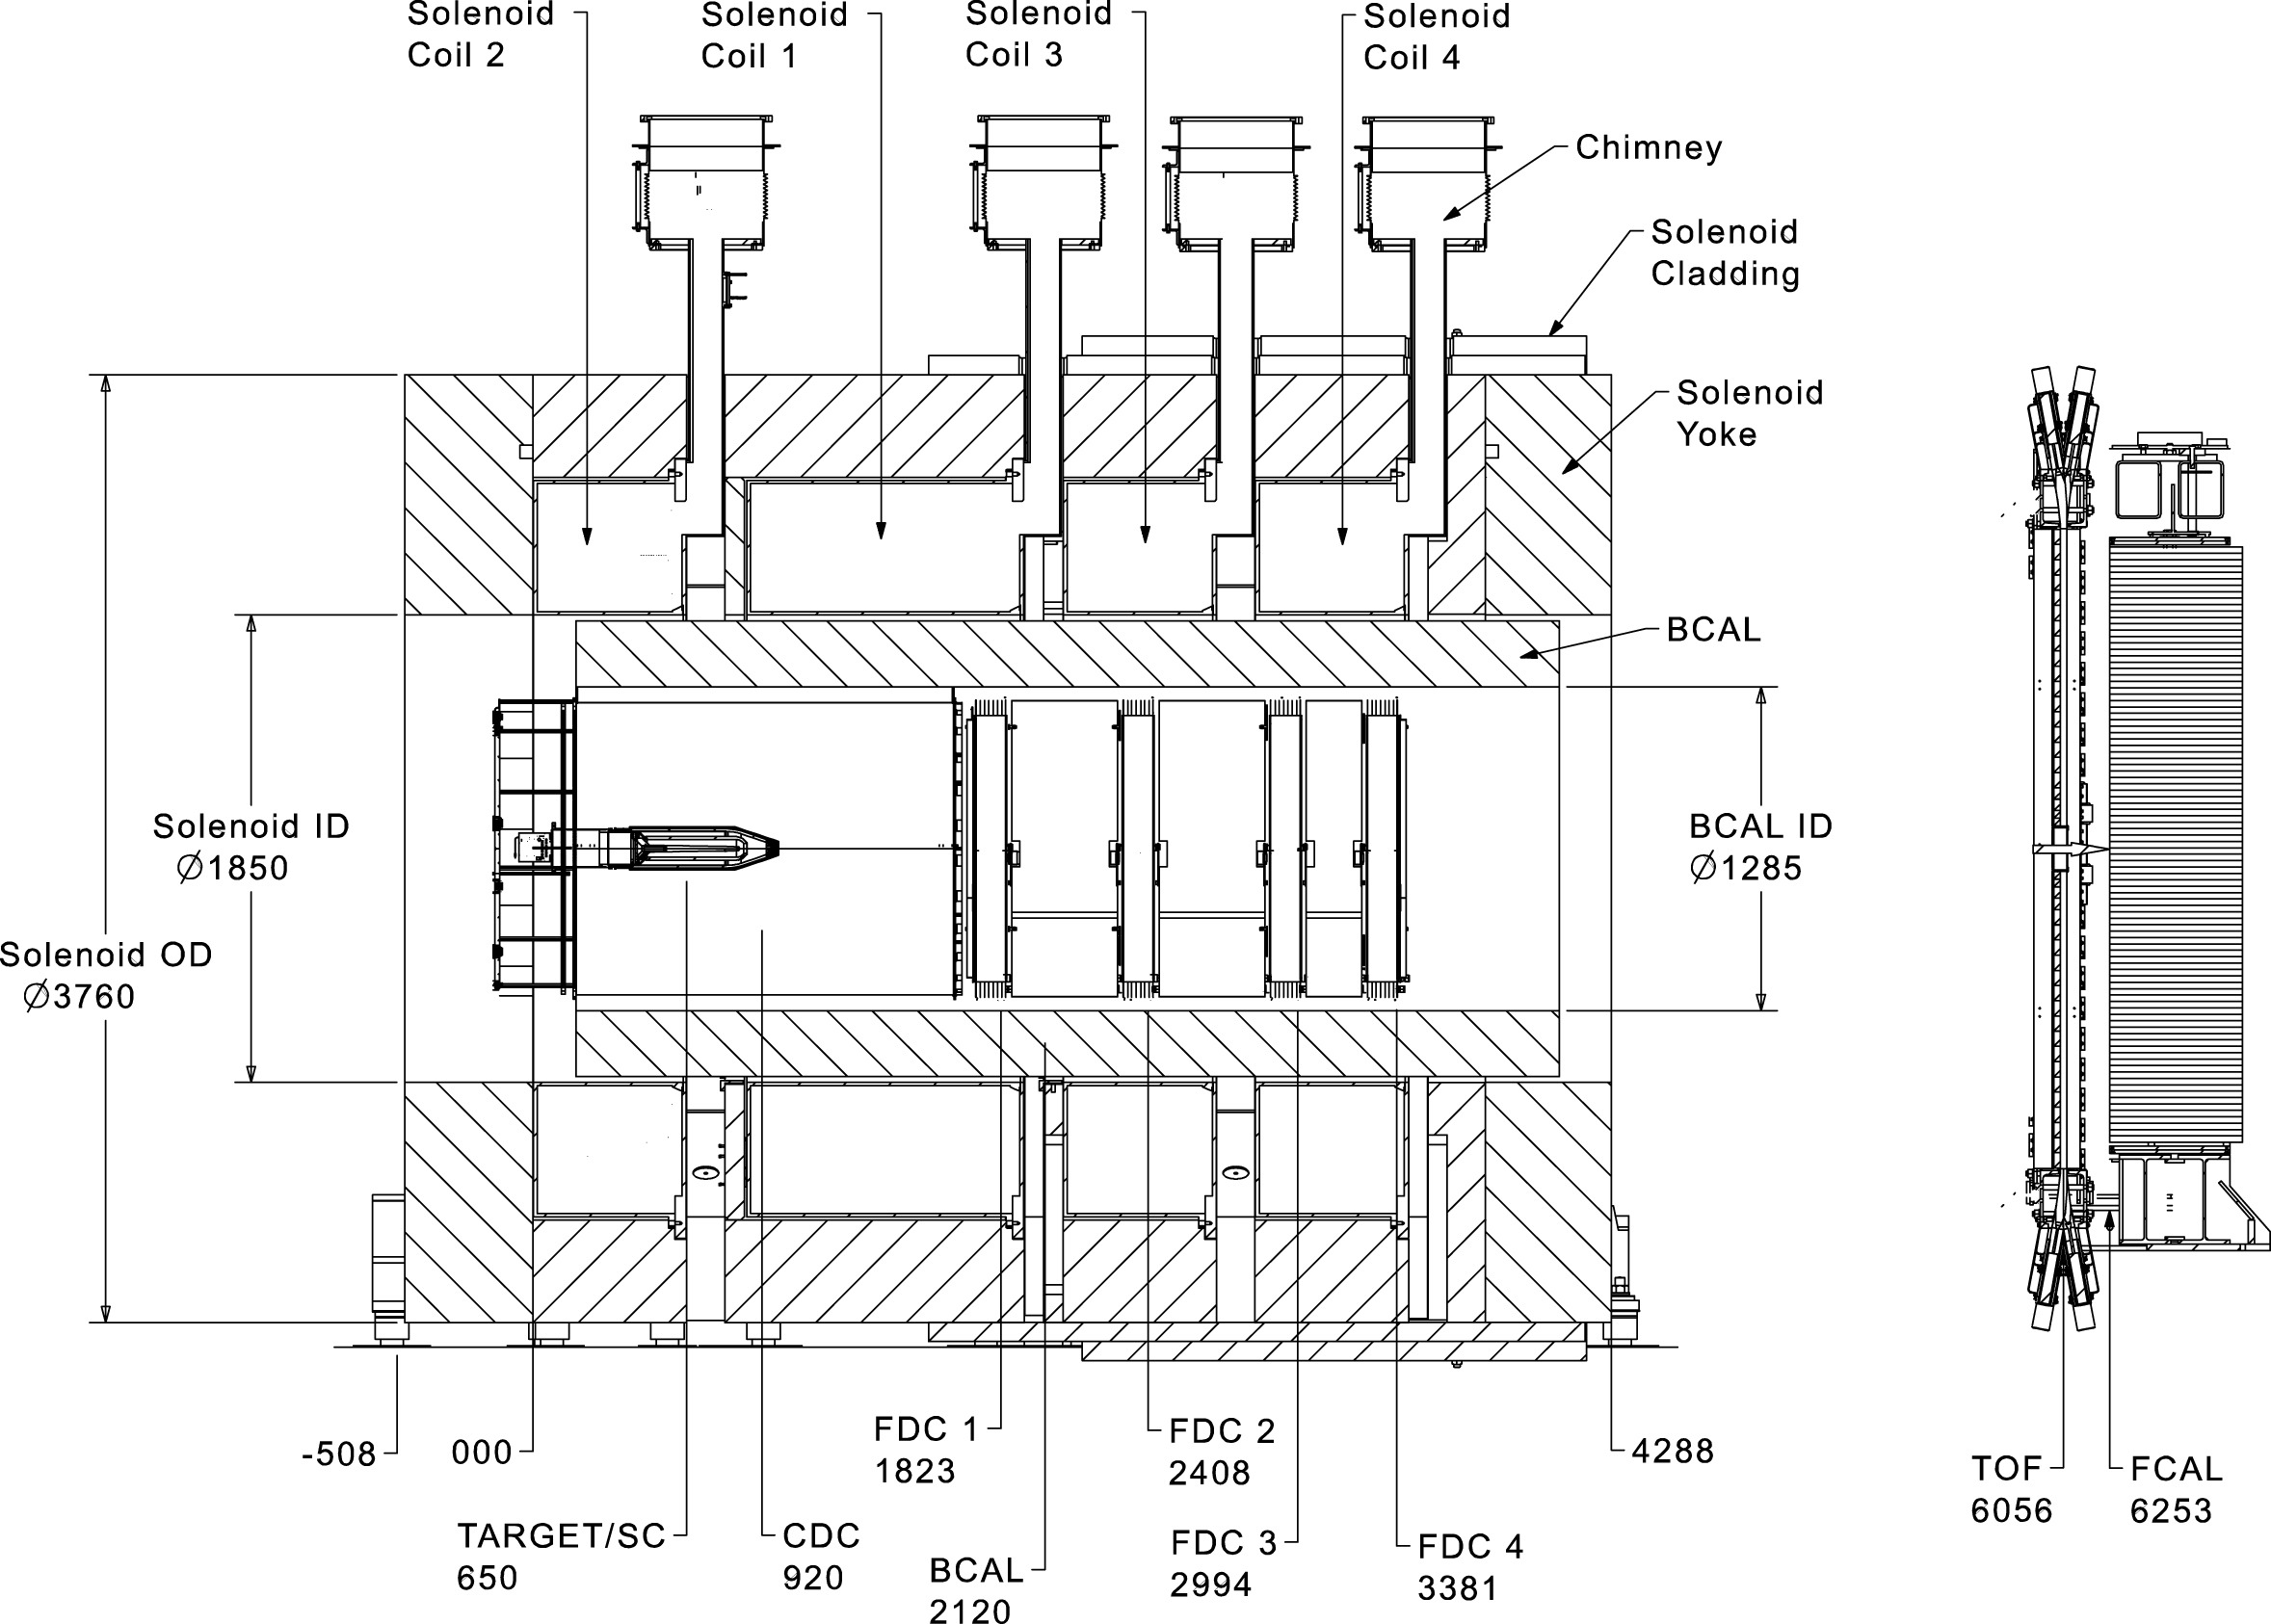
The GlueX Detector
The GlueX lab coordinate system has the origin of x and y on the nominal beam axis. The z origin is located at the upstream edge of the GlueX solenoid. The center of the GlueX target is located 65cm down stream from the origin.

Slide 5
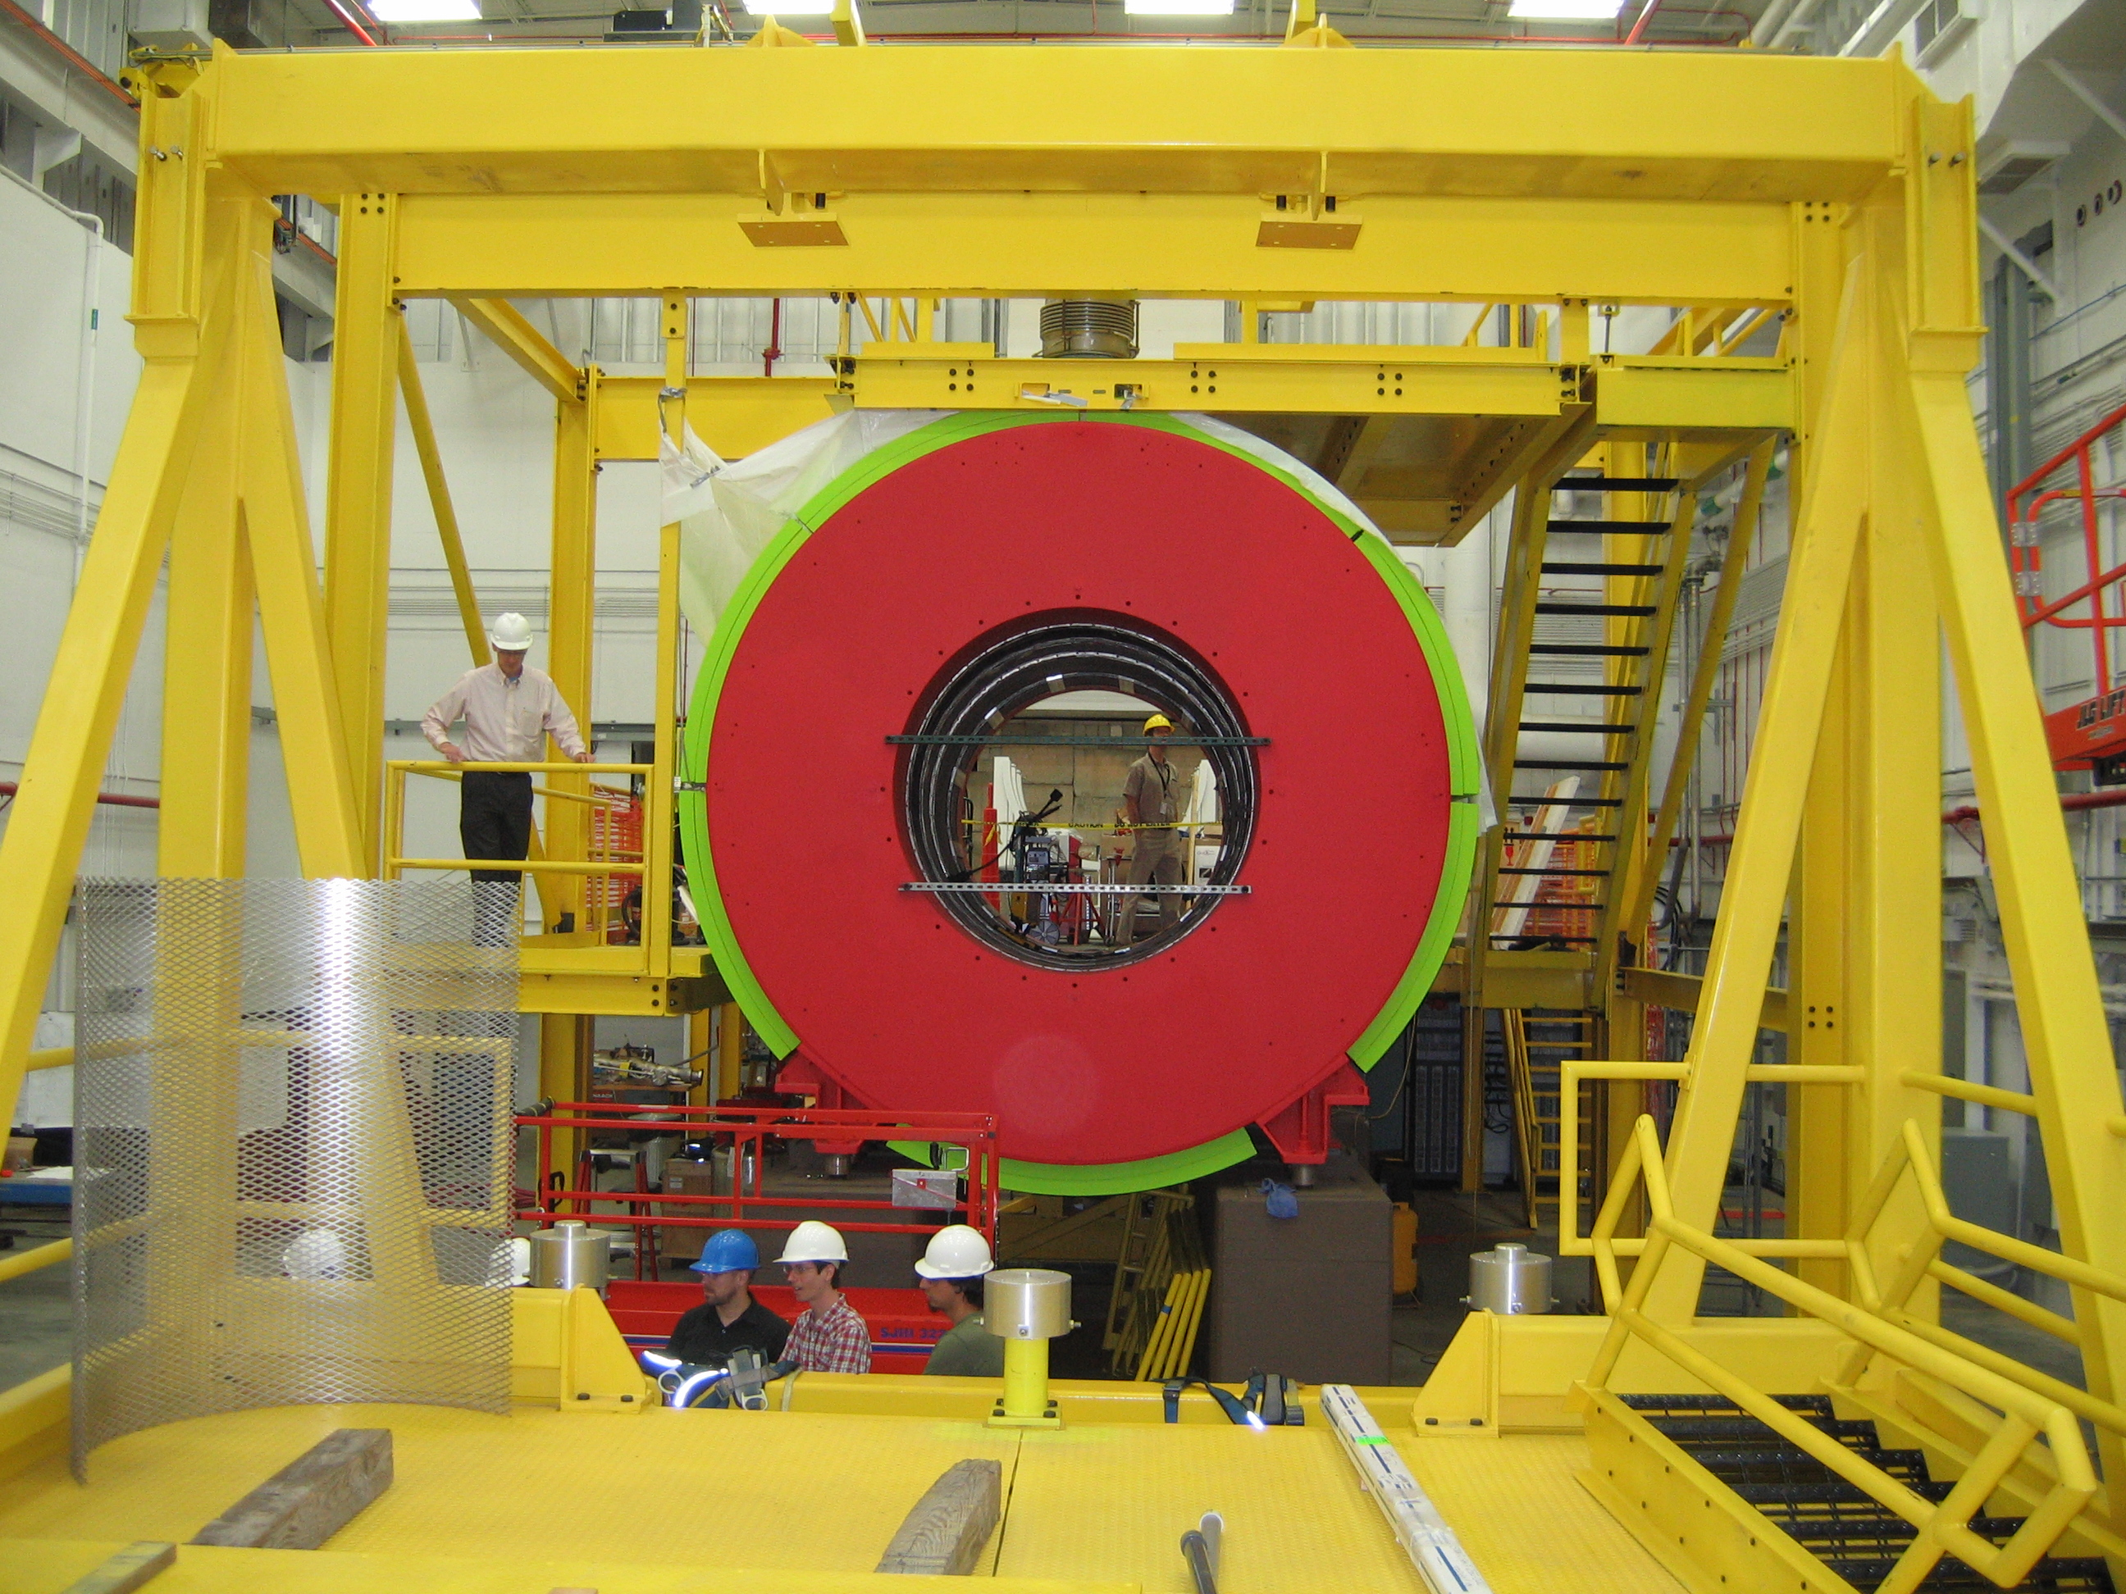
The Solenoid Magnet
The GlueX magnet is a superconducting solenoid with four coils that is operated at a maximum magnetic field strength of about 2T.
The magnet was originally built for the LASS experiment at operated at SLAC in the 1980’s. It was then moved to Los Alamos where 3 of the 4 coils were used in the MEGA experiment. In the early 2000’s, GlueX obtained ownership of the magnet and transported it to IUCF where refurbishment started. The magnet was later moved to JLab where the refurbishment was finished. The magnet was assembled in Hall-D starting in 2011.
Original GlueX plans called for running the magnet with a 2.25T field and a 1500A current. Physics studies later showed that operation 10% lower was better matched to GlueX needs, so normal operation is with 1350A and a 2T field.
Length: 4.8m
Diameter: 3.76m
Bore: 1.85m
G. Biallas & E. Chudakov, GlueX-doc-2378.

Slide 6
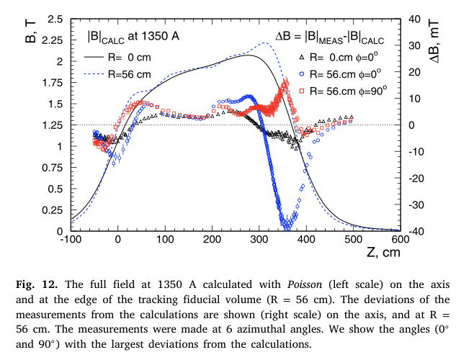
The Solenoid Magnet
The GlueX magnet is a superconducting solenoid with five coils that is operated at a maximum magnetic field strength of about 2T. The field is not uniform throughout the bore.
There were concerns that the solenoid would not be able to operate as needed for GlueX leading to a long string of magnet reviews lasting until 2018, and at one time there were plans for a replacement magnet.
The earliest GlueX running (prior to 2017) took place at 1200A over quench concerns. Those issues have now been resolved.

Slide 7
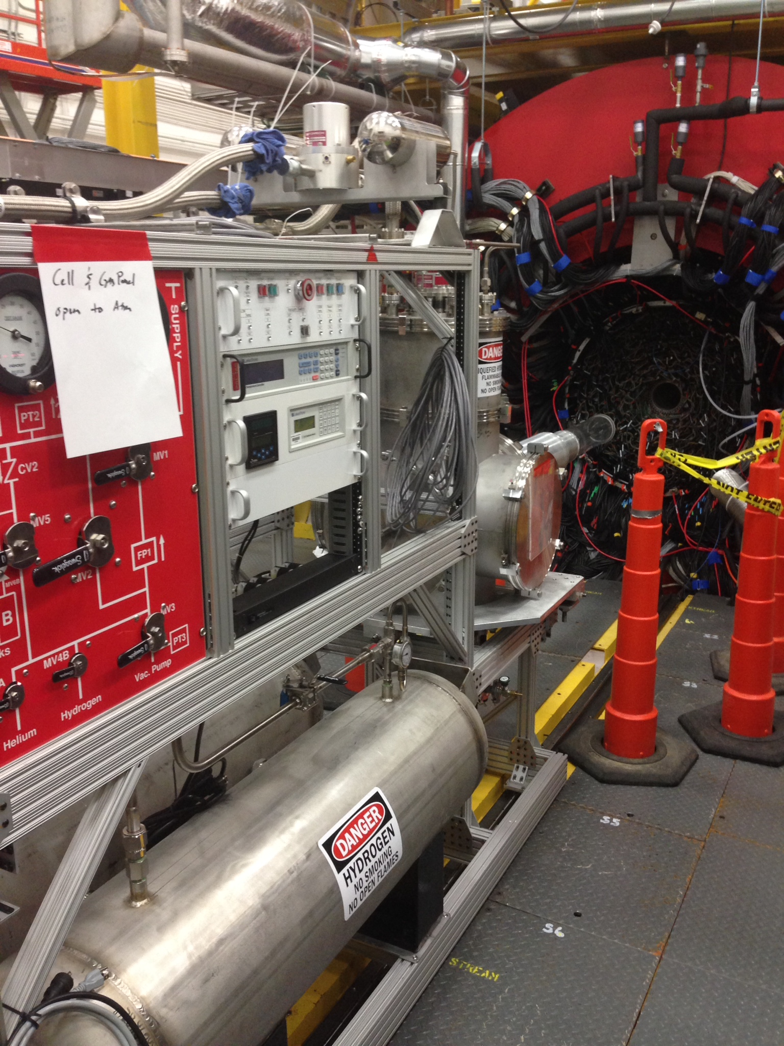
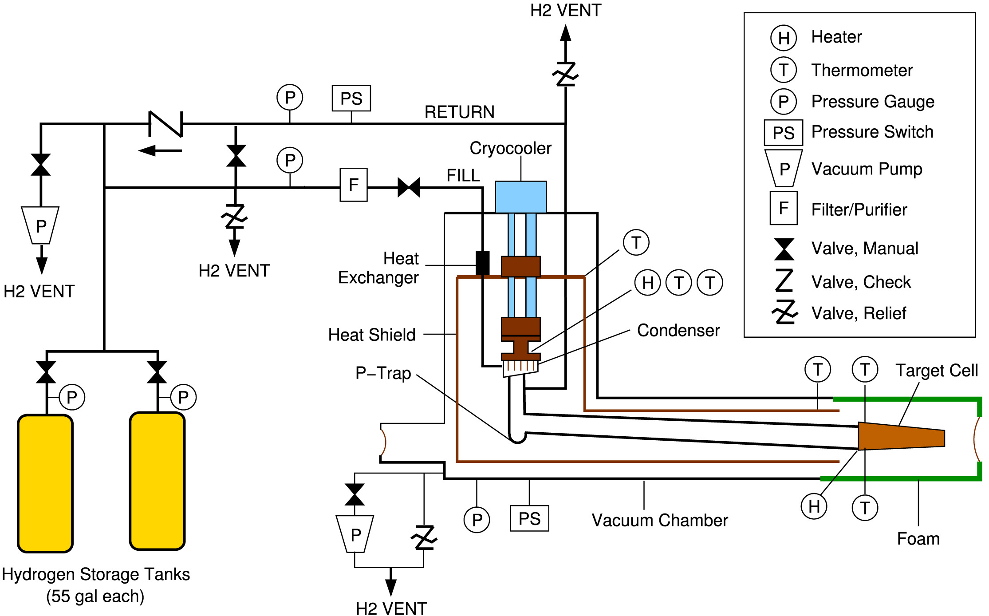
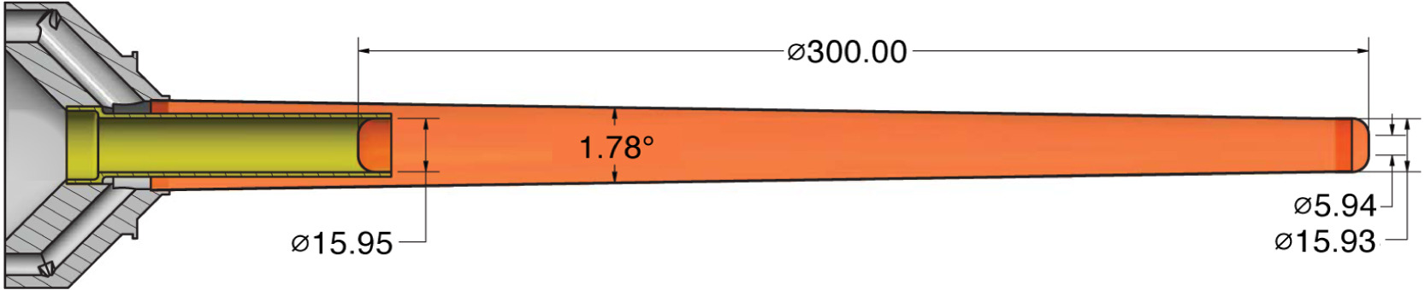
The Liquid Hydrogen Target

Slide 8
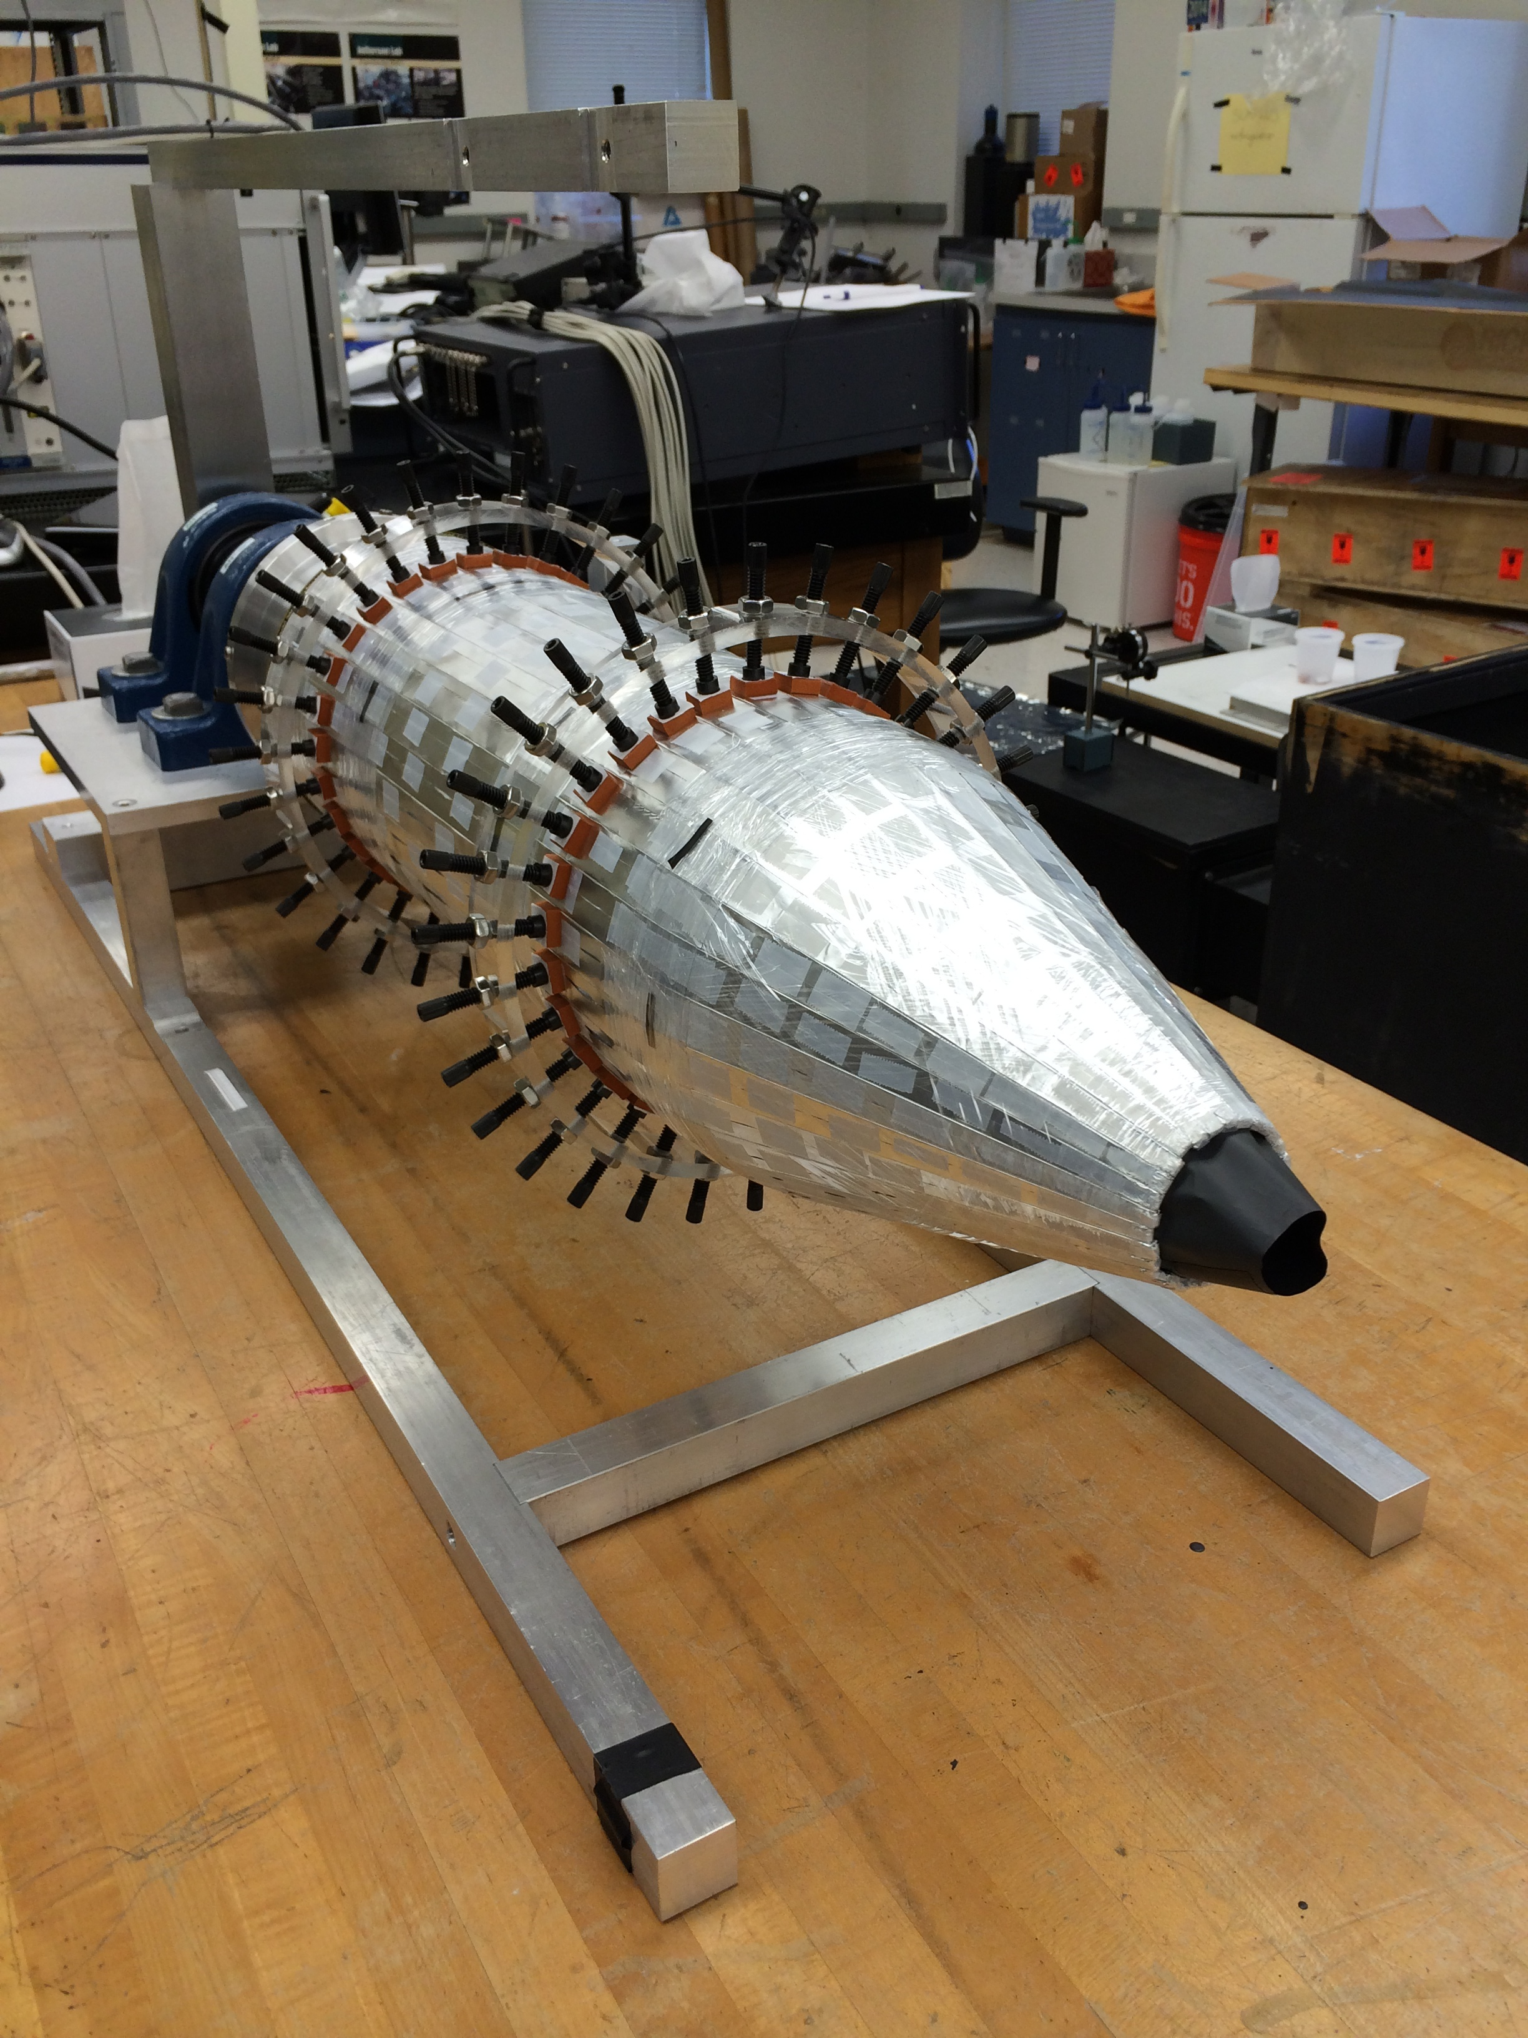
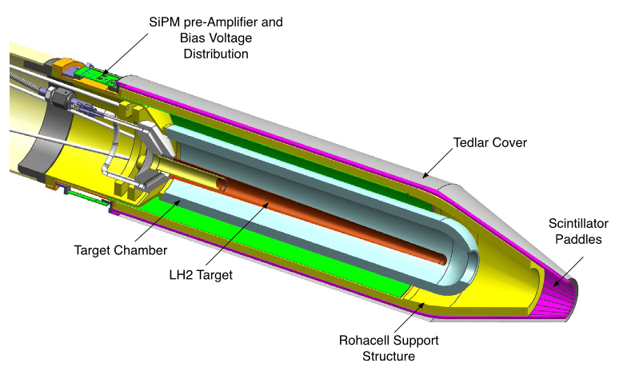
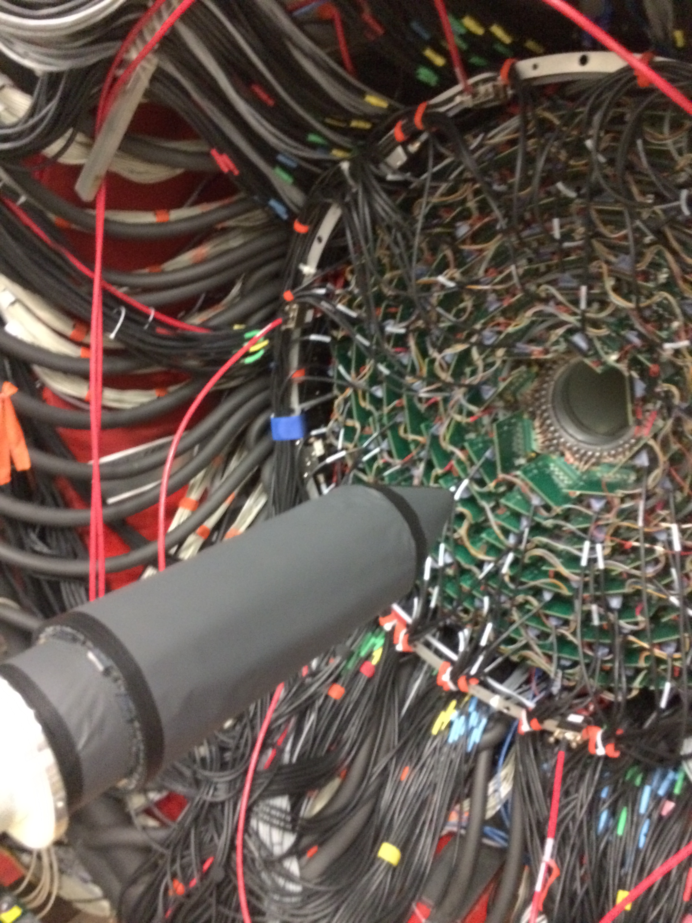
The Start Counter
The start counter (SC) consists of 30 scintillator strips that surround the GlueX target. In the forward direction, the strips follow a cone shape.
The strips are read out using silicon photomultipliers and provide a timing signal with a precision of about 350ps.
The SC was designed to provide a time measurement close to the target that is precise enough to select from which 4ns RF bucket the photon came.
E. Pooser, et al., Nucl. Instrum. & Meth. A927, 330-342 (2019)

Slide 9
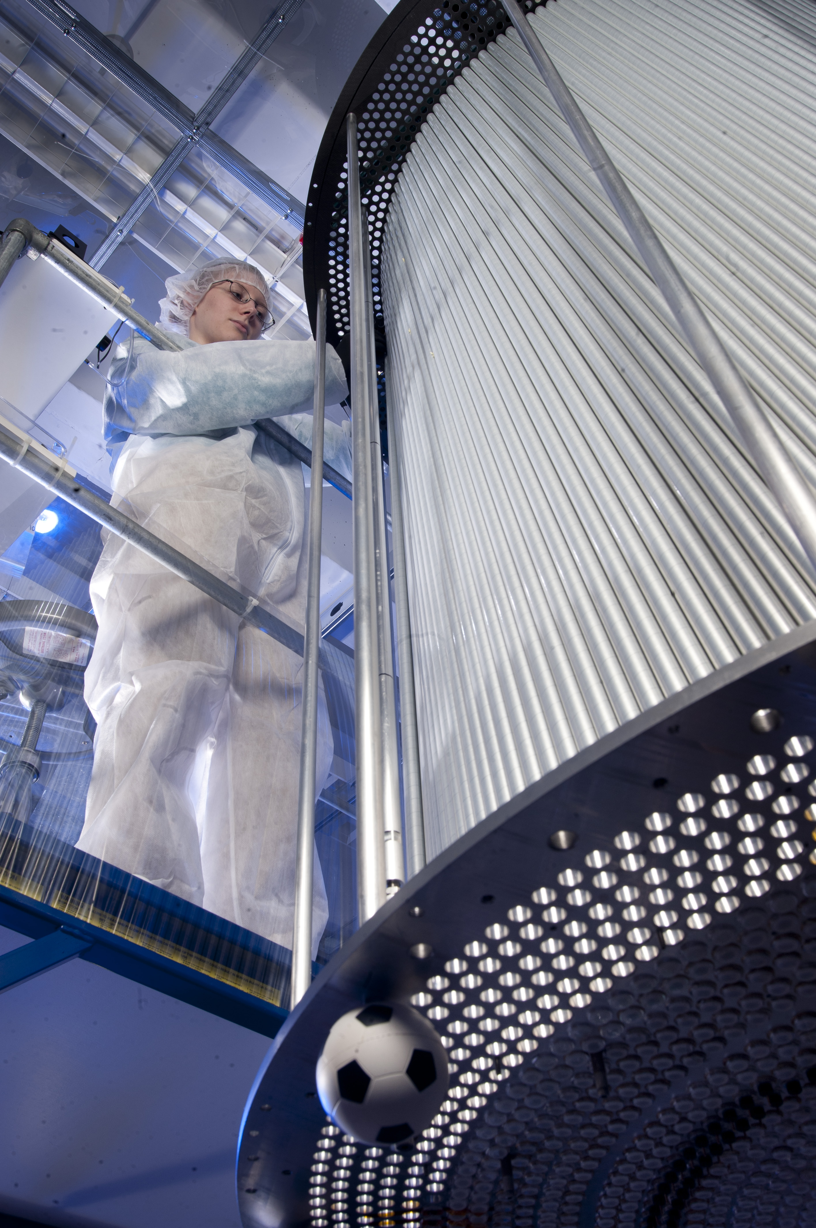
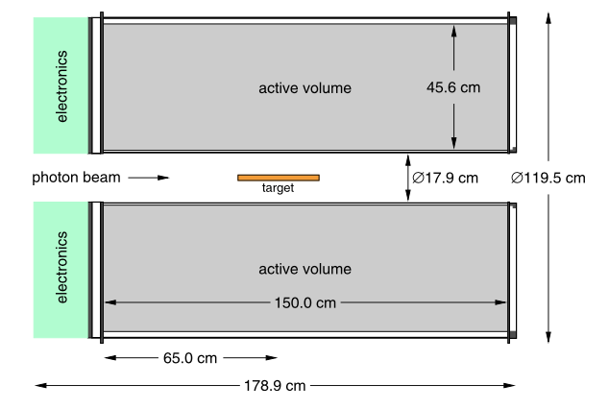
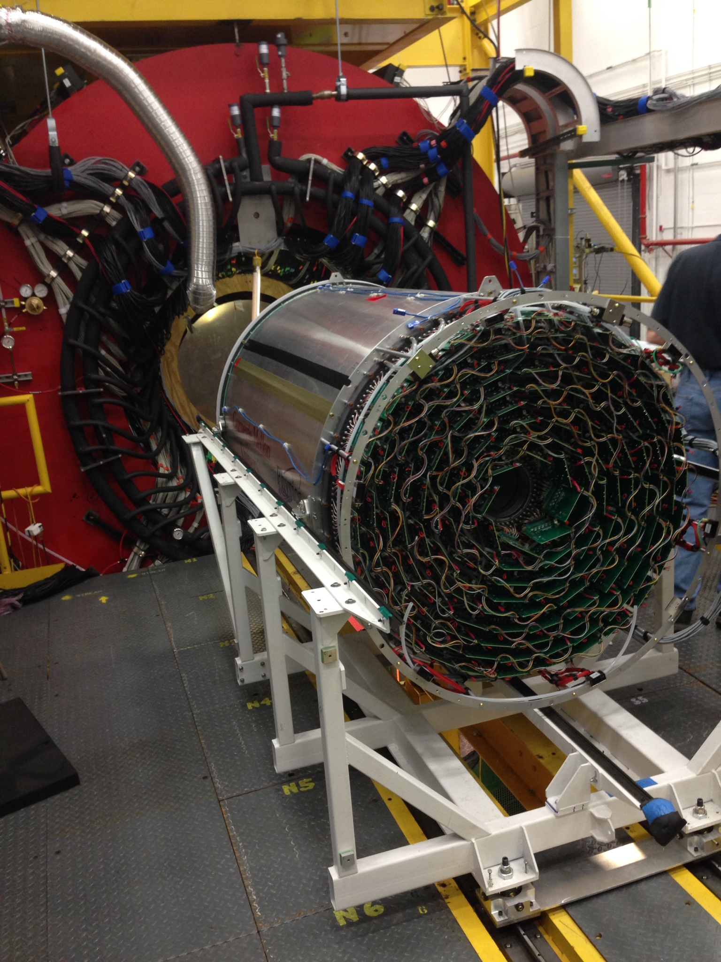
The Central Drift Chamber
The central drift chamber (CDC) is based on ~3500 1.5m long 1.6cm diameter aluminized mylar tubes. The 28 layers of tubes are arranged in 7 4-layer superlayers of tubes that alternate between axial and stereo. Each tube has a 20 μm diameter gold-plated tungsten wire along the axis of the tube. The chamber operates with 50-50 argon carbon dioxide gas and ~2000V on the central wire. The signals are read out using 125 MHz flash ADCs (F125).
The trajectory of the tracks is reconstructed, and when combined with the magnetic field provides a measurement of the particle’s momentum. The deposited energy in each straw is also measured, and the rate of energy loss per length provides particle identification information.
Y. Van Haarlem, et al., Nucl. Instrum. Methods A622, 142, (2010)
N.S. Jarvis, et al., Nucl. Instrum. & Meth. A962, 163727 (2020)

Slide 10
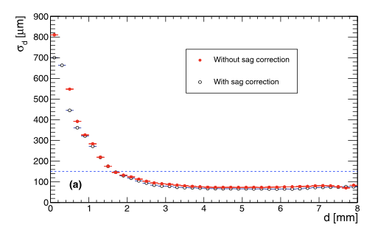
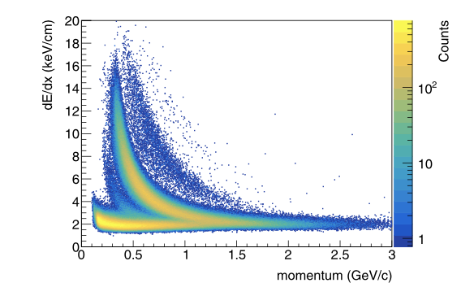
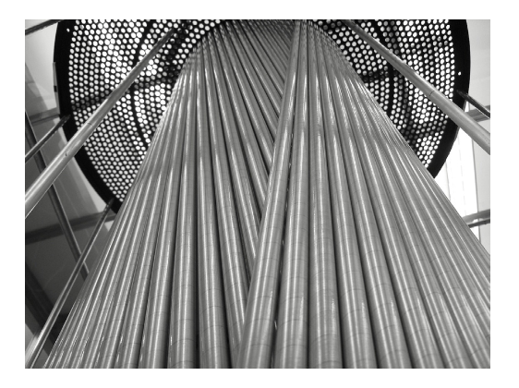
The Central Drift Chamber
dE/dx information allows pion-proton separation for particles of momentum less than 800 MeV/c.
The CDC is designed to reconstruct the trajectory of charged particles passing through it. It reconstructs the closest distance to the wire to about 150 μm precision and the z position of the track with cm precision.
p
K
π
Y. Van Haarlem, et al., Nucl. Instrum. Methods A622, 142, (2010)
N.S. Jarvis, et al., Nucl. Instrum. & Meth. A962, 163727 (2020)

Slide 11
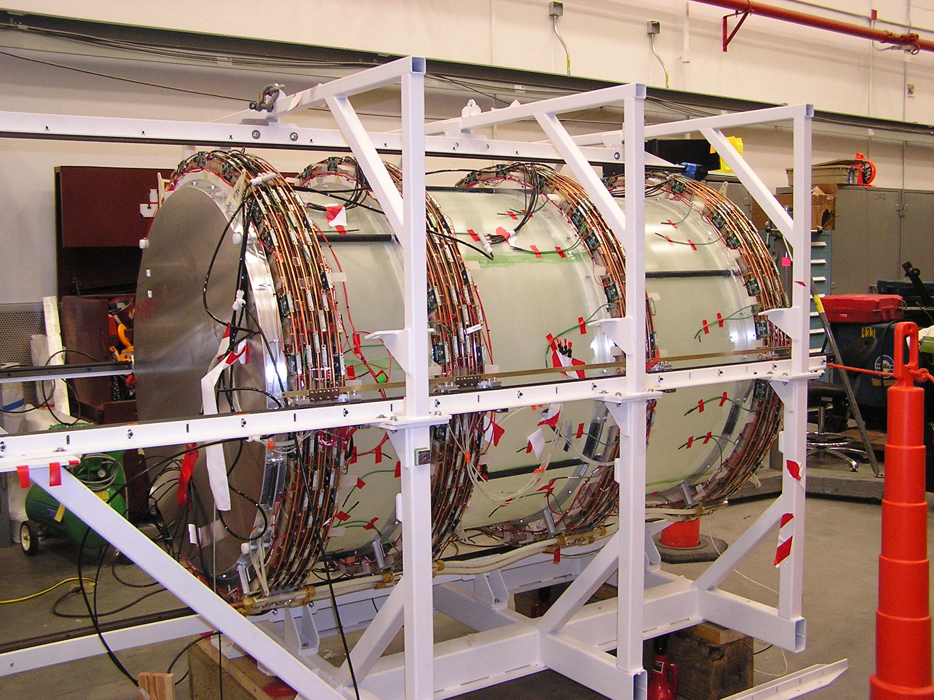
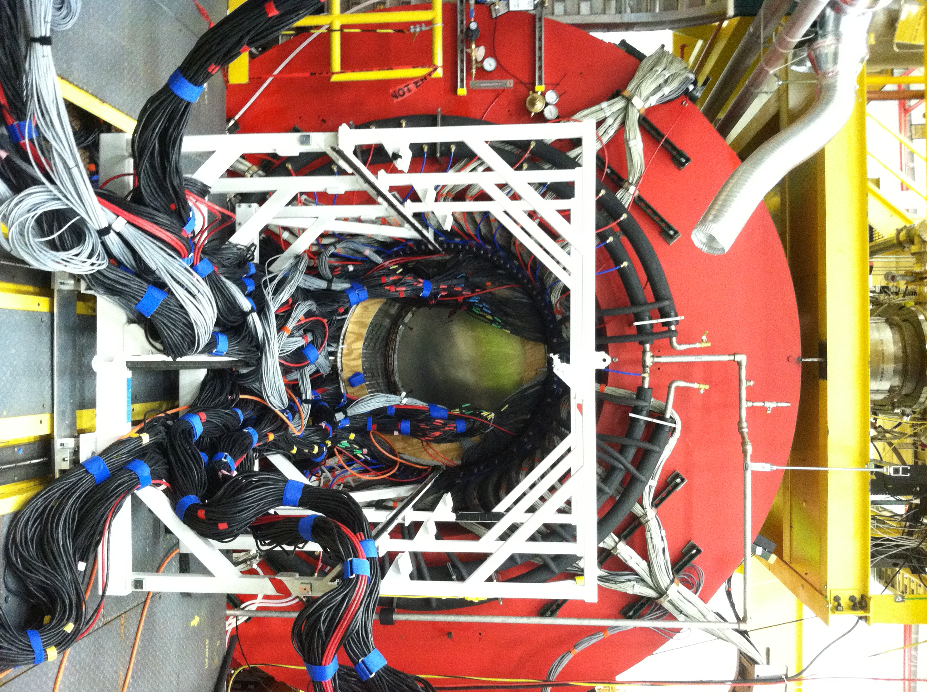
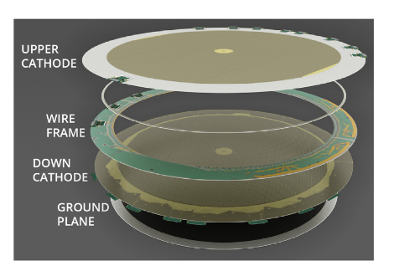
The Forward Drift Chambers
The forward drift chamber (FDC) consists of 24 layers of 1m diameter planar drift chambers arranged in 4 packages. The chambers have both anode wires and cathode strips for detection of charged particles. The 20 μm anode wires are spaced between 80 μm field wires and read out using TDCs. The cathodes have 5mm pitch and are oriented at 75º and 105º relative to the wires and are read out using 125 MHz flash ADCs. Each adjacent chamber plane is rotated by 60 degrees relative to the previous one. There are 12682 electronic channels.
The chamber operates with a 40-60 argon carbon dioxide gas mixture and reconstructs the position of of charged particles with about 100 μm precision.
The center of the chambers where the photon beam passes through are deadened.
V. V. Berdnikov, et al., Instrum. Exp. Tech. 58, 25 (2015)
L. Pentchev, et al., Nucl. Instrum. & Meth. A845, 281 (2017)

Slide 12
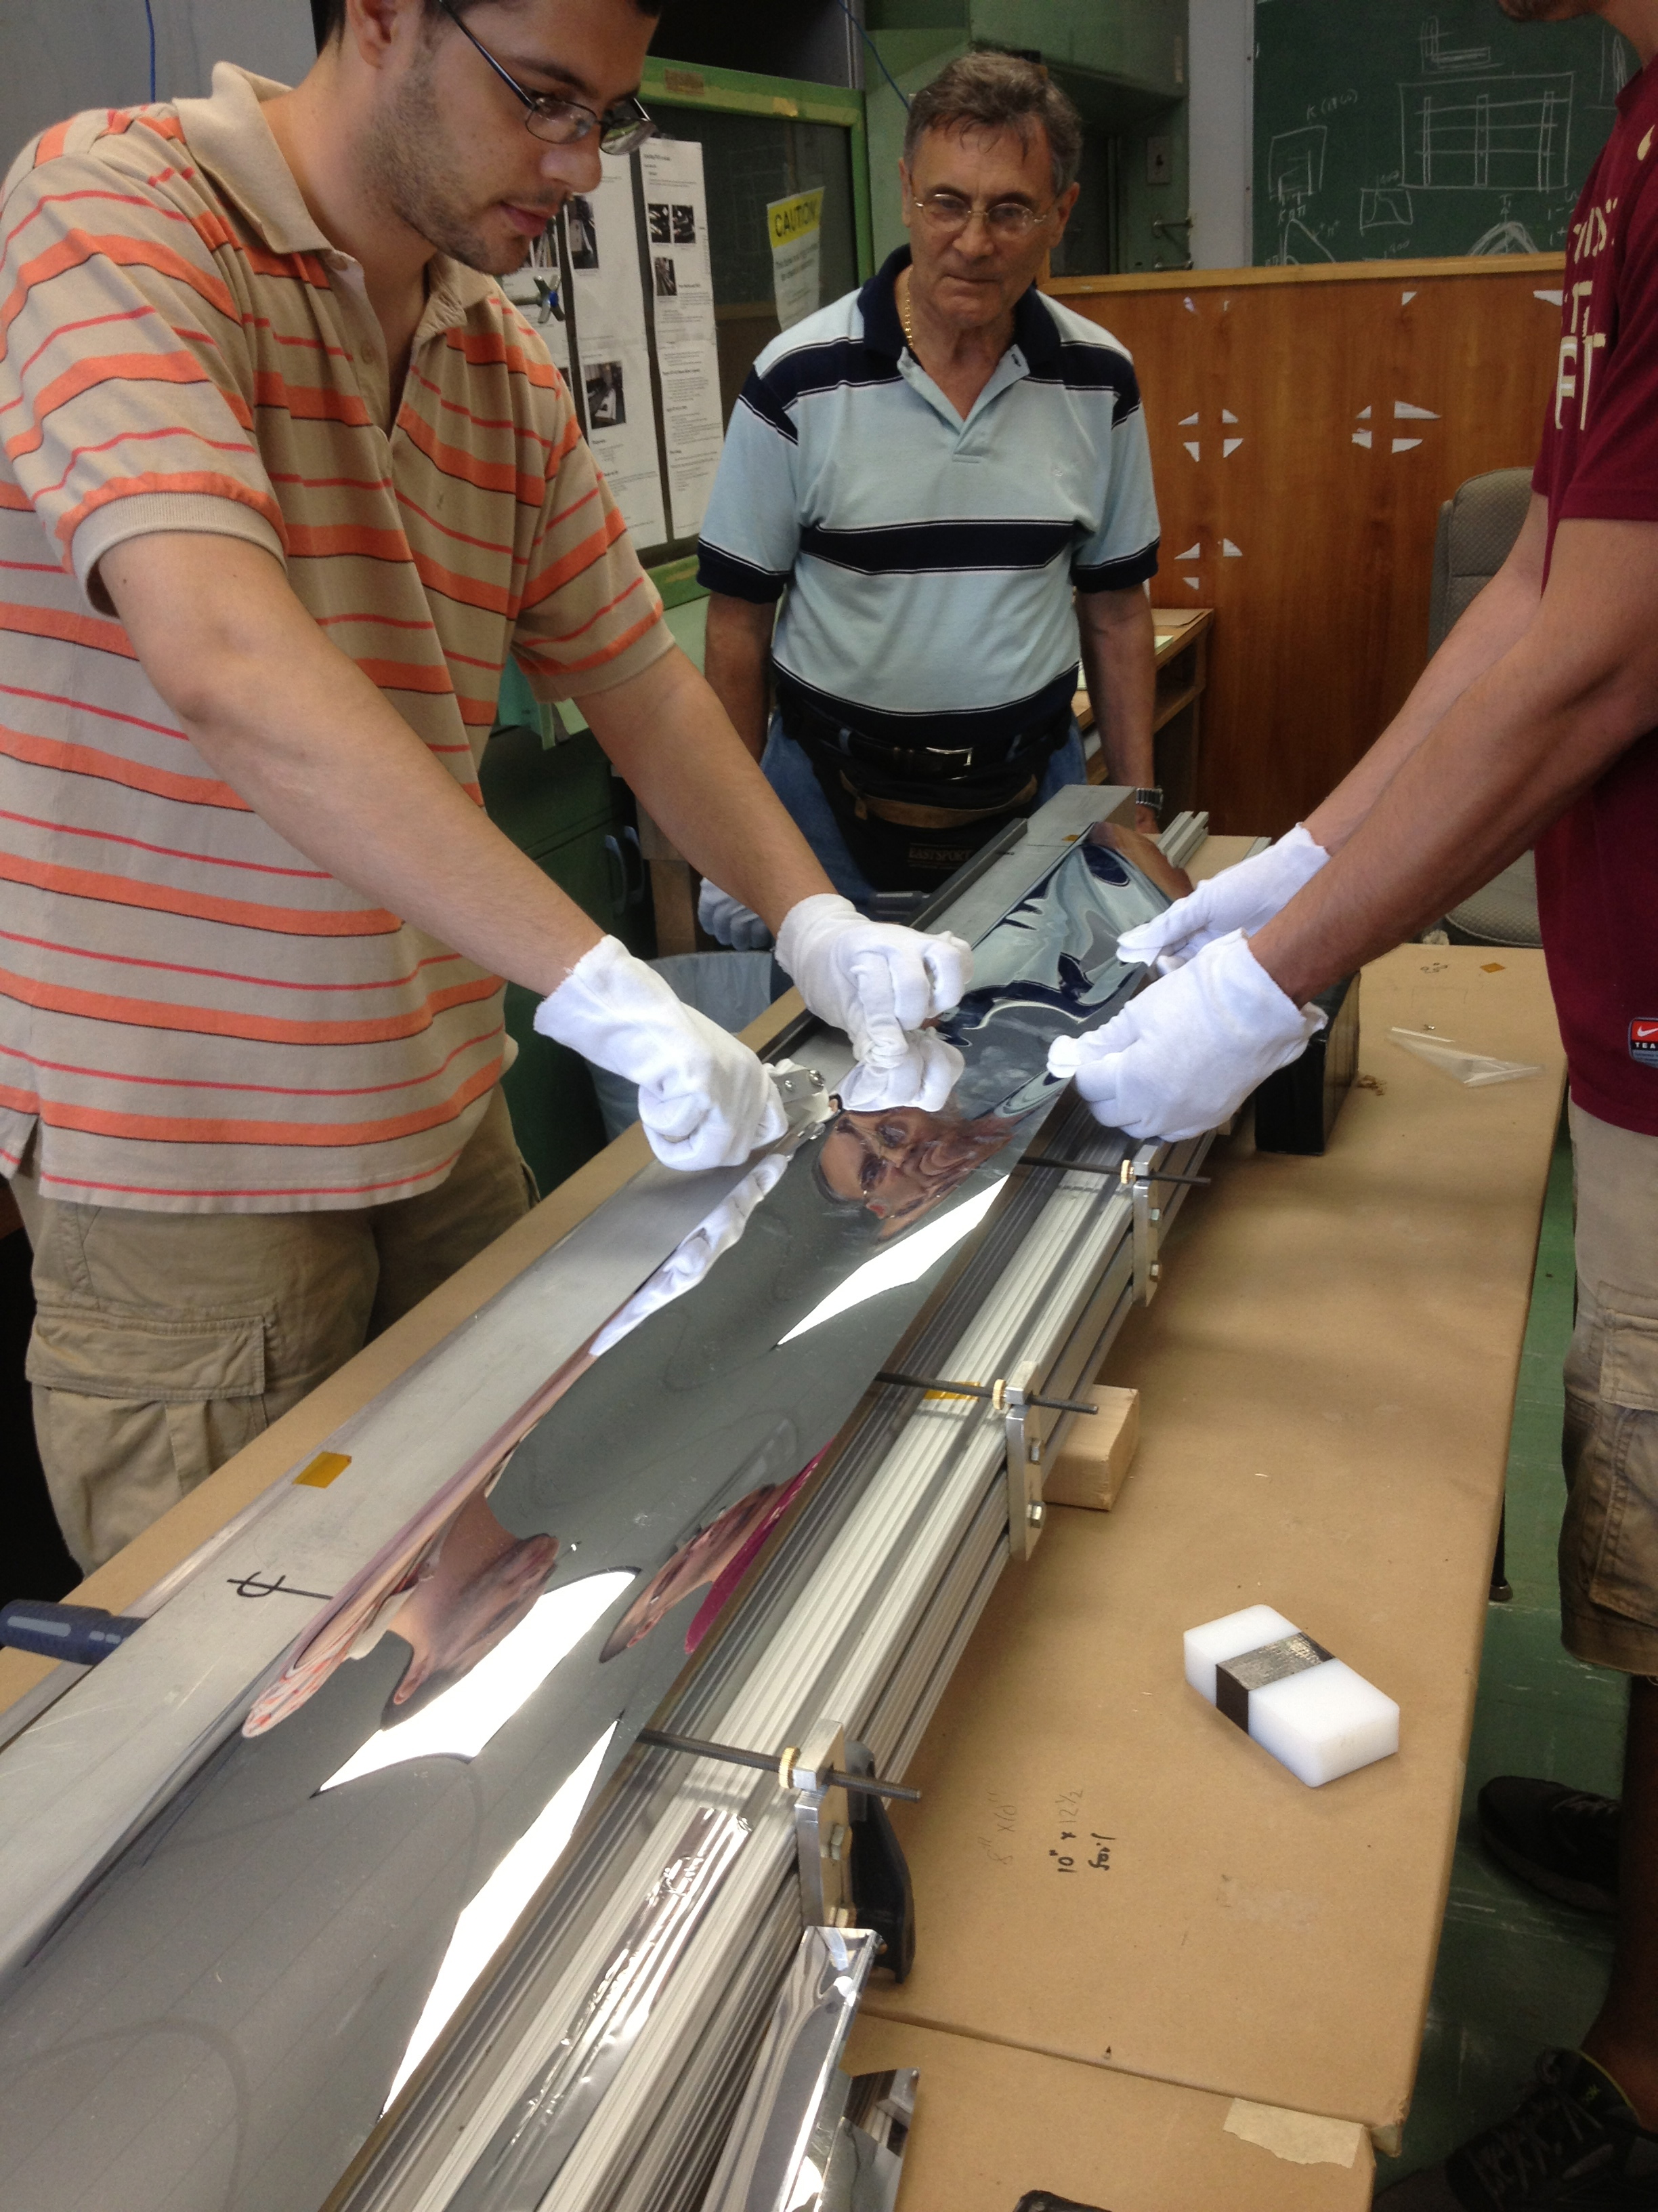
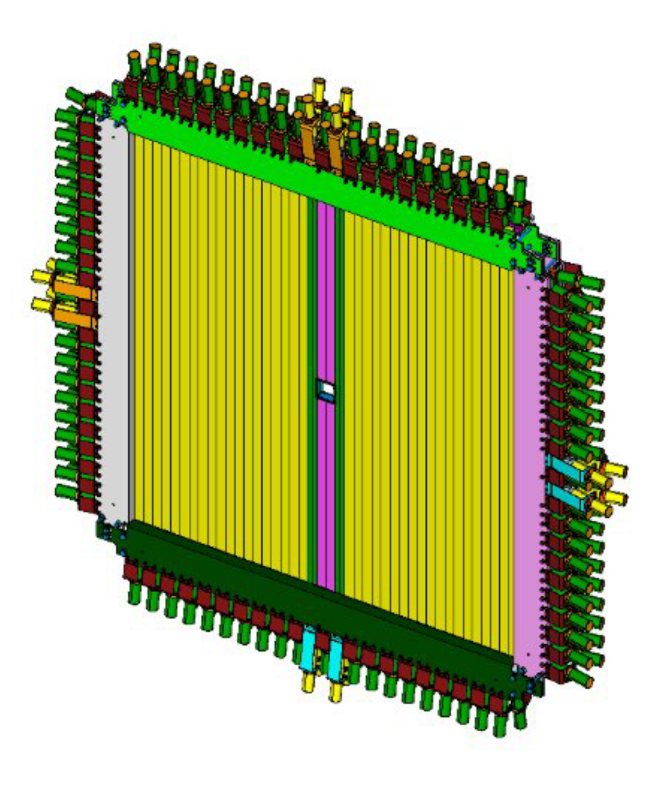
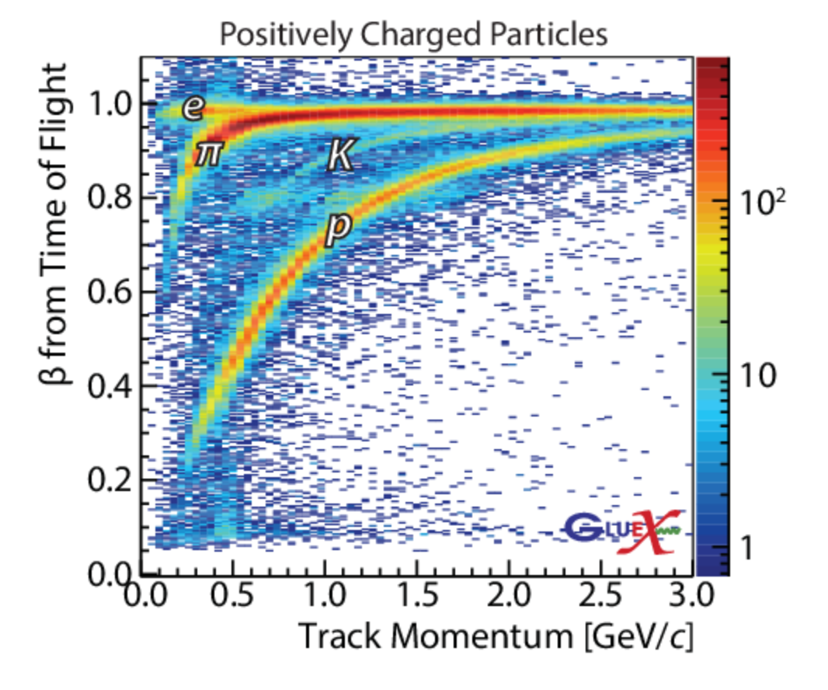
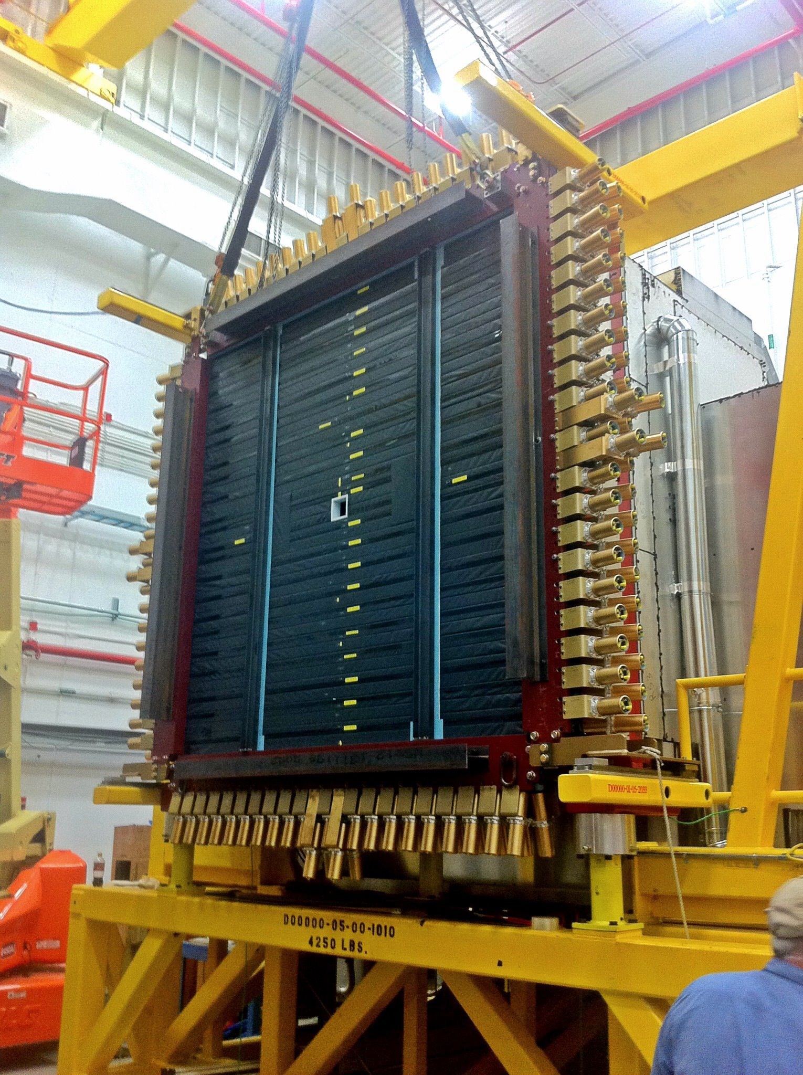
The Time-of-flight Wall
The time-of-flight wall (TOF) consists of two crossed layers of scintillator paddles read out by photomultipliers. The detector provides both energy and a precise timing measurement for charged particles passing through the paddles. When the timing measurement is combined with the momentum and path-length measurement from the drift chambers, it gives is a measure of the particle’s velocity and mass. Hence, providing particle identification.

Slide 13
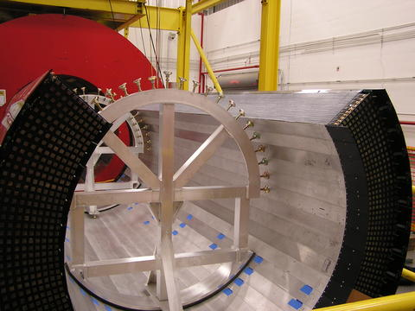
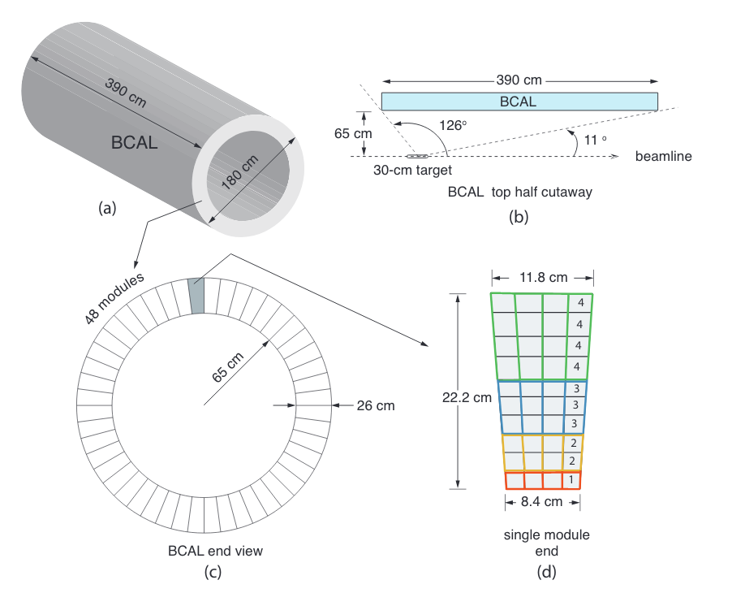
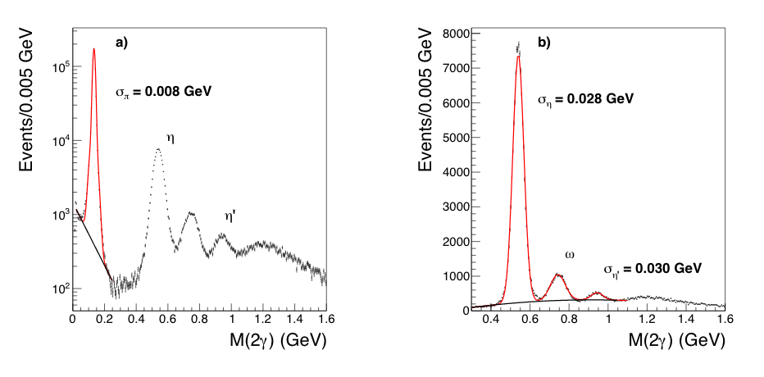
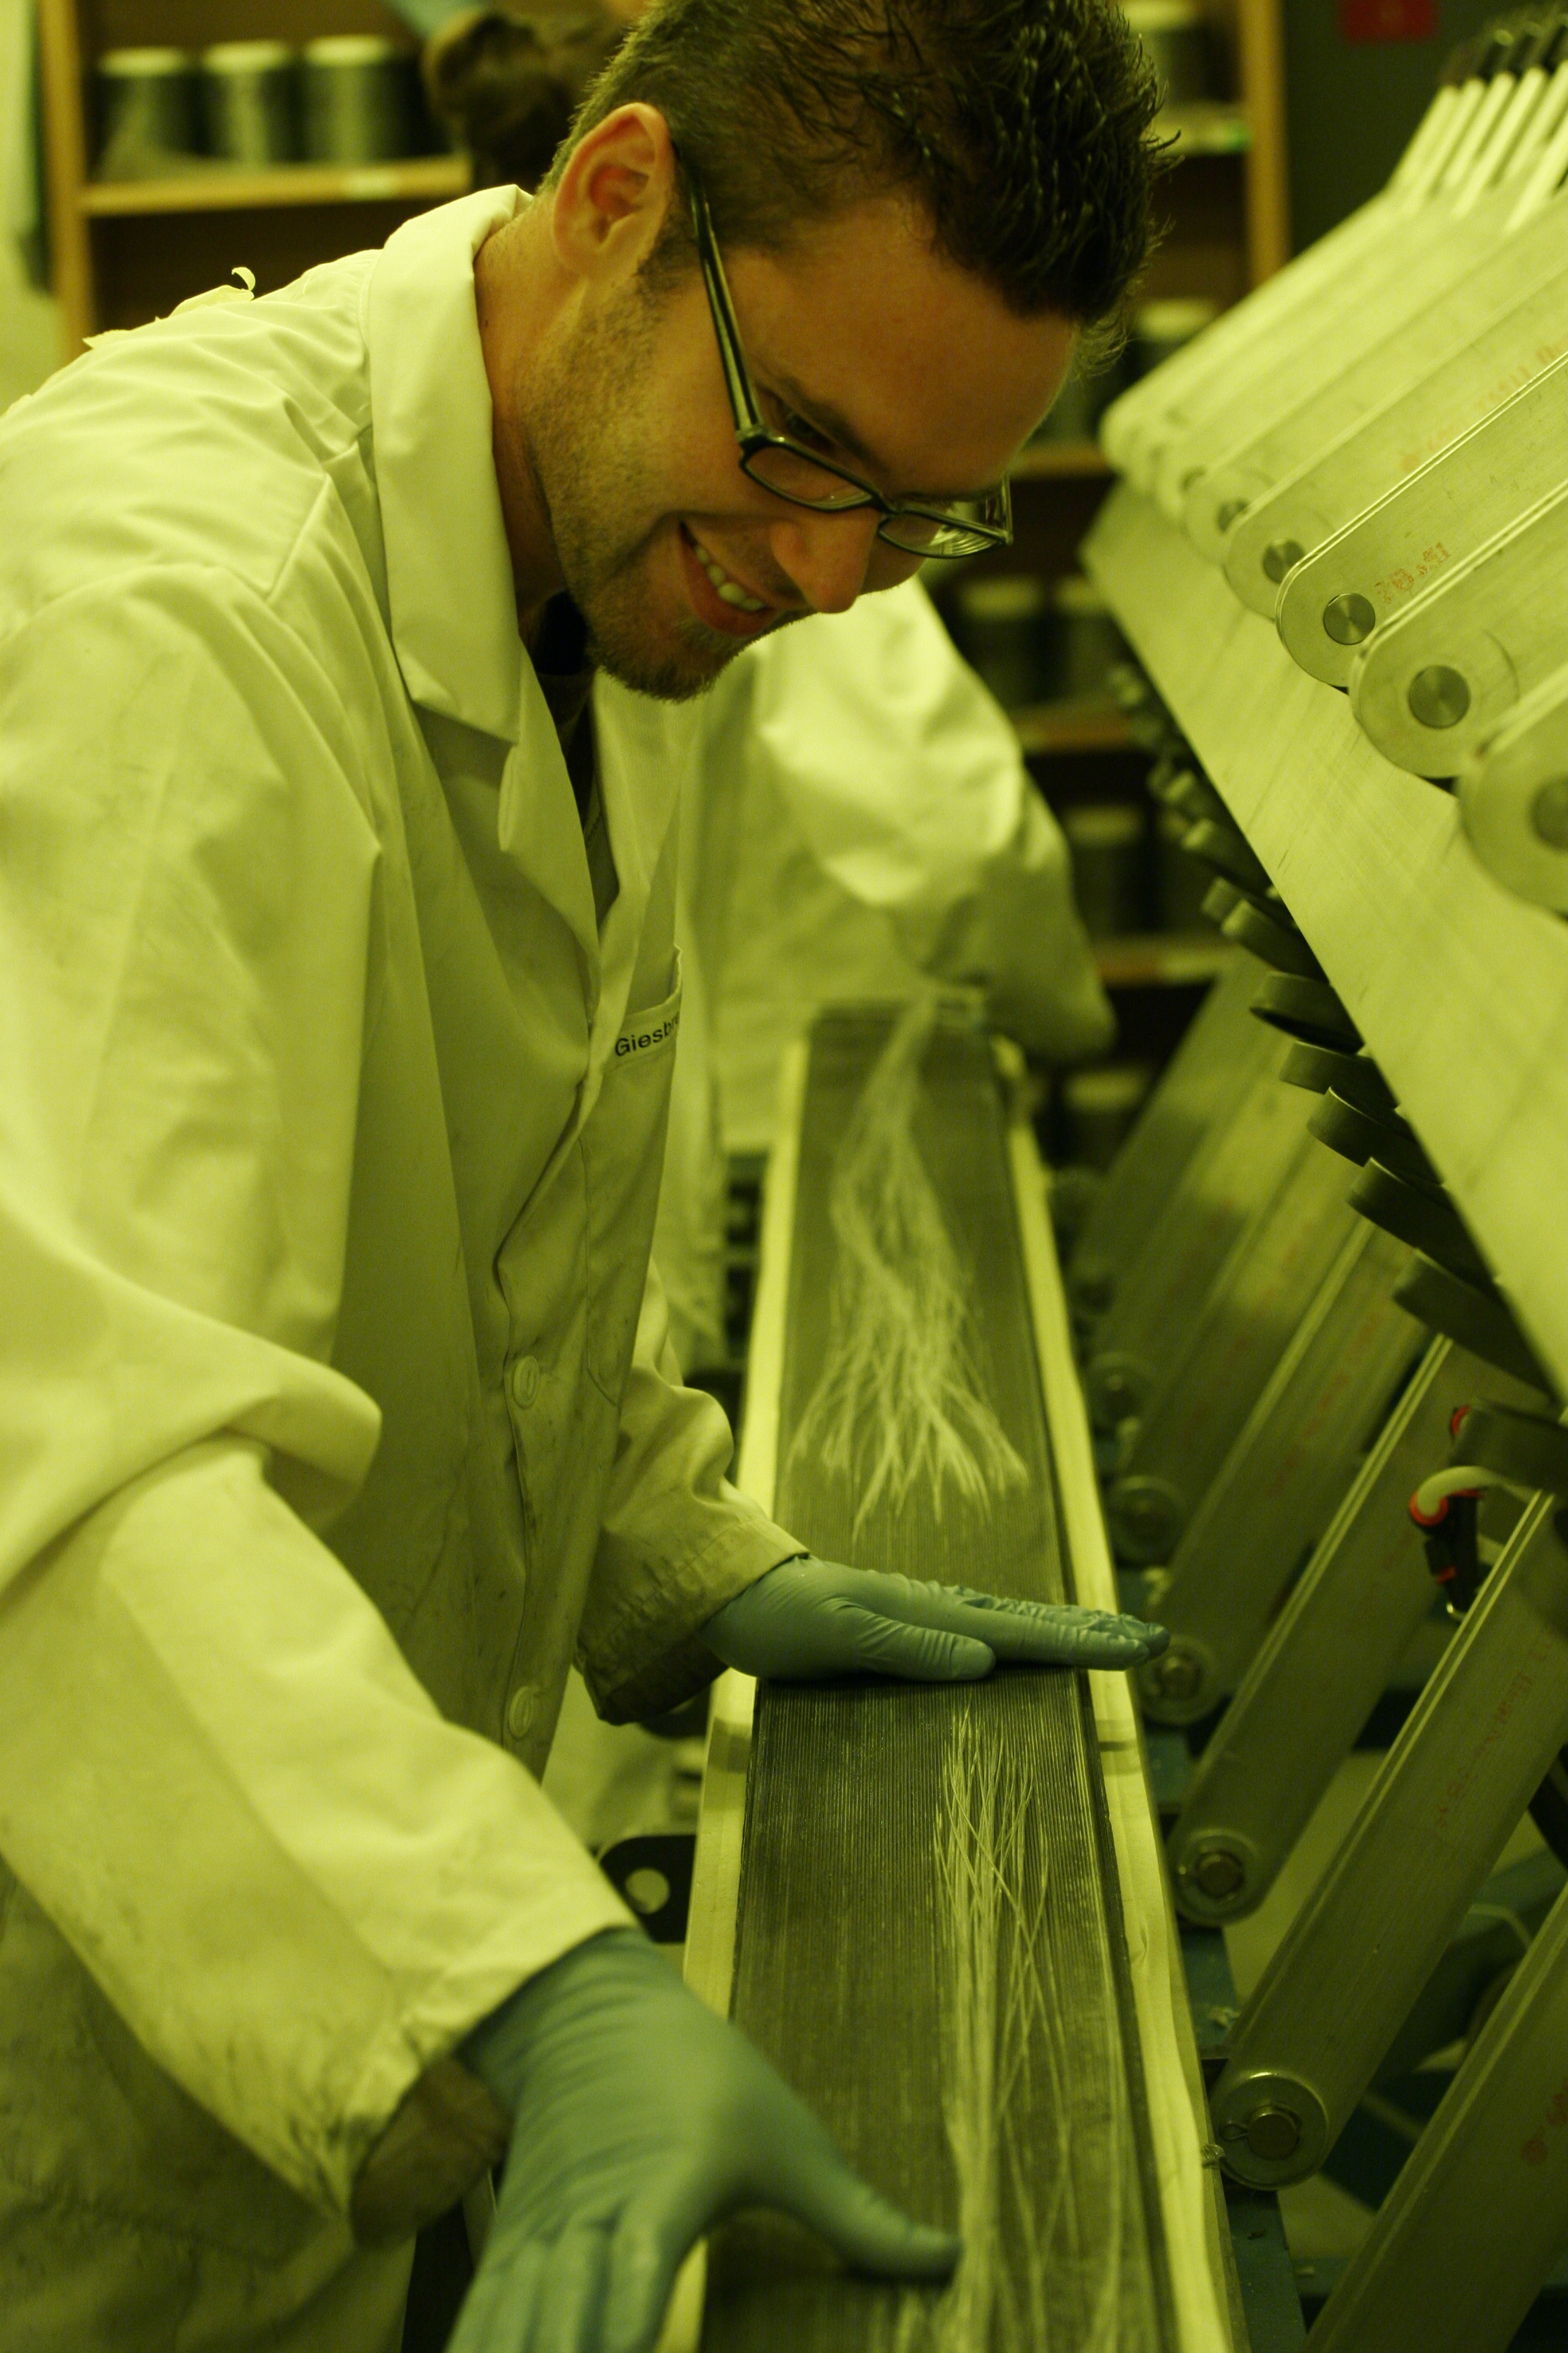
The Barrel Calorimeter
The barrel calorimeter (BCAL) is designed to measure the energy of photons and electrons as well as the impact position and time for all particles that interact in BCAL. The detector is built of layers of lead and scintillating fiber that is glued into a wedge-shaped module about 4m long. The full detector is 48 of those modules.
T.D. Beattie,, et al., Nucl. Instrum. & Meth. A767 245–251 (2014)
T.D. Beattie, et al., Nucl. Instrum. & Meth. A896, 24-42 (2018)

Slide 14
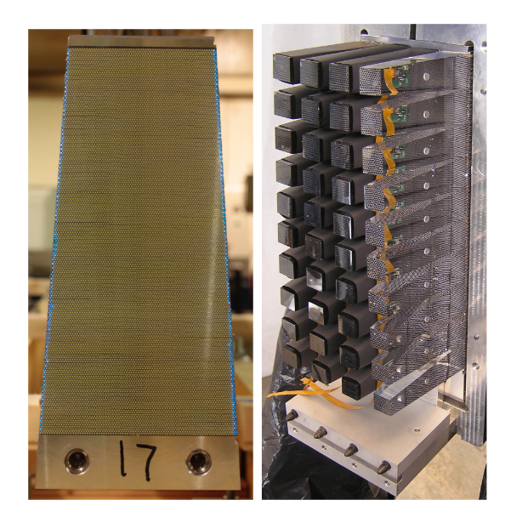
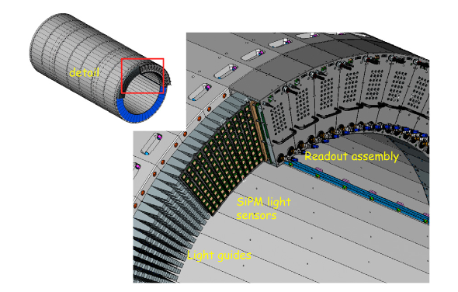
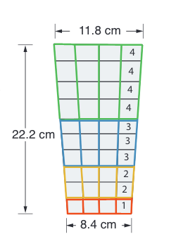
The Barrel Calorimeter Readout
The BCAL is read out at both ends using silicon photomultipliers (SiPM) optically
connected to the BCAL through light guides.
40 light guides transmit the light from the BCAL fibers to the SiPMs. Readout of the SiPMs is broken into 4 columns and 4 groups based on depth. Each of the 16 groups goes to a 250MHz flash ADC (F250).
Timing differences between the upstream and downstream end provide z information. The sum of the light in both ends provides energy information and impact point on the calorimeter.
Signals from the inner three groups also go to TDCs to provide accurate timing information.
O. Soto, et al., Nucl. Instrum. Meth. A 732, 431-436 (2013)
E.S. Smith, AIP Conf. Proc. 1753, 070006 (2016)
F. Barbosa, et al., Instrum. Exp. Tech. 60 , no. 3, 322 (2017)

Slide 15
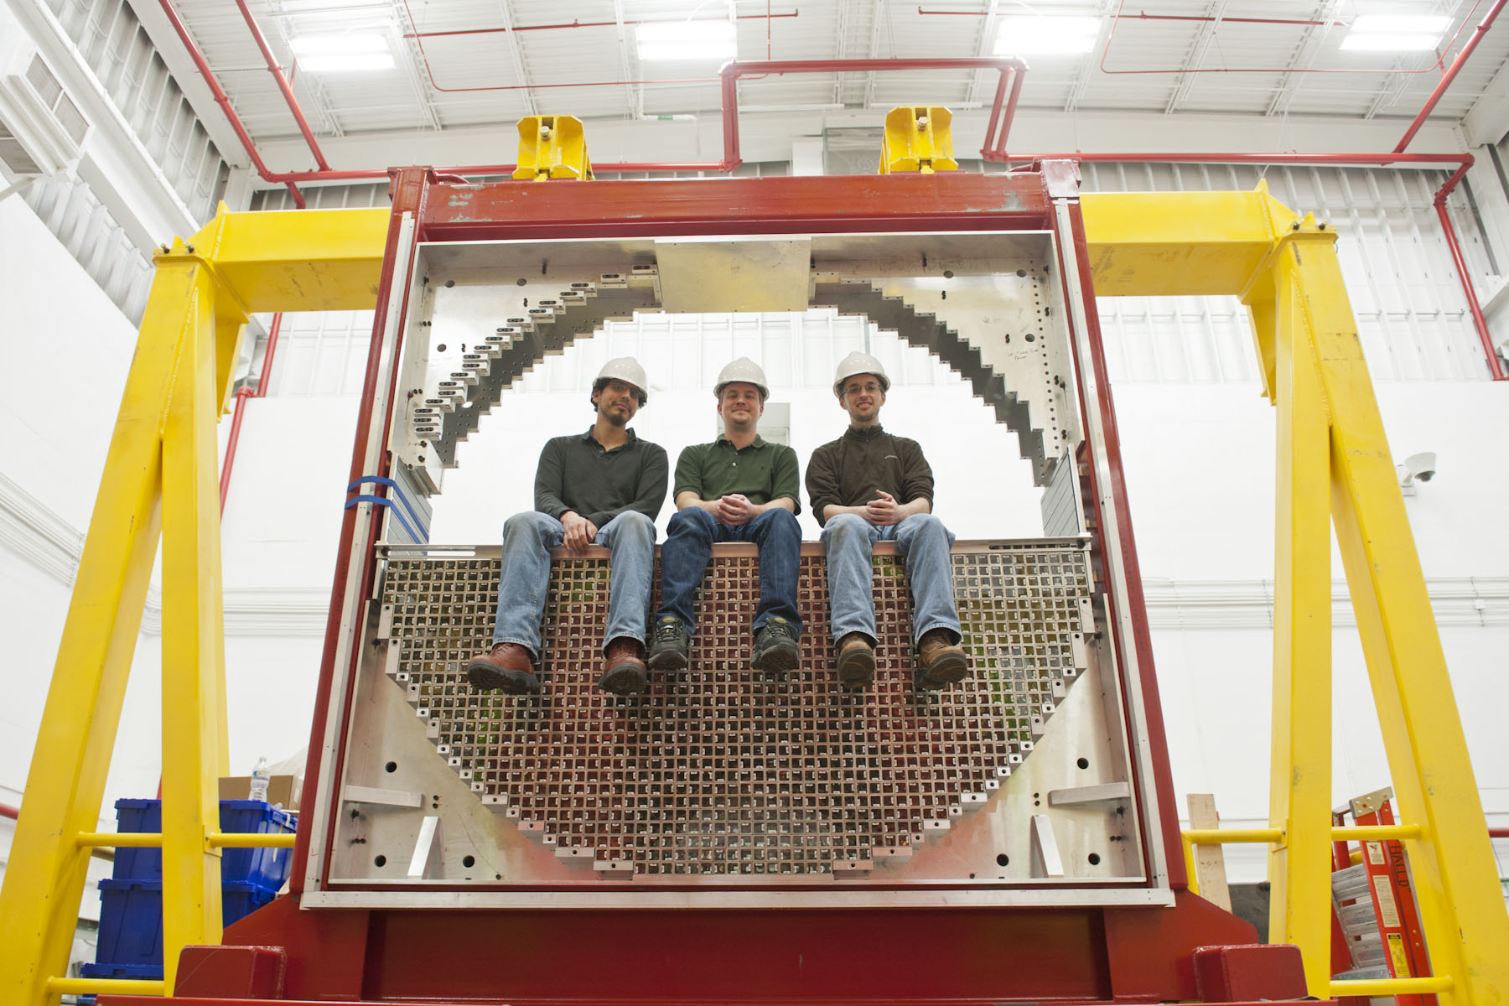
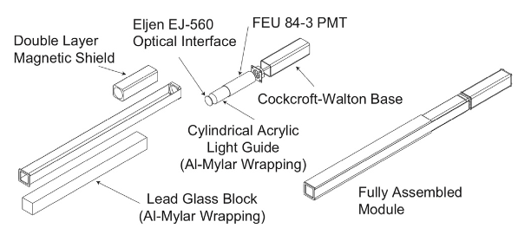
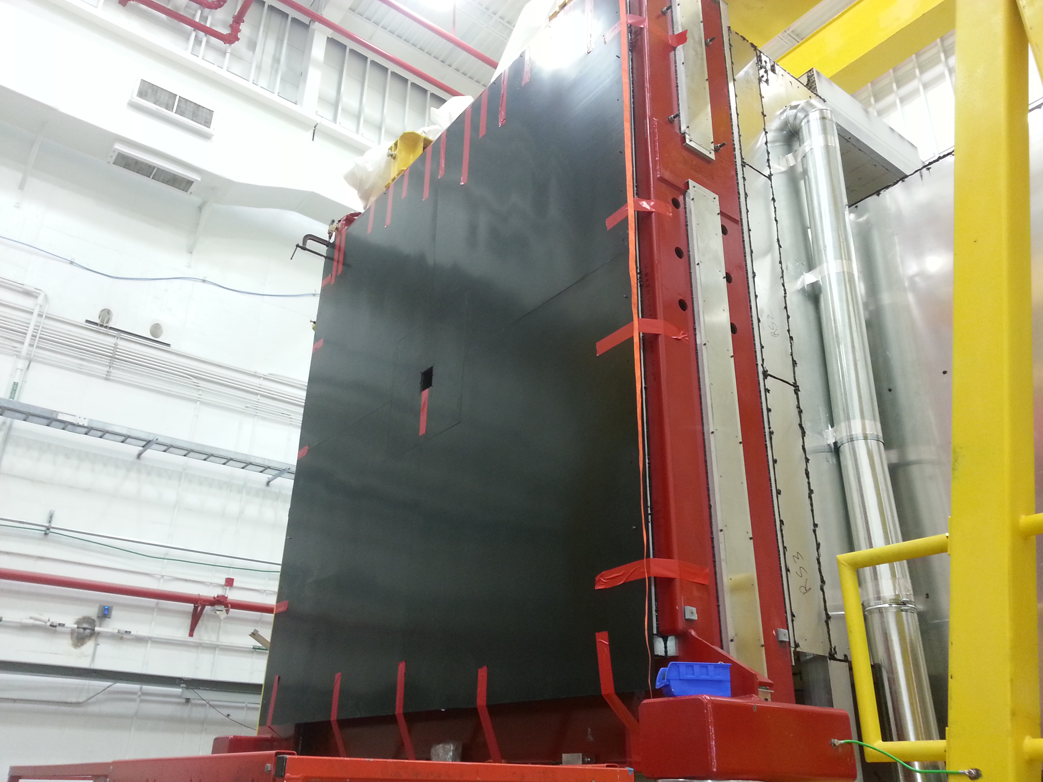
The Forward Calorimeter
The forward calorimeter (FCAL) is designed to measure the energy of photons and electrons as well as the impact position and time for all particles that interact in FCAL. The detector is built from ~2800 4cm by 4cm by 45cm lead-glass crystals which are read out using photomultipliers. The high voltage for the photo tubes is provided by a Cockcroft-Walton voltage multiplier in the base of the tube.

Slide 16
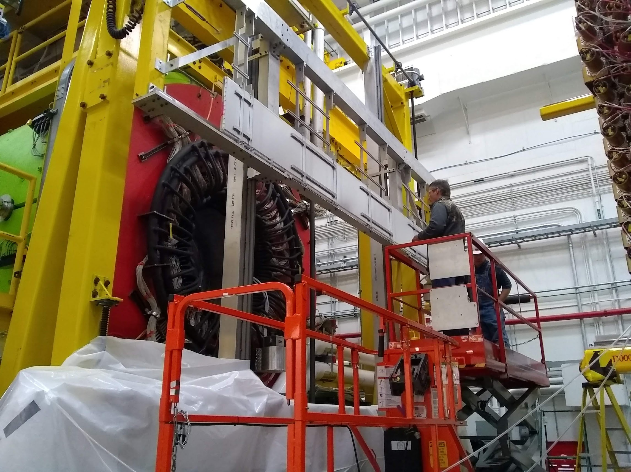
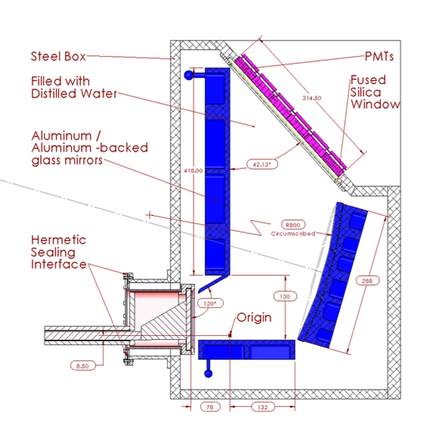
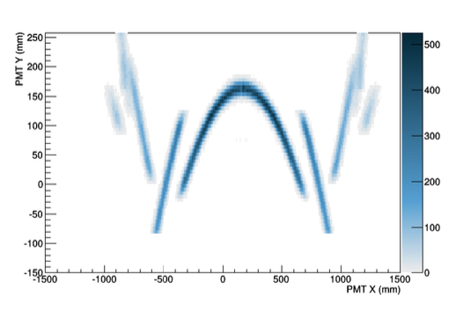
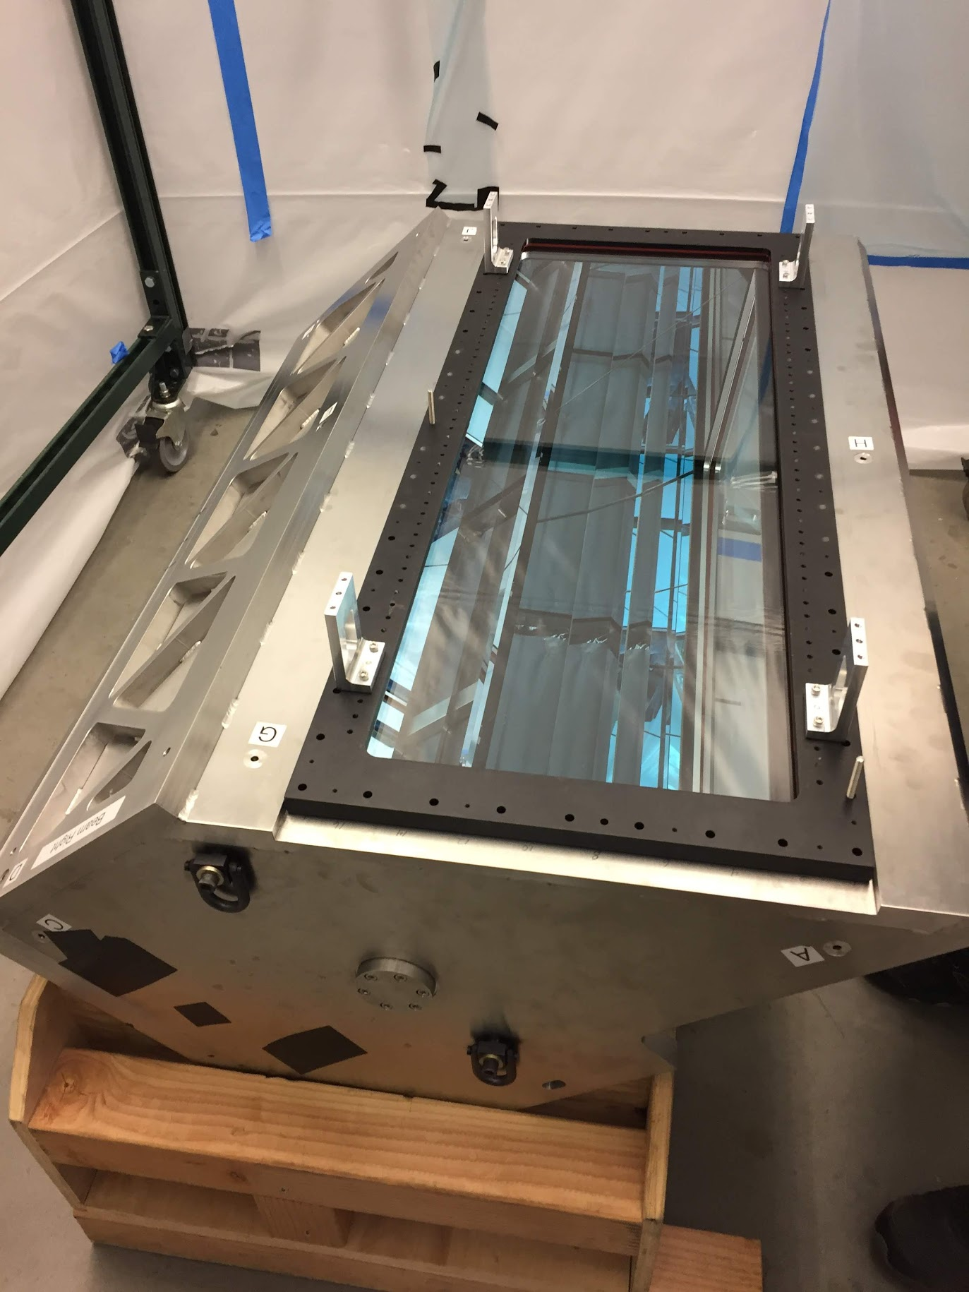
The DIRC
The DIRC (Detection of Internally Reflected Cherenkov light) detector provides enhanced kaon identification in the forward direction, increasing the separation available with the TOF to about 3.5GeV/c. The quartz bars came from the BaBar DIRC at SLAC, while new optics and readout has been built for GlueX. The DIRC was installed in late 2019 and is part of the Phase II GlueX program.
J. Stevens, et al., JINST 11 C07010 (2016)

Slide 17
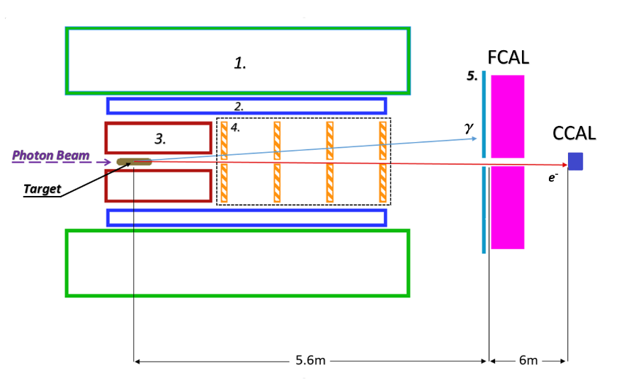
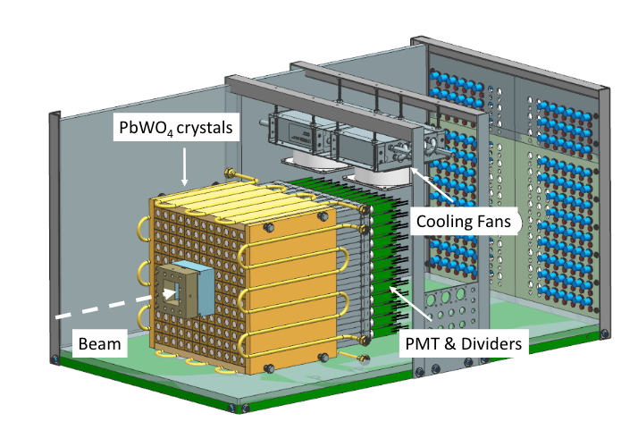
The Compton Calorimeter
The Compton calorimeter (CCAL) was built for PrimEx running of the GlueX experiment. It sits down stream of the FCAL and consists of 140 2.05cm by 2.05cm by 20cm blocks of lead tungstate crystals in a 12 by 12 array. In PrimEx, it detects both the electron and photon from Compton scattering: . The blocks are read out using
photomultiplier tubes.
During GlueX running the CCAL can also be used as the total absorption counter.
The CCAL also serves as a prototype for the planned FCAL insert which will replace the inner square meter of FCAL with about 2500 of the same crystals. This upgrade will allow us to run the GlueX η physics program.
A.Asaturyan et al., Glues-Doc 4784 (2021

Slide 18
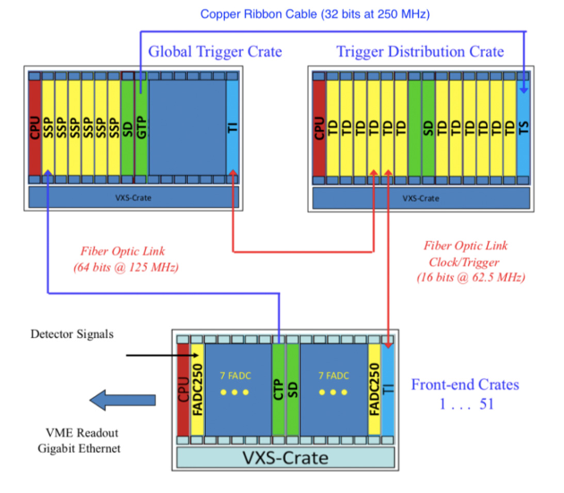
The GlueX Trigger
The GlueX physics trigger is a pipelined trigger based on energy in the BCAL & FCAL. The FPGA based pipeline stores several μs of data while trigger decision is being made.
Based on 12 FCAL and 8 BCAL F250 crates.
The crate trigger processor (CTP) sums energy signals in each crate.
The subsystem processors (SSP) collect the CTP signals and compute the total energy in FCAL & BCAL.
The global trigger processor (GTP) collects the SSP data and makes a trigger decision.
The trigger supervisor (TS) reads the GTP signal and sends the trigger information to the trigger distribution (TD) modules.
The TD modules send the trigger information to the trigger interface (TI) module in each crate which triggers event readout.
GlueX Phase II runs with about 80 KHz rate with 10% deadtime.
In addition to the physics trigger, there is also the PS trigger as well as special calibration and random triggers.

Slide 19
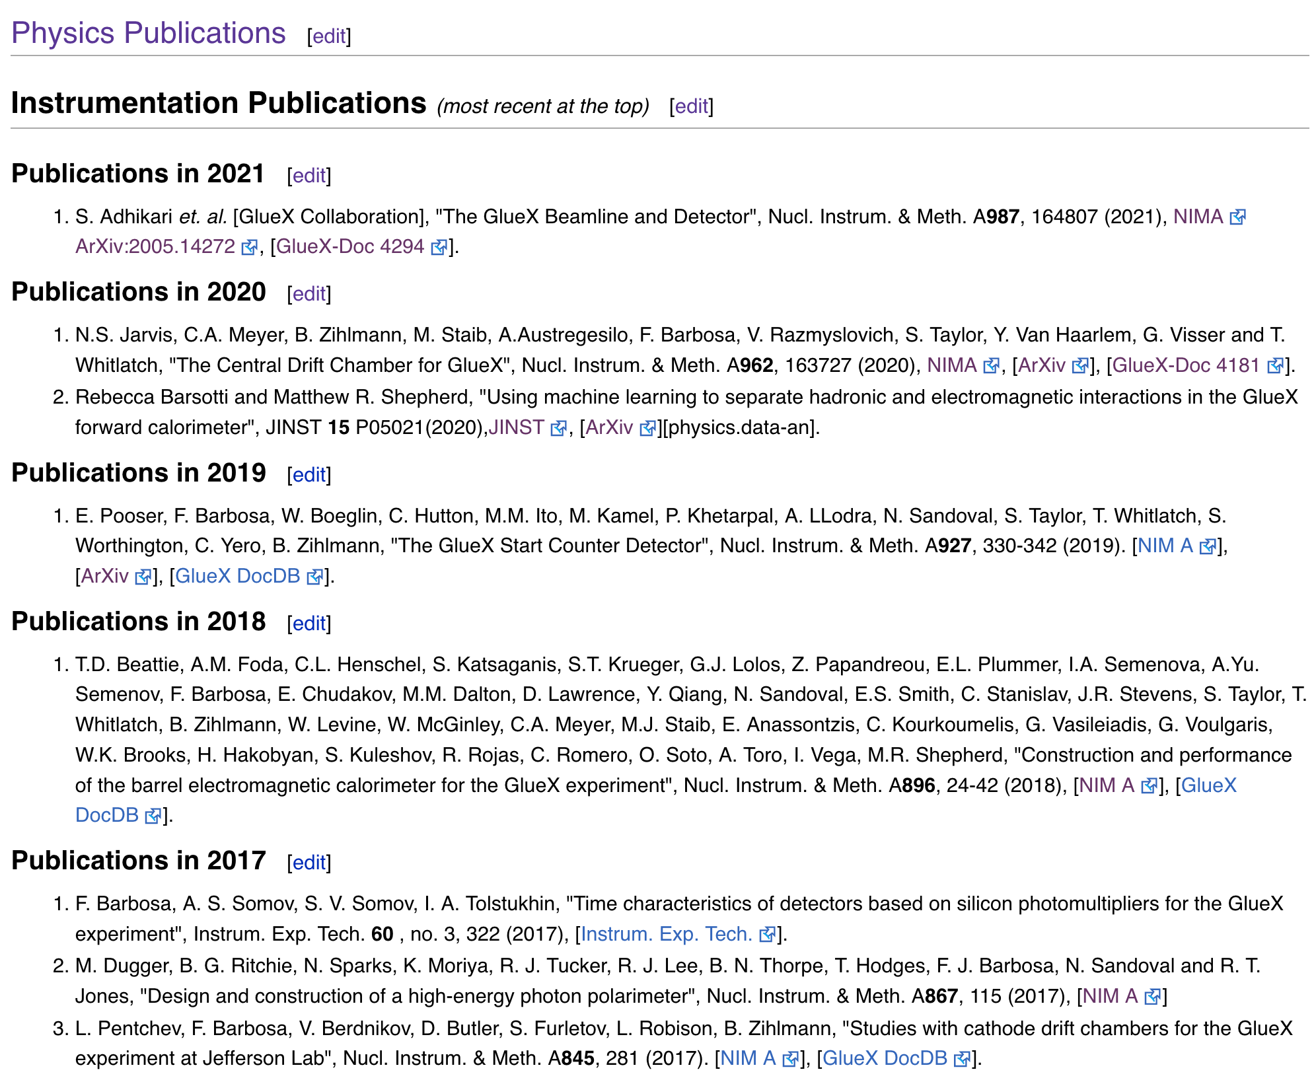
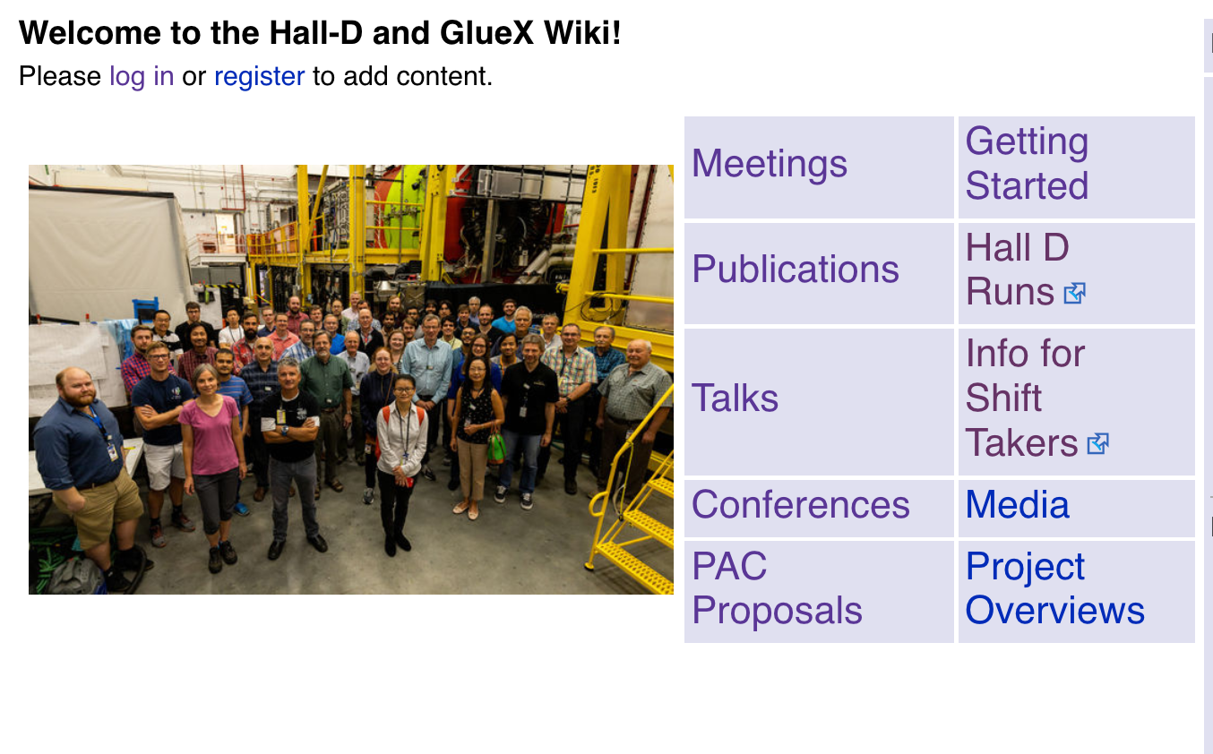
Instrumentation Publications
The GlueX Public Wiki:
https://halldweb.jlab.org/wiki/index.php/Main_Page
(The first instrumentation publication is from 1998.)

