Slide 1

Meson Decays to K*$\overline{K}$ and $\overline{K}$*K
Curtis A. Meyer
Carnegie Mellon University
April 2021

Slide 2
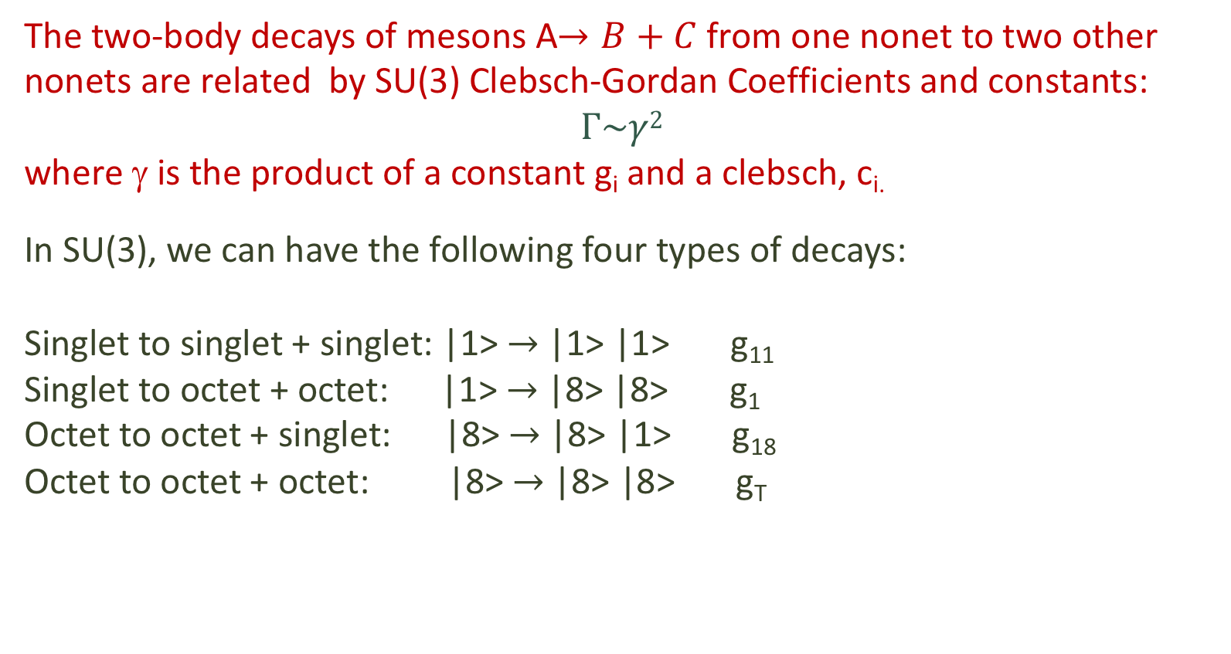
SU(3) Clebsch-Gordan Coefficients
The two-body decays of mesons A$→B+C$from one nonet to two other nonets are related by SU(3) Clebsch-Gordan Coefficients and constants:
$$Γ\sim γ2$$
where γ is the product of a constant g_{i} and a clebsch, c_{i.}
In SU(3), we can have the following four types of decays:
Singlet to singlet + singlet: |1> $→$ |1> |1> g₁₁
Singlet to octet + octet: |1> $→$ |8> |8> g₁
Octet to octet + singlet: |8> $→$ |8> |1> g₁₈
Octet to octet + octet: |8> $→$ |8> |8> g_{T}

Slide 3

SU(3) Clebsch-Gordan Coefficients
Singlet nonet mixing pseudoscalars
Octet
Singlet to singlet + singlet: |1> $→$ |1> |1> g₁₁ c_{i} = 1
Octet to octet + singlet: |8> $→$ |8> |1> g₁₈

Slide 4
SU(3) Clebsch-Gordan Coefficients
Singlet to octet + octet: |1> $→$ |8> |8> g₁
This is used to argue that a pure glueball will decay pairs of pseudoscalars as

Slide 5
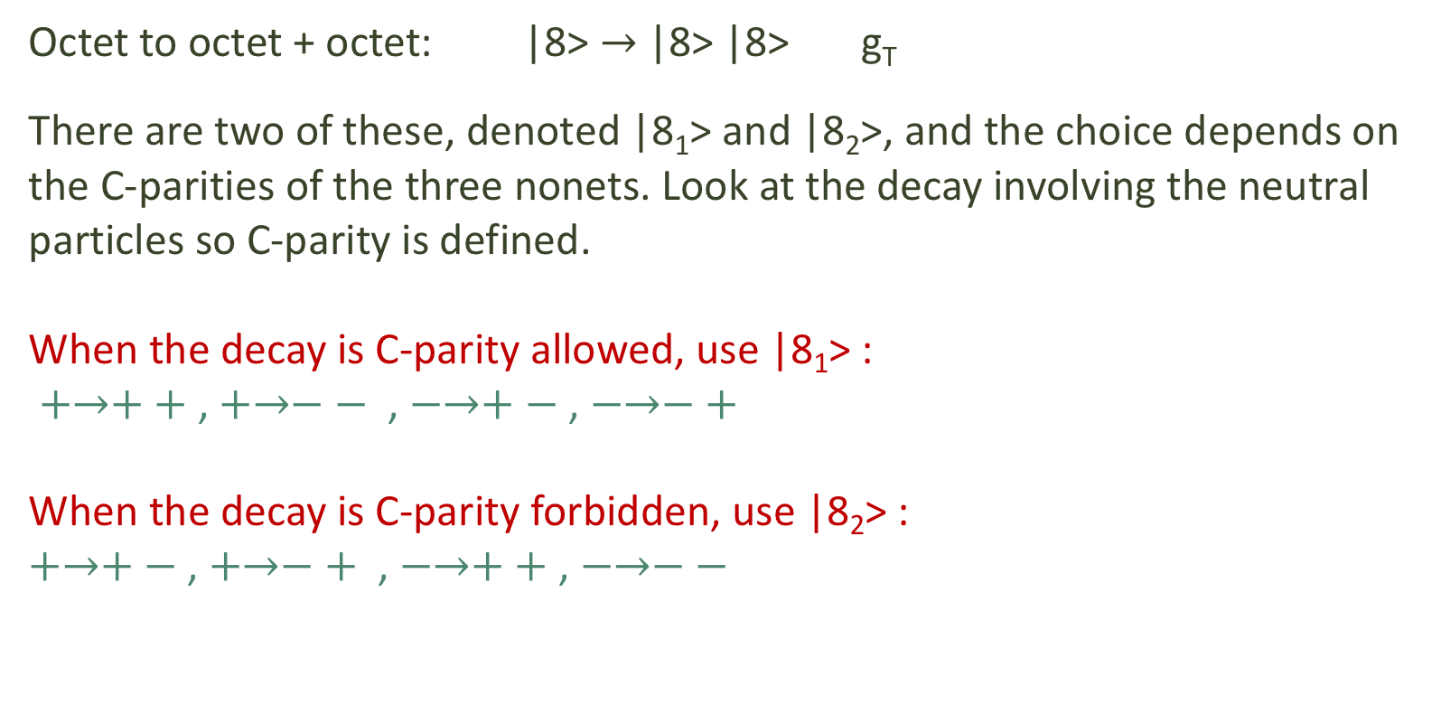
SU(3) Clebsch-Gordan Coefficients
Octet to octet + octet: |8> $→$ |8> |8> g_{T}
There are two of these, denoted |8₁> and |8₂>, and the choice depends on the C-parities of the three nonets. Look at the decay involving the neutral particles so C-parity is defined.
When the decay is C-parity allowed, use |8₁> :
$+→++$ , $+→−−$ , $−→+−$ , $−→−+$
When the decay is C-parity forbidden, use |8₂> :
$+→+−$ , $+→−+$ , $−→++$ , $−→−−$

Slide 6

SU(3) Clebsch-Gordan Coefficients
Octet to octet + octet: |8> $→$ |8> |8> g_{T}

Slide 7
Decays of f and f’ in the |8₂> Case
A generic f and f’will be admixtures of singlet and octet states.
For the singlet component,
For the octet component,
This sets us up for some interesting interference effects.

Slide 8
Decays of f and f’ in the |8₂> Case
We will now specialize the daughter nonets to be vector and pseudoscalar, so the daughters will be and .
These could come from f₁/f₁’, η/η’ , η₂/η₂’ or the exotic η₁/η₁’ .
These rates are not the same!

Slide 9
Dalitz Plot
Consider the Κ⁺ Κ⁻ π⁰ final state, so we have and .
(I think including K_{S} will overly complicate this).
m²(Κ⁻π⁰)
Choose finite regions in ΚΚπ invariant mass and form Dalitz plots.
One K* band will be be stronger than the other one.
m²(Κ⁺π⁰)

Slide 10
How useful is this?
Many things can couple to K*K, so any partial wave analysis is probably going to be very complicated.
For an ideally-mixed nonet,
This could help disentangle η₁ and η₁’ if we can see them.
The ground state and hybrid 2⁻⁺ nonets may be close. This could help disentangle the four η₂ states.

